Slide 1

Workshop for AI-Powered Materials Discovery at Great Plains, USD
June 23, 2025
Charge Carrier Modulation in Cr₂TiC₂Tx MXene: A Promising Material for Future Technology
Khimananda Acharya
Alexey Lipatov
Tula R. Paudel

Slide 2

Outlines
1
2D Materials
MXene Background
Electrical measurement
Structure Optimization
P-/n- tunable conductivity
Conclusion
CURIOUS
SMART
TENACIOUS

Slide 3

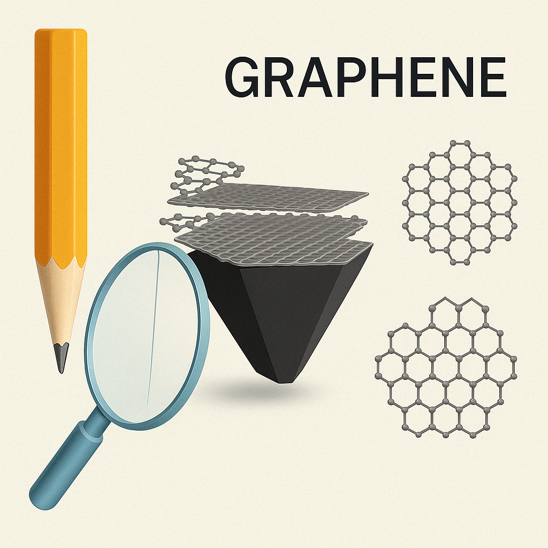
2D materials
1
Atomically thin layers: Strong in-plane covalent bonds, weak interlayer van der Waals interactions
Andre Greim and Konstantin Novoselov 2004
They got Nobel prize in physics in 2010
Graphene
Graphite
Currently, we have vast number of 2D materials beyond graphene
3 D
2 D
Notes:
Let’s begin with 2D materials.
What you see here is a regular pencil made of graphite. But if we zoom in under a microscope, we can find that graphite is made of many stacked layers of carbon atoms, which is one of the first and most famous 2D materials.
2. What makes these materials special is their bonding. Within the layers, the atoms are strongly connected by covalent bonds, but between the layers, they’re only loosely held together by van der Waals forces. That’s why it’s possible to separate them into atomically thin sheets.
This was first done in 2004 by Andre Geim and Konstantin Novoselov, using a surprisingly simple method—just scotch tape! For this discovery, they were awarded the Nobel Prize in Physics in 2010.
But graphene was just the beginning. Today, we have a huge variety of 2D materials, each with exciting properties—way beyond just graphene.

Slide 4
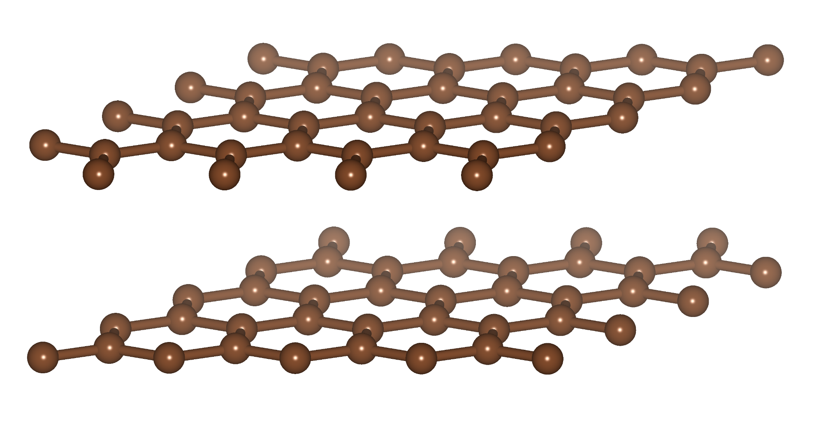
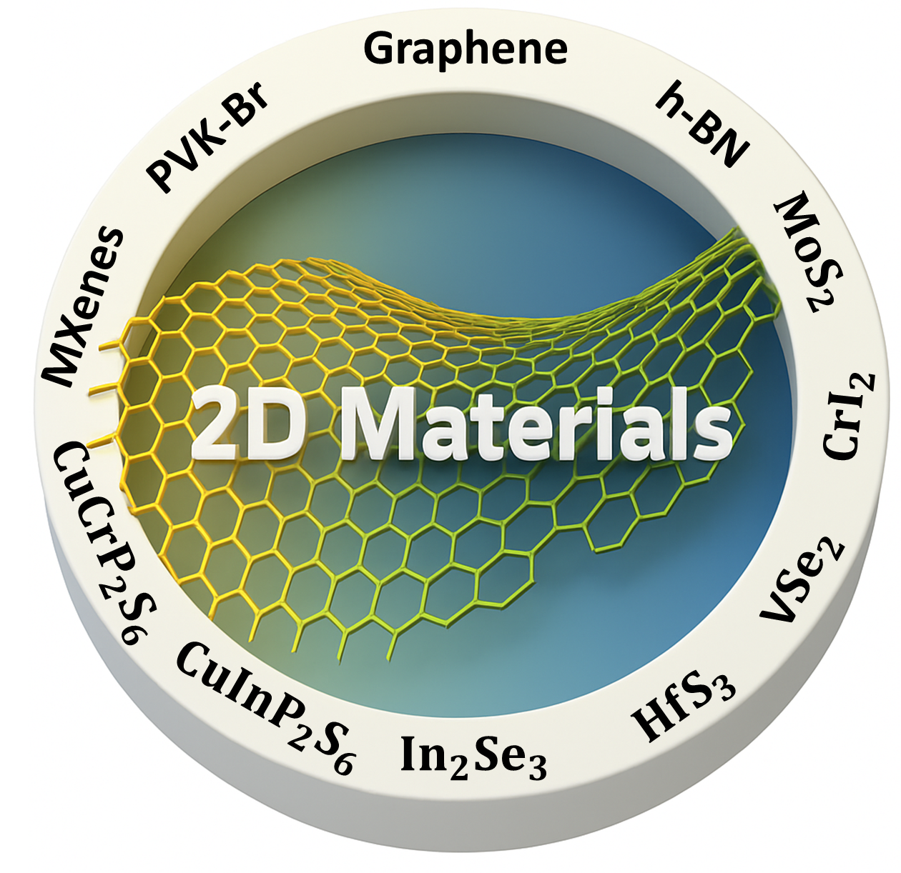
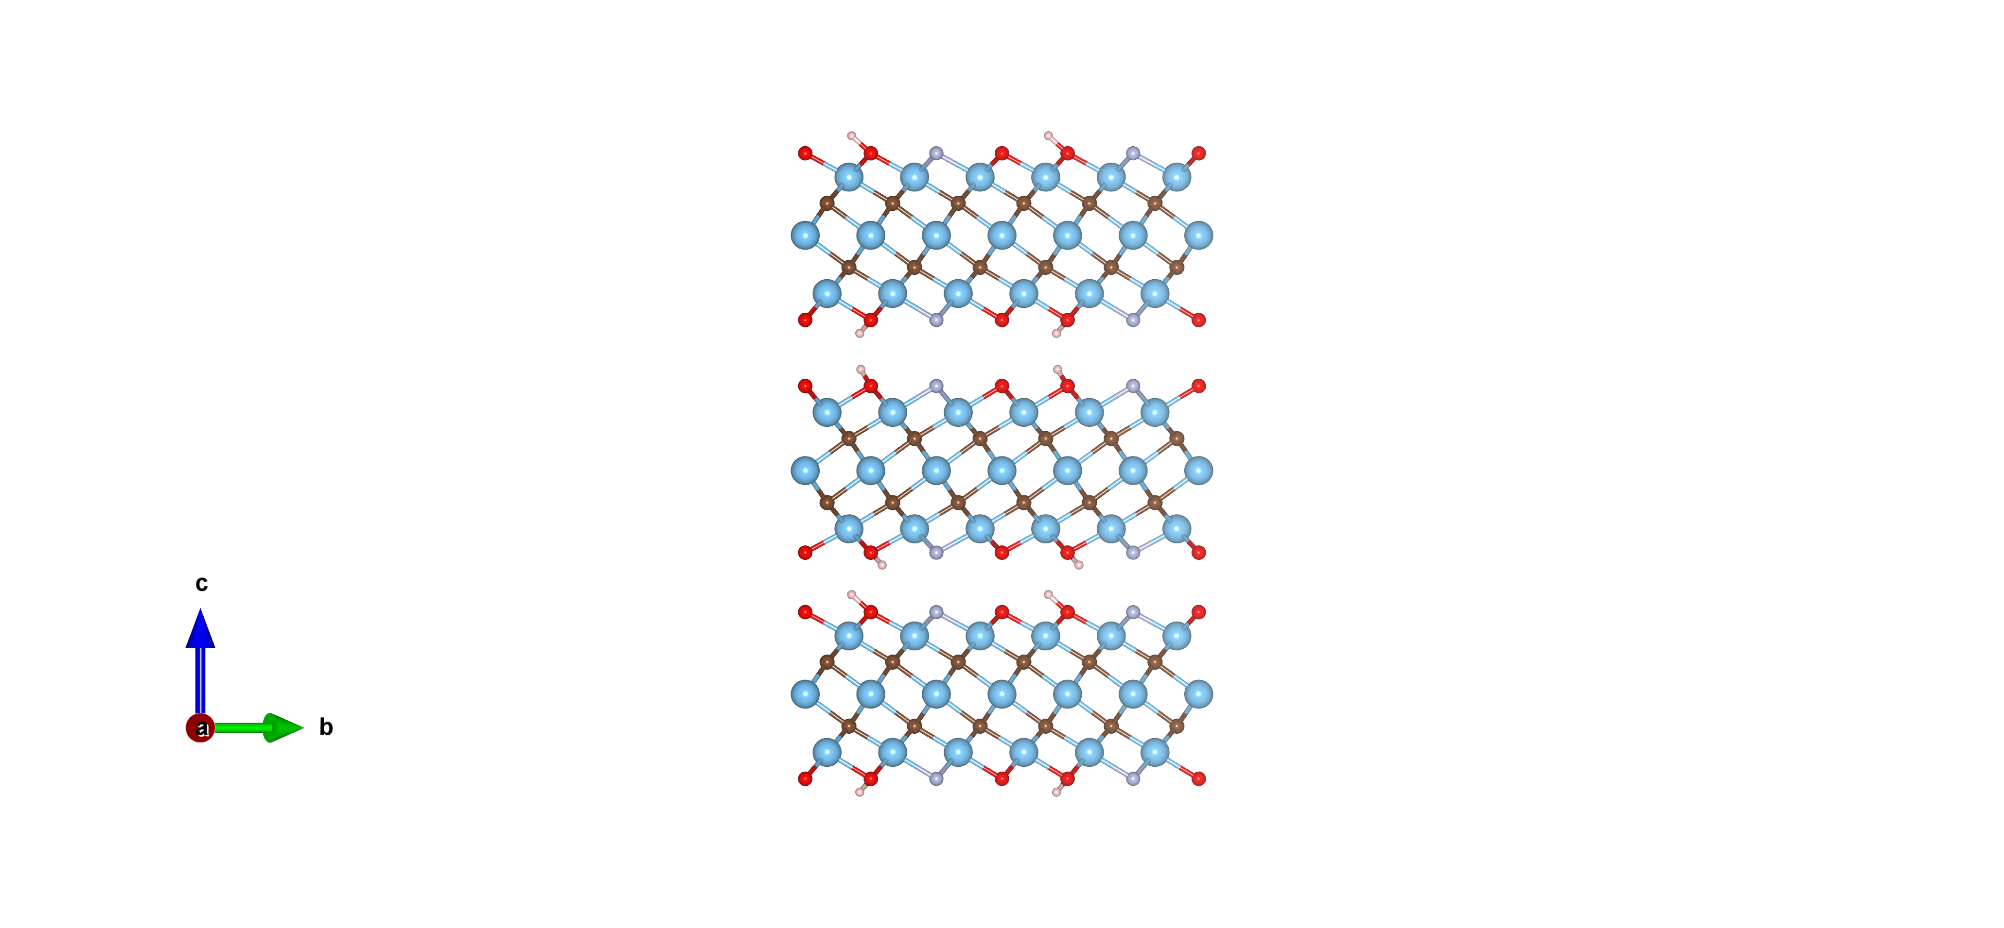
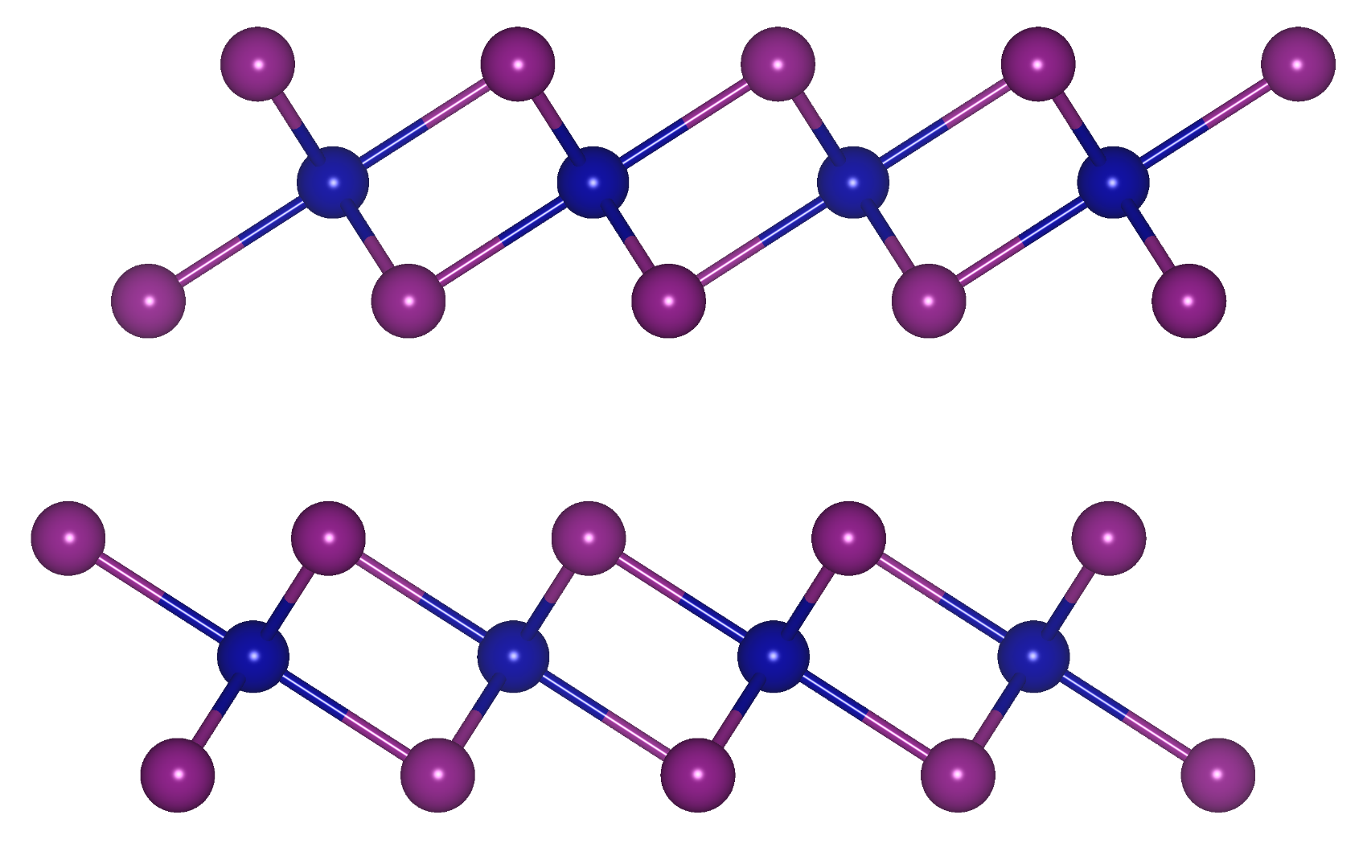
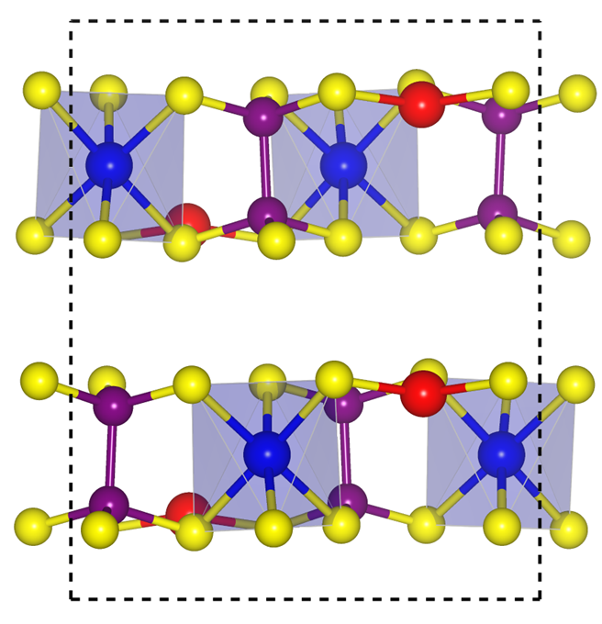
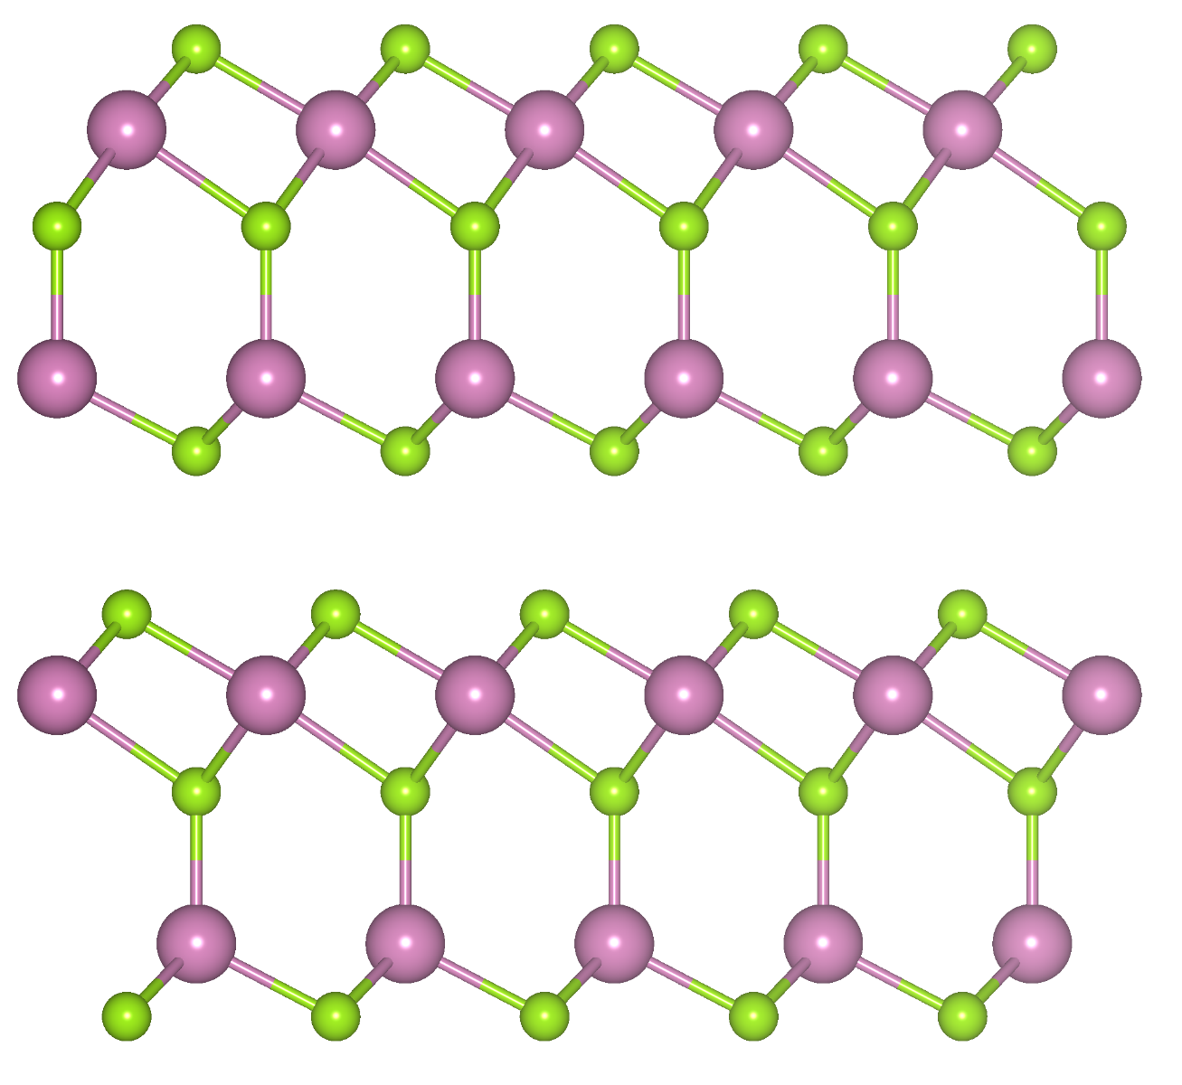
Beyond Graphene
1
Today’s talk
vdW
vdW
vdW
Bagheri, S., ...,Acharya, K. et. al. Matter, (2024).
Acharya, K., et. al., Physical Review B, (2025).
vdW
vdW
Lu, H. , Acharya, K, et. al. Advanced Functional Materials, (2024).
Notes:
2D materials are not limited to single atomic layers.
This center illustration shows several 2D materials that I have already worked on or am currently working with. Let me walk you through some examples.

Slide 5
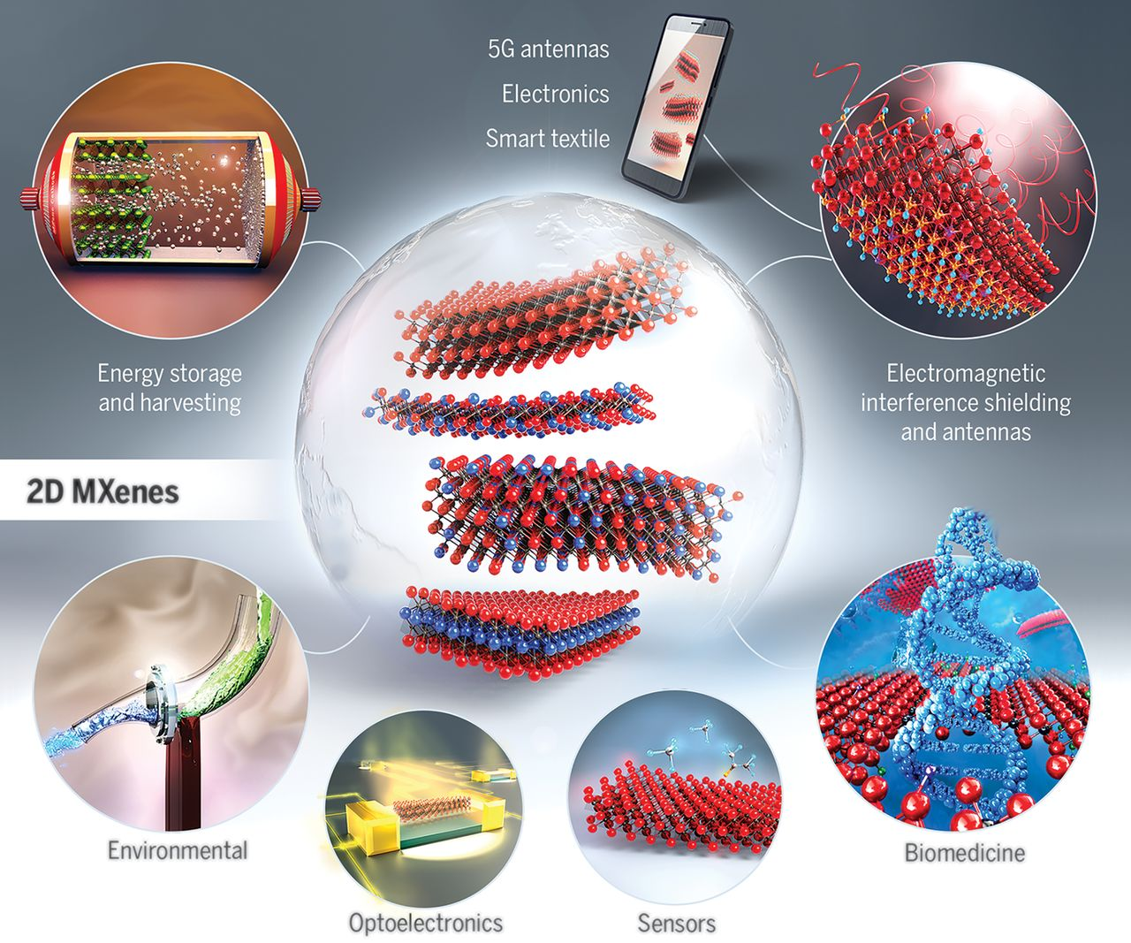
Background/Motivation
1
MXenes are a class of two-dimensional inorganic compounds
The first MXene (Ti₃C₂T_{x}) was discovered at Drexel University in 2011
Over 50 MXenes have been synthesized to date with many more predicted theoretically
Tunable compositions and exhibit rich surface chemistry
Potential applications : Batteries, electronics, medical devices, and more
CURIOUS
SMART
TENACIOUS
VahidMohammadi, A., Rosen, J., & Gogotsi, Y. (2021) Science
Notes:
MXenes were first discovered in 2011 at Drexel University. Since then, over 50 types have been created, with even more predicted.
What makes them special is their wide range of applications:
from batteries and electronics, to biomedicine, sensors, smart textiles, and even 5G antennas.
They’re strong, conductive, and versatile – making them one of the most promising families of 2D materials today.

Slide 6
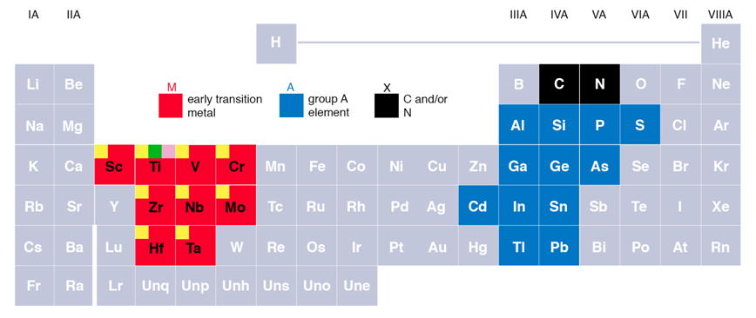
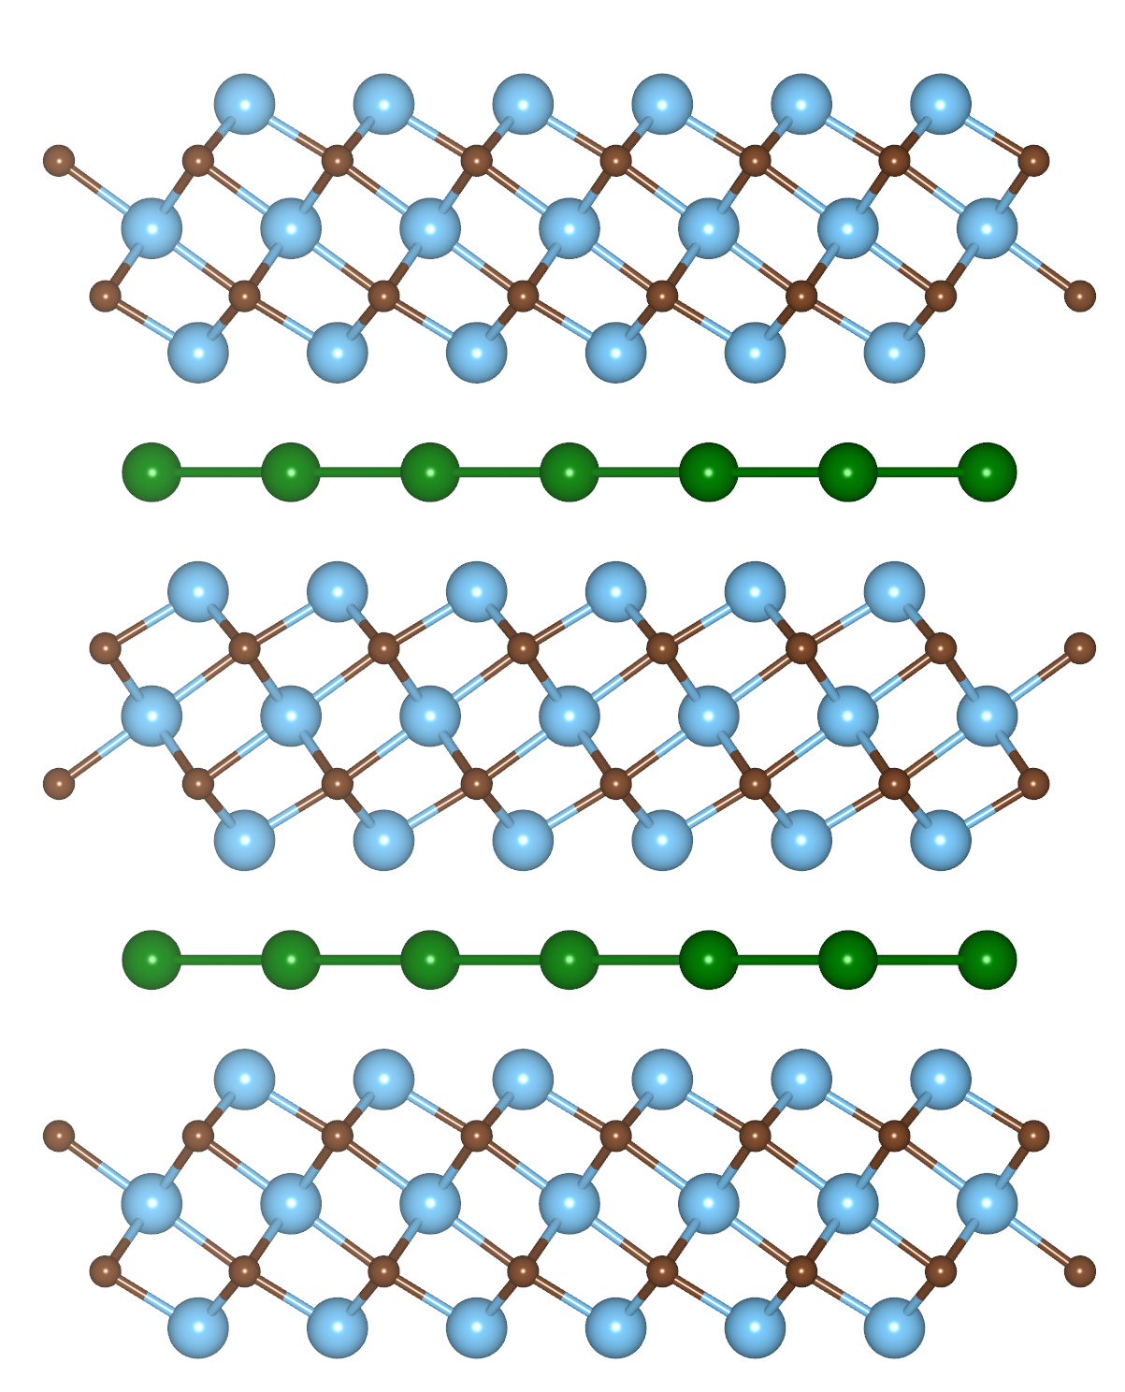
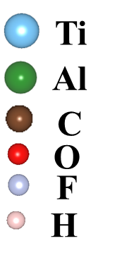
MAX Phase
1
M_{n+1}AX_{n}
n=1 to 4
M= transition metal
A= IIIA or IVA group
X= carbon, nitrogen
https://en.wikipedia.org/wiki/MAX_phases
MAX phases are layered hexagonal carbides and nitrides which have the general formula: M_{n+1}AX_{n}
MXene= MX (MAX)+ ene (graphene like)
CURIOUS
SMART
TENACIOUS

Slide 7

MXene Structure
1
M_{n+1}AX_{n}
M_{n+1}X_{n}T_{x}
M_{n+1}X_{n}T_{x}
Etching
Sonication
n=1 to 4
M= transition metal
A= IIIA or IVA group
X= carbon, nitrogen
Surface Functional Groups
Monolayer
-OH ,-F, -O, -Cl
MAX $⇒$ MXene
CURIOUS
SMART
TENACIOUS
Notes:
Now you might be wondering—how are MXenes made?
They actually come from a another material called a MAX phase. You can see it here on the left.
To make MXenes, we use a chemical process to selectively remove the A layer. What’s left is a thin, layered structure called a MXene, with surfaces often terminated with oxygen, fluorine, or hydroxyl groups.

Slide 8
Background/Motivation
1
Types
MAX
Single transition metal:
2-1 MXenes (Ti₂CTx), 3-2 MXenes (Ti₃C₂Tx), 4-3 MXenes (Ti₄N₃Tx) 5-4 MXenes (Mo₄VC₄Tx)
Double transition metal:
2-1-2 MXenes (Cr₂TiC₂Tx), 2-2-3 MXenes (Mo₂Ti₂C₃Tx)
Surface Functional Groups
This Work
-OH ,-F, -O, -Cl
It has more tunability due to two transition metal
It has magnetic property besides other MXenes
MXene
AI/Machine Learning
Many possibility???
CURIOUS
SMART
TENACIOUS
Notes:
We can have MXenes with either single or double transition metals.
Because of its magnetic property, this MXene offers more functionality for electronic devices
So based on this motivation, we selected a double transition metal MXene—Cr₂TiC₂Tₓ
Our collaborators synthesized high-quality Cr₂TiC₂Tₓ flakes and also carried out the electrical measurements

Slide 9
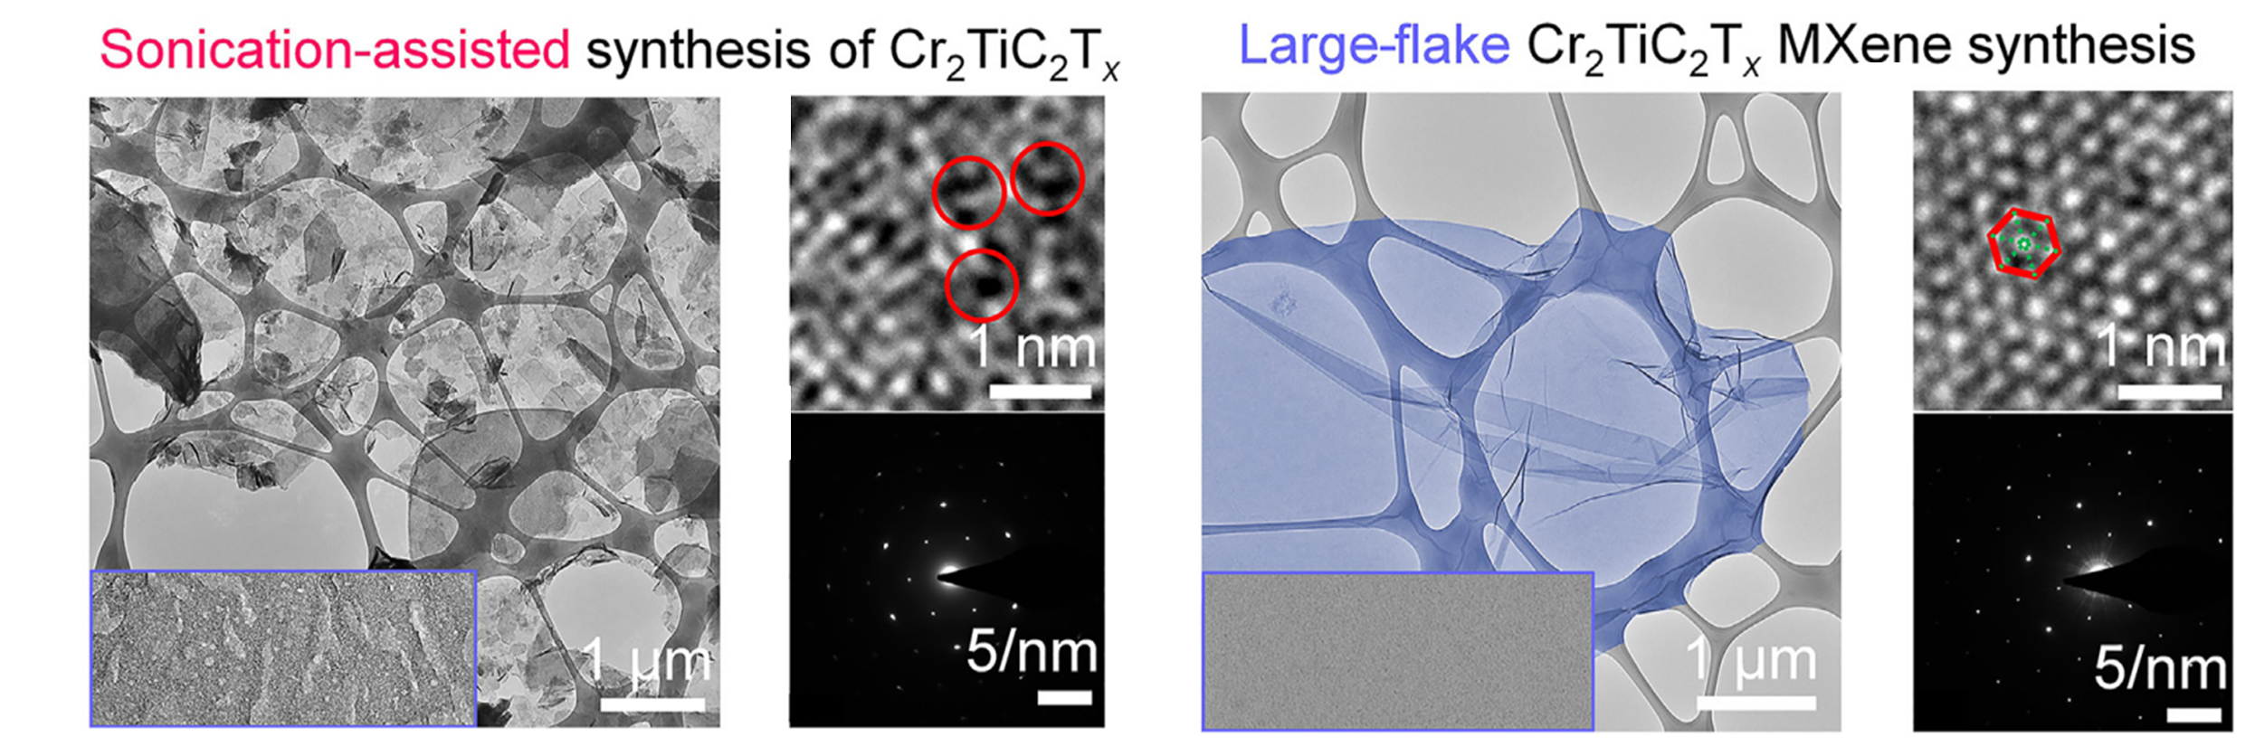
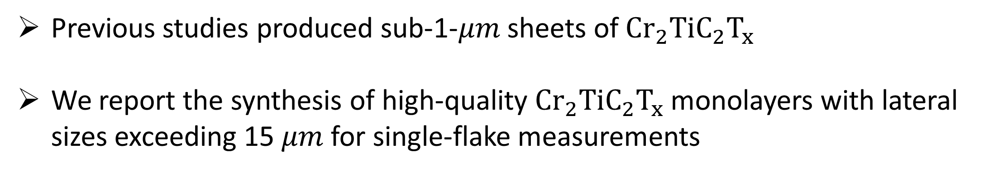
$$MXene Synthesis$$
1
Previous studies produced sub-1-$μm$ sheets of ${Cr}_{2}{TiC}_{2}T_{x}$
We report the synthesis of high-quality ${Cr}_{2}{TiC}_{2}T_{x}$ monolayers with lateral sizes exceeding 15 $μm$ for single-flake measurements
CURIOUS
SMART
TENACIOUS
Notes:
HRTEM (High-Resolution Transmission Electron Microscopy) and SAED (Selected Area Electron Diffraction)

Slide 10
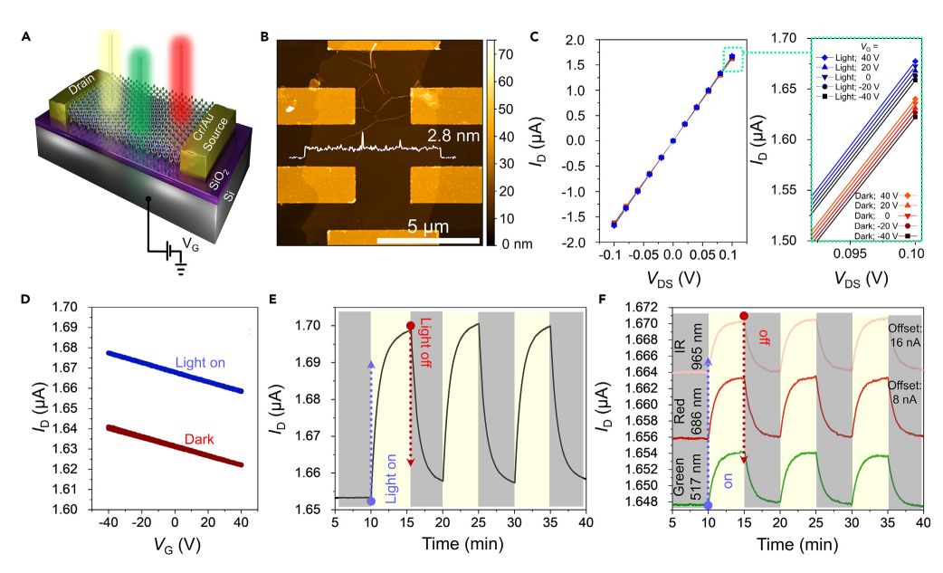

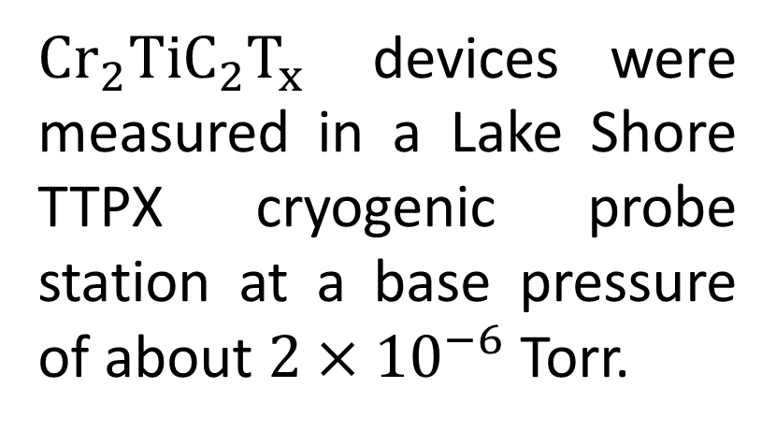
Electrical Measurement
1
Schematic of FET Device
AFM image
$Cr_{2}TiC_{2}T_{x}$ devices were measured in a Lake Shore TTPX cryogenic probe station at a base pressure of about $2×{10}^{−6}$ Torr.
Si/SiO2
MXene
Au
Au
First time reported p-type conductivity and semiconducting
But!! MXene known for metallic behavior with high concentration carrier
Linear $I_{D}−V_{Ds }$
Positive photoresponse
p-type conductivity
n = 5.25 ± 0.17×10²¹ cm⁻³
CURIOUS
SMART
TENACIOUS
Notes:
FET devices based on Cr2TiC2Tx as the channel material, conductive p-doped Si as the global back gate, 300-nm thermally grown SiO2 as the gate dielectric, and Cr/Au electrodes, which were fabricated using the e-beam lithography technique.
P-type conductivity: Indicating that holes are the major charge carriers
3. Positive photoresponse: Semiconducting nature
4. For a p-type semiconductor:
A negative gate voltage attracts holes to the channel, increasing their density and improving conduction, leading to a higher I_D.
A positive gate voltage repels holes from the channel, reducing their density and making conduction more difficult, leading to a lower I_D.

Slide 11

DFT Work Motivation
1
Questions:
Is Cr₂TiC₂Tₓ really a p-type semiconductor?
Can it also exhibit n-type or metallic behavior?
A quantum mechanical method that uses electron density
Vienna Ab Initio Simulation Package (VASP) for DFT calculations
Hubbard U = 4 eV for Cr 3d orbitals and 3 eV for Ti 3d
GGA approximation with 540 eV energy cutoff
DFT-D3 van der Waals correction is used
DFT Calculations:
CURIOUS
SMART
TENACIOUS

Slide 12
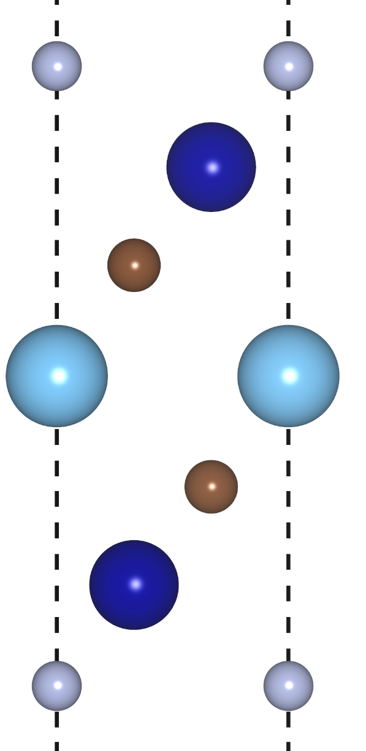
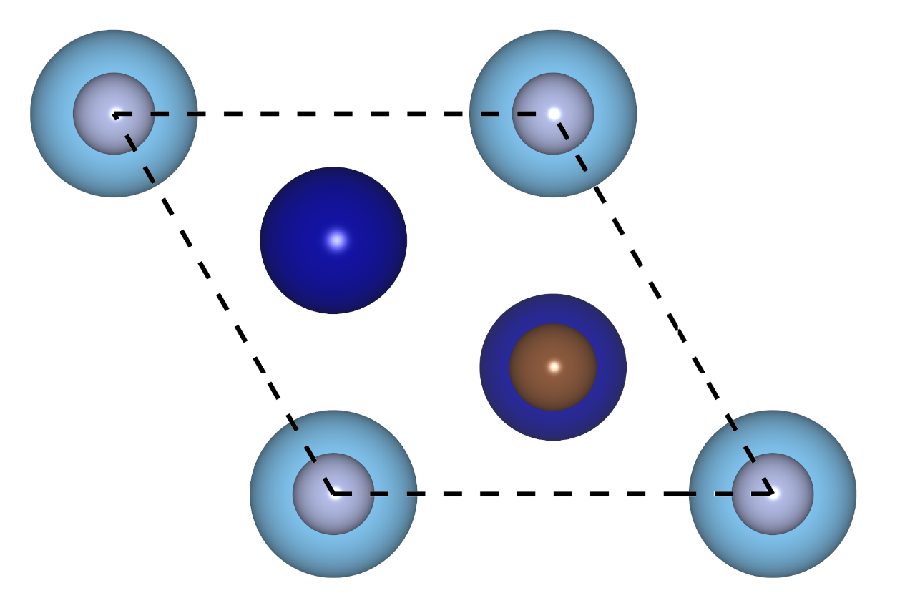
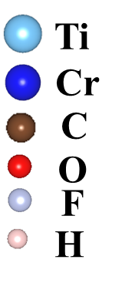
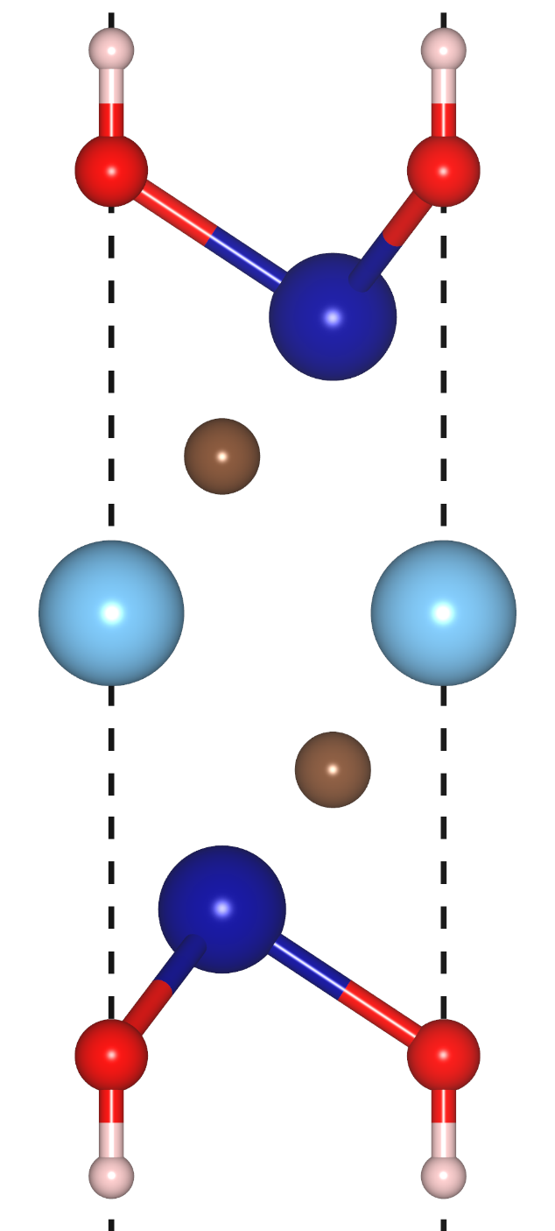
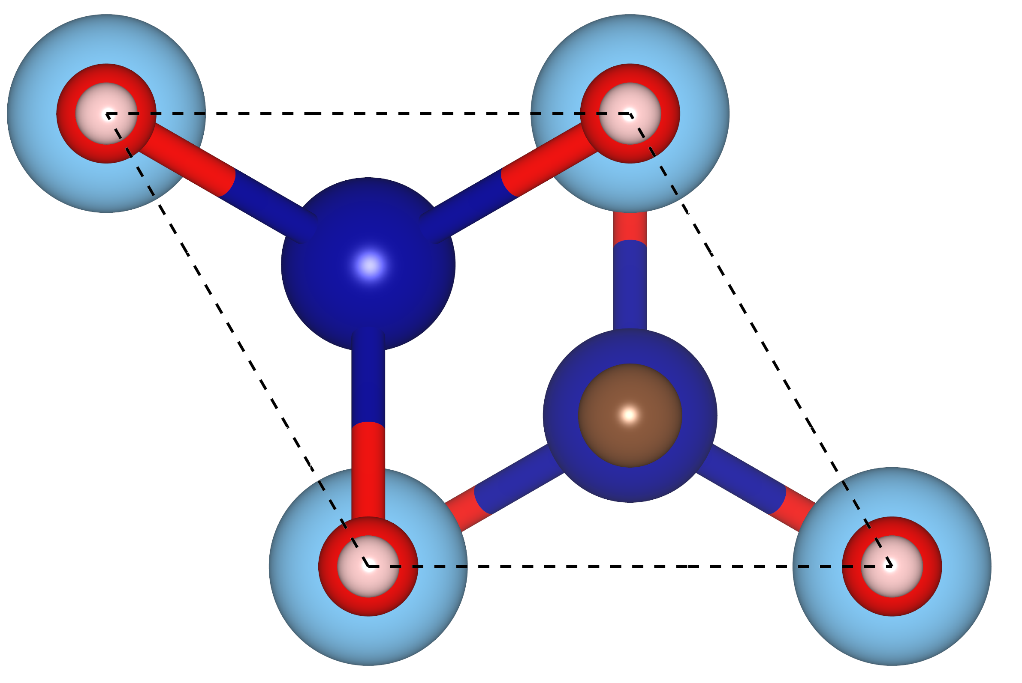


Optimizing Crystal Structure
1
Surface functional groups (–O, –F, –OH) were placed on energetically favorable hollow sites, right above the Ti atoms
$$Ti_{3}C_{2}F_{2}$$
Lattice Parameters
-OH ,-F, -O, -Cl
$$Ti_{3}C_{2}{\left(OH\right)}_{2}$$
These optimized structures were used for further analysis
CURIOUS
SMART
TENACIOUS
Notes:
In-plane lattice parameter obtained by lowest energy from ‘E’ Vs ‘a’ plot

Slide 13

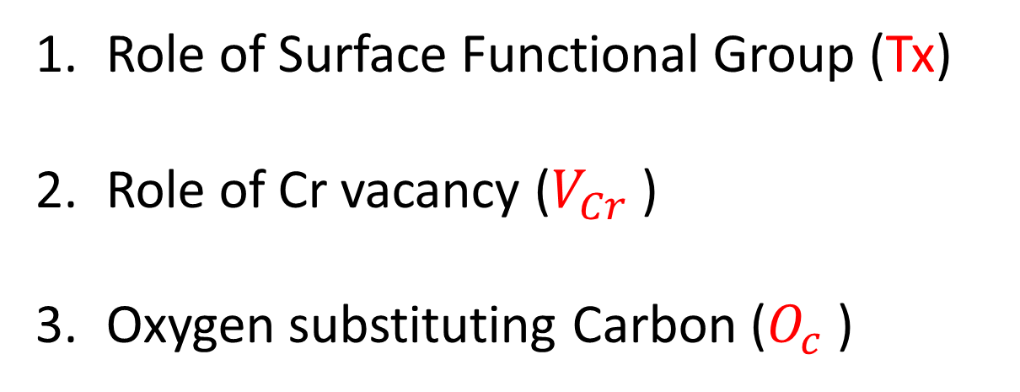

Optimizing Crystal Structure
1
$$Ti_{3}C_{2}F_{2}$$
Cr atoms are exposed on the outer surface during etching, making them susceptible to being etched away.
Formation of oxycarbides is possible, as indicated by Michałowski et al., Nature Nanotechnology (2022)
C
Ti
Cr
-OH ,-F, -O, -Cl
$$Ti_{3}C_{2}{\left(OH\right)}_{2}$$
Role of Surface Functional Group (Tx)
Role of Cr vacancy ($V_{Cr}$ )
Oxygen substituting Carbon ($O_{c}$ )
CURIOUS
SMART
TENACIOUS
Notes:
In-plane lattice parameter obtained by lowest energy from ‘E’ Vs ‘a’ plot

Slide 14
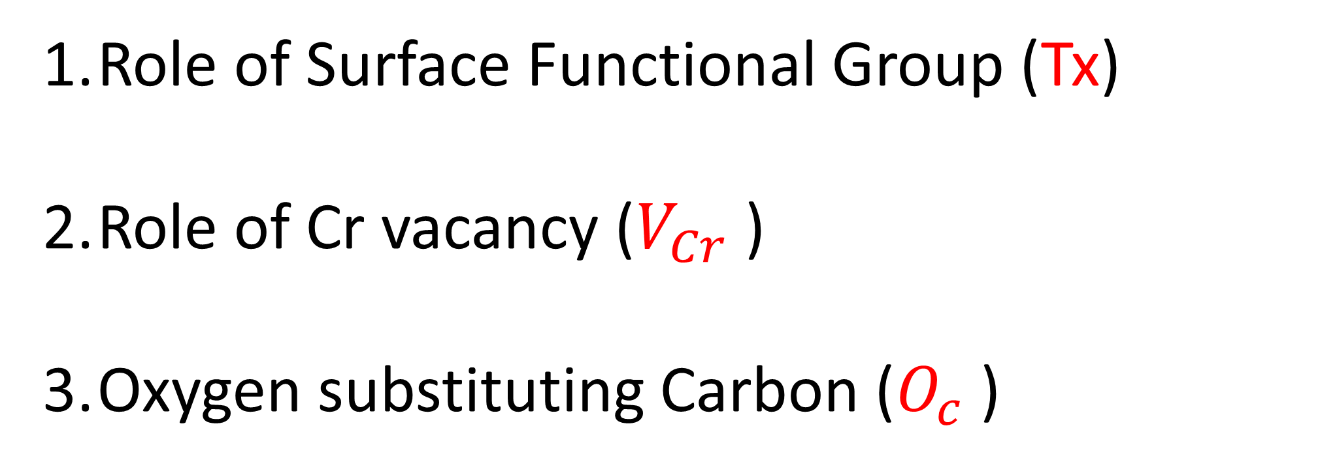
Different functional group
1
Role of Surface Functional Group (Tx)
Role of Cr vacancy ($V_{Cr}$ )
Oxygen substituting Carbon ($O_{c}$ )
CURIOUS
SMART
TENACIOUS
Notes:
In-plane lattice parameter obtained by lowest energy from ‘E’ Vs ‘a’ plot

Slide 15
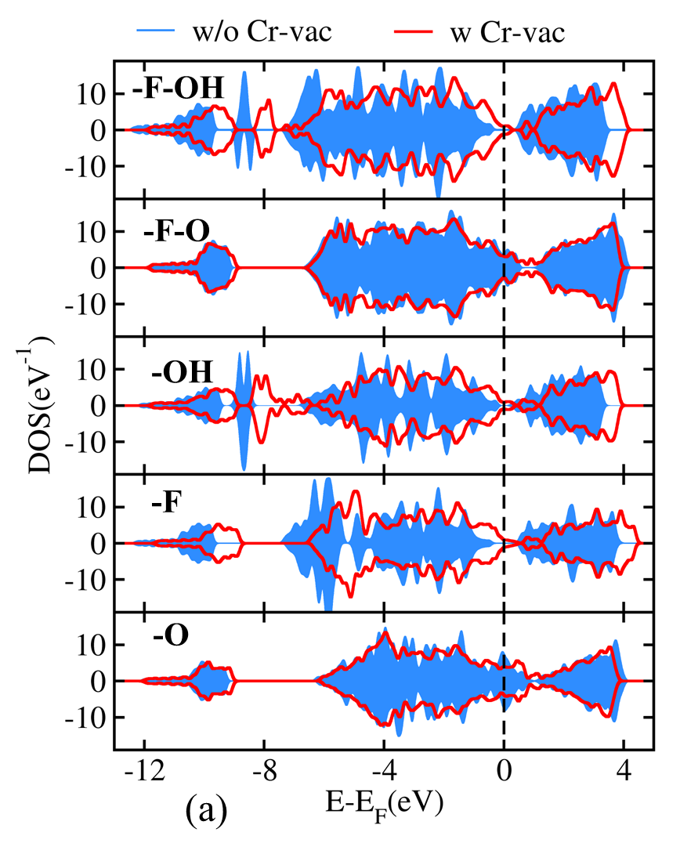
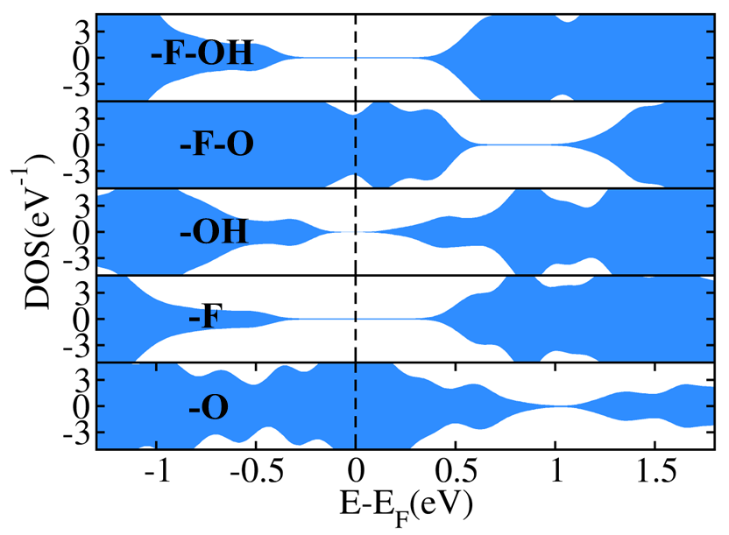
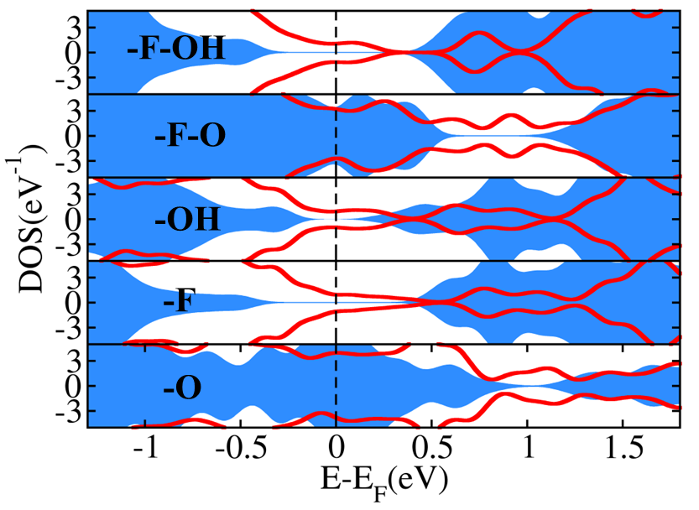
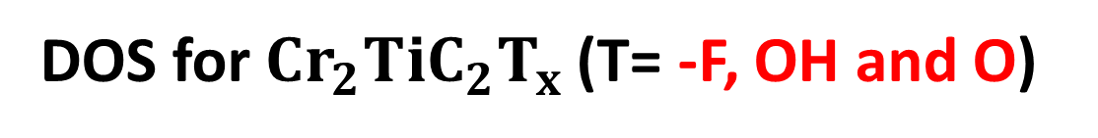
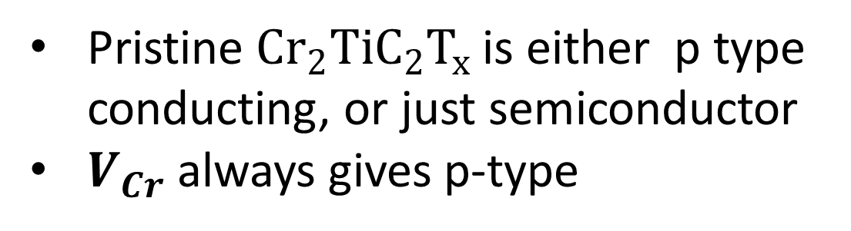
Different functional group
1
DOS for $Cr_{2}TiC_{2}T_{x}$(T= -F, OH and O)
+ Cr Vacancy
Pristine $Cr_{2}TiC_{2}T_{x}$ is either p type conducting, or just semiconductor
$V_{Cr}$always gives p-type
CURIOUS
SMART
TENACIOUS
Notes:
1. We considered the effect of individual (–O, –F, and –OH) functional groups and their equal mixtures: –O/–F and –F/–OH.
2. Cr vacancies at 1.67 atom % (corresponding to 2 vacancies in a 120-atom supercell) is used for all structure
3. O or a mix of O and F -→ p-type and OH, and F or mix of OH and F ---→ semiconducting

Slide 16
1
Role of Surface Functional Group (Tx)
Role of Cr vacancy ($V_{Cr}$ )
Oxygen substituting Carbon ($O_{c}$ )
CURIOUS
SMART
TENACIOUS
Notes:
In-plane lattice parameter obtained by lowest energy from ‘E’ Vs ‘a’ plot

Slide 17
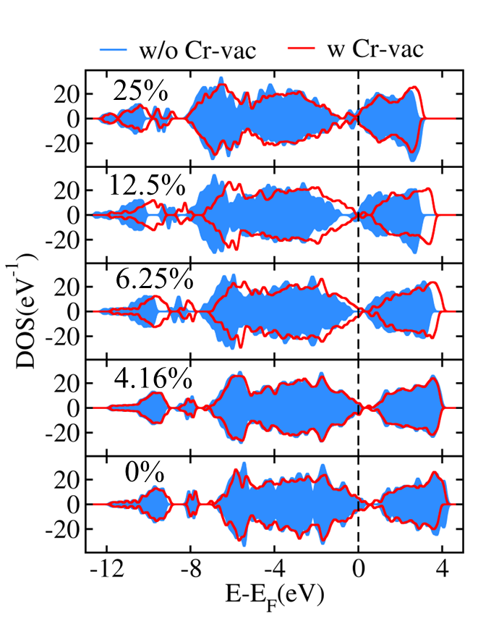
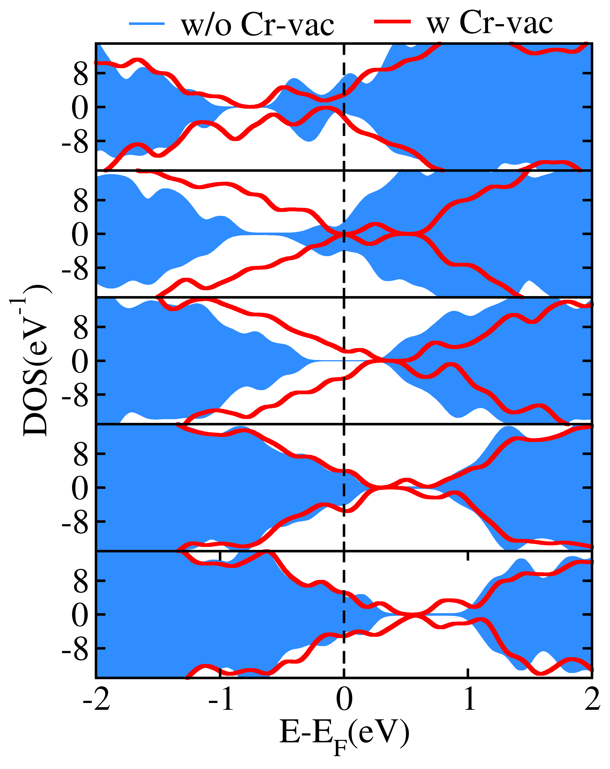
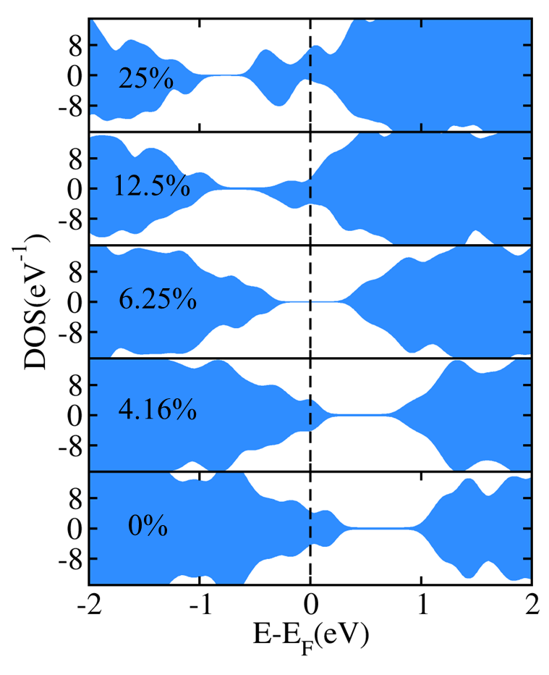

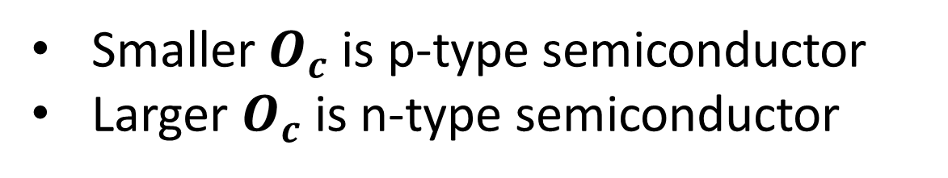
p-/n tunability with oxygen substitution
1
DOS of $Cr_{2}TiC_{2−δ}O_{δ}T_{x}$
25%
We fixed –O, –OH, and –F surface functional groups in a 1:2:5 ratio
12.5%
6.25%
4.16%
Michałowski et al., 2022, Nature Nanotechnology
0%
Smaller $O_{c}$ is p-type semiconductor
Larger $O_{c}$ is n-type semiconductor
CURIOUS
SMART
TENACIOUS
Notes:
1. We fixed –O, –OH, and –F surface functional groups in a 1:2:5 ratio¹, which is approximately similar to that determined in a recent SIMS measurement.
2. Different percentages of O substituting C (Oc) is used.
3. Cr vacancies at 1.67 atom % is used for all structure.

Slide 18
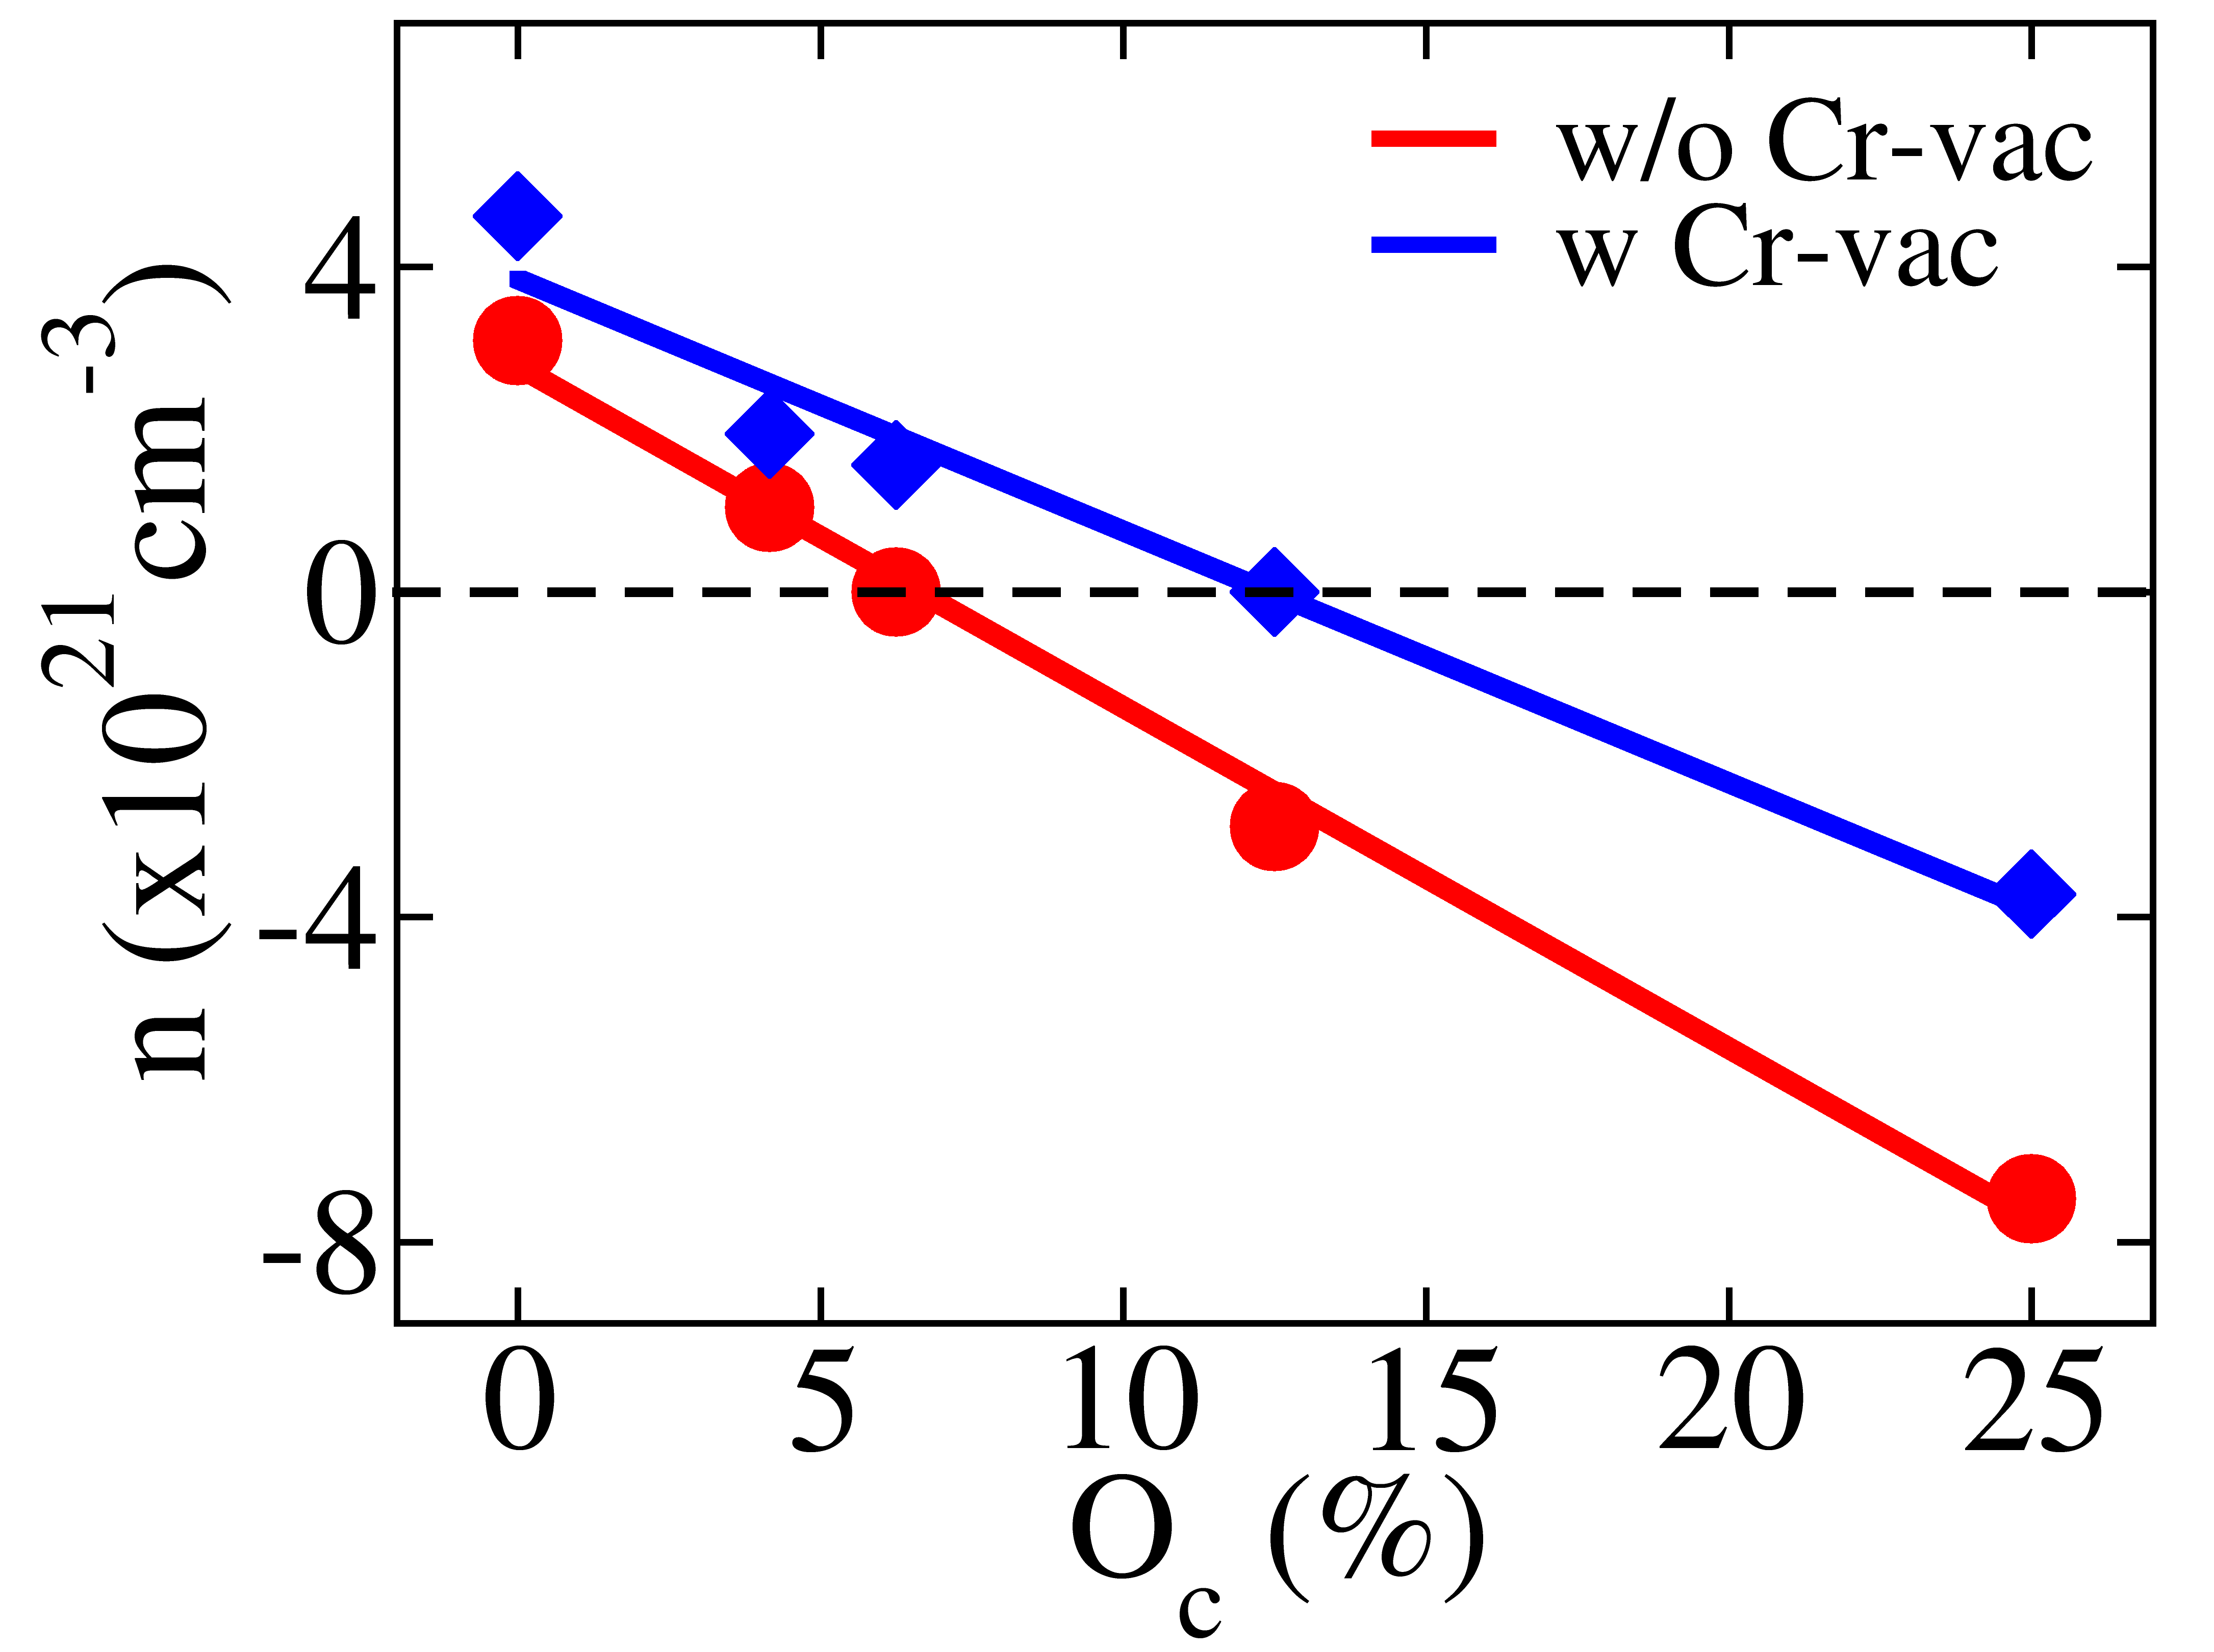
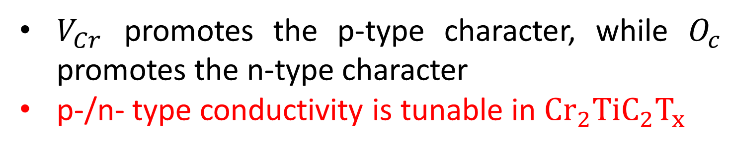
Tunable p-/n- conductivity
1
$V_{Cr}$ promotes the p-type character, while $O_{c}$ promotes the n-type character
p-/n- type conductivity is tunable in $Cr_{2}TiC_{2}T_{x}$
CURIOUS
SMART
TENACIOUS

Slide 19

MXene with AI/ML
1
Current Challenge:
Enormous configurational space: different transition metals, surface terminations, and stacking orders
Traditional DFT/Experimental measurement can't explore every possible structure due to high computational cost
MAX
Surface Functional Groups
AI/Machine Learning:
-OH ,-F, -O, -Cl
Can predict key material properties (e.g., bandgap, conductivity type etc.) without relying on expensive DFT calculations for every configuration.
Successfully applied to MXenes to predict properties like work function based on surface terminations and composition (e.g., Roy et al., J. Phys.: Energy, 2021).
MXene
Infinite possibility???
CURIOUS
SMART
TENACIOUS
Notes:
We can have MXenes with either single or double transition metals.
Because of its magnetic property, this MXene offers more functionality for electronic devices
So based on this motivation, we selected a double transition metal MXene—Cr₂TiC₂Tₓ
Our collaborators synthesized high-quality Cr₂TiC₂Tₓ flakes and also carried out the electrical measurements

Slide 20
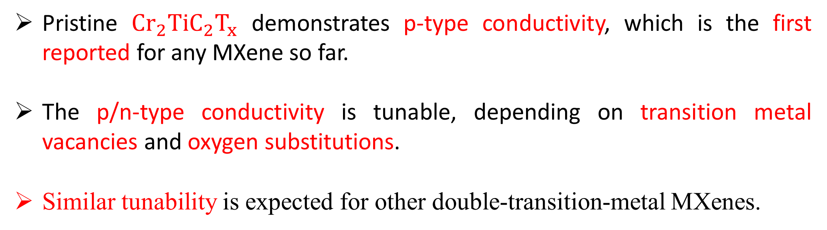
Summary
1
Pristine $Cr_{2}TiC_{2}T_{x}$ demonstrates p-type conductivity, which is the first reported for any MXene so far.
The p/n-type conductivity is tunable, depending on transition metal vacancies and oxygen substitutions.
Similar tunability is expected for other double-transition-metal MXenes.
Questions:
Is Cr₂TiC₂Tₓ really a p-type semiconductor? Yes
Can it also exhibit n-type or metallic behavior? Yes
Redefining MXene boundary
Beyond the traditional metallic behavior.
CURIOUS
SMART
TENACIOUS

Slide 21



Acknowledgement
1
Bagheri, S., Loes, M. J., Lipatov, A., Acharya, K., Paudel, T. R., Lu, H., ... & Sinitskii, A. (2024). Synthesis of high-quality large Cr2TiC2Tx MXene monolayers, their mechanical properties, p-type electrical transport, and positive photoresponse. Matter, 7(12), 4281-4296.
QR code for paper
Collaborator
CURIOUS
SMART
TENACIOUS
Notes:
Big thanks to our collaborators and funding sources, especially South Dakota Mines, NSF, and others.

Slide 22
THANK YOU
Any Questions??
1
CURIOUS
SMART
TENACIOUS

Slide 23
Extra Slides

Slide 24
CrI₂
vdW
vdW

Slide 25
📶 Electromagnetic Interference (EMI) Shielding and Antennas
Why MXenes?
MXenes block electromagnetic waves effectively due to their metallic nature and layered structure—useful in shielding electronics and making compact antennas.
🧬 Biomedicine
Why MXenes?
They are biocompatible and can be functionalized for drug delivery, imaging, or even killing cancer cells via photothermal therapy.
🧪 Sensors
Why MXenes?
MXenes respond quickly to gases, chemicals, and physical changes due to their high surface area and conductivity—perfect for sensitive sensors.
💡 Optoelectronics
Why MXenes?
They can absorb and conduct light and electricity, making them useful in solar cells, LEDs, and transparent electrodes.
🌍 Environmental
Why MXenes?
MXenes can adsorb toxic metals, dyes, and pollutants thanks to their surface chemistry—ideal for water and air purification.
📱 5G Antennas, Electronics, Smart Textiles
Why MXenes?
Their flexibility, conductivity, and printability make them ideal for wearable electronics and high-speed communication devices like 5G antennas.
🔋 Energy Storage and Harvesting
Why MXenes?
MXenes have high electrical conductivity and a layered structure, which allows fast ion movement—perfect for batteries and supercapacitors.

Slide 26
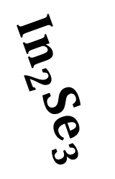
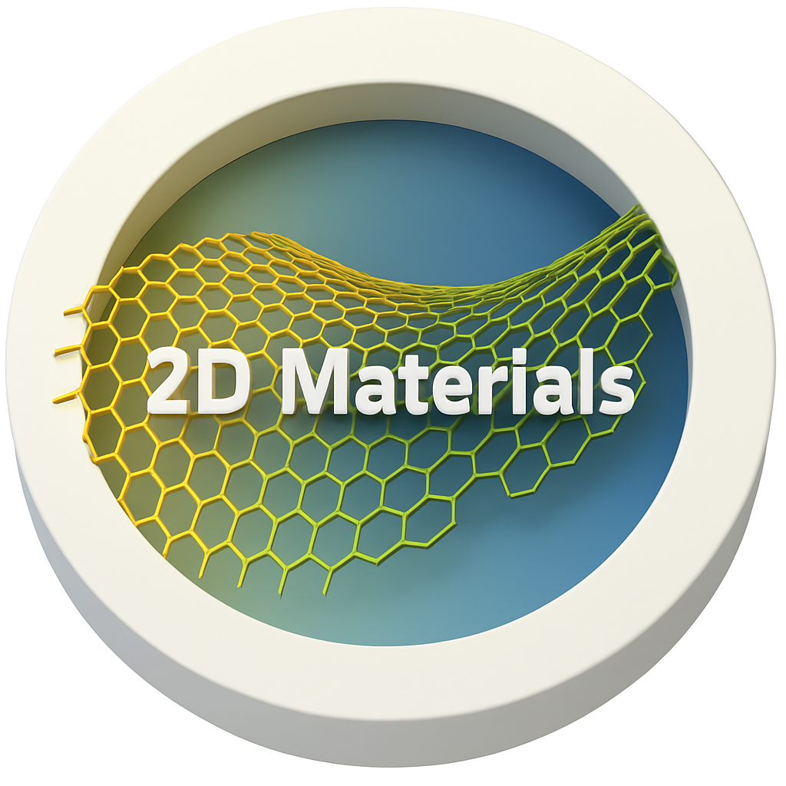
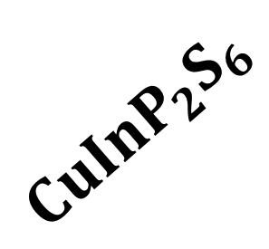
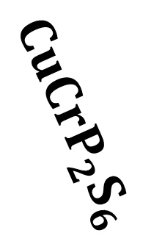

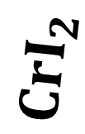
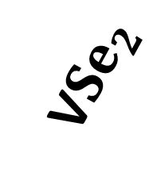
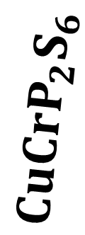
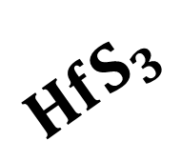

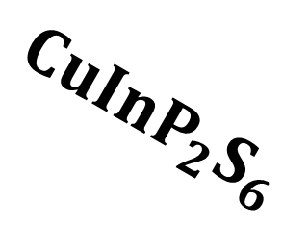



Graphene
Graphene
PVK-Br
h-BN
$$CuInP_{2}S_{6}$$
h-BN
$$MoS_{2}$$
$${In}_{2}{Se}_{3}$$
MXenes
$$CuCrP_{2}S_{6}$$
$$CrI_{2}$$
$$CuCrP_{2}S_{6}$$
$$CrI_{2}$$
V${Se}_{2}$
$$MoS_{2}$$
$$CuInP_{2}S_{6}$$
$$HfS_{3}$$
PVK-Br
$$HfS_{3}$$
$$In_{2}Se_{3}$$
MXenes

