Slide 1
How AI Is Helping Us Discover New Materials?
Dr. Rodrigue Rizk
Artificial Intelligence Research Lab
Department of Computer Science
University of South Dakota
Rodrigue.Rizk@usd.edu
Notes:
"Good [morning/afternoon/evening], everyone. Today, I'm excited to talk to you about a revolution in healthcare and biomedical research - what I like to call 'The Penicillin 2.0 Revolution: AI in Healthcare and Biomedical Research.'"

Slide 2
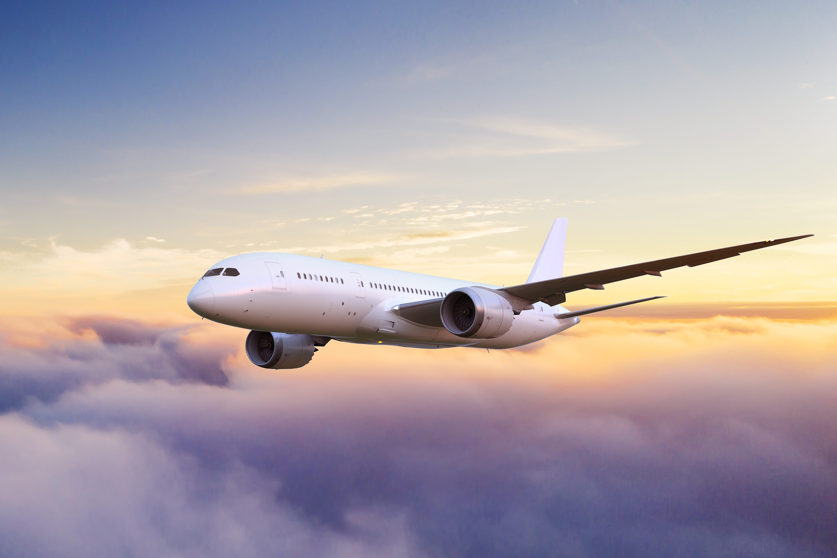
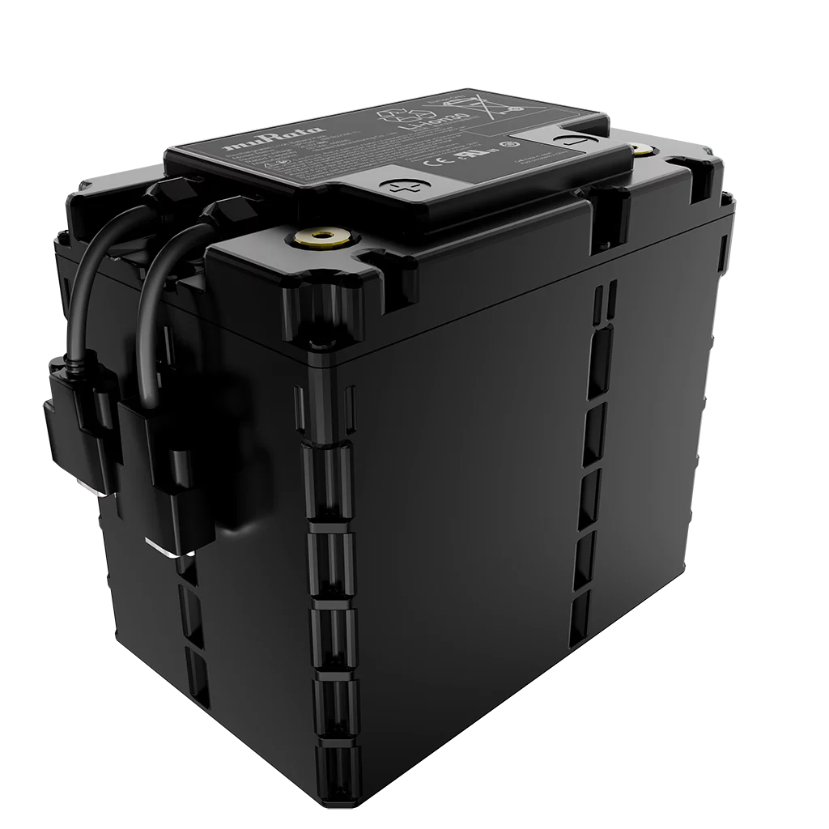
What Is Materials Discovery?
Simple explanation: “Finding new stuff to build better things”
(e.g., lighter airplanes, faster phones, cleaner batteries)
2
Notes:
I think we just want to start with the big picture. Does AI have a place in the legal landscape?
Absolutely, yes, if not I wouldn’t be here today

Slide 3
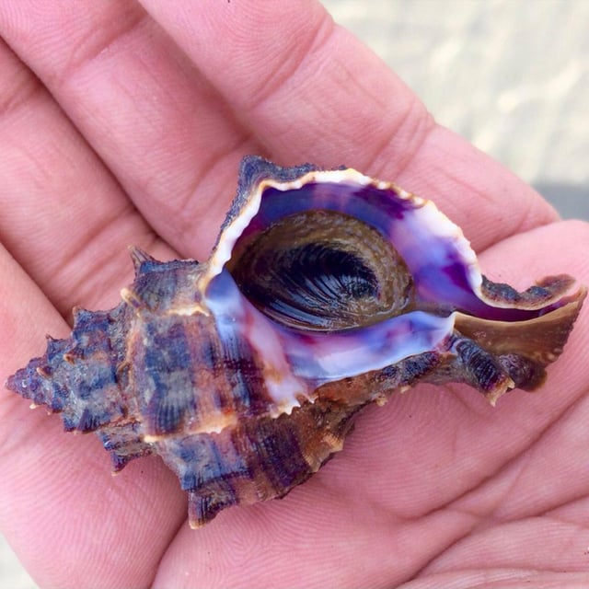
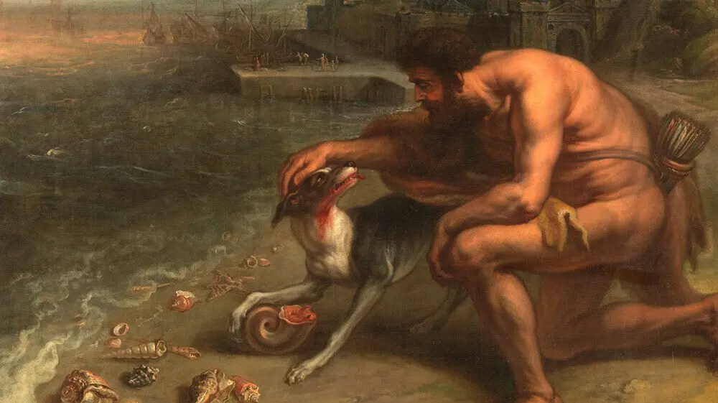
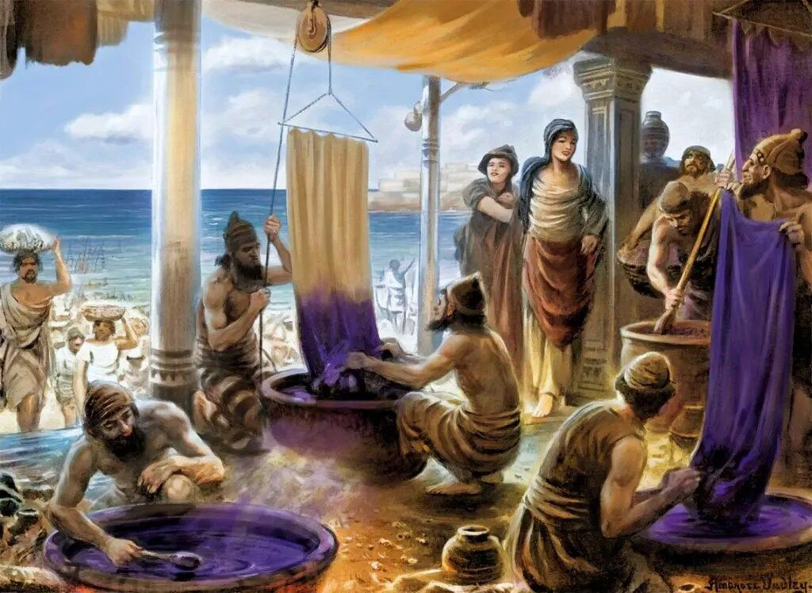
What Is Materials Discovery?
The discovery of murex, the snail used to create Tyrian purple dye, was accidental.
A dog belonging to Melqart, the Phoenician lord of Tyre, is said to have stained its mouth purple after biting into a murex snail on the beach.
The dye became known as Tyrian purple, named after the city of Tyre, and was highly valued for its vibrant color and association with royalty and power.
3
Notes:
I think we just want to start with the big picture. Does AI have a place in the legal landscape?
Absolutely, yes, if not I wouldn’t be here today

Slide 4
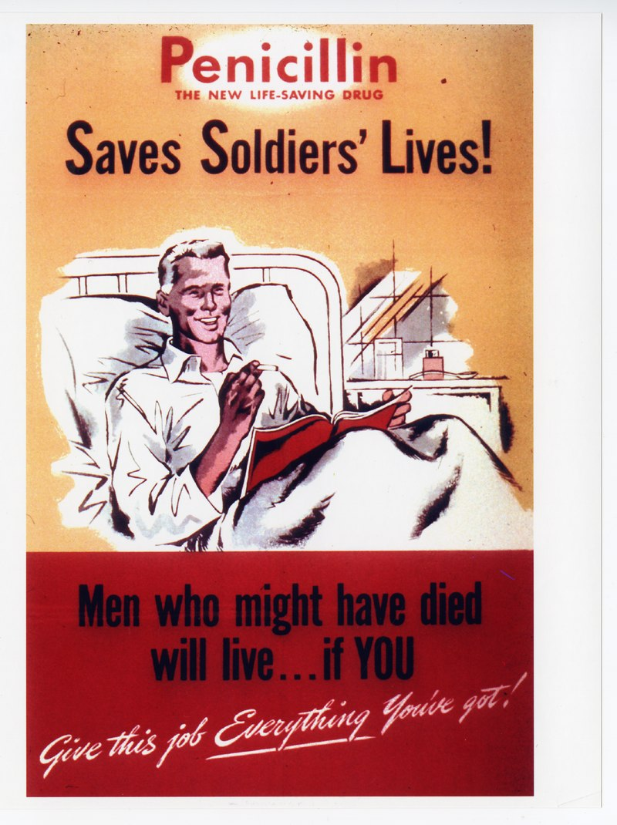
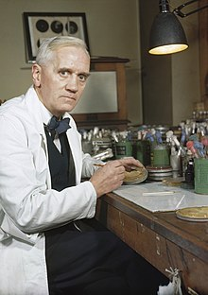
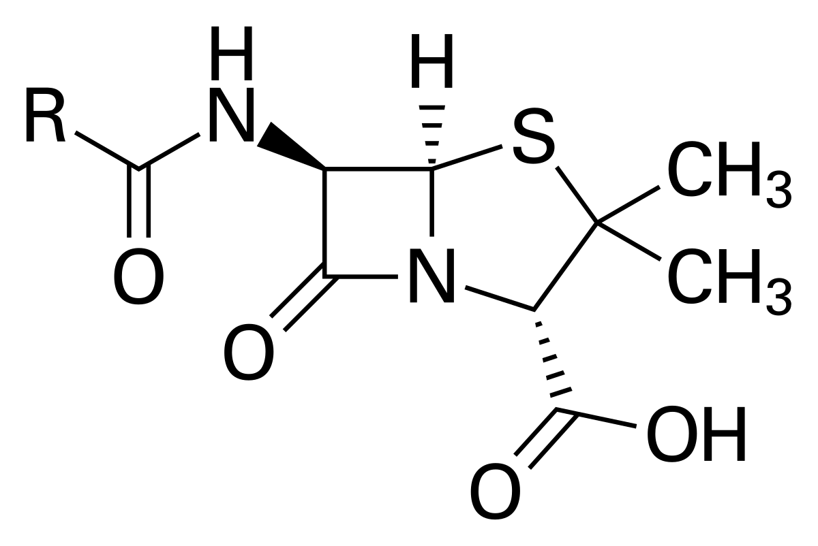
What Is Materials Discovery?
Penicillin (1928): the world’s first broadly effective antibiotic substance
Penicillin was discovered accidentally by Sir Alexander Fleming in 1928.
He noticed that a mold had contaminated a Petri dish of bacteria, and that the mold inhibited bacterial growth around it.
Penicillin
Sir Alexander Fleming
4
Notes:
"Let's begin with a quick trip down memory lane. In the 20th century, Alexander Fleming's discovery of penicillin revolutionized medicine.
this is a picture of Alexander fleming who discovered penicillin
you see he's not very happy because he couldn't order it from CVS
he had to discovered himself, and of course he had no no no AI and nothing to analyze the data but his brain which was pretty good

Slide 5
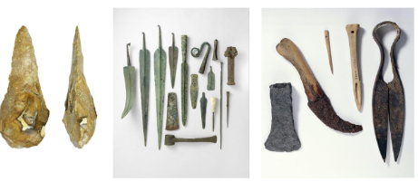
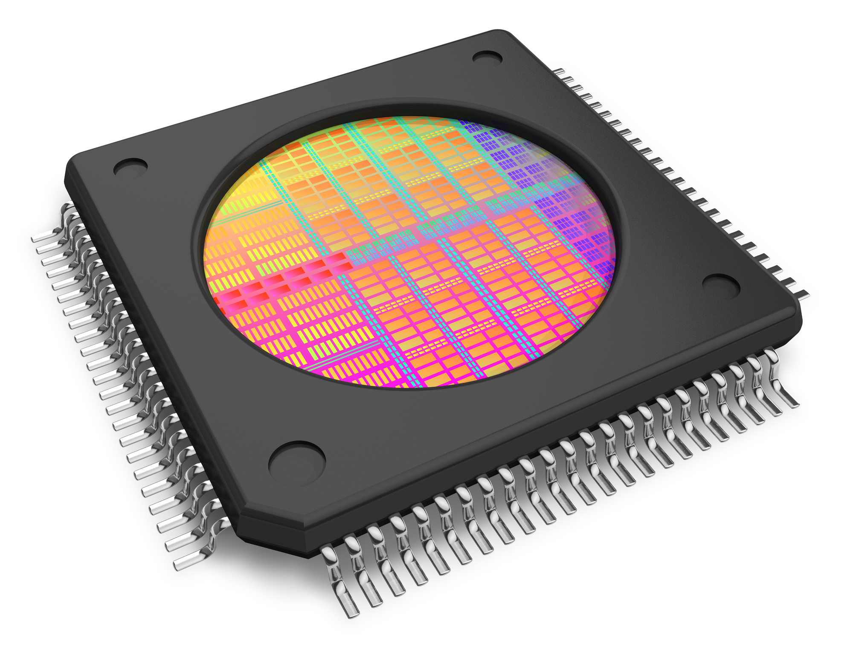
Materials Discovery Precursor to Progress in Society
Materials changed societies and enabled new technology:
Stone → Bronze → Iron → .. → Silicon
5
Notes:
I think we just want to start with the big picture. Does AI have a place in the legal landscape?
Absolutely, yes, if not I wouldn’t be here today

Slide 6
14 Grand Challenges for Humanity in the 21st Century
6
Notes:
I think we just want to start with the big picture. Does AI have a place in the legal landscape?
Absolutely, yes, if not I wouldn’t be here today

Slide 7
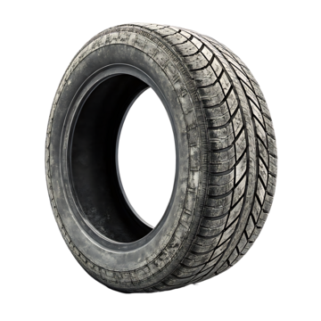
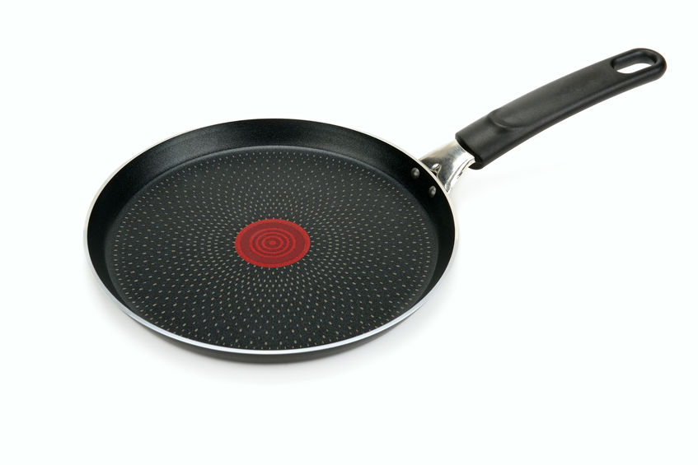
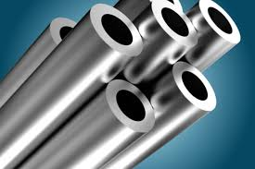
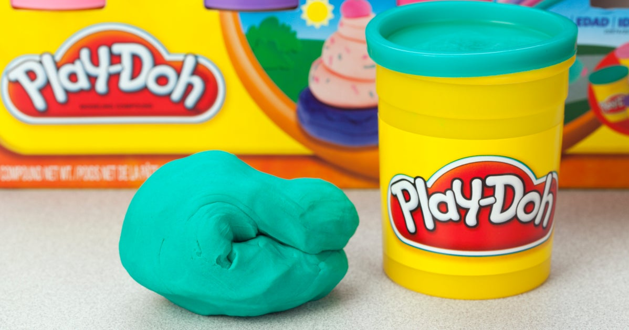
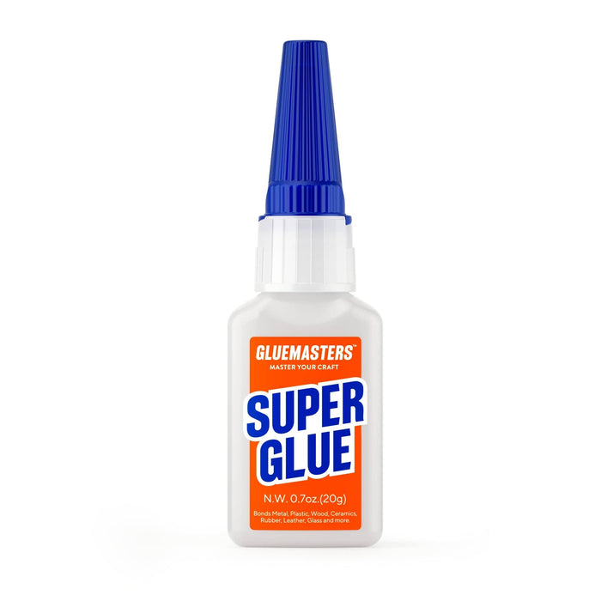
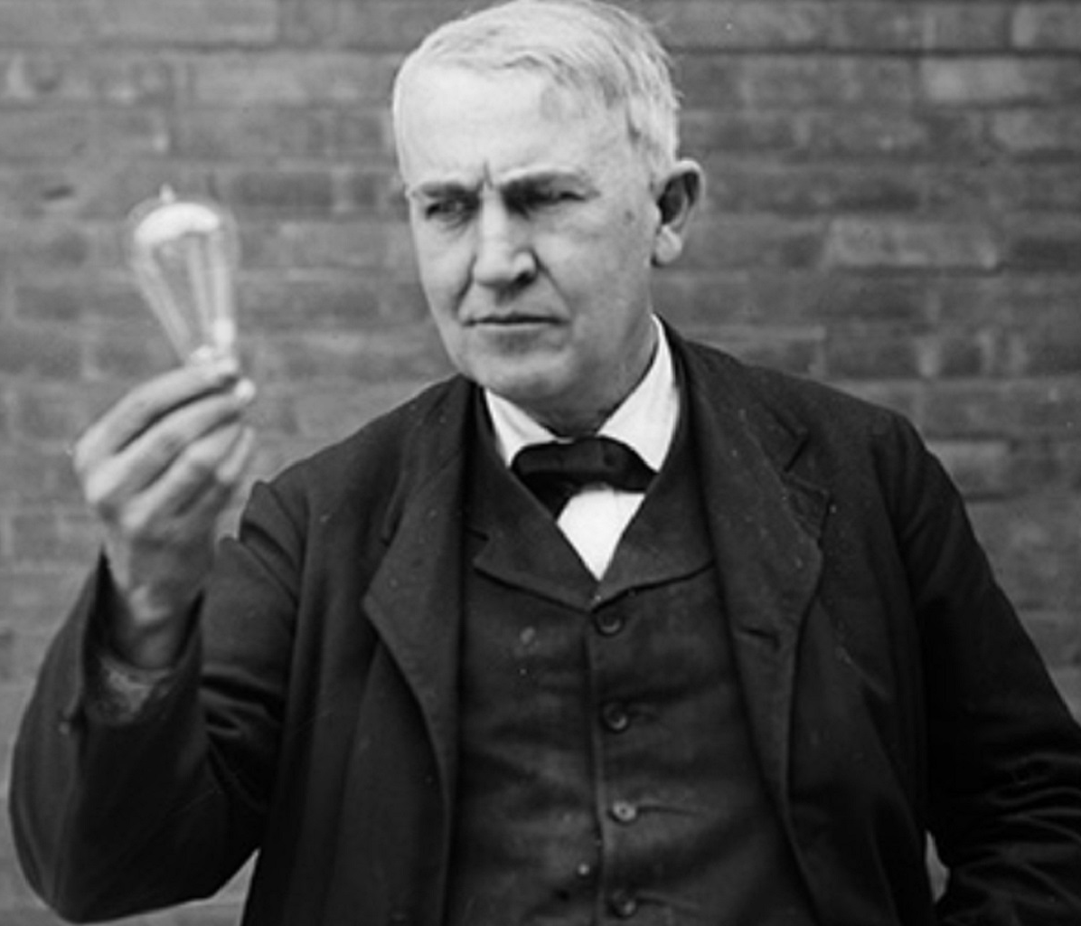
How are Materials Discovered?
By Luck / Accident:
Purple Dye, Stainless steel, vulcanized rubber (car tires),Teflon, Play-doh, Super Glue, ...
Edisonian (Trial and Error) Approach:
Named after Thomas Edison
He tested over 6,000 plant materials to discover the final light bulb filament
7
Notes:
I think we just want to start with the big picture. Does AI have a place in the legal landscape?
Absolutely, yes, if not I wouldn’t be here today

Slide 8
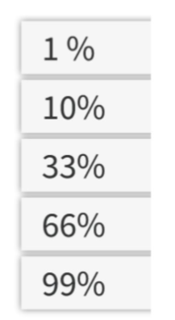
Materials Discovery over Time
Of all (solid state) materials that we know of today, how many were discovered in the last 10 years?
8
Notes:
I think we just want to start with the big picture. Does AI have a place in the legal landscape?
Absolutely, yes, if not I wouldn’t be here today

Slide 9
Materials Discovery over Time
Of all (solid state) materials that we know of today, how many were discovered in the last 10 years?
9
Notes:
I think we just want to start with the big picture. Does AI have a place in the legal landscape?
Absolutely, yes, if not I wouldn’t be here today

Slide 10
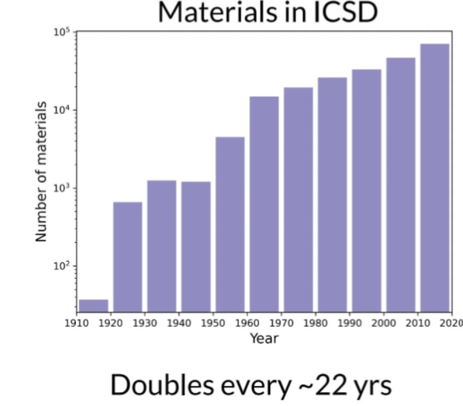
Materials Discovery over Time
10
Notes:
I think we just want to start with the big picture. Does AI have a place in the legal landscape?
Absolutely, yes, if not I wouldn’t be here today

Slide 11
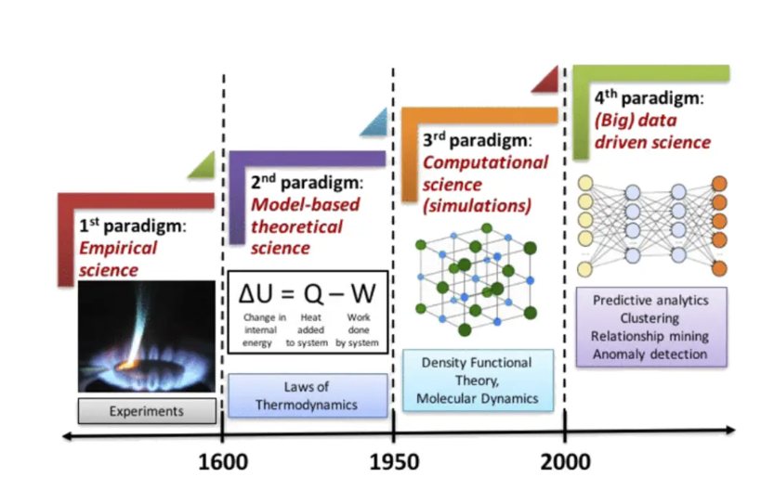
Materials Discovery over Time
11
Notes:
I think we just want to start with the big picture. Does AI have a place in the legal landscape?
Absolutely, yes, if not I wouldn’t be here today

Slide 12
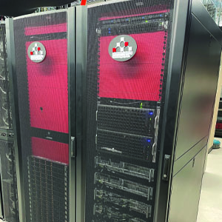
Time Required for Experiment vs. Computation
Lawrence HPC Cluster
USD operates the "Lawrence" supercomputer system - High Performance Computing (HPC) cluster.
Lawrence is named after Nobel Laureate and USD Alumnus E. O. Lawrence.
Lawrence is made up of over 2,300 CPU cores, including systems with 1.5TB of memory, GPU accelerators, and over 400TB of shared high-speed data storage accessible.
12
Notes:
I think we just want to start with the big picture. Does AI have a place in the legal landscape?
Absolutely, yes, if not I wouldn’t be here today

Slide 13
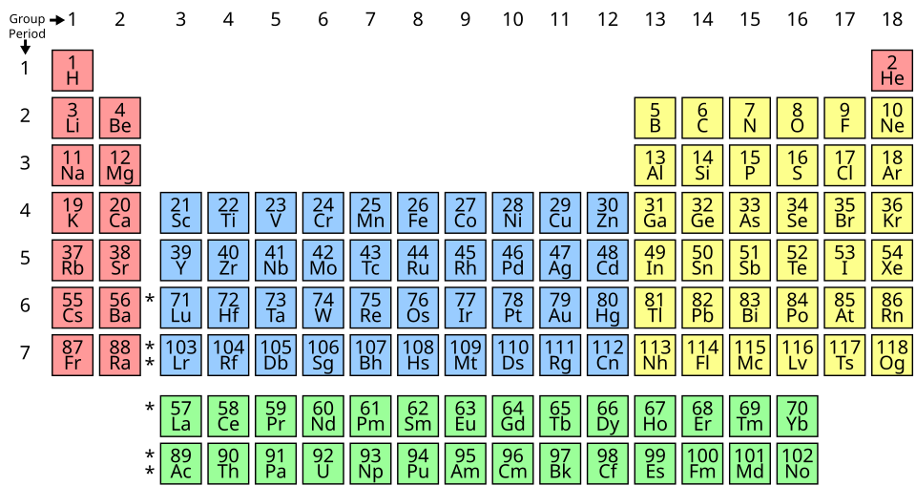
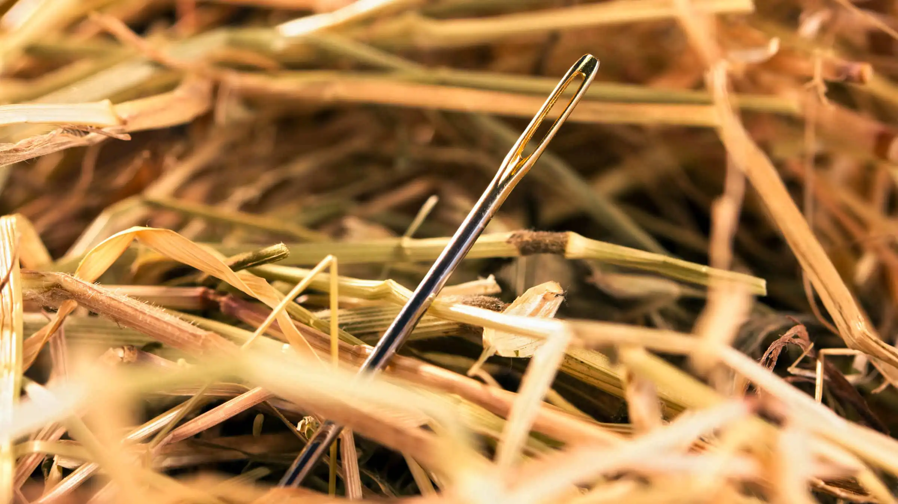
Why Is It Hard Without AI?
So many combinations of elements → “needle in a haystack”
Traditional methods = slow and expensive
13
Notes:
I think we just want to start with the big picture. Does AI have a place in the legal landscape?
Absolutely, yes, if not I wouldn’t be here today

Slide 14
How AI Helps?
Predict properties of materials before making them
Simulate experiments in seconds
Real example: AI finding new battery materials or superconductors
14
Notes:
https://youtu.be/y7sgJoc-ynI

Slide 15
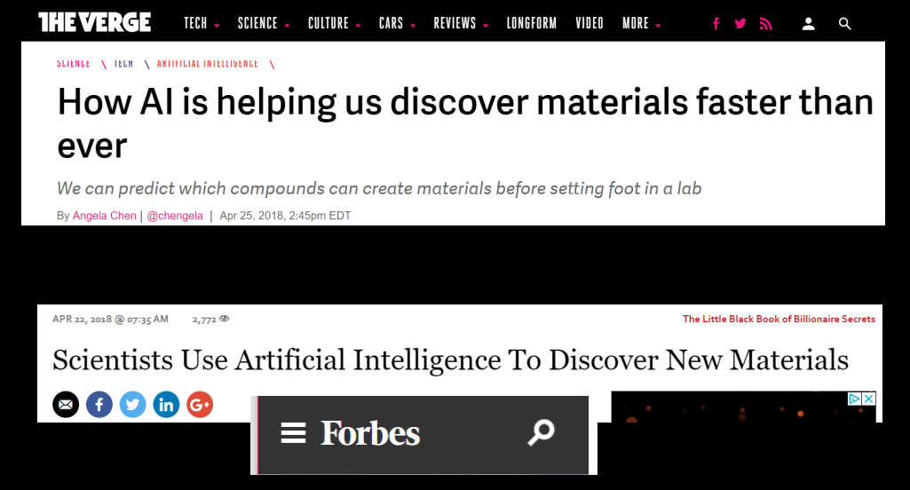
AI as a tool to accelerate discovery
15
Notes:
I think we just want to start with the big picture. Does AI have a place in the legal landscape?
Absolutely, yes, if not I wouldn’t be here today

Slide 16
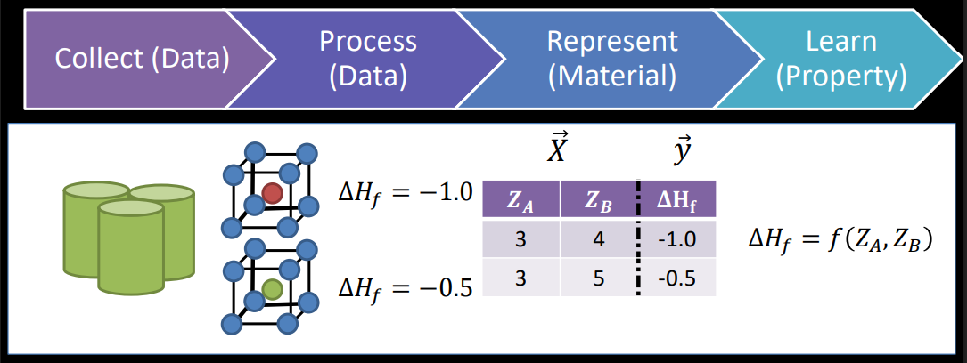
Materials Informatics Workflow
16
Notes:
I think we just want to start with the big picture. Does AI have a place in the legal landscape?
Absolutely, yes, if not I wouldn’t be here today

Slide 17
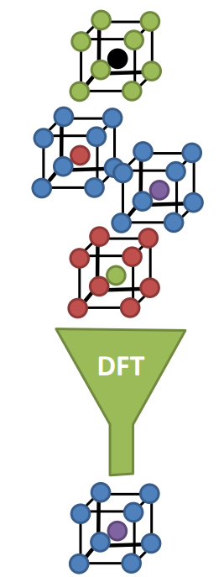
Application: The Prototype Search
Common Method: Prototype Search
Select a crystal structure
Evaluate all possibilities with Density Functional Theory (DFT)
Select only stable ones
Challenge: Computational cost (success rate in finding stable compounds can be very low)
17
Notes:
I think we just want to start with the big picture. Does AI have a place in the legal landscape?
Absolutely, yes, if not I wouldn’t be here today

Slide 18
Application: The Prototype Search
Possible Solution: Machine Learning / AI
18
Notes:
I think we just want to start with the big picture. Does AI have a place in the legal landscape?
Absolutely, yes, if not I wouldn’t be here today

Slide 19
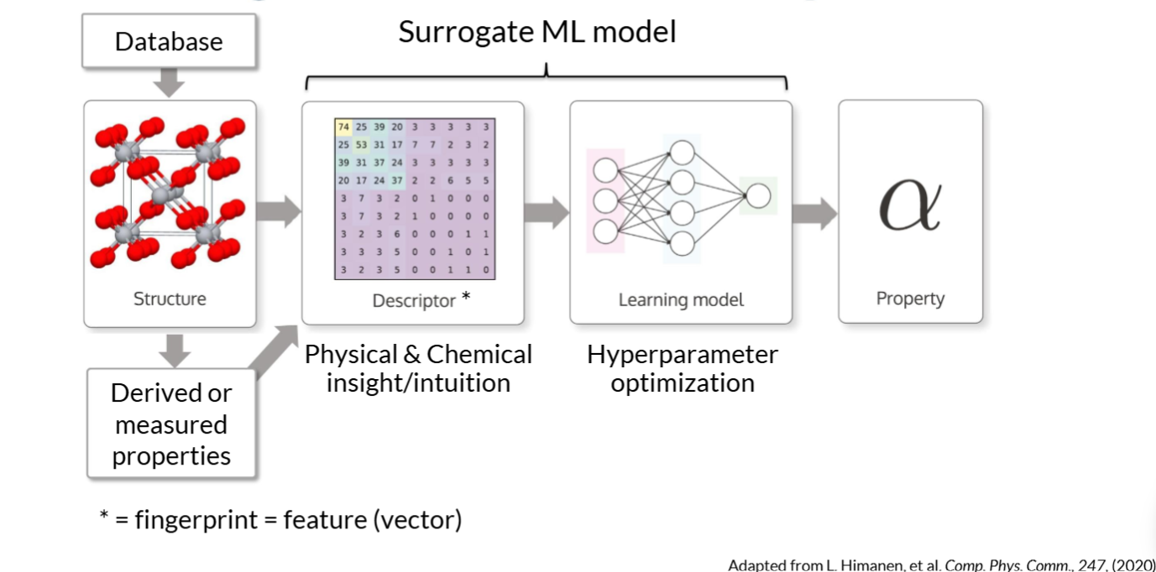
The 4th Paradigm: Data-Driven Discovery
19
Notes:
I think we just want to start with the big picture. Does AI have a place in the legal landscape?
Absolutely, yes, if not I wouldn’t be here today

Slide 20
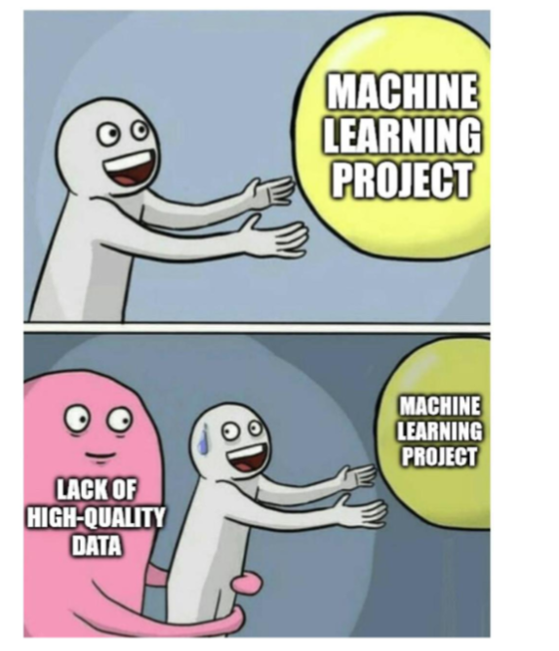
High-Quality Data?
20
Notes:
I think we just want to start with the big picture. Does AI have a place in the legal landscape?
Absolutely, yes, if not I wouldn’t be here today

Slide 21
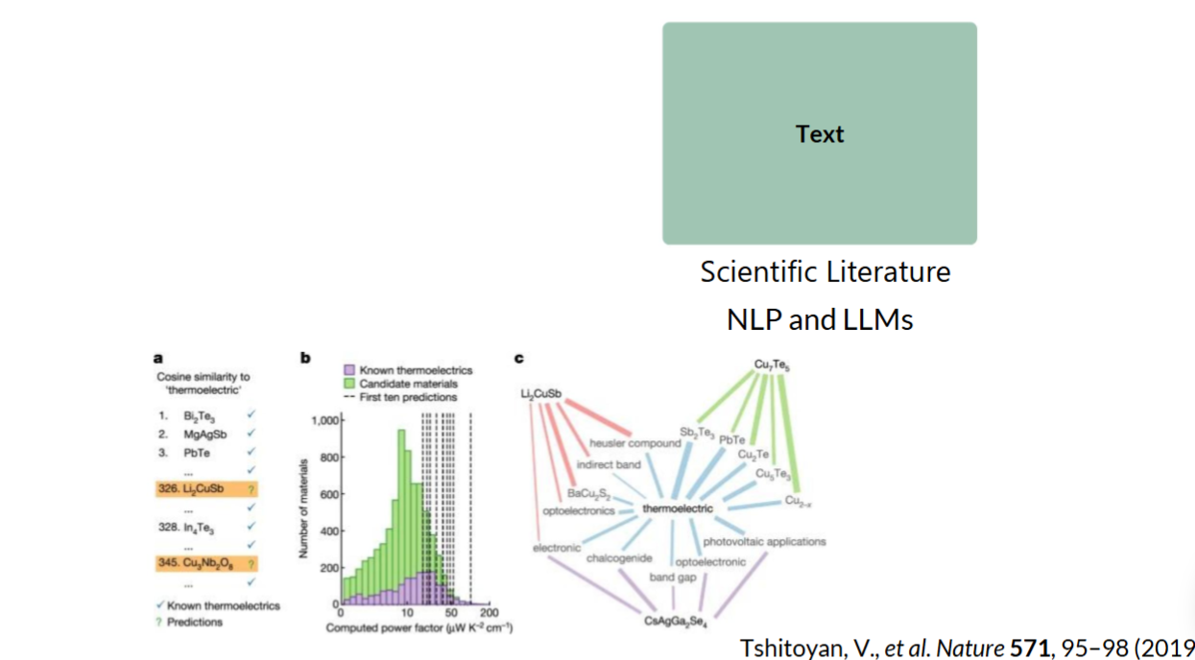
Types of Materials Data
21
Notes:
I think we just want to start with the big picture. Does AI have a place in the legal landscape?
Absolutely, yes, if not I wouldn’t be here today

Slide 22
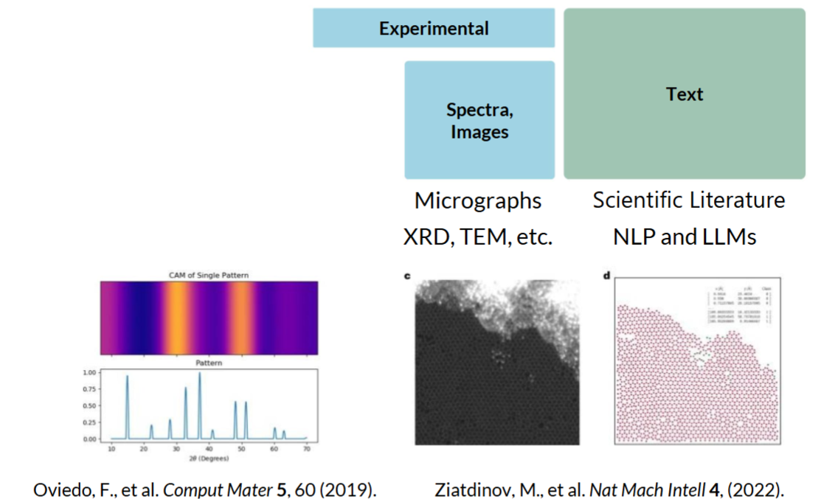
Types of Materials Data
22
Notes:
I think we just want to start with the big picture. Does AI have a place in the legal landscape?
Absolutely, yes, if not I wouldn’t be here today

Slide 23
Types of Materials Data
23
Notes:
I think we just want to start with the big picture. Does AI have a place in the legal landscape?
Absolutely, yes, if not I wouldn’t be here today

Slide 24
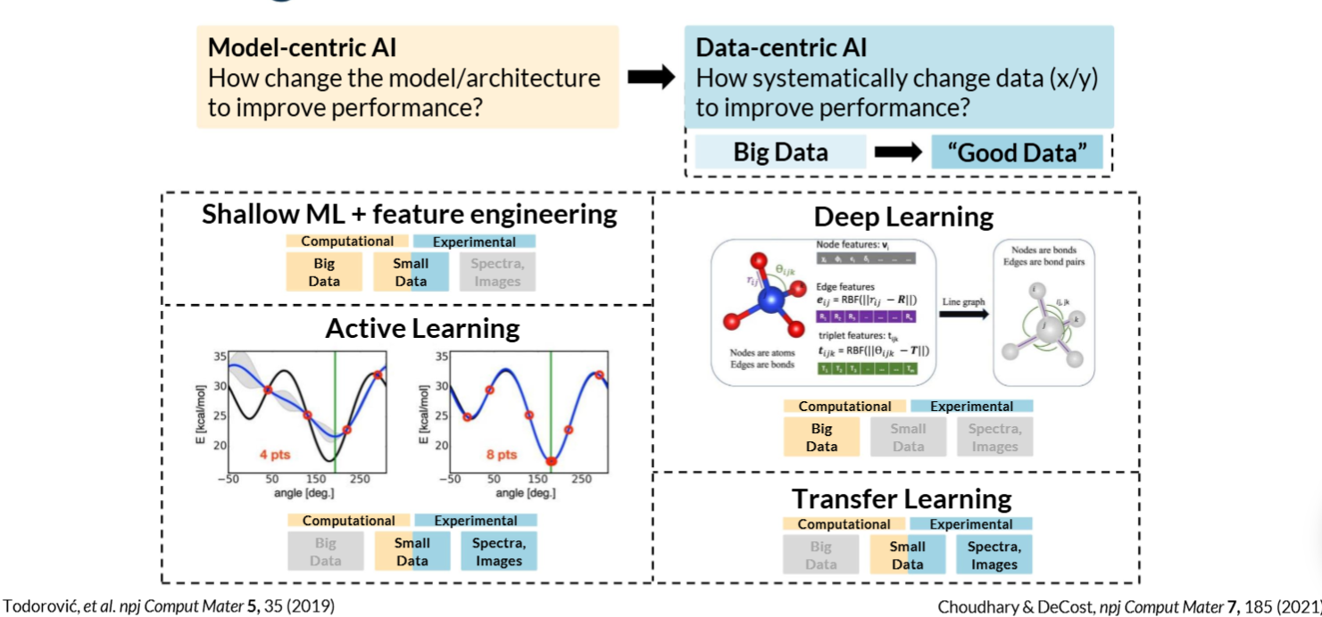
Machine Learning (ML) Paradigms in Materials Science
24
Notes:
I think we just want to start with the big picture. Does AI have a place in the legal landscape?
Absolutely, yes, if not I wouldn’t be here today

Slide 25
Real World Projects
Google DeepMind’s AlphaFold (proteins)
25
Notes:
https://youtu.be/gg7WjuFs8F4

Slide 26
Real World Projects
NASA and AI-designed alloys
26
Notes:
https://youtu.be/C_j1QriqPZc

Slide 27
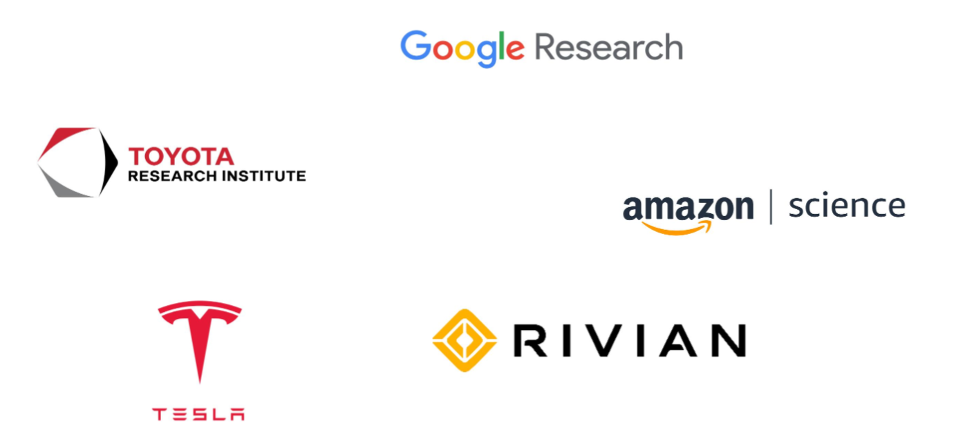
"Materials Informatics" in Industry?
27
Notes:
I think we just want to start with the big picture. Does AI have a place in the legal landscape?
Absolutely, yes, if not I wouldn’t be here today

Slide 28
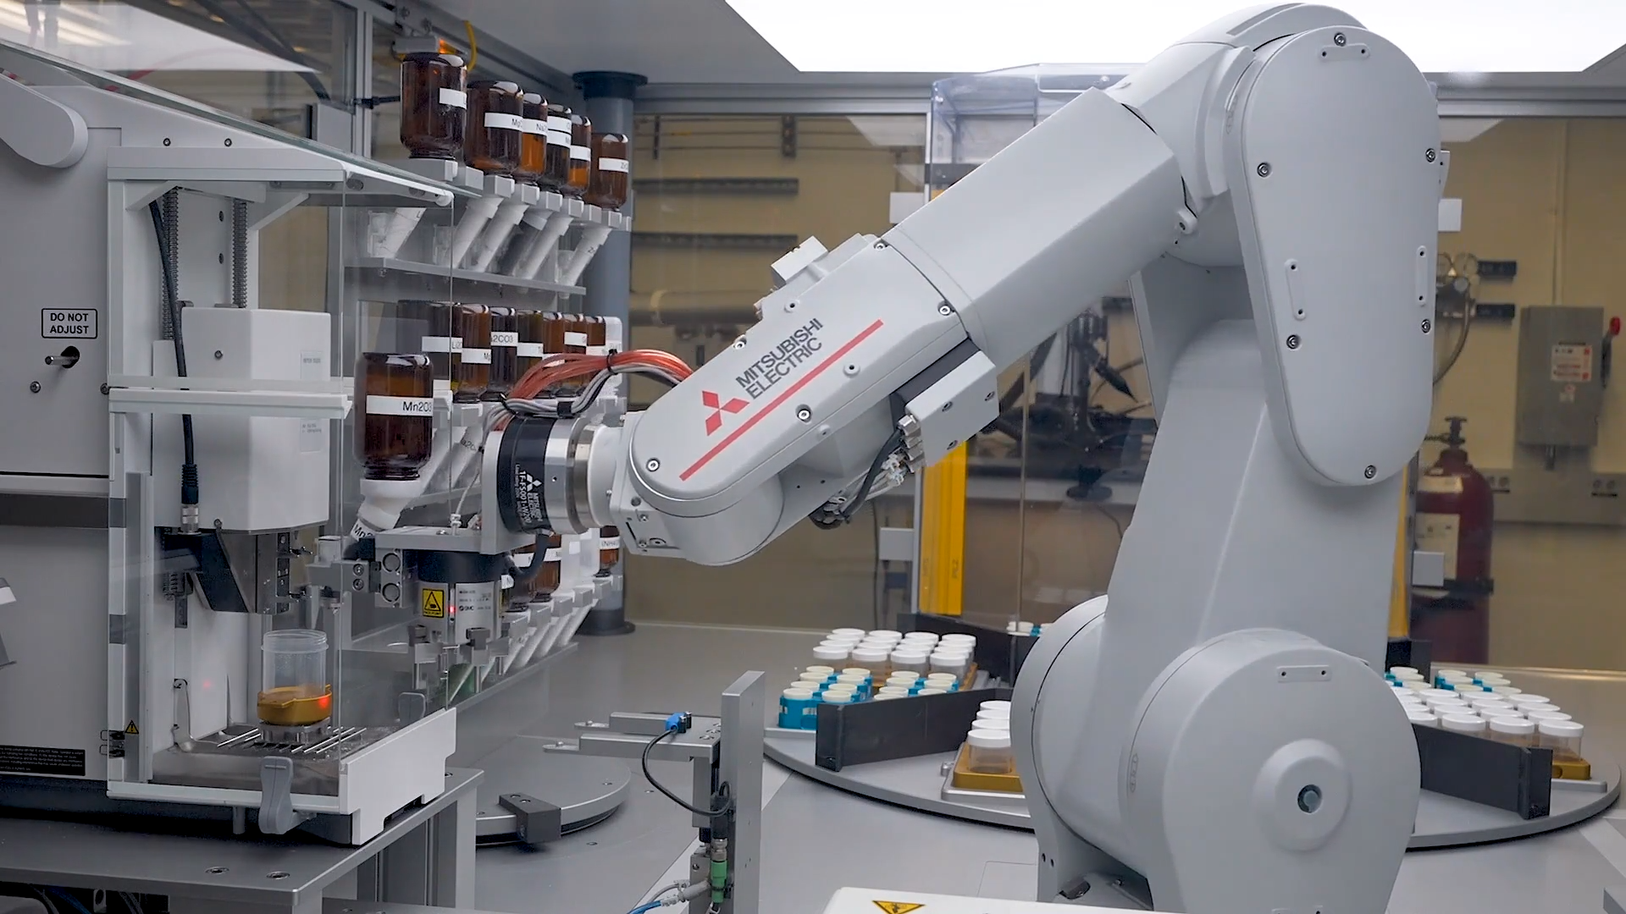
The Future of AI in Science
Smarter labs with robots and AI scientists
“Citizen scientists” using AI tools
28

Slide 29
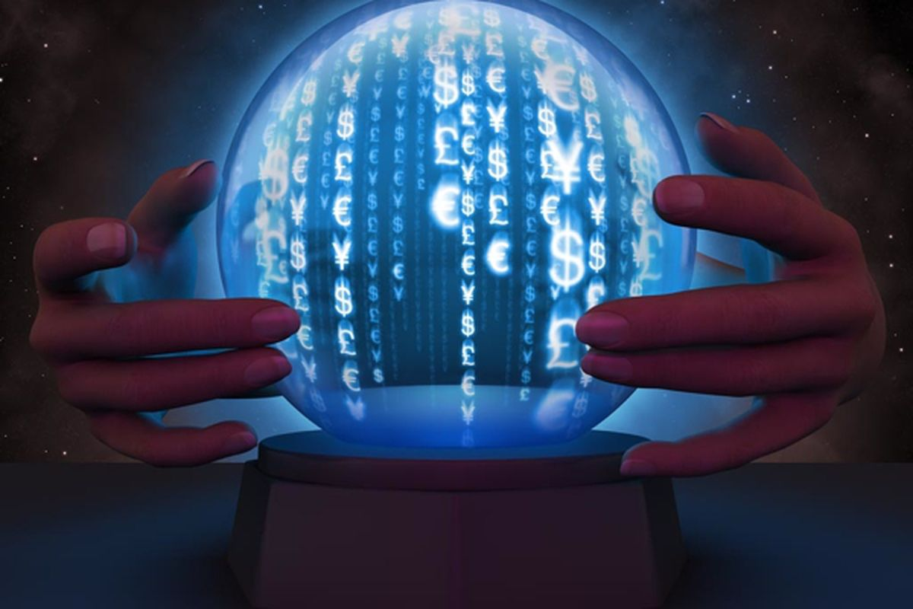
🚀 Closing Activity
“Imagine the Future”: “What would YOU discover with AI?”
29

Slide 30
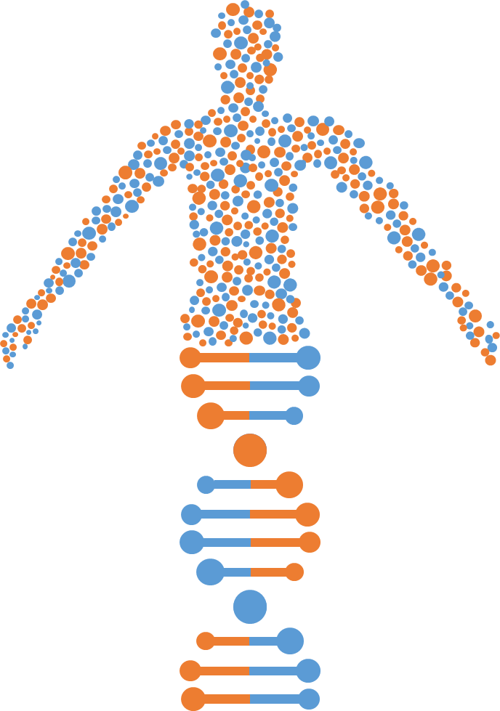
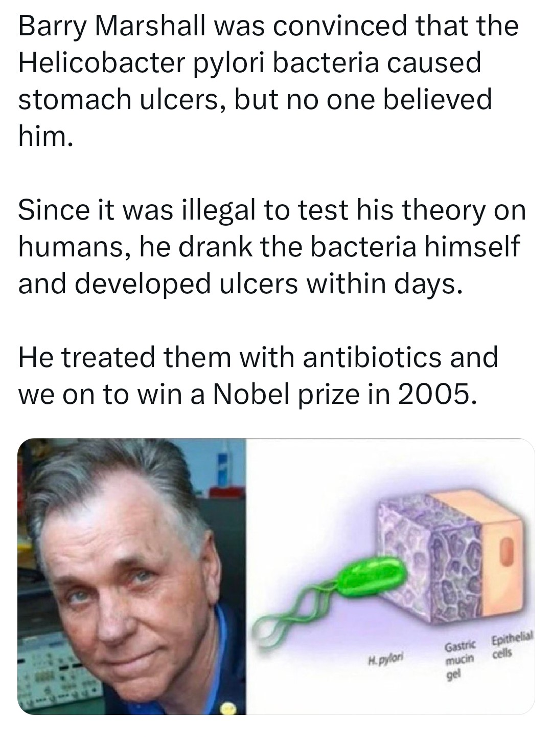
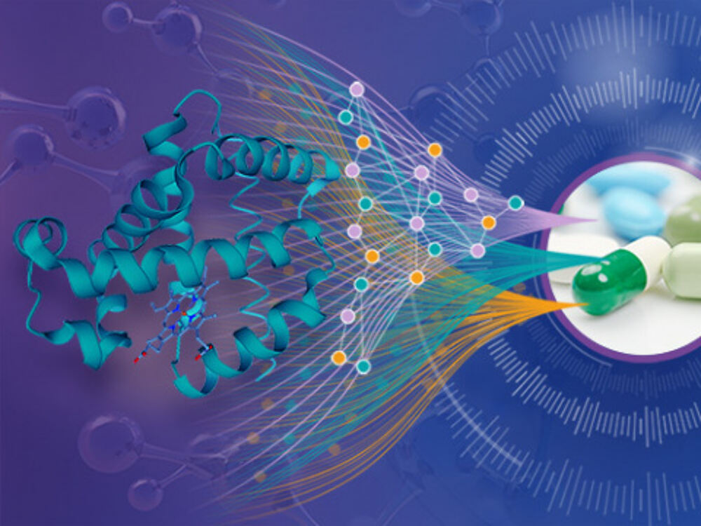
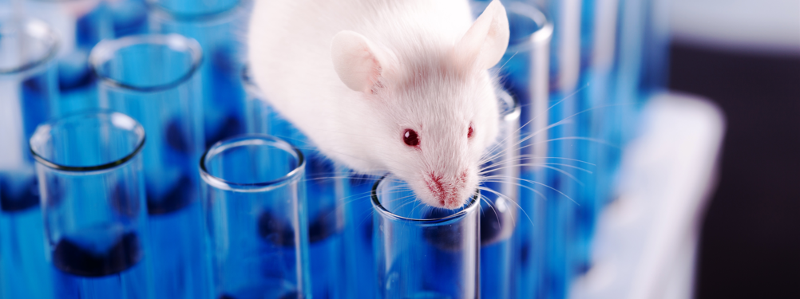
AI-driven Framework
30
Notes:
Mice might be doing experiments on humans. However, in the real world its vice versa. Mice are subject to several scientific experiments carried out by humans.

Slide 31
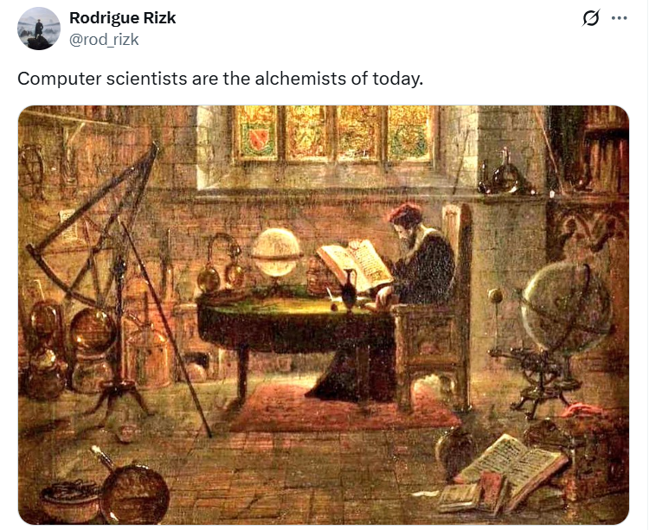
Final Note
31
Notes:
Mice might be doing experiments on humans. However, in the real world its vice versa. Mice are subject to several scientific experiments carried out by humans.

Slide 32
AI Symposium
June 26-27, 2025
USD – Sioux Falls Avera Hall 4801 N. Career Ave. Sioux Falls, SD 57107
https://www.ai-research-lab.org/events/ai-symposium/2025
32

Slide 33
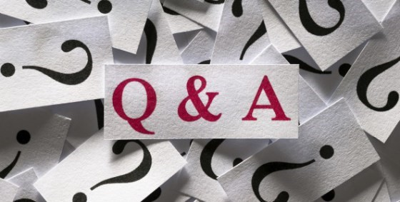
Q&A
“Today's technology was yesterday's science fiction.”
- Dr. Rodrigue Rizk
33

Slide 34
References
Peter Schindler. How AI is Revolutionizing the Discovery of Materials. 2023

