Slide 1
Tuning Soft Magnetic Properties in Fe-Based Nanocrystalline Alloys via Ge Substitution
Paul W. White
Tula R. Paudel
Department of Physics
South Dakota School of Mines and Technology
Rapid City, South Dakota

Slide 2
collaborators
Tula R. Paudel (SDSM&T Physics Department)
Nick Bruno (Glenn Research Center)
Jacob Peterson (SDSM&T, EMES Research Scientist)
Eli Meakins (Mechancial Engineering Masters Student, Graduated)
Parashu Kharel (SDSU Physics Department)

Slide 3
outline
Background
Amorphous Materials
Machine Learning Force Fields in VASP
Hybrid method of generating amorphous structures
Magnetic properties of Fe-Nb-Cu-Si-Ge-B
DFT Results
Magnetization from VSM
p-d hybridization of Fe-Si and Fe-Ge
Conclusions

Slide 4
Amorphous Materials

Slide 5
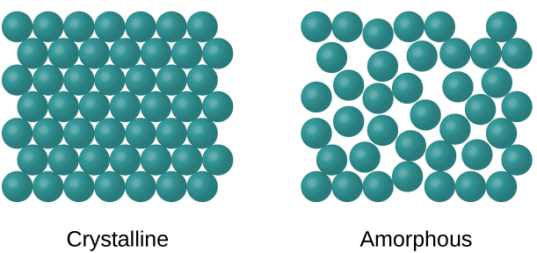
Amorphous vs crystalline
Crystalline: long-range order from repeating unit cells
Amorphous: lacks long-range ordering
If formed from a supercooled liquid, it can be referred to as a glass
Nanocrystalline alloys contain both

Slide 6
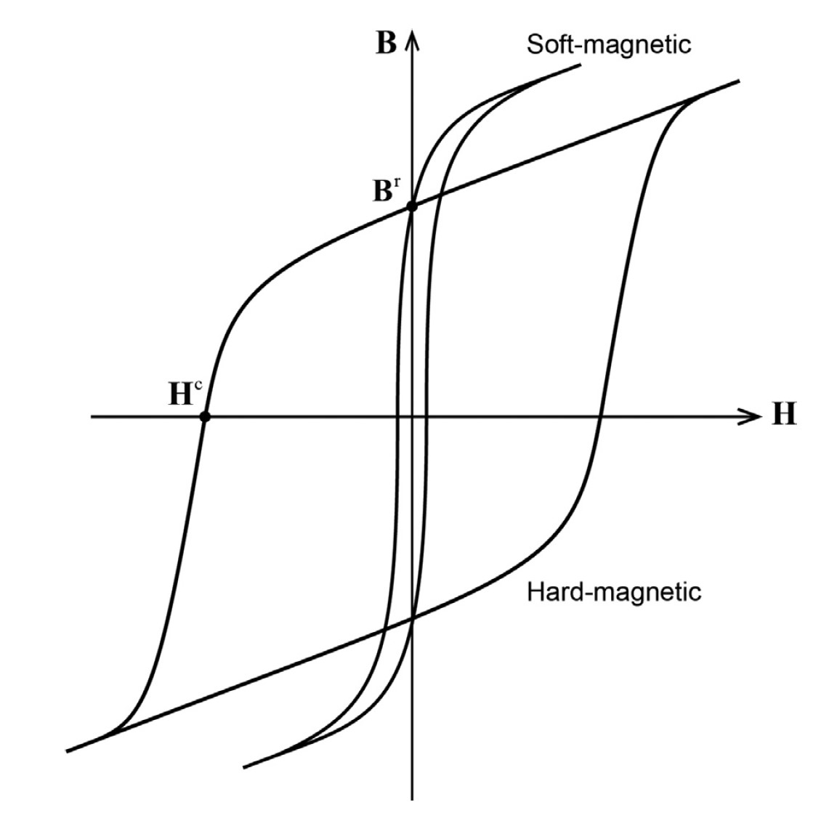
Ferromagnetic metallic glasses
Contain (Fe, Co, Ni)
Make excellent soft magnets
High magnetic saturation, high magnetic permeability, low magnetic coercivity

Slide 7
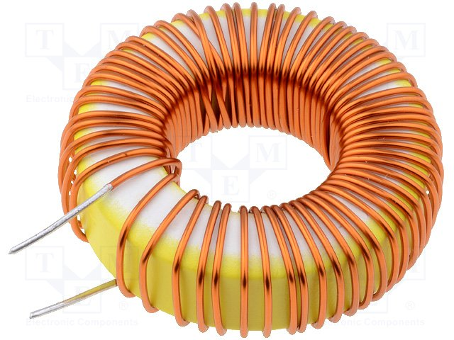
High efficiency inductors
Electric propulsion systems need increased power density
Half of the weight of an advanced motor controller is the filter inductor
Needs to operate at high frequencies (>50kHz)
High magnetic saturation (>0.8T)
Low power losses, combination of eddy currents and hysteresis losses
$$\begin{aligned}&P_{max}= \frac{I_{0}^{2}ω}{2}\left(\frac{μN^{2}A_{e}}{l_{e}}\right)\#\end{aligned}$$

Slide 8
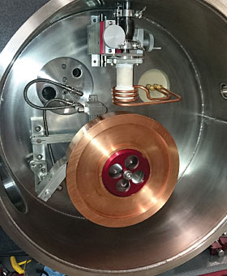
Making a metallic glass ribbon
Set crucible 10$μm$ from Cu-wheel
Pump chamber to vacuum and fill with Ar
Melt ingot using induction heating
Eject liquid metal onto Cu-wheel
Achieves ~10⁶$℃/s$ cooling rate

Slide 9
VASP ‘on-the-fly’ Machine Learning Force Fields
White, Paul W., et al. Journal of Non-Crystalline Solids, vol. 647, Jan. 2025, p. 123283, https://doi.org/10.1016/j.jnoncrysol.2024.123283.

Slide 10
AIMD Simulations with MLFFs
Ab-initio molecular dynamics (AIMD) vs classical molecular dynamics
AIMD uses density functional theory (DFT) to solve for the interatomic forces
Classical MD uses the gradient of a predetermined interatomic potential to calculate interatomic forces (LAMMPS)
DFT is costly to do
Employ machine learning force fields (MLFF) to accelerate the AIMD
MLFF is trained by the structure, energies, forces, and stresses evaluated during AIMD calculations
When to use the MLFF is determined by the Bayesian linear regression which predicts the uncertainties of using the MLFF

Slide 11
How MLFFs work
Total energy is the sum of local energies
$$E=\sum_{i}^{N_{a}}{U_{i}}$$
Local energy is a function of the local environment (Key Assumption!)
$$U_{i}=U(\{c_{n}^{i},p_{nvl}^{i}\})$$
Energies, forces and stress tensor are simultaneously fitted by one local energy function(al) $U(\{c_{n}^{i},p_{nvl}^{i}\})$

Slide 12
Descriptors
Local environment can be described by radial and angular distribution functions
Radial Descriptor
Angular Descriptor
$$ρ_{i}^{\left(2\right)}\left(r\right)$$
$$ρ_{i}^{\left(3\right)}\left(r,s,θ\right)$$
i
r
k
j
s
i
$$θ$$
r
j

Slide 13
Descriptor functions
Radial and angular distribution functions are written as
$$ρ_{i}^{\left(2\right)}\left(r\right)=\frac{1}{\sqrt{4π}}\sum_{n=1}^{N_{R}^{0}}{c_{n00}^{i}χ_{n0}(r)}$$
$$ρ_{i}^{\left(3\right)}\left(r,s,θ\right)=\sum_{l=1}^{L_{max}}{\sum_{n=1}^{N_{R}^{l}}{\sum_{ν=1}^{N_{R}^{l}}{\sqrt{\frac{2l+1}{2}}p_{nvl}^{i}χ_{nl}(r)}χ_{νl}(s)P_{l}(cosθ})}$$
$c_{nvl}^{i}$, $p_{nvl}^{i}$denote expansion coefficients
Up to 1000 coefficients for each atom, and is a non-linear function!
n, l, and m denote radial numbers, angular numbers and magnetic quantum numbers respectively

Slide 14
Kernel Trick
It is now convenient to express the local potential energy of atom i in structure $α$ in terms of linear coefficients $w_{iB}$ and a Kernel $K(X_{i},X_{iB})$
$$U_{i}^{α}\left(r\right)=\sum_{i_{B}=1}^{N_{B}}{w_{iB}}K(X_{i}^{α},X_{iB})$$
The Kernel $K(X_{i},X_{iB})$ contains all of our coefficients $c_{n00}^{i}$, $p_{nvl}^{i}$
$$K(X,X_{4})$$
$$K(X,X_{1})$$
$$K(X,X_{2})$$
$$K(X,X_{3})$$
Adjust $w_{1}$, $w_{2}$, $w_{3}$,…, to get peak heights
Observable
x₁
Structure x
x₄

Slide 15
‘on-the-fly’ MLFF
Bayesian linear regression is used to predict the error of the MLLF if the MLFF were to be used
If the error is above a user defined threshold first principles is used otherwise the MLFF is used
When a first principles calculation is done the results are added to the training data
The MLFF is NOT refit every time, only when the error is above a second separate threshold

Slide 16
Verification of the MLFF
Check how accurately the MLFF can predict energy, forces, and stresses of the training data
The error is extremely small
16

Slide 17
Hybrid Method for Generating Amorphous Structures
White, Paul W., et al. Journal of Non-Crystalline Solids, vol. 647, Jan. 2025, p. 123283, https://doi.org/10.1016/j.jnoncrysol.2024.123283.

Slide 18
Generating amorphous structures
Randomly insert 100 atoms into a box
Equilibrate the initial random structure at 300K (NPT) for 20ps using ab-initio molecular dynamics
Hold the equilibrated structure at 300K for an additional 5ps, sampling a structure every 50fs, a total of 100 new structures
Only ~450 first-principles calculations were done for 20,000 total steps

Slide 19
Check Amorphousness
X-ray diffraction of experimental measurement and simulated patterns match

Slide 20
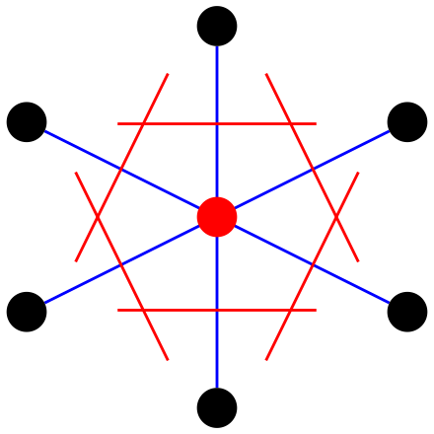
Voronoi analysis
Draw a line to all nearest neighbors
At the midpoint, draw a plane perpendicular to the line
Intersections of planes create the edges and vertices of the Voronoi polyhedra

Slide 21
Generated structures are unique
Voronoi analysis shows us that the local configuration changes from structure to structure
Pentagons are the most common which is a sign of amorphousness

Slide 22
Magnetic properties of Fe₇₂Nb₄Cu₁Si_{16-x}Ge_{x}B₇
(x=0-8) at %

Slide 23
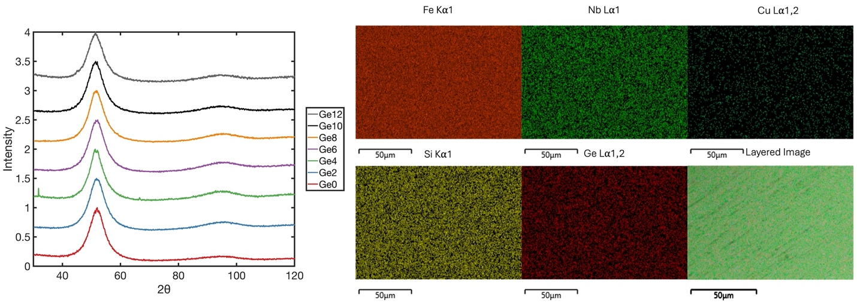
X-ray diffraction of ge samples
XRD shows that the casted ribbons are amorphous and contain no crystallinity
EDS shows samples are homogenous at the microscale

Slide 24
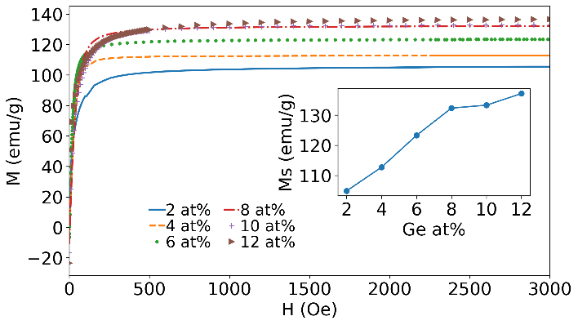
Magnetization from vsm
High magnetic saturation
Increases with Ge concentration
Dr. Parashu Kharel

Slide 25
Magnetization from dft
Increase in magnetization with Ge
Predicts a plateau in magnetization above 12% Ge, which we have not been able to synthesize

Slide 26
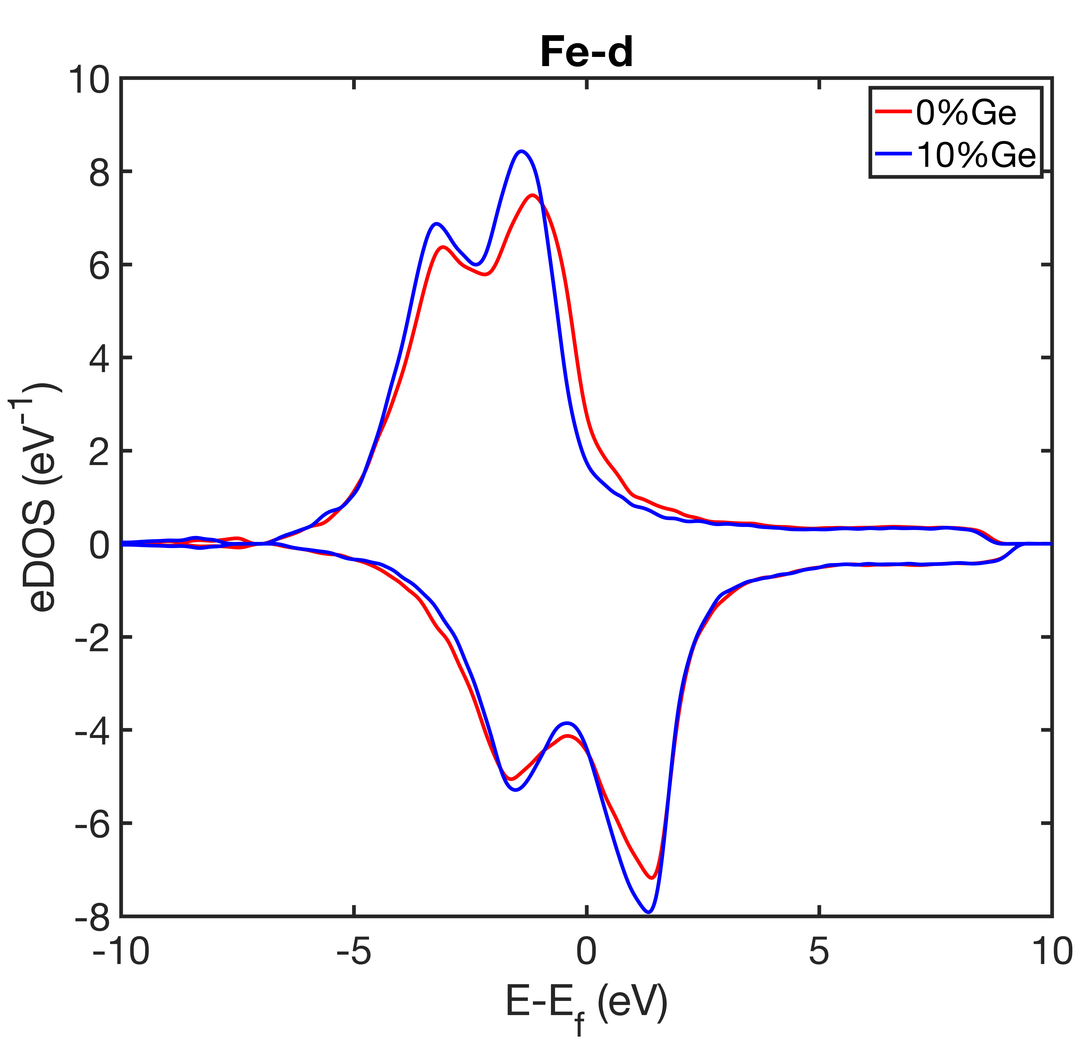
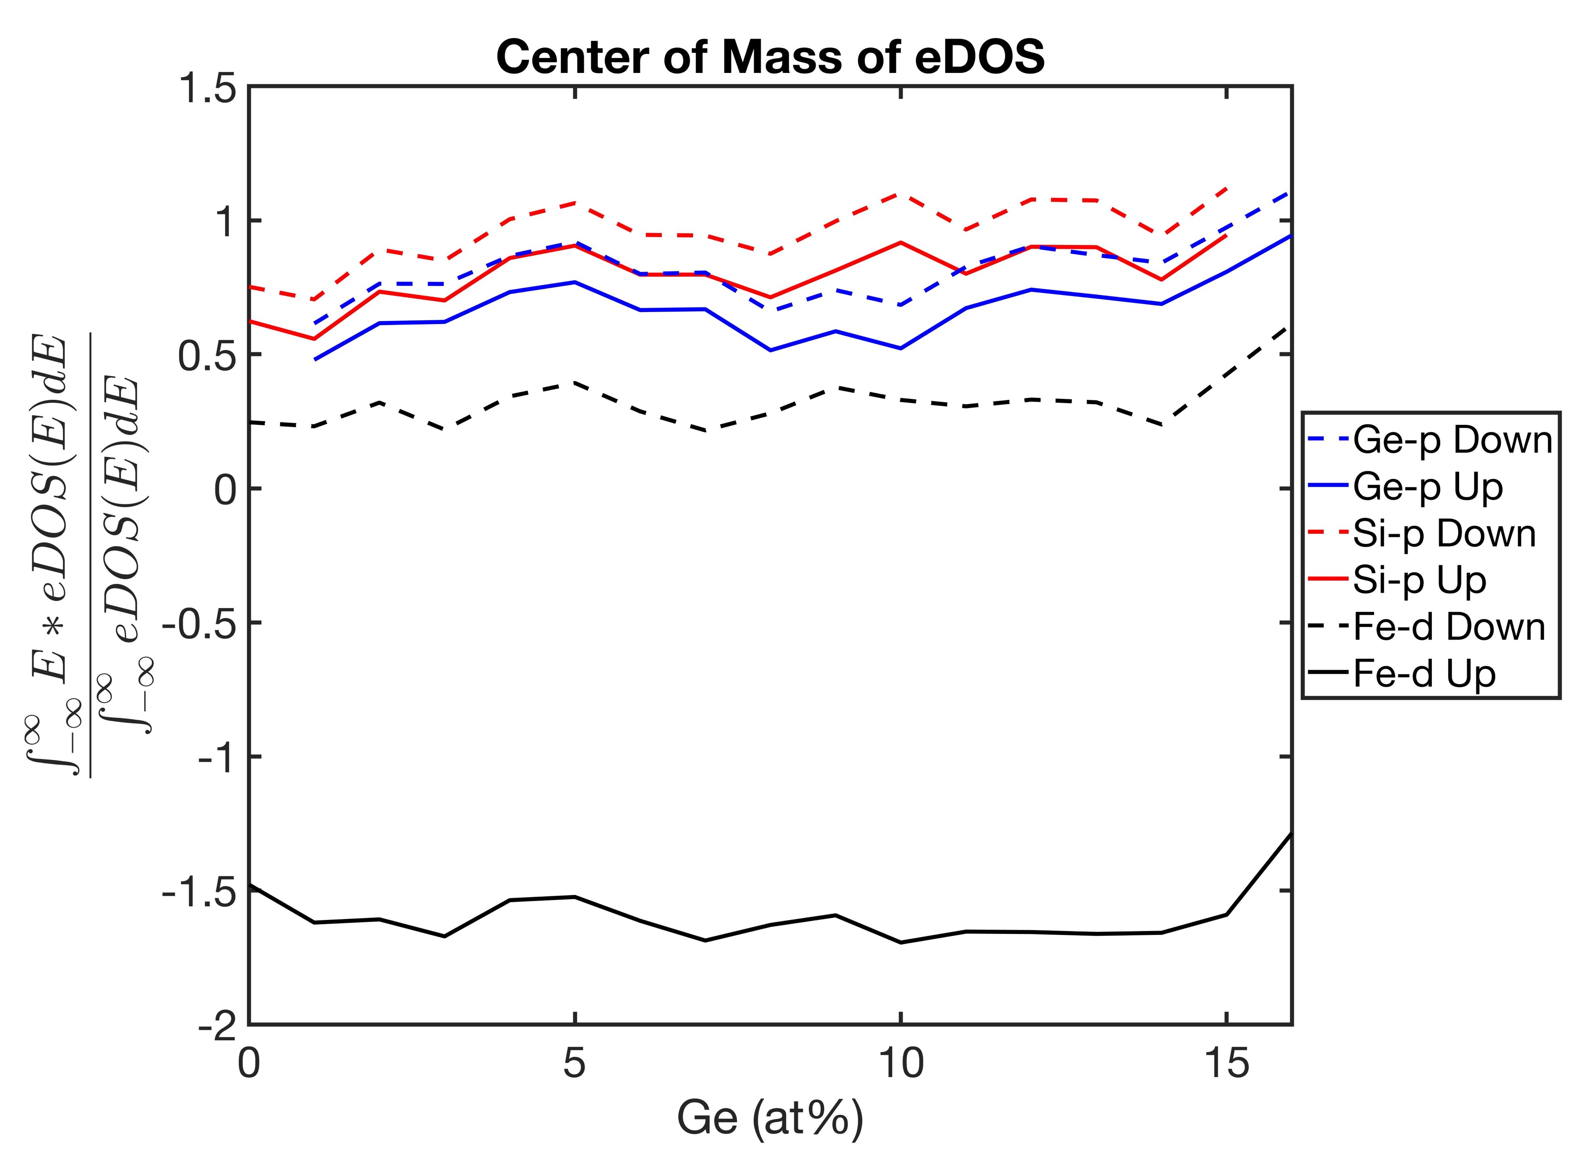
Fe-ge hybridization
Stronger hybridization between Fe-Ge increases magnetization

Slide 27
Conclusions
The hybrid method for generating amorphous structures is efficient and reliable
Mechanical and magnetic properties can be calculated from this method
Magnetization agrees with experimental results and can explain the increase in magnetization through increased p-d hybridization of Ge-Fe
White, Paul W., et al. Journal of Non-Crystalline Solids, vol. 647, Jan. 2025, p. 123283, https://doi.org/10.1016/j.jnoncrysol.2024.123283.

