Slide 1
What is AI and Why Should We Care?
Dr. Rodrigue Rizk
Artificial Intelligence Research Lab
Department of Computer Science
University of South Dakota
Rodrigue.Rizk@usd.edu
Notes:
"Good [morning/afternoon/evening], everyone. Today, I'm excited to talk to you about a revolution in healthcare and biomedical research - what I like to call 'The Penicillin 2.0 Revolution: AI in Healthcare and Biomedical Research.'"

Slide 2
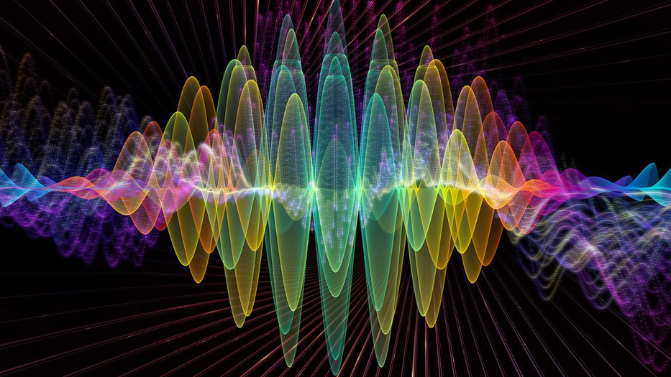
Quote
“Today's technology was yesterday's science fiction.”- Rodrigue Rizk, Ph.D.
2
Notes:
I won’t ask you what most speakers usually start their presentations on AI with: ‘By a show of hands, who uses an AI tool?’ Probably most of you, so I’ll spare you and move on to something else instead.
This is an exciting time for Advancement and technology in general just to give you a sense of how things are changed

Slide 3
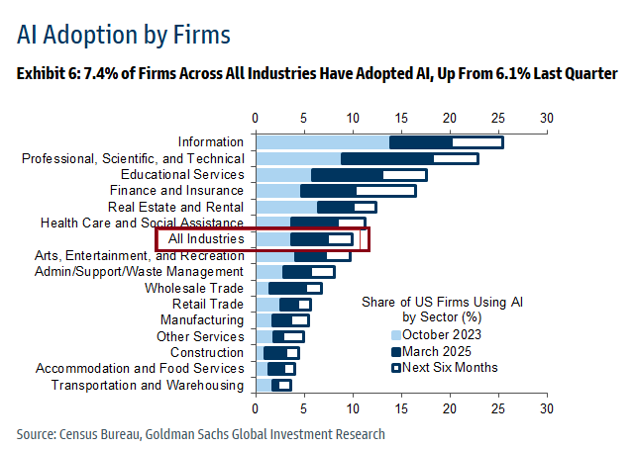
Introduction
Artificial Intelligence (AI) has transitioned from a niche field in computer science to a cornerstone of technological innovation across industries.
3
Notes:
I think we just want to start with the big picture. Does AI have a place in the legal landscape?
Absolutely, yes, if not I wouldn’t be here today

Slide 4
AI in Daily Life
4

Slide 5
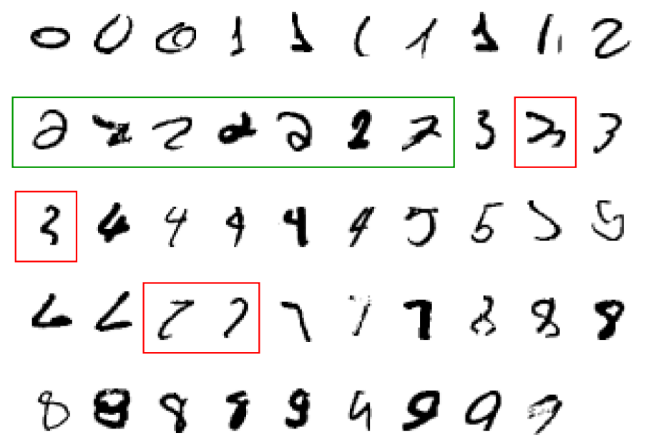
When Do We Use AI?
A classic example of a task that requires AI
It is very hard to say what makes a 2
5

Slide 6
Introduction
1st Industrial Revolution (Late 18th – Early 19th Century):
Key Focus: Transition from agrarian to industrial societies
Key Innovations: Steam engine, mechanized textile production, mass manufacturing
Impact: Introduction of mechanization in agriculture and industry
2nd Industrial Revolution (Late 19th – Early 20th Century):
Key Focus: Mass production, electricity, and assembly lines
Key Innovations: Electricity, internal combustion engine, telecommunication
Impact: Expansion of factories, urbanization, and improved transportation
3rd Industrial Revolution (Mid-20th Century):
Key Focus: Digital revolution and automation
Key Innovations: Computers, electronics, and the internet
Impact: Rise of information technology and automation in production
6
Notes:
I think we just want to start with the big picture. Does AI have a place in the legal landscape?
Absolutely, yes, if not I wouldn’t be here today

Slide 7
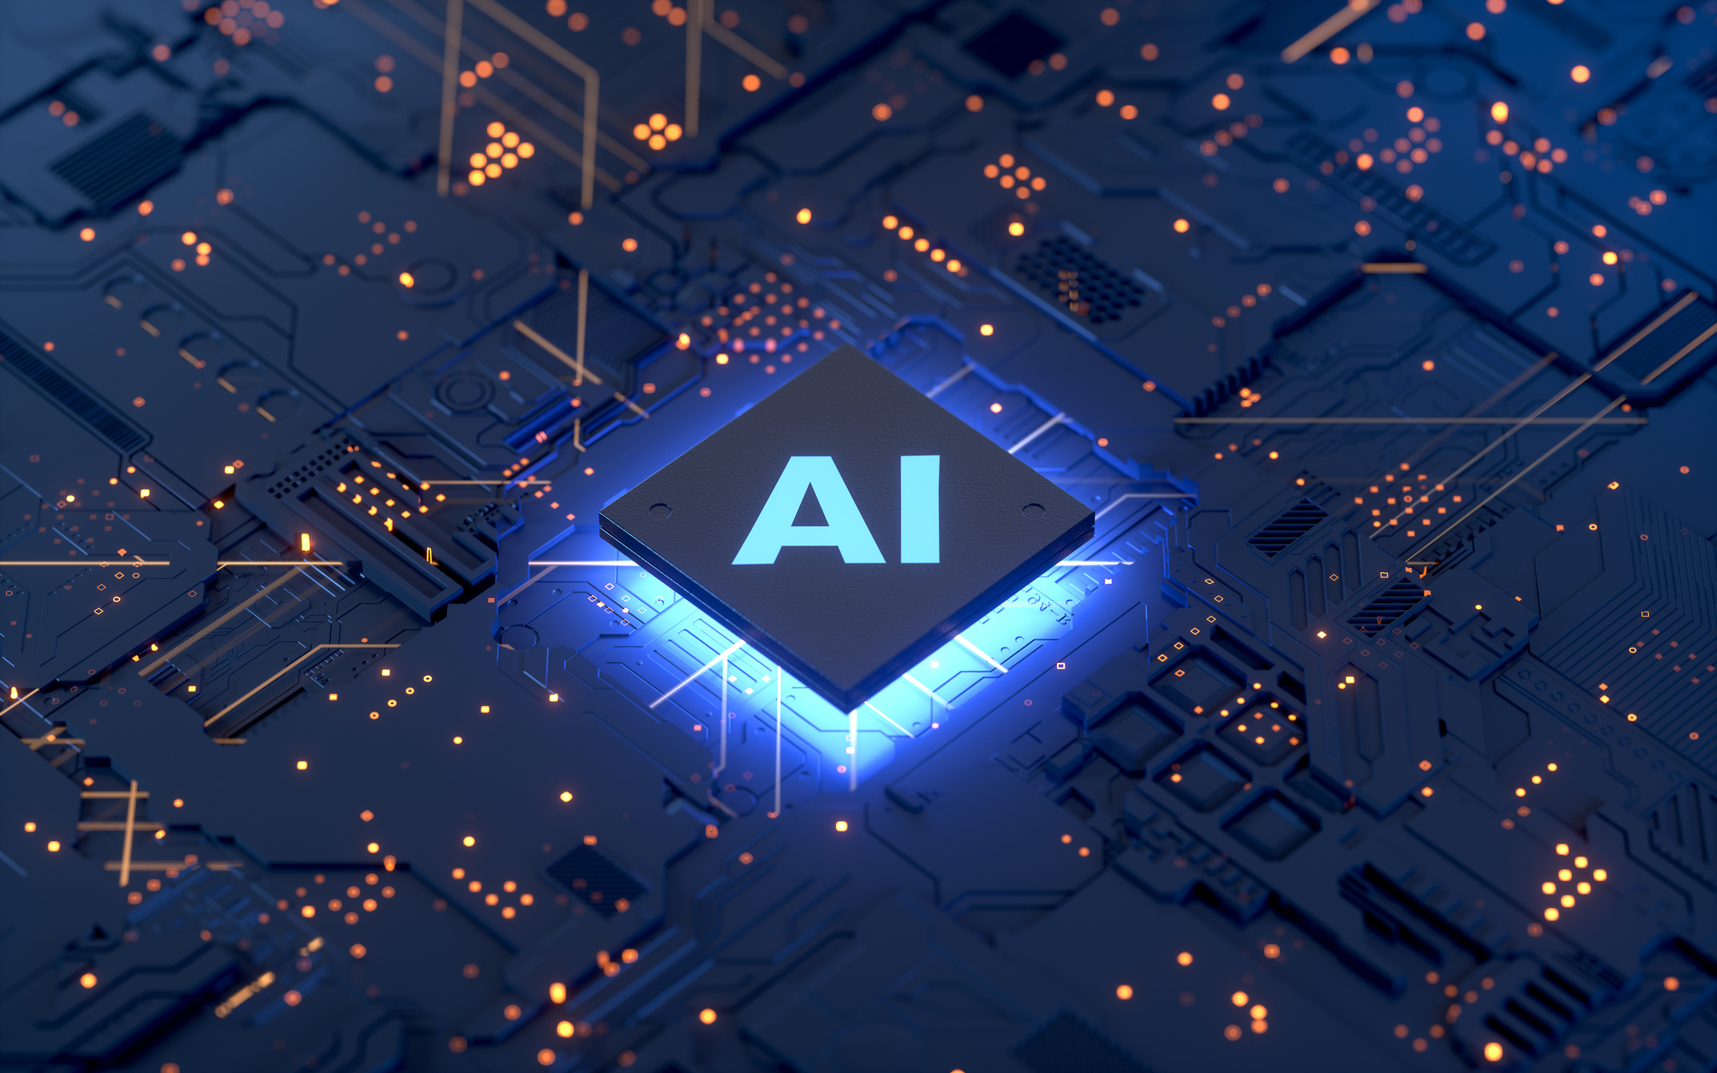
Introduction
4th Industrial Revolution (21st Century – Present):
Key Focus: Integration of AI, robotics, and IoT with advanced digital technologies
Key Innovations: Artificial intelligence, machine learning, big data, robotics
Impact: Revolutionizing industries with automation, smart technologies, and data-driven decisions
7
Notes:
Fast forward to the 21st century, and we are witnessing a similar transformative force - Artificial Intelligence.“
we have today in AI and machine learning deep learning etc come into play and you see this across all sciences

Slide 8
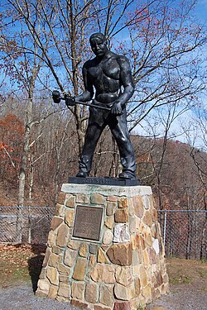
Introduction
John Henry and the Machine is a famous American folk tale that symbolizes the conflict between humans and machines, especially during the Industrial Revolution.
The story is a metaphor for the societal changes brought about by the rise of machines during the Industrial Revolution.
It reflects the fears, challenges, and conflicts that arose as technology started replacing traditional, human-based work.
8
Notes:
Key Story Overview: John Henry was a strong, skilled steel driver who worked on building railroads in the 19th century. The story centers around a competition between John Henry and a new steam-powered drilling machine, designed to increase efficiency in the construction of railways.
The machine, introduced as a tool for automation, was intended to replace manual labor like John Henry’s, which represented a larger societal shift toward mechanization.
In the legend, John Henry competes against the machine in a race to drill through rock faster than the steam-powered device.
John Henry wins the race but dies from exhaustion shortly after, symbolizing the tension between human strength and mechanical efficiency.

Slide 9
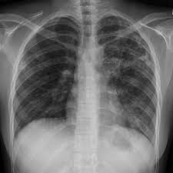
Artificial Intelligence
AI can be broadly defined as technology that can learn and produce intelligent behavior.
Input
Output
AI Algorithm
“Tuberculosis”
9
Notes:
"Since I’m a computer scientist/engineer, I have to throw in a bit of technicality—so bear with me!"

Slide 10
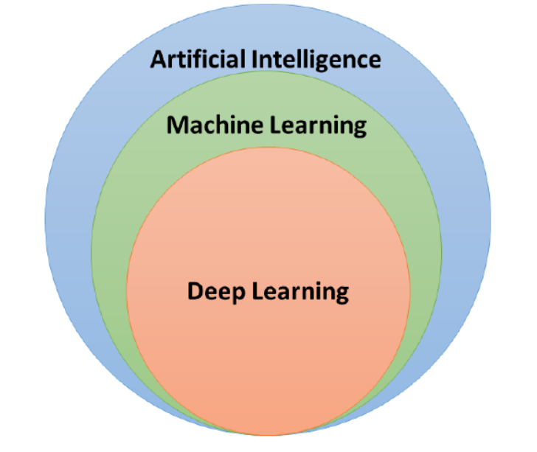
Artificial Intelligence (AI) – Machine Learning (ML) – Deep Learning (DL)
Artificial Intelligence, Machine Learning, and Deep Learning
10

Slide 11
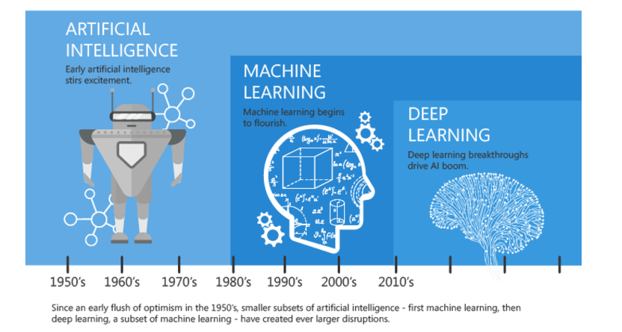
Artificial Intelligence (AI) – Machine Learning (ML) – Deep Learning (DL)
Artificial Intelligence, Machine Learning, and Deep Learning
11

Slide 12
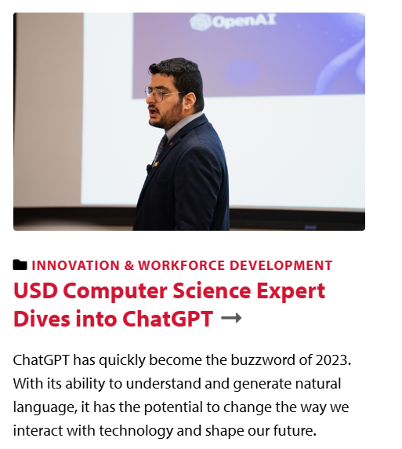
Introduction
November 30, 2022: the day the world changed
The day when ChatGPT was officially released by OpenAI
“It’s like you wake up to the news of the first nuclear explosion and you don’t know yet what to think about it, but you know the world will never be the same again.”
12

Slide 13
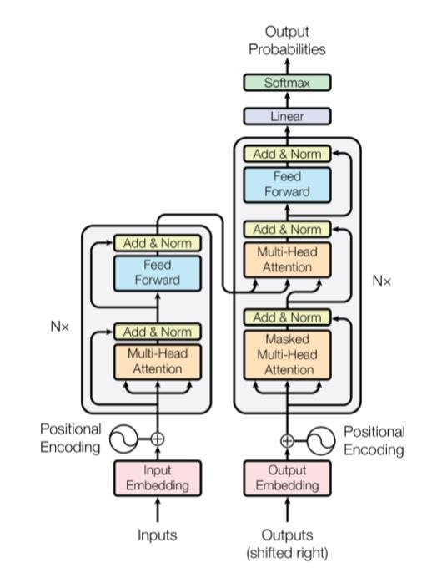
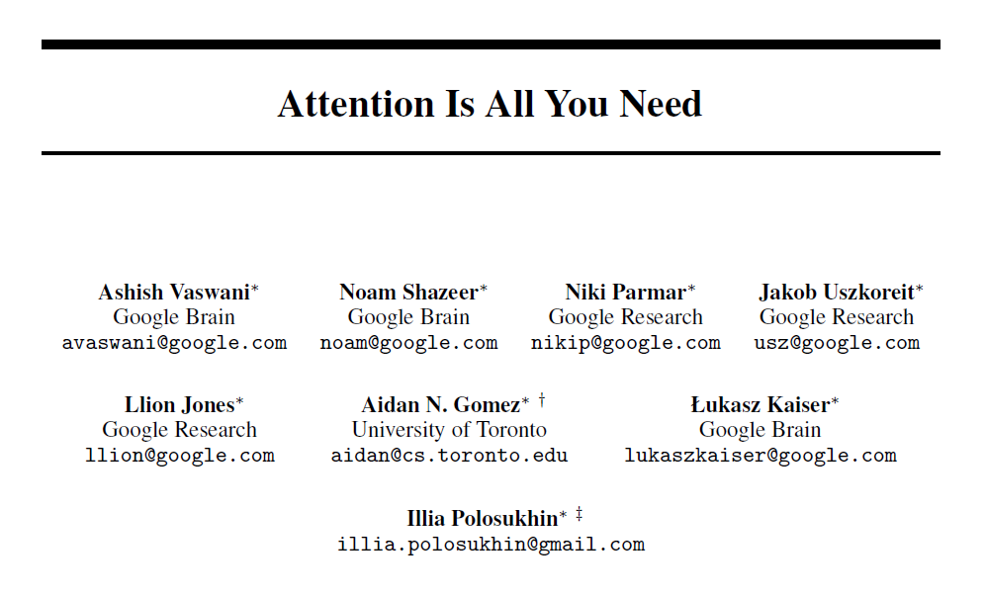
Introduction
“Attention Is All You Need” is a 2017 landmark research paper in machine learning authored by eight scientists working at Google.
The paper introduced a new deep learning architecture known as the transformer, based on the attention mechanism.
13
Notes:
It is considered a foundational[5] paper in modern artificial intelligence, and a main contributor to the AI boom, as the transformer approach has become the main architecture of a wide variety of AI, such as large language models.
"It was a dynamite moment. The people who created Transformers didn’t know back then that, many years later, someone would use their architecture to create a fake video of someone."

Slide 14
What is Machine Learning?
Humans: learn from past experiences
Computers: follow instructions
Question: Can we have computers to learn from past experiences too?
14

Slide 15
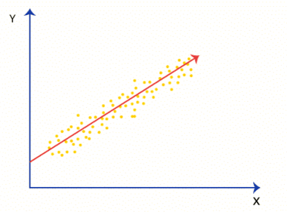
Machine Learning
Linear Regression
15
Notes:
"Let's begin with a quick trip down memory lane.
Good news is that the techniques we have are actually very simple to understand
they are just a slight extension of something you have known since high school which is linear regression
so linear regression you have a bunch of points that's your data the blue dots and you're trying to fit a model to those blue dots
and it happens to be a very simple model it's it is a line
what we're doing today is the same thing but we have slightly more complex models which are not linear and we operate in very high dimensional spaces
but the idea is essentially the same all the problems of machine learning can already be seen in this in this figure if you think about it carefully

Slide 16
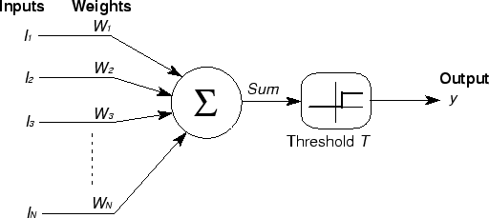
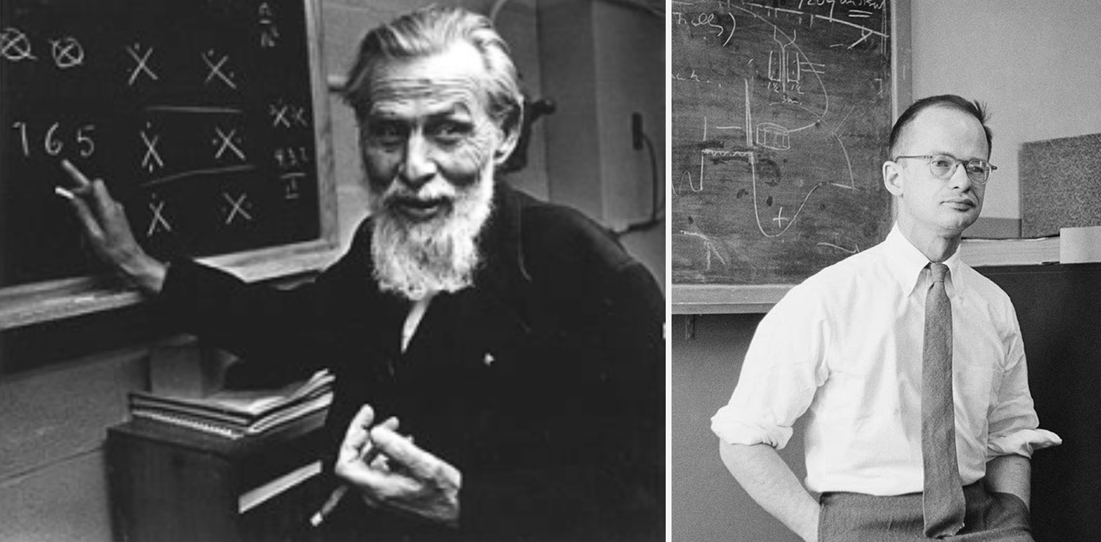
McCulloch & Pitt's neuron model (1943)
Warren McCulloch and Walter Pitts introduced a simple mathematical model of an artificial neuron in their 1943 paper titled "A Logical Calculus of the Ideas Immanent in Nervous Activity."
Mathematical formulation of a biological neuron, could solve AND, OR, NOT problems.
This work laid the foundation for the field of artificial neural networks, which has become a key component of modern machine learning.
16
Notes:
so the models we use they go back to the 1950s
The 1950s where people started thinking about how the brain may be working and in fact all the basic concept concepts about neural function were already in place around 1950 they knew about synapses evolution action potentials etc etc
and so the idea one idea that came up is to try to model a neuron as a simple processing device that consists a device that takes a weighted average of its inputs which you see here and if you stop here it's just linear regression you're you’re back to a linear model but then you pass this weighted average through a nonlinear function for instance a threshold function or a sigmoid function I mean there are different different search functions and you produce an output and this very simplified model of a neuron is basically what we're using today in deep learning we're just building large circuits of devices of this and what we call learning is simply is simply how how you store information in the weights of these processing neurons so that they implement the right input/output functions

Slide 17
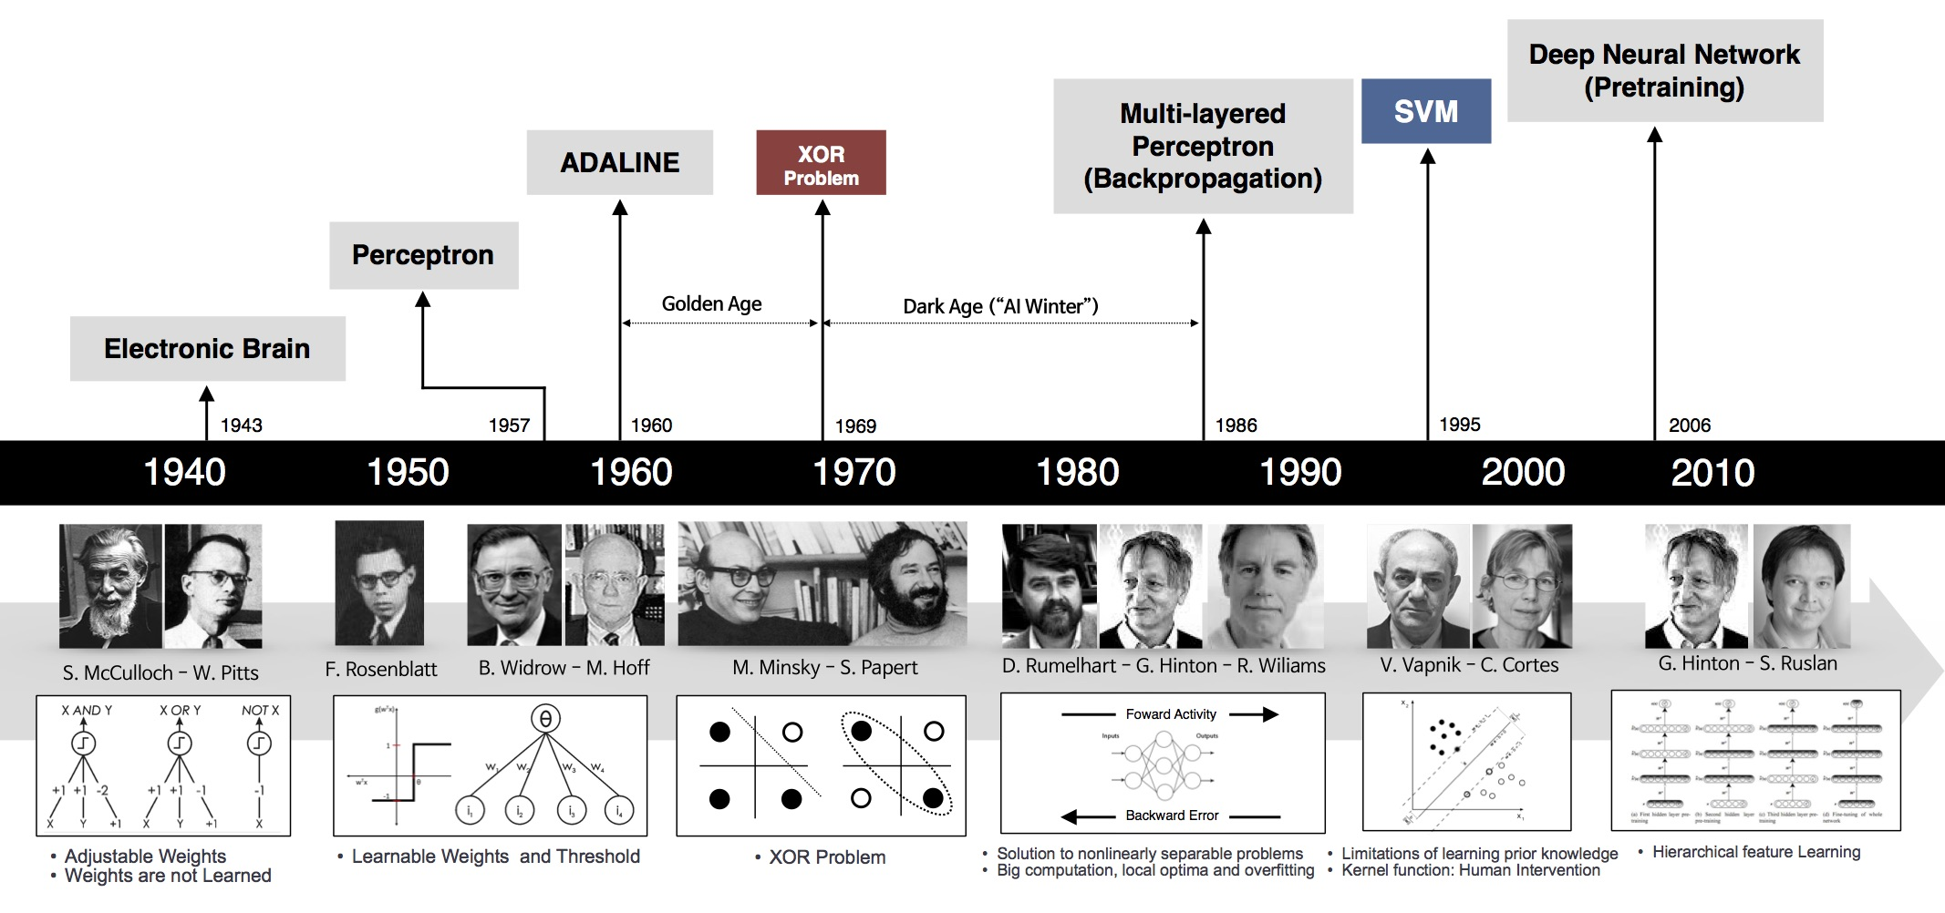
Timeline
17

Slide 18
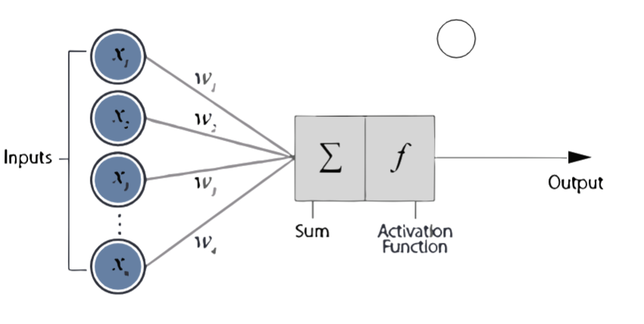
Computational Neuron Model
18

Slide 19
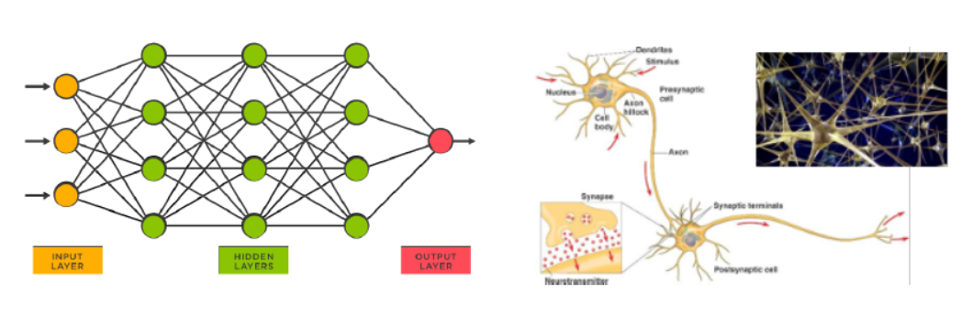
Artificial Neural Networks – Deep Learning
Idea: mimic the brain to do computation
Artificial neural network:
Nodes (a.k.a. units) correspond to neurons
Links correspond to synapses
Deep Neural Networks
19

Slide 20
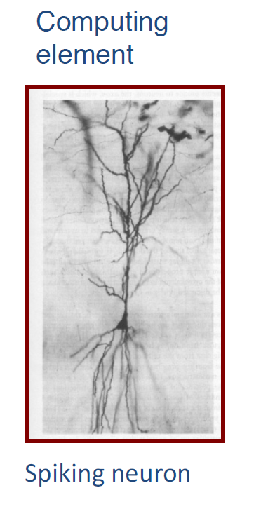
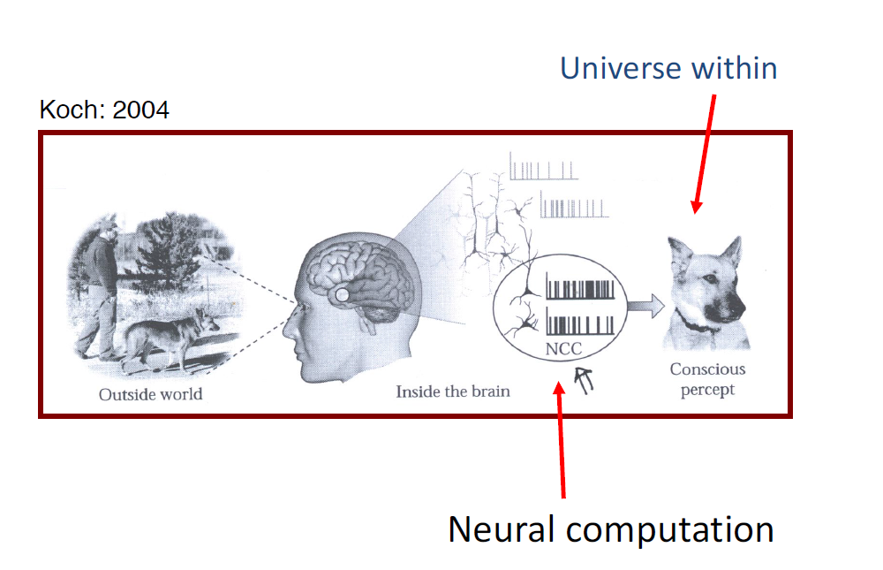
Computing and thought
20

Slide 21
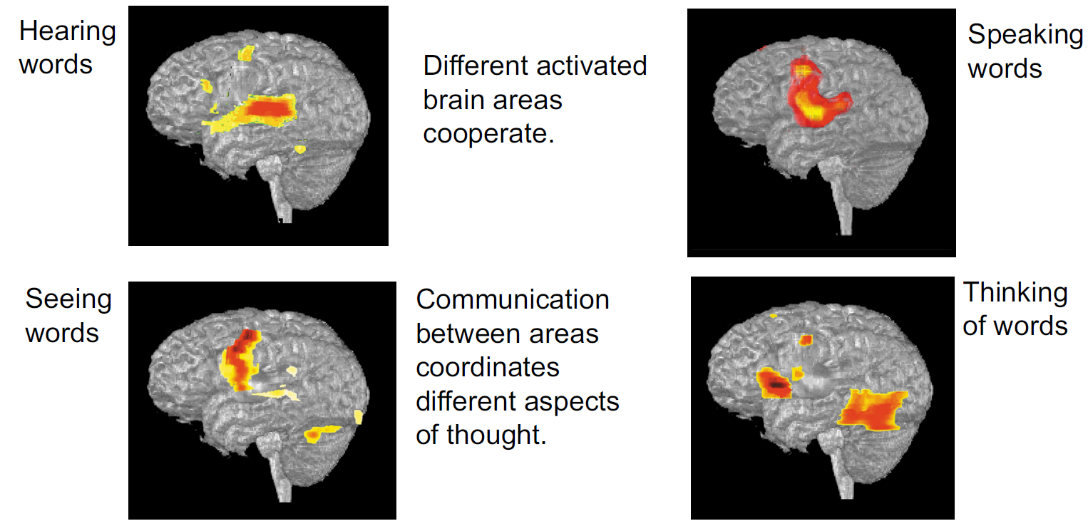
Computing and thought
21

Slide 22
Van Essen Diagram
22

Slide 23
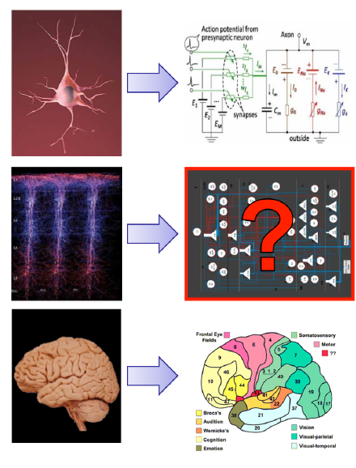
Universal learning circuits
23

Slide 24
Learning Paradigm
Machine learning is the process of fitting a mathematical model to a given dataset (called the training set), then using this model to predict answers for any new unseen inputs.
Training Set
Learning Algorithm
Model (or Hypothesis)
Input
Predicted Output
24

Slide 25
Learning Paradigm
Subsequently, you can train your model
Pneumonia
Tuberculosis
Tuberculosis
Example 1
25

Slide 26
Learning Paradigm
Again, with a different known example
Pneumonia
Tuberculosis
Tuberculosis
Example 2
26

Slide 27
Learning Paradigm
Yet again, with yet another different known example
Pneumonia
Tuberculosis
Tuberculosis
Example 3
Repeat until it learns the patterns
of Tuberculosis (and Pneumonia) in
input images
27

Slide 28
Learning Paradigm
After training your model, you can use it to infer what an unknown image may show
Pneumonia
Tuberculosis
Tuberculosis
?
28

Slide 29
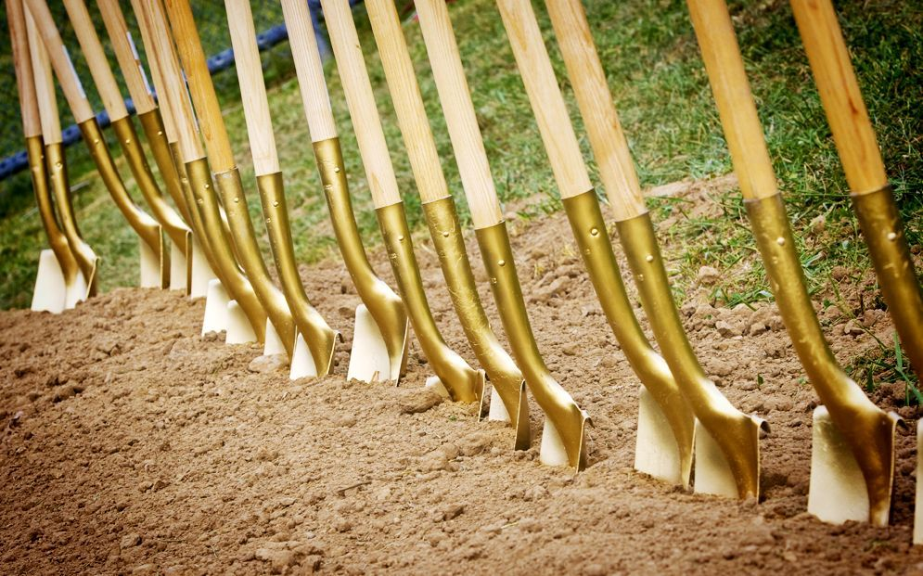
Selling Shovels in a Gold Rush: AI Tools
29

Slide 30
AI Assistant / Chatbot: Ch‎atGPT
30
Notes:
https://youtu.be/cWMeBDgLOuo

Slide 31
AI Assistant / Chatbot: Claude
31
Notes:
https://youtu.be/rHqk0ZGb6qo

Slide 32
AI Assistant / Chatbot: Gemini
32
Notes:
https://youtu.be/_fuimO6ErKI

Slide 33
AI Assistant / Chatbot: Grok
33

Slide 34
AI Image Generator: GPT-4o
34
Notes:
https://youtu.be/PFsOUNfBhzI

Slide 35
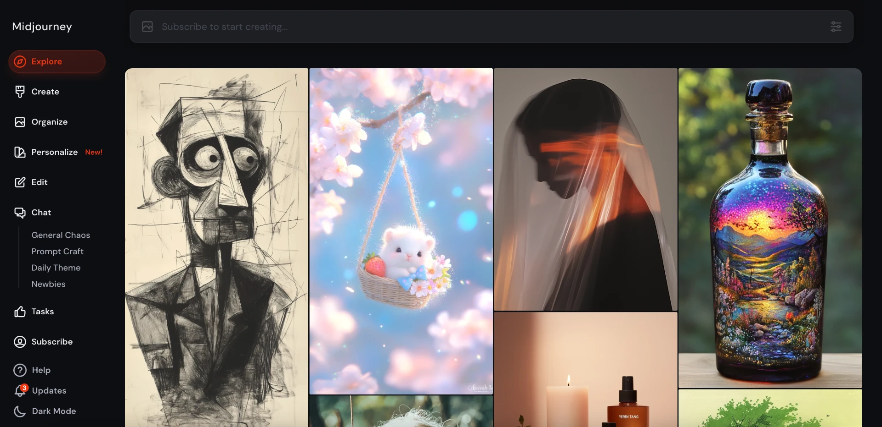
AI Image Generator: Midjourney
35

Slide 36
AI research/education tool: Deep Research
36
Notes:
https://youtu.be/zm6F0vo2E64

Slide 37
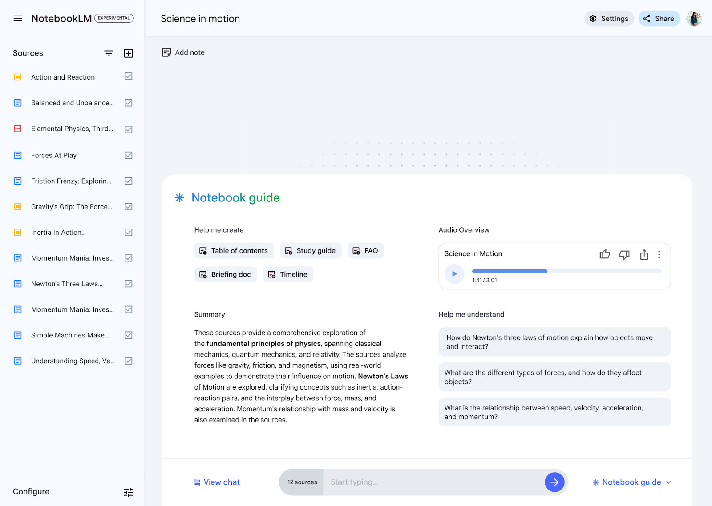
AI research/education tool: NotebookLM
37
Notes:
https://youtu.be/Judvk8yVUk4

Slide 38
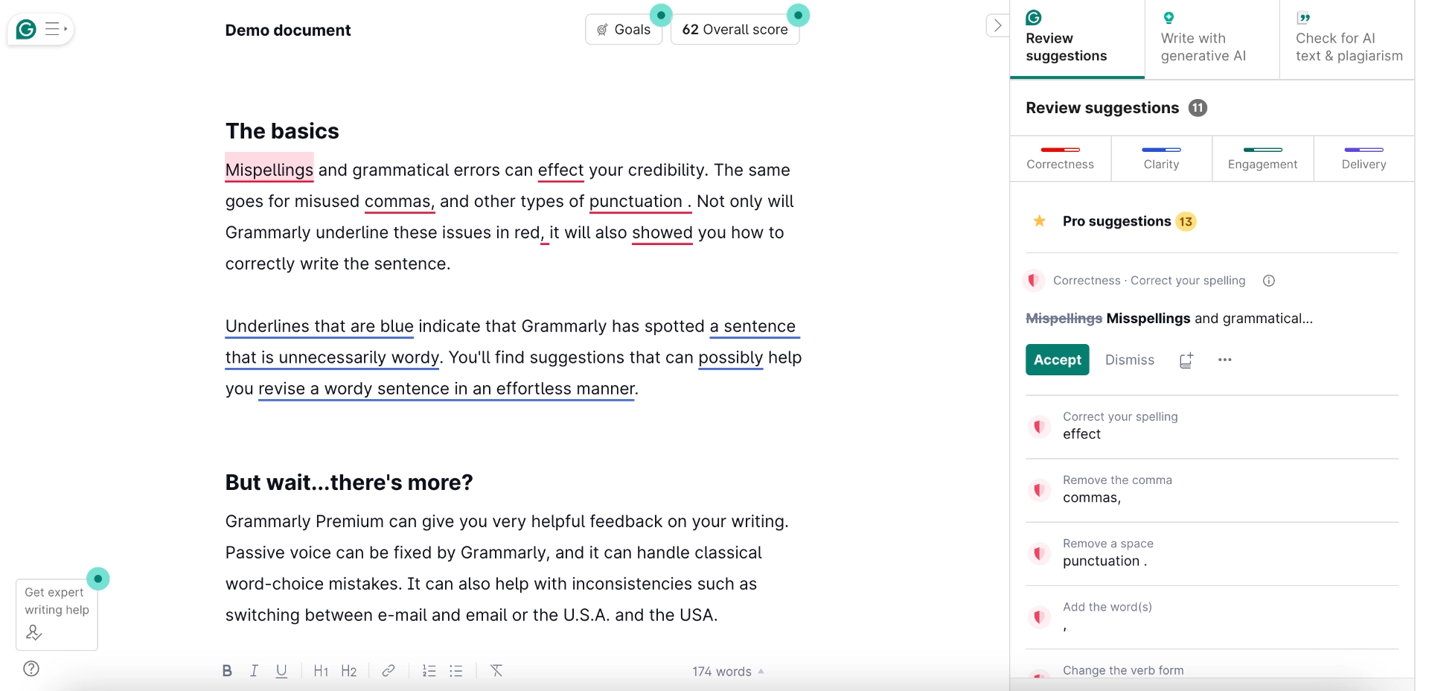
AI Grammar Checker: Grammarly
38

Slide 39
AI Search Engine: Perplexity
39

Slide 40
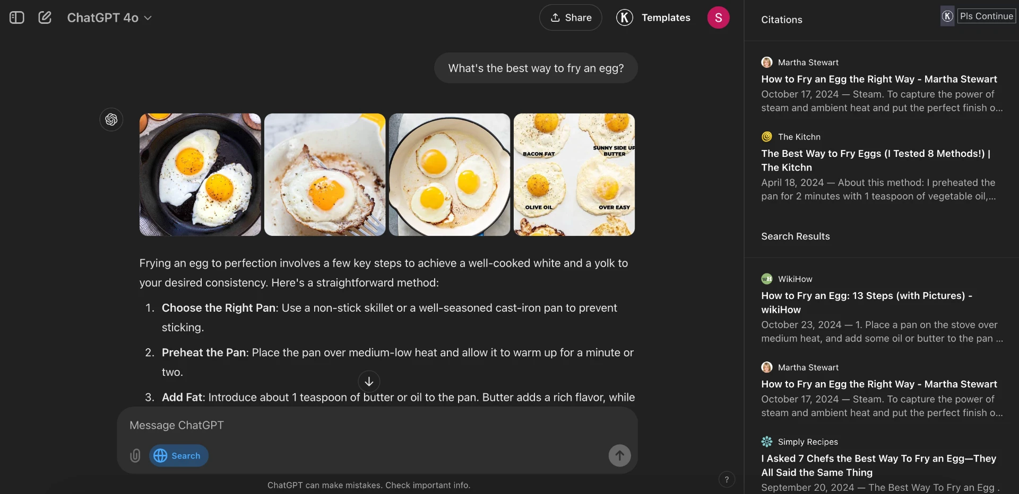
AI Search Engine: ChatGPT Search
40

Slide 41
AI Search Engine: Google AI Mode
41
Notes:
https://youtu.be/qbqZQFOVfA8

Slide 42
AI Design Tool: Canva Magic Studio
42
Notes:
https://youtu.be/bVCRcNlY1yw

Slide 43
AI App Builder: Lovable
43
Notes:
https://youtu.be/xhW9up0Gi2E

Slide 44
AI App Builder: Gemini 2.5 Pro
44
Notes:
https://youtu.be/LUpQl3owixw

Slide 45
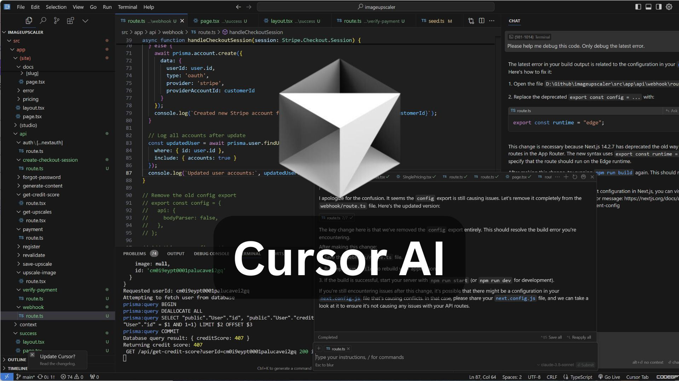
AI Code Editor: Cursor
45

Slide 46
AI Voice Generator: ElevenLabs
46
Notes:
https://youtu.be/IWPjpE8shZw

Slide 47
AI Music Generator: Suno
47
Notes:
https://youtu.be/ghwEgqDvvaI

Slide 48
AI Symposium
June 26-27, 2025
USD – Sioux Falls Avera Hall 4801 N. Career Ave. Sioux Falls, SD 57107
https://www.ai-research-lab.org/events/ai-symposium/2025
48

Slide 49
Q&A
“Today's technology was yesterday's science fiction.”
- Dr. Rodrigue Rizk
49

