Slide 1


Utilizing Chatbots To Improve The Growth of High Purity Germanium Crystals at USD
Sanjay Bhattarai
The University of South Dakota
June 24, 2025
This work was supported in part by NSF OISE 1743790, NSF PHYS 2310027, DOE DE-SC0024519, DE-SC0004768, and a research center supported by the State of South Dakota.

Slide 2
MOTIVATIONS
Simulate the thermophysical process of the high purity germanium crystal growth process through Chatbot-assisted simulations to simplify and accelerate the design and analysis.
Understand thermal field, temperature gradient in the crystal and crystal growth components.
Predict the dislocation density, thermal stress, defects,meniscus shape.
Optimize pull rate, rotation rate, applied power and hence the shape, size and quality of crystal.
Cultivate large HP-Ge crystals consistently, transform them into functional detectors, and conduct in-depth analyses to understand detector behavior, with a particular emphasis on rare event detection

Slide 3
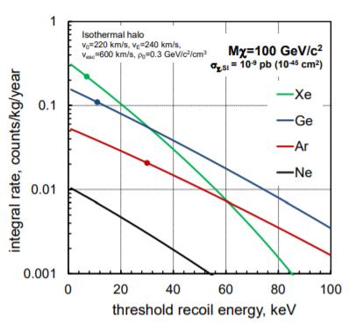
Why Germanium?
Low energy threshold
Excellent energy resolution
Relatively simple cooling systems
Excellent event/background discrimination power
For neutrinoless beta decay ⁷⁶Ge acts as both source and detector with relatively low half time for decay
More recoil (more energetic interaction) for Ge; more counts for Xe.
Counts can be increased by increasing detector size.
WIMP Dark Matter Direct Detection
P. Cushman, C. Galbiati, D. N. McKinsey, H. Robertson, T. M. P. Tait

Slide 4
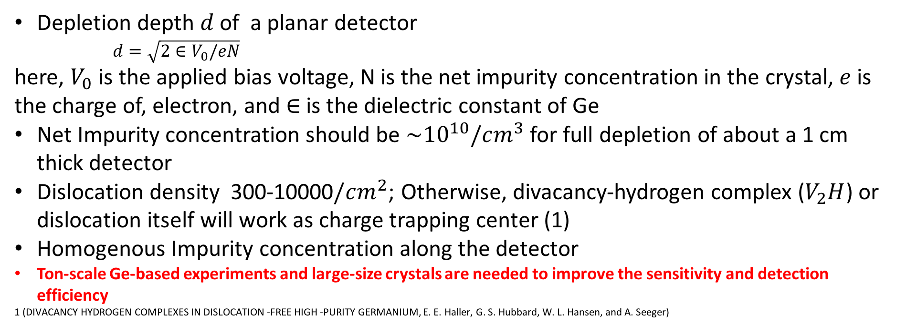
Requirements of Germanium Detectors
Depletion depth $d$ of a planar detector
$d=\sqrt{2∈V_{0}/eN}$
here, $V_{0}$ is the applied bias voltage, N is the net impurity concentration in the crystal, $e$ is the charge of, electron, and $∈$is the dielectric constant of Ge
Net Impurity concentration should be ${\sim 10}^{10}/cm^{3}$ for full depletion of about a 1 cm thick detector
Dislocation density 300-10000$/cm^{2}$; Otherwise, divacancy-hydrogen complex ($V_{2}H$) or dislocation itself will work as charge trapping center (1)
Homogenous Impurity concentration along the detector
Ton-scale Ge-based experiments and large-size crystals are needed to improve the sensitivity and detection efficiency
1 (DIVACANCY HYDROGEN COMPLEXES IN DISLOCATION -FREE HIGH -PURITY GERMANIUM, E. E. Haller, G. S. Hubbard, W. L. Hansen, and A. Seeger)

Slide 5
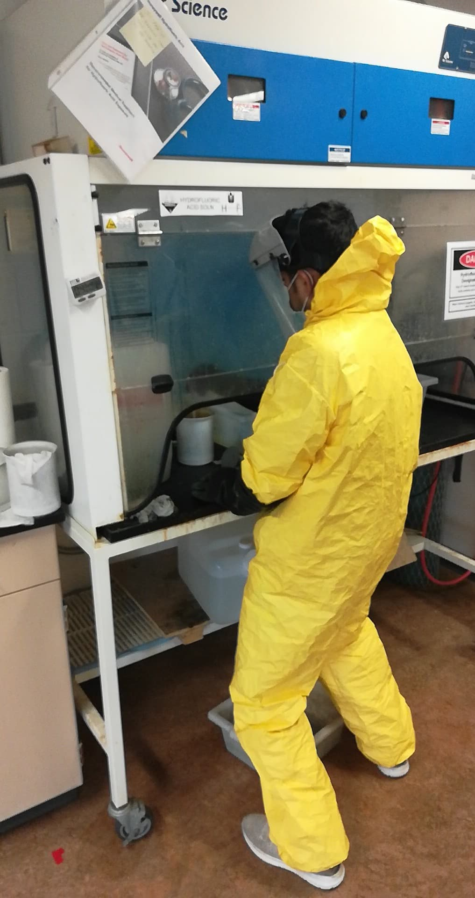
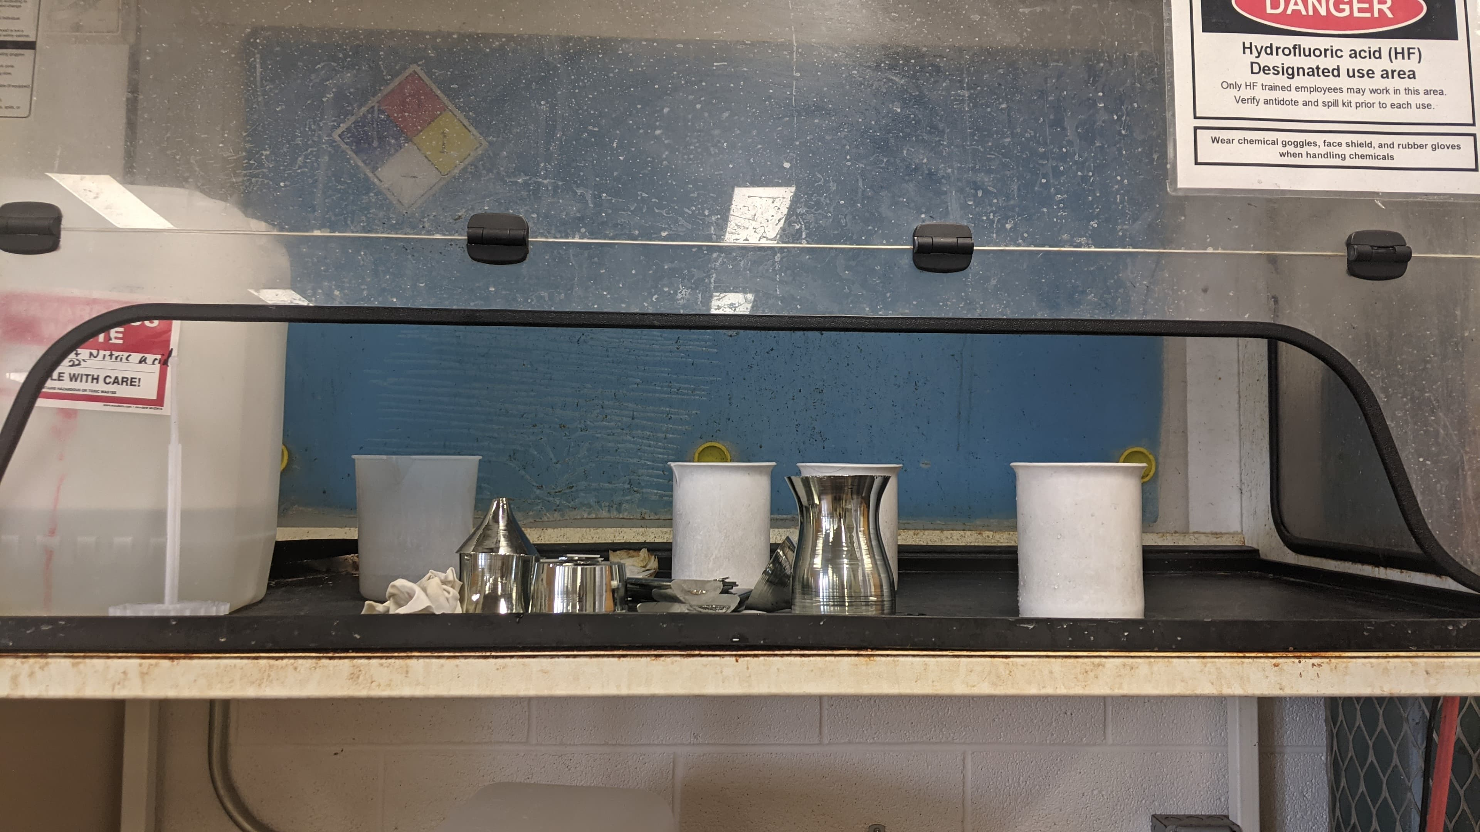
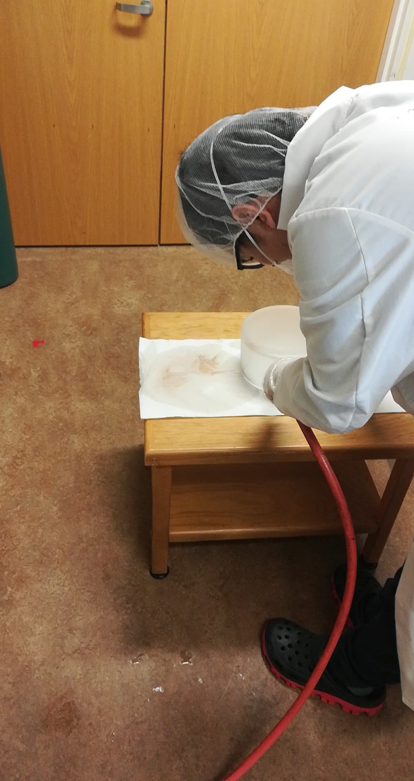
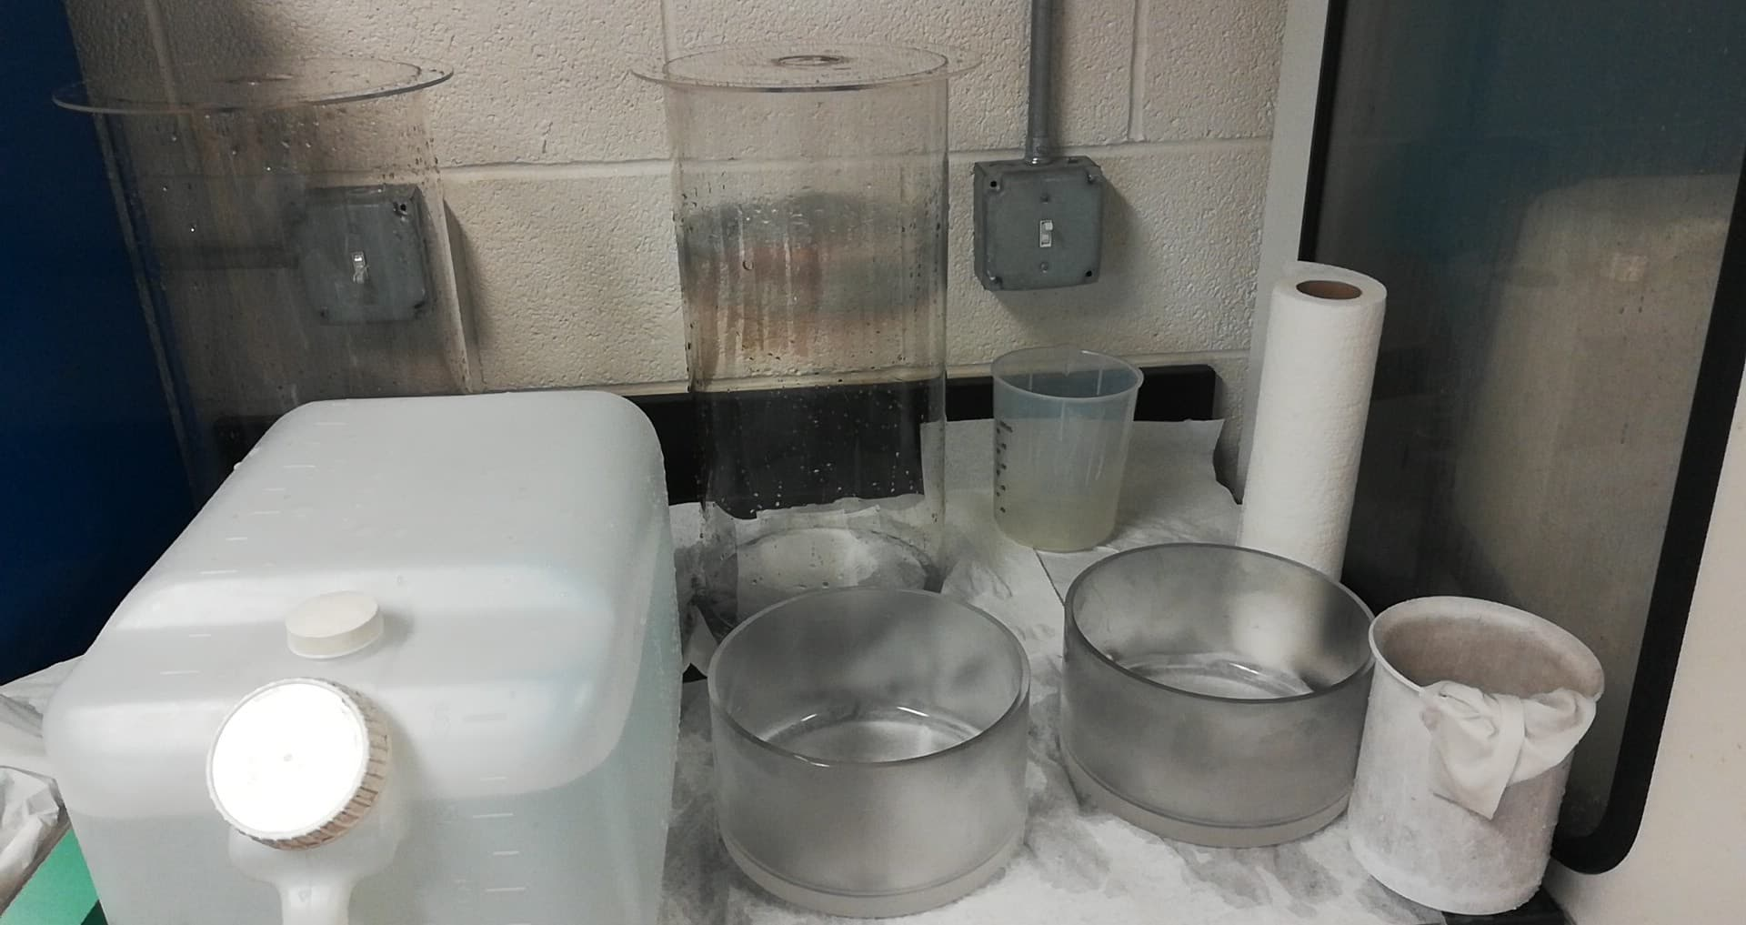
Material Preparation
Germanium ingots ready for etching
Etching ingots with strong acid,HF: HNO₃ (1:3)
Crucible and glass tubes being cleaned with hydrogen peroxide
Drying with Nitrogen before loading in the chamber

Slide 6
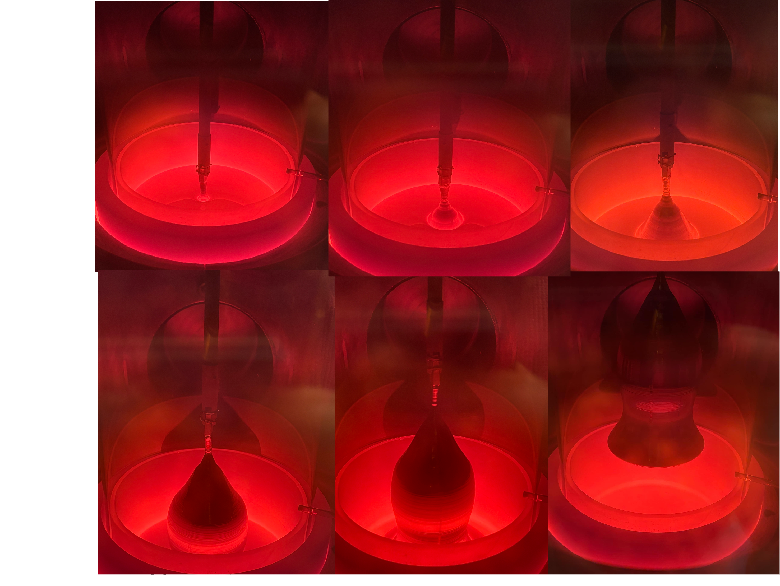
Procedure
Seed crystal (100) Ge) is dipped into the molten Ge and withdrawn slowly, while maintaining the temperature of melt just above the melting point.
The rate of crystal withdrawal (pull speed) and temperature (applied power) of melt are adjusted to control the growth of the crystal.

Slide 7
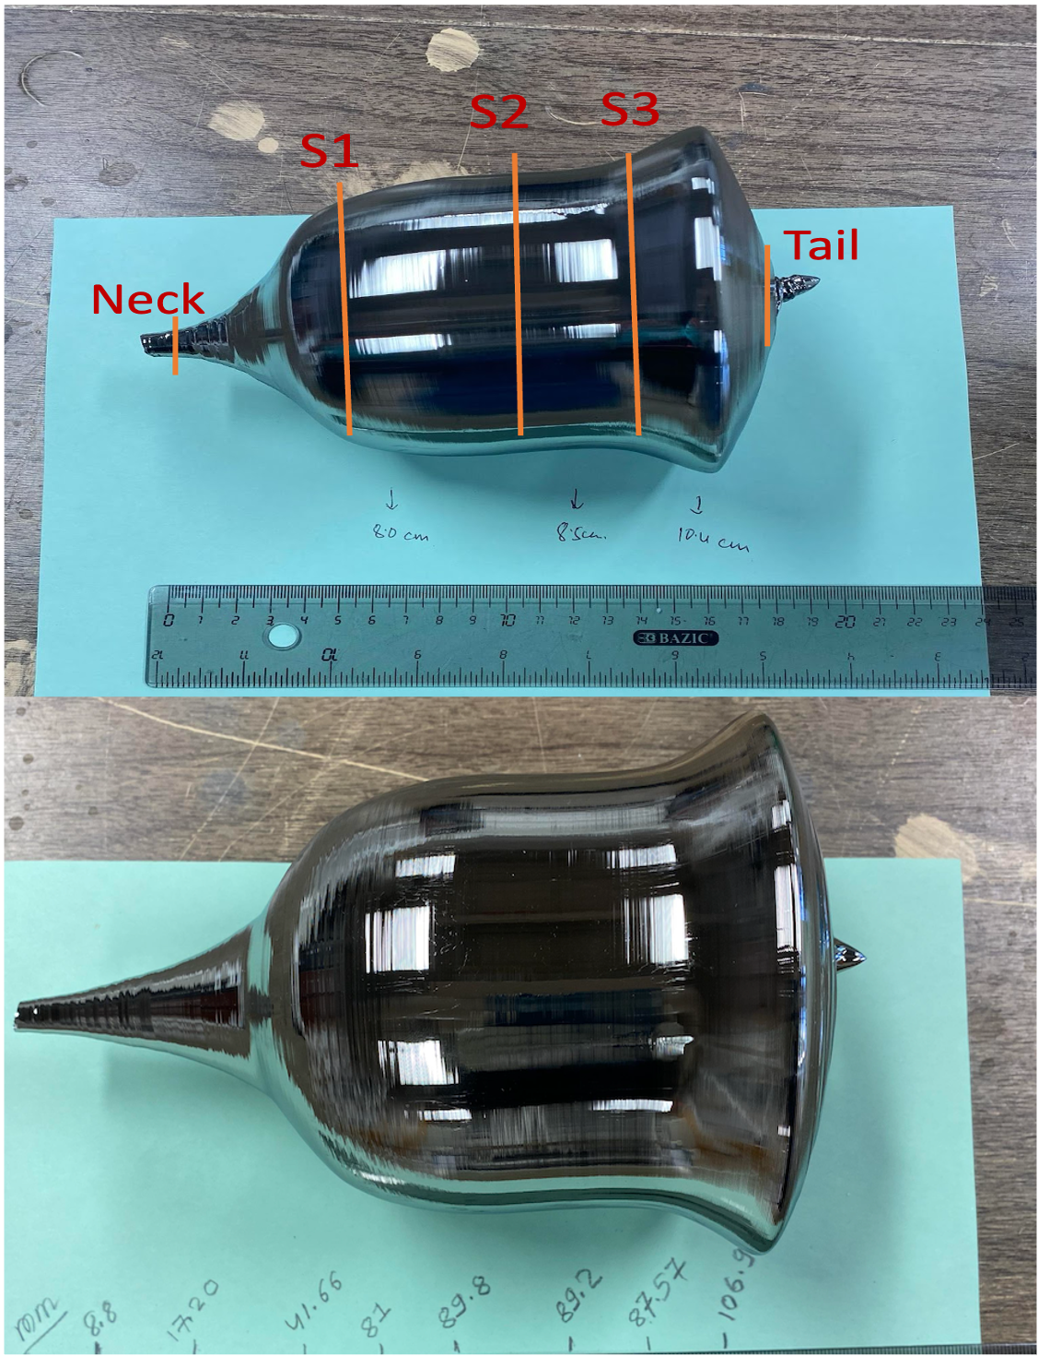
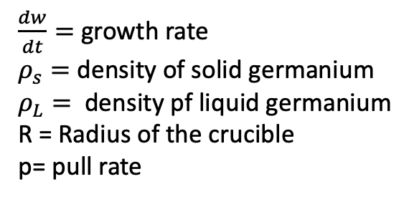
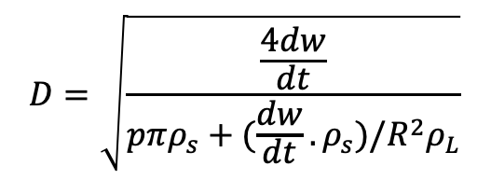
Diameter Control
$$D=\sqrt{\frac{\frac{4dw}{dt}}{pπρ_{s}+(\frac{dw}{dt}.ρ_{s})/R^{2}ρ_{L}}}$$
$\frac{dw}{dt}=$ growth rate
$ρ_{s}=$ density of solid germanium
$ρ_{L}=$ density pf liquid germanium
R = Radius of the crucible
p= pull rate

Slide 8
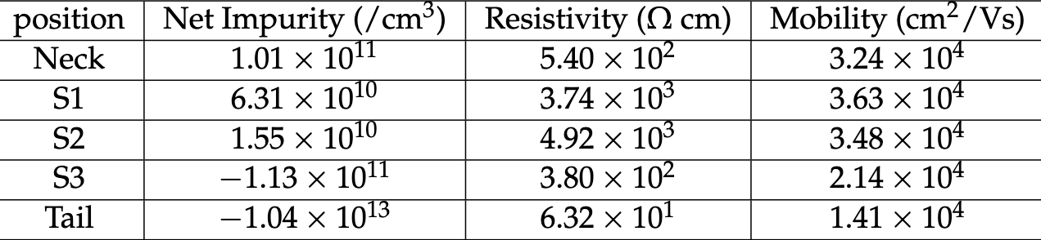
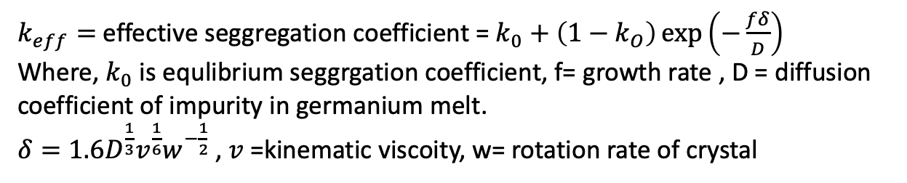
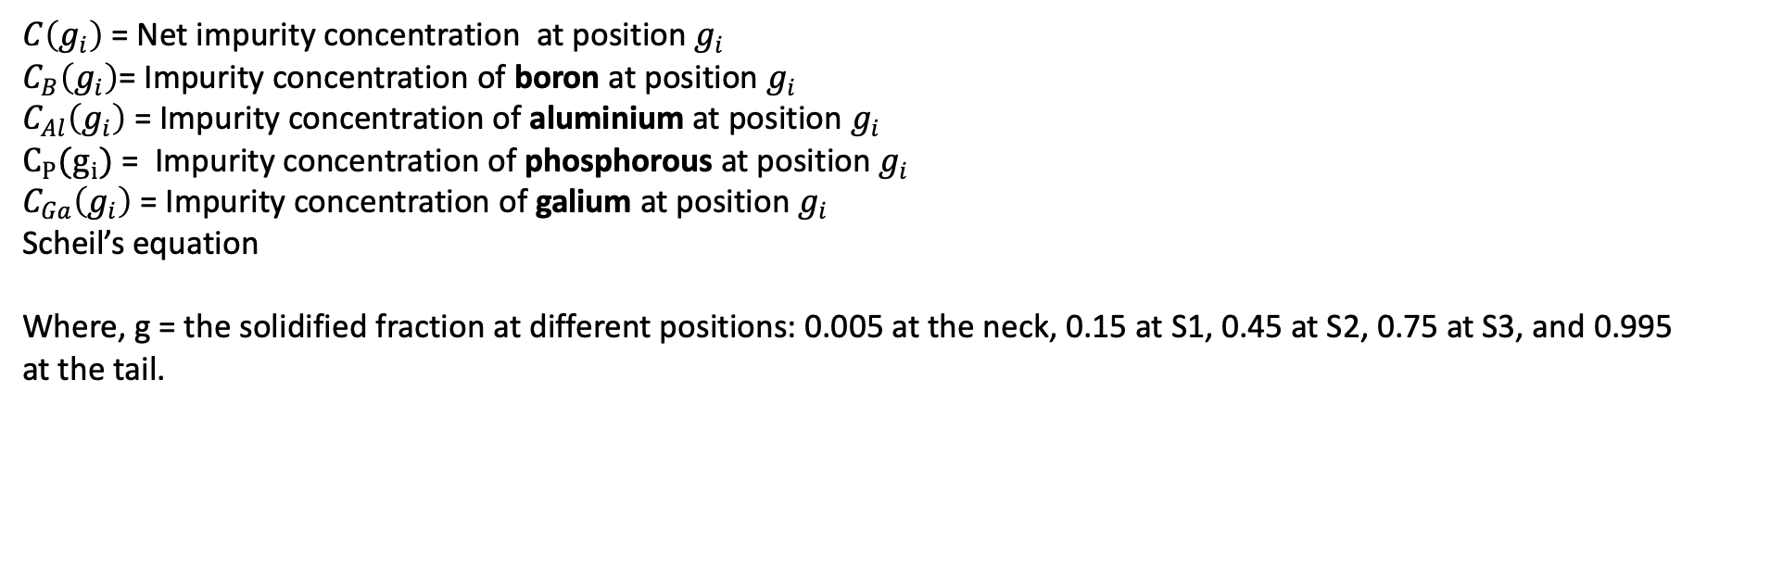
Impurity Segregation
$$C\left(g_{i}\right)=C_{B}\left(g_{i}\right)+C_{Al}\left(g_{i}\right)+C_{Ga}\left(g_{i}\right)+C_{P}(g_{i})$$
$C\left(g_{i}\right)$ = Net impurity concentration at position $g_{i}$
$C_{B}\left(g_{i}\right)$= Impurity concentration of boron at position $g_{i}$
$C_{Al}\left(g_{i}\right)$ = Impurity concentration of aluminium at position $g_{i}$
$C_{P}(g_{i})$ = Impurity concentration of phosphorous at position $g_{i}$
$C_{Ga}\left(g_{i}\right)$ = Impurity concentration of galium at position $g_{i}$
Scheil’s equation
Where, g = the solidified fraction at different positions: 0.005 at the neck, 0.15 at S1, 0.45 at S2, 0.75 at S3, and 0.995
at the tail.
$$C=C_{0}k_{eff}{\left(1−g\right)}^{K_{eff}−1}$$
$k_{eff}=$ effective seggregation coefficient = $k_{0}+\left(1−k_{O}\right)\exp\left(−\frac{fδ}{D}\right)$
Where, $k_{0}$ is equlibrium seggrgation coefficient, f= growth rate , D = diffusion coefficient of impurity in germanium melt.
$δ=1.6D^{\frac{1}{3}}v^{\frac{1}{6}}w^{−\frac{1}{2}}$ , $v$ =kinematic viscoity, w= rotation rate of crystal

Slide 9
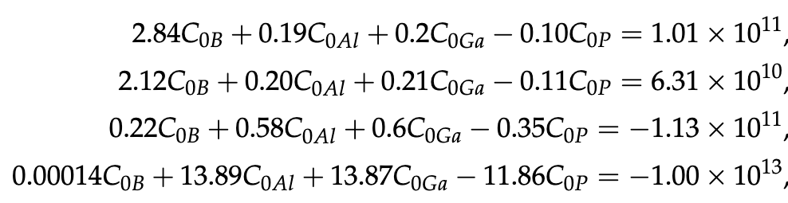
Results
The initial concentration (C₀) of B, Al, Ga and P for this crystal were found to be 3.87 × 10¹⁰/cm³, 2.21 × 10¹¹/cm³, 7.13 × 10¹¹/cm³ and 1.89 × 10¹²/cm³ respectively.

Slide 10
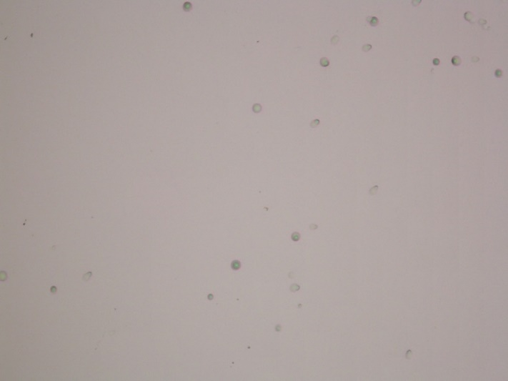
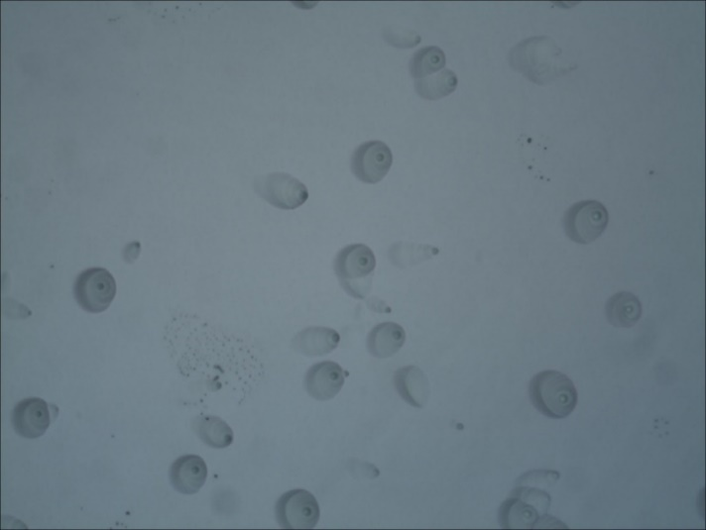
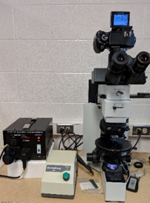
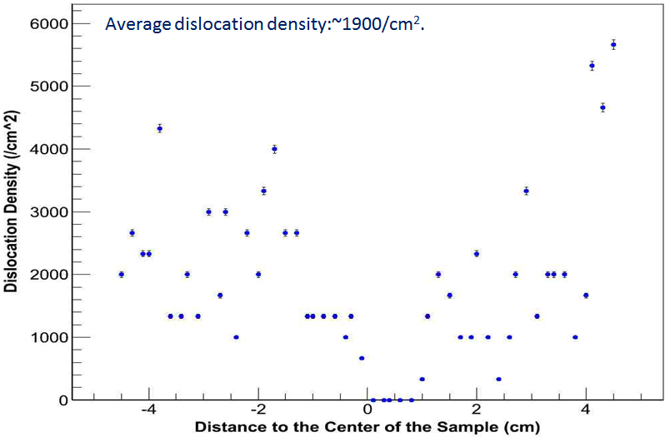
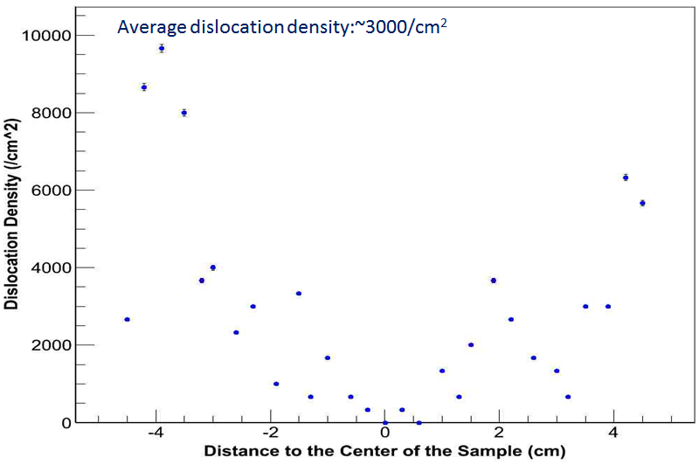
Dislocation Measurement
Cutting
Polishing
Etching2
HF: HNO3:Acetic acid=5:10:11 with 30 mg iodine
Etching1
HNO3:HF=3:1
10X
50X
Dislocations observation under microscope
Full view of the dislocation distribution on the whole slice

Slide 11
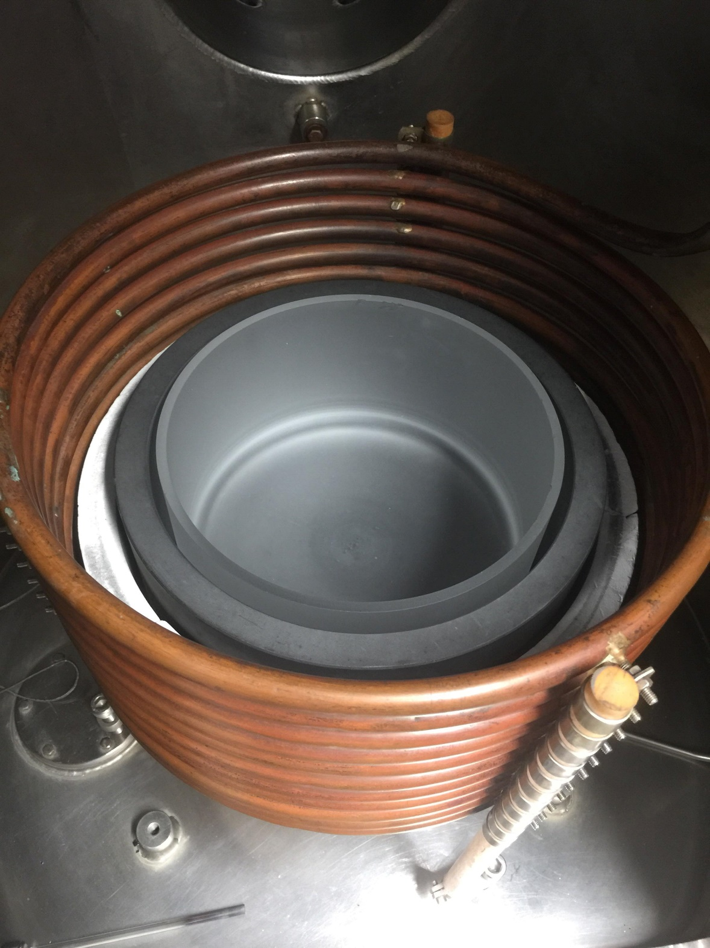
Furnace
High Frequency AC current (25 KHz) is provided by high voltage source(not shown in figure)
The graphite susceptor (conductor) kept inside the solenoidal copper coil gets heated by eddy current due to electromagnetic induction
Quartz crucible containing the germanium ingots gets heated by conduction.
Tried to maintain exact dimension and materials. Position may vary within acceptable range of error.
Only 2D simulation to start
Complete help from GROK 3 beta

Slide 12
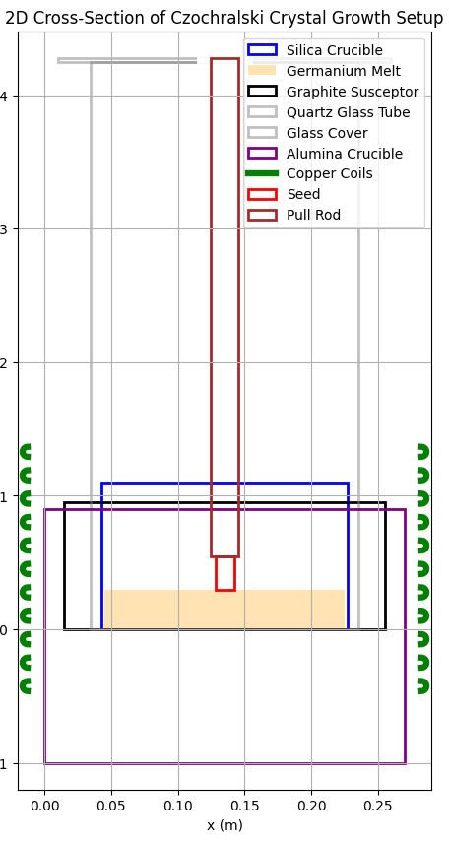
Gemoetry in 2D
Used help of GROK 3 to write the code for setting up geometry
Provided the dimensions of our crystal growth chamber and its components.
2D geometry of grower with 4Kg of germanium melted with (8600 watts) and without seed (11000 watts) and rod.

Slide 13
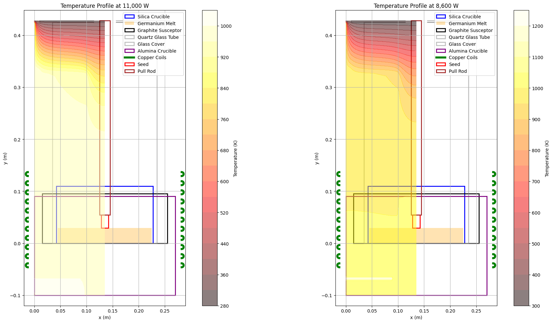
Simulation of melting process
Simulation for 11000 KW, 67A rms current, 25khz and 8600 watts, 48A rms, 22khz.
Reasonable temeprature profile with some errors in the sorrounding.

Slide 14
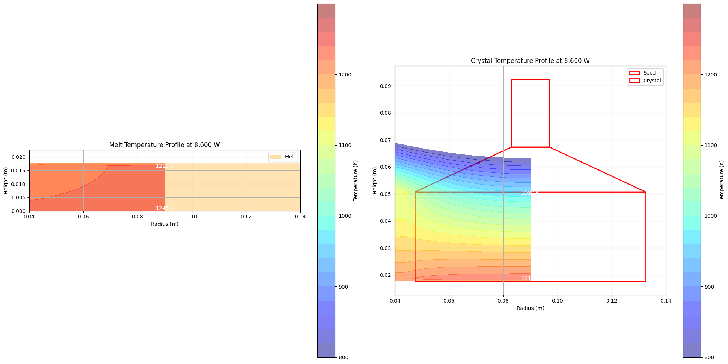
Temperature Profile
Crystal assumed to be of mass 1500 grams with 2500 grams melt in crucible.
Axial temperature gradient ~20K/cm.
Need more simulation for various growth stages and more accurate physics process. (gas flow, fluid dynamics etc).
Based on electromagnetic induction joules heating by eddy current and heat transfer equation.
Close up simulation for crystal and melt.
Boundary condition used: Melt: seed interface temperature: 1210K.
Coil temperature: 300K
Sorrounding temperature: 300K

Slide 15
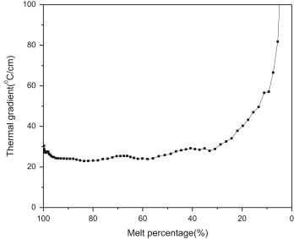
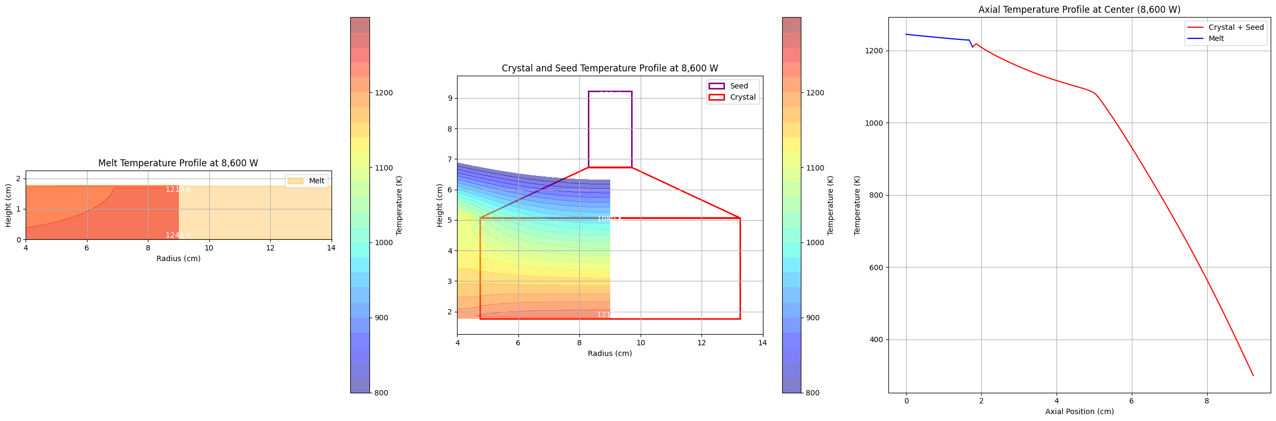
Temeprature gradient
Temperature plot on right for axial position in central part of crystal.
8.5 cm diameter
Measured thermal gradient for same chamber (Fig from : Dislocation density control in high-purity germanium crystal growth(For 3.5 cm diameter USD grown crystal) Guojian Wang, Yutong Guan, Hao Mei, Dongming Mei, Gang Yang, Jayesh Govani, Muhammad Khizar

Slide 16
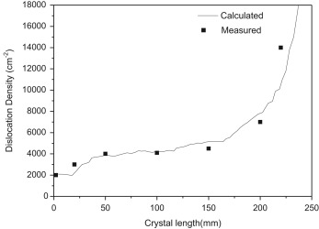
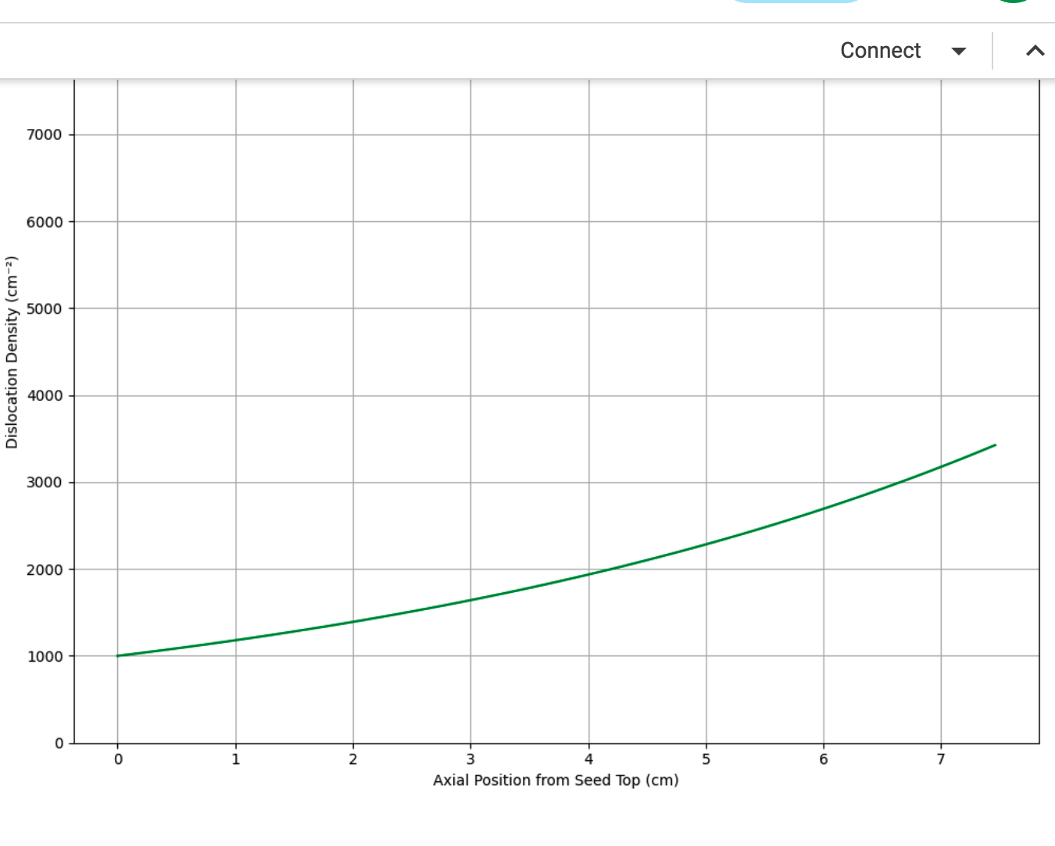
Dislocation Density
Fig from : Dislocation density control in high-purity germanium crystal growth(For 3.5 cm diameter USD grown crystal) Guojian Wang, Yutong Guan, Hao Mei, Dongming Mei, Gang Yang, Jayesh Govani, Muhammad Khizar
Reasonable prediction of dislocation densities (8.5cm diameter).

Slide 17
Conclusions
At USD, we have successfully built a production chain that can purify Ge raw materials, grow detector-grade HP-Ge crystals, and fabricate them into Ge detectors
Chatbots could be useful for further analysis and improvement of well-controlled segregation method and thermal field used to control the shape of the crystal and the distribution of impurities during crystal growth to meet the requirements for detector-grade Ge crystals.
In future we plan use multiphysics simulation software COMSOL or SimScale to simulate with time steps for all processes from start to finish in 3D (chatbots are useful for geometry creation and can help with software use).

Slide 18
Thanks!

