Slide 1

Accelerating Electrolyte Discovery with AI: High-Throughput screening of multi-component Li and Na electrolytes for battery applications
Sokseiha Muy and Yang Shao-Horn
Photo: Guardian, Alex Ford.
Carbon dioxide information analysis center, Oak Ridge National Lab.

Slide 2
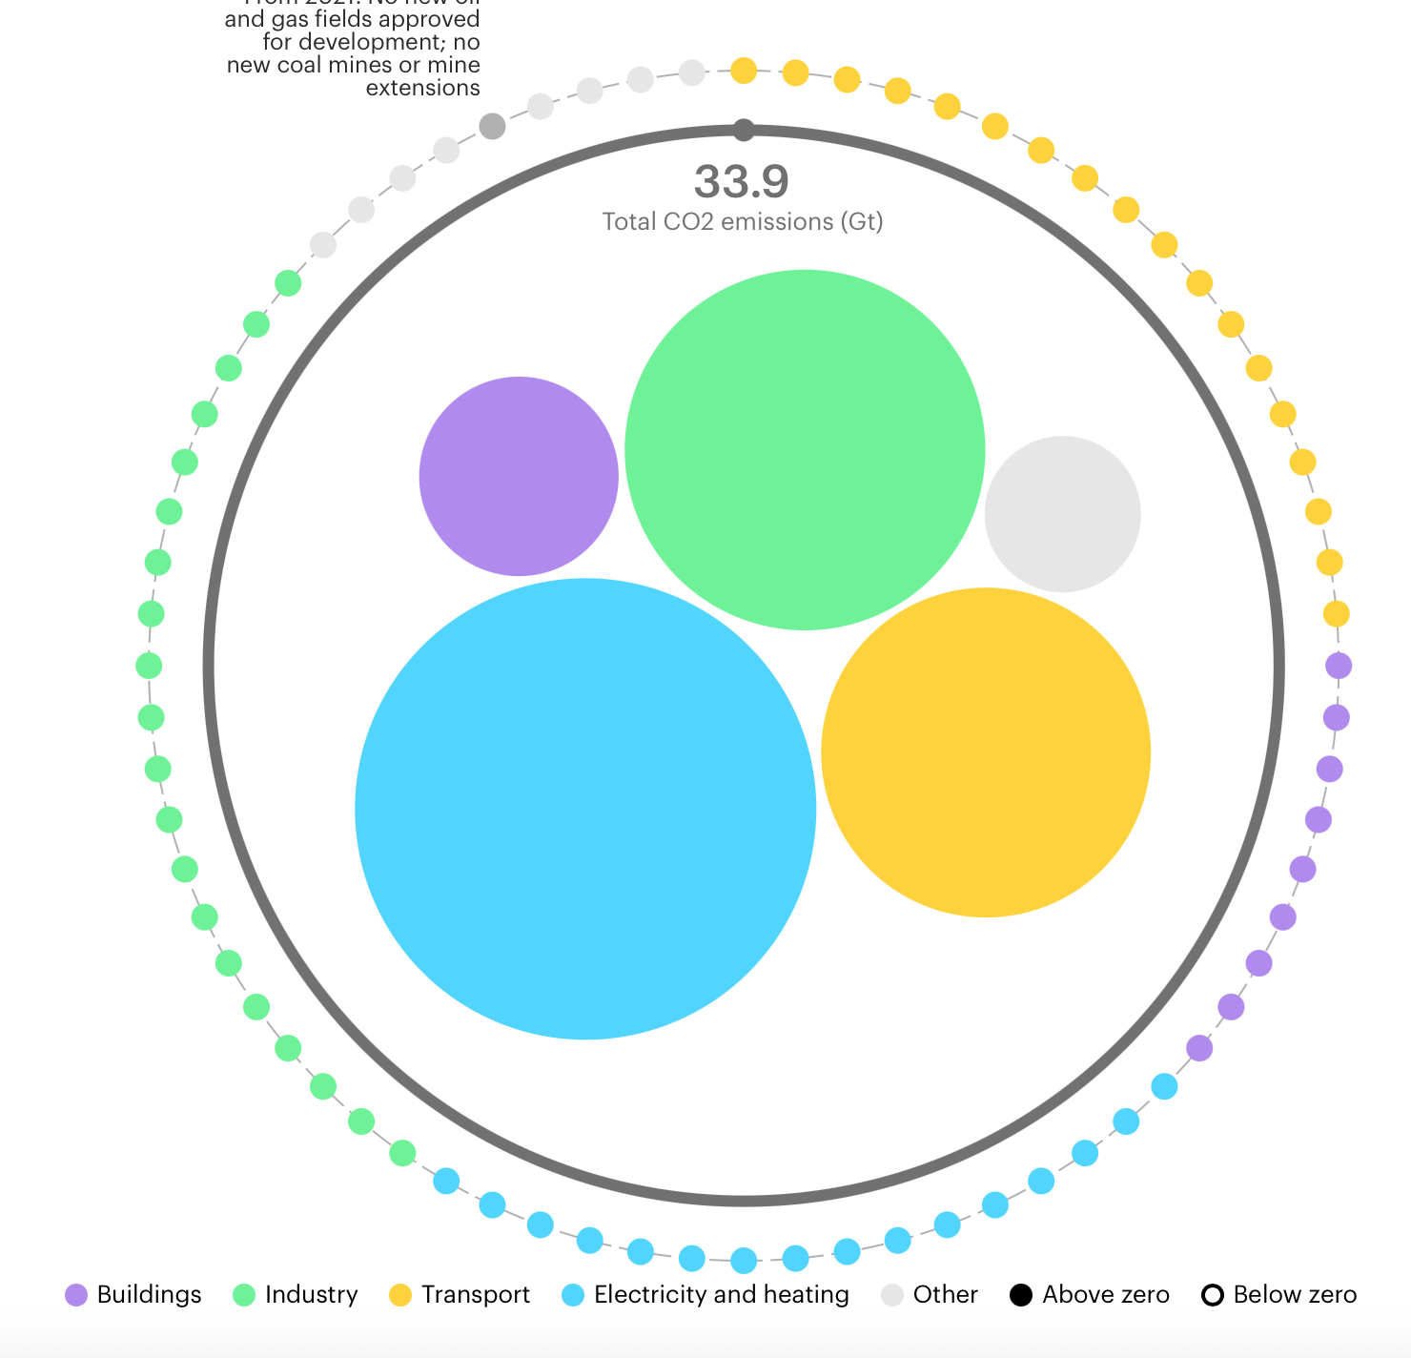
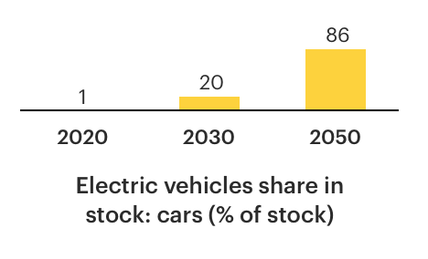
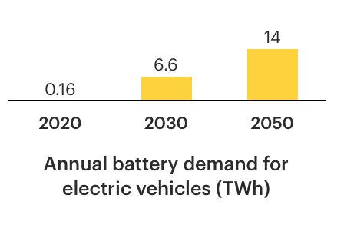
Decarbonizing the transportation sector
In its Net-zero-by-2050 emission roadmap, the IEA projects the annual battery demand to reach 6.6 TWh in 2030 and 14 TWh in 2050
Require massive investment in electricity storage technology that is cost-effective and highly efficient.
https://www.iea.org/reports/net-zero-by-2050

Slide 3
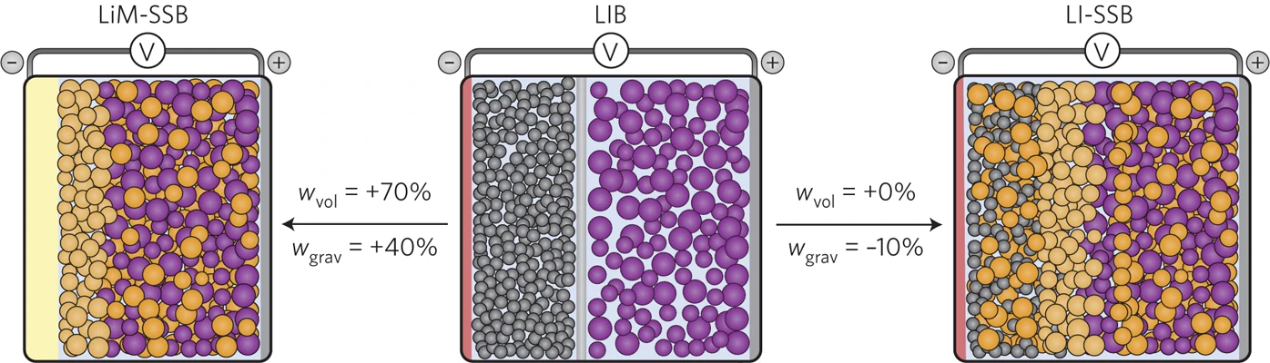
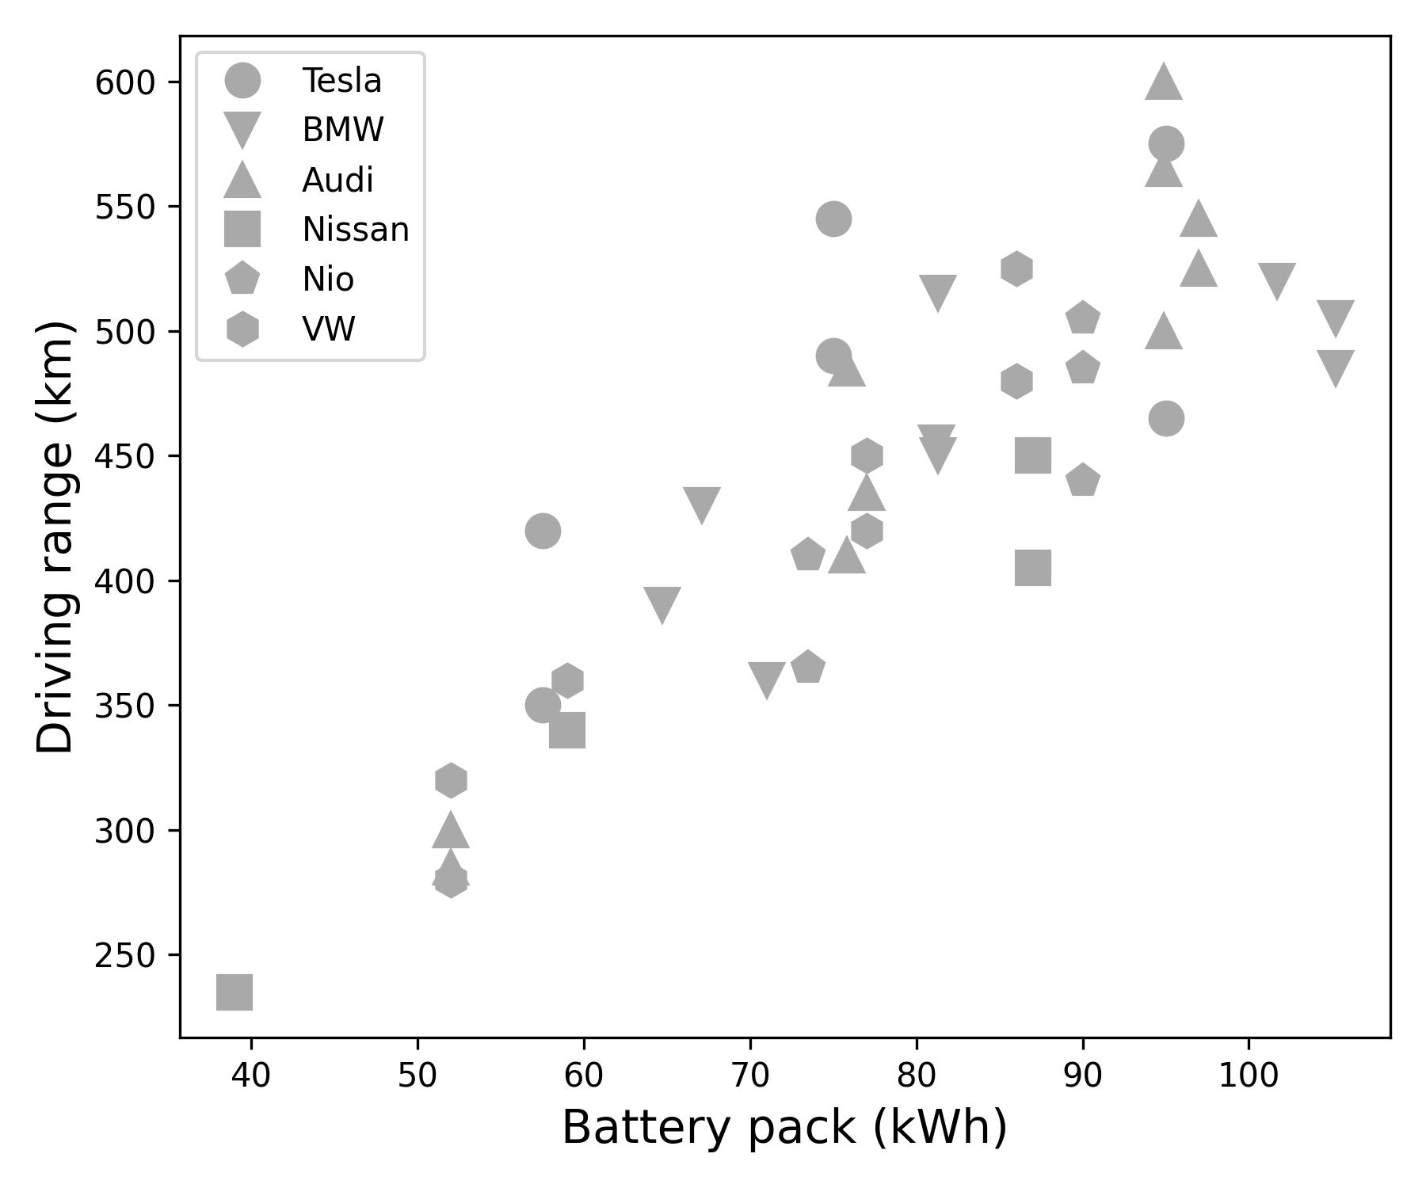
From Li-ion to Na-metal batteries
Li-ion battery
Na metal battery
Current LIB technology with graphite anode has limited
energy density ~ 250 Wh/kg which translates into a
maximum driving range ~ 600 km
Replacing Li and graphite by Na can increase the energy density and lower the cost
Na metal, being more reactive than graphite, require a new electrolyte for stable cycling.
https://ev-database.org/cheatsheet/range-electric-car
J. Janek et al., Nat. Energy., 1, 16141, 2016

Slide 4


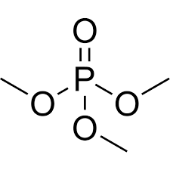
Leveraging AI and HT experiment to efficiently navigate chemical space
Na electrolyte database
12 organic solvents
Liquid chemical space
5 salts
> 10¹⁴
possible combinations
NaTFSI
NaFSI
NaClO4
NaOTf
NaPF6
Number of salts
1
5
Salts ratio
Solvents ratio
Number of solvents
Total concentration
1
12
Total concentration
Temperatures
0.05
2 M
0.05
25
40
60
80 ºC
Courtesy of Dr. Vanesa Munoz Perales

Slide 5



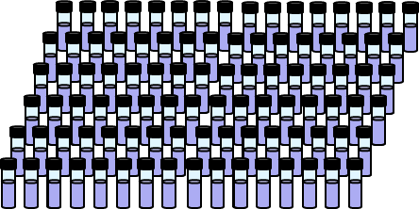
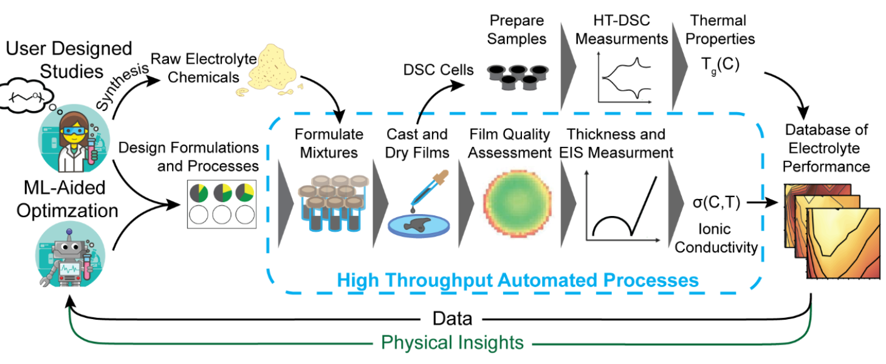

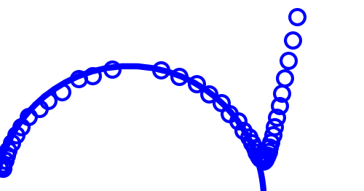

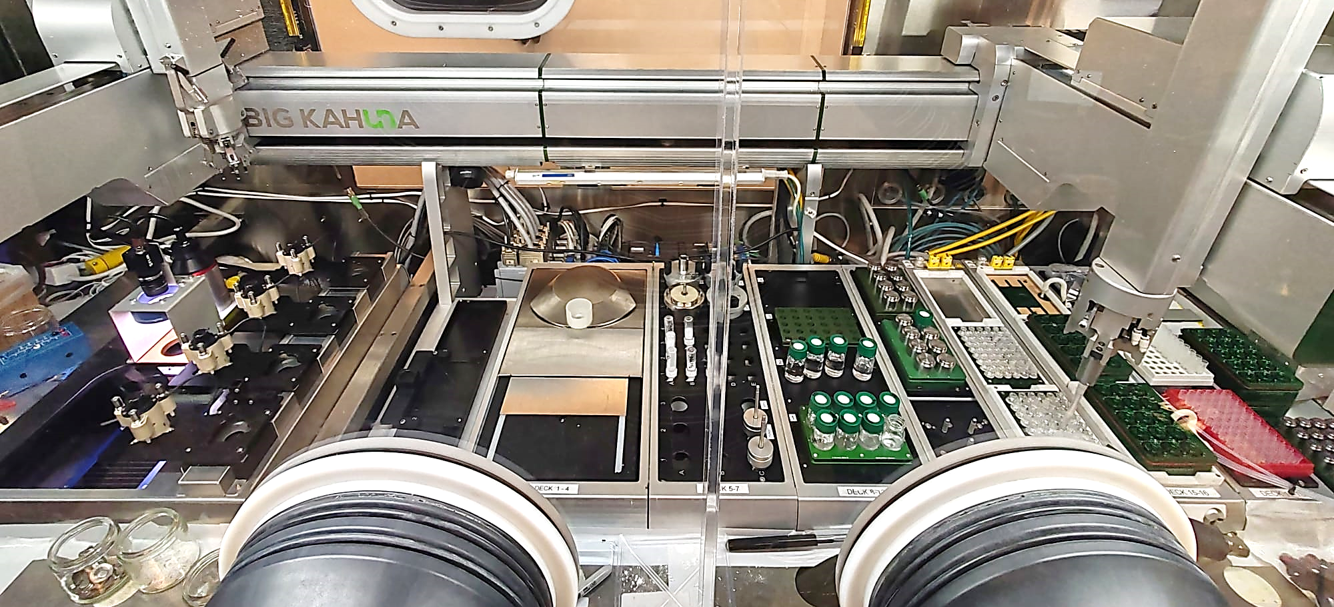
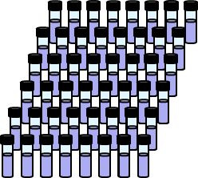
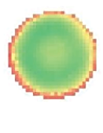
Optimizing the robotics workflow for liquids and polymers
100 new formulations in 5 days
96 formulations
Dispense
Liquid electrolytes
Assemble liquid cells
EIS measurements and fittings
x4 EIS setups
Creating the design
Ionic conductivity
50 new formulations in 5 days
-Im (Z) / Ω
Re (Z) / Ω
45 formulations
Cast and dry films
Assemble polymer cells
Film quality and thickness
Polymer electrolytes
Courtesy of Dr. Vanesa Munoz Perales

Slide 6
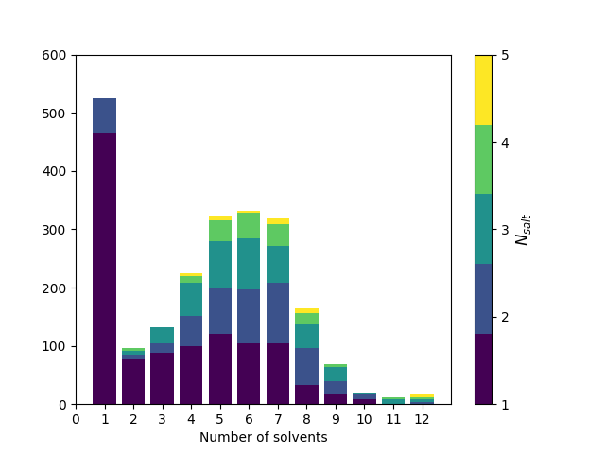
The largest database of Na electrolytes
2240 datapoints from our robot.
560 unique formulations at 4 temperatures.
Only Na electrolytes
12 solvents, 5 salts
Other solvents and salts will be added
We envision having 10 000 datapoints by the end of 2025
Courtesy of Dr. Vanesa Munoz Perales

Slide 7
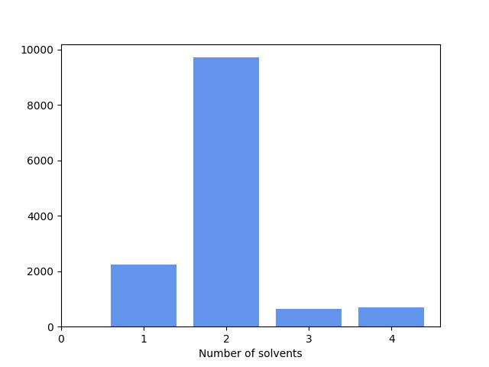
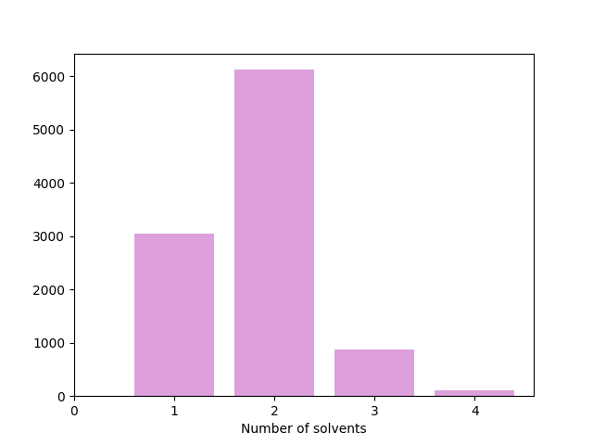
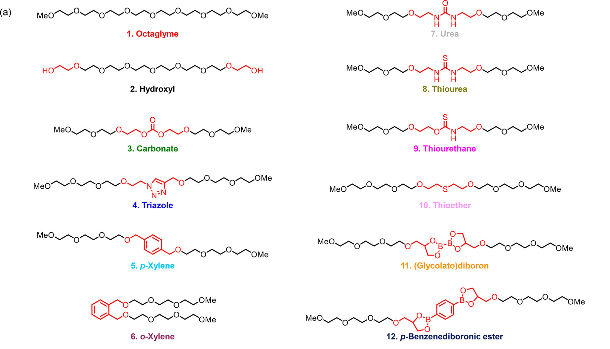
Li-Electrolyte Databases
CALiSol-23
Chicago
In-house
13267 datapoints mined from
the literature
Only Li electrolytes
38 solvents and 14 salts
10143 datapoints mined from
the literature
8187 Li-electrolytes datapoints
202 solvents and 73 ‘salts’
~100 datapoints of PEO-based
oligomers
P.D. Blasio et al., Scientific Data, 11, 750, 2024.
K. Ritesh et al., Chem. Mater., 37, 2720, 2025.
B. Qiao et al. ACS Cent. Sci., 6, 1115, 2020.

Slide 8
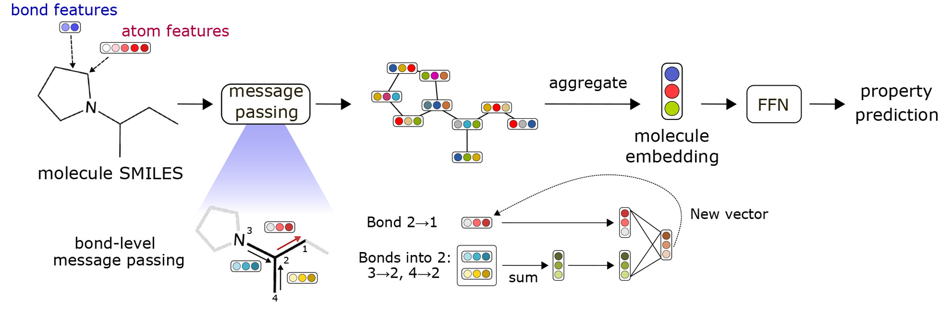
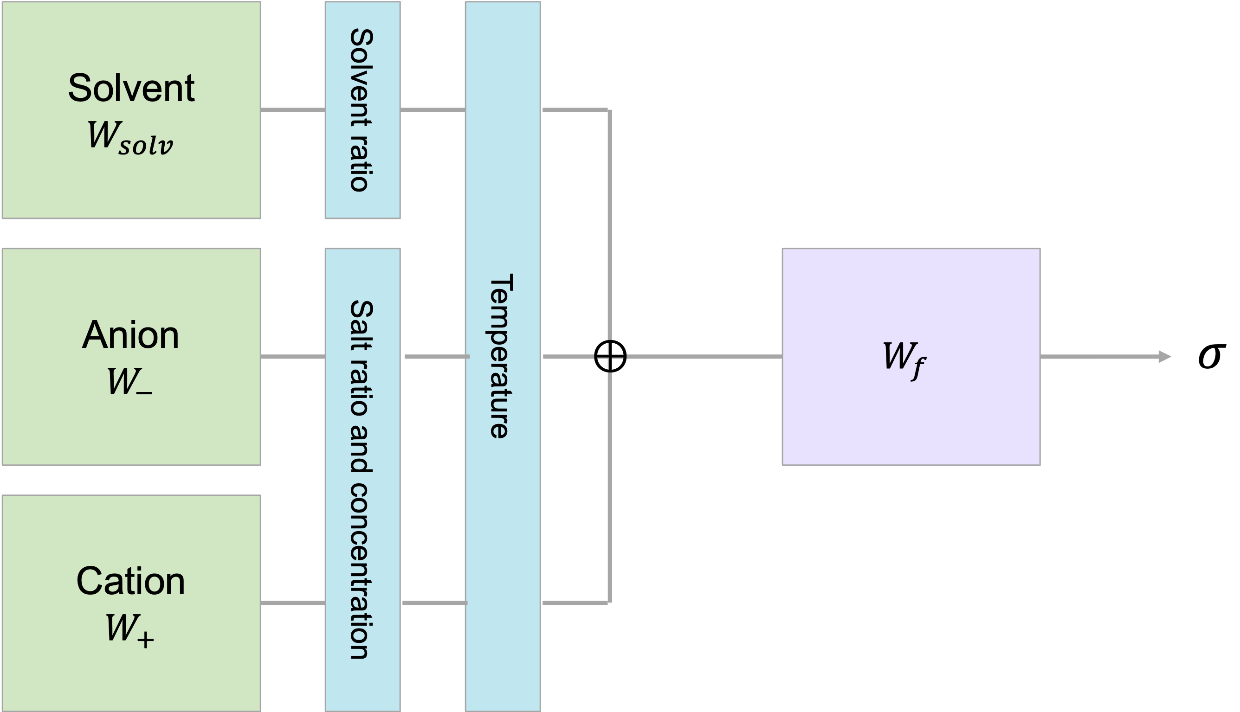
ML: schematic of the Neural Network Architecture
Encoding
Block
Fitting
Block
FC1COC(=O)O1
F[P-](F)(F)(F)(F)F
[Li+]
Heid et al., J. Chem. Inf. Model, 9, 64, 2024.

Slide 9
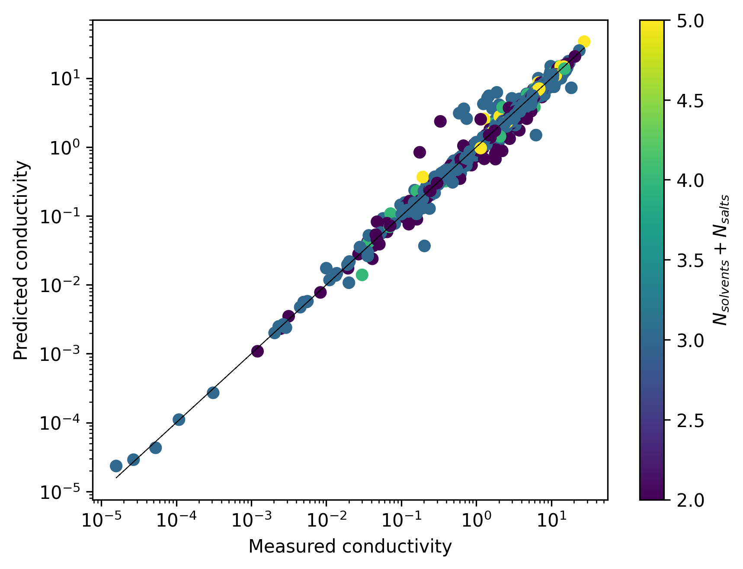
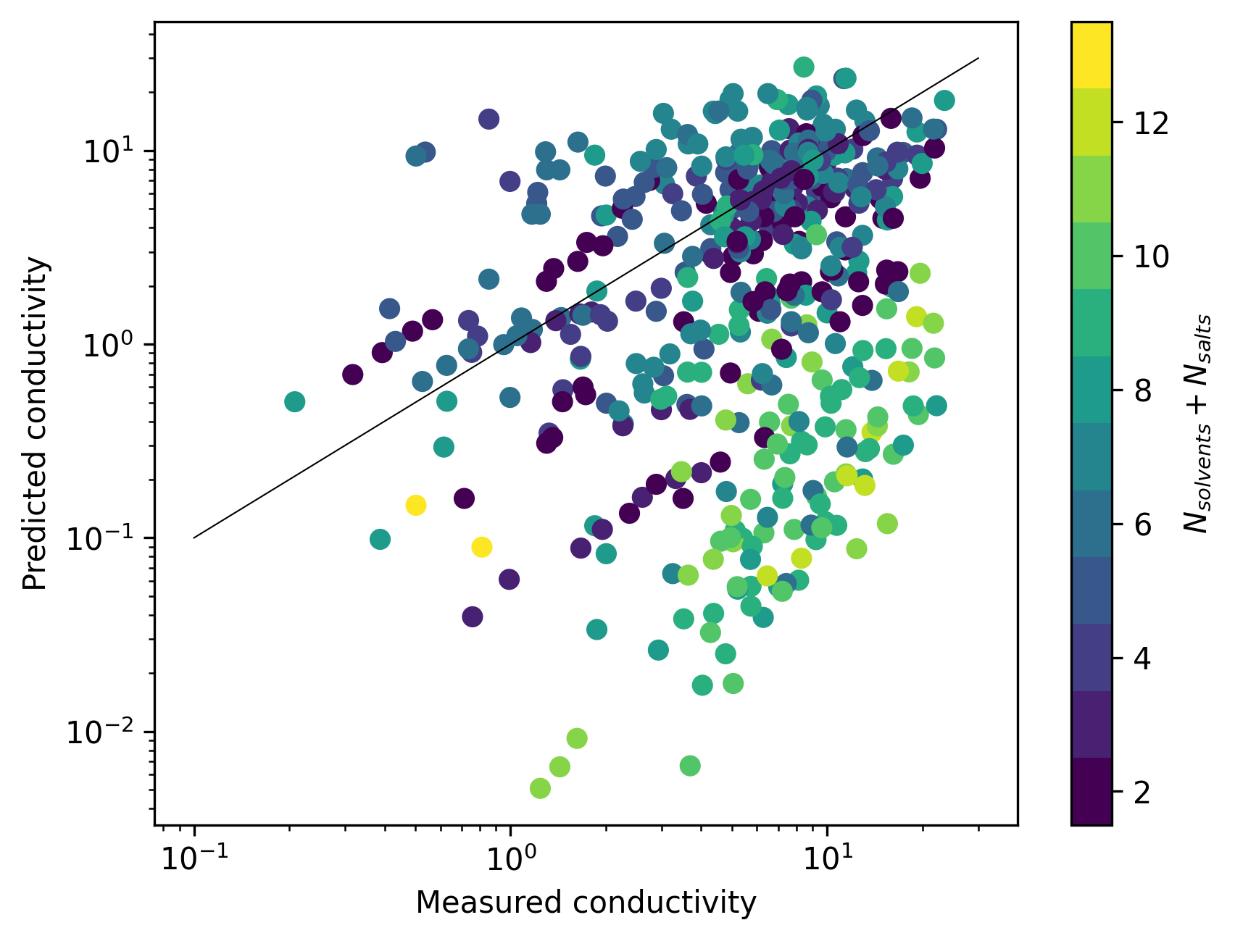
ML model trained on Calisol database

Slide 10
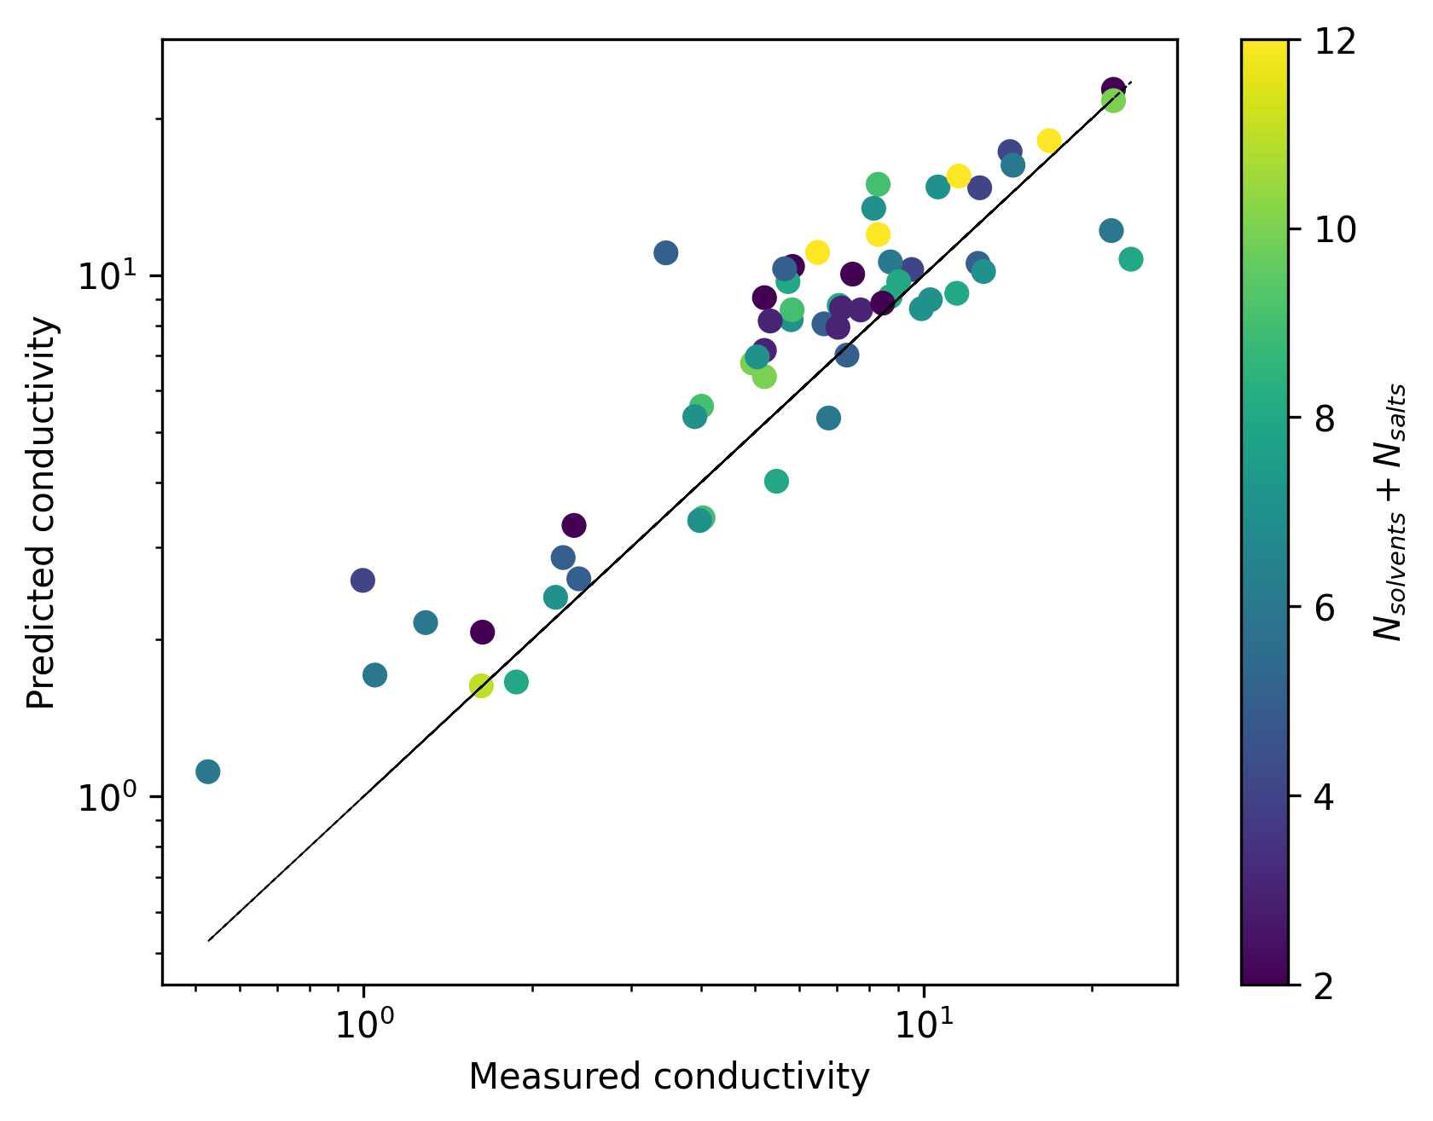

Transfer learning to Na electrolytes
The encoding blocked of the solvents and anions are ‘locked’ and only the fitting block and the encoding block of the cation are allowed to adjust during training.

Slide 11
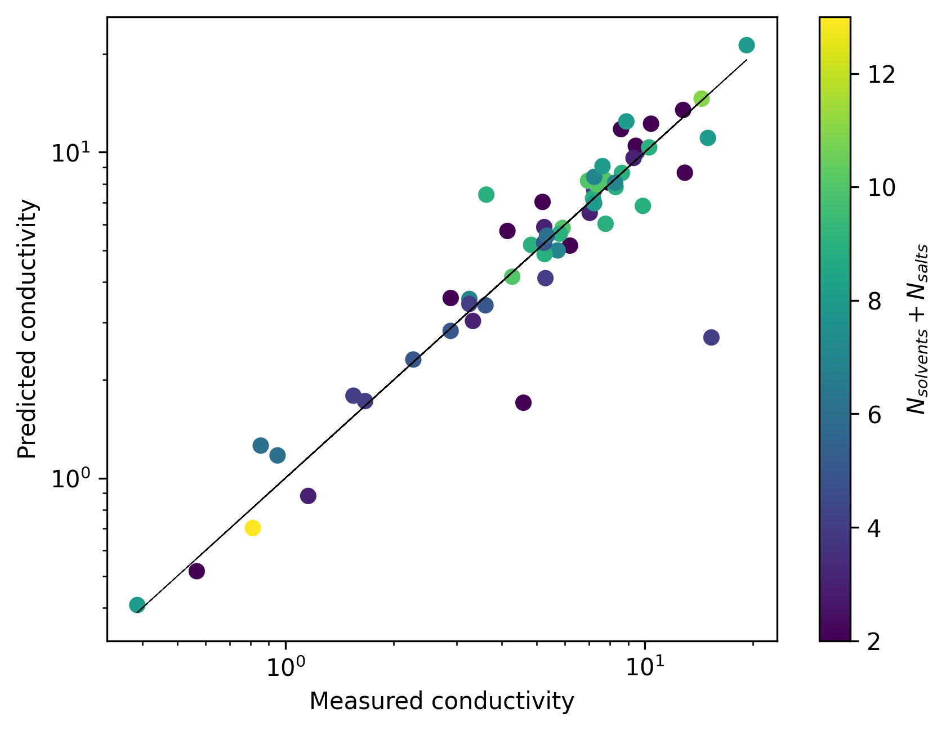
ML trained on combined CALiSol-23 and Na electrolyte databases
Li electrolytes
Na electrolytes

Slide 12
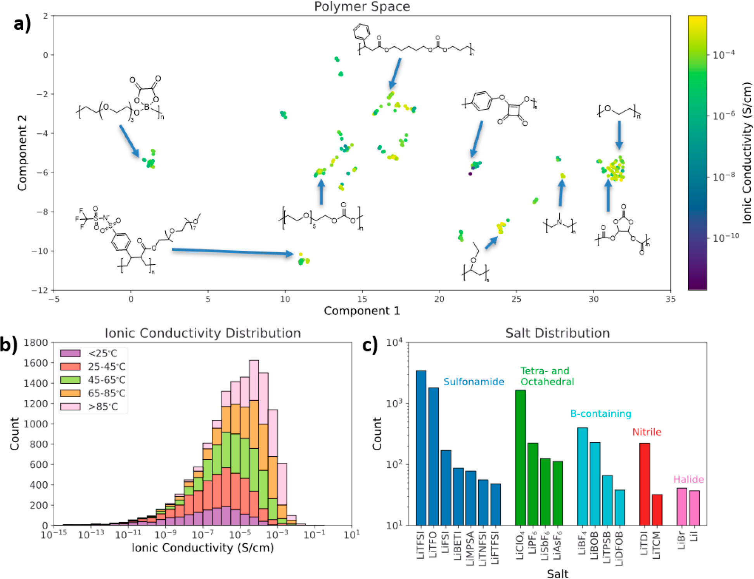
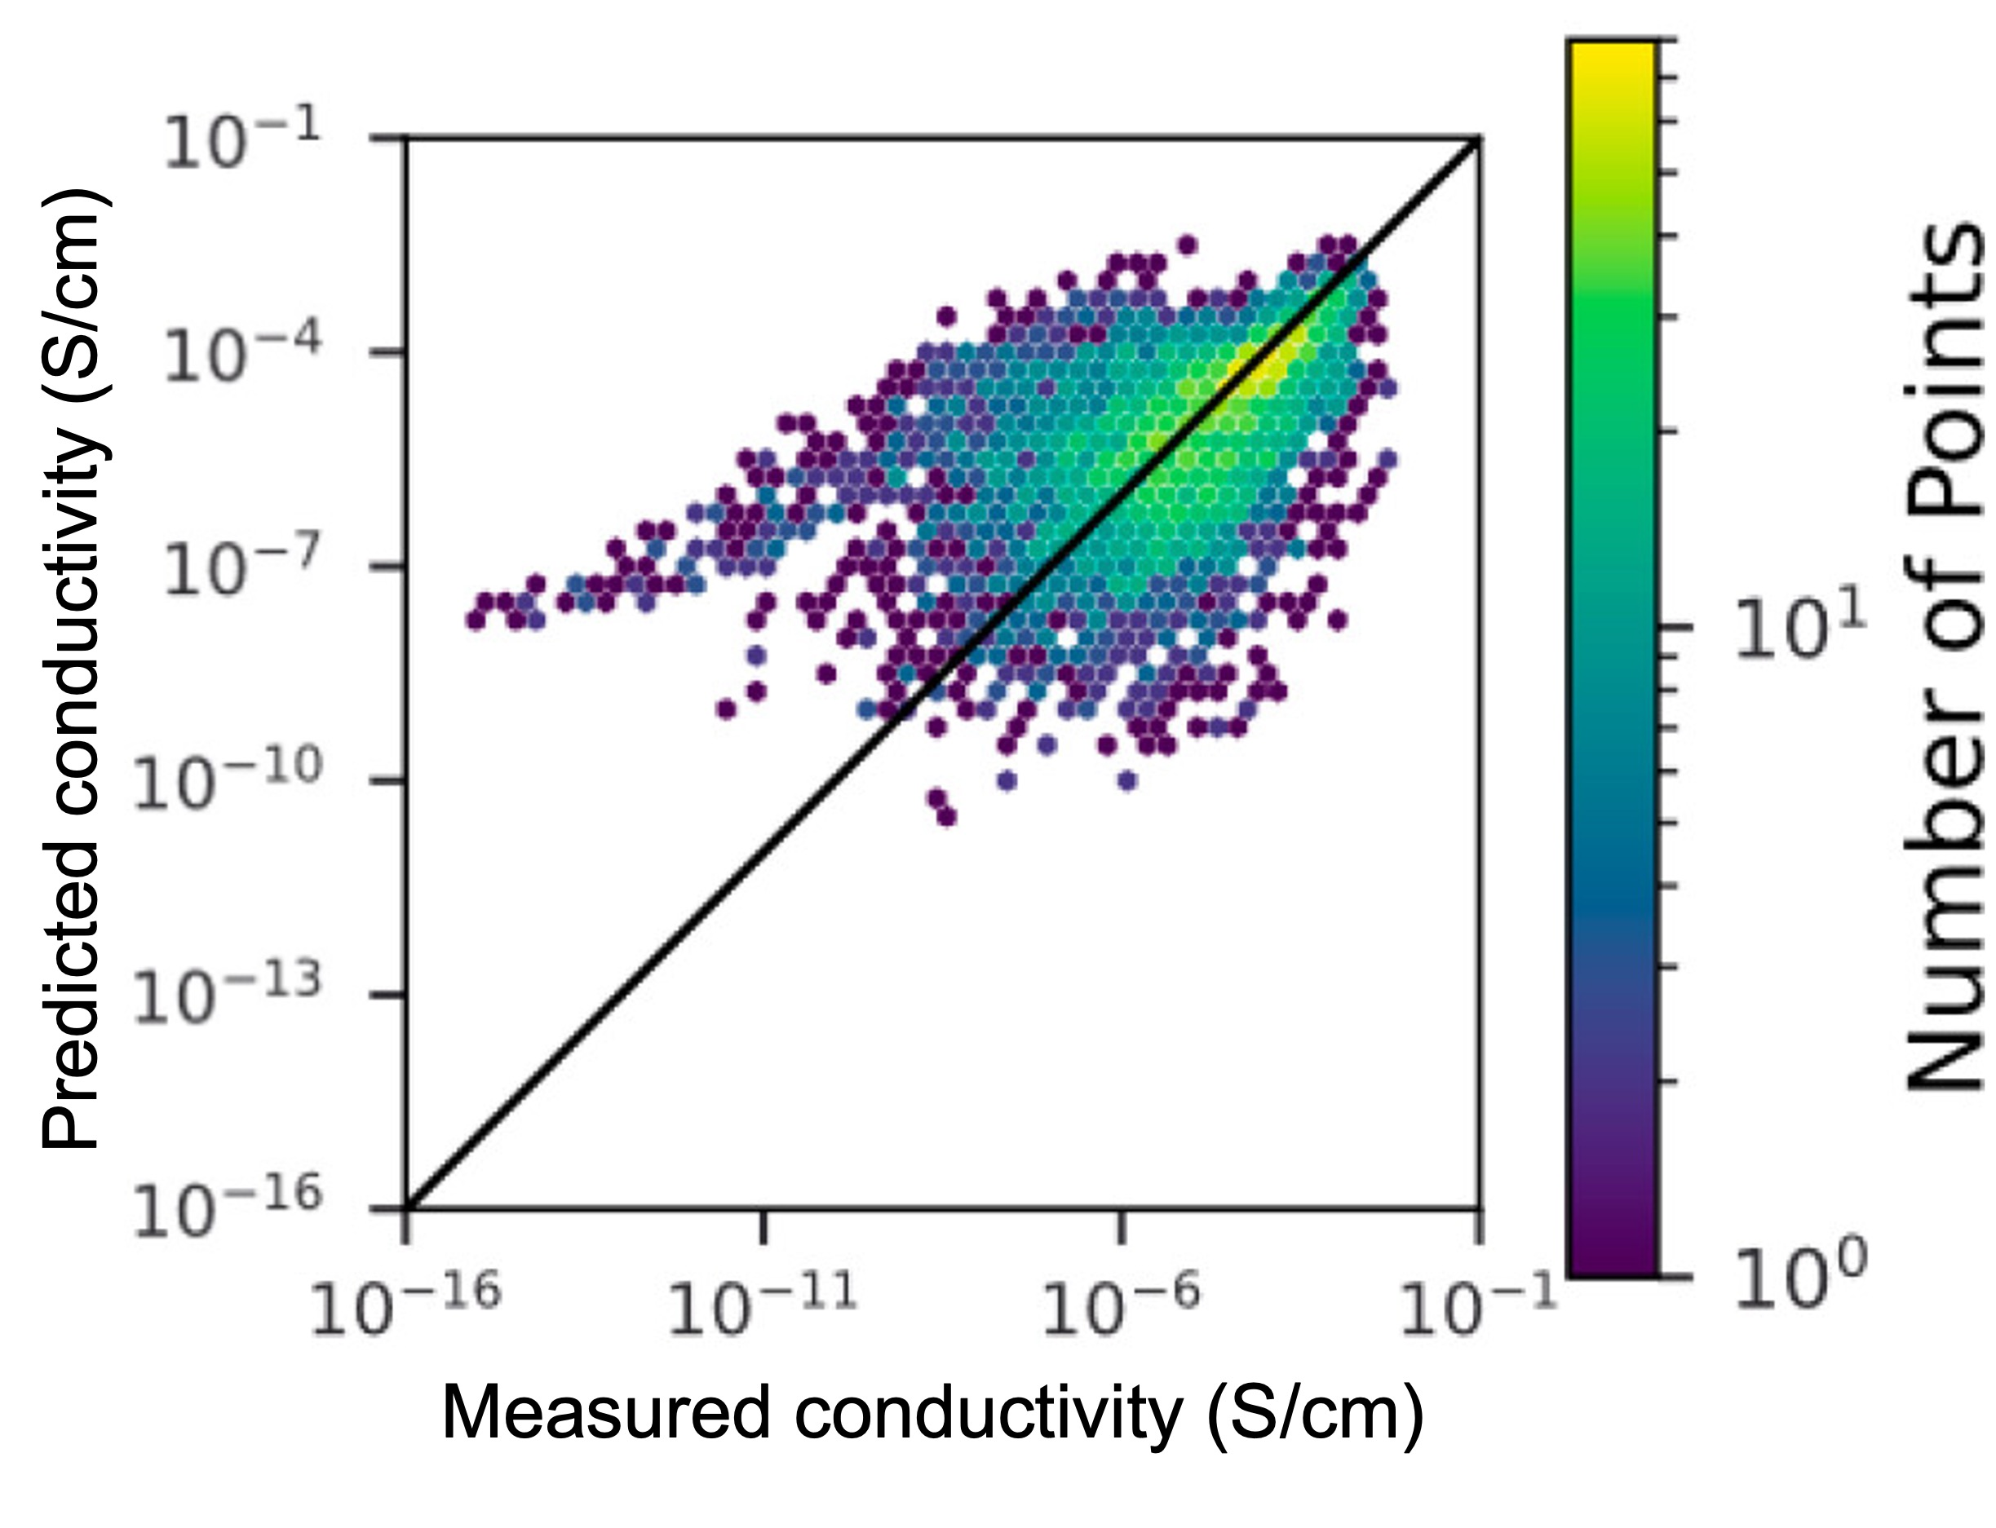
Ongoing work: Combine with Polymer Electrolyte Databases
G. Bradford et al., ACS Cent. Sci., 9, 206, 2023

Slide 13
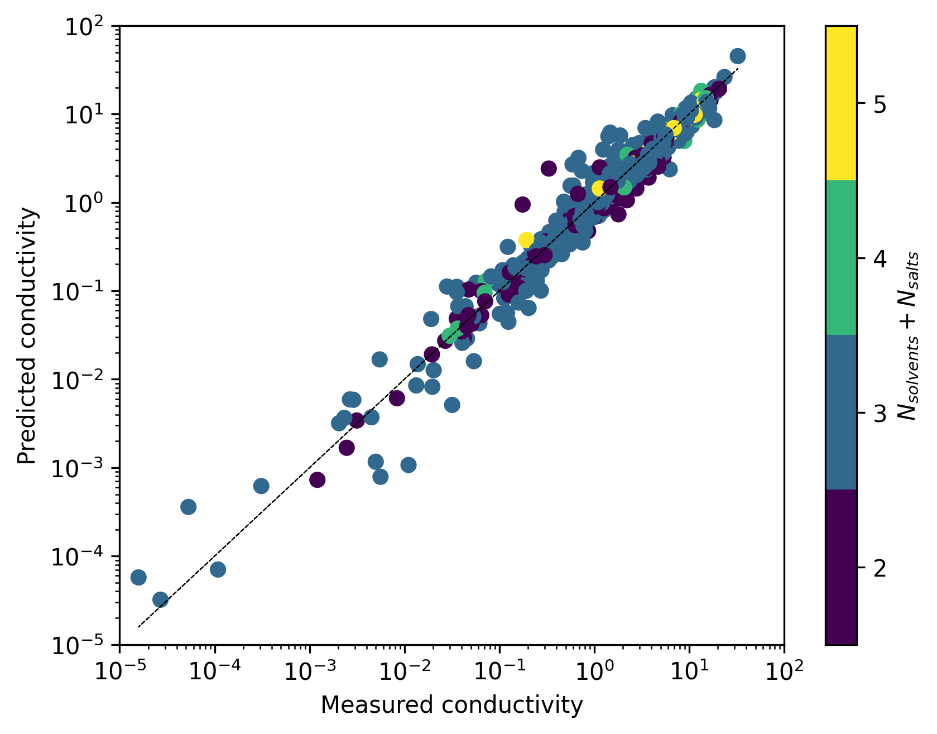
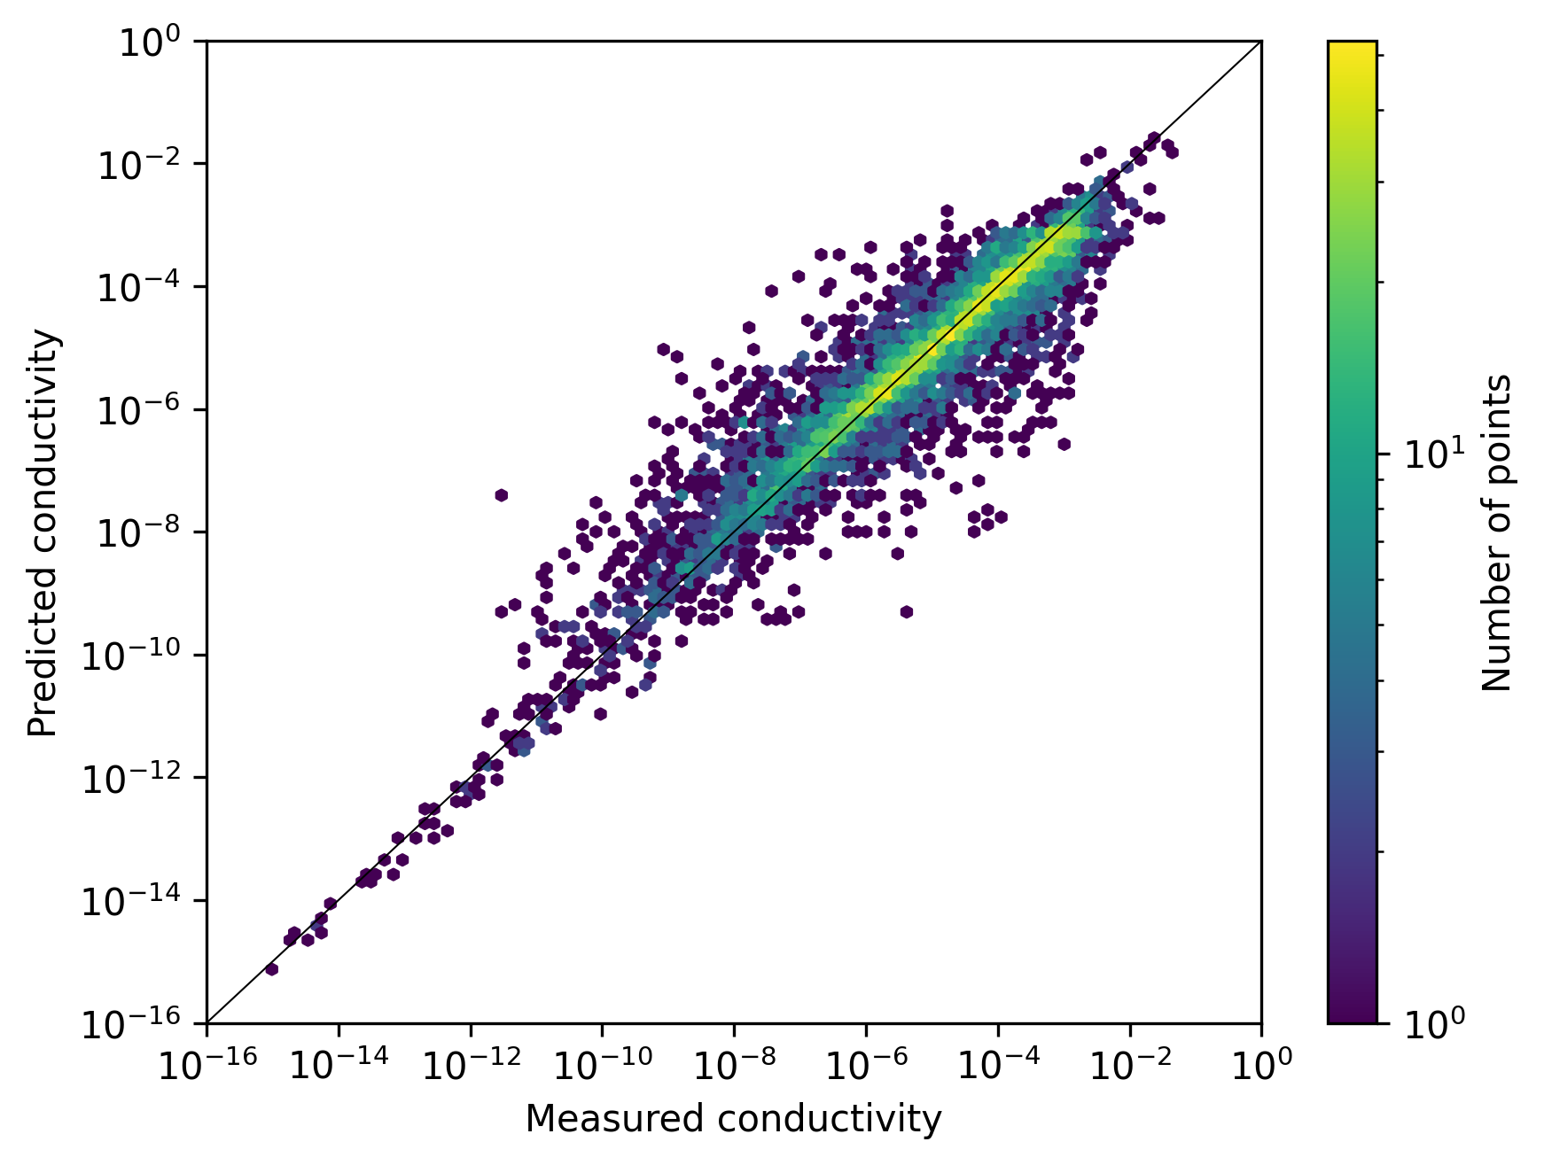
ML model trained on combined Calisol and polymers databases
Li liquid electrolytes
Li polymer electrolytes

Slide 14
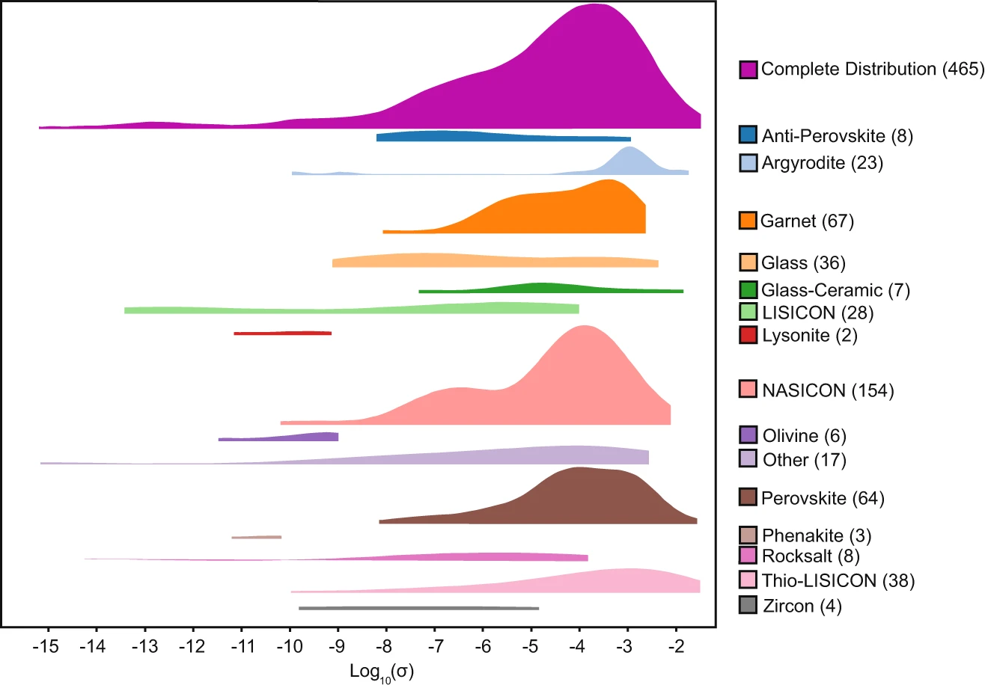
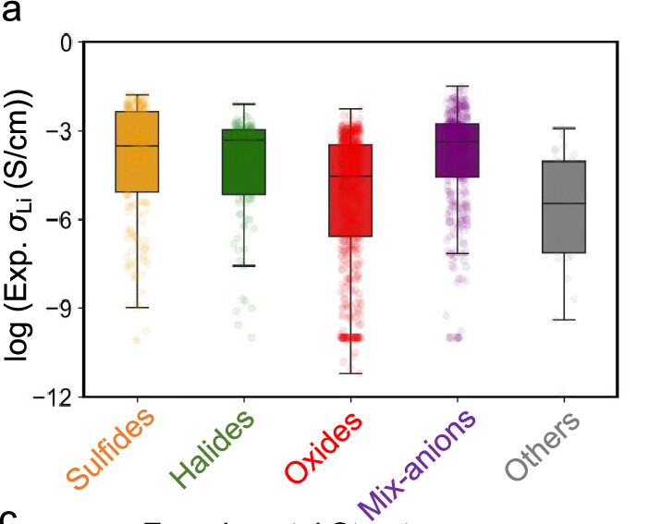
Toward a General AI Model for Ionic Conductivity in Liquid, Polymer, and Solid Electrolytes
C.J. Hargreaves et al., npj Comput. Mater., 9, 9 (2023)
S. Wang et al., Chem. Mater., 36, 11541, 2024

Slide 15
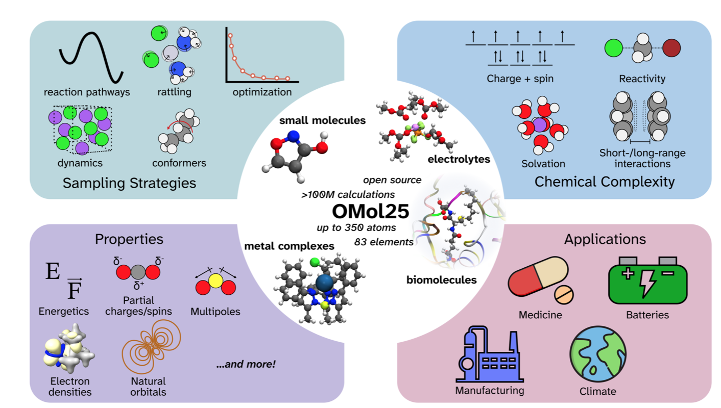

Future outlook: Leveraging computational databases
OMol25: The largest open computational database to date with ~ 83 millions molecular systems
SES Molecular Universe: 100 million molecules.
Only solvents. Only 1 million molecules accessible through the free version.
https://arxiv.org/pdf/2505.08762
https://molecular-universe.ses.ai

Slide 16
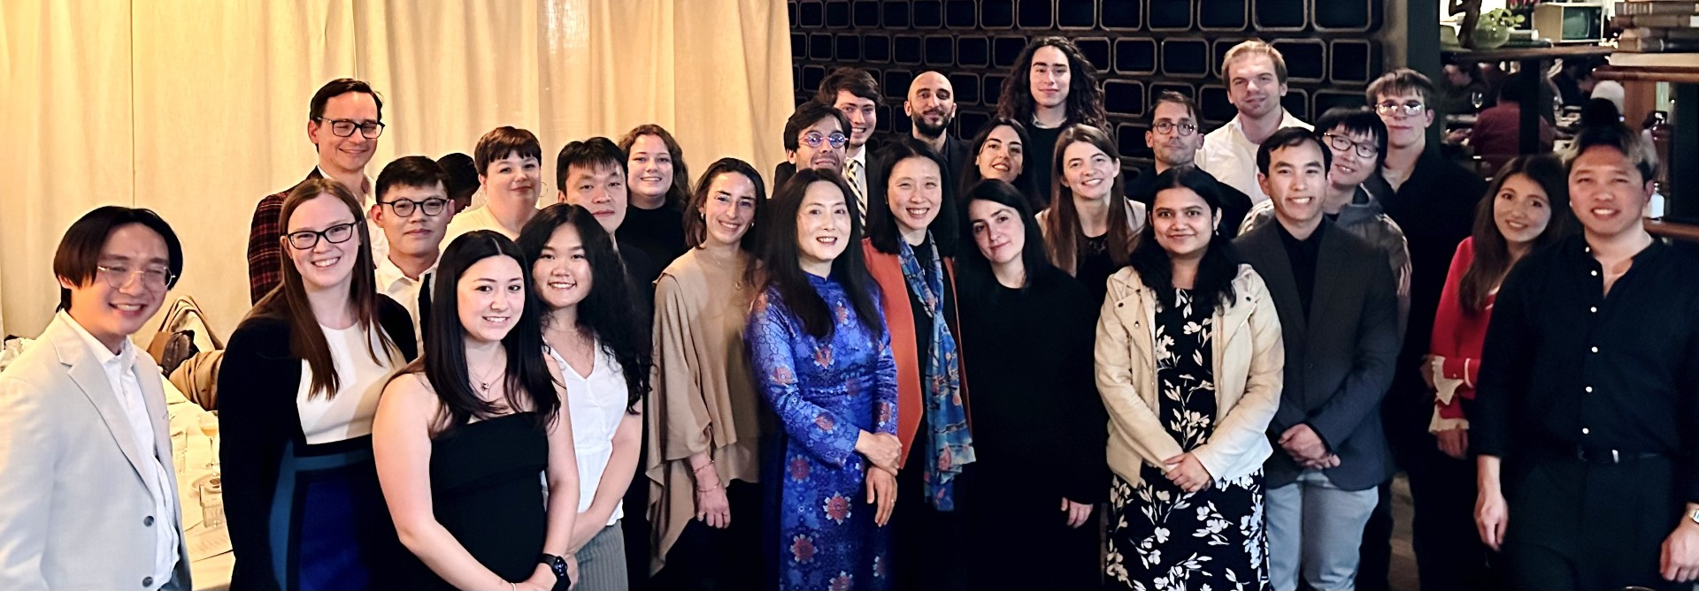


Acknowledgement

Slide 17
Back-up slides

Slide 18
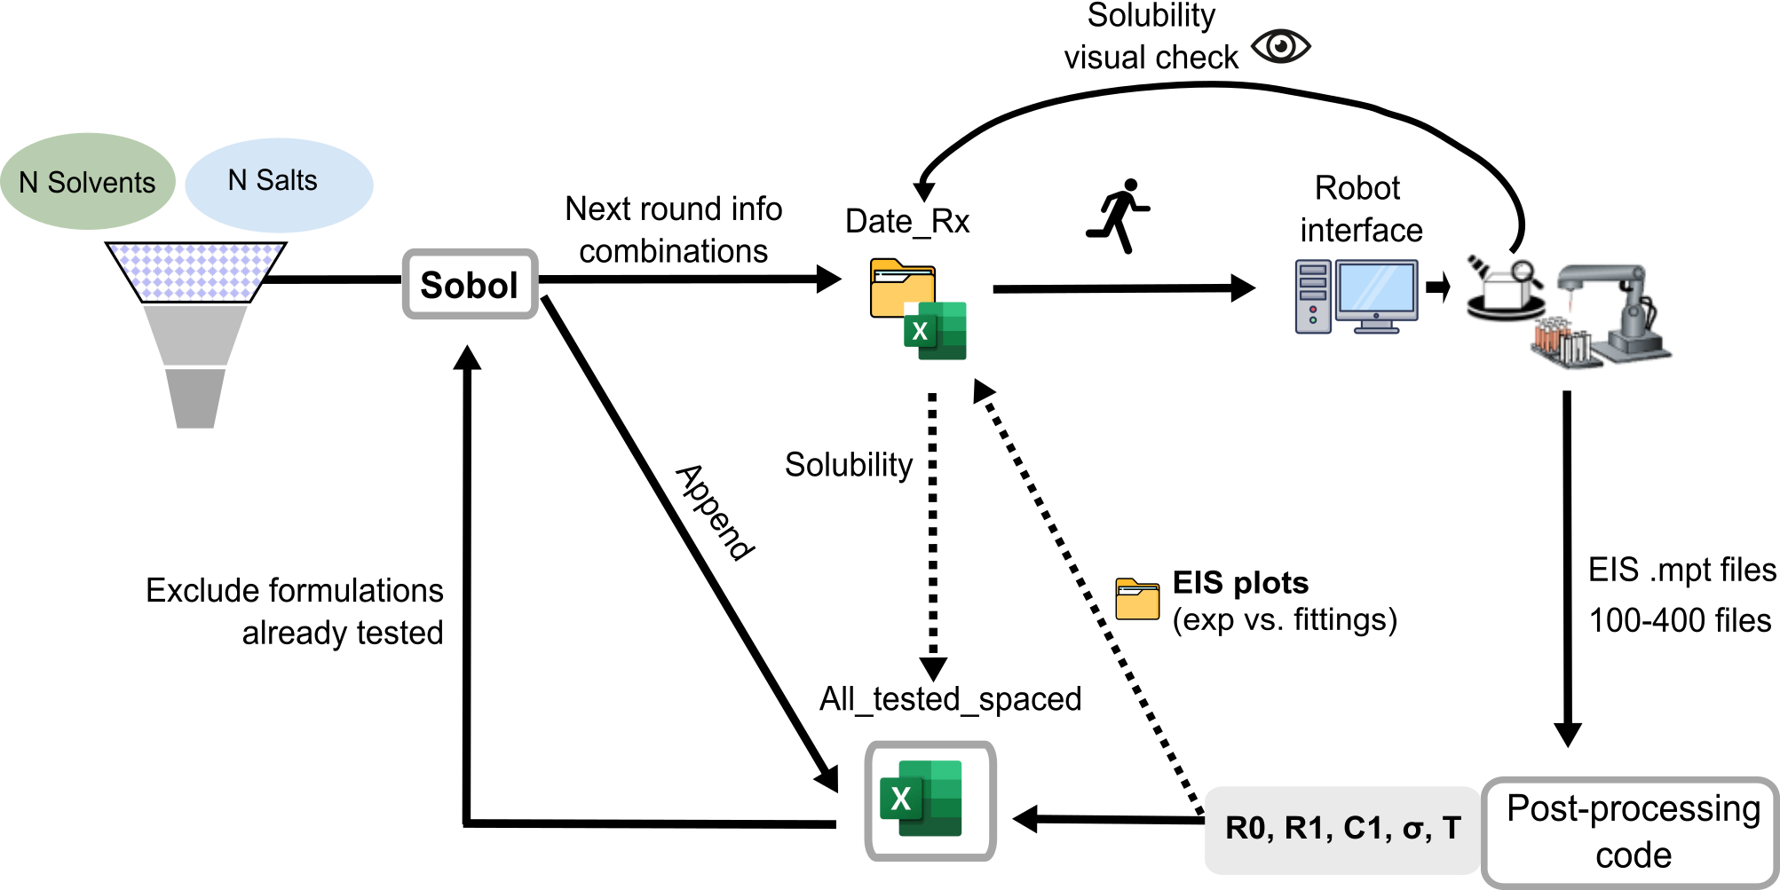
Developing an efficient and automated workflow
P.D. Blasio et al., Scientific Data, 11, 750, 2024.
K. Ritesh et al., Chem. Mater., 37, 2720, 2025.

Slide 19
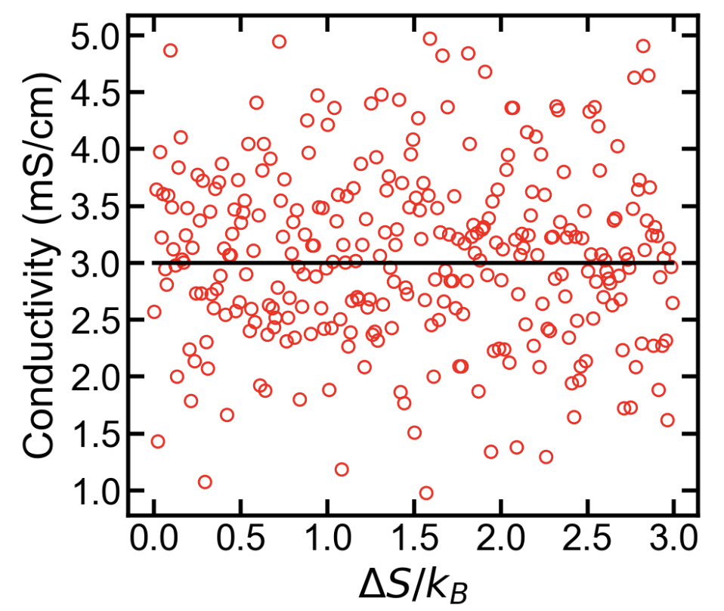
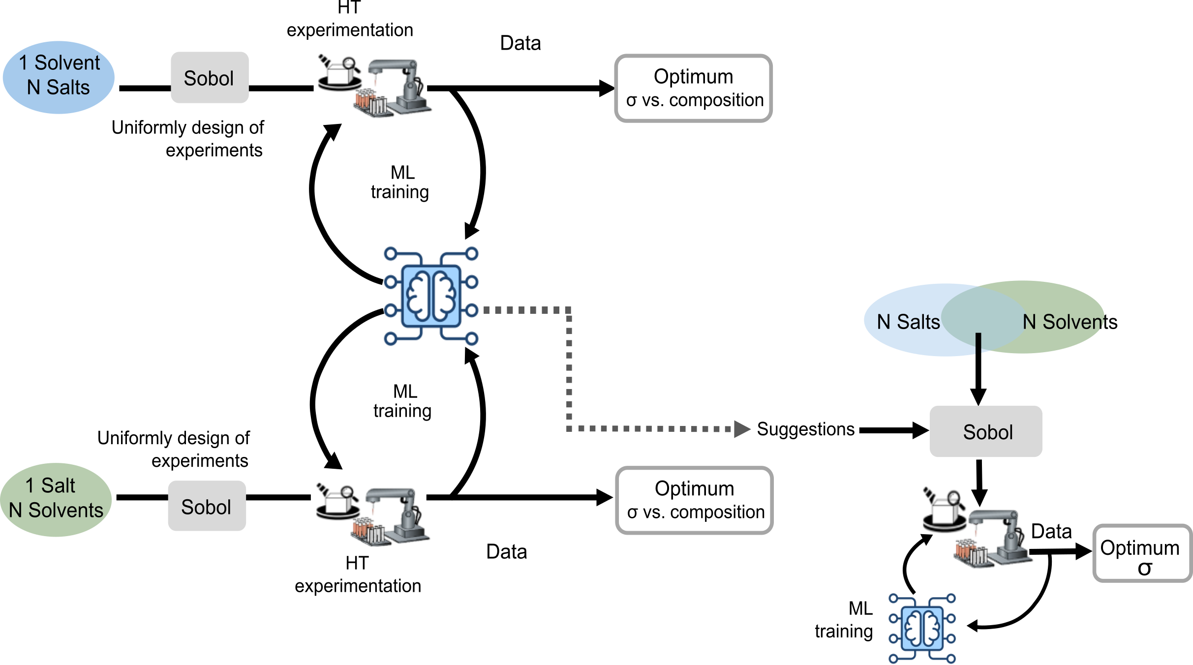
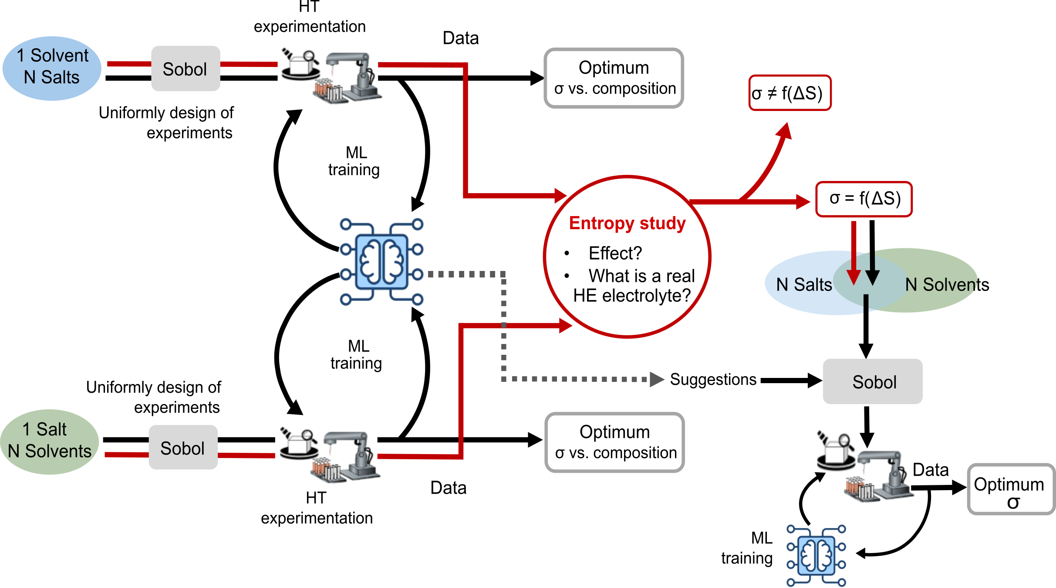
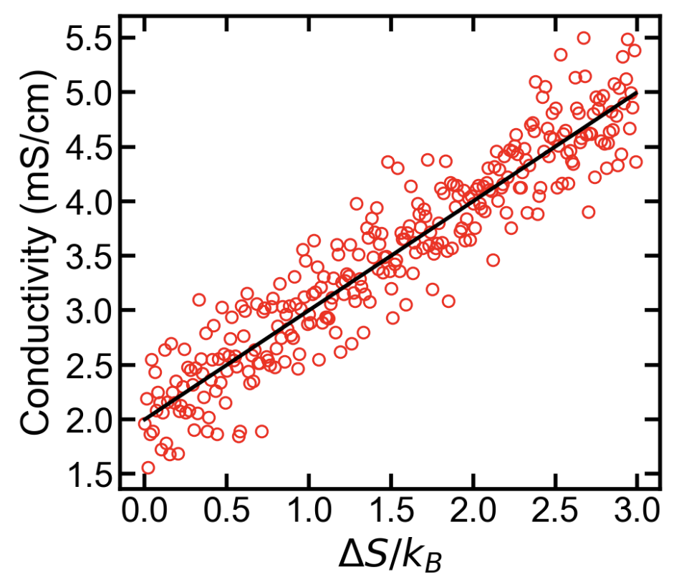

High-throughput methodology – “high entropy” electrolytes – Breakthrough Energy Explorer Fellow
Goal 1: Identify promising high conductivity electrolytes using high-throughput experimentation and machine learning.
Goal 2: Measure various entropies of electrolytes and correlate to ionic conductivity and composition.
N = 1, 2, 3, … n

Slide 20
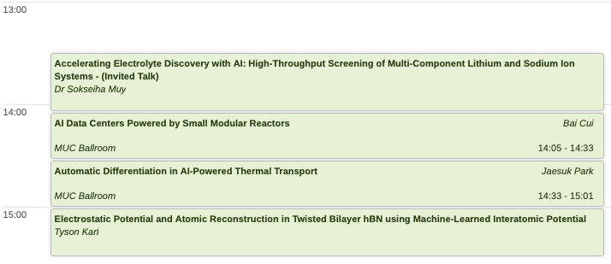
Parallel Session A: AI-Driven Materials Discovery, Energy Systems, and Computational Modeling

Slide 21
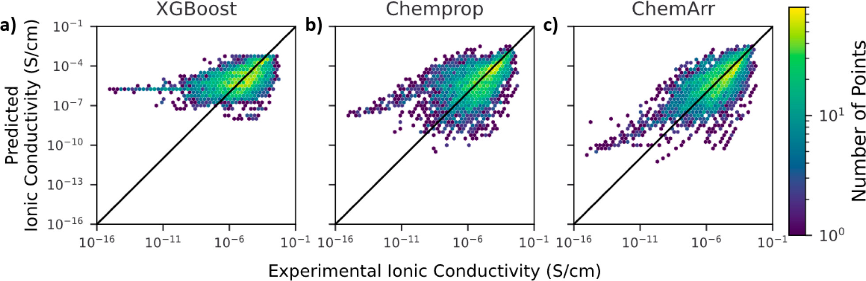

Slide 22
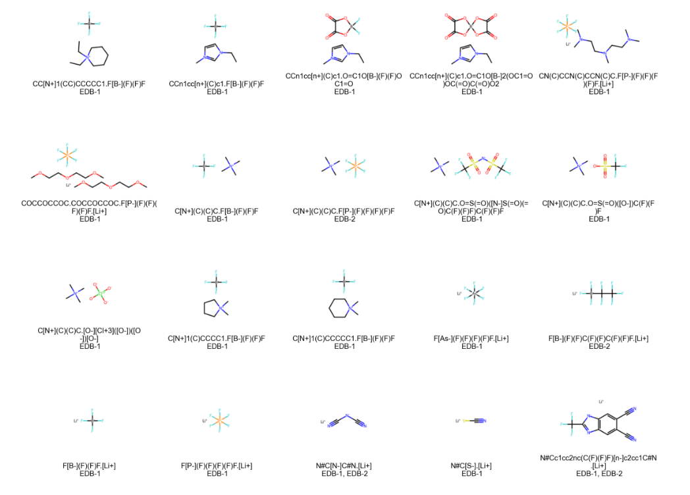
Examples of salts used in Chicago database

Slide 23
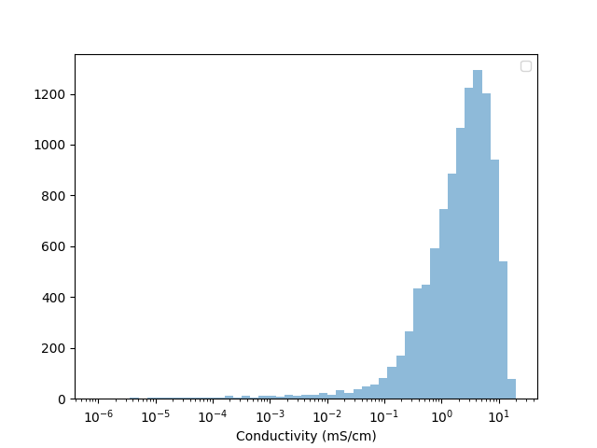
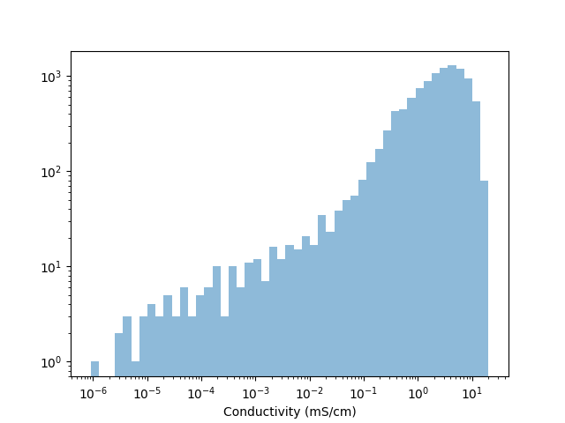
Ionic conductivity

Slide 24
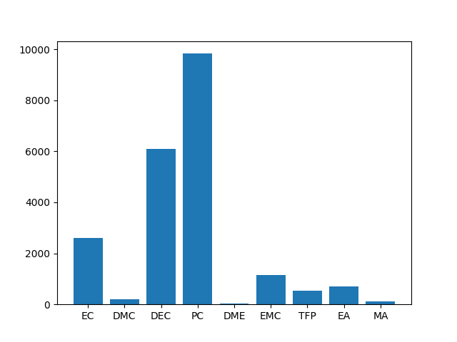
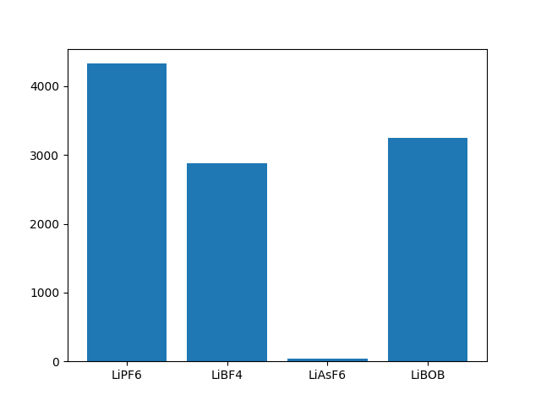
Solvents and Salts

Slide 25
ML model
Based on message-passing graph convolutional neural network as implemented in the Chemprop package.
Similar to the one used in Chibueze’s paper
Heid et al., J. Chem. Inf. Model, 9, 64, 2024.

Slide 26
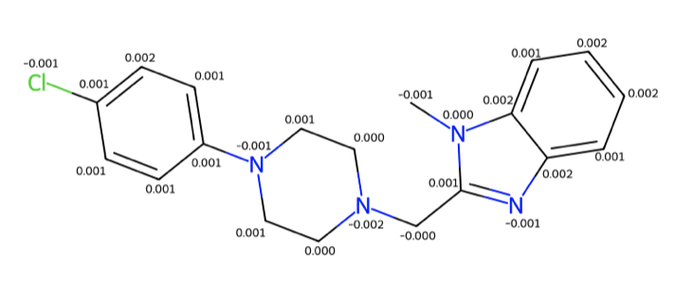
Next steps
Improve the accuracy of models:
  Including more data
  Finetuning the hyperparameters
  Testing new model architectures (taken into account the 3D coordinates of the molecules)
Transfer learning to Na-database
Importance analysis

Slide 27
~30 slides with 5 slides of general intro.
ML/AI, protein structure?/drug discovery
Al/ML discovery of materials.
Progress/contra
Nature, google and Berkeley, as well as Nature from Tian Xie?
Bo’s work changing PEO, Gab’s polymer paper, Chibueze
Robot’s role

