Slide 1
Surface-Functionalized Ti₃C₂Tₓ MXene for Enhanced Gas Sensing: Tailoring Selectivity and Sensitivity via Material Engineering
Xiaojun Xian, Jiahui Yuan, Wei Ding
South Dakota State University
2025/06/23

Slide 2
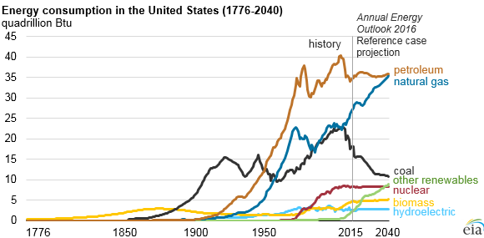
Gas sensors
Background
Environmental Impact Assessment.
Overreliance on petroleum, natural gas, and coal
Greenhouse gas: CO₂, methane
Toxic gases: SO₂, NO₂, etc.
High sensitivity and selectivity gas sensor to monitor gas pollution

Slide 3
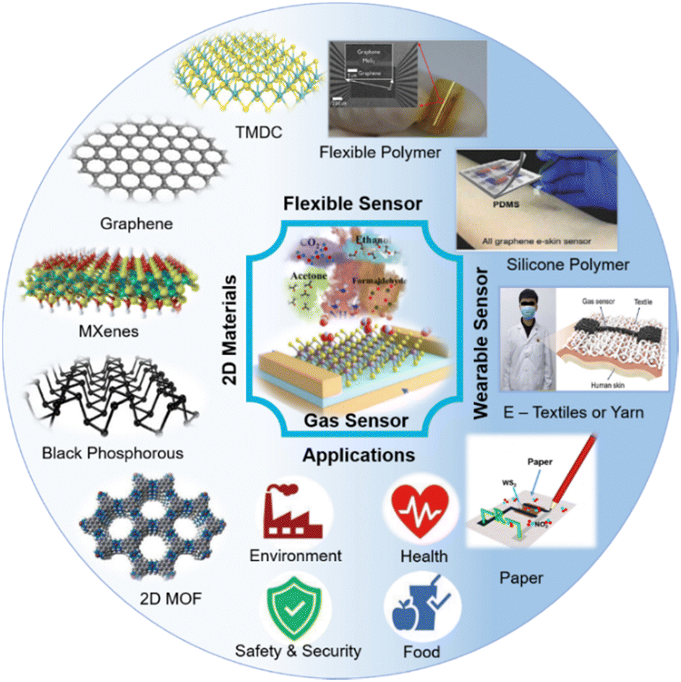
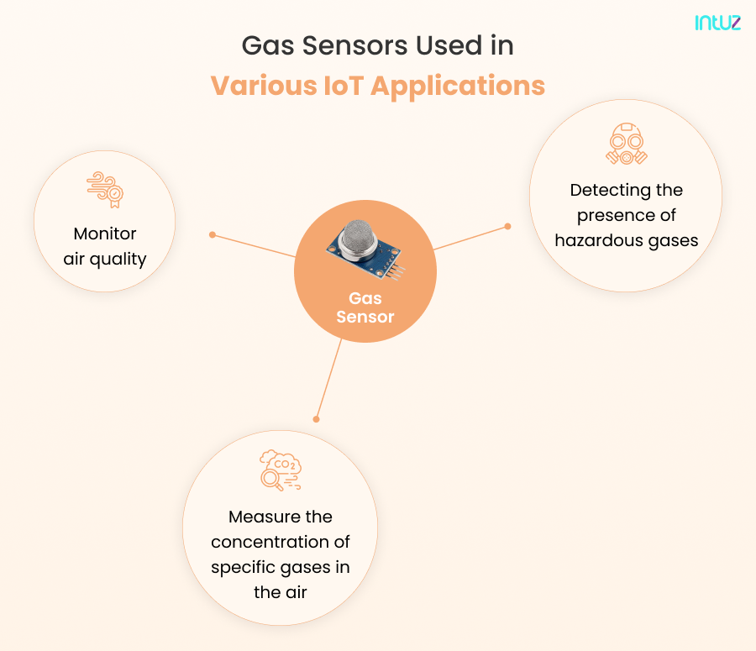
Introduction
Their tunable electrical conductivity
Exceptional mechanical properties
Abundant surface functional groups
Adjustable interlayer spacing

Slide 4
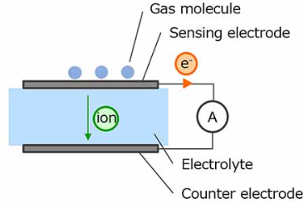
What are gas sensors?
Introduction to gas sensors
Definition: detect specific gases and measure the presence and concentration of gases in the air surrounding the sensor
Electrochemical gas sensor
Field-effect transistors gas sensor
Heterojunction gas sensor
The sensing material: the core of the sensor, determines the performance of the device

Slide 5
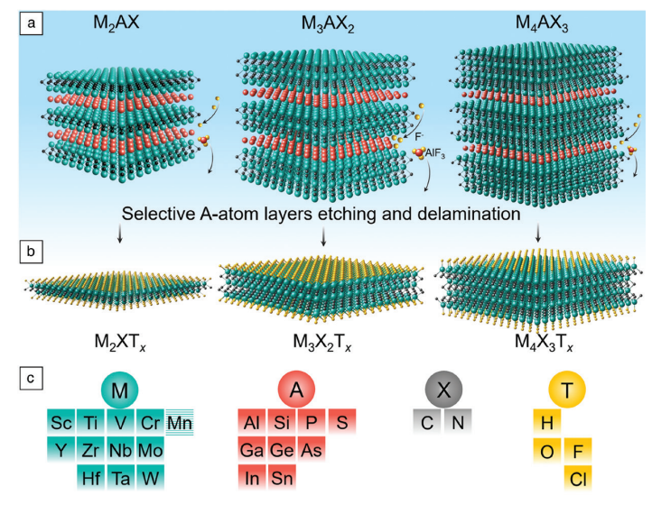
What are Mxenes?
Introduction to MXenes
“MXenes” are a new family of two-dimensional materials (few atoms thick) that are produced by selective removal of ‘”A” layer atoms from the parents “MAX phases” .
MAX phases have the following general formula (M_{n}AX_{n+1} (n=1,2,3)):
M₂AX， M₃AX₂， M₄AX₃
Hexagonal structure
M-A bonds are weaker and more reactive than M-X bonds
M-X: ionic/covalent bond
M-A: metallic bond

Slide 6
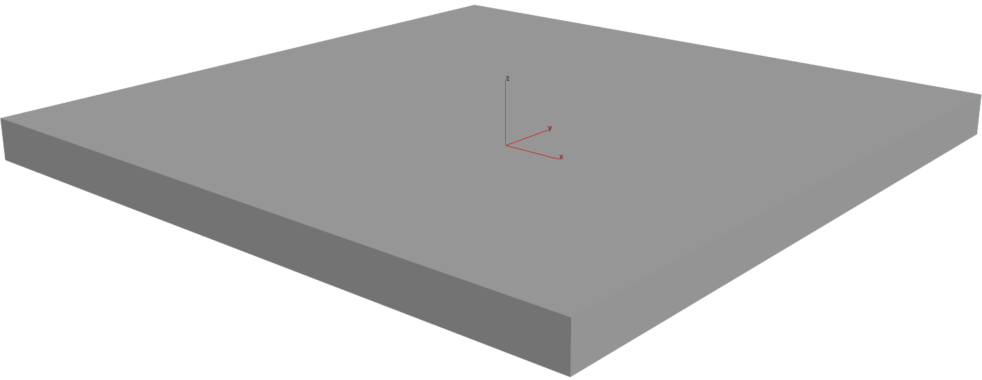
MXene synthesis methods
Top-down
Etching agents
Intercalation of cation and molecules
Acid (HF, H₃PO₄)
Alkali (NaOH)
Floride salt + HCl (LiF, KF, NH₄F)
Molten salt (LiF+ KF, CdBr₂)
NH₄HF₂
Etching of the A-layer
Delamination of 2D MXene
Bottom-up
Crucial parameters
Direct synthesis
The types of precursors (TiCl₄, VCl₃, TaCl₅，etc)
Substrate ( metal foil, such Ti, Mo, Ta, etc)
Growth temperature
Gas flow (Morphology)
CH₄, TiCl₄
Ti₂CCl₂
CVD
950°C

Slide 7
MQTF as transduction platform
Micro Quartz Tuning Forks (MQTFs) made from high-quality quartz crystal and are used to produce stable, resonant frequencies for precise timekeeping, vibration sensing, and frequency generation.
Tuning forks
Advantages of MQTFs:
High Quality Factor
Frequency stability
Low power consumption
Miniaturized form factor
MQTFs operate based on the piezoelectric properties of quartz. When a voltage is applied, quartz crystals will oscillate at a specific frequency, depending on the crystal's dimensions and the applied electric field.

Slide 8
Experimental section
The synthesis of MXene: use LiF/HCl to etch MAX phase for 24 h; washed via centrifugation with deionized water and ethanol until the pH value reached ~ 6.
Surface functionalization of Ti₃C₂T_{x} MXene: adopt two different kinds of chemicals to modify MXene; AEAPTMS is added more –NH₂ functional group (Ti₃C₂T_{x} -NH₂); FOTS is added to MXene to get Ti₃C₂T_{x} -F (more F functional group).
AEAPTMS
FOTS
Ding, Wei, Jingjing Yu, Francis Tsow, Laxmi Raj Jaishi,…Parashu Kharel, Yue Zhou, and Xiaojun Xian. npj 2D Materials and Applications 8, (2024).

Slide 9
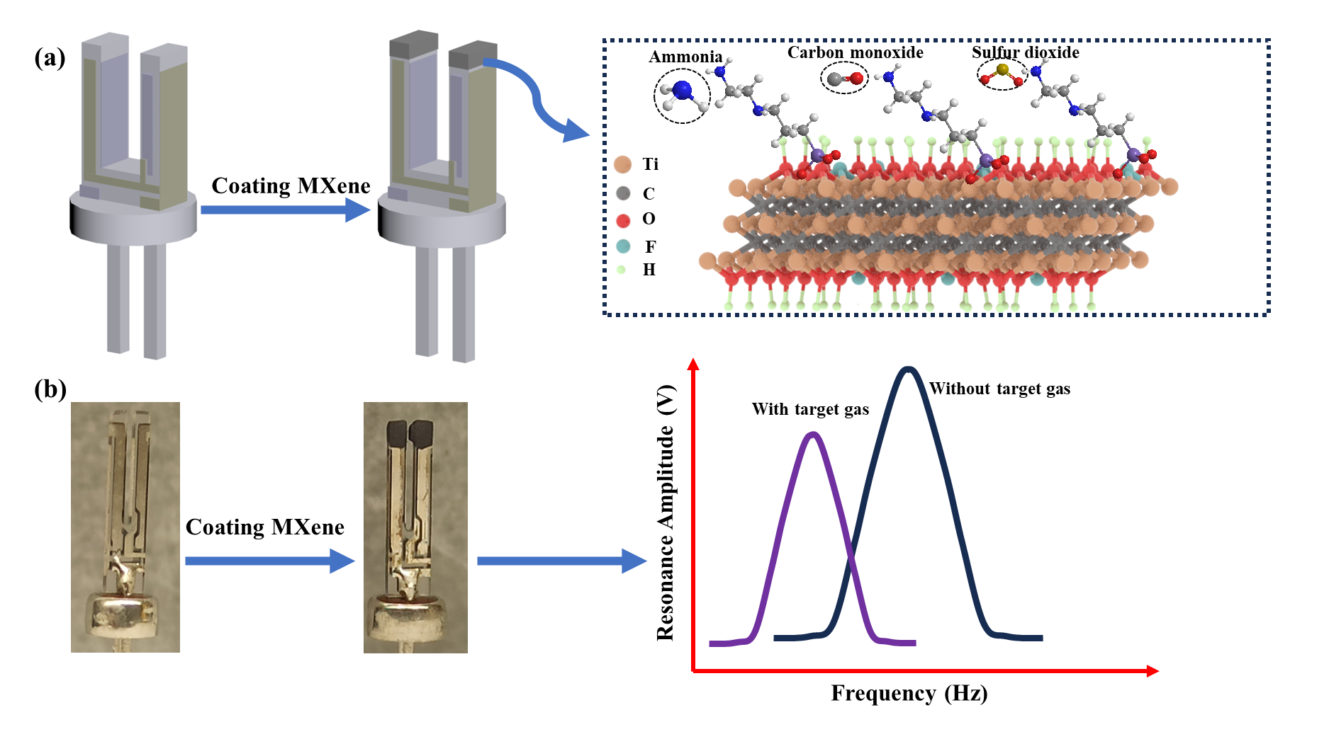
The Sensor Design and working principle
$$f_{0}=\frac{1}{2π}\sqrt{\frac{K}{m_{eff}}}$$
K:Quartz stiffness (fixed by crystal structure)
$m_{eff} :T$he effective mass
Ding, Wei, Jingjing Yu, Francis Tsow, Laxmi Raj Jaishi,…Parashu Kharel, Yue Zhou, and Xiaojun Xian. npj 2D Materials and Applications 8, (2024).

Slide 10
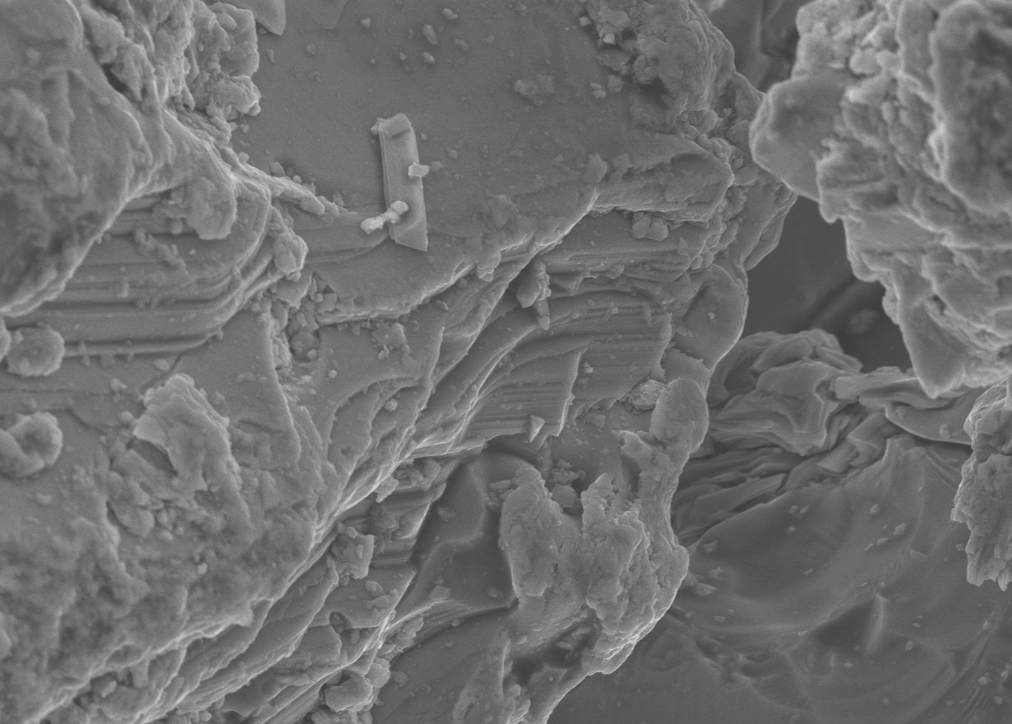
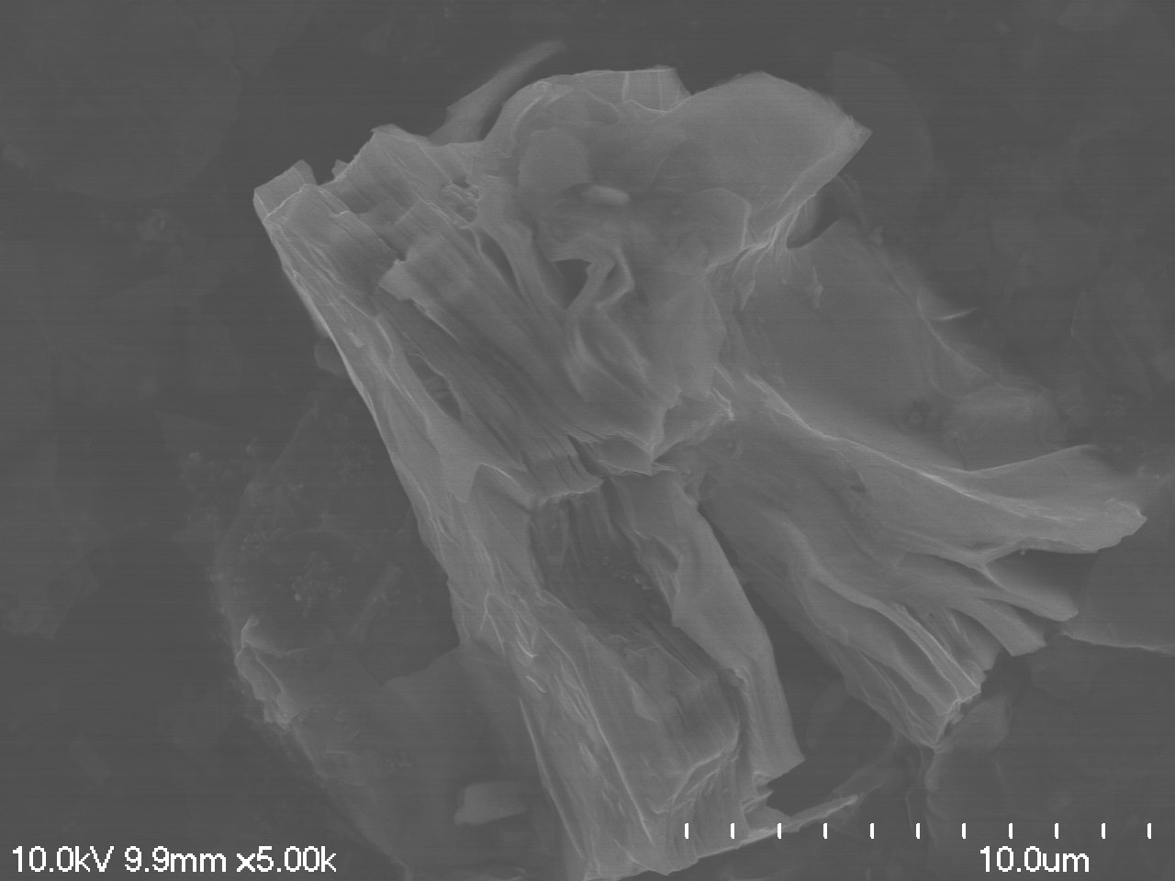
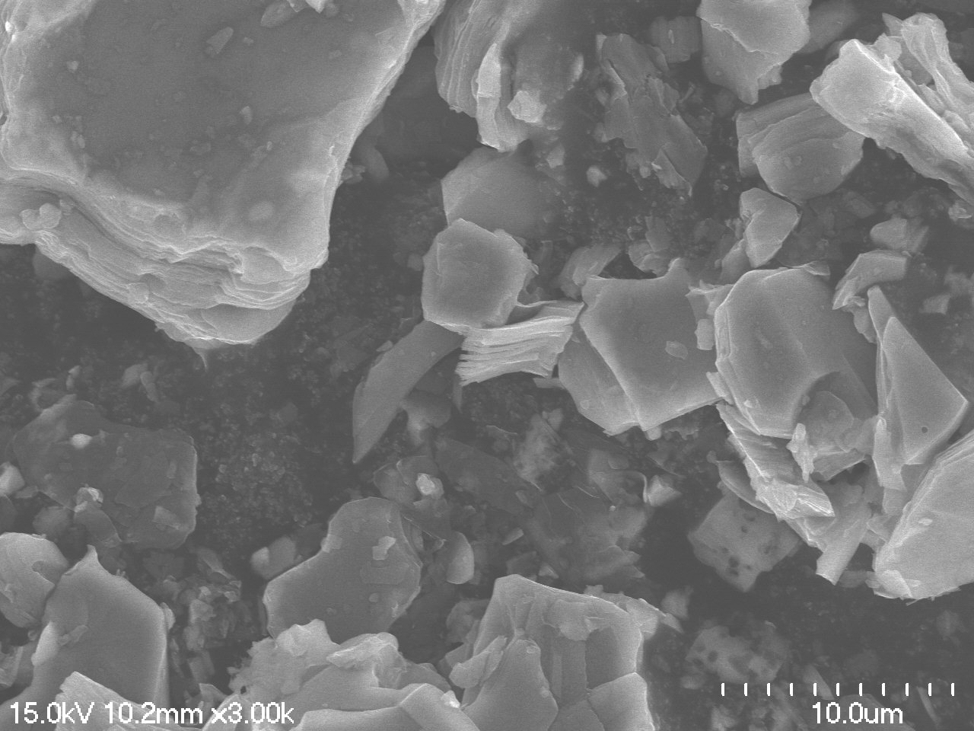
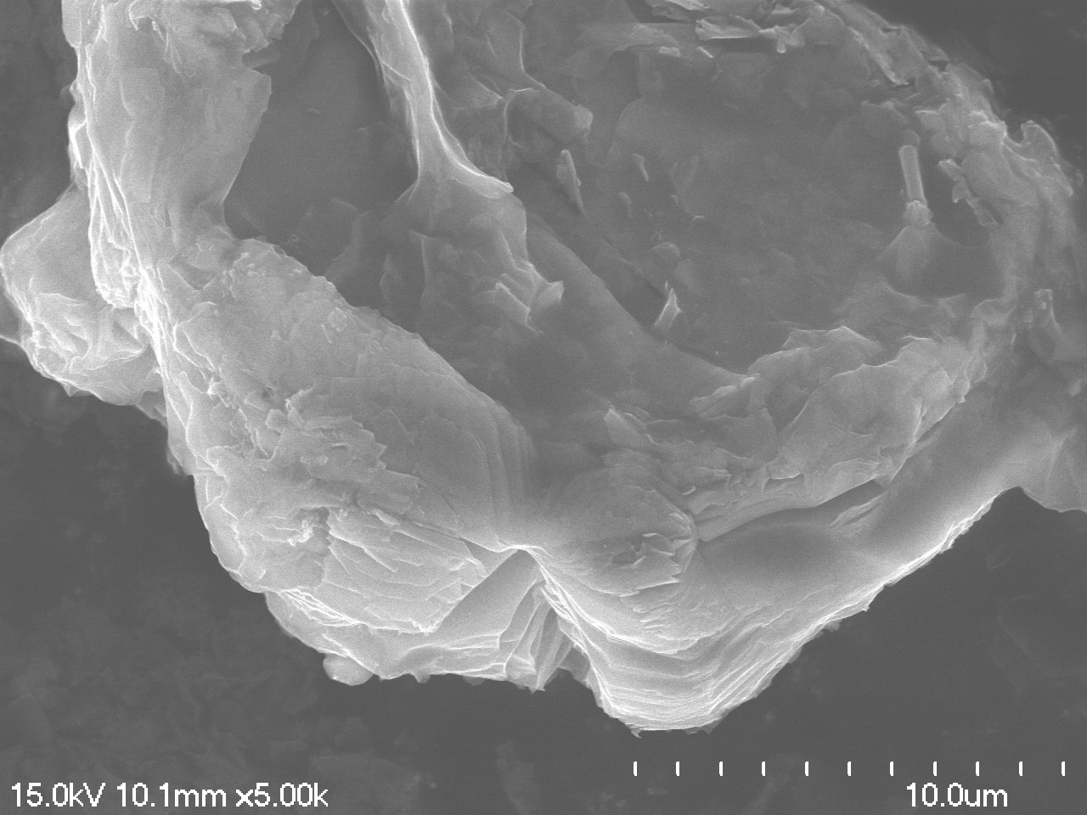
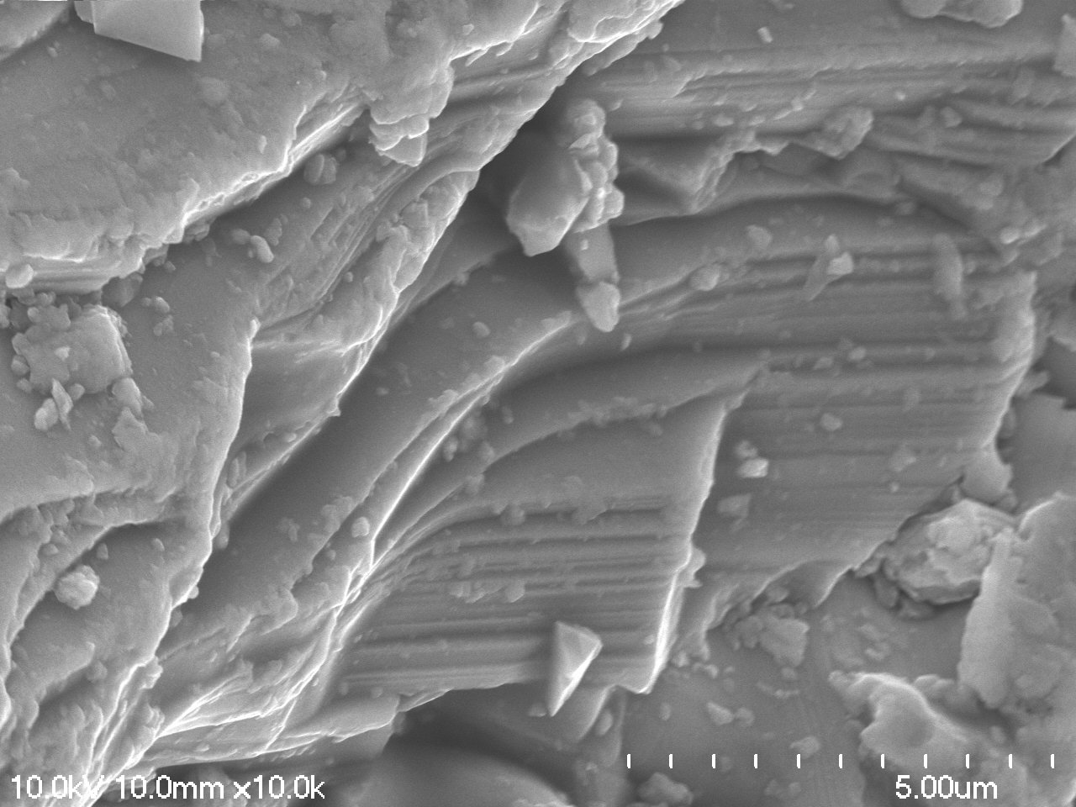
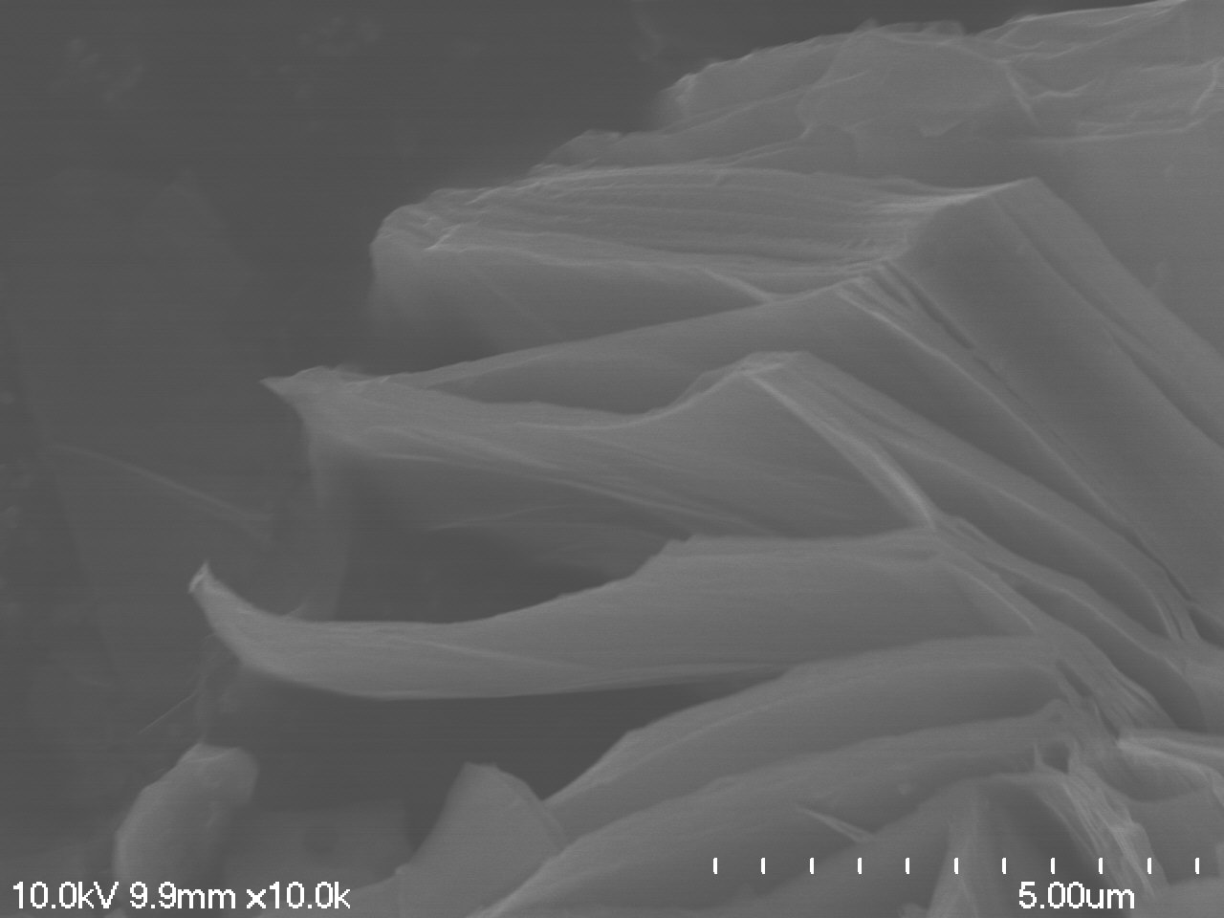
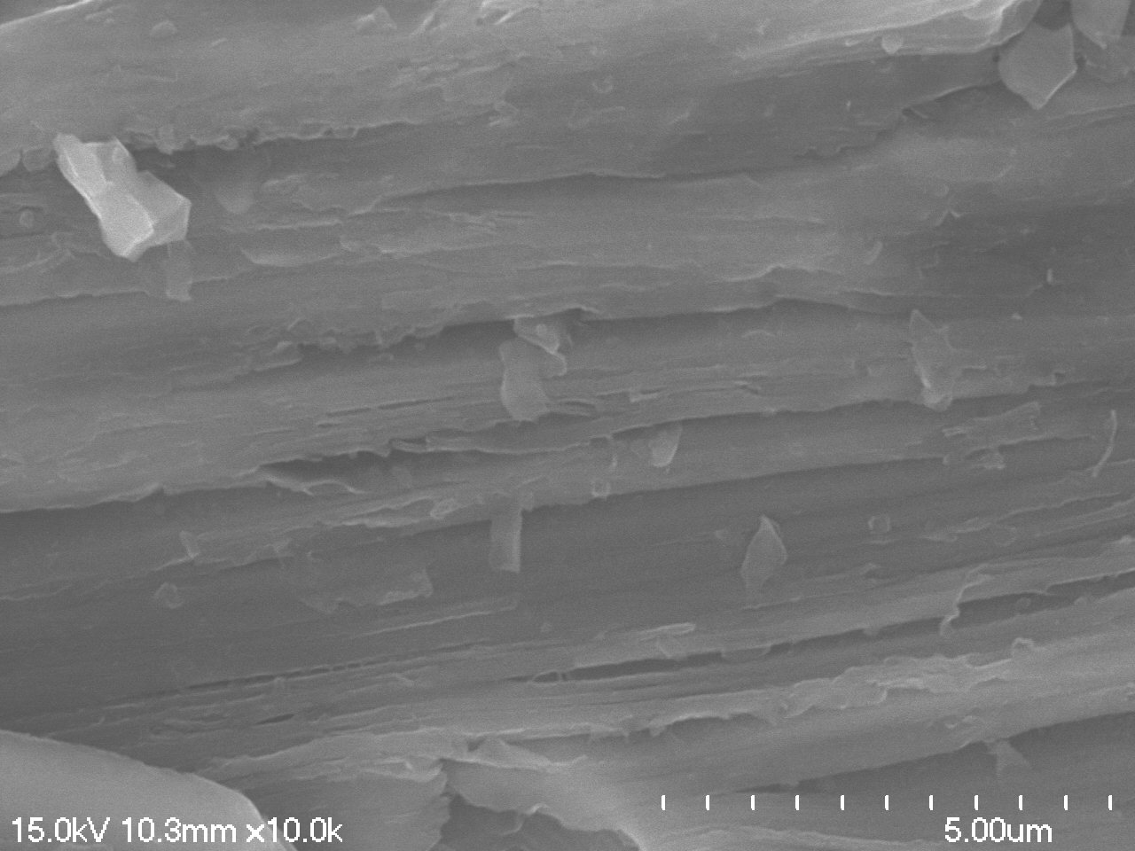
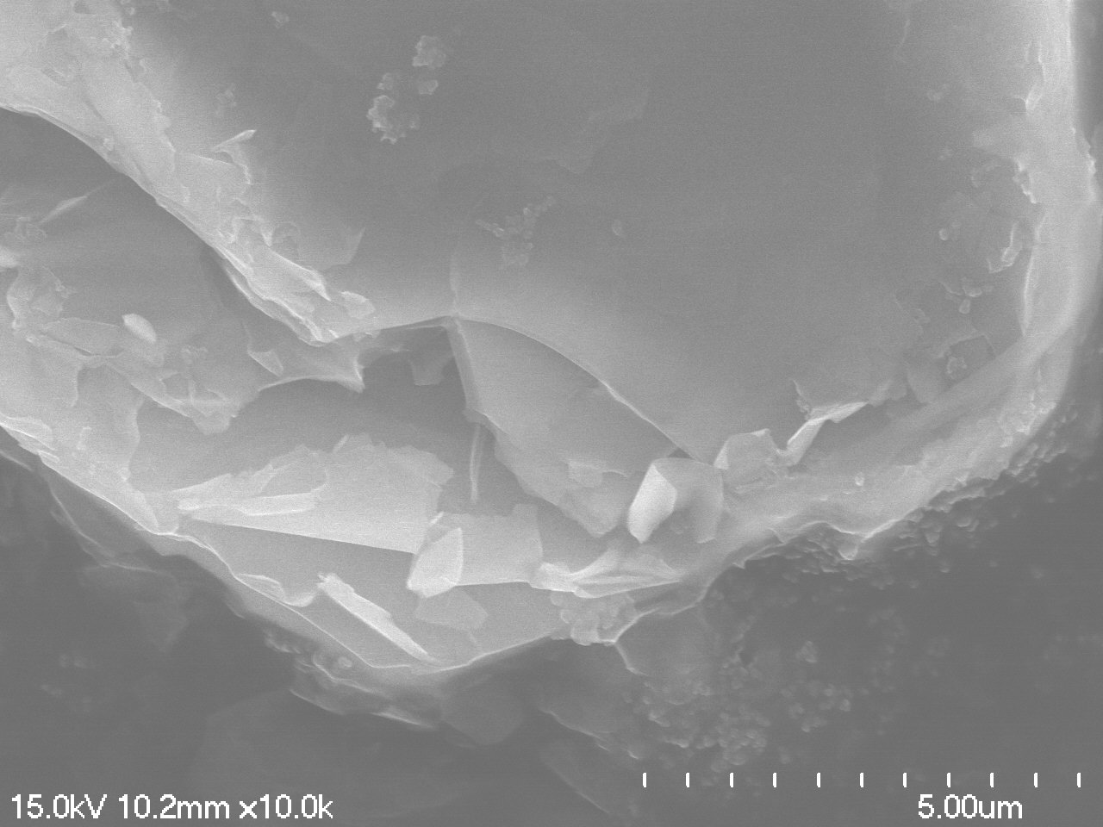
MXene surface modification, and characterization
Ti₃AlC₂
Ti₃C₂T_{x}
Ti₃C₂T_{x}-NH₂
Ti₃C₂T_{x}-F
4 µm
4 µm
4 µm
4 µm
Ti₃AlC₂
Ti₃C₂T_{x}
Ti₃C₂T_{x}-NH₂
Ti₃C₂T_{x}-F
1 µm
1 µm
1 µm
1 µm
Ding, Wei, Jingjing Yu, Francis Tsow, Laxmi Raj Jaishi,…Parashu Kharel, Yue Zhou, and Xiaojun Xian. npj 2D Materials and Applications 8, (2024).

Slide 11
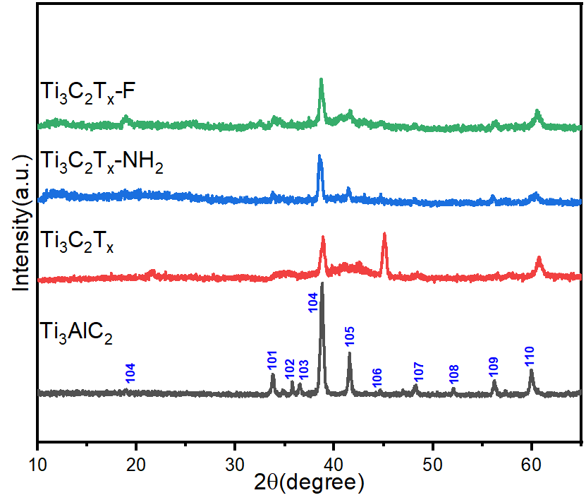
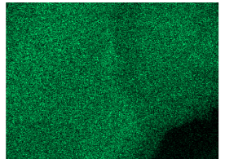
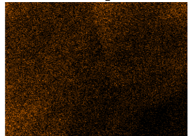
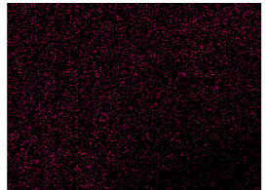
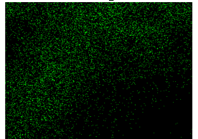
MXene surface modification, and characterization
(a)
(b)
1 µm
Ti
1 µm
C
1 µm
1 µm
N
Si
N
Ti₃C₂T_{x}-NH₂ nanosheets
XRD analysis: After HCl/LiF etching, the (104) peak weakened, and other peaks (101, 102, 103. 105) broadened or disappeared, confirming successful Al layer removal
Uniform distribution of Ti, C, Si, and N elements on the Ti₃C₂T_{x}-NH₂ nanosheets
Ding, Wei, Jingjing Yu, Francis Tsow, Laxmi Raj Jaishi,…Parashu Kharel, Yue Zhou, and Xiaojun Xian. npj 2D Materials and Applications 8, (2024).

Slide 12
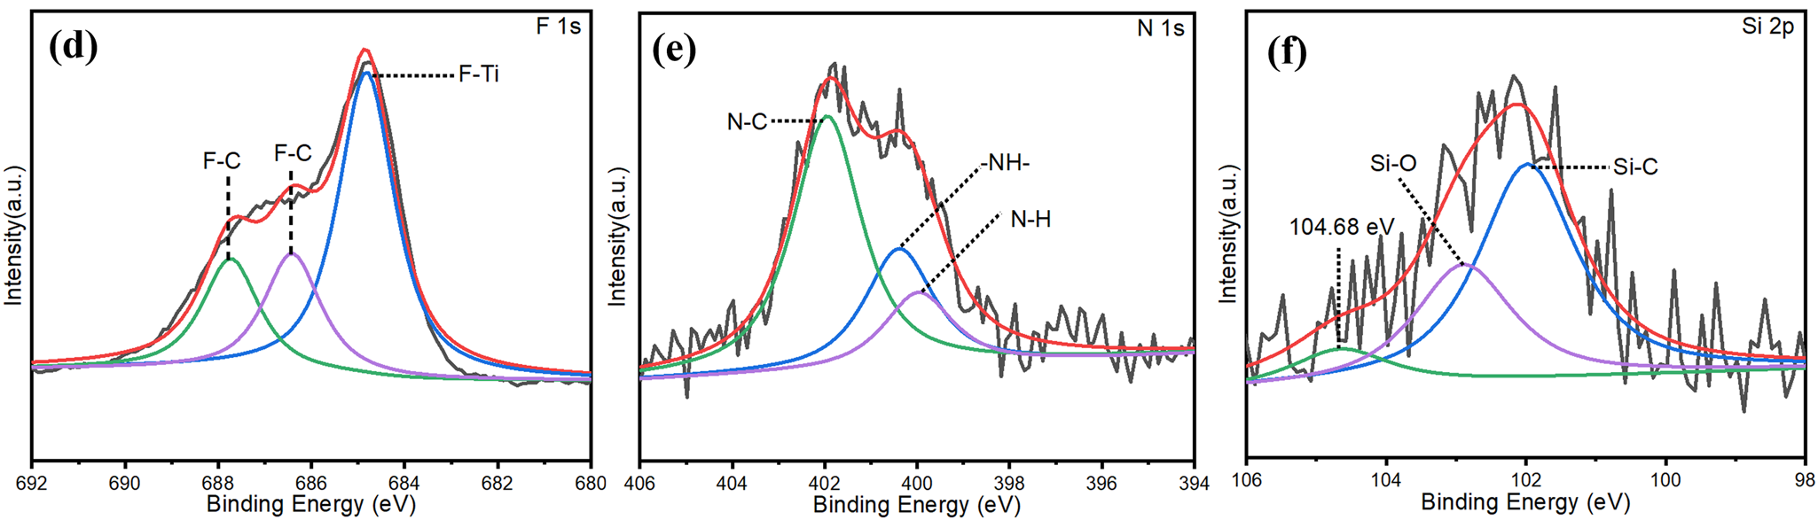
Characterization of Ti₃C₂T_{x}-NH₂ nanosheets
Ding, Wei, Jingjing Yu, Francis Tsow, Laxmi Raj Jaishi,…Parashu Kharel, Yue Zhou, and Xiaojun Xian. npj 2D Materials and Applications 8, (2024).

Slide 13
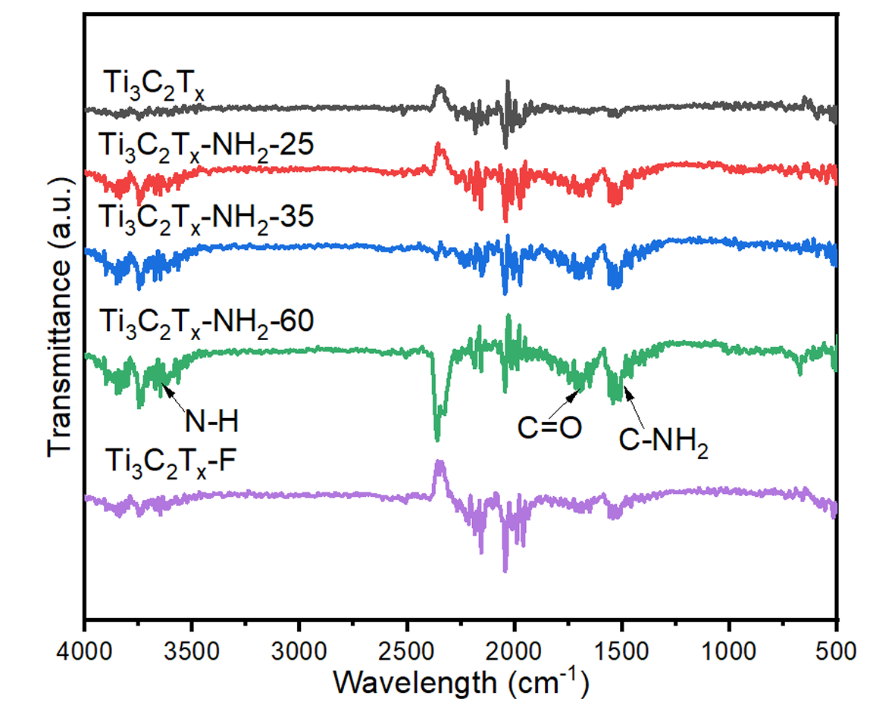
Characterization of Ti₃C₂T_{x}-NH₂ nanosheets
Comparison of FTIR analysis results for Ti₂C₃T_{x}, Ti₂C₃T_{x}-NH₂-25 powder, Ti₂C₃T_{x}-NH₂-35 powder, Ti₂C₃T_{x}-NH₂-60 and Ti₂C₃T_{x}-F powder.
Ding, Wei, Jingjing Yu, Francis Tsow, Laxmi Raj Jaishi,…Parashu Kharel, Yue Zhou, and Xiaojun Xian. npj 2D Materials and Applications 8, (2024).

Slide 14
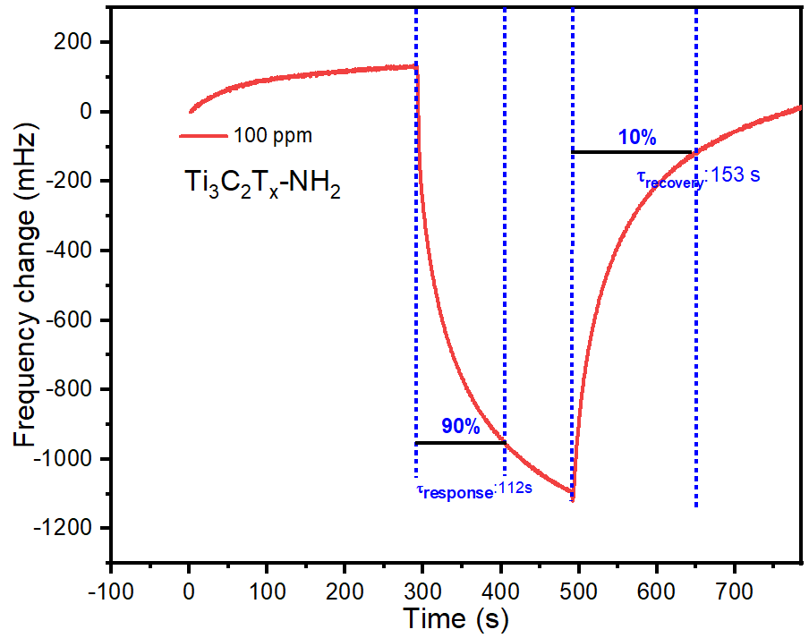
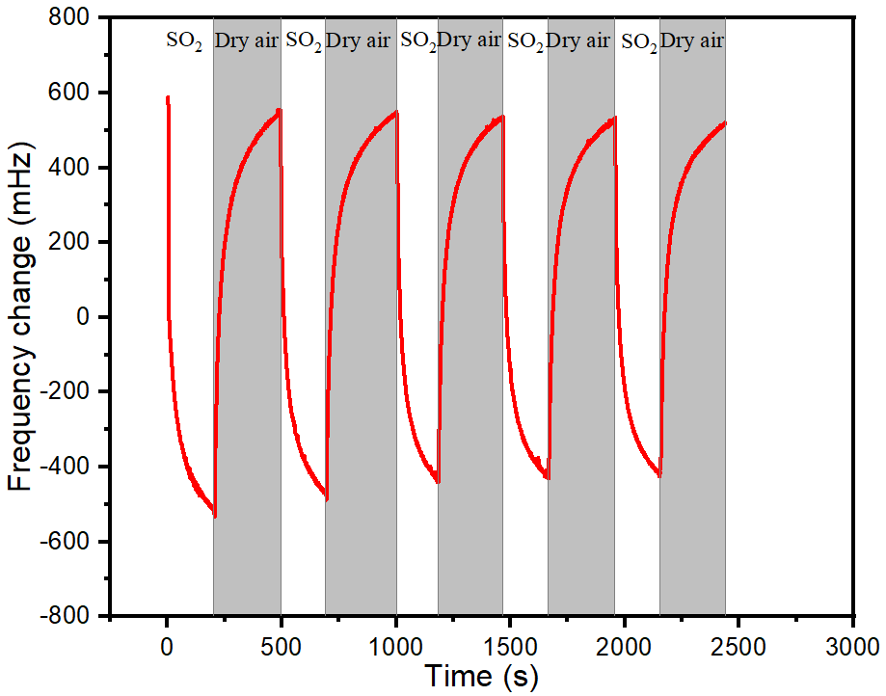
Characteristics of the MXene-MQTF sensors
(a)
(b)
Exhibited rapid response upon SO₂ exposure, reaching a plateau due to adsorption kinetics, and fully reversible recovery in air
Baseline stability in air and reliable reversibility
Ding, Wei, Jingjing Yu, Francis Tsow, Laxmi Raj Jaishi,…Parashu Kharel, Yue Zhou, and Xiaojun Xian. npj 2D Materials and Applications 8, (2024).

Slide 15
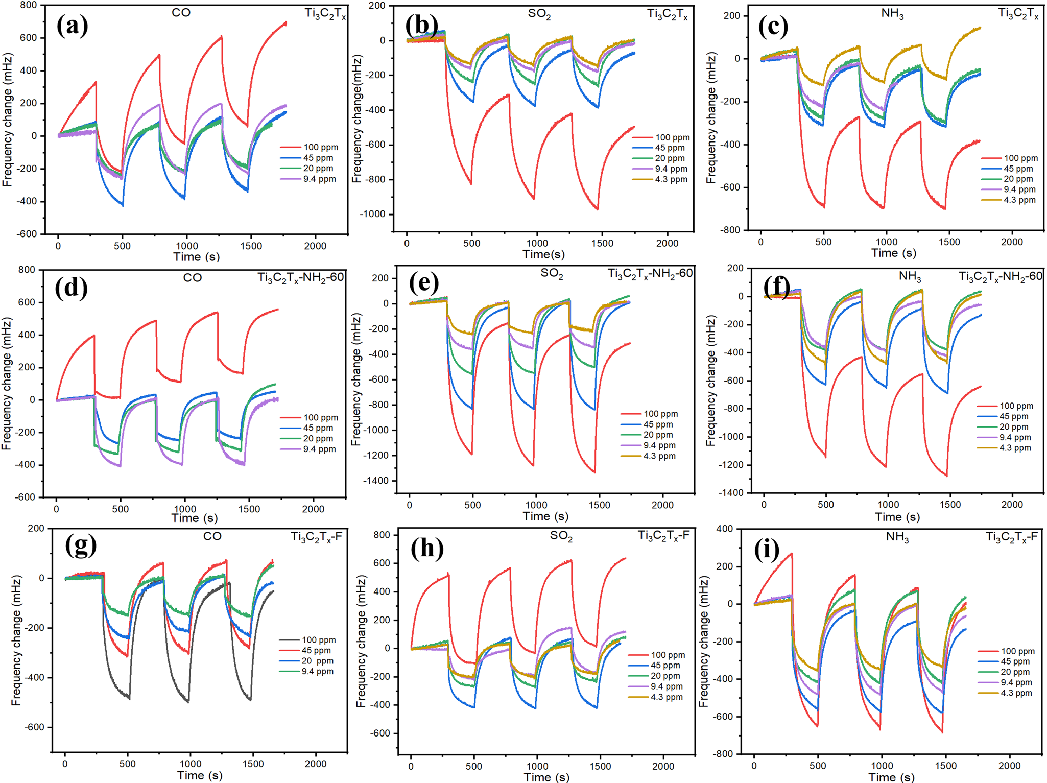
Modulating sensor selectivity through surface-modification of MXenes
Frequency change on a–c Ti₃C₂T_{x}; d–f Ti₃C₂T_{x}-NH₂; g, h and i Ti₃C₂T_{x} -F toward a wide range of diluted CO, SO₂, and NH₃ gases (4-100 ppm).
Ding, Wei, Jingjing Yu, Francis Tsow, Laxmi Raj Jaishi,…Parashu Kharel, Yue Zhou, and Xiaojun Xian. npj 2D Materials and Applications 8, (2024).

Slide 16
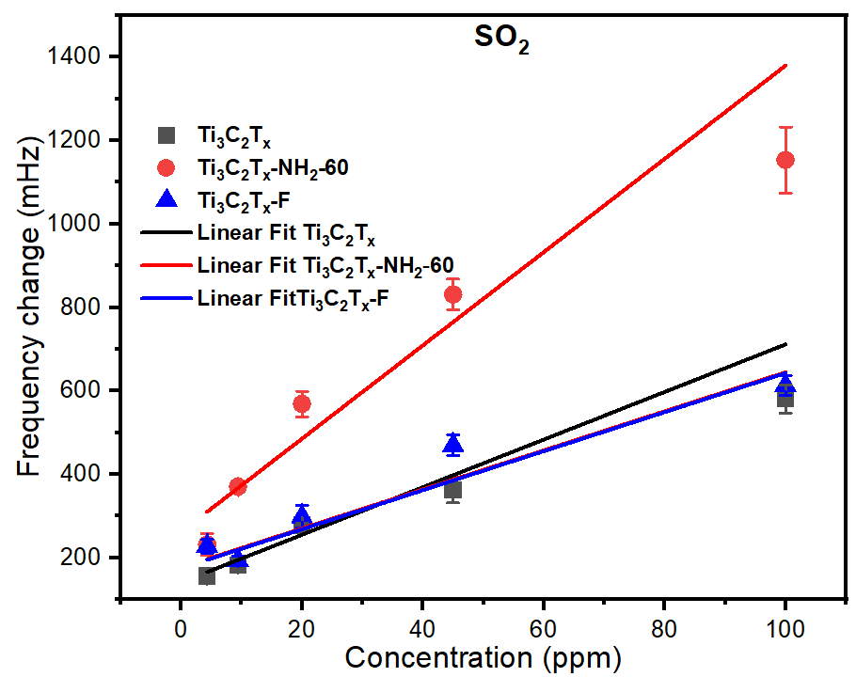
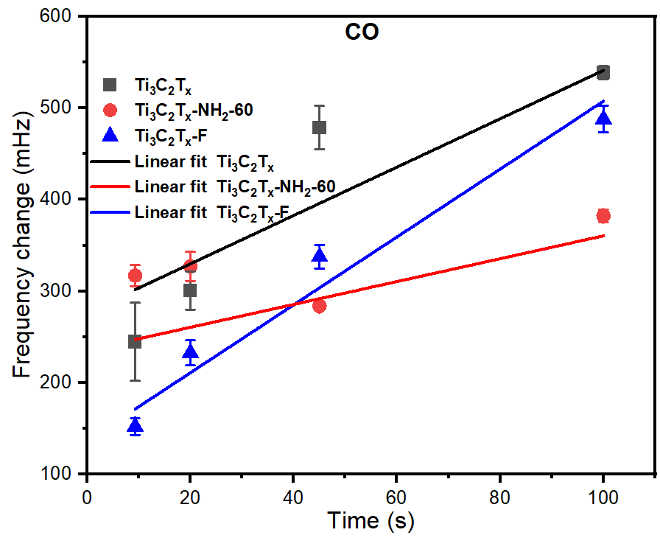
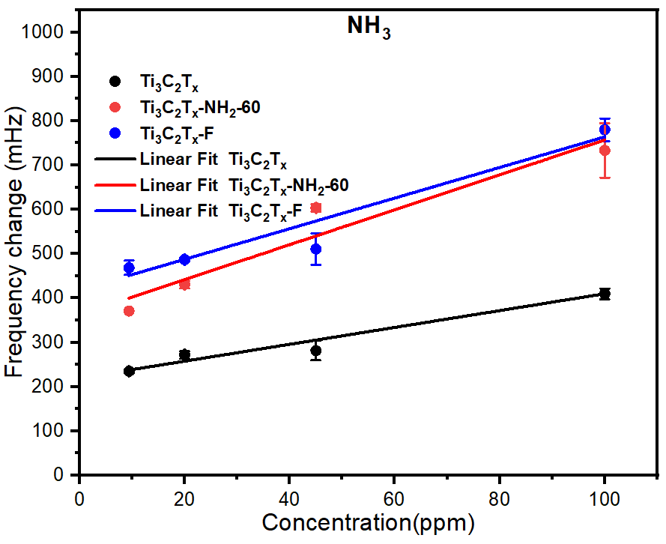
Modulating sensor selectivity through surface-modification of MXenes
The slopes of Ti₃C₂T_{x}, Ti₃C₂T_{x}-NH₂-60, and Ti₃C₂T_{x}-F MXene Sensors toward SO₂ gas are 5.71, 11.18, and 4.68.
Ti₃C₂T_{x}-F MXene Sensor had the strongest response to CO gas (3.71)
Ding, Wei, Jingjing Yu, Francis Tsow, Laxmi Raj Jaishi,…Parashu Kharel, Yue Zhou, and Xiaojun Xian. npj 2D Materials and Applications 8, (2024).

Slide 17
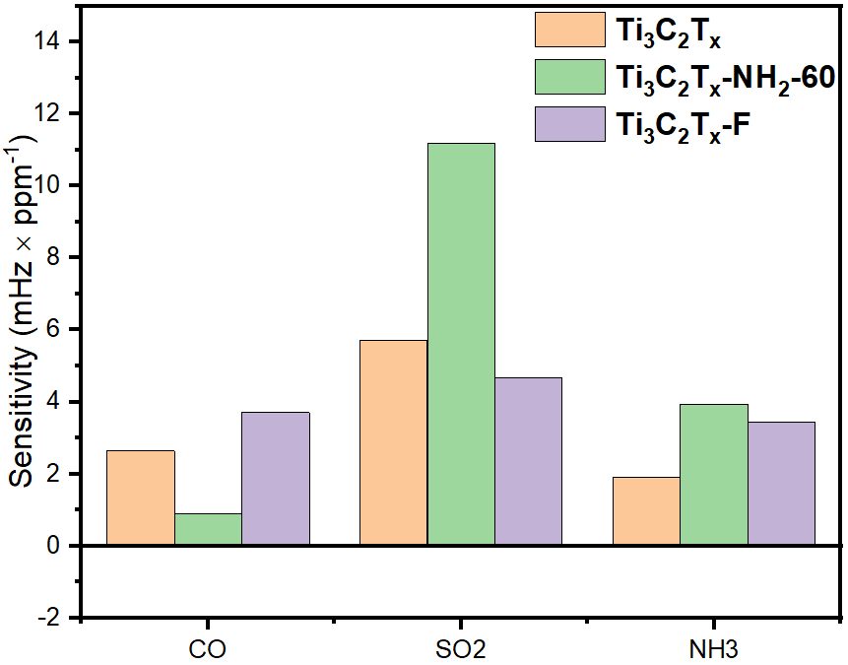
Response principle of Gas sensors on MXene
(a)
Ti₃C₂Tₓ-NH₂ Sensor
Ti₃C₂T_{x}-NH₂ sensor: Alkaline-NH₂ groups enhance acid-base interaction with acidic SO₂ gas, yielding the highest sensitivity
Ti₃C₂T_{x}-F sensor: halogen (-F) groups reduce reactivity with both SO₂ and NH₃ due to weaker interactions
Ding, Wei, Jingjing Yu, Francis Tsow, Laxmi Raj Jaishi,…Parashu Kharel, Yue Zhou, and Xiaojun Xian. npj 2D Materials and Applications 8, (2024).

Slide 18
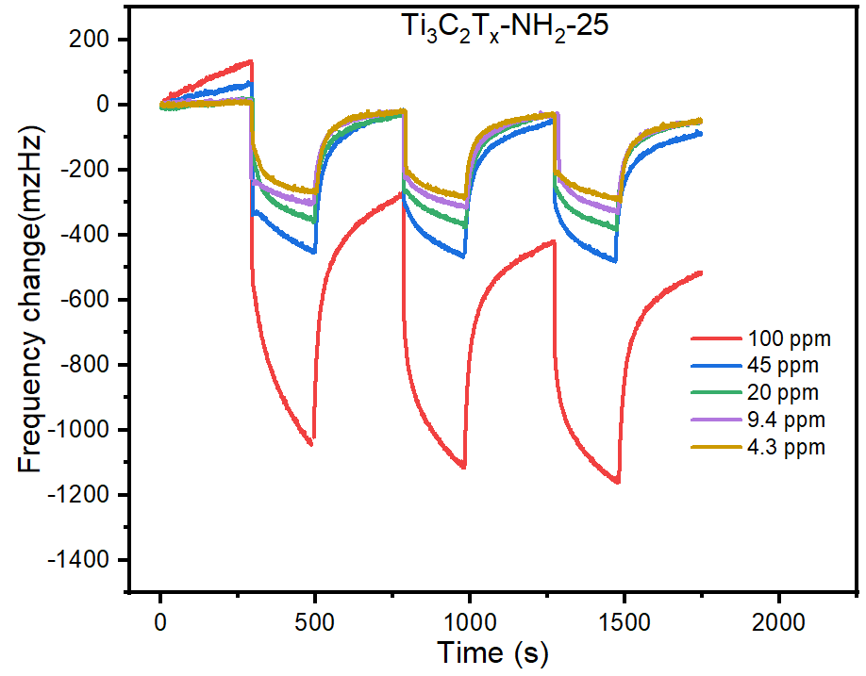
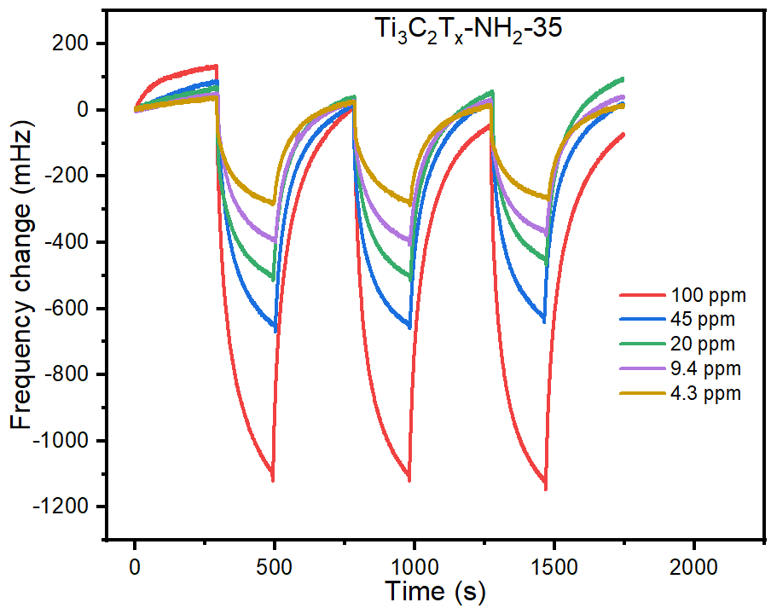
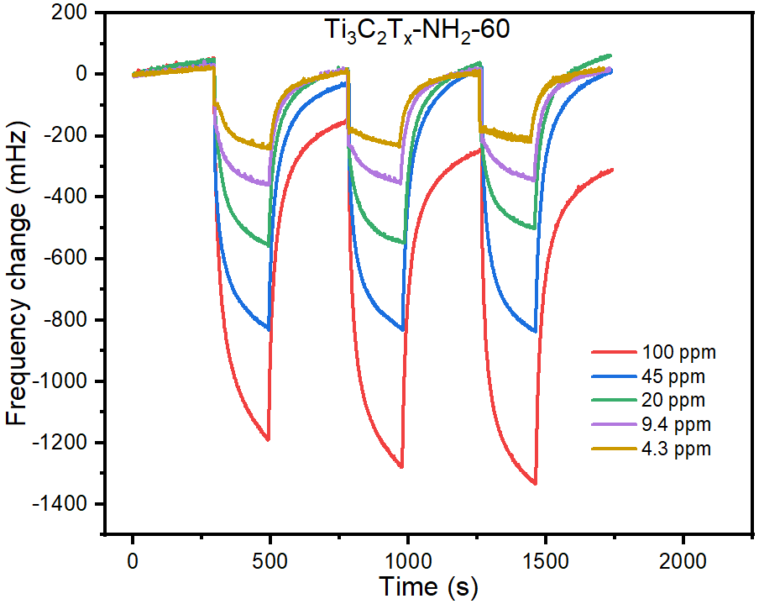
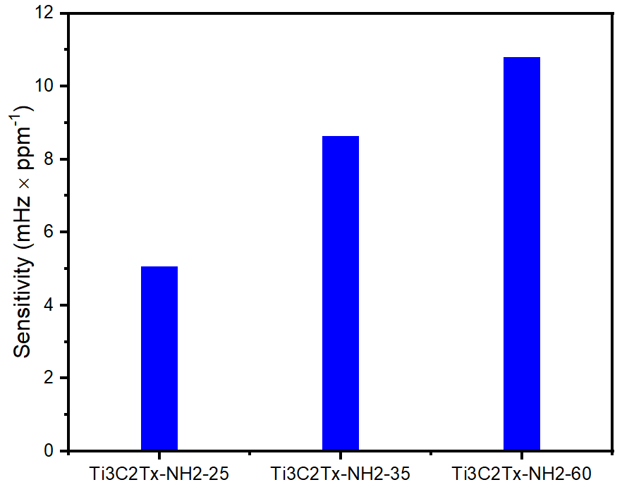
Reaction temperature increase sensitivity of gas sensors
(a)
(b)
The sensitivity of the Ti₃C₂T_{x}-NH₂ MXene increased from 6.18 to 11.18 as the temperature rose from 25 to 60 °C, likely attributed to enhanced surface-NH₂ group density
(c)
(d)
Ding, Wei, Jingjing Yu, Francis Tsow, Laxmi Raj Jaishi,…Parashu Kharel, Yue Zhou, and Xiaojun Xian. npj 2D Materials and Applications 8, (2024).

Slide 19
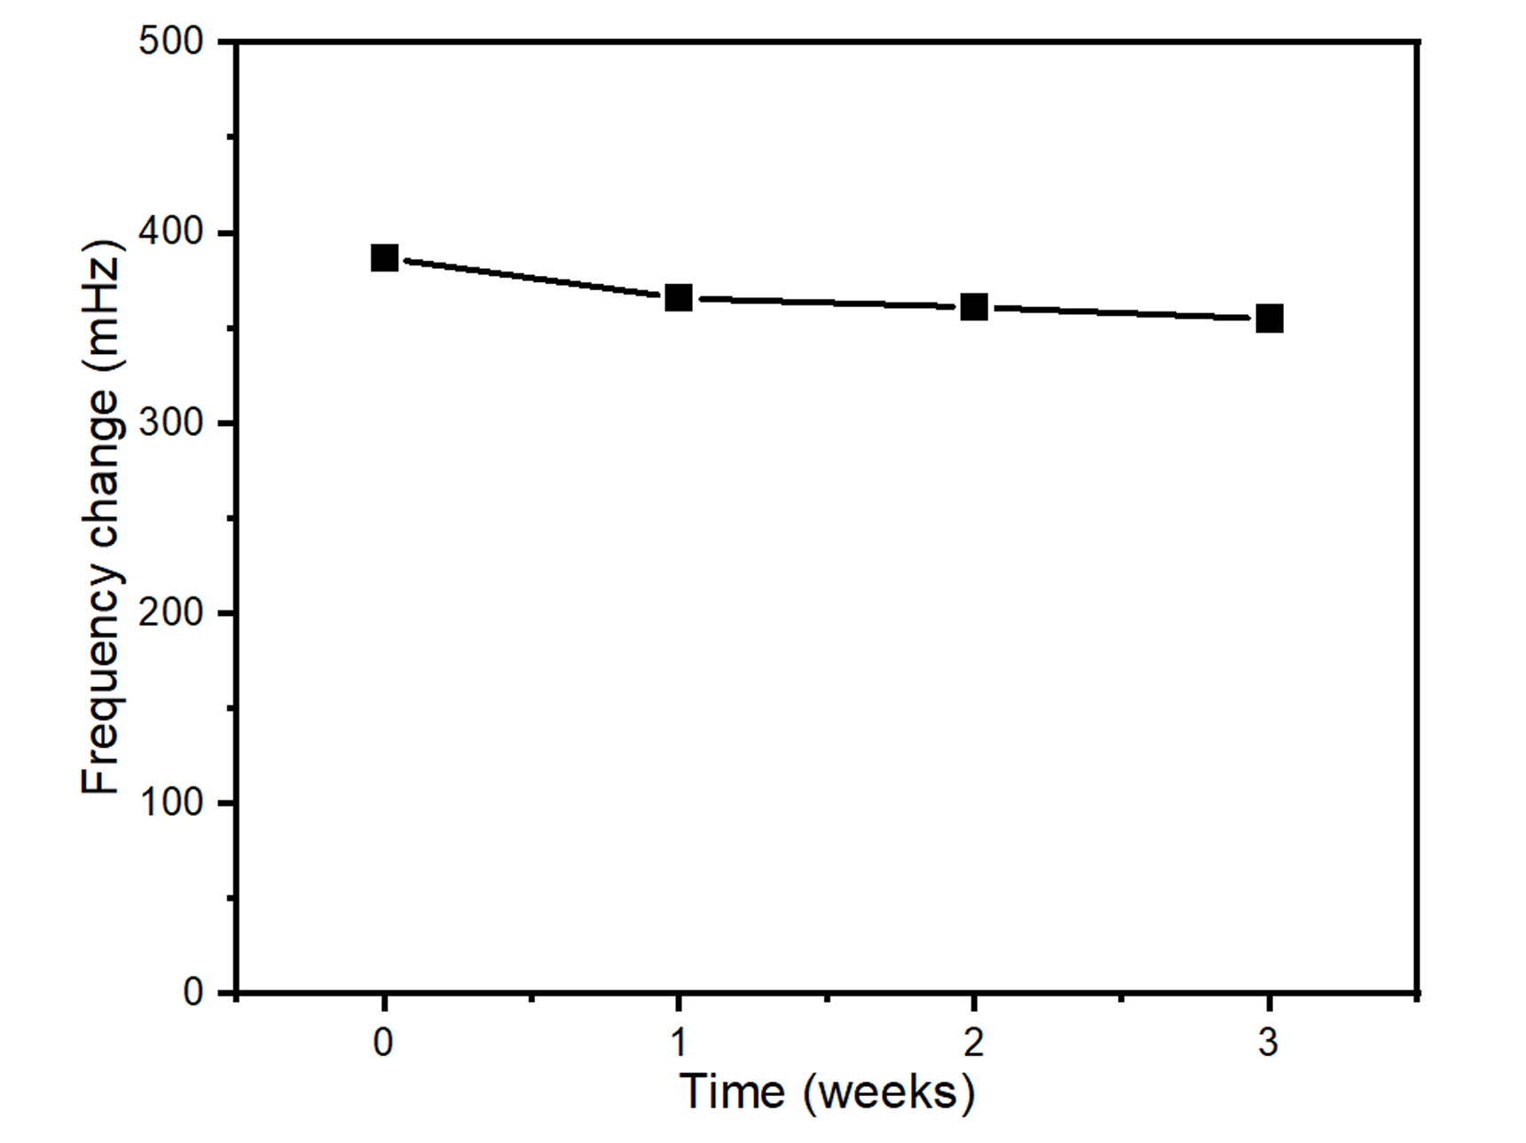
Stability of the MXene-MQTF sensor
Under room temperature conditions, the gas response performance of the Ti₂C₃T_{x}-NH₂-60 MXene sensor to 10 ppm sulfur dioxide remained stable within 3 weeks.
Ding, Wei, Jingjing Yu, Francis Tsow, Laxmi Raj Jaishi,…Parashu Kharel, Yue Zhou, and Xiaojun Xian. npj 2D Materials and Applications 8, (2024).

Slide 20
How can AI promote MXene-based sensor research?
Material Screening: AI enables rapid discovery of optimal MXene structures and surface groups from large datasets.
Performance Prediction: Machine learning models help predict gas sensitivity and selectivity, reducing experimental workload.
Optimization of Surface Functionalization: AI guides the design of functional groups and modification conditions to boost sensor response.
Signal Analysis and Processing: AI improves real-time signal interpretation, noise reduction, and anomaly detection.
Stability and Lifetime Prediction: AI can predict long-term performance, supporting the design of durable sensors.
IoT Integration: Smart sensor systems with AI allow for self-calibration, data analysis, and remote monitoring.

Slide 21
Conclusions
We successfully designed, fabricated, and tested the Ti₃C₂T_{x}-MQTF gas sensors, in which MXenes served as the selective receptors and MQTF as the transducer.
By coating the surface-modified Ti₃C₂T_{x} onto the tips of the MQTF as a recognition layer, we created MXene-MQTF gas sensors capable of sensitive, selective, and reversible detection of CO, SO₂, and NH_{3.}
Ti₃C₂T_{x}-NH₂-based sensors exhibited high selectivity to SO₂, an acidic gas; Ti₃C₂T_{x}-F-based sensors showed the strongest response toward CO.
The sensitivity of the Ti₃C₂T_{x}-NH₂-MQTF sensor for SO₂ detection doubled when the surface modification temperature was increased from 25 to 60 ºC.
Ding, Wei, Jingjing Yu, Francis Tsow, Laxmi Raj Jaishi,…Parashu Kharel, Yue Zhou, and Xiaojun Xian. npj 2D Materials and Applications 8, (2024).

