Slide 1

  Transforming Polymer R&D with AI
Chiho Kim
School of Materials Science and Engineering, Georgia Institute of Technology
Workshop for AI-Powered Materials Discovery at Great Pains
1:30-2:05 PM CDT, Jun 23, 2025, University of South Dakota

Slide 2
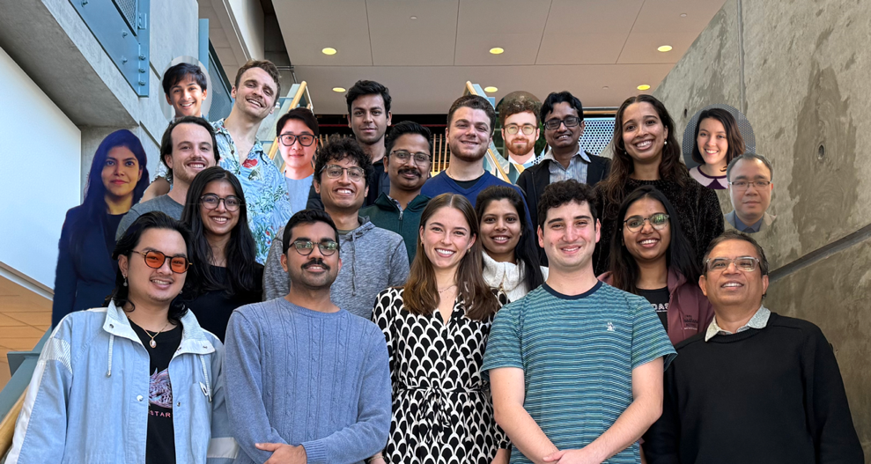
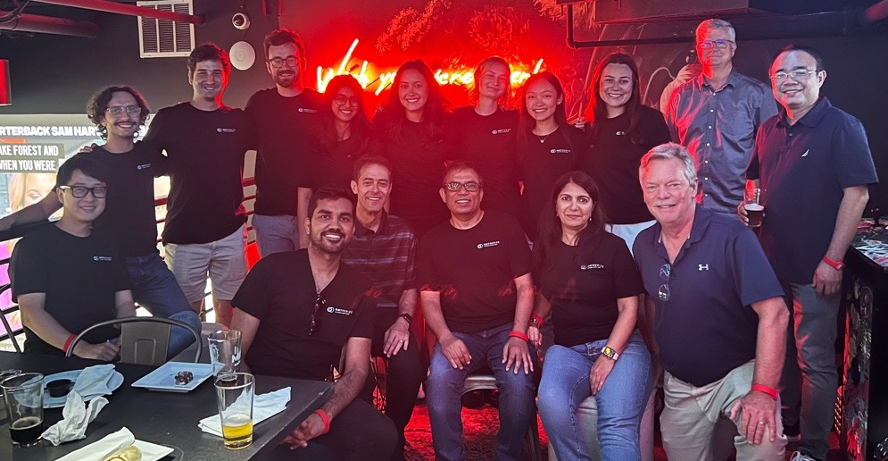
Credits
Ramprasad Research Group at Georgia Tech
Collaborators (GT): Ryan Lively, Blair Brettmann, Will Gutekunst, M. G. Finn, Jerry Qi, Natalie Stingelin, Mark Losego, Valeria Milam, Roshan Joseph, Chao Zhang / Collaborators (UConn): Greg Sotzing, Yang Cao
Matmerize, Inc.
Co-Founder: Rampi Ramprasad (Georgia Tech)
Advisors: Jonathan Goldman (Georgia Tech); Bill Midgette (GRA); Ward Broom (ATDC)

Slide 3
Materials Development Takes Time
R&D, lab trials
Pilot production
Testing and scaling
Commercialization
Nylon®
For abrasion resistance
10 years
$500 Million R&D cost
1930
1940
WW-II
Today
Discovered
by DuPont
Went to
department store
Parachutes &
mosquito nets
Toothbrush, fishing
line, tents, toys …
Teflon®
For coating
22 years
$1 Billion fines for environmental pollution
1938
1950
1960
Today
Discovered
by Ohio State University
First
plant
Marketing
for cookware
New variants
still coming out
Kevlar®
For protective clothing
13 years
$700 Million R&D cost
1965
1978
2014
Discovered
by DuPont
Military uses
1,000,000th
vest produced

Slide 4
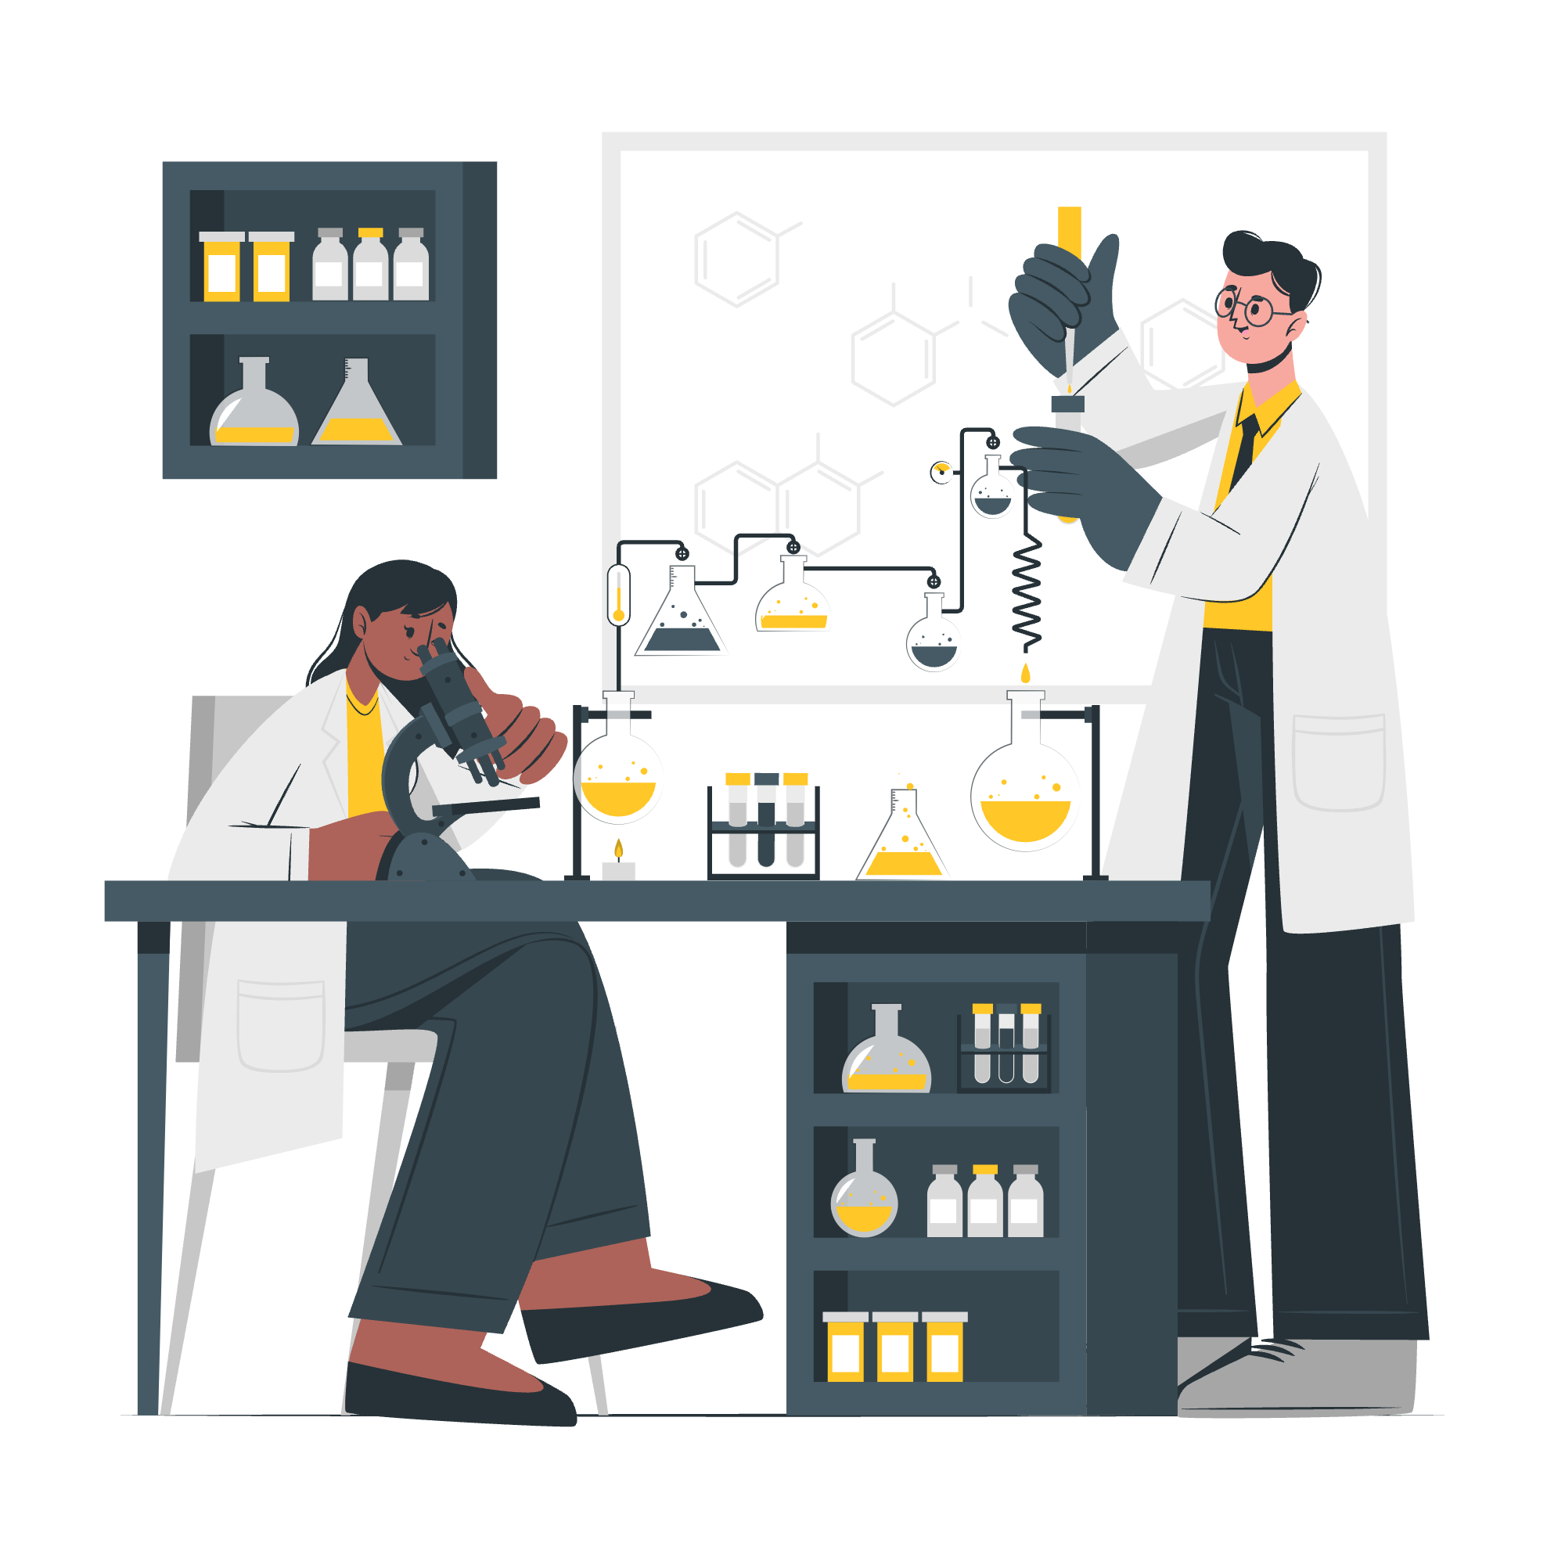
Too Vast to Search & Optimize
Polymer chemistry space
Homo/copolymers, commercial/
synthesizable/hypothetical polymers, neat resin,
composites, crosslinked, etc.
Recipe/formulation space
Additives, curing agents, catalysts, solvent,
reinforcements, mixing ratio, molecular weight,
compatibilizers, etc.
Synthesis/processing space
Polymerization methods, curing conditions, mixing
techniques, extrusion, injection molding, post-processing
treatments, etc.

Slide 5
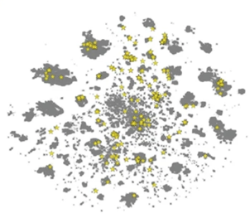
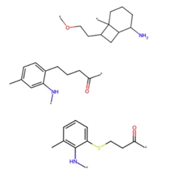
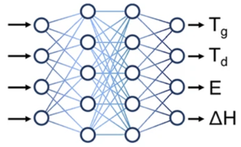
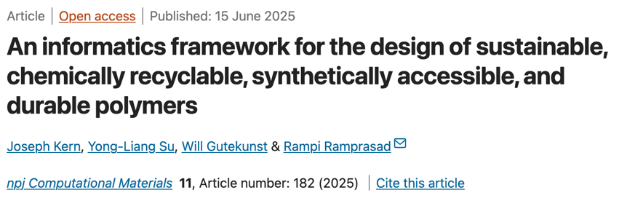
Polymer Design with AI
Models
Goal setting
Candidate design
Predict/screen
Property | Target
T_{g} (K) | > 373
T_{d} (K) | > 473
E (GPa) | > 2
𝛥H (kJ/mol) | -10 ~ -20
Data
Decision
Develop ML models
to rapidly predict properties
Define
screening
criteria
Define search space
and generate
polymers
Screen and recommend candidates for experiments

Slide 6
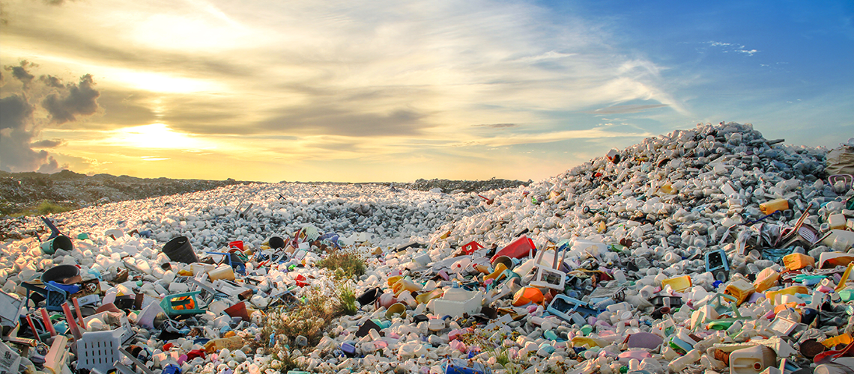
Designing Bioplastics
Tackling the crisis: a journey to sustainability

Slide 7
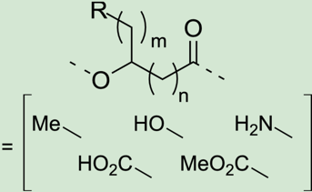
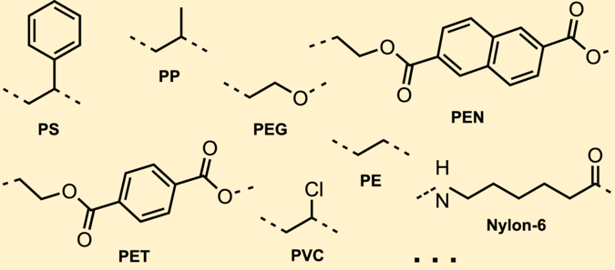
540 PHAs
R
1.4 million copolymers
Instant prediction for the key properties using multitask property predictors
Search for polymers
that meet the screening criteria
13 conventional polymers
14 PHA-based bioplastic candidates
PHAs
PHAs
PHAs
Conventional polymers
“Bioplastic design using multitask deep neural networks” Commun Mater 3, 96 (2022).
Christopher Künneth (University of Bayreuth, Faculty of Engineering Science) and
Jessica Lalonde, Babetta L. Marrone, Carl N. Iverson, Rampi Ramprasad and Ghanshyam Pilania

Slide 8
1.4 million copolymers
R
540 PHAs
PHAs
PHAs
Instant prediction for the key properties using multitask property predictors
Search for polymers
that meet the screening criteria
14 PHA-based bioplastic candidates
PHAs
Conventional polymers
13 conventional polymers
Poor mechanical properties of PHAs
Large chemical space to search for the optimal copolymer
“Bioplastic design using multitask deep neural networks” Commun Mater 3, 96 (2022).

Slide 9
Thermal properties – T_{g}, T_{m}, T_{d},
Mechanical properties – YM (E), TS (σ), Elongation (ℇ_{b})
Gas permeabilities – O₂, CO₂, N₂, He, CH₄, H₂
Model trained on 22,731 homo & co polymers
Instant prediction for the key properties using multitask property predictors
540 PHAs
1.4 million copolymers
Search for polymers
that meet the screening criteria
14 PHA-based bioplastic candidates
PHAs
PHAs
13 conventional polymers
PHAs
Conventional polymers
Solution - Utilize machine learning’s ability to rapidly canvas large search spaces
“Bioplastic design using multitask deep neural networks” Commun Mater 3, 96 (2022).

Slide 10
Thermal properties – T_{g}, T_{m}, T_{d},
Mechanical properties – YM (E), TS (σ), Elongation (ℇ_{b})
Gas permeabilities – O₂, CO₂, N₂, He, CH₄, H₂
Model trained on 22,731 homo & co polymers
Search for polymers
that meet the screening criteria
540 PHAs
1.4 million copolymers
Instant prediction for the key properties using multitask property predictors
14 PHA-based bioplastic candidates
PHAs
PHAs
13 conventional polymers
PHAs
Conventional polymers
Solution - Utilize machine learning’s ability to rapidly canvas large search spaces
“Bioplastic design using multitask deep neural networks” Commun Mater 3, 96 (2022).

Slide 11
Pipeline to design new PHA-based bioplastic candidates
14 PHA-based bioplastic candidates
540 PHAs
1.4 million copolymers
Instant prediction for the key properties using multitask property predictors
Search for polymers
that meet the screening criteria
PHAs
PHAs
13 conventional polymers
PHAs
Conventional polymers
“Bioplastic design using multitask deep neural networks” Commun Mater 3, 96 (2022).

Slide 12

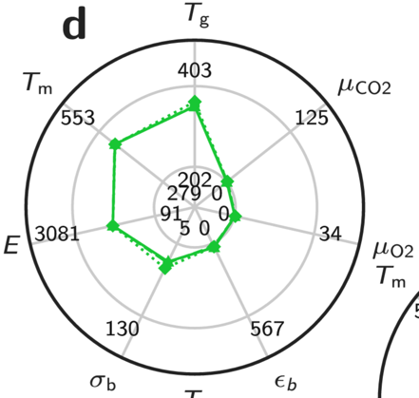
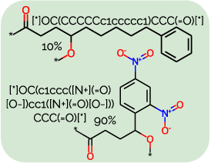
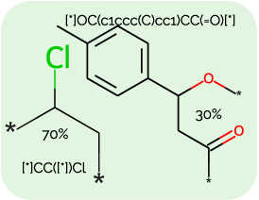
2 Candidates : Bio-replacements for PVC
PVC
PHAs
PHAs
PHAs
PHAs
PHAs
Conventional polymers
PHAs
Conventional polymers
“Bioplastic design using multitask deep neural networks” Commun Mater 3, 96 (2022).

Slide 13
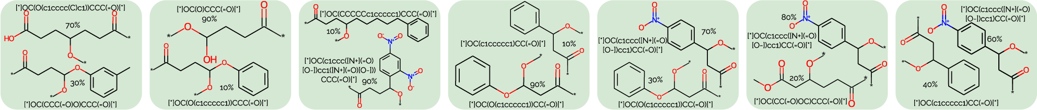
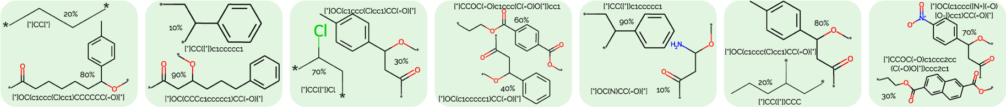
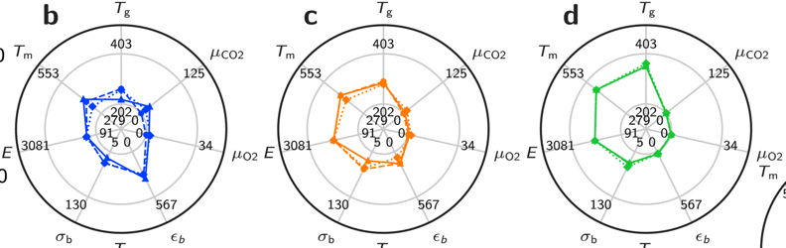
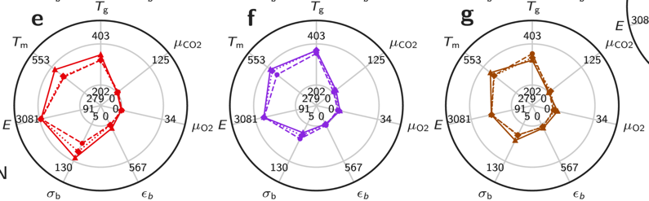
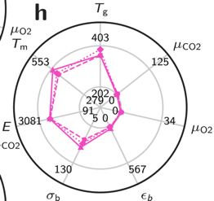
Bio-replacements
PE
PP
PVC
PET
PS
N6
PEN
“Bioplastic design using multitask deep neural networks” Commun Mater 3, 96 (2022).

Slide 14
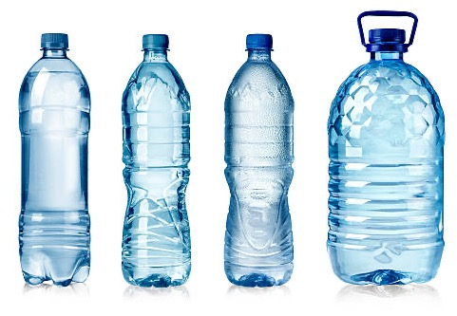
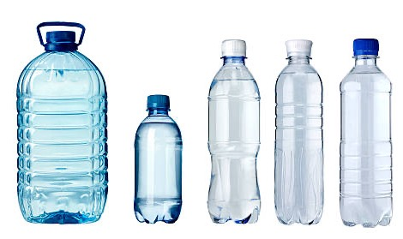
Designing PET-replacements
Can the new polymers surpass PET’s performance?

Slide 15
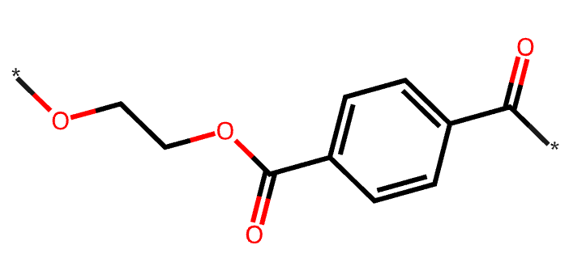
PET – Polyethylene Terephthalate
Light weight, strong, good gas & moisture barrier properties
Broad range of use temperature -60 C – 130 C
Transparent (when quench processed)
Obtained by esterification (terephthalic acid + ethylene glycol) or trans-esterification (ethylene glycol + dimethyl terephthalate)

Slide 16
Design Target
Design new polymers with property target criteria …
Target property | Proxy property | PET’s property (experimental) | PET’s property (predicted) | Goal (predicted)
Glass transition temperature (Tg) | Tg | 67 C – 81 C | 72 C | > 72 C
Transparency | Bandgap | 3.1 eV – 3.8 eV | 3.7 eV | > 3.7 eV
Transparency | Tendency to crystallize | 30% - 40% | 40% | < 40 %

Slide 17
Procedure
Step 1
Generate candidate
polymers
Step 2
Predict properties
& screen candidates
ML models (Tg, bandgap, tendency to crystallize) used:
Available at PolymRize™ (https://www.matmerize.com)
and Polymer Genome (https://www.polymergenome.org)

Slide 18
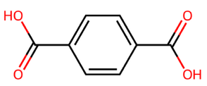

Approach for Generating Polymers
Reference polymer (PET) & reaction template
[#8:1]
[#8:1]
[#8H:4]
[#6:2]
n
n
[#6:5]
[#6:2]
+nH₂O
[#6:5]
Polycondensation
(Esterification)
[#8:3]
[#8H:3]
n
[#8:4]
Diacid - PTA
CAS# 100-21-0
C1=CC(=CC=C1C(=O)O)C(=O)O
Diol - MEG
CAS# 107-21-1
C(CO)O
PET
SMARTS reaction template
[#8:1]=[#6:2][#8H:3].[#8H:4][#6:5] >>[#8:1]=[#6:2][#8:3][#6:5]
New polymers inspired by the reference
R_{A}
R_{A}
R_{B}
R_{B}
+nH₂O
n
n
Polycondensation
n
72 monomers
from TSCA inventory
168 monomers
from TSCA inventory
12,100 PET-like polymers
Can these polymers surpass PET?

Slide 19
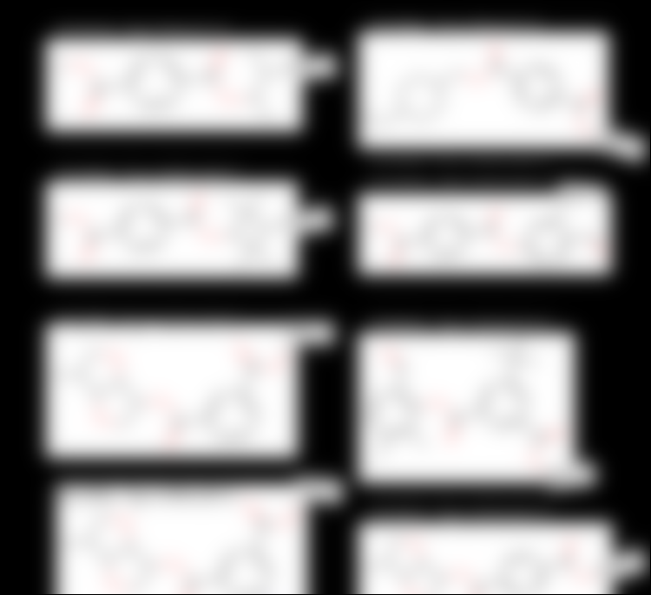
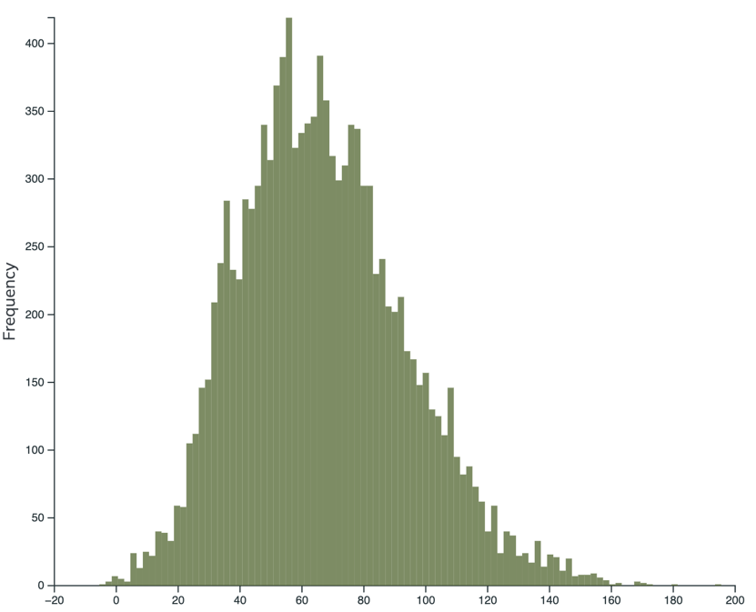
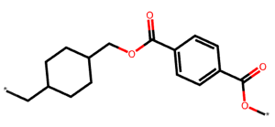
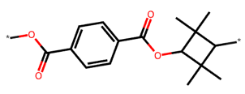
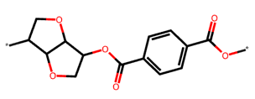
Promising Candidate PET Replacements
Candidate polymers
Example polymers, Tg > 72 C
#1413, Tg=75±17 C
#1456, Tg=75±17 C
Mean
Total 12,100 new polymer designs
Mean = 66.8 C
Standard dev. = 26.9 C
Minimum = -5.5 C
Maximum = 195.5 C
Comparable to PET
Confidential
PETG
PET-*
#1454, Tg=100±18 C
#1362, Tg=102±26 C
4,787 copolymers with Tg
greater than PET’s Tg
PET-*
Confidential
Better than PET
Tritan
#1595, Tg=122±22 C
#5003, Tg=123±23 C
Pure PET
Predicted Tg
= 72±15 C
#1456
#1413
#1454
#1362
#1595
#5003
#1259
#1427
Excellent
Confidential
Confidential
#1259, Tg=149±29 C
#1427, Tg=153±22 C
Exceptional
Confidential
PET-*
Predicted Tg (C)
Ecozen

Slide 20
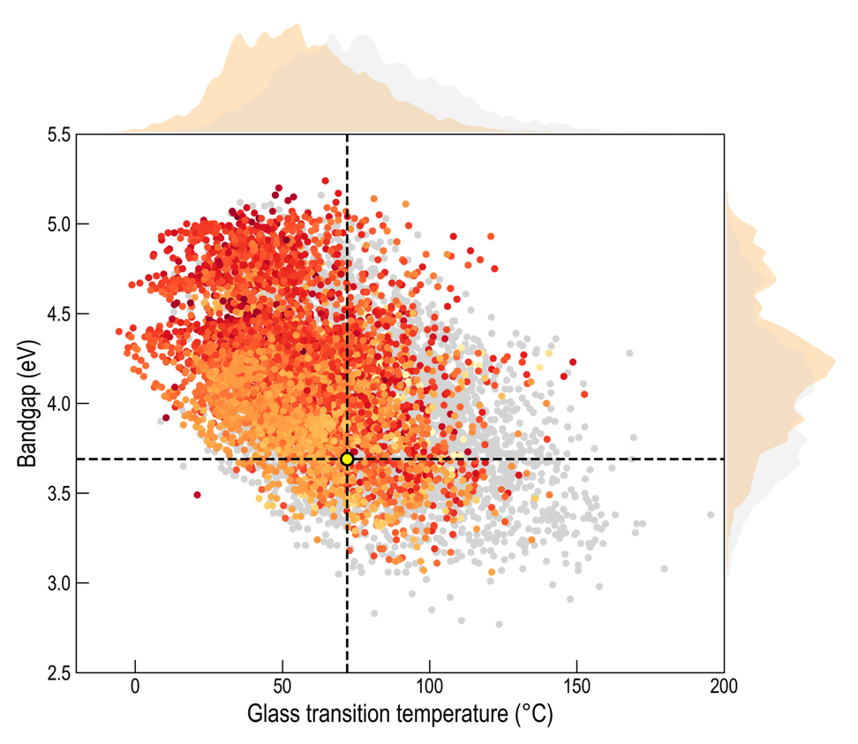
Screened Candidates
1,108 polymers surpass PET’s Tg and bandgap with tendency to crystallize lower than 40%
Tendency to crystallize
15.9%
40%
>40%
Next step
Experimental validation
A few cases are handpicked, and being tested in the Ramprasad Research Group at Georgia Tech.
PET
Tritan
Ecozen
“Designing PET-replacement copolymers using AI and virtual forward synthesis”
in preparation

Slide 21
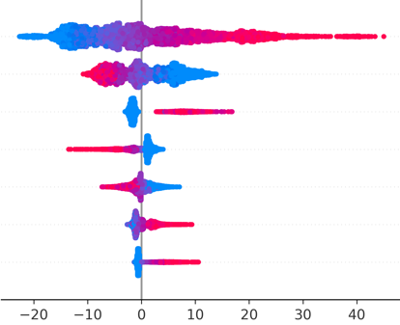
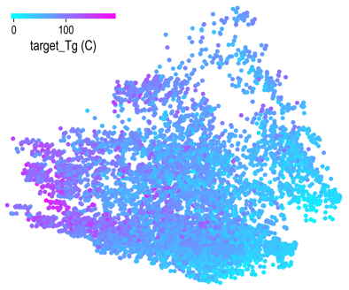
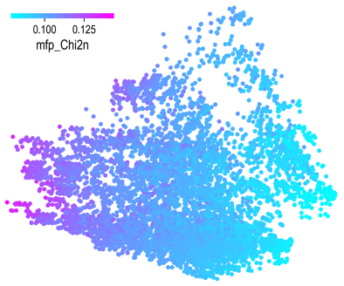
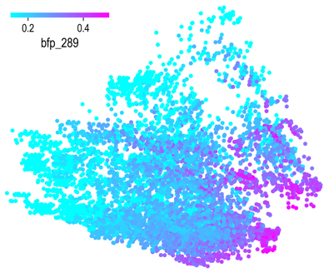
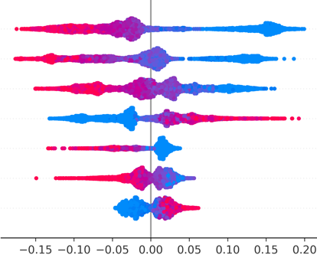
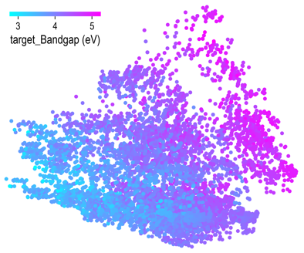
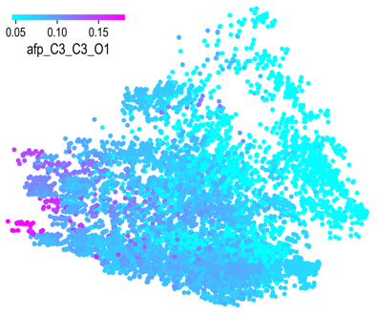
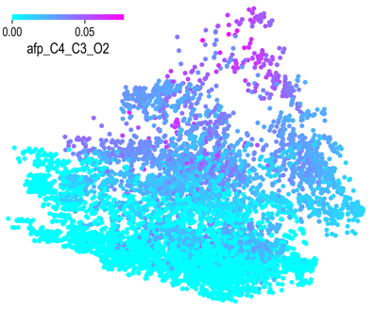
Understanding Patterns and Correlations
Chi2n
Tg (C)
Chi2n
-CH₂- (not in a ring)
-CH₂- (not in a ring)
C₃-C₃-N₃
c1cc(C)ccc1(C)
n(side chains,
length<9 atoms)
Feature value
n(rings in main chain)
Low
High
C-C=C
PC2
PC2
PC2
PC1
PC1
PC1
Feature
SHAP value (Impact on Tg)
C₃-C₃-O₁
Bandgap (eV)
C₃-C₃-O₁
C₄-C₃-O₂
C₃-C₃-O₂
C₃-C₃-C₃
C₄-C₃-O₂
c1cc(C)ccc1(C)
Feature value
n(rings in main chain)
Low
High
C₄-C₄-C₄
PC2
PC2
PC2
PC1
PC1
PC1
Feature
SHAP value (Impact on bandgap)

Slide 22
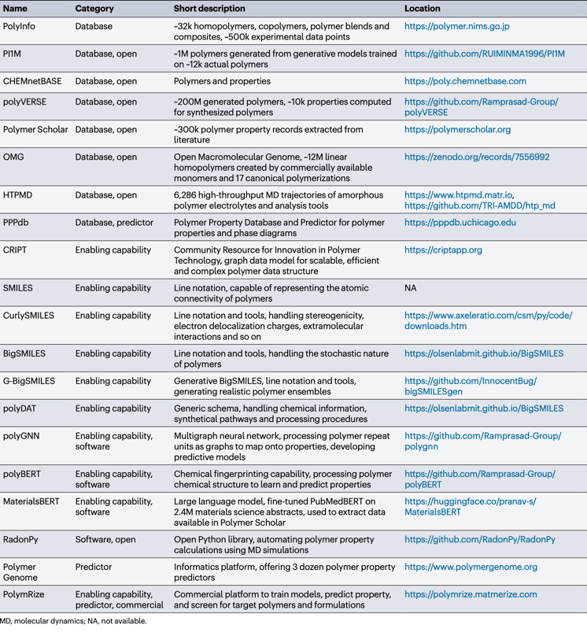
Notable Polymer Informatics Ecosystems
Known polymer database
Hypothetical polymer database
Tools for polymer representation
Simulation tools
Fingerprinting scheme
Tools for visualization and statistics
AI tools for property prediction
AI tools for AI model training
Polymer Genome by Ramprasad Research Group
https://www.polymergenome.org
Property prediction for neat resins (homo-, co-polymers)
PolymRize™ by Matmerize, Inc.
https://polymrize.matmerize.com
Property prediction, model training, design for resin and complex formulations

Slide 23

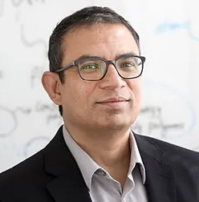
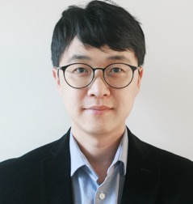
Established in 2021 as a spin-out from the Ramprasad Group at Georgia Tech
Founded by Prof. Rampi Ramprasad and Dr. Chiho Kim
Built on more than a decade of pioneering AI technologies in polymer informatics
Co-founder
Prof. Rampi Ramprasad
Co-founder
Dr. Chiho Kim
2010
2015
2020
Established in 2021
2023
2024
Launched
Polymer Genome Project
sponsored by DOD
Launched
Polymer Genome
for academic use
Licensed polymer
informatics IP exclusively
to Matmerize by GTRC
Matmerize develops
PolymRize™
Matmerize creates
new IP & databases
Virtual PI
assistant
ASKPOLY

Slide 24
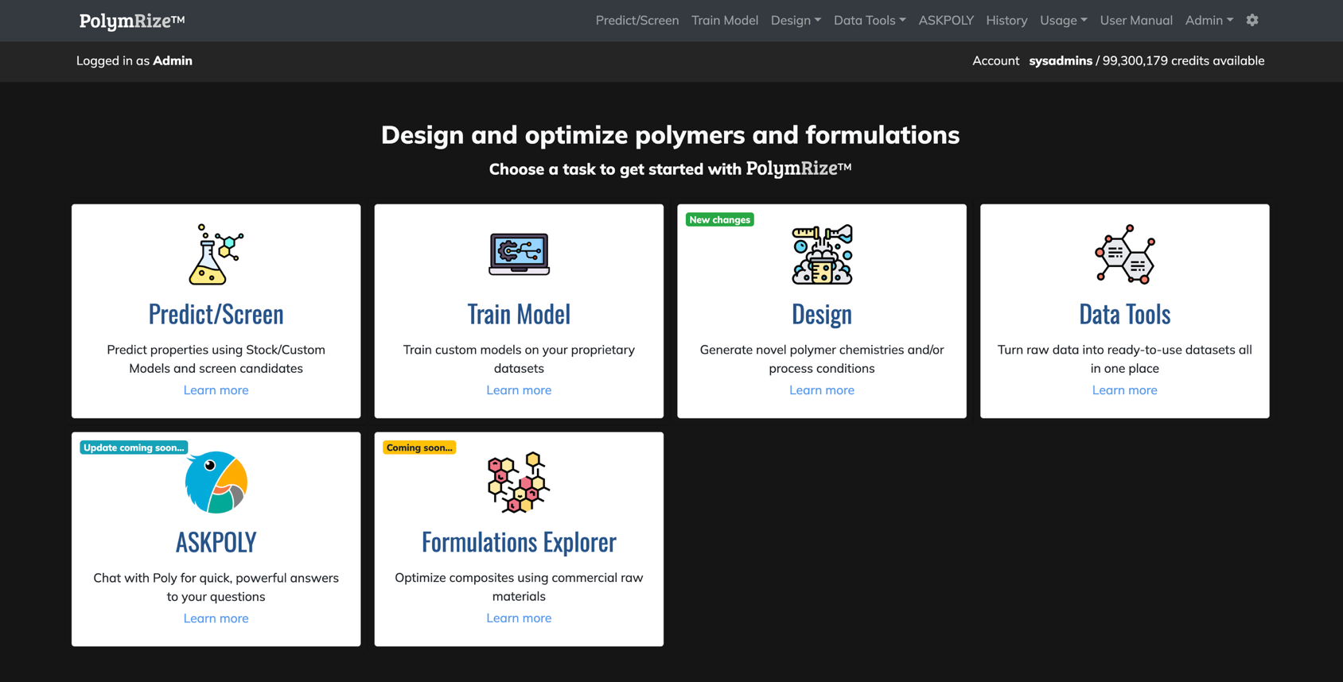
PolymRize™ Quick Views

Slide 25
PolymRize™ Stock Models
PolymRize™ Stock Models
Library of pre-trained models for polymer composites and neat polymers
Ready-to-use from day-1 for prediction, design/screening, and reinforced training
Electronic properties | Dielectric & optical properties | Thermal properties | Mechanical properties | Physical & thermodynamic
Bandgap Ionization energy Electron affinity | Dielectric constant Refractive index | Glass transition temperature Melting temperature Thermal decomposition temperature Coefficient of thermal expansion | Tensile strength Young’s modulus | Density Atomization energy Specific heat Fractional free volume
Solubility properties | Transport properties | Flammability properties | Electrical properties | Other properties
Hildebrand solubility parameter Solvent/non-solvent | Gas permeability Gas diffusivity Gas solubility Proton conductivity Water uptake Electrical conductivity | Time to ignition Peak heat release rate Average heat release rate Total heat release Optical smoke density Max. optical smoke density | Relative permittivity Electric strength | Limiting oxygen index

Slide 26
Thank You
Focuses on AI-assisted design of
application-specific polymeric materials for:
Dielectric polymers for electrostatic energy storage
Polymers for fuel-cell applications
Polymers for Li-ion battery electrolytes
Membranes for gas separation
Membranes for organic liquid mixture separations
Conducting Conjugated polymers
Polymers for sustainable world
Nature Reviews Materials V9, p866–886, 2024
https://doi.org/10.1038/s41578-024-00708-8

