Slide 1



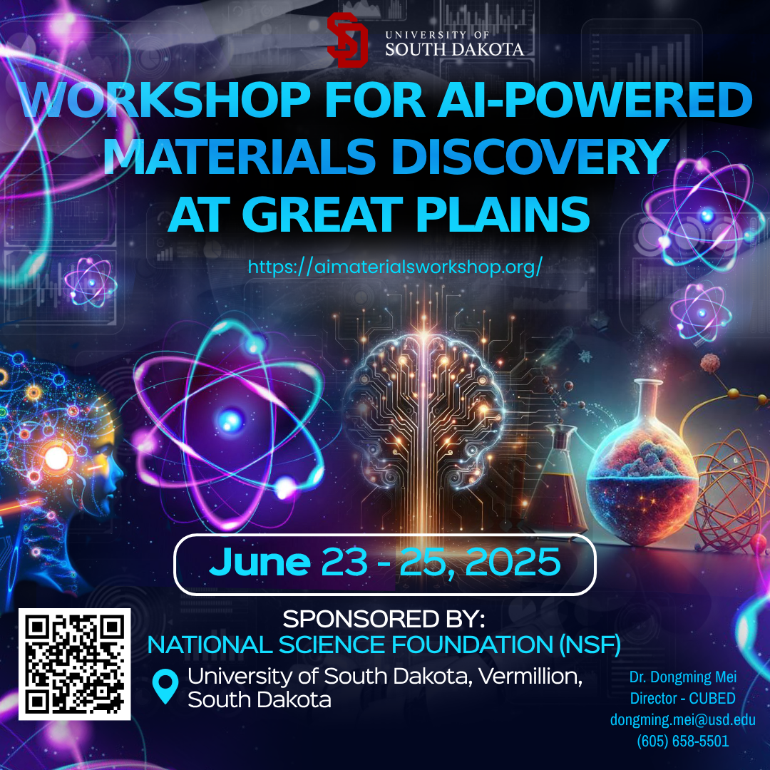

Quantum Machine Learning Applications in High Energy Physics and Beyond
Konstantin Matchev
University of Alabama
University of South Dakota,
Vermillion, SD
June 25, 2025

Slide 2
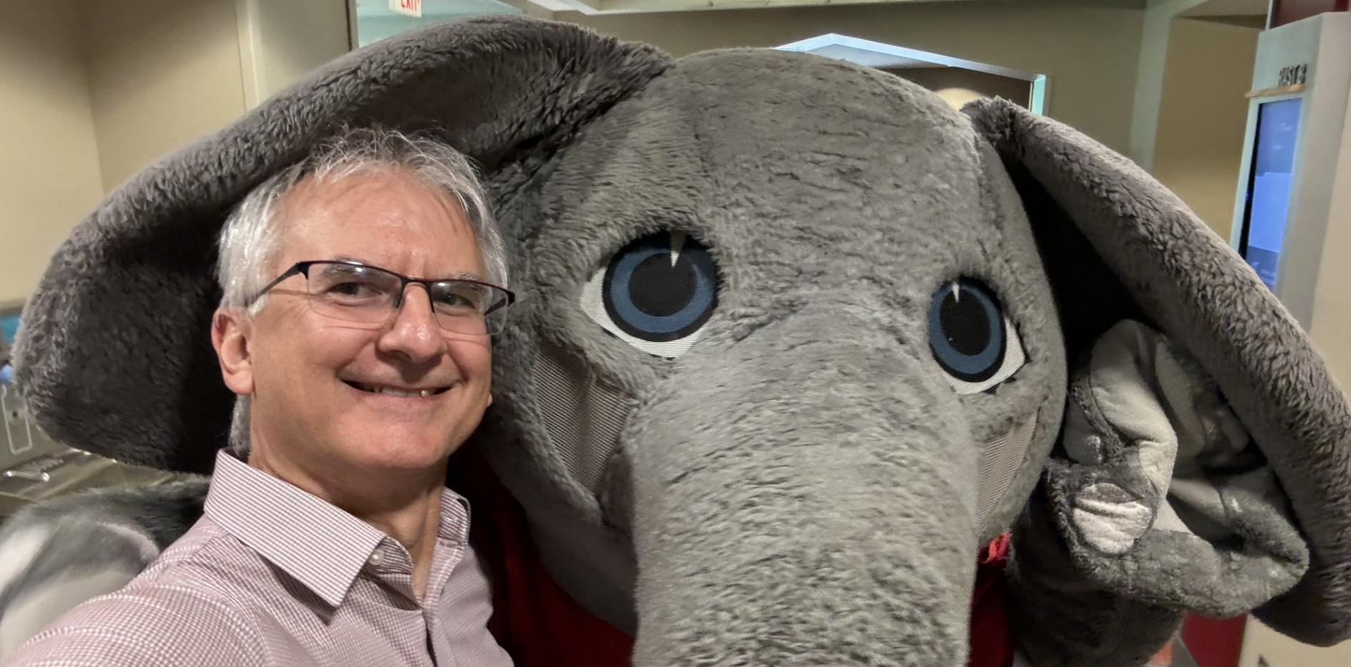





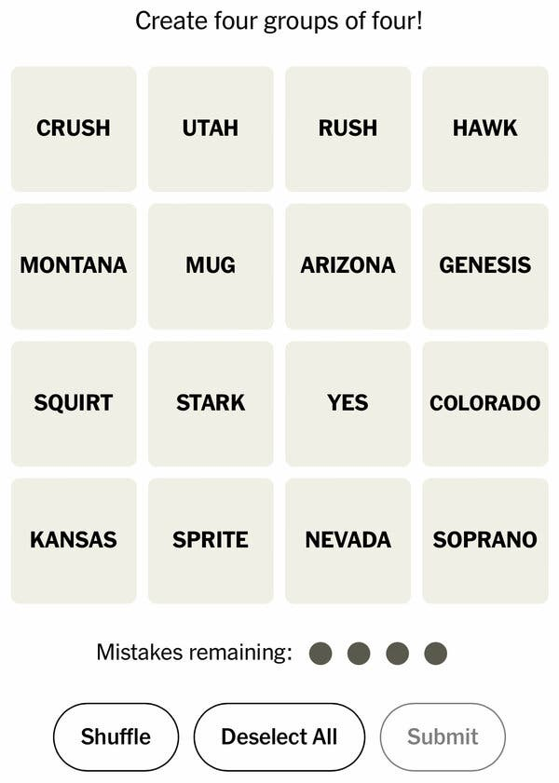

Konstantin Matchev
HET, HEE, AI, QIS, Exoplanets
Physics & Astronomy
University of Alabama
Work
High energy theory and phenomenology
  Physics Beyond the Standard Model (BSM)
    Supersymmetry, extra dimensions, weird stuff
  Higgs boson properties: spin, couplings
  Dark matter: direct, indirect detection
High energy experiment (CMS at CERN)
  Monte Carlo event generation
Artificial intelligence and Machine Learning (ML)
  Fundamental AI: statistical learning
  ML applications to physics & astronomy & beyond
Quantum computing and quantum information
  Quantum machine learning
Exoplanets
  Atmosphere characterization
Math and statistics
  Simulation based inference, hypothesis testing
Fun
Grilling and chilling
(Half-)marathons/beer
Puzzles and games
Coffee

Slide 3


Outline
Particle physics as an international enterprise
  The present: The Large Hadron Collider at CERN, the highest energy accelerator in the world
  The future: TBD, see
    Report of the 2023 Particle Physics Project Prioritization Panel
    Conference on European Strategy for Particle Physics, Venice, June 23-27, 2025
  Upcoming challenges / possible solutions:
    Machine Learning?
    Quantum Computing?
HEP sociology: theory versus experiment
  at Google Summer of Code
Typical data analysis tasks in HEP
  Hypothesis testing: quantum test statistic
  Event generation: quantum GANs, quantum diffusion models
  Classification: quantum transformers, EQNNs, QGNNs, …

Slide 4
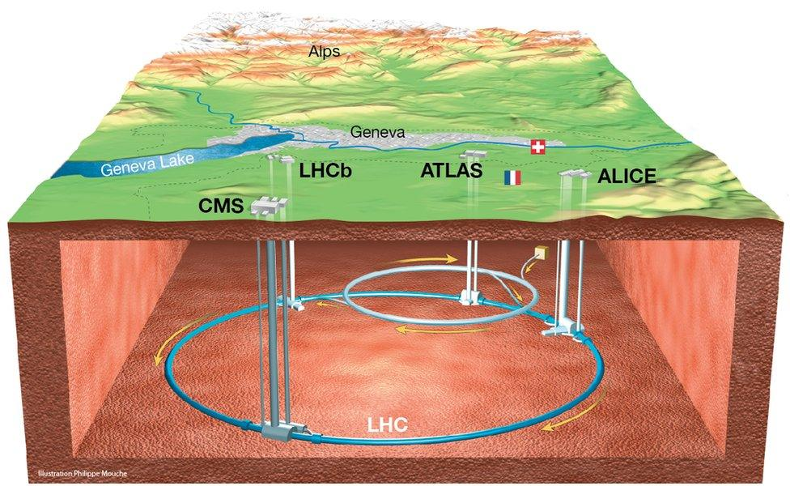
The Large Hadron Collider at CERN

Slide 5
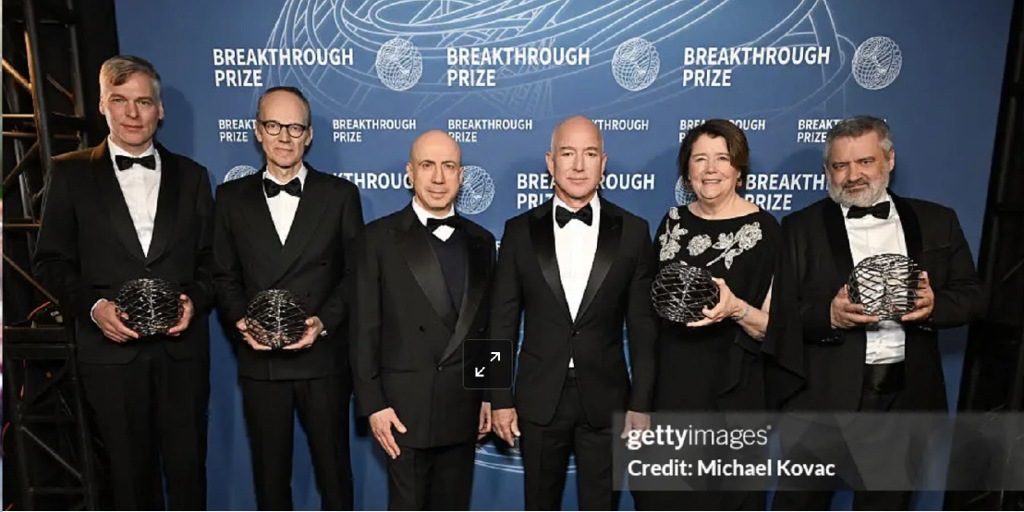
2025 Breakthrough Prize in Fundamental Physics

Slide 6
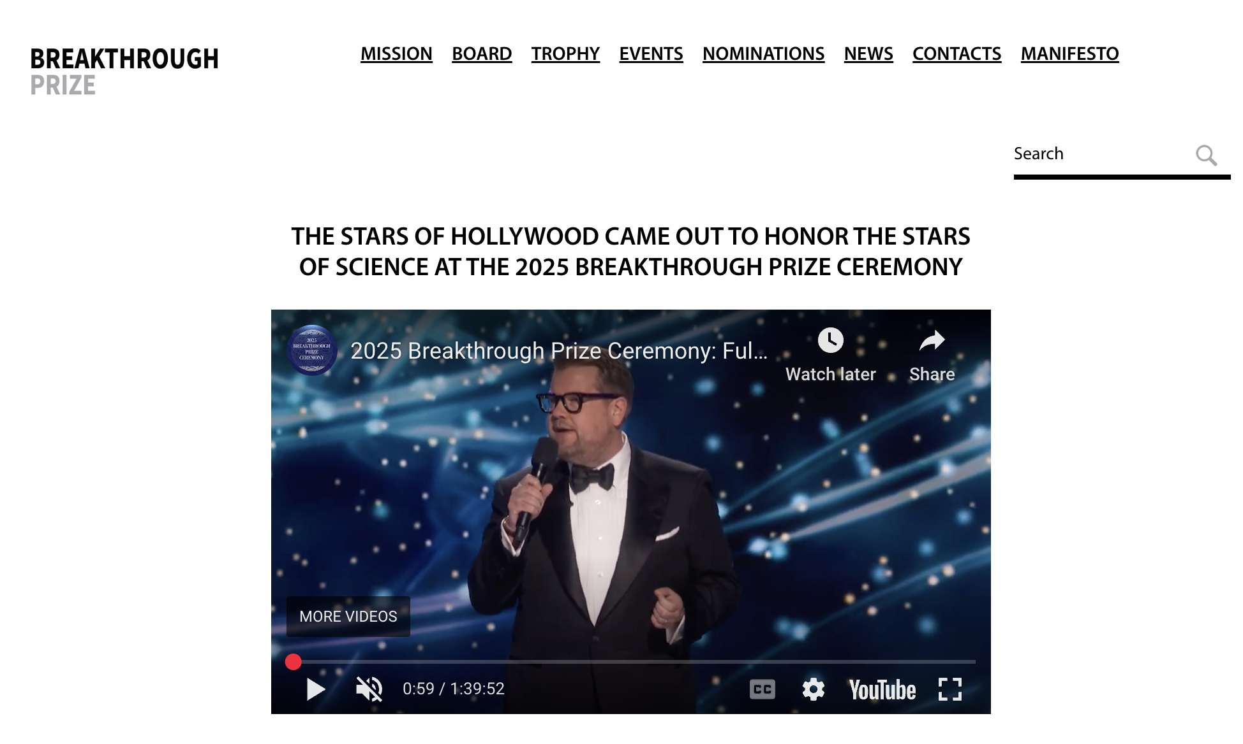
The video of the full 2 hour ceremony hosted by James Corden is available on YouTube, including live performances by Katy Perry, Sia, David Blaine, and appearances by many Hollywood celebrities.

Slide 7
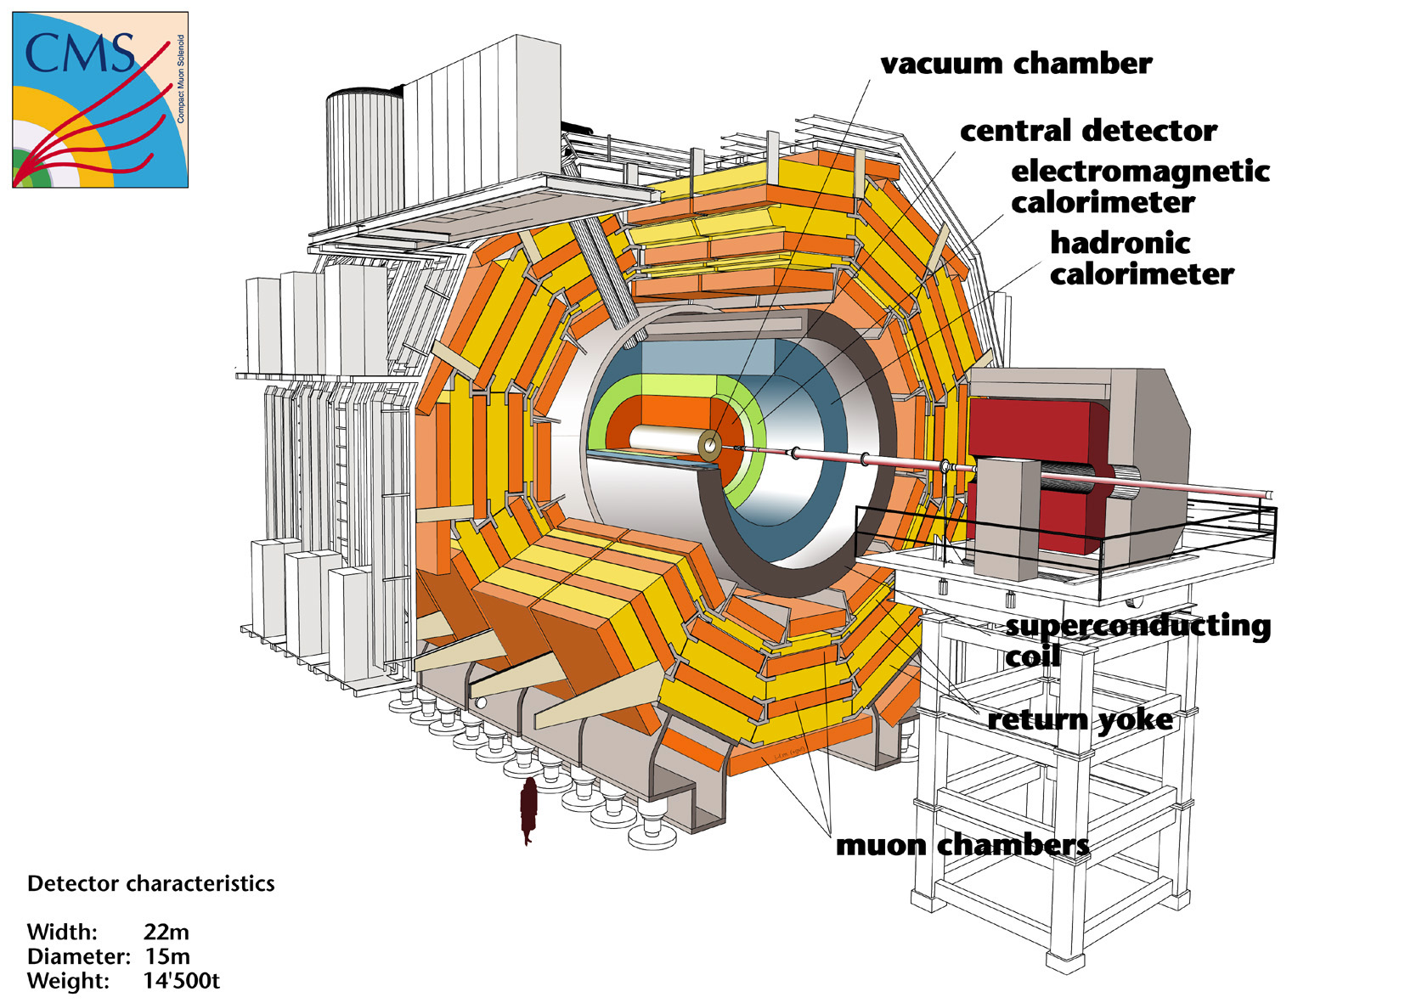

Slide 8
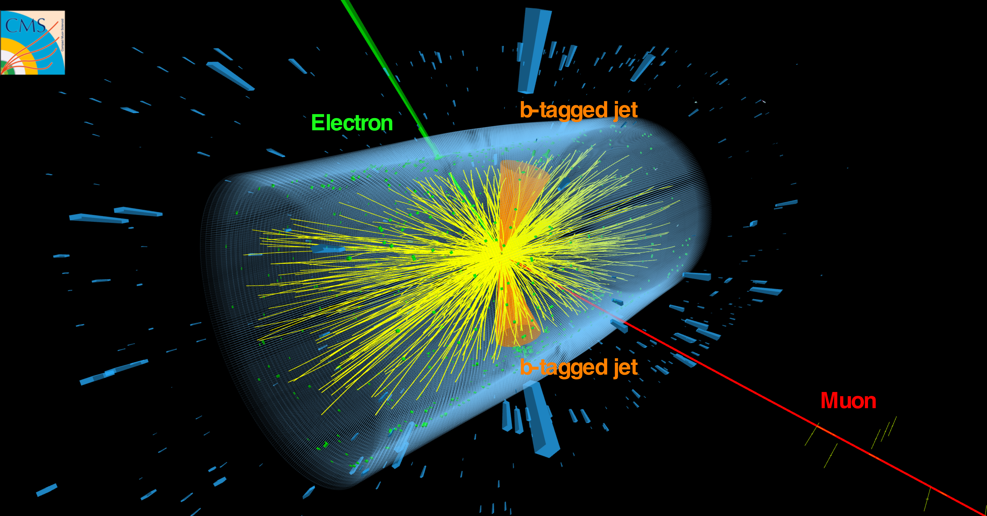
Example event: two top quarks

Slide 9
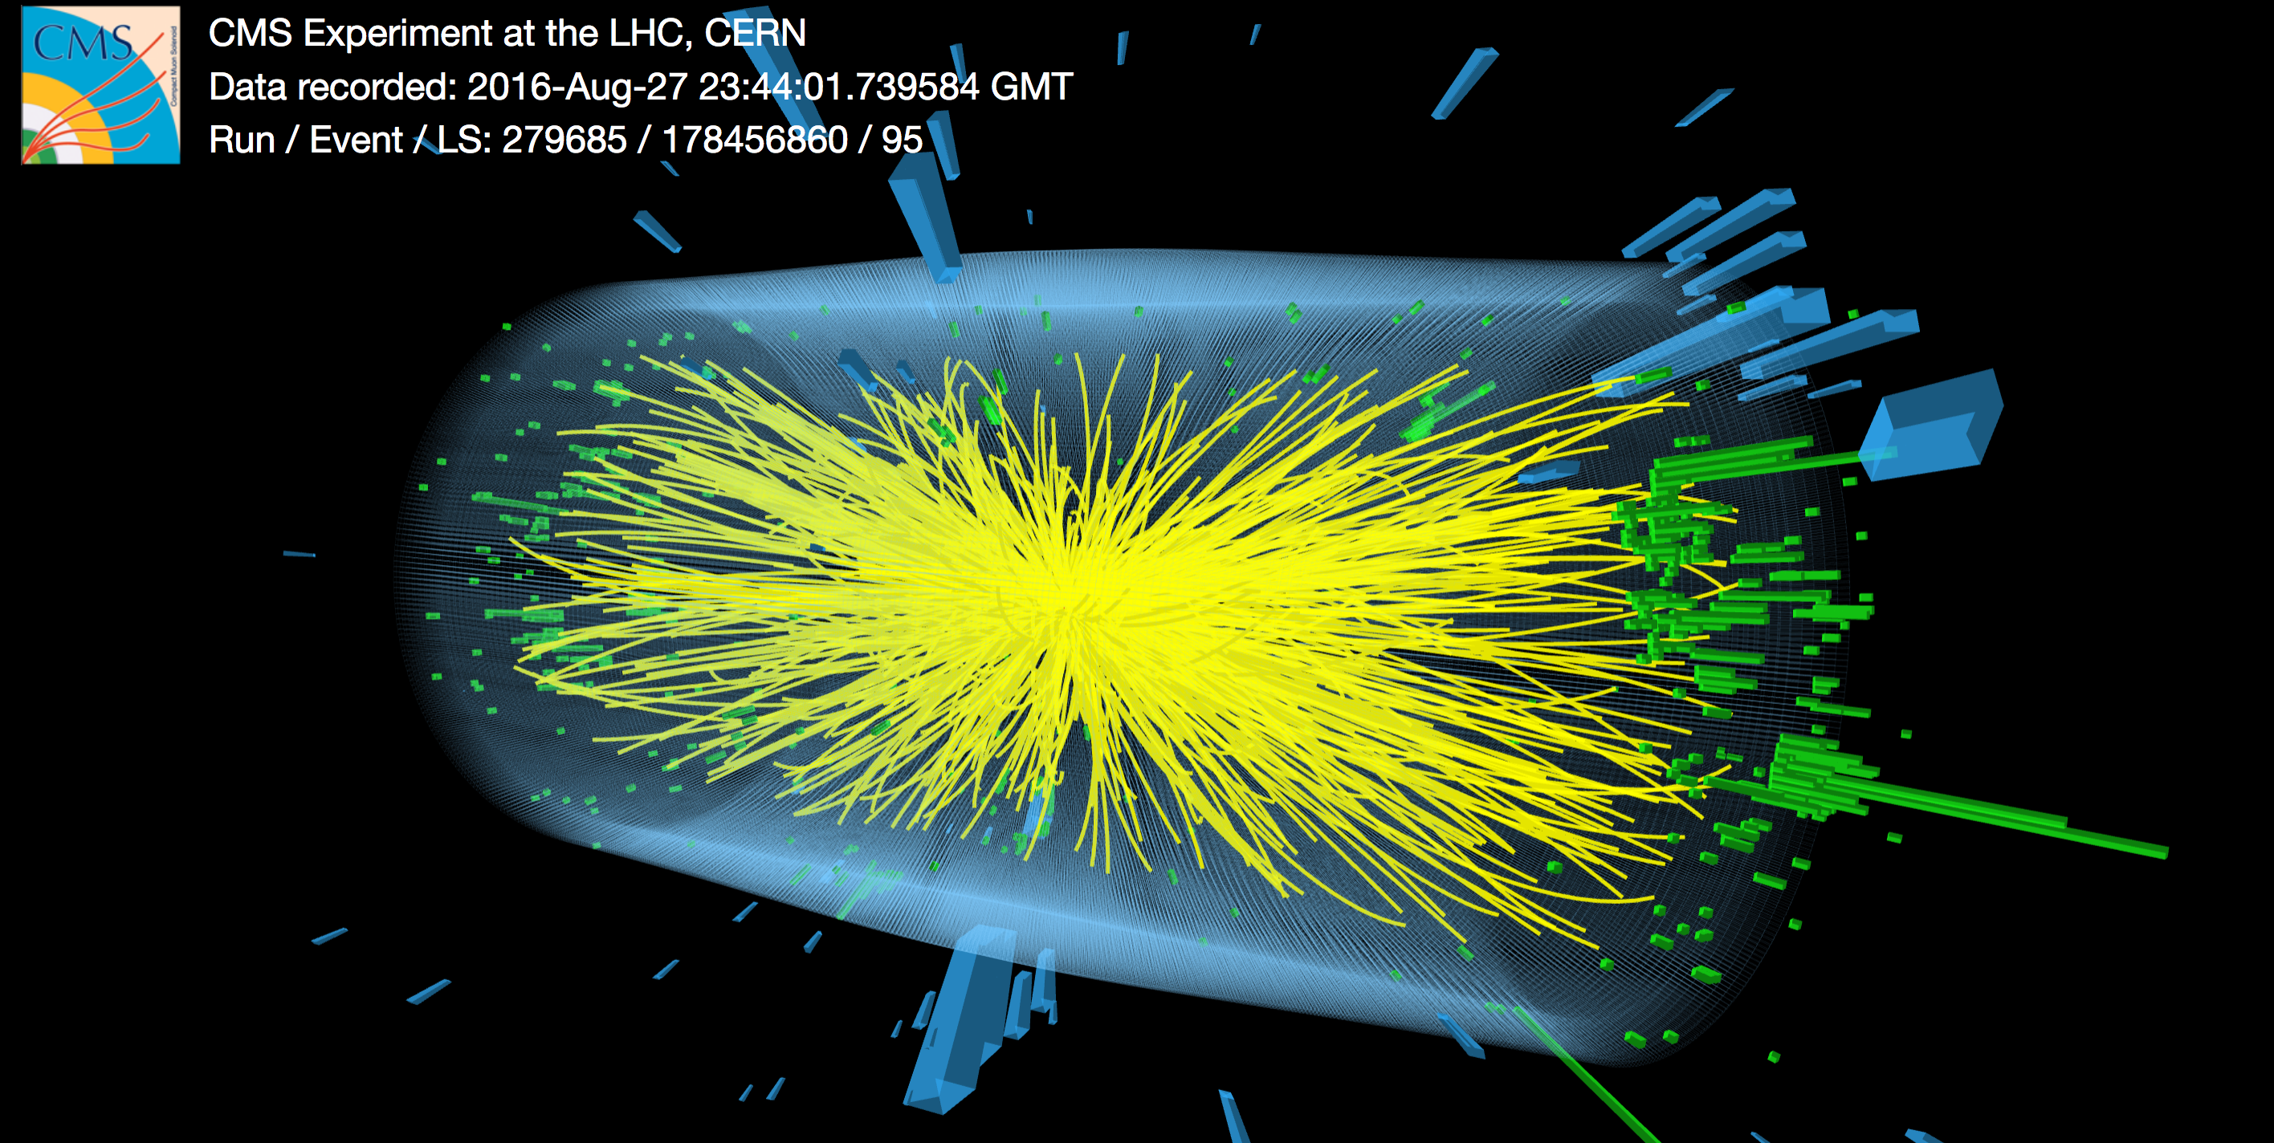
Example event: high pile-up

Slide 10
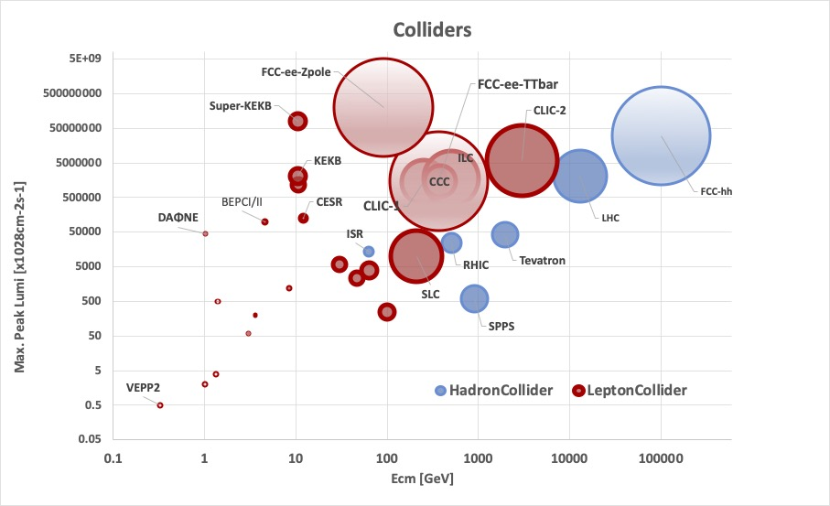
Past, current and future colliders
Bai, Shiltsev, White, Zimmermann 2022

Slide 11
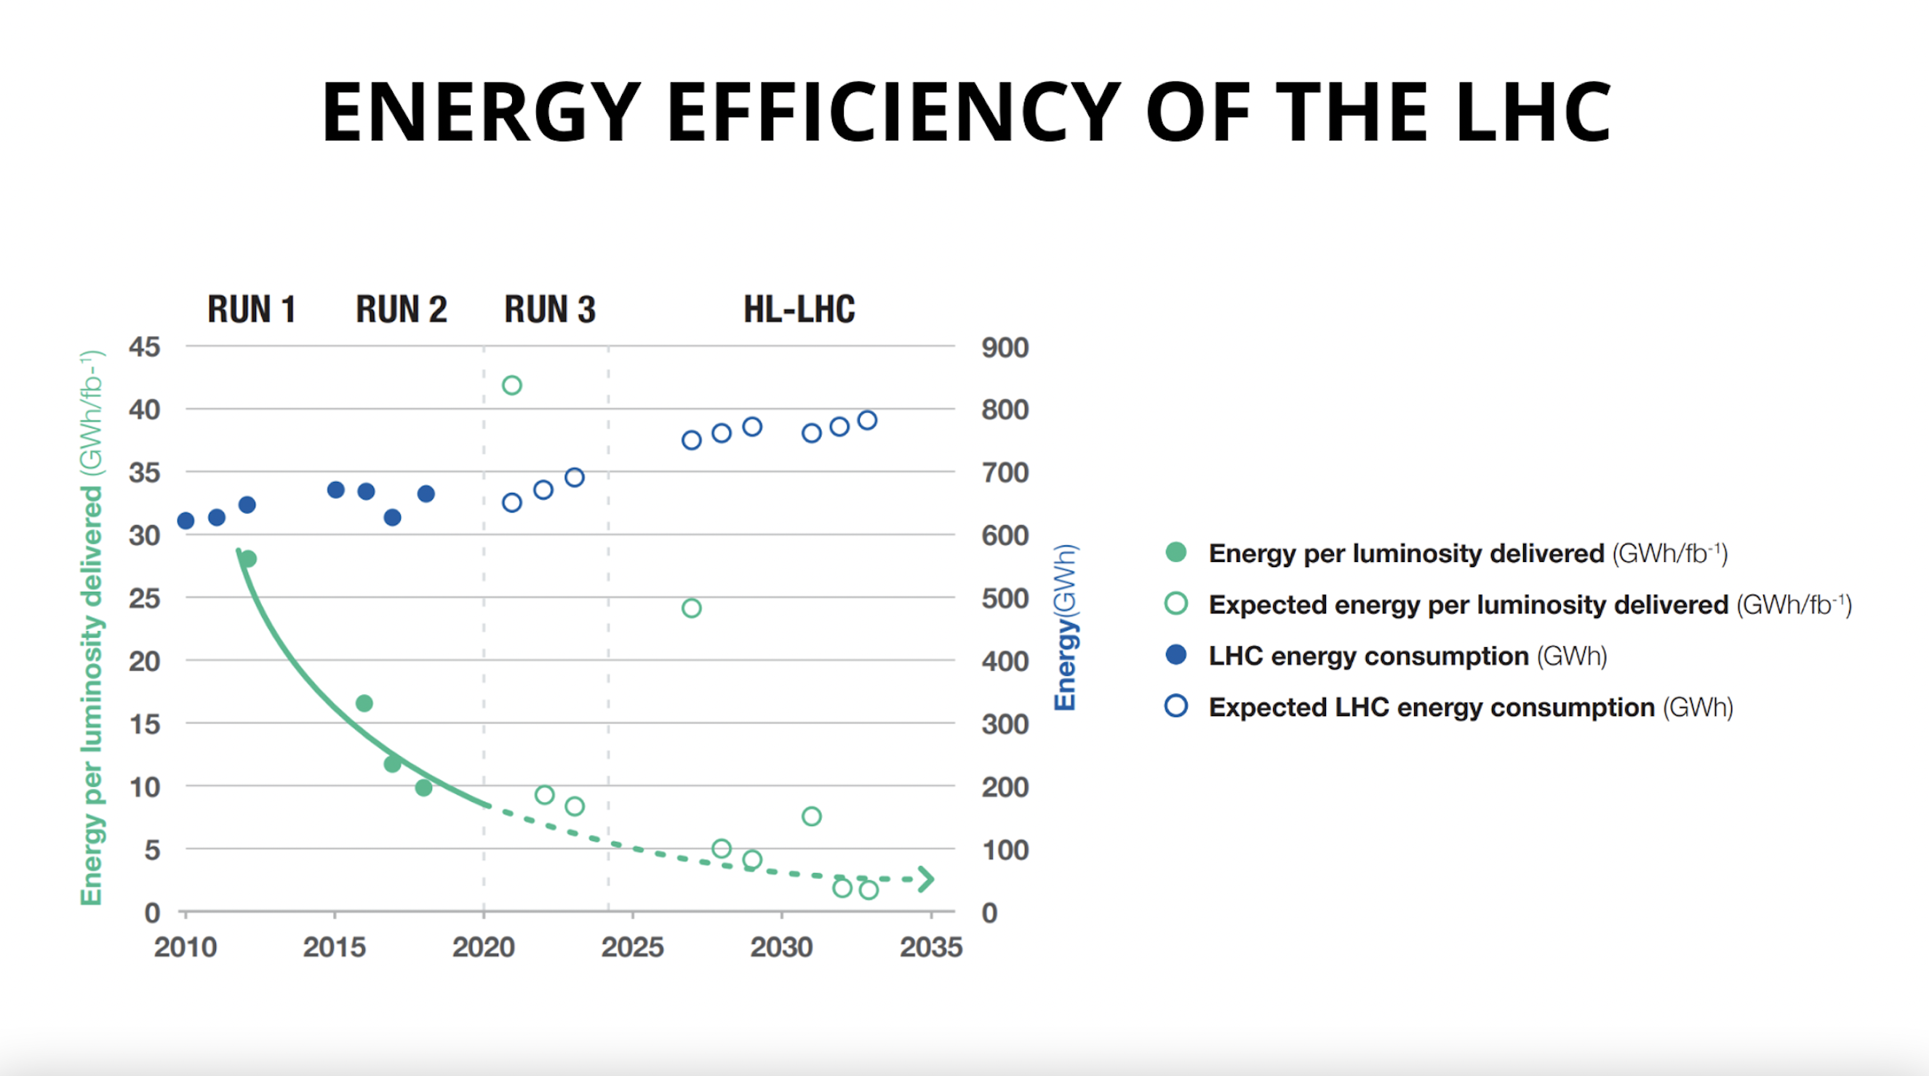
LHC Energy Consumption
When in operation LHC consumes as much energy as 1/3 of the city of Geneva
“Sustainable HEP 2025” May 12-15 2025
  https://indico.global/event/4745/
Image: CERN

Slide 12
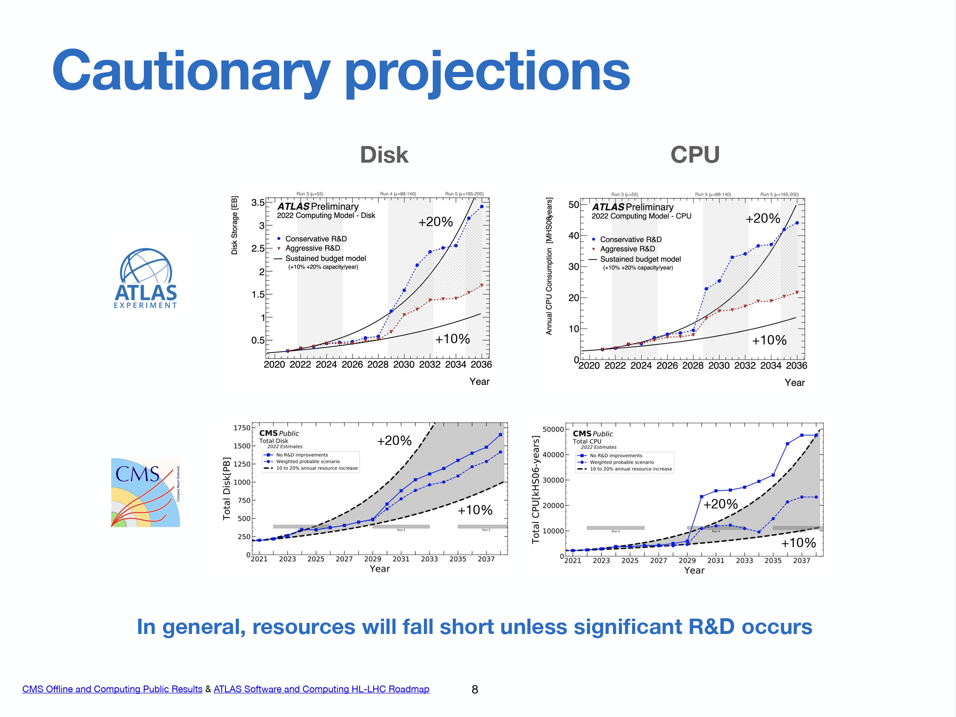
E. Kourlitis 2024

Slide 13
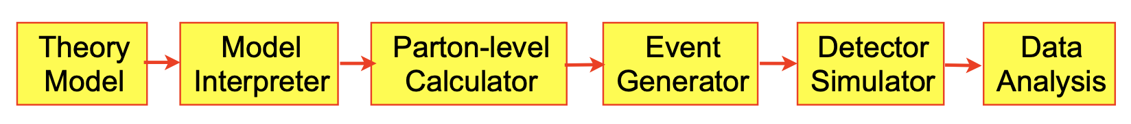
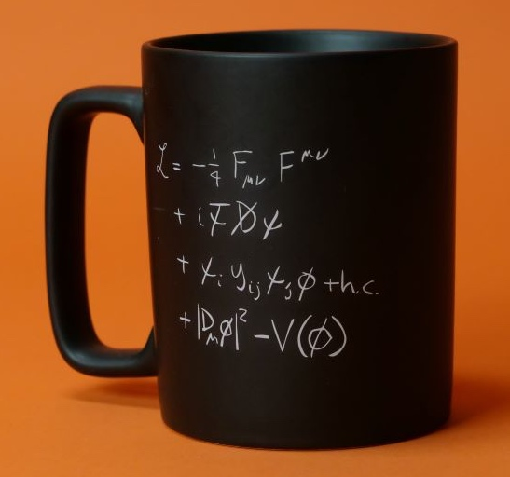
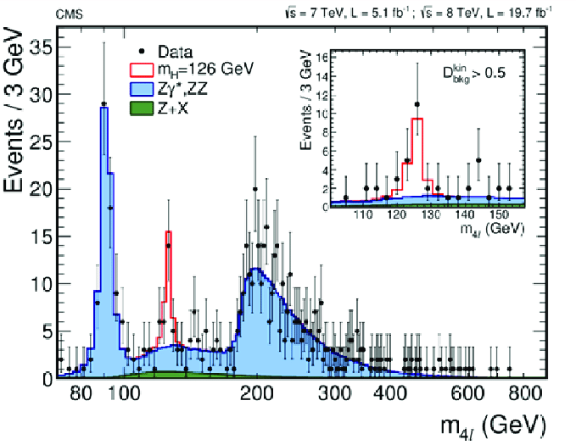
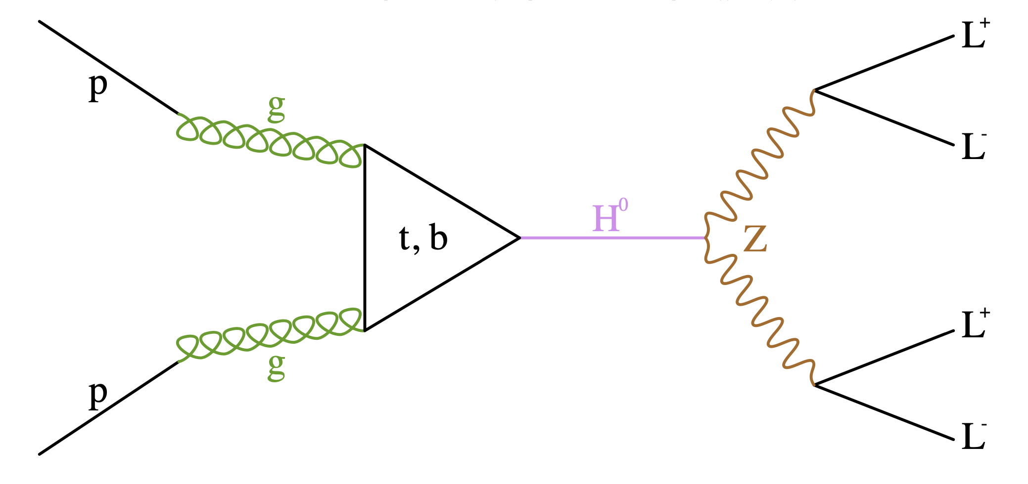
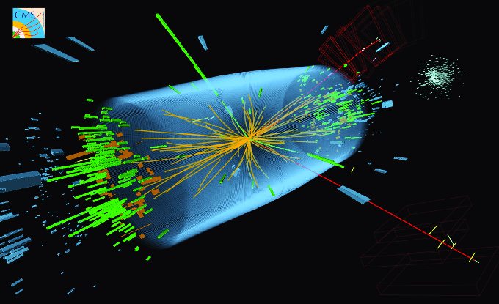
The simulation pipeline in HEP
RGEs
Vacuum structure
Mass spectrum
Feynman rules
Feynman diagrams
Cross sections (rates)
Branching fractions (rates)
MC event generation
Fragmentation
Hadronization
Higher Order Corrections
Resolution
RecoObjects
Histograms
Backgrounds
Selection cuts
ROC curve
Error analysis
Symmetries
Representations
Fields (basis)
Lagrangian
Aesthetics

Slide 14
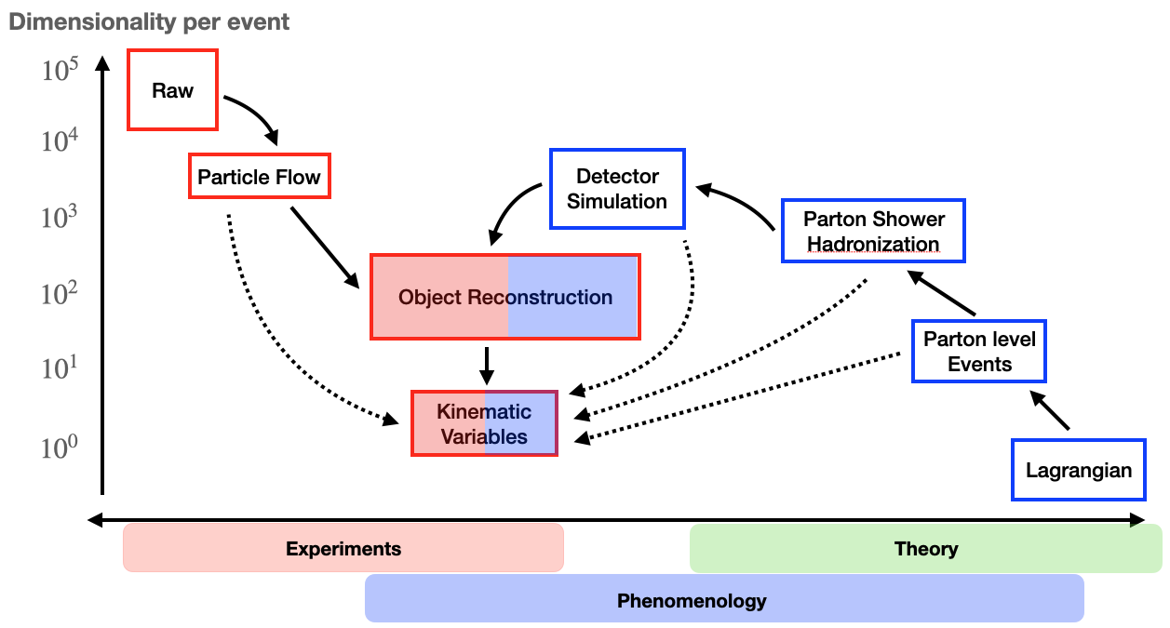
The curse of dimensionality
Franceschini,Kim,Kong,KM,Park,Shyamsundar Rev.Mod.Phys. 2023

Slide 15
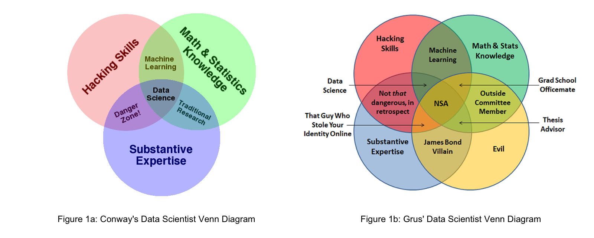



Machine Learning versus Data Science
Data science is necessarily an interdisciplinary paradigm
  The battle of the Venn diagrams
http://drewconway.com/
Joel Grus
Gru

Slide 16
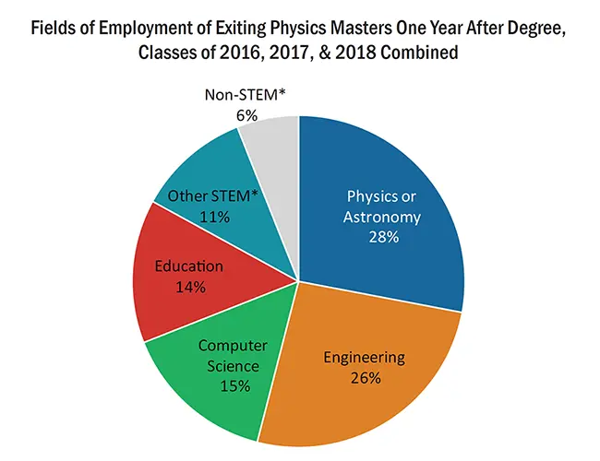
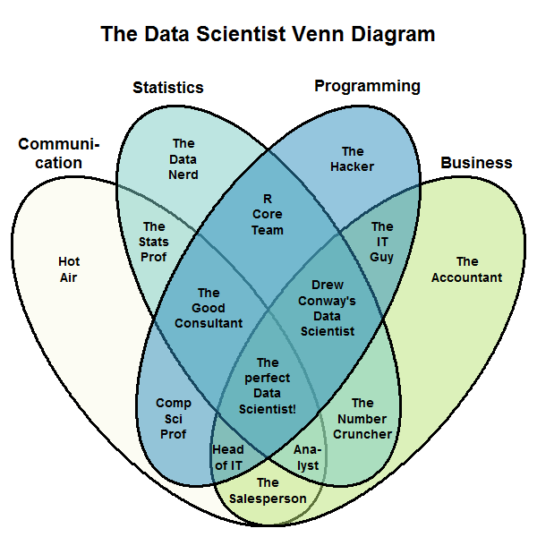

The Job Market
Many of our students do not end up going into academia
  Data science skills are important
  Communication skills are also important
My ML course @ UF
https://datascience.stackexchange.com/
users/2853/stephan-kolassa

Slide 17
I. Work smarter, not harder
MC generate weighted events primarily in the region most useful to the experimental analysis
KM, Shyamsundar 2020

Slide 18
II. Quantum-inspired test statistic
KM, Shyamsundar, Smolinsky 2020
Counting experiments in neighboring bins of phase space
Study the distribution of normalized residuals
Test statistic: the ground state energy of an Ising Hamiltonian
Consistency check:

Slide 19
Performance benefit
KM, Shyamsundar, Smolinsky 2020
The new test statistic improves the statistical significance of a spatially-correlated signal

Slide 21
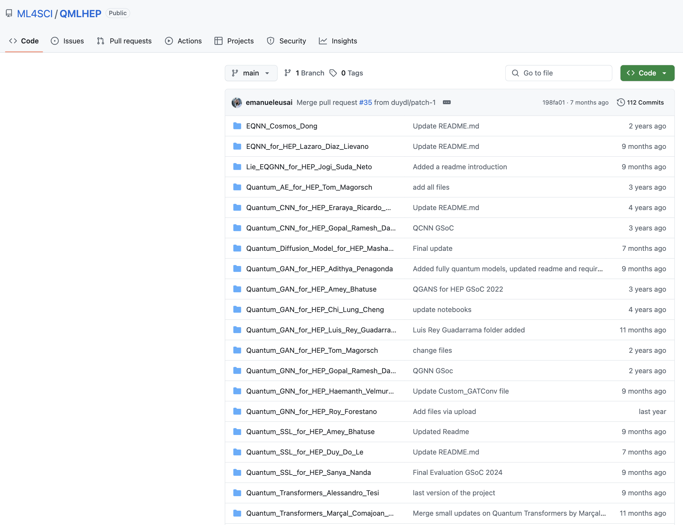

Slide 22
Quark or Gluon?
individual sample
cumulative distribution
Electron or Photon?
typical
atypical

Slide 23
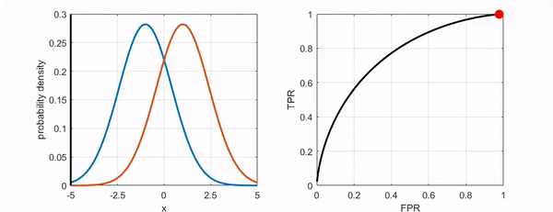
ROC Curve
A graph showing the performance of a classifier at all thresholds
Count the fraction of samples on one side of the threshold
Background
(Bad)
Signal
(Good)
Ideal
classifier
Signal fraction
above threshold
Background fraction above threshold

Slide 24
Model performance
Quantum Utility: if a quantum or hybrid architecture EITHER (1) requires less computing time OR (2) requires less power OR (3) yields more accurate results compared to the best classical device of similar size, weight and cost.
Benchmark comparison of quantum versus comparable classical architectures of comparable size/capacity
  ROC curves of TPR versus FPR
Forestano et al. 2024
Dong et al. 2024
Cara et al. 2024

Slide 25
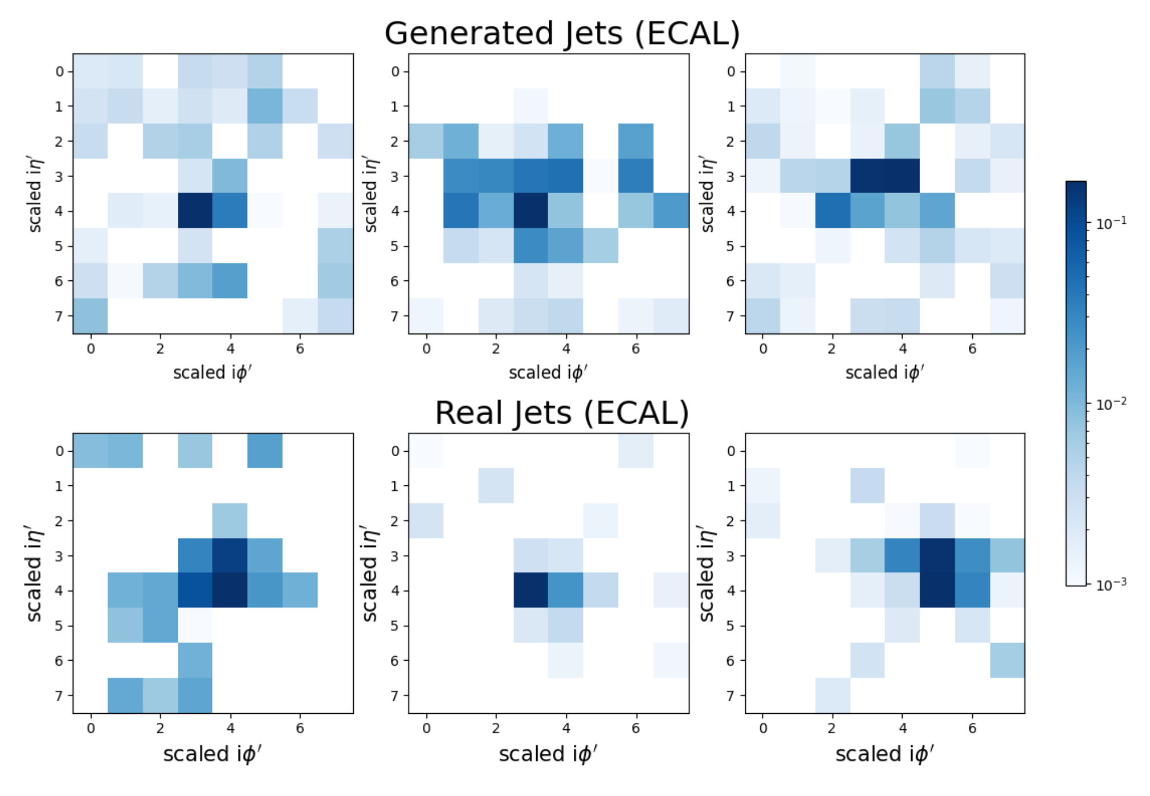
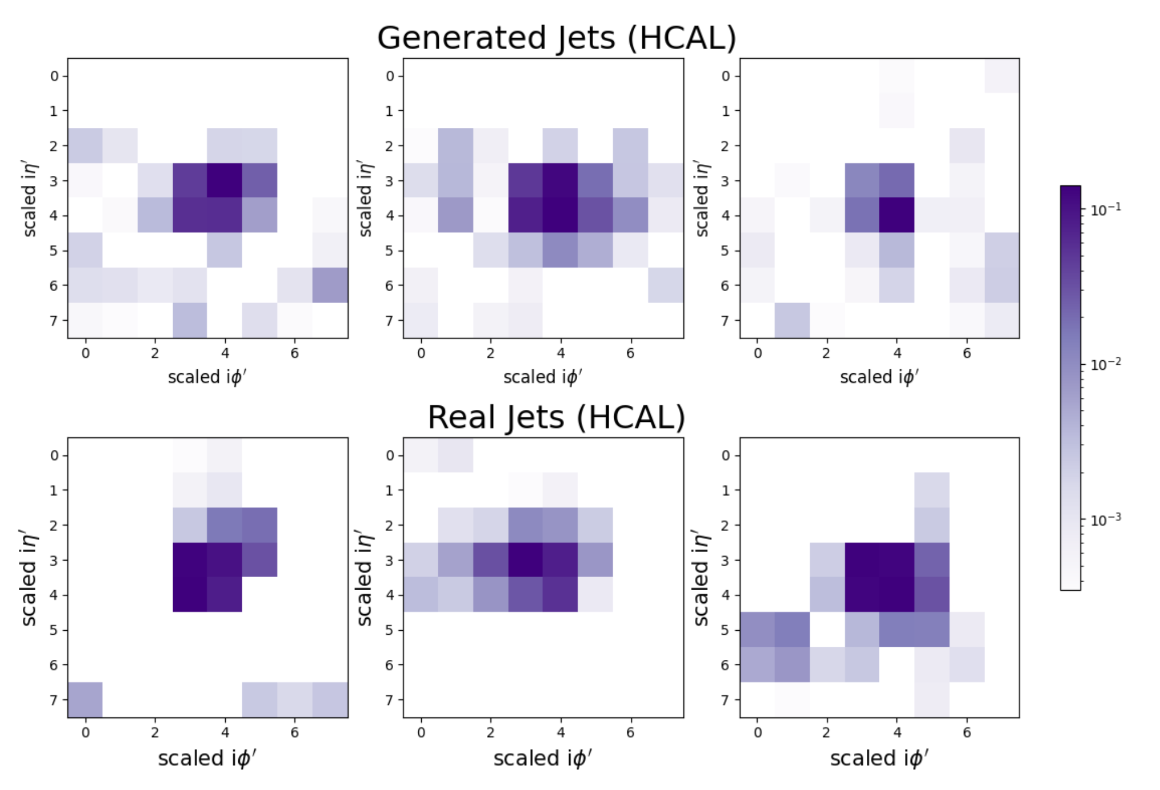
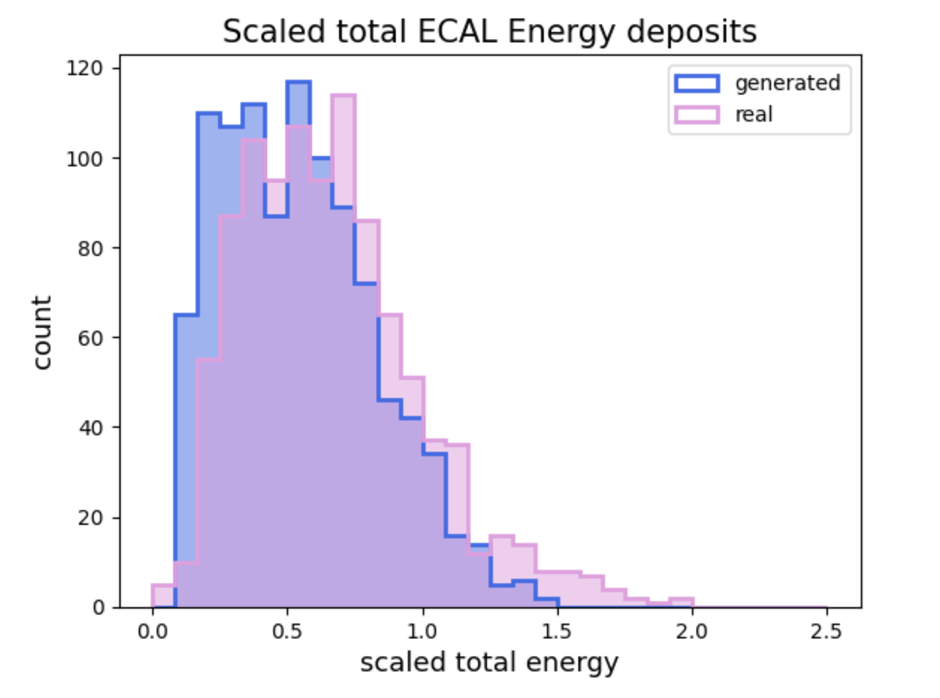
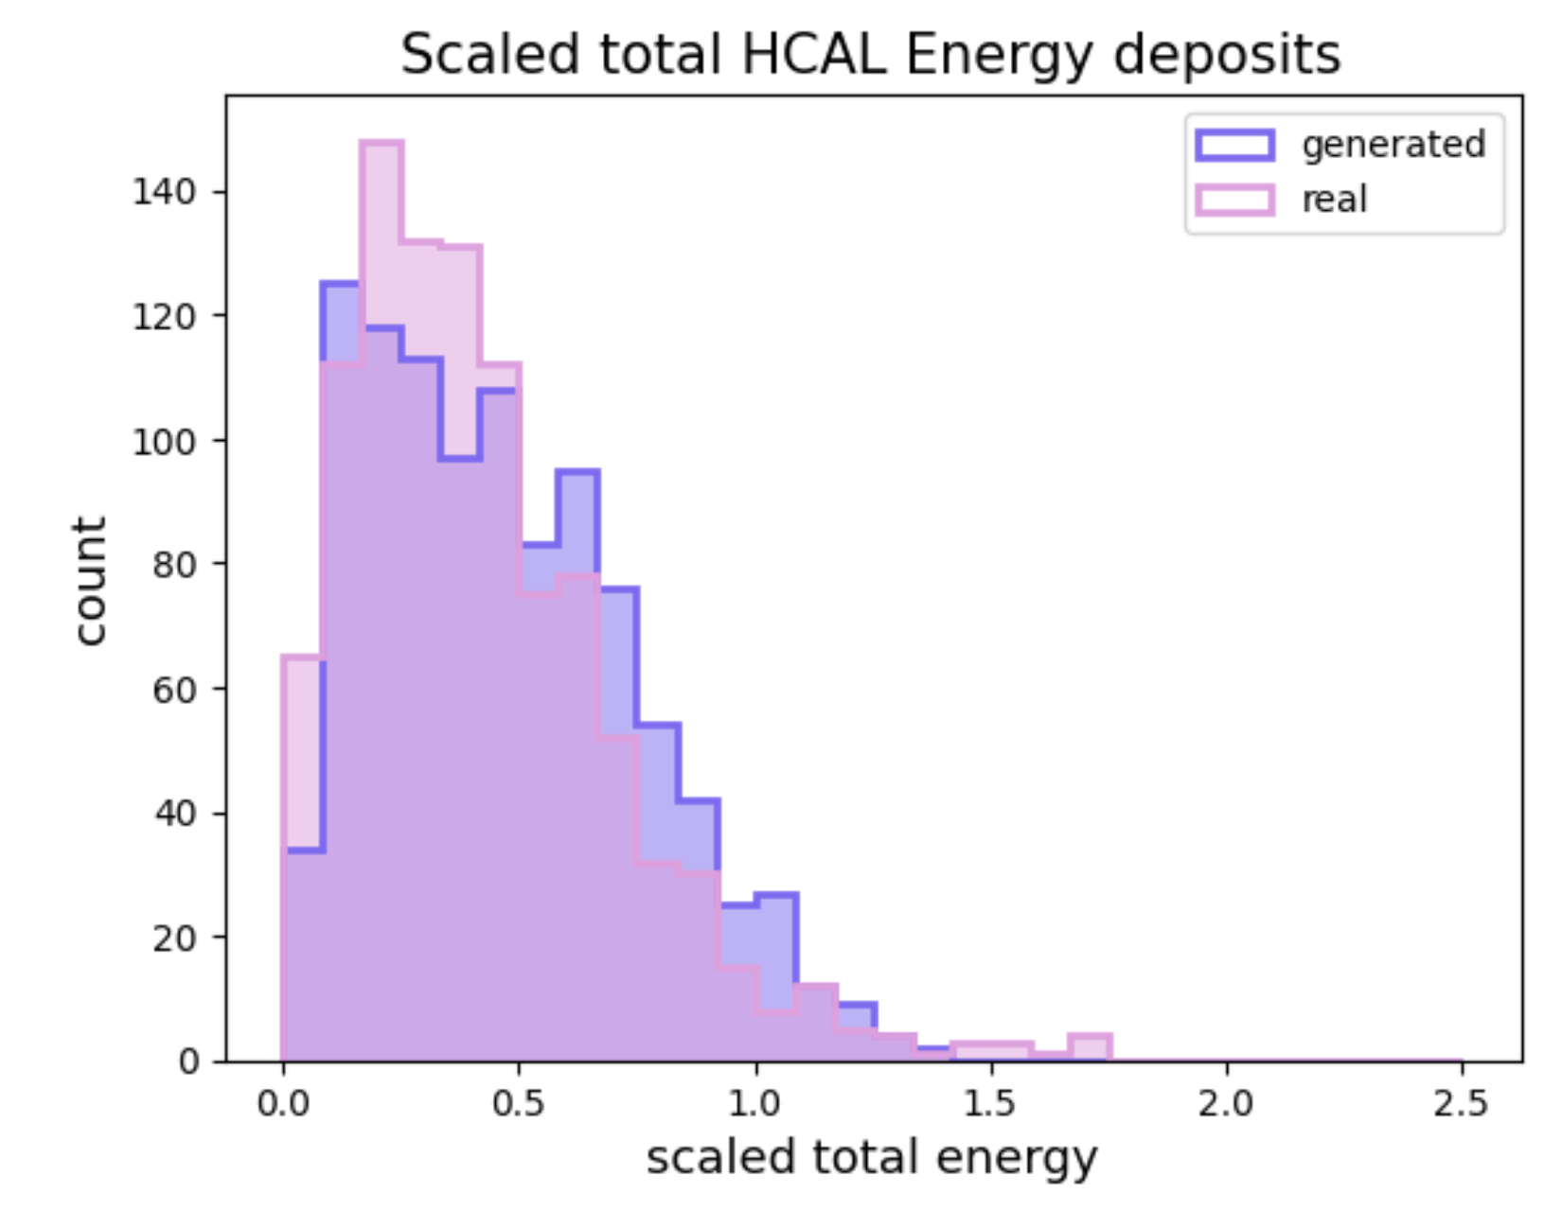
Event generation
R. Guadarrama et al. 2025
Quantum GAN for gluon jet image data

Slide 26
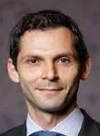
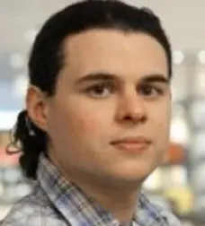
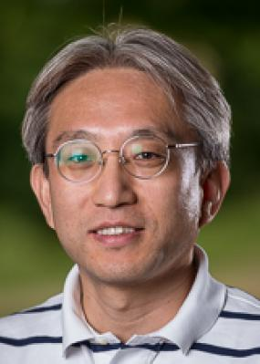
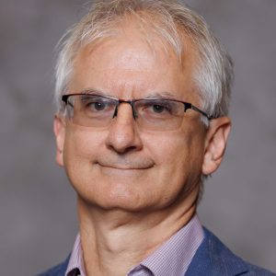

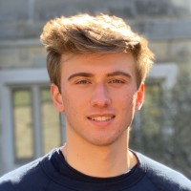


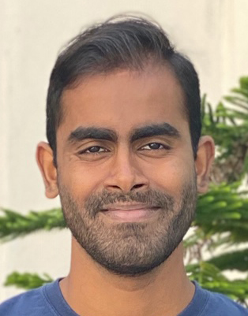
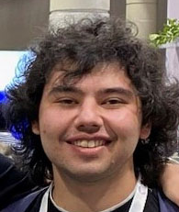
Our Team
Sergei Gleyzer
U. Alabama
Daniel Justice
CMU, PQI
Kyoungchul Kong
U. Kansas
Konstantin Matchev
U. Alabama
Katia Matcheva
U. Alabama
Roy Forestano
U. Florida
PhD 2025
Marco Knipfer
U. Alabama
Alex Roman
U. Alabama
P. Shyamsundar
Fermilab
Quantum Institute
Eyup Unlu
U. Florida
PhD 2025
+ many, many GSOC students

Slide 29
Summary
Quantum-inspired ideas can be useful to HEP analyses
Quantum machine learning is beginning to make roadways in HEP
Hybrid quantum-classical architectures show promise
  better generalization from fewer training samples
  faster convergence/learning
These were just toy examples, more work is needed to make these realistic/useful for the experiments

