Slide 1
Data-driven detection and assessment of nanoplastics in agricultural and biological systems
Department of Agricultural and Biosystems Engineering
Chenxu Yu
Department of Agricultural and Biosystems Engineering, Iowa State University, Ames, IA 50011, USA.

Slide 2
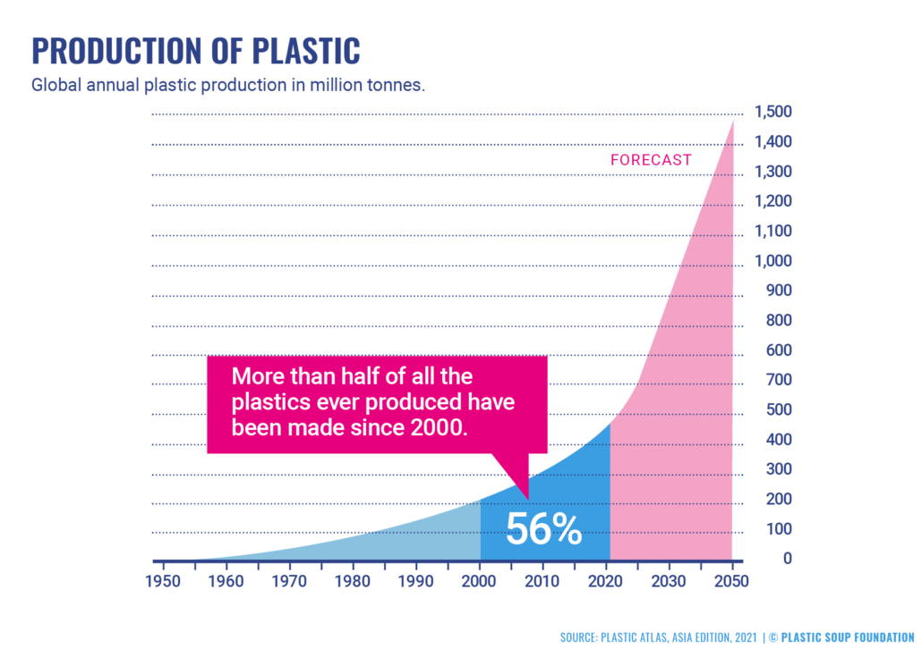
Plastics in Today’s world
Global consumption of plastics
  460 million tons in 2020
Per capita
  210 kg/yr in US
  140 kg/yr in EU
  46 kg/yr world-wide
According to UN data, PL not processed
  57% in Africa
  40% in Asia
  32% in Latin America
Plastics recycling and waste
(EU data from 2018)
  32.5% recycled
  42.6% incinerated
  24.9% waste disposal as landfills
10-20 million tons of plastics enter the ocean annually

Slide 3
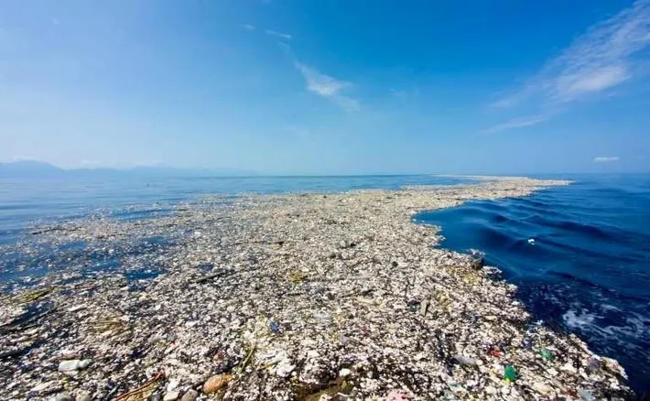
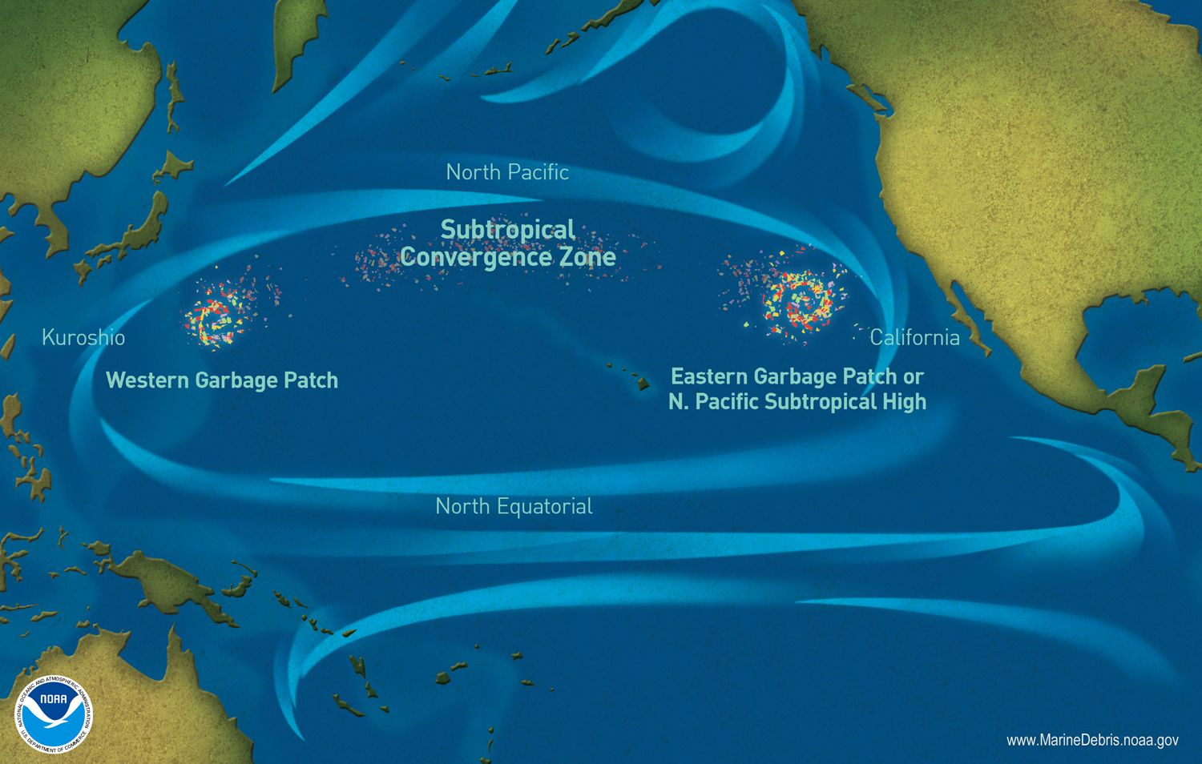
“White Pollution”
Plastics are not easily degradable
  Could take hundreds of years to fully degraded
  At ambient T, via hydrolysis and/or oxidation
  Accelerated by light, heat, microbes, etc.
  Even “biodegradable” PLAs do not degrade well in soil or ocean
Great Pacific Garbage Patch
  1.6 million km²
  79,000 tons of floating garbage
94% of GPGP are micro- or nano plastics

Slide 4
Problem: Micro- (MP) and Nano- plastics (NP)
MP and NP are ubiquitous in the environment
  indoor/outdoor air
  Water, both fresh and sea
  soil
  Plants, animals, microbes and humans
They originate from various sources
  Plastic packages
  Textiles and runoffs
  paints, tires, urban dust, etc.
NP in particular can pass through almost all industrial processes due to their tiny size as no process is designed specifically to retain them

Slide 5
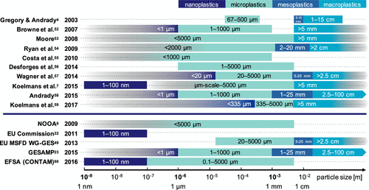
Evolving Definition of Nanoplastics
Traditional definition: 1-1000 nm
More meaningful:
Nanoplastics 1-100 nm
Submicron plastics 100-1000 nm
Microplastics 1- 1000 μm
Mesoplastics 1 -10 mm
Macroplastic > 1 cm
May enter cells
Sharing properties
Hartmann et al., Are We Speaking the Same Language? Recommendations for a Definition and Categorization Framework for Plastic Debris, Environ. Sci. Technol. 2019, 53, 3, 1039–1047
Notes:
Traditional definition of nanoplastics is based on size (<1000 nm) only, which may not be the most useful and meaningful. Particles less than 100 nm can enter cells easily and can have significant effects on cellular behavior; larger nanoparticles (100-1000 nm) may share more properties with microplastics than with their smaller counterparts, also the properties of the plastics (surface chemistry, charge, composition) all have effects on their interaction with living organisms. More recently a trend has emerged to define nanoplastics as particles less than 100 nm, while the unique behaviors of the particles in living organisms as well as in environment are dominated by their size; and define particles 100-1000 nm as submicron particles which overlaps with both nano and microplastics, and their behaviors (more nano-like or more micro-like) are also dependent on their surface chemical properties.

Slide 6
Some chilling facts…
Nanoplastics in bottled water were found to be 10-100 times higher than previously thought, at ~240,000 pieces/L, of which 90% were nano-sized.
  Min W. et al., PNAS, 121(3):e2300582121, 2024
The accumulation of micro/nano plastics in human brains has been positively correlated to neurodegenerative diseases, such as Alzheimer’s and Parkinson’s.
  Kozlov M., Nature, 638, 311, 2025.
The numbers of micro/nano plastics in decedent human brains were rising in the past decade, with statistically significant differences observed between samples collected in 2016 vs. 2024.
  Campen M., et al., Nature Medicine, https://doi.org/10.1038/s41591-024-03453-1, 2024
Notes:
Traditional definition of nanoplastics is based on size (<1000 nm) only, which may not be the most useful and meaningful. Particles less than 100 nm can enter cells easily and can have significant effects on cellular behavior; larger nanoparticles (100-1000 nm) may share more properties with microplastics than with their smaller counterparts, also the properties of the plastics (surface chemistry, charge, composition) all have effects on their interaction with living organisms. More recently a trend has emerged to define nanoplastics as particles less than 100 nm, while the unique behaviors of the particles in living organisms as well as in environment are dominated by their size; and define particles 100-1000 nm as submicron particles which overlaps with both nano and microplastics, and their behaviors (more nano-like or more micro-like) are also dependent on their surface chemical properties.

Slide 7
Key entry points of NP into Agr/Bio Systems
Most common types: acrylic, acrylonitrile butadiene styrene (ABS), polyamide (nylon), polycarbonate (PC), polyethylene (PE), polyethylene terephthalate (PET or PETE), polylactic acid (PLA), polypropylene (PP), polystyrene (PS), polytetrafluoroethylene (Teflon), polyurethane (PU), polyvinyl chloride (PVC)
Yu et al., Bioanalytical approaches for the detection, characterization, and risk assessment of micro/nanoplastics in agriculture and food systems, Analytical and Bioanalytical Chemistry 414 (16), 4591-4612

Slide 8
Detect NPs at various entry points
Water and soil: environmental samples
Plant
  Roots
  Foliar uptake via stomata
Animal
  Inhalation
  Dermal contact
  Ingestion
  Injection/wounds
Microbes
  endocytosis
Human tissues and cells
Key entry points into ABS

Slide 9
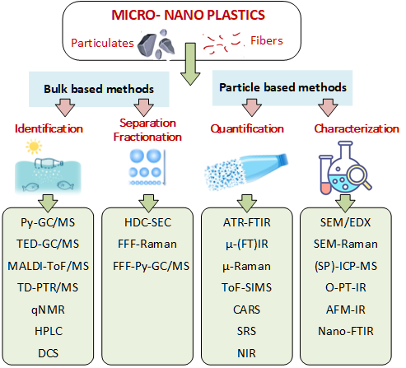
Existing methods for NP detection/characterization and their limitations
Low throughput
  Particle-based methods
Destructive
  Pyrolysis based, yield compositional/chemical info but destructive
No chemical/compositional info from nondestructive methods
  SEM/TEM/AFM/microscopy
Limited spatial resolution for identify individual NPs
  Most spectroscopic methods have this problem
Complex lab operation, not for onsite analysis
  A key problem for assessing NPs at various entry points

Slide 10
Detection and Characterization of M/NP in Irrigation Water and Soil
Sample type | Separation | Concentration quantification | Composition identification | Size characterization
Surface water | ultrafiltration, AF4 | UV spectroscopy | GC-MS | LSS
Surface water | – | ICP-MS | – | SEM
Surface water | filtration | – | SERS | optical microscopy, SEM
Surface water | filtration, CPE | GC-MS | GC-MS | TEM
Surface water | filtration, centrifugation | UV spectroscopy | – | LSS, SEM
Surface water | filtration, CPE | GC-MS | GC-MS | SEM
Surface water | protein extraction, CPE | GC-MS | GC-MS | SEM, LSS
Surface water | filtration | – | SERS | TEM, LSS
Pure water | AF4 | TOC test | – | LSS
Pure water | H₂O₂ digestion, ultrafiltration | – | GC-MS | LSS, TEM
Pure water | – | – | Raman tweezer | optical microscopy
Farmland soil | water extraction, AF4 | UV spectroscopy | GC-MS | LSS
Separation
  Filtration
  Asymmetrical flow-field-flow fractionation
  Cloud point extraction (CPE)
  AF4: size-based separation
Detection
  Microscopy
  Mass spectrometry
  Spectroscopy

Slide 11
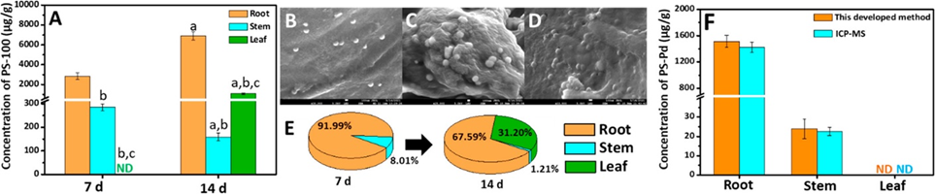
Risks associated with M/NP in Food Crops
Quantification and identification of nanoplastic uptake in cucumber tissues
Uptake of 200 nm and 2 μm PS MP via crack entry at sites where lateral roots grow; and these particles are translocated through the epidermal layers and diffuse to the xylem and then move to the shoots driven by transpiration.
The use of non-food plants that uptake NP abundantly in order to remediate the soil contamination analogous to heavy metal phytoremediation could offer a remedy
NP (PS and PTE) uptakes were found to:
Increase levels of hydrogen peroxide in roots of rice; decrease the length of roots but promote lateral growth of roots;
Activate carbon metabolism but inhibit synthesis of lignin and Jasmonic acids
Interact with As and Cd soil to inhibit growth of A. thaliana
Li et. al, (2020). Effective uptake of submicrometre plastics by crop plants via a crack-entry mode. Nature Sustainability 3(11), 929-937
Notes:
A. Concentrations of nanoplastics in the roots, stems, and leaves after exposure to 50 mg/L of 100 nm PS nanoplastics for 7 and 14 days with the developed method (n = 5, aP < 0.05, compared with the same tissues in the 7-day group; bP < 0.05, compared with the roots at the same exposure time; cP < 0.05, compared with the stems at the same exposure time). (B–D) SEM images of nanoplastics inside the roots (B), stems (C), and leaves (D) of a cucumber plant after exposure to 50 mg/L of 100 nm PS nanoplastics for 14 days (scale bars = 100 nm). (E) Relative tissue burdens of nanoplastics in the roots, stems, and leaves. (F) Concentrations of PS-Pd nanoplastics in the roots, stems, and leaves after exposure to 5 mg/L PS-Pd nanoplastics for 4 days with the developed method and ICP-MS. No statistically significant differences were obtained between these methods using t-tests. ND: not detected

Slide 12
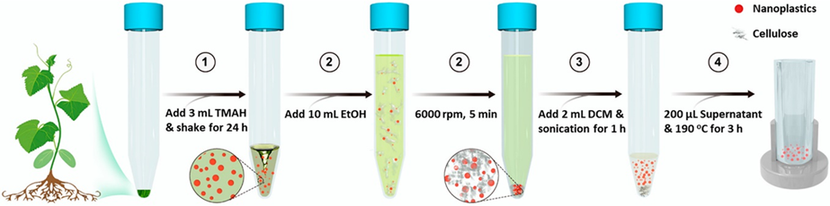
Detection of NP in food crops
Food Crop | Sample Preparation | Analytical Detection Method
Fruits and Tubes (apple, pear, carrot, potato) | Peeling & blending, Drying, Mineralization with HNO₃, Dichloromethane extraction | SEM-EDX
Roots (wheat, lettuce) | Plant roots tips exposed to suspensions of fluorescent labeled NPs (PS, PMMA). Standard preparatory methods for LSCM | LSCM, SEM, AFM, X-ray computed microtomography
Whole plant (wheat) | Plants grown in agar growth media with fluorescently labeled M/NPs 40 nm & 1 μm | LSCM, Pyrolysis GC-MS
Seeds (Onion, wheat) | Seed exposed to ~50-100 nm dyed PS NPs during germination. | TEM, SEM and LSCM
Leaves (corn) | Amino and carboxy modified fluorescently dyed 22 nm NPs were dispersed and spread on the surface of leaves | SEM
Quantify PMMA: extraction, pyrolysis and GC-MS
Li et al. (2021). Quantification of Nanoplastic Uptake in Cucumber Plants by Pyrolysis Gas Chromatography/Mass Spectrometry. Environmental Science & Technology Letters 8(8), 633-638

Slide 13
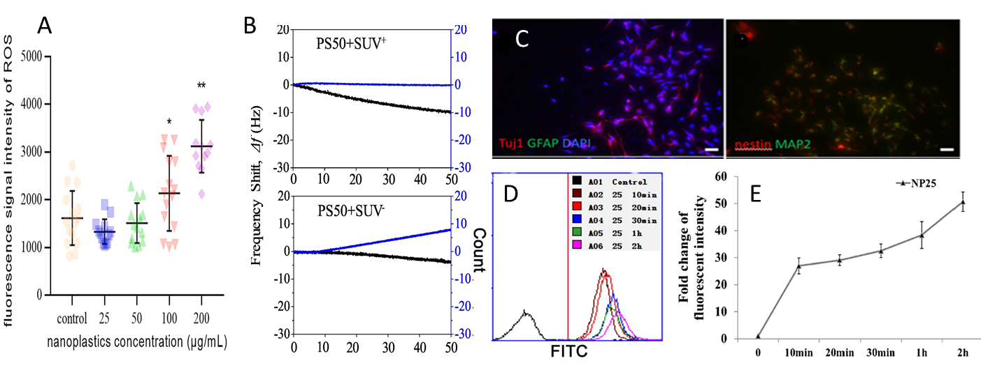
Risks associated with M/NP in Animals/Humans
Animal/human uptake of NPs is primarily through gastric ingestion and pulmonary inhalation
NP (PS and PTE) uptakes were found to:
Entering cells via endocytosis;
Penetrate cellular lipid bilayer and alter membrane structure;
Related to elevated inflammation and oxidative stress
Related to altering metabolic homeostasis
Li et. al, (2020). Effective uptake of submicrometre plastics by crop plants via a crack-entry mode. Nature Sustainability 3(11), 929-937
Notes:
Instrument analysis of nanoplastics/human cell interaction. (a) fluorescence emission intensity in ROS quantitation, image taken from Facciola et al. [65] with permission, (b) interaction between 50 nm polystyrene (PS50) nanoplastics and small unilamellar vesicles (SUVs) monitored by QCM-D, image taken from Liu et al. [70] with permission, (c) immunofluorescence staining of human neuroblastoma cells, image taken from Ban et al. [71] with permission, (d and e) flow cytometry analysis of the uptake of 25 nm polystyrene nanoplastics by human A549 cells at different times (10, 20, 30, 60, 120 min

Slide 14
Detection of NP in Animals and Humans
NPs, with their large area to volume ratio, are more susceptible to contamination of hydrophobic pollutants;
Hydrophobic fluorescent probes (e.g., DCVJ) are used for NP detection
Receptors are also used to detect NPs via SPR
Estrogen receptor/SPR
Microfluidic sensor for NPs
SPR/Immunoassay for NPs

Slide 15
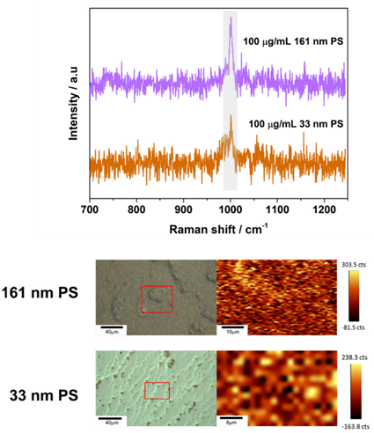
Characterization of NPs in food matrices
Nondestructive methods
Raman microscopy
FTIR microscopy
SERS
SEM/XPS
Destructive
ICP-MS
Some findings:
Up to 5857 MP particles/L in white wine with PE stoppers
M/NPs found in oysters. mussels, and other shellfish
PE/HDPE found in vinegar, can lead to 4.9 and 21.2 mg/kg/bw/year exposure
MNPs found in tea brewed from teabags
Sample preparation is a big challenge. Typically, samples were washed, then followed with filtration and particle extraction

Slide 16
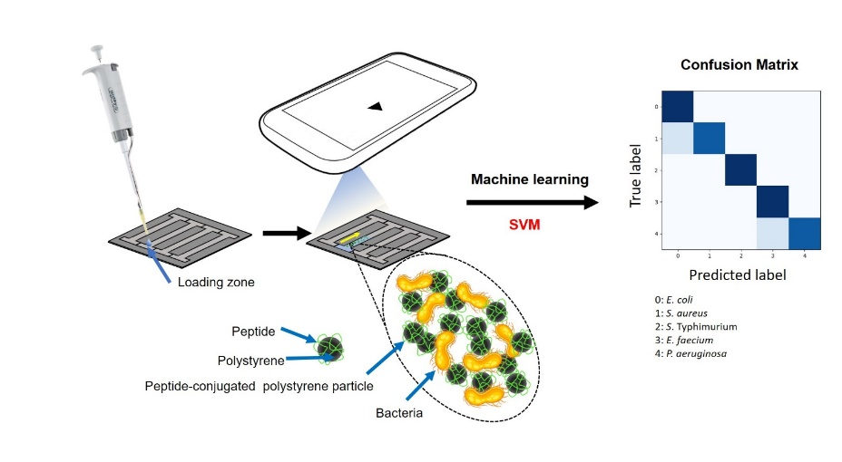
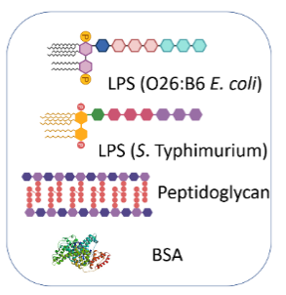
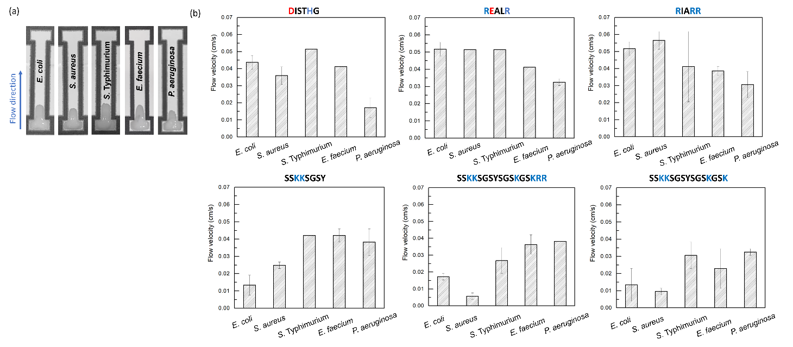
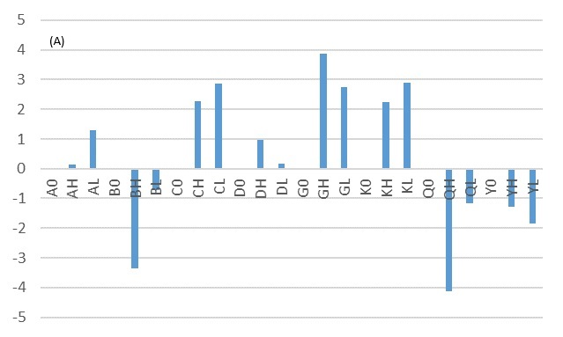
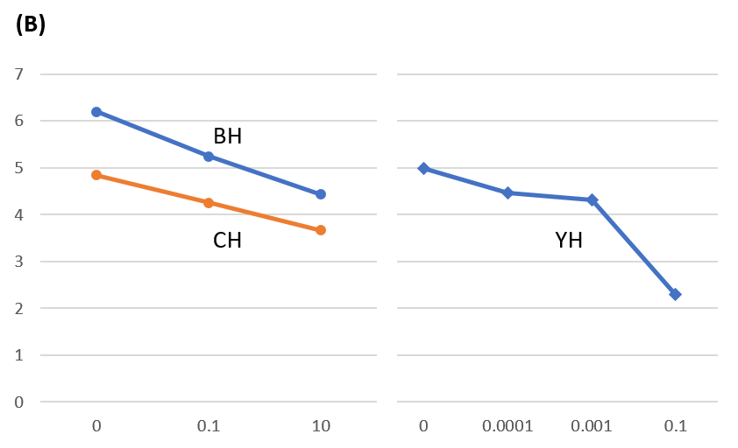
Detect NPs rapidly and reliably using paper-based microfluidic chip (pMFC)
A set of peptide-conjugated PS nanoparticles and bacterial mixtures are loaded into the pMFC channels, and capillary flow velocities are measured using the smartphone’s video capture capability. A multi-dimensional training data set was collected and analyzed via ML to predict the dominant bacterial species from various bacterial mixtures from field water and food (milk) samples.
(A). Normalized capillary flow velocities of 500 nm PS nanoparticles with various pre-loaded reagents. A = aspartic acid, B = bovine serum albumin (BSA), C = cysteine, D = histidine, G = glycine, K = lysine, Q = glutamine, Y = lysozyme, 0 = zero concentration (normalization standard), H = high concentration, and L = low concentration. (B). Standard curves for estimating the concentration of polystyrene nanoparticles (in ng/μL) using the selected pre-loaded reagents (BH, CH, and YH).

Slide 17
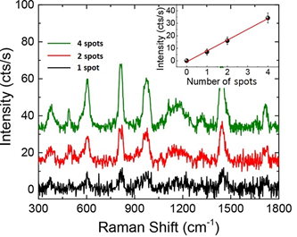
Characterization of NP-protein interaction
Step 2: Monitoring NP-protein interaction
  AFM/Raman spectroscopy (TERS/SERS)
  PiFM, nano-FTIR
Step 1: Making controlled NP substrates via lithography
  Size, shape, composition
  Weathering, aging, surface chemistry

Slide 18
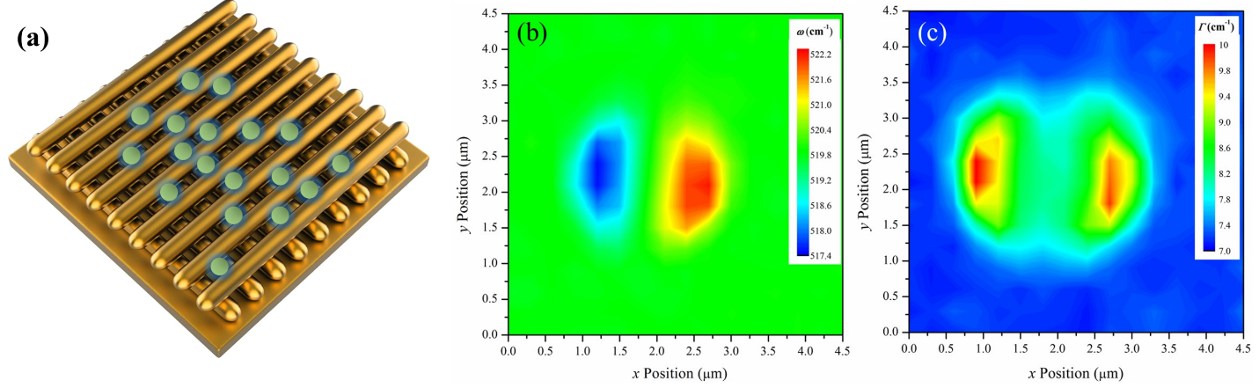
Characterization of NP-protein interaction
Step 3: Raman imaging to illustrate NP-protein interaction
A substrate with cross-Au nanowires from Pico SERS Inc. Also scattered NP on the substrate are shown schematically. (b) Asymmetric Raman wavenumber distribution and (c) linewidth distribution caused by a 1200 nm SiO₂ particle in our preliminary study

Slide 19
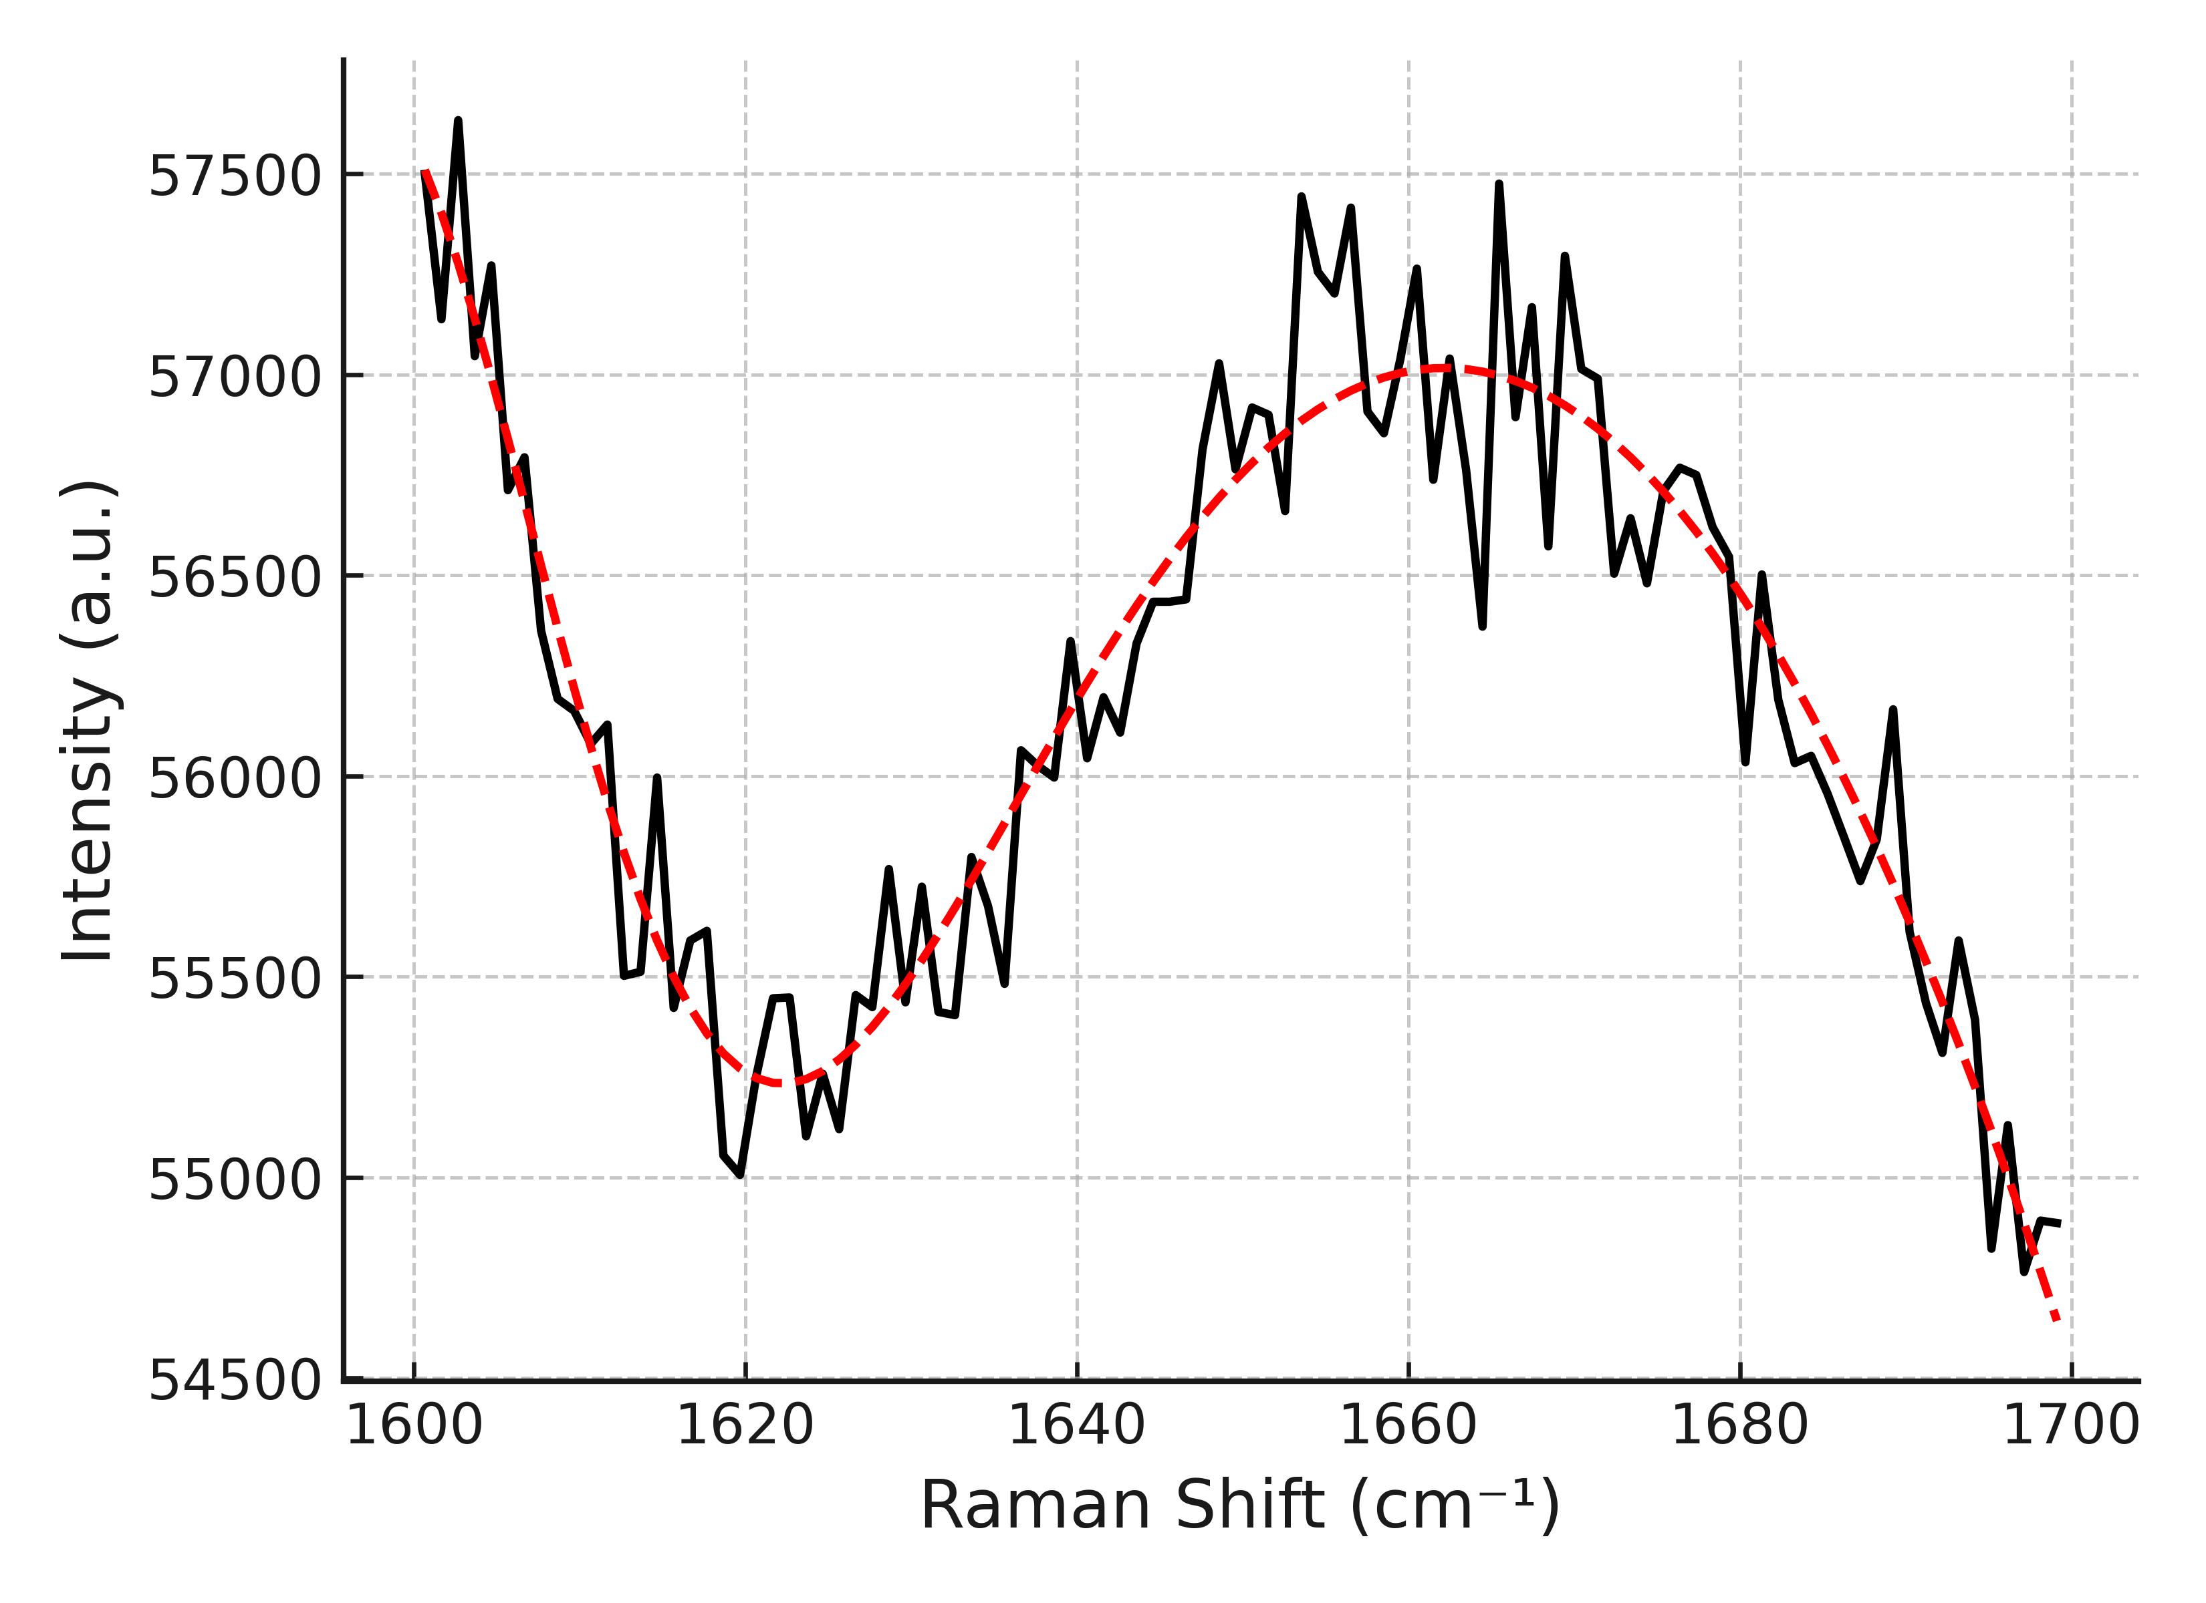
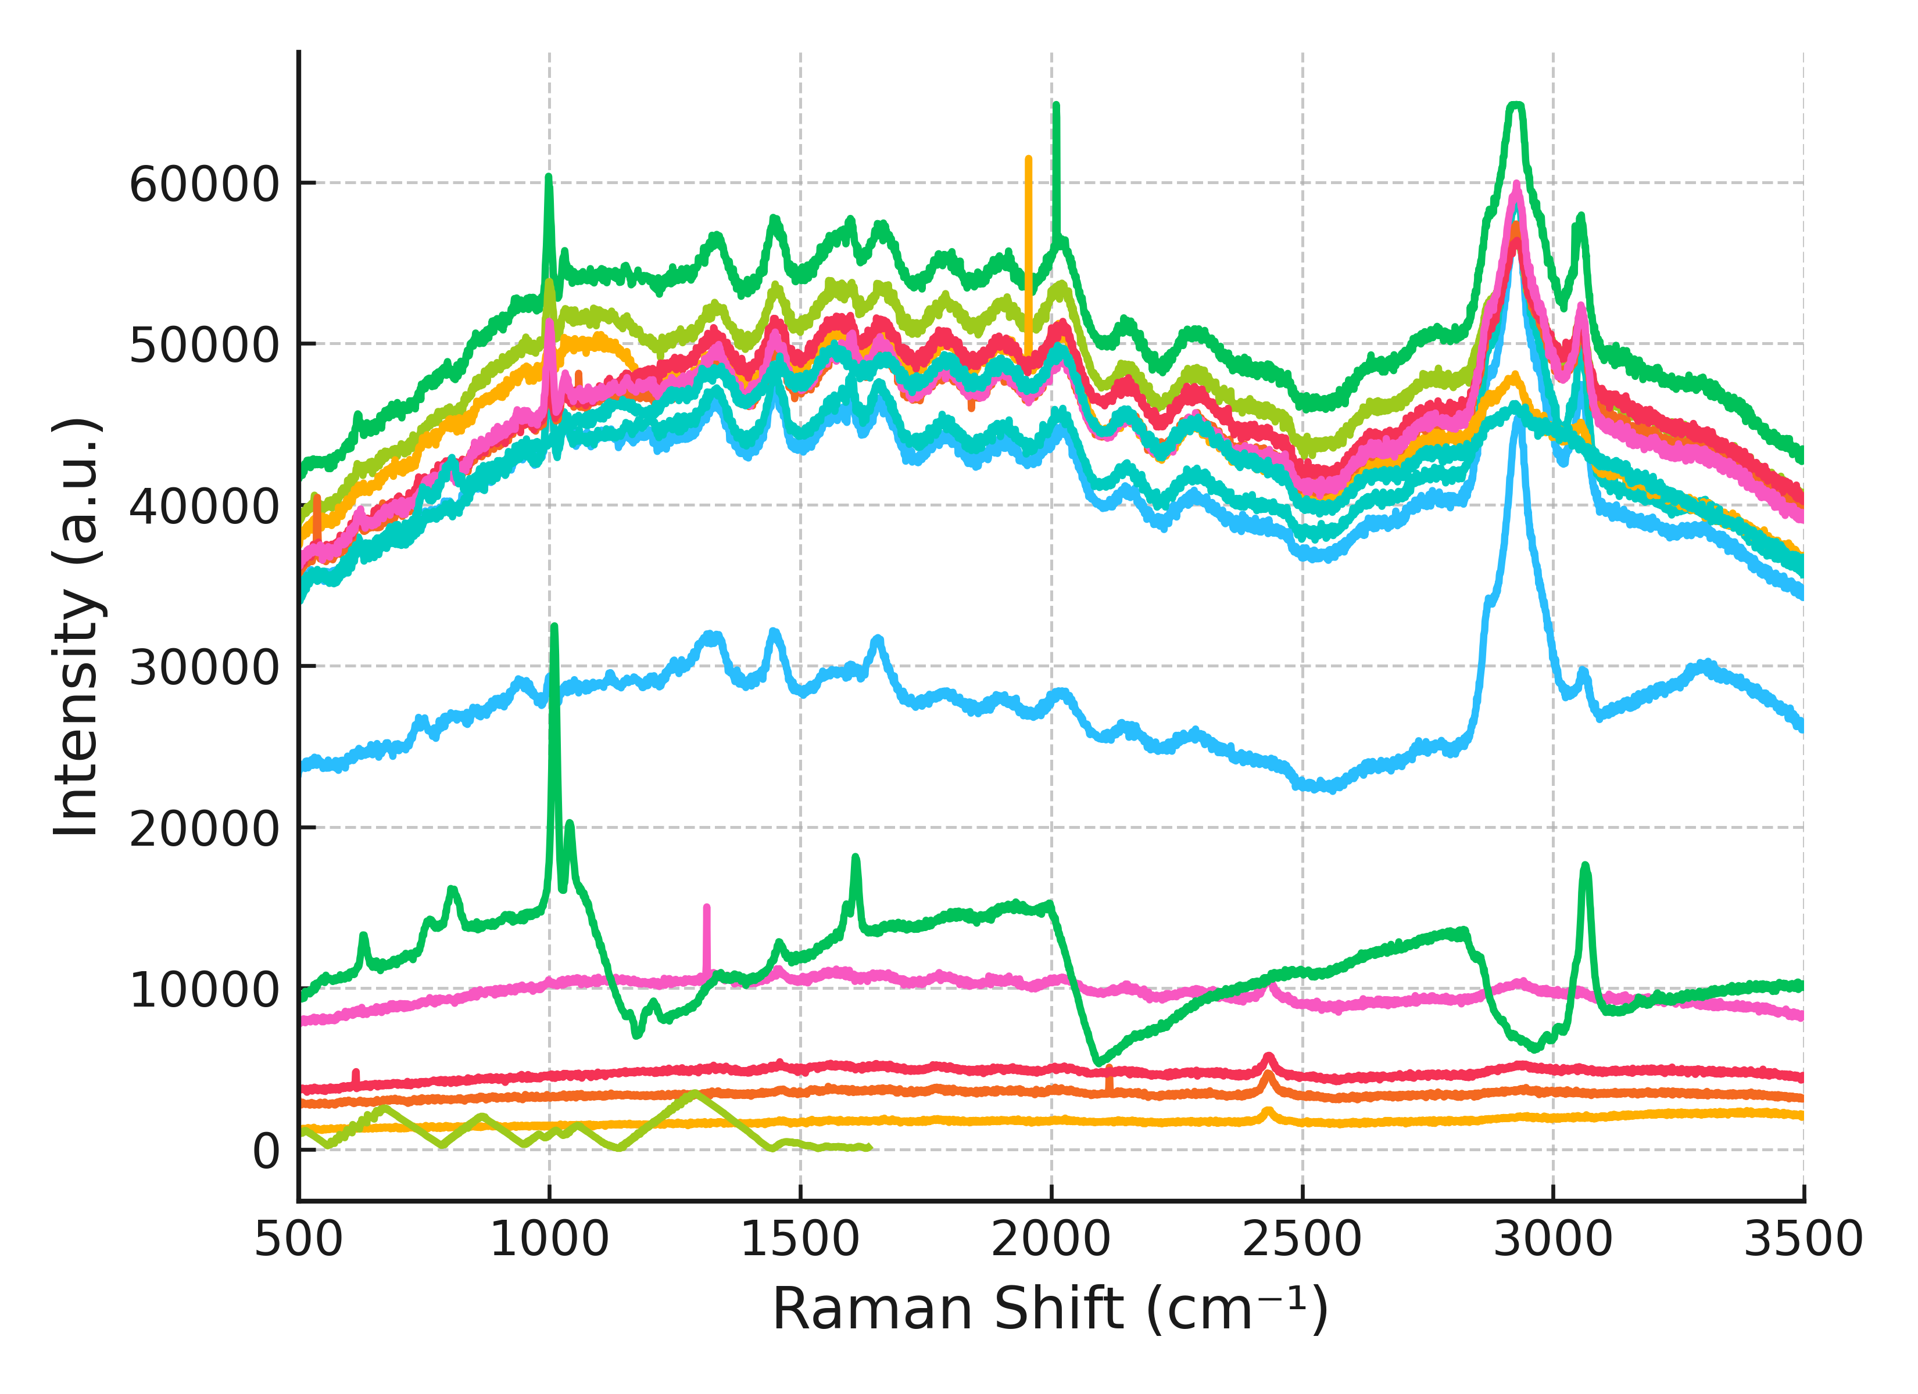
Characterization of NP-protein interaction
Raman microspectroscopic characterization
  Polystyrene (PS) binding with Bovine Serum Albumin (BSA)
BSA concentration goes up

Slide 20
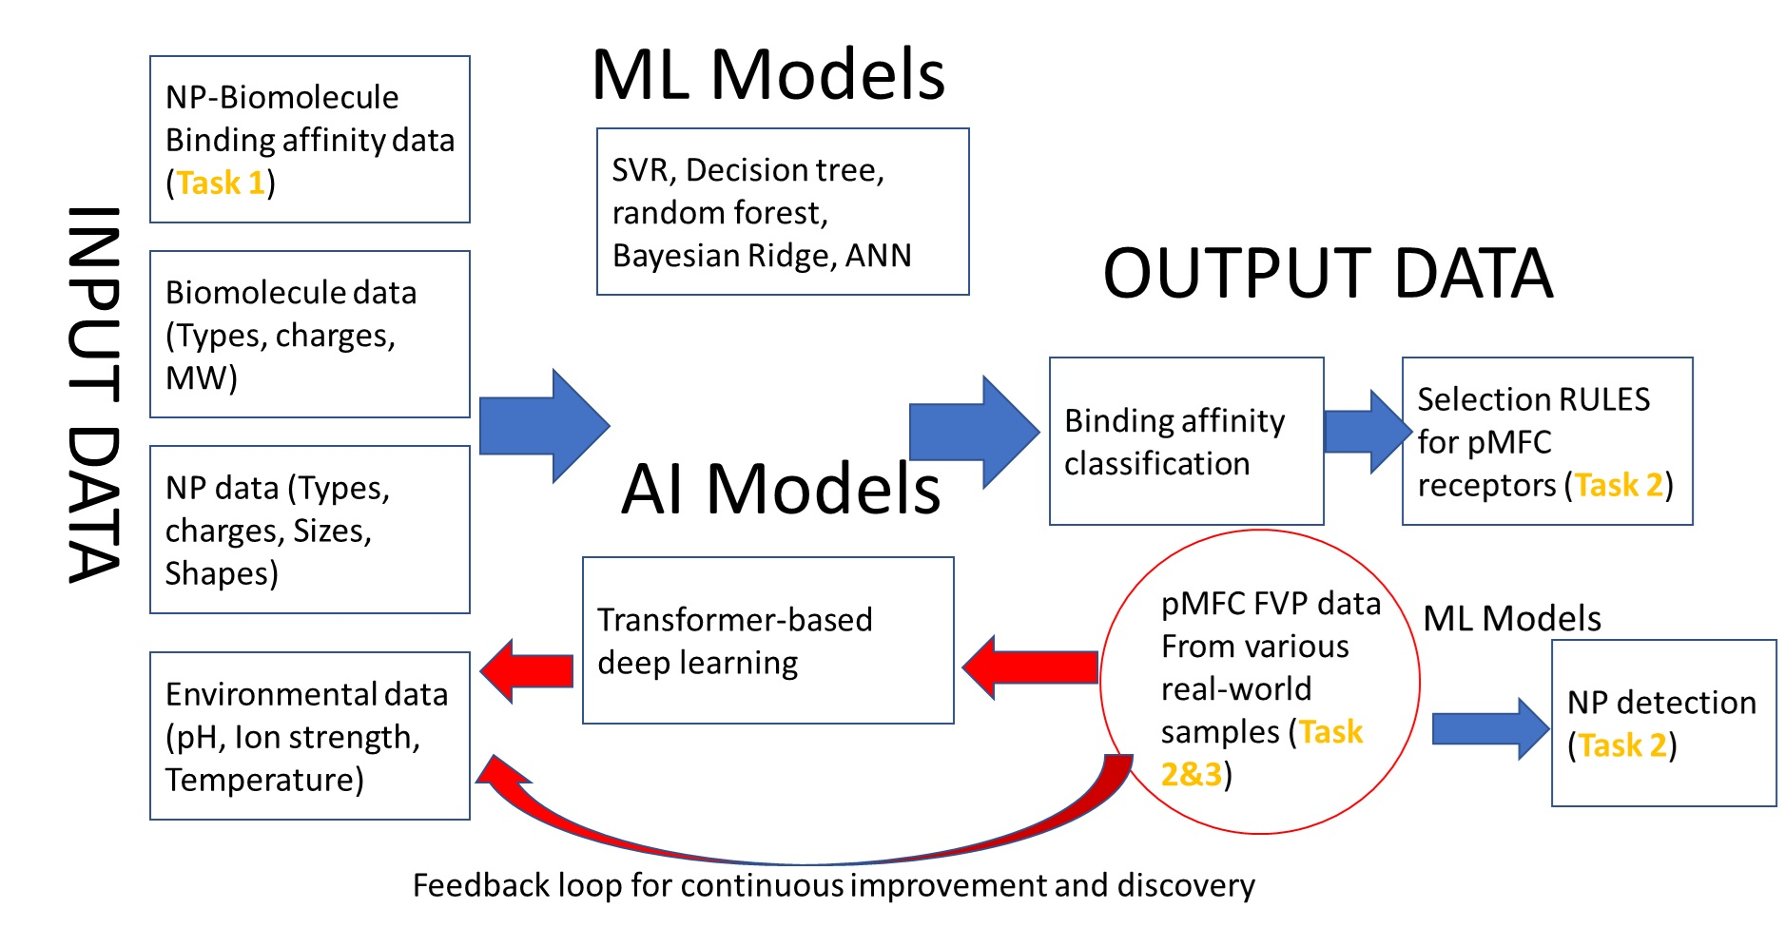
ML- and AI-Powered Data Analysis

Slide 21
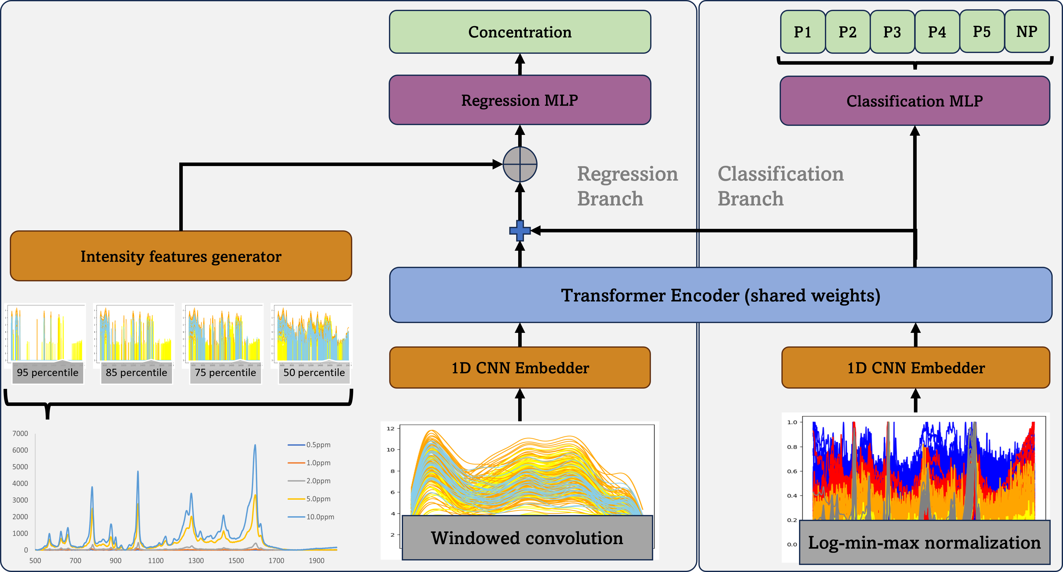
A transformer scheme to analyze Raman data
Concentration-dependent spectral data
PS+BSA

Slide 22
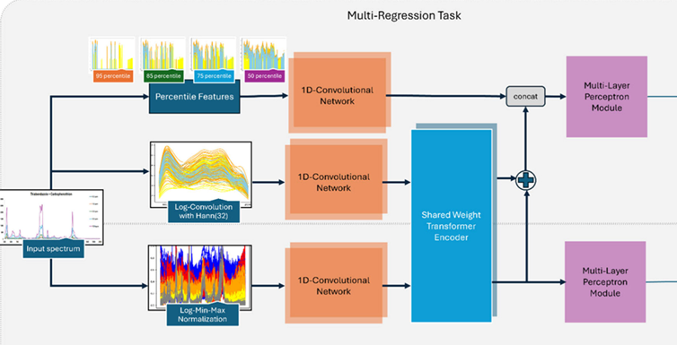
A transformer scheme to analyze Raman data
Conc. Pred.
Conc 1 | PPM
Conc 2 | PPM
Conc 3 | PPM
Conc 4 | PPM
Conc 5 | PPM
NP+BSA
NP Pred.
NP1 | 0.2
NP2 | 0.98
NP3 | 0.3
NP4 | 0.2
NP5 | 0.1
NP2 in presence

Slide 23
Challenges and Future directions
New sensing technologies should be tested and validated using environmental MP/NPs
  The vast majority of studies on M/NP and cellular activities were based on using polystyrene NP as a model. However, environmental micro-nanoplastic materials are different in composition, size distribution, surface properties, and shape factors, which is greatly affecting their transport properties, affinity to environmental matrices, and aggregative stability.
Rapid field-deployable sensors for quantitative characterization of the MP/NP materials
  Micro- and nanoplastics have typically been detected and quantified with analytical instruments in a laboratory. Such detection is thus neither portable nor in situ. There are several attempted efforts of detecting and quantifying MPs/NPs from water samples in a portable and situ manner. However, such devices utilize working principles that are not very different from the lab-scale analytical instruments, and therefore are facing the same types of limitations;

Slide 24
Challenges and Future directions
Big data approach for the detection and quantification of the MP/NP
  Due to the complexity of the food, agricultural and environmental matrices, it is hard to expect that the problem of microplastic detection and quantification can be solved with standalone sensing devices or instruments. However, implementation of the risk-based and knowledge-based decision support system that includes data from the environmental monitoring, matrix characterization, and data on the micro-nanoplastics generation, distribution, and migration will increase the reliability of the sensors data overcoming physical limits of the detection.
High throughput sensing technologies to characterize NP-bio interactions
  Existing technologies cannot rapidly provide information on NP-bio interaction in real time, and the throughput is generally very low. More improvement on limit of detection (LOD), resolution and throughput is much needed.

Slide 25
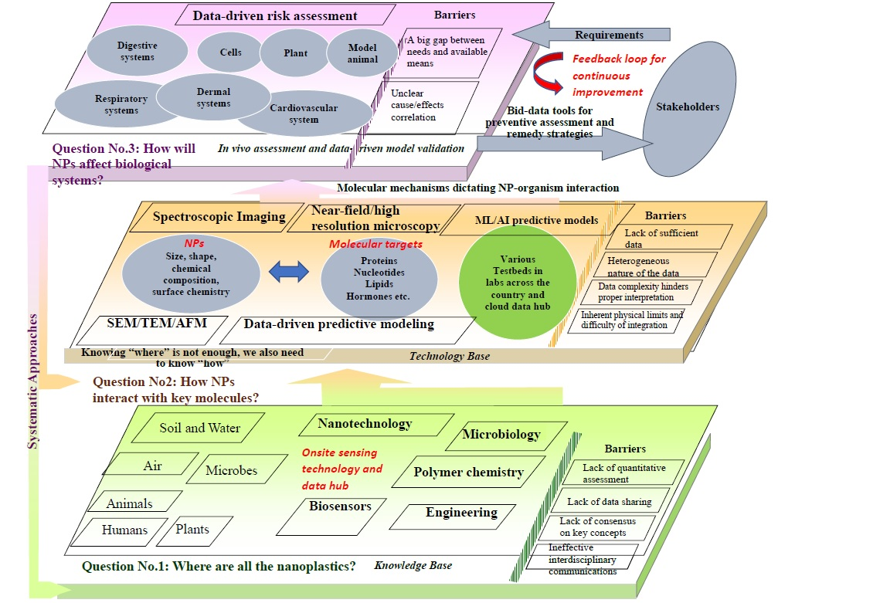
Data-driven systematic approach

Slide 26

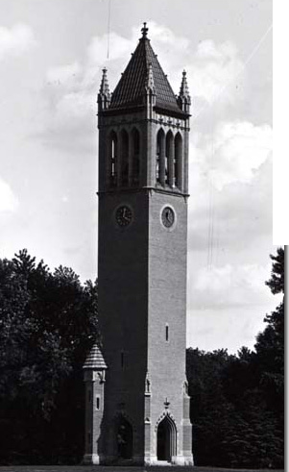

Acknowledgement
Collaborators
Xinwei Wang, Iowa State University
Paul Takhistov, Rutgers University
Evangelyn Alocilja, Michigan State University
Jose Reyes de Corcuera, University of Florida
Margaret W. Frey, Cornell University
Carmen L. Gomes, Iowa State University
Yu J. Mao, Oklahoma State University
Eric S. McLamore, Clemson University
Mengshi Lin, University of Missouri
Olga V. Tsyusko, University of Kentucky
Tzuen-Rong J. Tzeng, Clemson University
Jeong-Yeol Yoon, University of Arizona
Anhong Zhou, Utah State University
Notes:
need modification

Slide 27
Questions?

