Slide 1
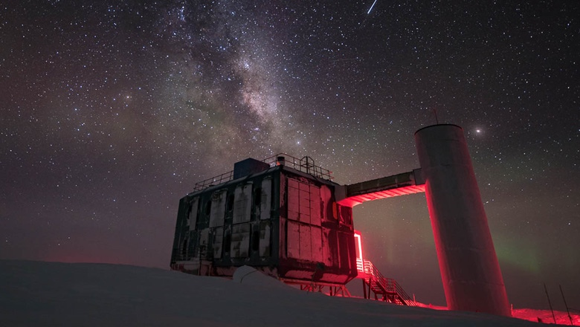
Advancing Astroparticle Physics with AI
Machine Learning Techniques and Recent Results from the IceCube Neutrino Observatory
Matthias Plum
South Dakota Mines

Slide 2
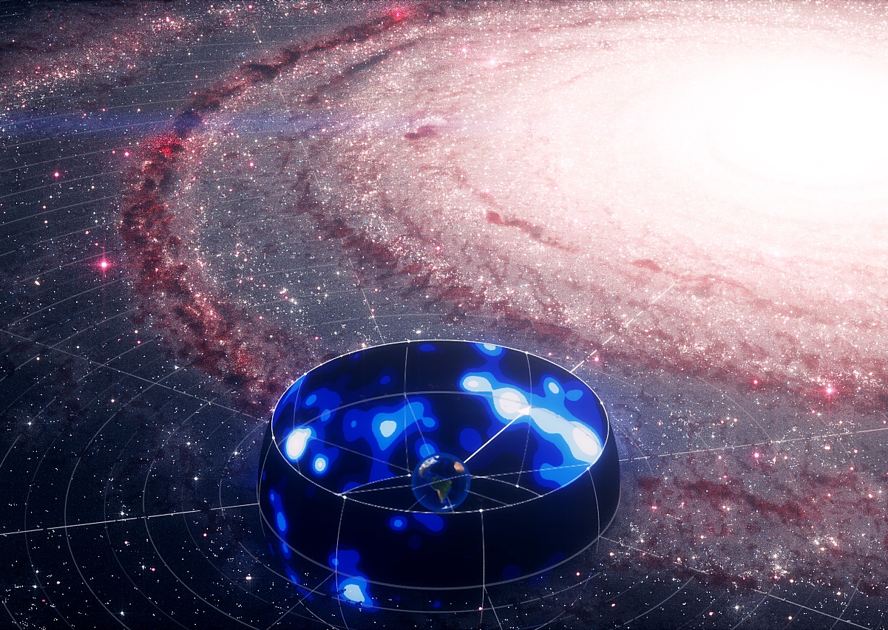
Outline
‘Brief’ Introduction to Astroparticle Physics
IceCube Neutrino Observatory
Machine Learning Analyses
Galactic Plane Neutrinos
High energy Particle physics
GraphNeT Toolkit
Summary
2

Slide 3
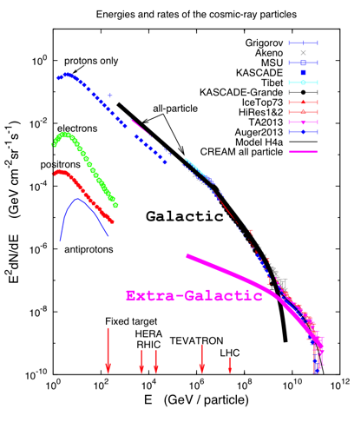
Astroparticle physics Why are we doing it?
Measuring particles from outer space for 100 years
Energies way beyond state-of the-art accelerators – Nature’s free big accelerator ☺
Astroparticle physics is one way to probing the universe and looking for new physics
axeon
3

Slide 4
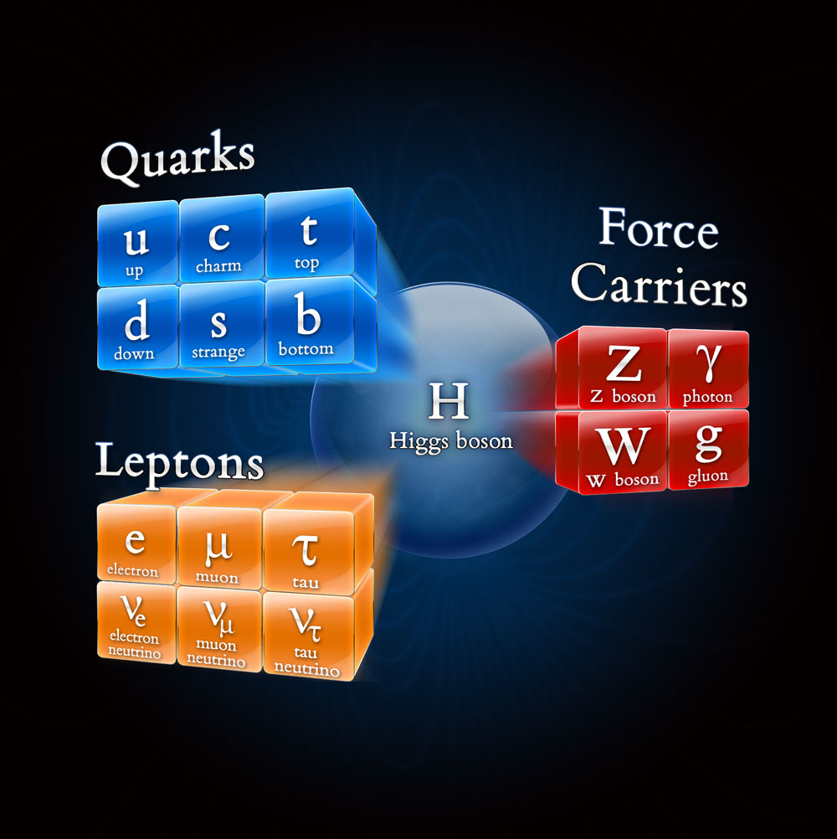
Standard Model of Particle Physics
The Standard Model is the most complete and experimentally verified theory of fundamental particles and forces
What It Explains
Why atoms exist (forces + particles)
Origins of mass (Higgs field)
Foundation of particle physics and cosmology
What It Doesn't Explain
Gravity
Dark matter & dark energy
Neutrino masses (fully)
Why It Matters Across Fields
Tools from particle physics enable advances in AI, medical imaging, computing, and materials science.
The model’s search for completeness inspires interdisciplinary innovation
4

Slide 5
Astroparticle physics
Cosmic ray source
High energy cosmic ray & neutrino sources and acceleration processes are are still unknown
/ Fe
Cosmic rays as messenger particles:
Highest energy particle we know
Charged nuclei (Proton up to Iron)
Deflected by magnetic field
Interact with atmosphere
….relatively easy to detect
Neutrinos as messenger particles:
electrically neutral
Unabsorbed
Reveal the sources of cosmic rays
… but very difficult to detect
n
Galactic magnetic field
5

Slide 6
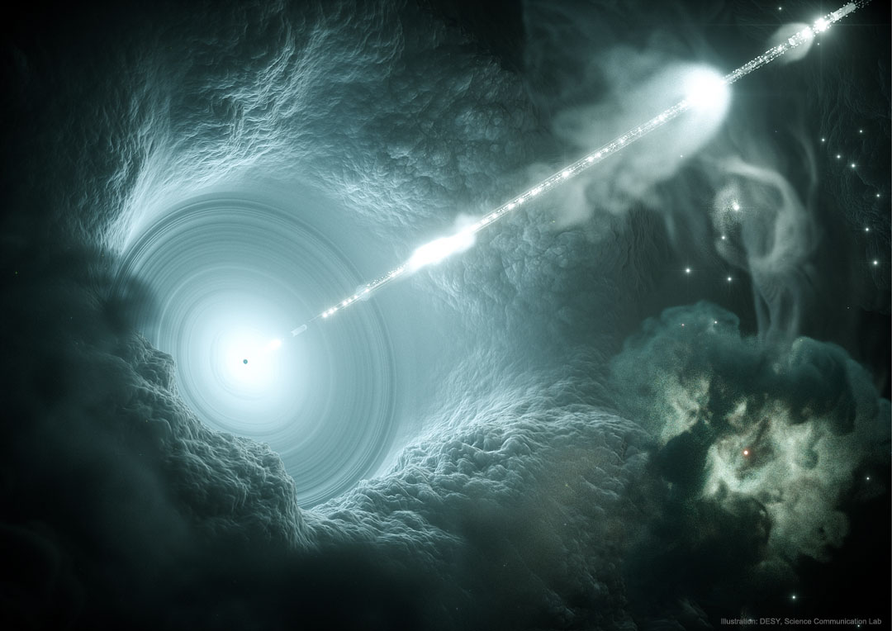
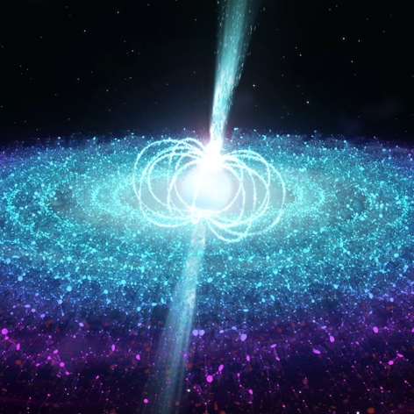
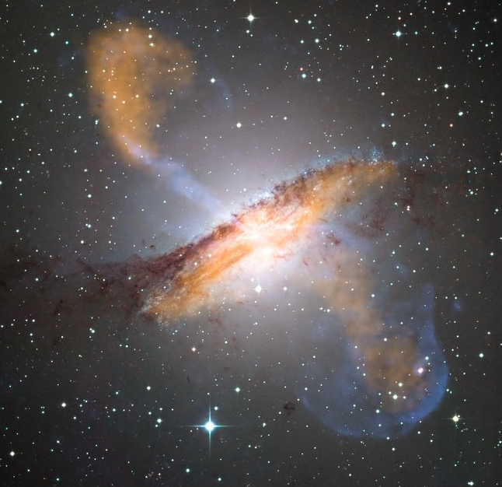
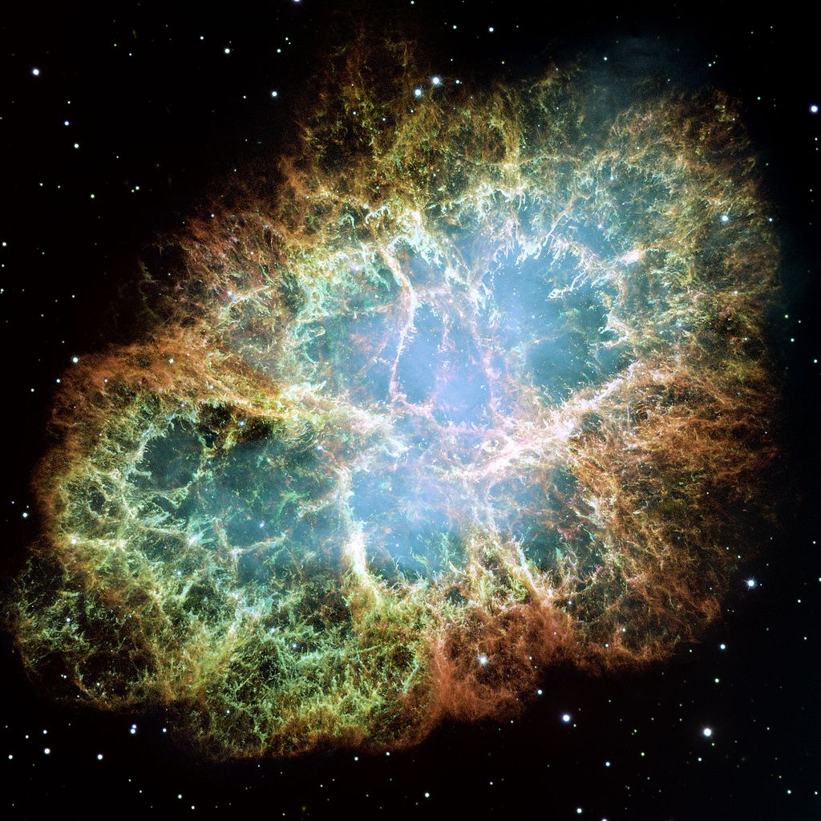
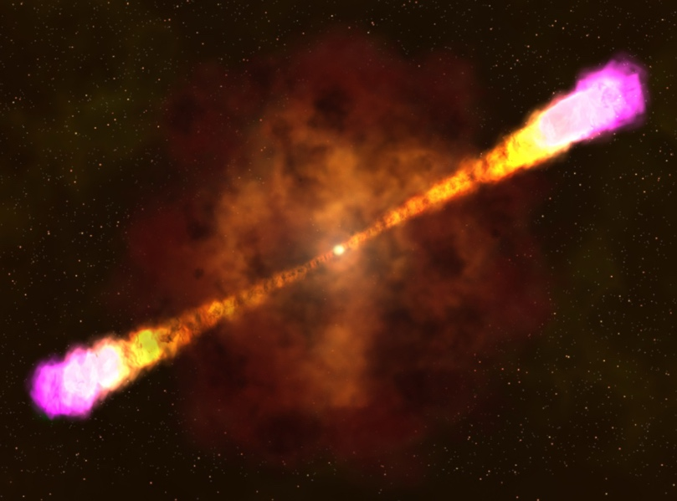
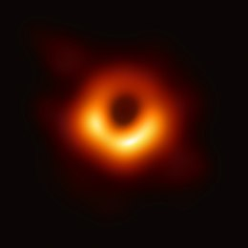
Cosmic Ray & Neutrino Source Candidates
Blazar
Jet
‘Unknown’ sources produce cosmic rays and neutrinos
Strong magnetic fields or large acceleration volumes are needed for this process
Supermassive black hole
Artist impression
Galactic source
candidates
Neutron stars
Extra-galactic source candidates
Active galactic nuclei AGN
Super Nova Remnants
Gamma Ray Burst
Artist impression
Black holes
Supermassive black hole
6

Slide 7
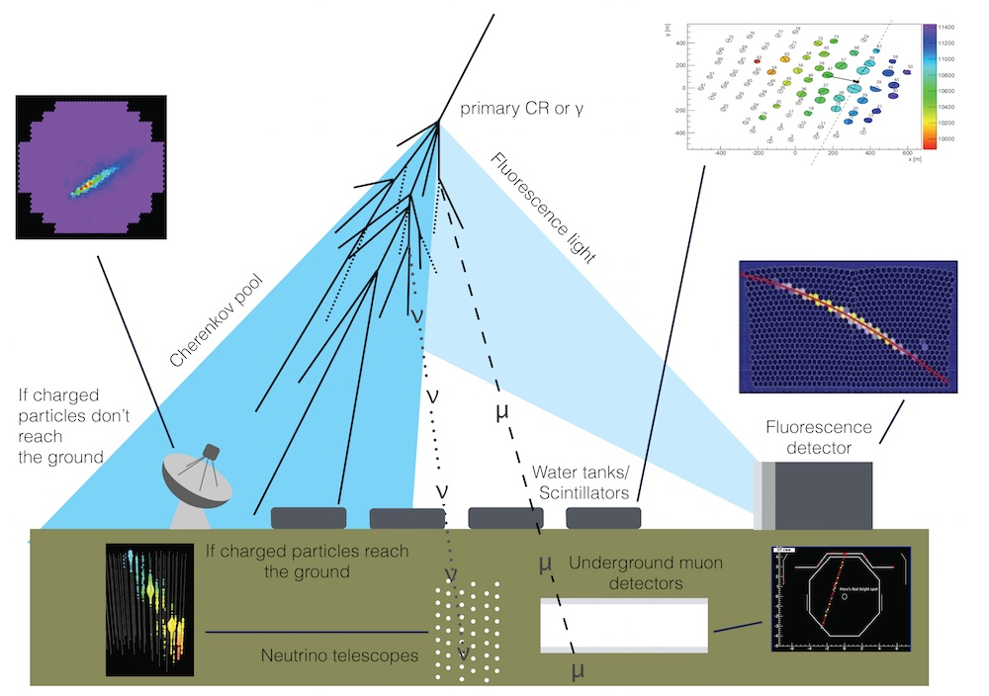
Indirect Astroparticle Physics Detections Methods
Due to low particle flux, very large observatories are needed to detect astroparticle events
Several different observation modes exist to study those events

Slide 8
IceCube Neutrino Observatory
Unique astroparticle detector at the South Pole for high-energy particles
IceTop
Mostly electromagnetic particles and low-energy muons
IceCube
High-energy air shower muons
Neutrinos (indirect)
8

Slide 9
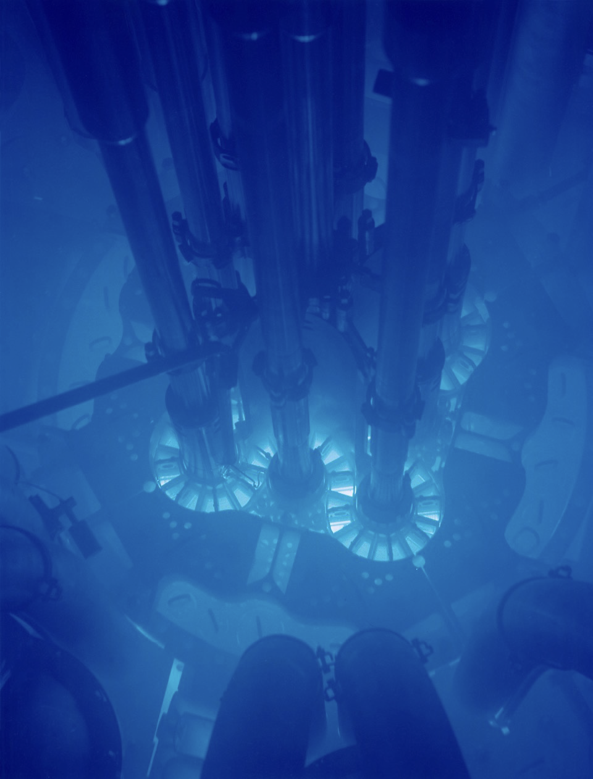
Detecting Neutrinos
Almost all neutrinos pass completely through Earth without any interaction
Need to wait for an interaction/collision — means you need a big, transparent target or medium
Detect the light produced by the secondary particles
Cherenkov light at the Advanced Test Reactor
(credit: Argonne National Laboratory)
9

Slide 10
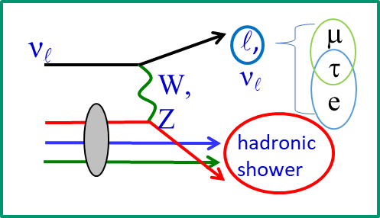
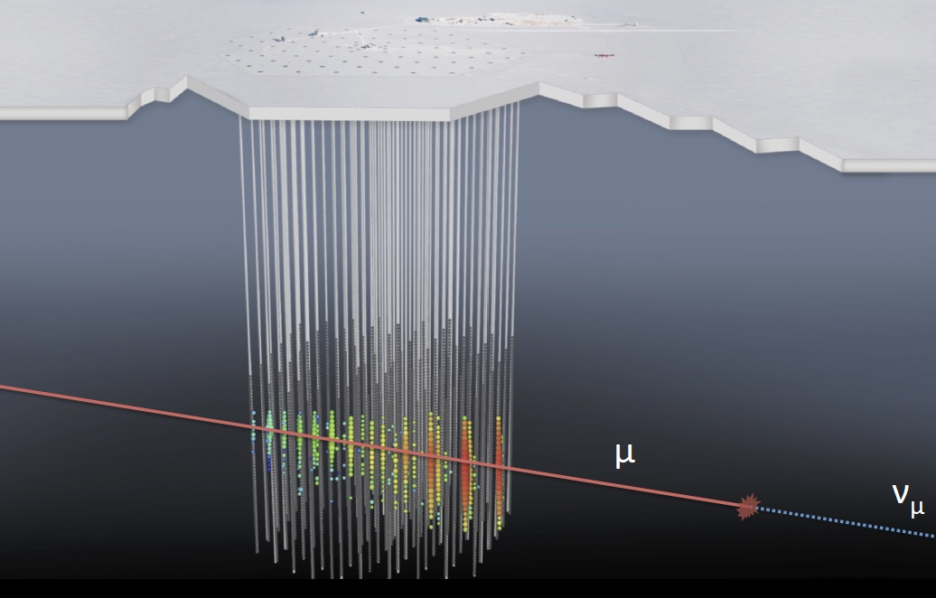
Detecting Neutrinos
Neutrino interacts with a nucleon
Detect light from hadronic shower and/or from leptons from charged current interactions
Timing (red to blue) determines direction
Total light (indicated by diameter) is an energy proxy
10

Slide 11
Neutrino Signals and Backgrounds
Dominant signal:
Downgoing muons from cosmic rays interacting in the atmosphere
~2600/sec (~10¹¹/year)
Neutrino discriminators:
Upgoing (through Earth) or starting inside the array
~12/hour (~10⁵/year)
Astrophysical discriminators:
Energy: Crossover ~ 100TeV
Muon veto (starting events)
Spatial: Clusters/Catalogs
Time: Bunches/Multimessenger
10s per month (~100s/year)
11

Slide 12
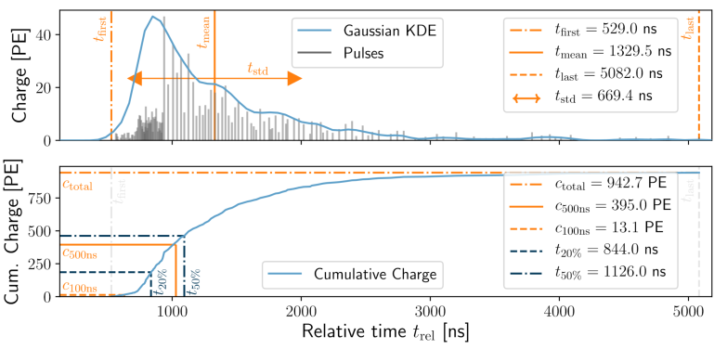
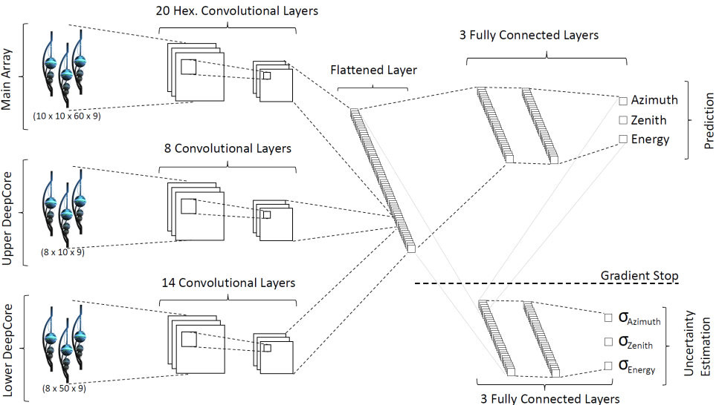
Convolutional Neural Network in IceCube
Modification for IceCube
Unify time dimension into a fixed set of input features
Transform IceCube geometry such that it can be utilized by standard CNNs
Hexagonal convolutional kernels
Additional uncertainty estimation layer via Gaussian likelihood
12

Slide 13
Convolutional Neural Network in IceCube
Achievements of CNNs in IceCube
Versatile tool for event reconstruction
Improved reconstruction accuracy at high energies
Reduced per-event runtime by 3 orders of magnitude
Allows ‘Online’ event reconstruction with the limited hardware at the South Pole
https://doi.org/10.22323/1.395.1065
13

Slide 14
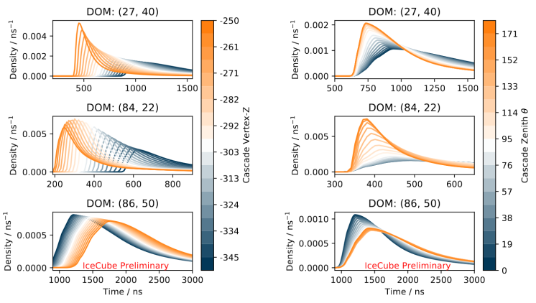
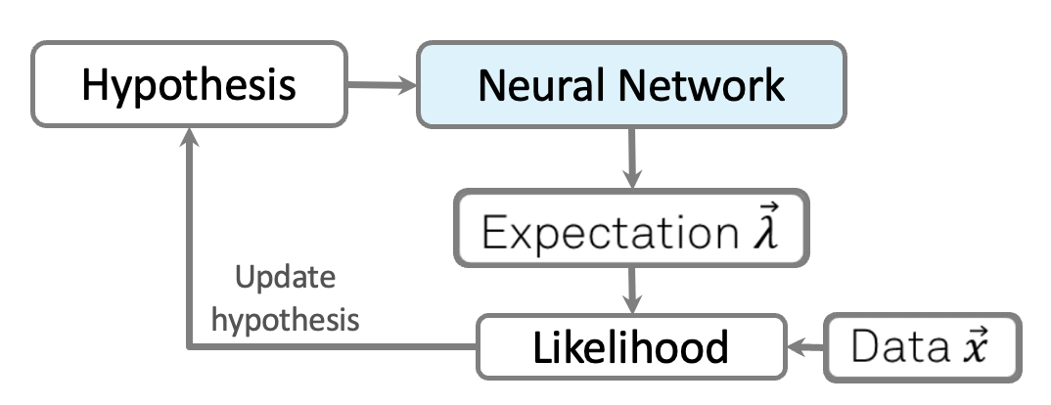
Reconstructing Event Properties
Hybrid reconstruction method:
Combines maximum-likelihood estimation with deep learning
Modeling of high-dimensional PDFs via neural networks
Exploits available information and symmetries
14

Slide 15
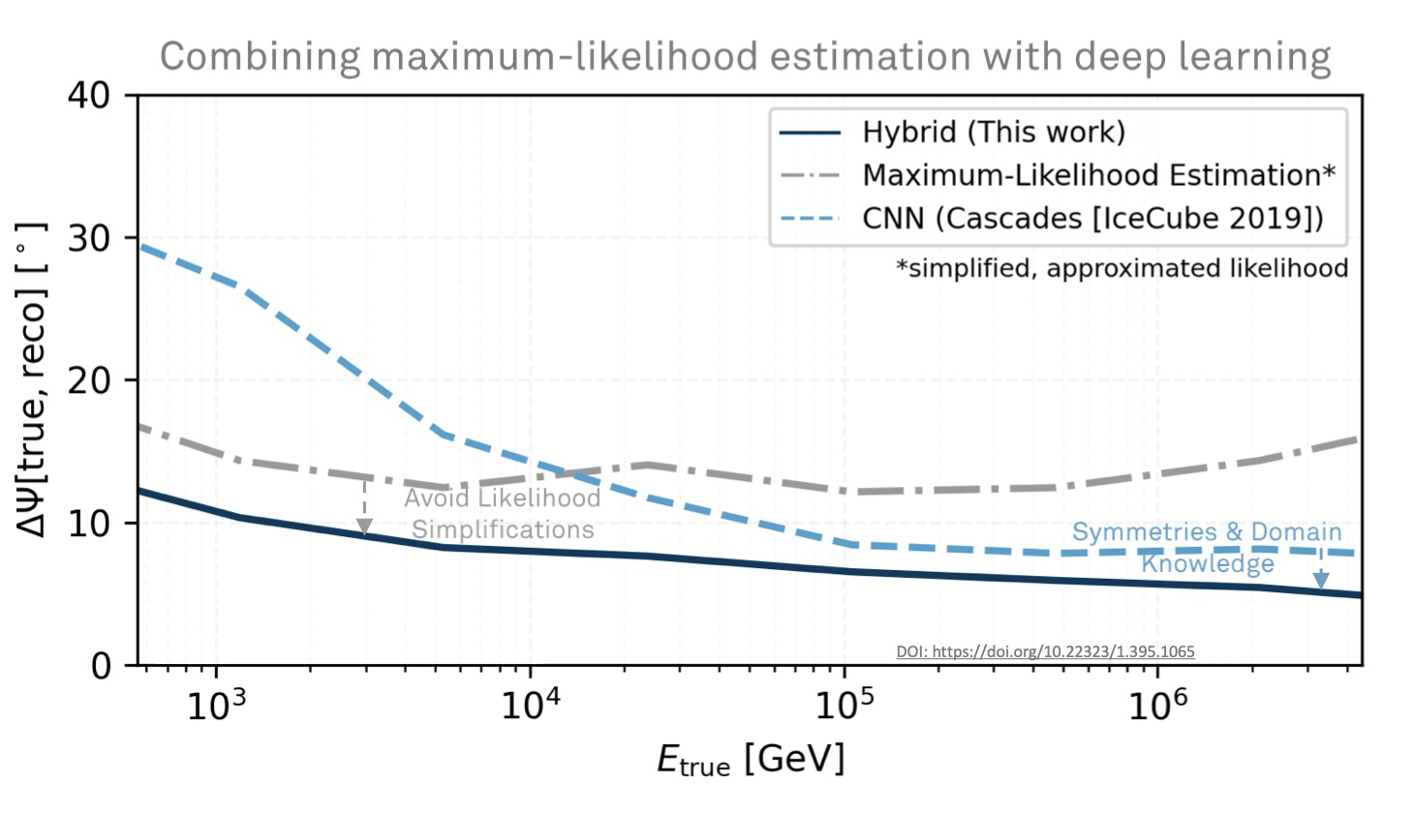
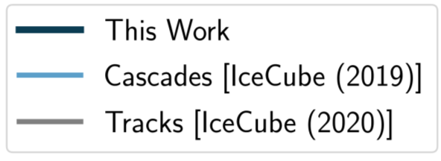
Improvements by Novel Methods
Improvements due to novel methods:
Improved reconstruction resolution over entire energy range
30 times as many events
Analysis sensitivity improved by a factor of 3
The equivalent of 75 years of detector lifetime and > $500 million
https://doi.org/10.22323/1.395.1065
15

Slide 16
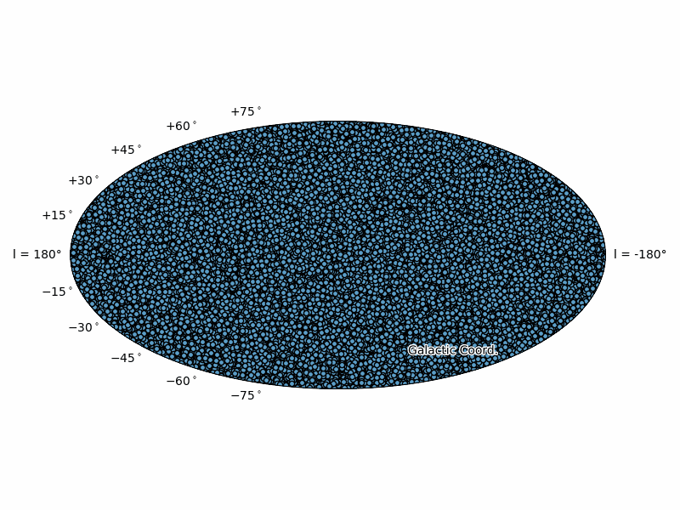
Event selection
Series of convolutional neural networks (CNNs)
Final step via boosted decision trees (BDTs)
https://doi.org/10.22323/1.395.1065
16

Slide 17
The multiwavelength Milky Way
17
https://doi.org/10.22323/1.395.1065
17

Slide 18
GraphNeT
https://doi.org/10.48550/arXiv.2501.03817
A Deep Learning Library for Neutrino Telescopes
graphnet-team/graphnet
A framework for developing DL-based tools for neutrino telescopes
One-stop shop: from model development to deployment
Developers
Everything needed to build, train and validate models from scratch
Physics Domain Experts
Can choose from a library of pre-trained models and apply them
Actively maintained with modern industry-standard code practices
code conventions
proper documentation
Unit tests
18

Slide 19
GraphNeT
https://joss.theoj.org/papers/10.21105/joss.04971
graphnet-team/graphnet
Different data representations can be built in GraphNet, making it compatible with the established deep learning paradigms like
CNNs, GNNs, RNNs, Transformers, etc.
Illustration of how fundamentally different data representations can be generated in
GraphNeT 2.0, making the framework compatible with established deep learning
paradigms
19

Slide 20
GraphNet @ IceCube
Information used are DOM position and pulse timing
Each DOM knows about its neighbors
20

Slide 21
GraphNet @ IceCube
21

Slide 22
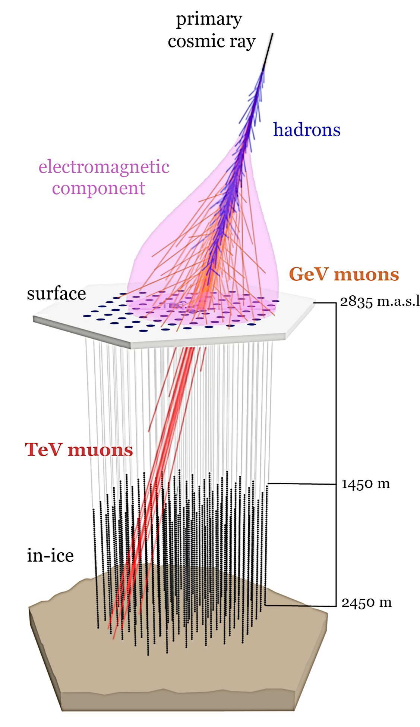
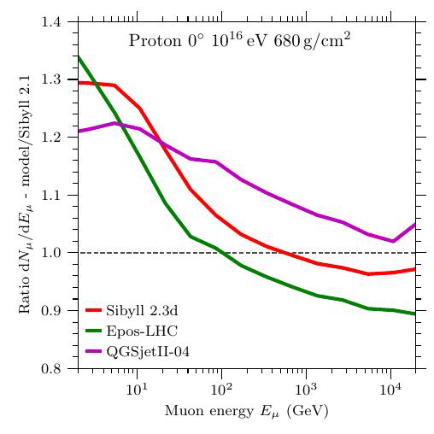
Cosmic ray Analysis
Combined IceCube and IceTop
Electromagnetic (electrons & gamma rays) air shower
Low-energy muons at surface
Very high-energy muons deep in the ice
Performing particle physics at energies far beyond human-made accelerators
22

Slide 23
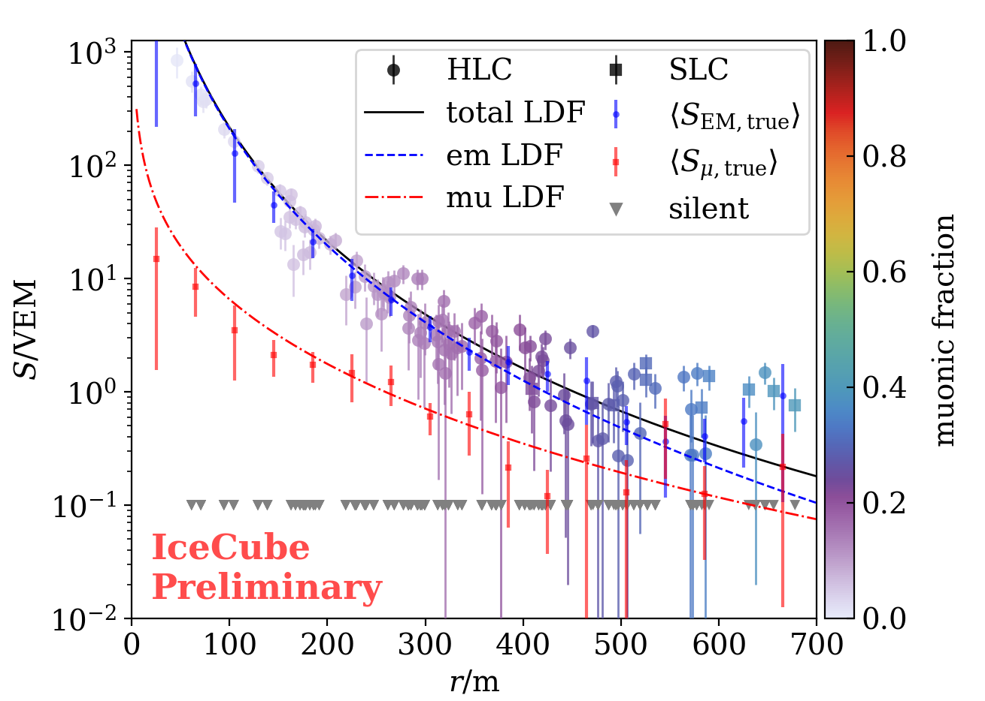
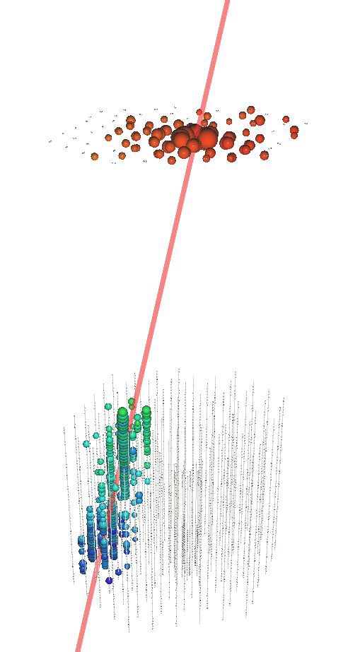
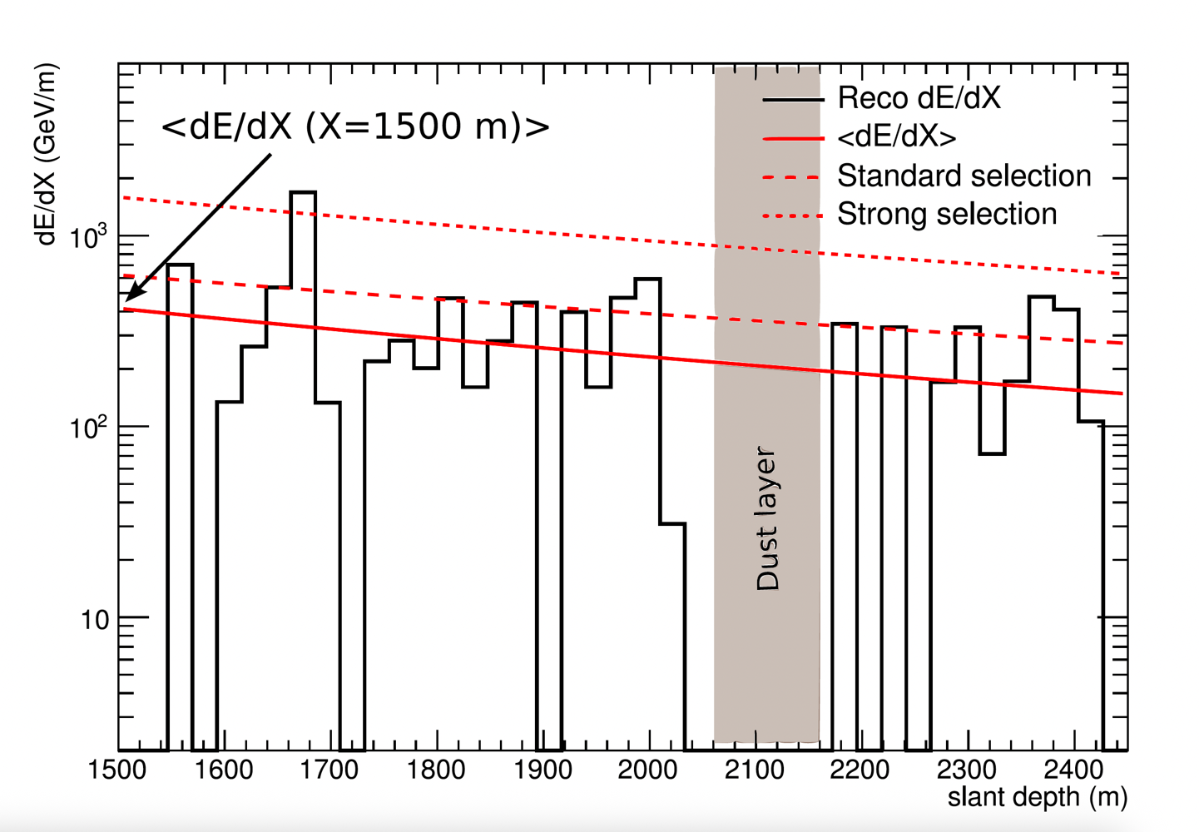
Cosmic ray Air shower reconstruction
IceTop
Fit to IceTop signals
Lateral distribution function (charge)
Shower front (time)
→ Direction & core position
→ Shower size S₁₂₅ : proxy for primary energy
In-Ice
Energy loss reconstruction
Along the reconstructed IceTop track
23

Slide 24
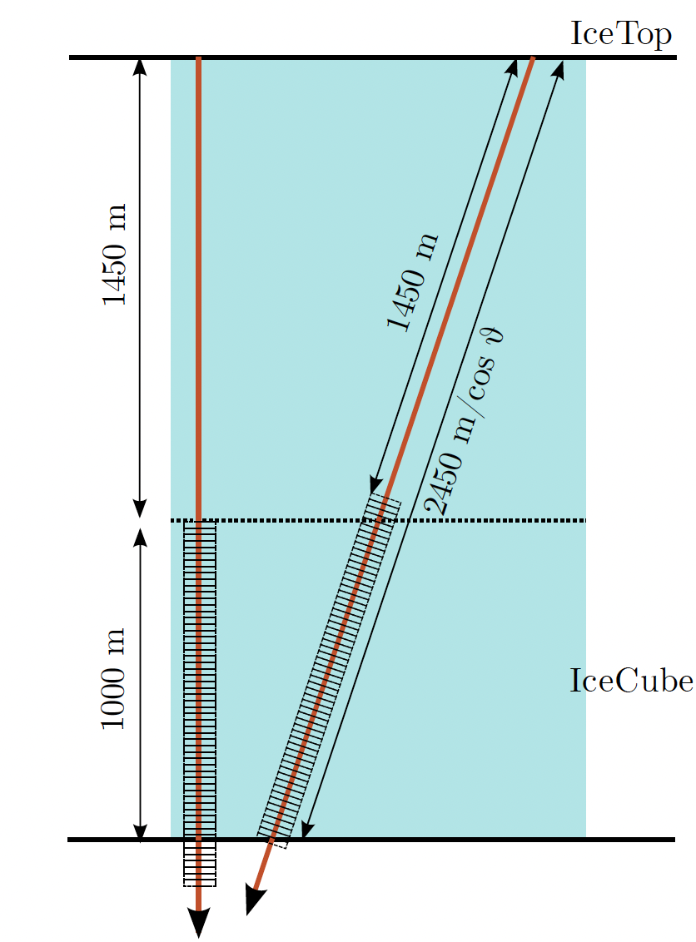
Cosmic ray RNN Analysis
https://doi.org/10.22323/1.444.0207
In-Ice RNN input
Energy loss output is written as a vector of length 57 (20 m segments)
Single bidirectional GRU layer with 57 units works well out of the box
Amount of light at a certain depth
24

Slide 25
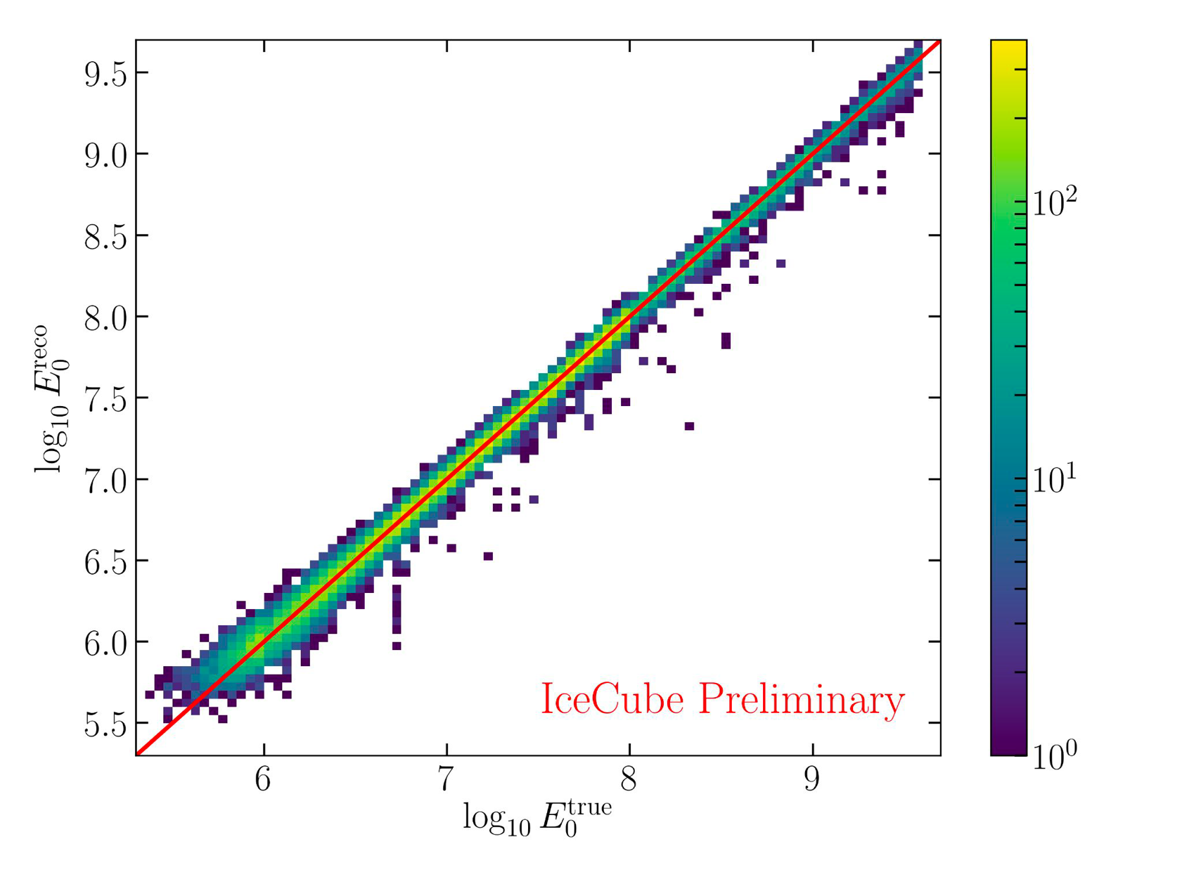
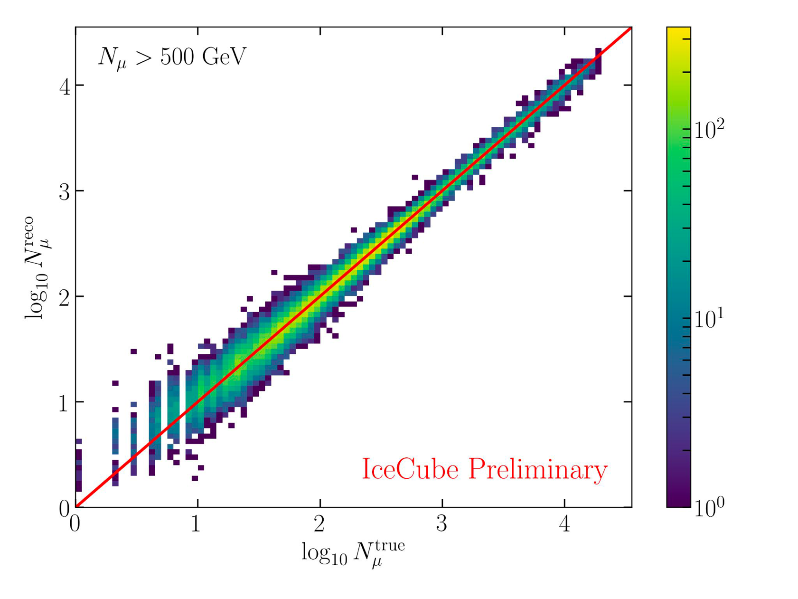
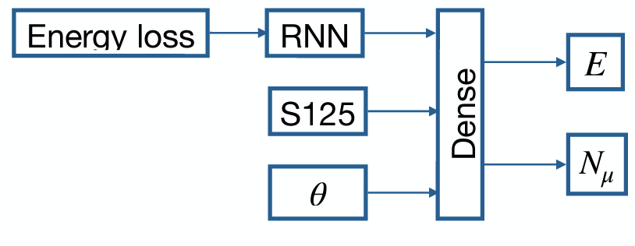
Neural Networks for cosmic rays
Energy reconstruction
Inputs
Shower Size S₁₂₅
Zenith $θ$
Energy loss vector
Outputs
Primary energy of cosmic ray
Number of muons >500 GeV
High level parameter + RNN + Dense layers
Muon number reconstruction
https://doi.org/10.22323/1.444.0207
25

Slide 26
Kaggle competition "IceCube -- Neutrinos in Deep Ice”x
The participants were tasked with developing direction reconstruction algorithms for various IceCube neutrino events
Goal:
Predict a neutrino particle’s direction from ‘raw’ detector data
Prize
1st Place - $18,000
2nd Place - $12,000
3rd Place - $10,000
Training set:
Nearly 140 million simulated events, together with the true directions
Energy range from 100 GeV to 100 PeV
Competition:
812 competing teams
11,206 solutions had been submitted
https://www.kaggle.com/competitions/icecube-neutrinos-in-deep-ice
26

Slide 27
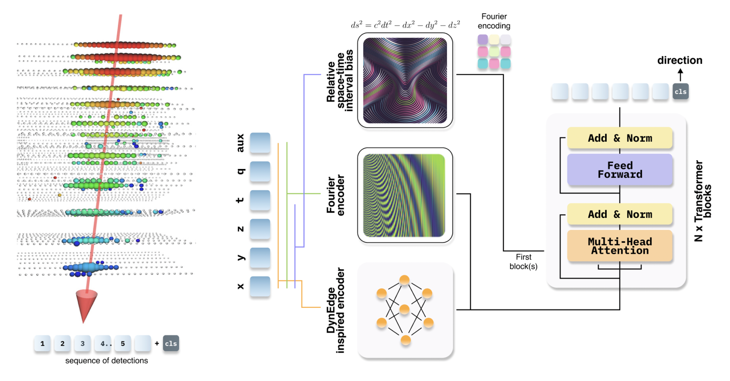
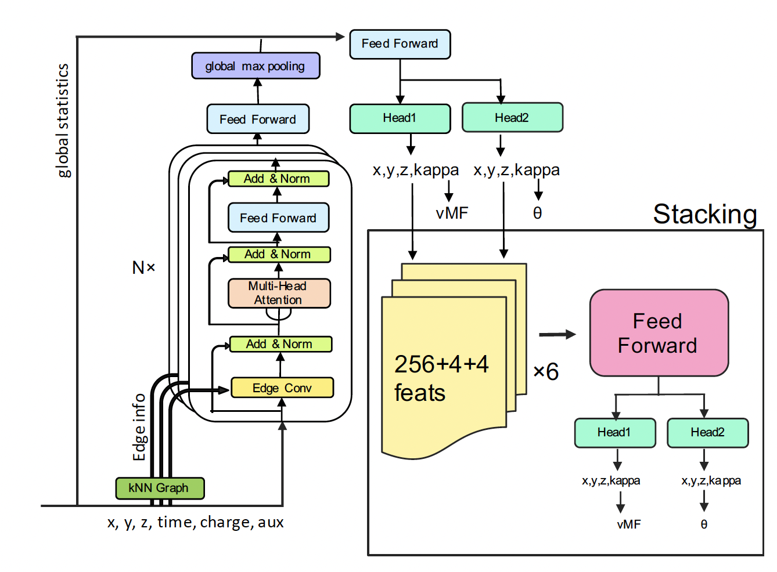
Kaggle Results
1st place
2nd place
The final kaggle scores of the three solutions were almost on par
New combination of graph convolutional neural networks and transformers
Angular resolution:
For cascade events, better than 5 degrees
For tracks, better than 0.5 degrees.
These performance measures compare favourably to the current state-of-the-art in the field.
This provides a strong hint on how future ML-based reconstruction algorithms could look in IceCube.
3rd place
https://arxiv.org/abs/2310.15674
27

Slide 28
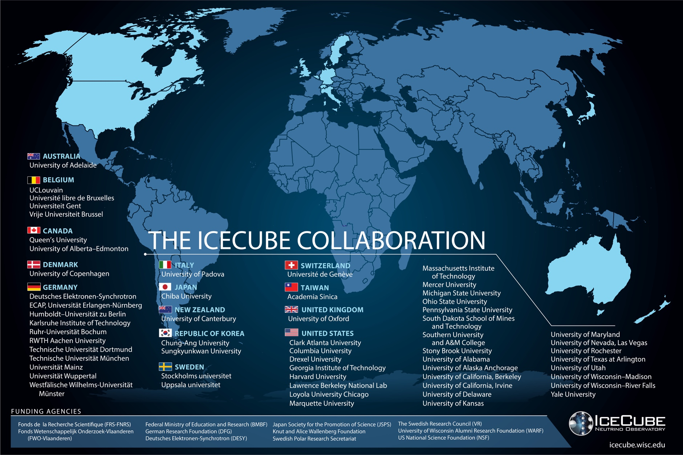
International collaboration of ~500 scientists worldwide
28

Slide 29
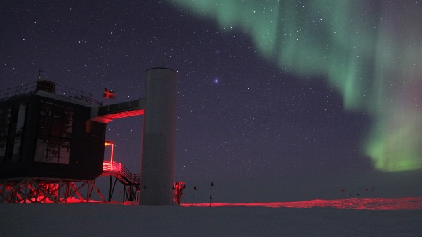
Summary
Machine Learning is becoming one of the essential methods in high-energy particle physics and astrophysics
Great fundamental physics results about particle physics and cosmology are found
Machine learning gets easier by utilizing state-of-the-art toolkits to allow physicists to perform great analysis without being an expert in them
Thank you very much for listening!!!
29

Slide 30
Backup

Slide 31
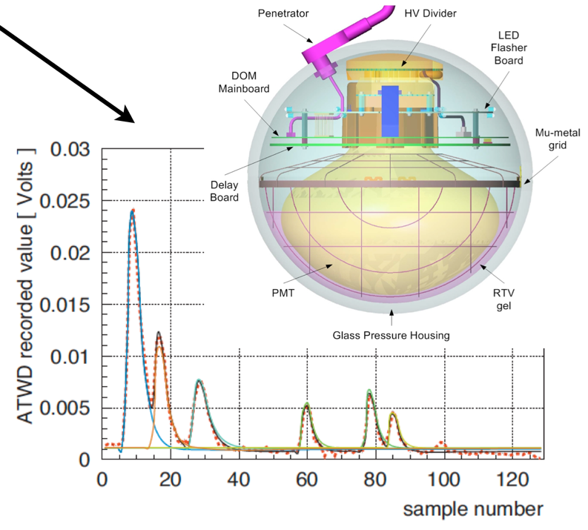
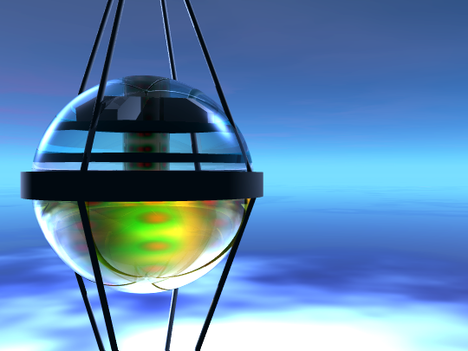
Digital Optical Module
Each Digital Optical Module (DOM) operates independently
collects light signal
digitizes
time stamp with 2 nanoseconds precision
Send results to a computer on the surface for further reconstruction
31

Slide 32
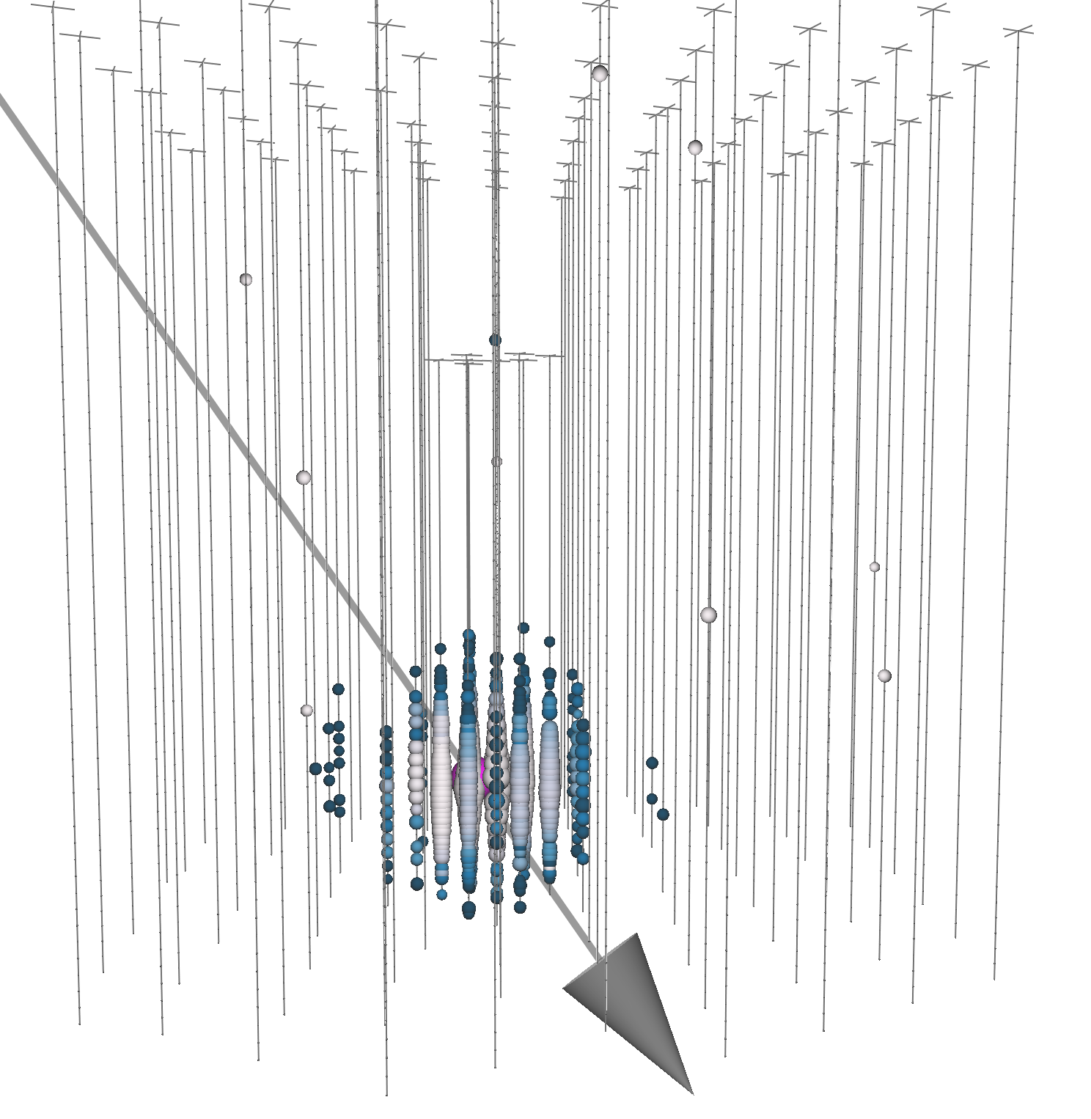
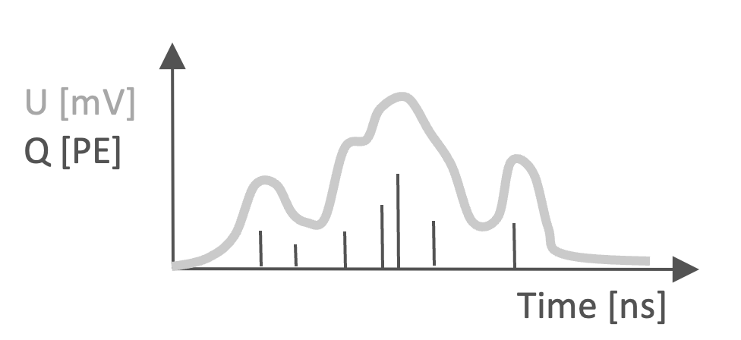
Event reconstruction
Cherenkov Radiation
Event reconstruction:
Neutrino events are characterized by their energy and direction
Properties are inferred from observed light pattern in detector
32

