Slide 1
Correcting Modeling of Organic field effect transistors (OFETs)
Siva Prasad Chimminiankuttichi Prabhakaran
2025
In collaboration with
Dr. Predeep Padmanabhan and Abhinav T
Dept. of Physics
NIT Calicut

Slide 2
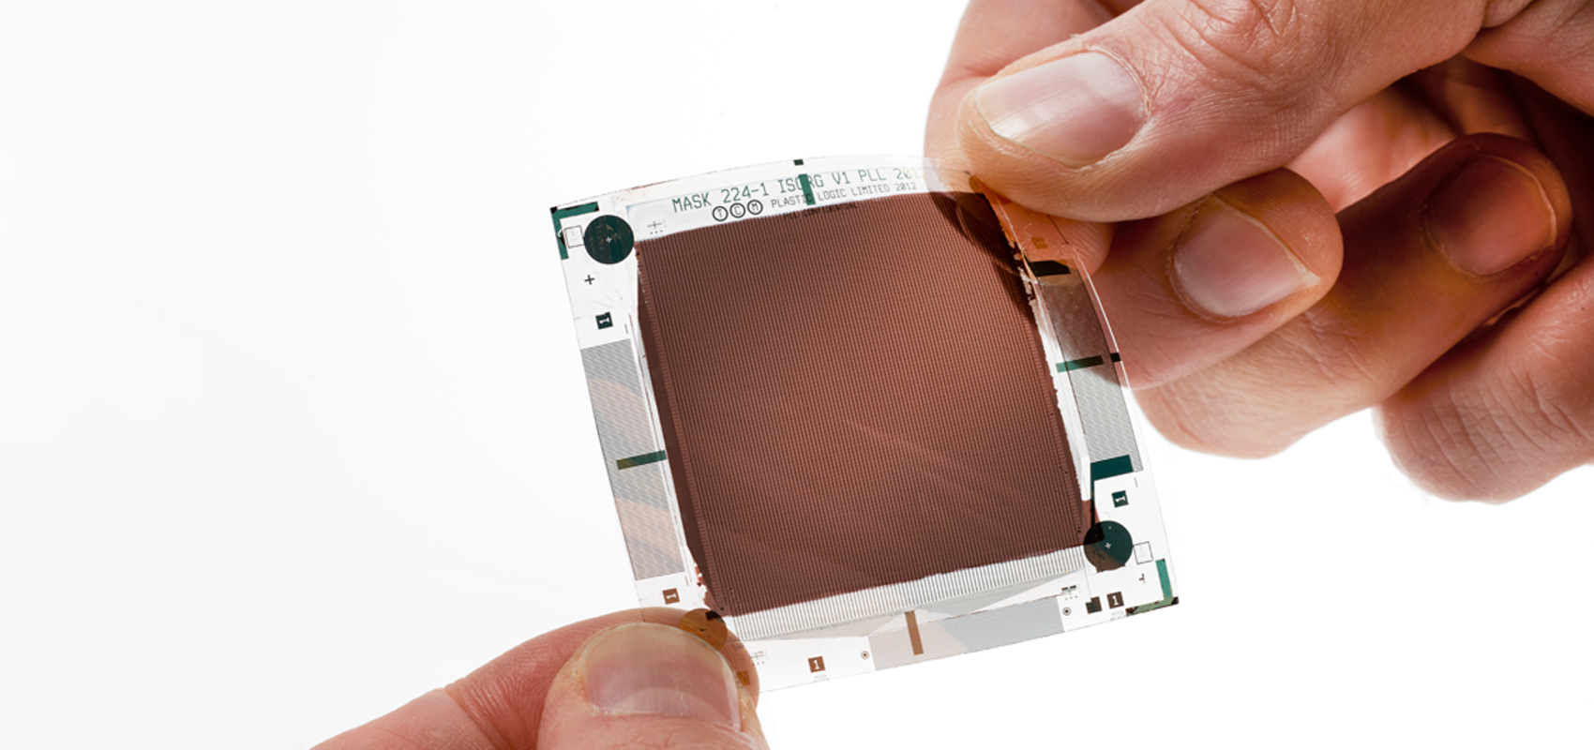
What is an Organic field effect transistor?
An Organic Field effect Transistor (OFET) is a transistor that works in an electric field and the semiconductor used is an organic material. They can be p-type (pentacene) or an n-type (C-60).
https://veniversum.me/ofet/

Slide 3
OFET and its working
There are three electrodes in an OFET (gate, source, drain). A voltage (V_{g}) is applied on the gate terminal, if V_{g} is greater than a threshold voltage, V_{t}, induces charges in the semiconductor-dielectric interface.
These charges when a potential difference V_{ds} is applied a current I_{ds} is induced (output).

Slide 4
Graphs of OFETs

Slide 5
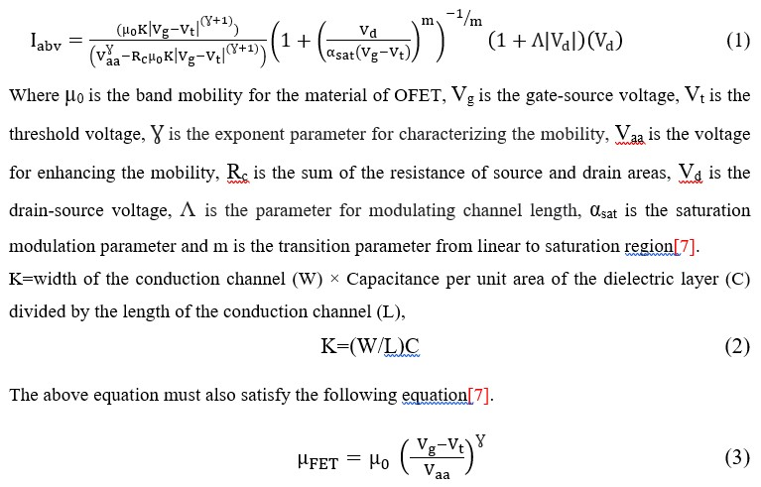
Modeling an OFET and equations
Model by Li et.al using genetic algorithm based approach
This model is divided into three: above threshold model, sub threshold model and the complete model by unifying
Above threshold model

Slide 6
Subthreshold model
Complete model

Slide 7
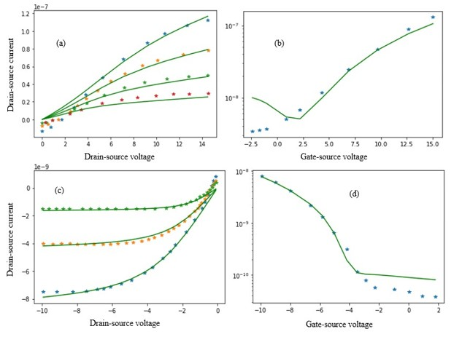
Limitations of the model
Even though the model shows great fitting for most of the OFETs, it does not fit polarity conversion points above the zero gate-source voltage in an output graph. From the sub threshold equation we can see the lower saturation is at I₀. So there are modeling problems in certain cases as shown below.

Slide 8
Genetic Algorithm Approach in OFET Modeling
• Why Genetic Algorithms (GAs)?
Traditional methods struggle with the non-linearity and noise in OFET data. GAs offer a robust, stochastic optimization approach.
• GA Implementation in This Work:
- Objective: Extract parameters for above- and sub-threshold OFET regions.
- Chromosomes: Encode model parameters like threshold voltage, mobility, saturation current.
- Fitness Function: Minimize error (RMSE/MAPE) between model and experimental I-V data.

Slide 9
- Operators:
• Selection: Tournament/roulette-wheel.
• Crossover: Blend/arithmetic crossover.
• Mutation: Gaussian mutation.
• Advantages:
- Models polarity switching (p-type ↔ n-type) with high accuracy.
- Effective near zero gate voltage where traditional models fail.
• Next Steps:
- Incorporate temperature effects, contact resistance, hysteresis.
- Explore hybrid GA-ML models for faster, real-time predictions.

Slide 10
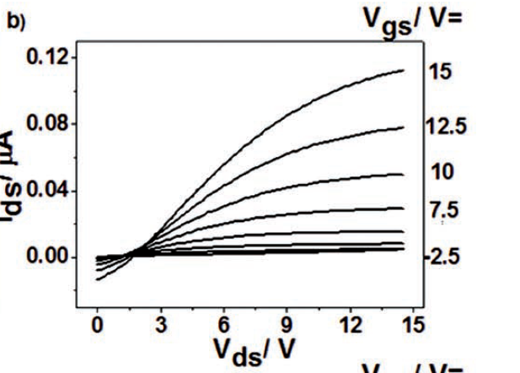
The changed model
Above threshold model
The V_{p} and I_{p} are the polarity conversion points of the OFET, converting polarity of p-type into n-type and vice versa.
Subthreshold model
I_{lowest} is the lowest value of drain-source current attaining in an OFET transfer curve
Complete model
The same as before
(V_{p},I_{p})

Slide 11
Results

Slide 12
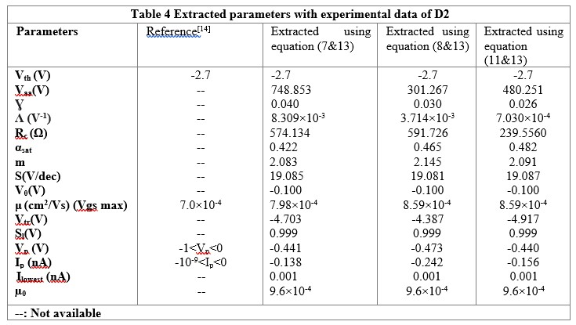
Parameters extracted

Slide 13
References
Mihai Irimia-Vladu,* Pavel A. Troshin, Melanie Reisinger, Lyuba Shmygleva, Yasin Kanbur, Günther Schwabegger, Marius Bodea, Reinhard Schwödiauer, Alexander Mumyatov, Jeffrey W. Fergus, Vladimir F. Razumov, Helmut Sitter, Niyazi Serdar Sariciftci, and Siegfried Bauer. Biocompatible and Biodegradable Materials for Organic Field-Effect Transistors. Adv. Funct. Mater. 2010, 20, 4069–4076.
Cheng-YinWangCanek, Fuentes-Hernandez, Wen-FangChou, Bernard Kippelen. Top-gate organic field-effect transistors fabricated on paper with high operational stability. Organic Electronics, vol. 41, pp. 340-344, 2017.
Sun, B. et al. Polyethylenimine (PEI) as an effective dopant to conveniently convert ambipolar and p-type polymers into unipolar n-type polymers. ACS Appl. Mater. Interfaces 7, 18662–18671 (2015).
Sun, B. et al. Facile conversion of polymer organic thin film transistors from ambipolar and p-type into unipolar n-type using polyethyleneimine (PEI)-modified electrodes. Org. Electron. 15, 3787–3794 (2014).
Park, J. K., Walker, B. & Seo, J. H. Controlling polarity of organic bulk heterojunction field-effect transistors via solvent additives. ACS Appl. Mater. Interfaces 5, 4575–4580 (2013).
Imad Benacer Zohir Dibi. Extracting parameters of OFET before and after threshold voltage using Genetic Algorithms. International Journal of Automation and Computing vol. 13, no. 4, pp. 382-391, 2016.
A. Cerdeira, M. Estrada, R. Gar´ıa, A. Ortiz-Conde, F. J.Gar´ıa S´anchez. New procedure for the extraction of basica-Si: H TFT model parameters in the linear and saturation regions. Solid-state Electronics, vol. 44, no. 7, pp. 1077–1080, 2001.
S.Mijalkovic, D. Green, A. Nejim, G.Whiting, A. Rankov, E. Smith, J. Halls, C. Murphy. Modelling of organic fieldeffect transistors for technology and circuit design. In Proceedings of the 26th International Conference on Microelectronics, IEEE, Nis, Serbia, pp. 469–476, 2008.
C. H. Kim, A. Castro-Carranza, M. Estrada, A. Cerdeira,Y. Bonnassieux, G. Horowitz, B. I˜niguez. A compact model for organic field-effect transistors with improved output asymptotic behaviors. IEEE Transactions on Electron Devices, vol. 60, no. 3, pp. 1136–1141, 2013
Nehal Zehra, Laxmi Raman Adil, Arvin Sain Tanwar, Subrata Mondal, Parameswar Krishnan Iyer, Chapter 11 - Thin-film devices for chemical, biological, and diagnostic applications, Editor(s): Soumen Das, Sandip Dhara, Chemical Solution Synthesis for Materials Design and Thin Film Device Applications, Elsevier, 2021, Pages 369-405.
Irimia-Vladu, Mihai & Troshin, Pavel & Baumgartner, Melanie & Schwabegger, Günther & Chaudhry, Mujeeb & Schwoediauer, Reinhard & Mumyatov, Alexander & Bodea, Marius & Fergus, Jeffrey & Razumov, Vladimir & Sitter, Helmut & Bauer, Siegfried & Sariciftci, Niyazi. (2010). Environmentally sustainable organic field effect transistors. Organic Electronics. 11. 1974-1990. 10.1016/j.orgel.2010.09.007.

Slide 14
Thank you

