Slide 1
Advancing Fe-Ga Magnetic Alloys: Synthesis and Theory of Disordered and Ordered Phases
Connor McCollar
Workshop for AI-Powered Materials Discovery at Great Plains
June 24, 2025
1

Slide 2
Overview of Presentation
MANC briefing and research aims
Experimental aspects of the research
Ribbon fabrication and characterization
Theoretical/computational aspects of the research
Utilization of machine learning in studying disordered phase
6/24/2025
2

Slide 3
MANCs Background
MANC – Metal Amorphous Nanocomposite
Composed of both amorphous and crystalline phases
Nanocrystalline grains
Metallic amorphous matrix
6/24/2025
3

Slide 4
MANCs Background cont.
Hysteresis loop of soft magnet.
M
MANC – Metal Amorphous Nanocomposite
Composed of both amorphous and crystalline phases
Important properties of MANCs:
Distinct magnetic properties: soft magnetism & relatively large saturation magnetization
Applications
Inductor cores, energy storage
H
Hysteresis loop of hard magnet.
M
H
6/24/2025
4

Slide 5
Research Aims
Explore alternative composition to commercial FINEMET
FINEMET composition: Fe-Nb-Cu-Si-B
Our composition swapping Si for Ga: Fe-Nb-Cu-Ga-B
Study the properties of Fe-Ga alloys
Utilize Machine-Learned force fields (MLFFs) for studying disordered systems
Long term: Produce Fe-Ga MANC with optimal magnetic properties
6/24/2025
5
Notes:
The main goals of this research project are:
Explore alternative composition MANC from the commercially available FINEMET MANC.
We want to produce an iron-gallium based MANC in the lab
We want to study it’s properties (magnetic and structural) since FINEMET properties come in part from very small nanocrystals in the amorphous matrix

Slide 6
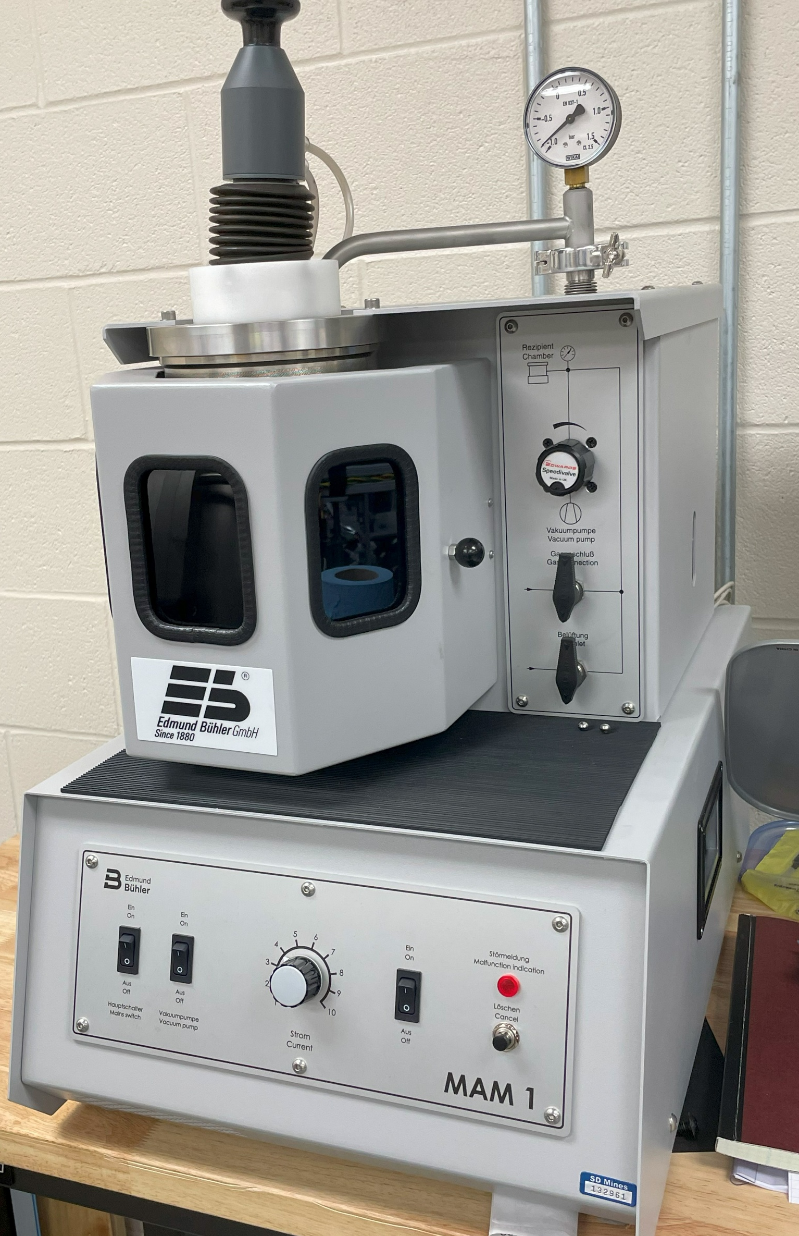
Fabricating Amorphous Alloys
Prevent atoms from arranging into ordered structure
Prepare ingots with desired composition by arc melting
Rapidly cool and spin out into thin ribbon (~20μm thick)
Ingot of alloy produced by arc melting.
Laboratory arc melter.
6/24/2025
6

Slide 7
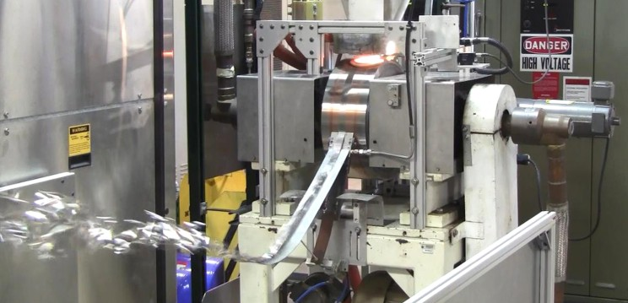
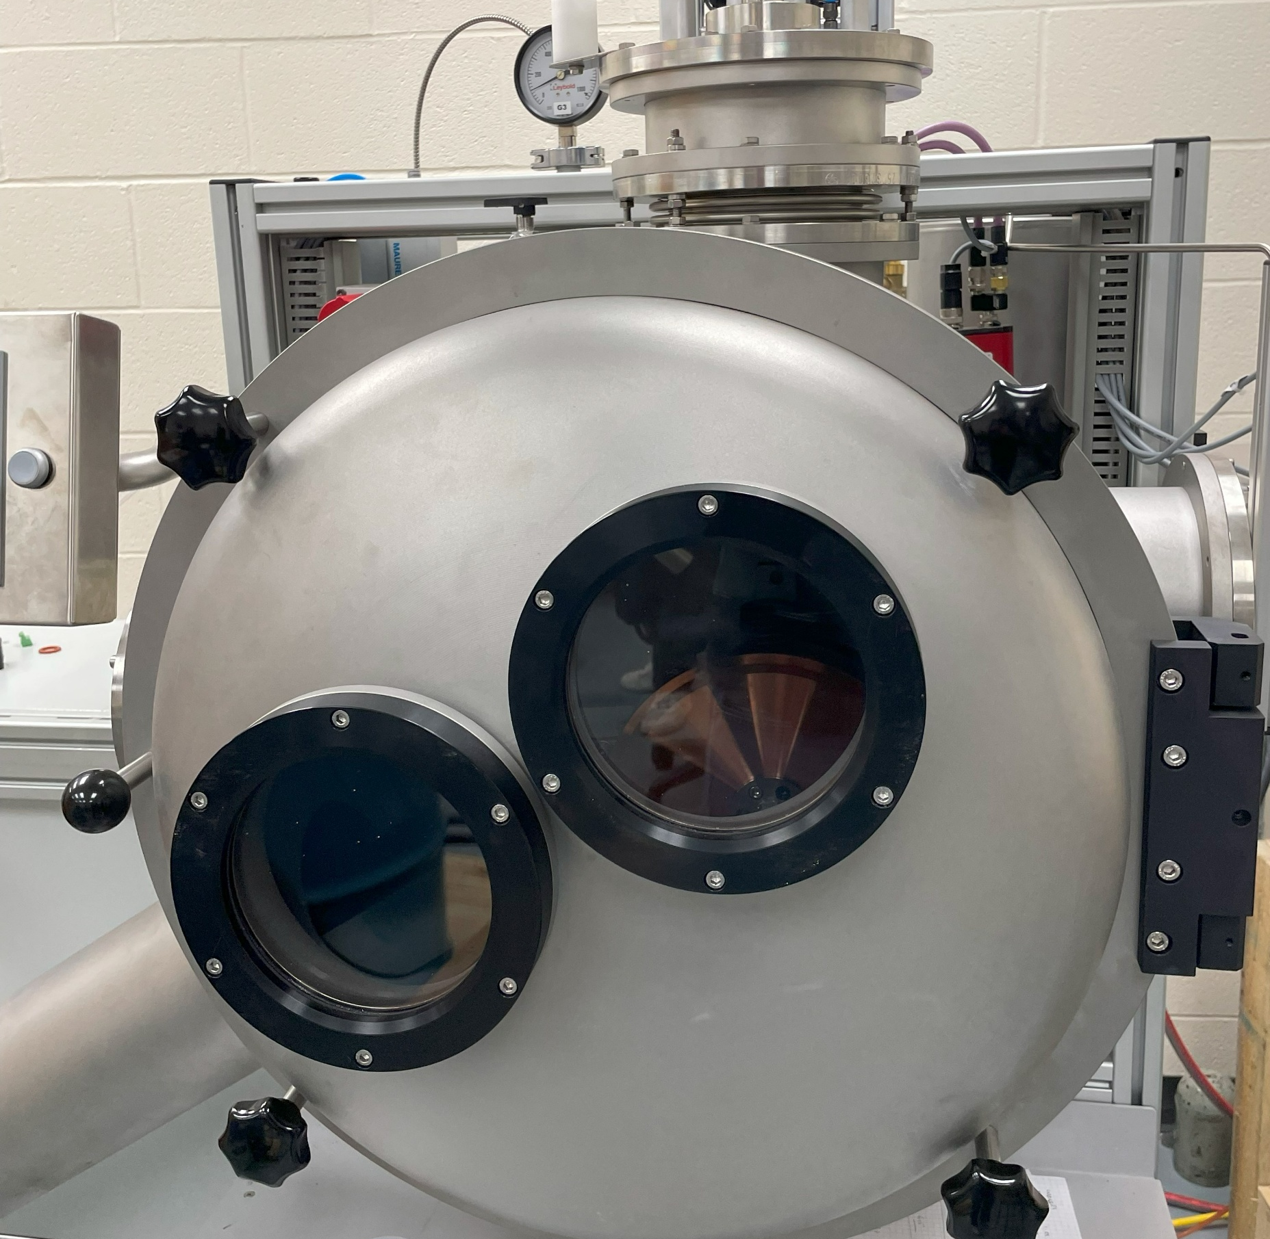
Fabricating Amorphous Alloys cont.
Prevent atoms from arranging into ordered structure
Prepare ingots with desired composition by arc melting
Rapidly cool and spin out into thin ribbon (~20μm thick)
Ribbon being produced at NASA Glenn Research Center (NASA).
Laboratory melt-spinner.
6/24/2025
7

Slide 8
Characterizing Fe-Ga Alloys
Studying structural properties
Tools: X-ray diffraction, TEM/Selected Area Electron Diffraction (SAED)
Studying magnetic properties
Tools: Vibrating sample magnetometer (VSM)
Important experimental step in studying the properties of the materials
6/24/2025
8

Slide 9
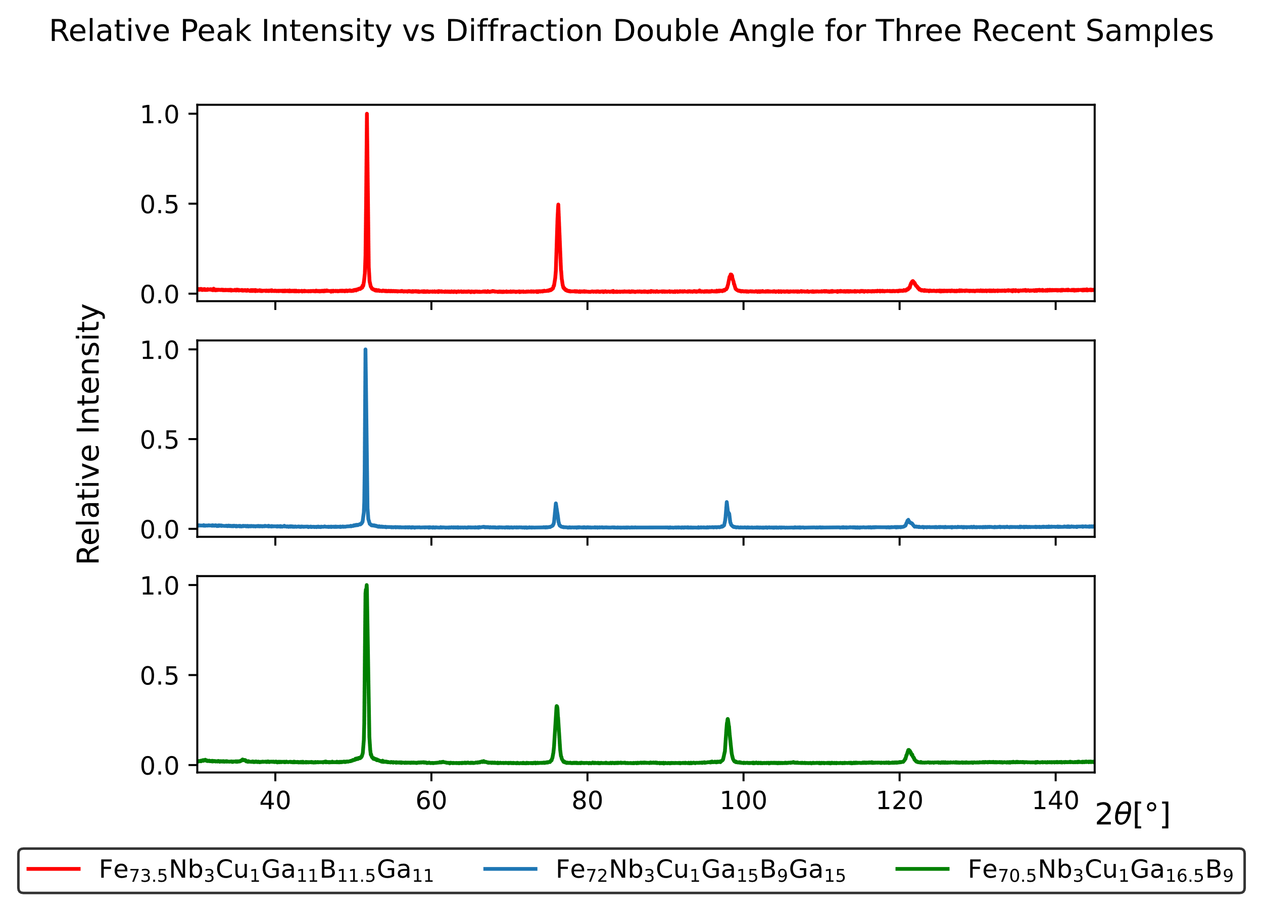
Determination of Crystalline Alloy by XRD
Bragg’s Law
$$nλ=2dsin\left(θ\right)$$
$d$ – distance between crystal planes
(2 2 0)
(4 0 0)
(4 2 2)
$θ$ – angle of incident X-rays
or
or
or
(1 1 0)
(2 0 0)
(2 1 1)
2 possible crystalline phases of Fe-Ga:
Ordered Fe₃Ga
Disordered Fe₄Ga
6/24/2025
9
Notes:
d tells us about the structure of the material
Theta we use to determine d. Tells us about the structure of the materials
Given all the correct measurements, we can quite determine the exact plane & crystal structure. With our methods of fabrication, this is difficult we form polycrystalline material and can’t reduce samples to powder.
A. Factors like sample height displacement and instrument misalignment can cause a systematic shift in the absolute peak positions (2θ values). However, these factors generally don't affect the relative distances between the peaks, making relative peak distances more reliable for structural analysis and phase identification.

Slide 10
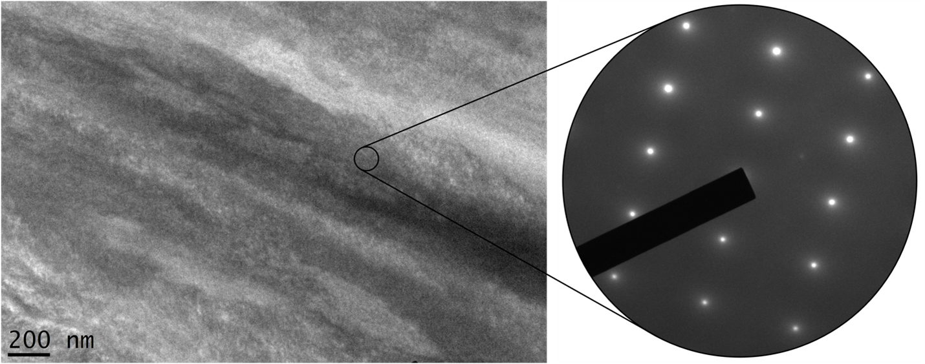
TEM and Selected Area Electron Diffraction
TEM image (left) and SAED pattern (right) for the $⟨$1 1 0$⟩$ zone axis of single crystal in a sample of Fe_{73.5}Nb₃Cu₁Ga_{16.5}B₆ alloy (Paul White).
6/24/2025
10

Slide 11
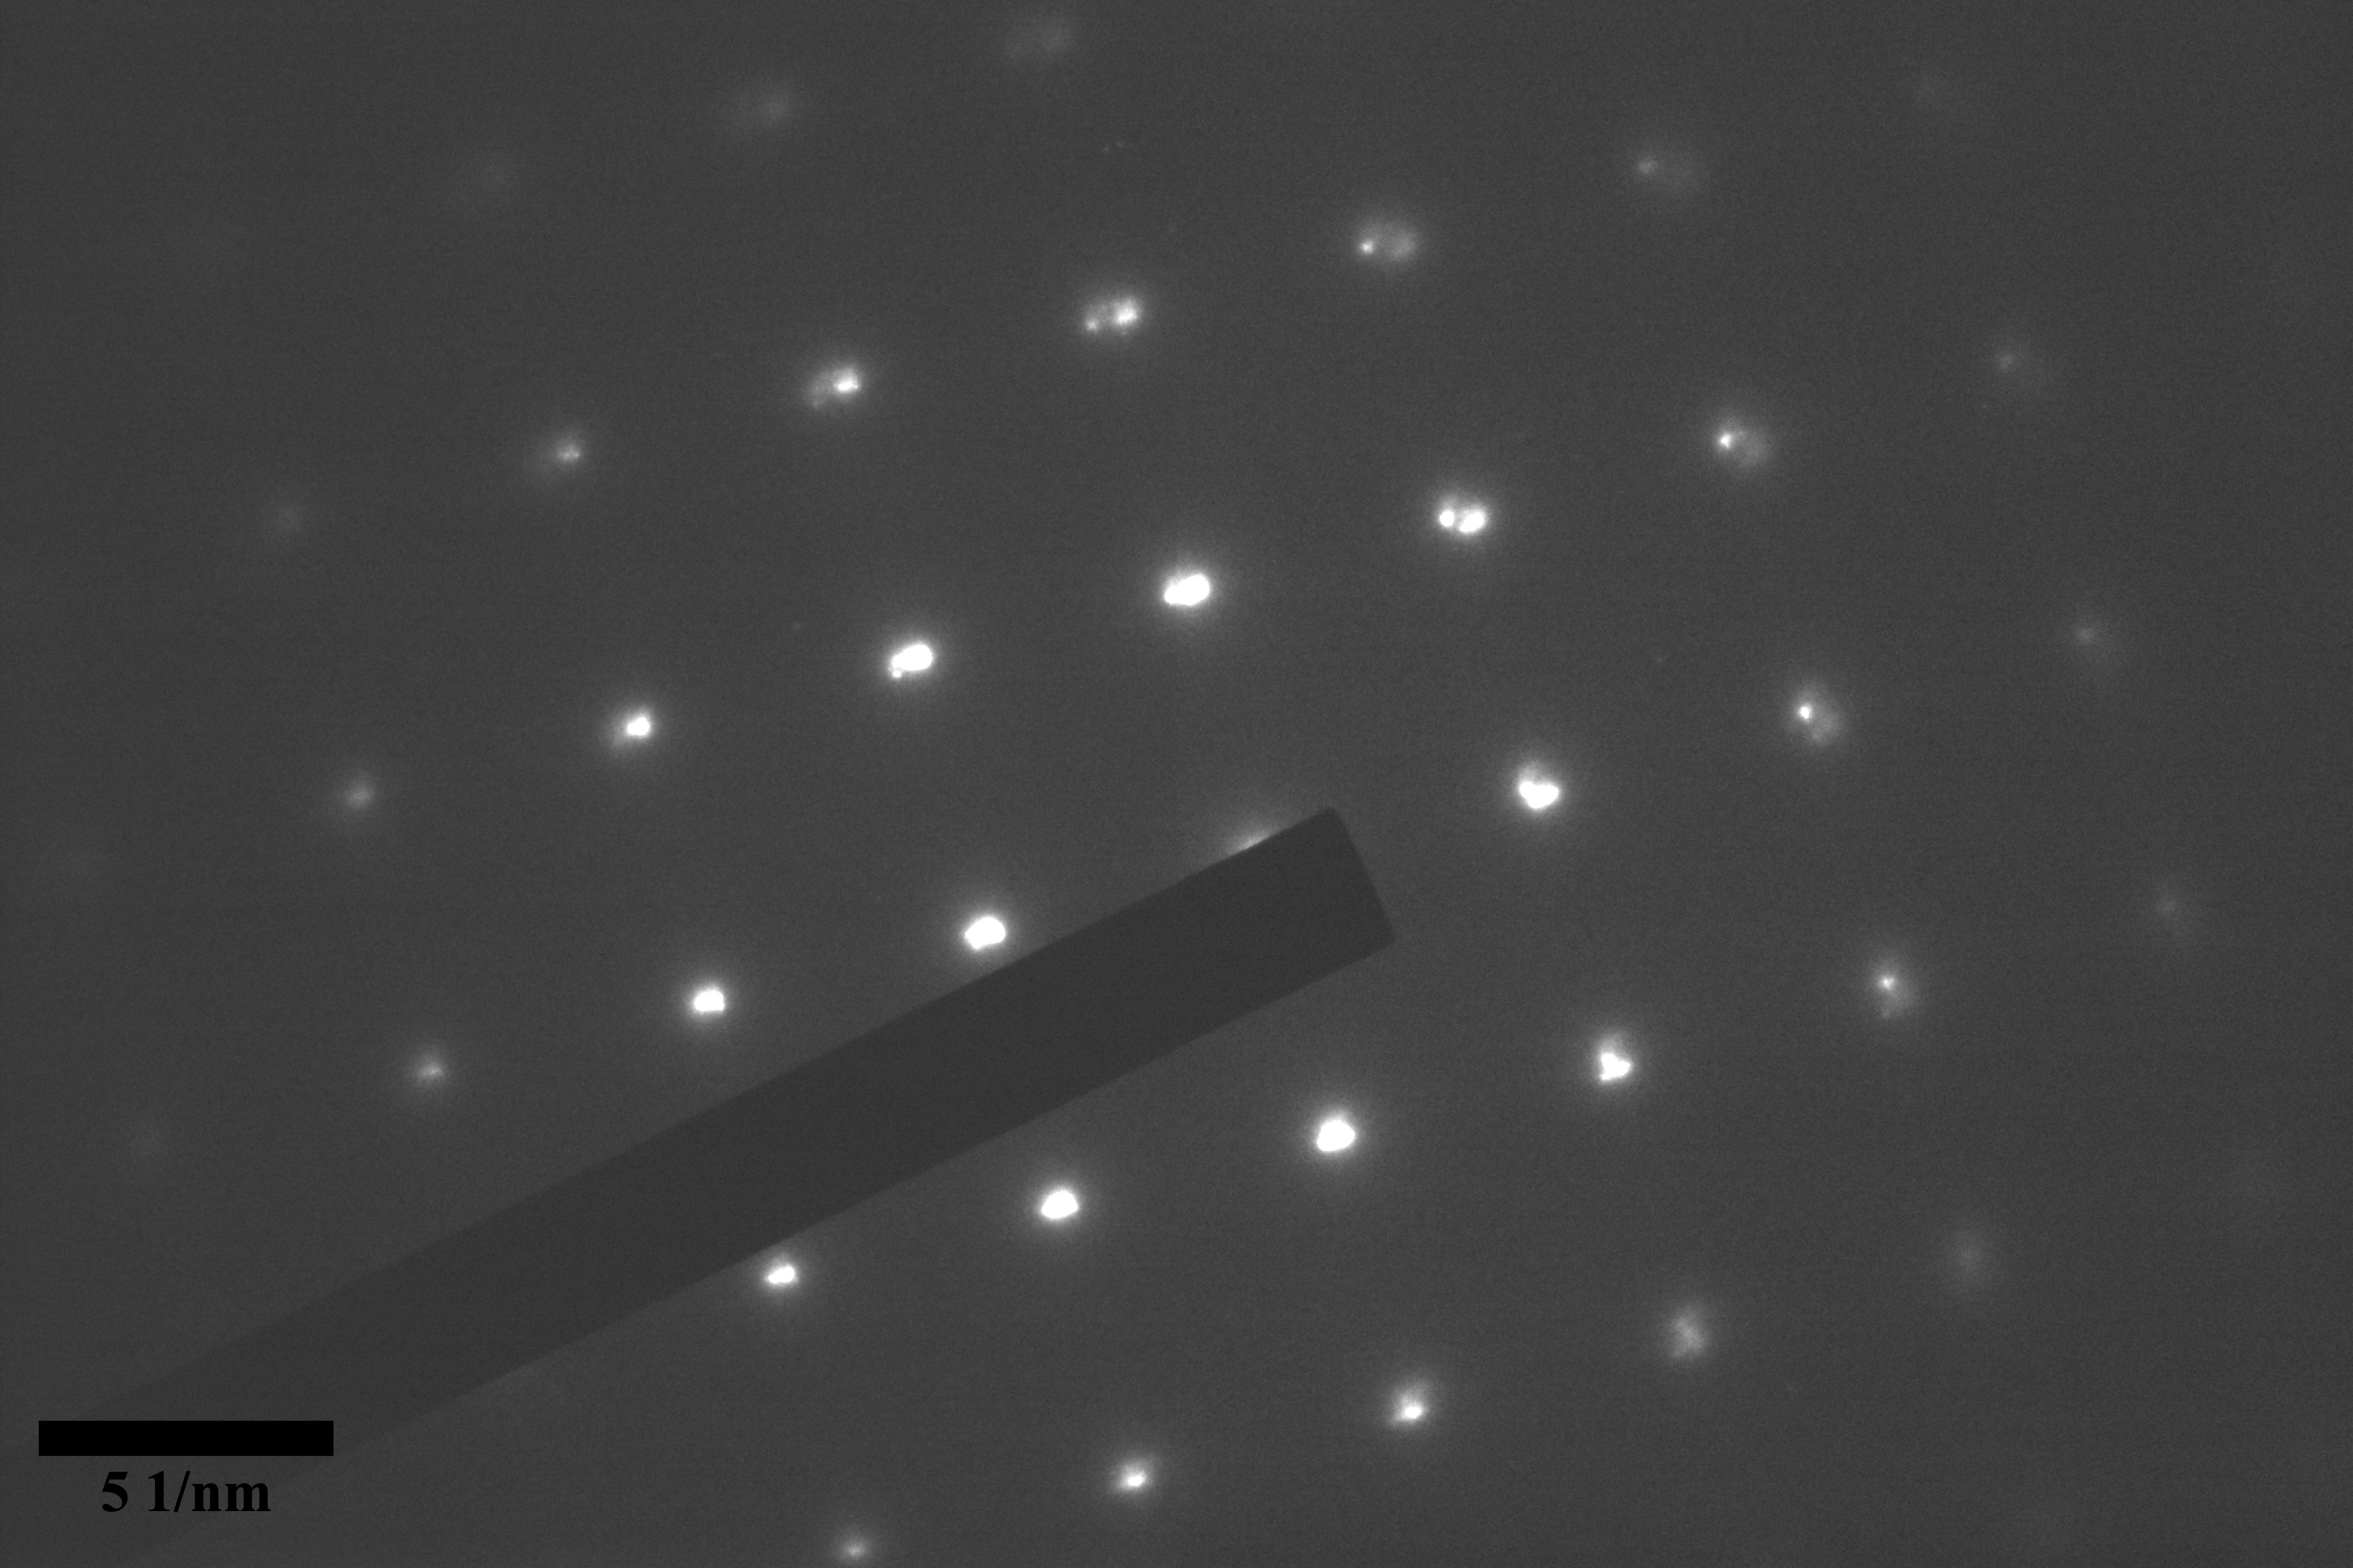
TEM and Selected Area Electron Diffraction
SAED pattern for $⟨$1 1 0$⟩$ zone axis of recent sample exhibiting signs of both the ordered Fe₃Ga and disordered Fe₄Ga phases.
6/24/2025
11

Slide 12
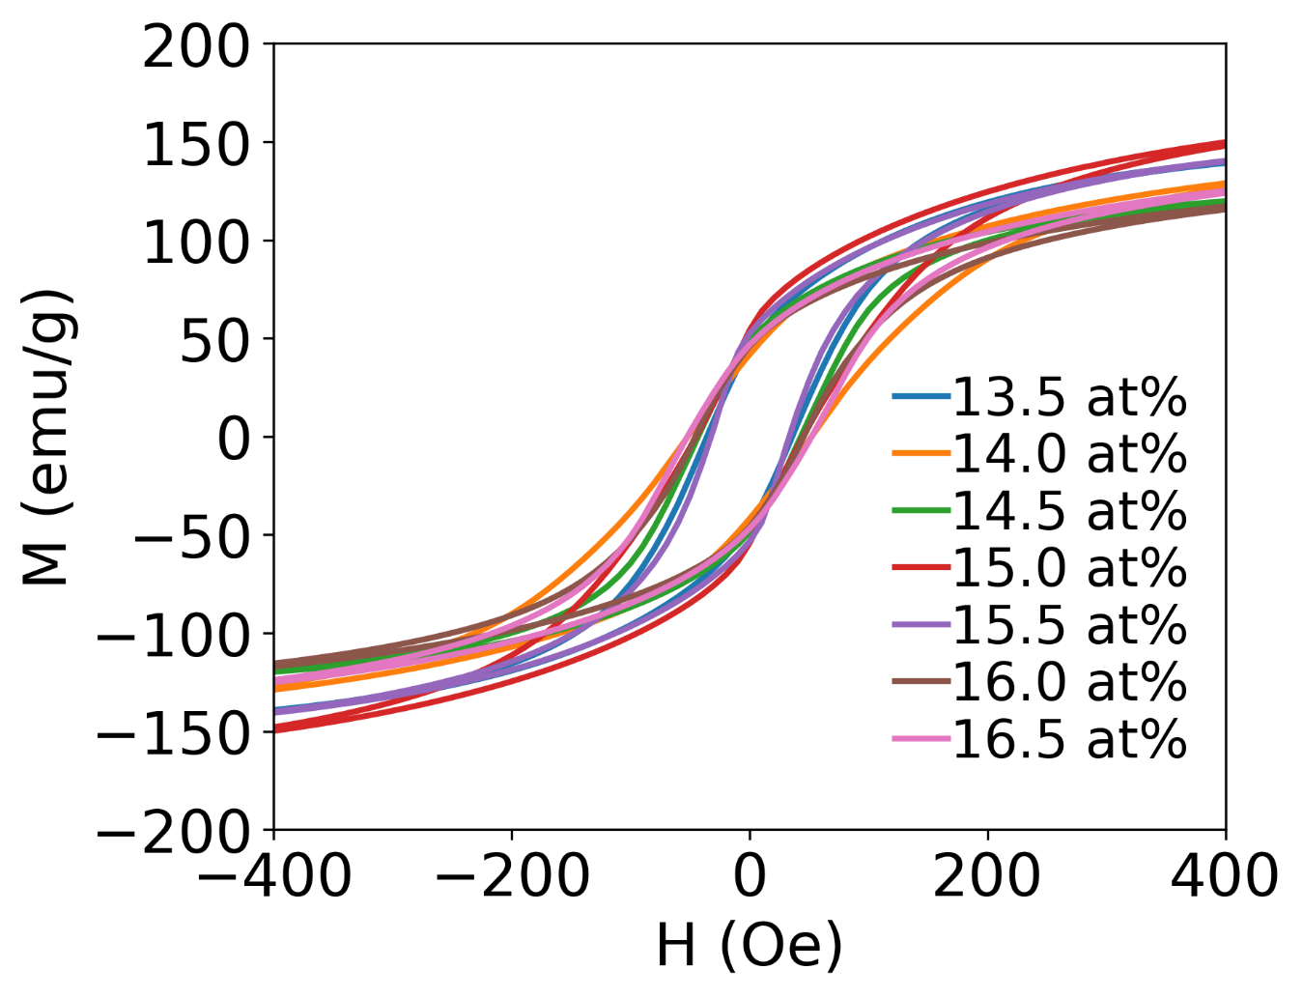
VSM Results
Overlaid Hysteresis Loops for Alloys of Varying Ga Concentration
Magnetometry performed at SDSU
Relatively wide hysteresis loops
Suspected Fe₄Ga with significantly increased saturation magnetization
6/24/2025
12

Slide 13
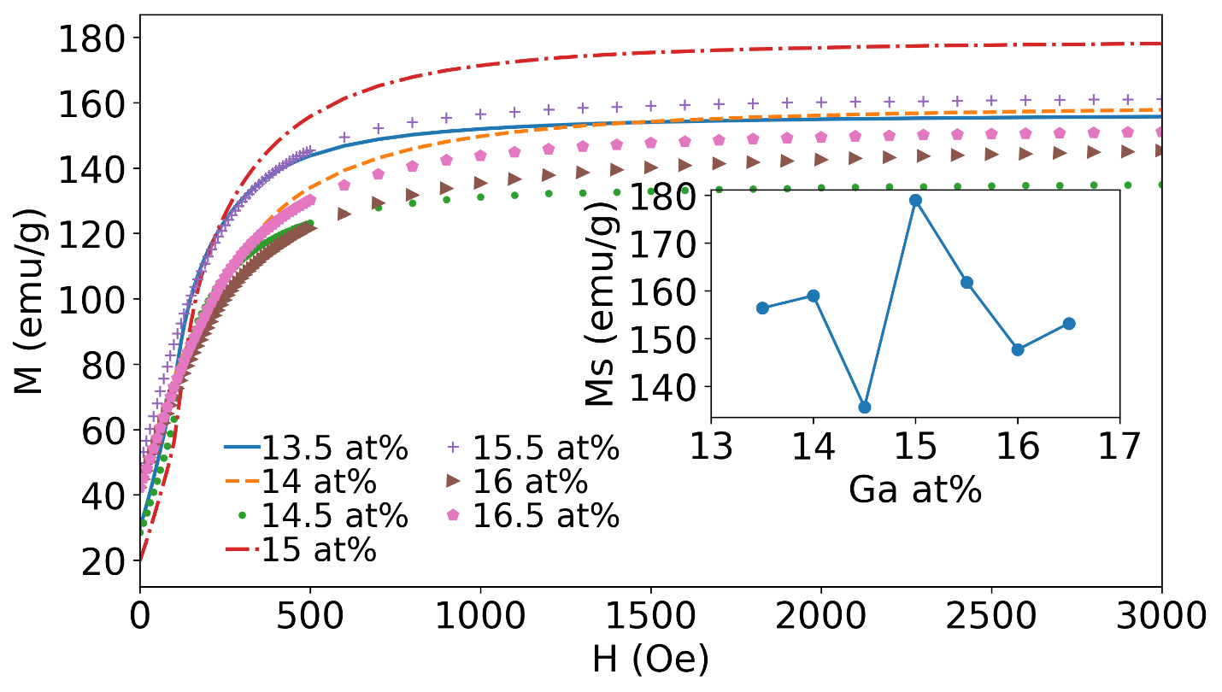
VSM Results cont.
Comparison of Saturation Magnetizations of Alloys of Varying Ga Concentration
Composition | M_{s} (emu/gm)
Fe-Nb₃Cu₁Ga_{13.5}B₉ | 156
Fe-Nb₃Cu₁Ga₁₄B_{8.5} | 158
Fe-Nb₃Cu₁Ga_{14.5}B₈ | 136
Fe-Nb₃Cu₁Ga₁₅B_{7.5} | 179
Fe-Nb₃Cu₁Ga_{15.5}B₈ | 162
Fe-Nb₃Cu₁Ga₁₆B_{8.5} | 148
Fe-Nb₃Cu₁Ga_{16.5}B₉ | 153
6/24/2025
13

Slide 14
DFT Results on Each Phase
Performed Density Functional Theory (DFT) calculations with VASP
Fe₃Ga cell containing 16 atoms (12 Fe)
Fe₄Ga special quasirandom structure (SQS) cell containing 54 atoms (43 Fe)
Magnetization and energy per atom of each phase determined to be:
Magnetization: 2.07 μ_{B}/atom Fe
Magnetization: 2.29 μ_{B}/atom Fe
Fe₃Ga
Fe₄Ga
Energy: -7.02 eV/atom
Energy: -7.22 eV/atom
6/24/2025
14

Slide 15
Completed Work
Fabricated ribbons of Fe-Ga alloy
Characterized the structural and magnetic properties of alloy
XRD determined none were amorphous—possibility of either ordered Fe₃Ga and disorder Fe₄Ga states
TEM/SAED confirmed presence of Fe₄Ga
VSM found large magnetization values for Fe₄Ga alloy
Used DFT to verify results with theory
Found Fe₄Ga to have higher magnetization in agreement with VSM
6/24/2025
15

Slide 16
How will machine learning influence this research?
6/24/2025
16

Slide 17
VASP Machine Learning Force Fields
Goal: Build a machine learning force field to explore the composition and configuration spaces of disordered phase
Machine Learning Force Fields (MLFFs)
Ab initio calculations with DFT & machine learning enable finding force fields for given system
On-the-fly learning
Suited well for efficiency in choosing training data
6/24/2025
17

Slide 18
MLFF Training
Disordered system training accomplished by use of many starting SQSs of appropriate composition
Compiled training data of structures
Produce MLFF and/or perform on-the-fly training for improved MLFF
6/24/2025
18

Slide 19
Acknowledgements
Dr. Tula R. Paudel and Paul White
SDSU for VSM measurements and use of INNOVATOR cluster
NASA EPSCoR
6/24/2025
19

Slide 20
Thank you for listening!
All questions and comments are appreciated.
Contact me: connor.mccollar@mines.sdsmt.edu
6/24/2025
20

