Slide 1

A DFT Study of Rare Earth-Benzene Complexes
Nayana Suresh Palaparambil
Michigan Technological University
Houghton, MI
(nsureshp@mtu.edu)
In collaboration with Prof. Anil Kandalam and Prof. Ravindra Pandey

Slide 2

Time-Independent Schrödinger Equation
The goal of most quantum chemical approaches is to find the solution of the time-independent Schrödinger equation for a multi-electron system.
Where
Strong Coulombic correlations → non-factorizable wavefunction → not easy to solve multi-particle systems.
$$\hat{H}Ψ_{i}\left(r,R\right)=E_{i}Ψ_{i}\left(r,R\right)$$
[1]

Slide 3

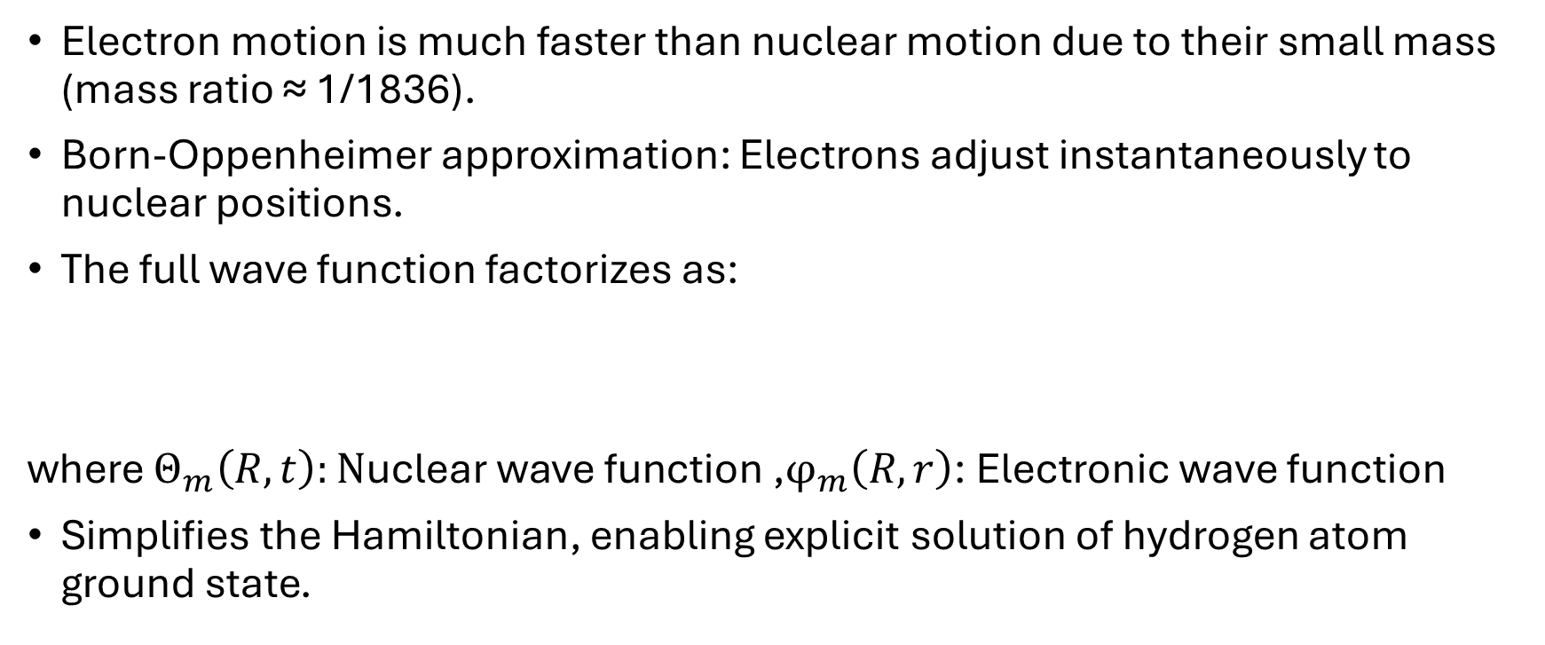
Adiabatic approximation(Born–Oppenheimer)
Electron motion is much faster than nuclear motion due to their small mass (mass ratio ≈ 1/1836).
Born-Oppenheimer approximation: Electrons adjust instantaneously to nuclear positions.
The full wave function factorizes as:
where $Θ_{m}\left(R,t\right):\text{N}\text{uclear} \text{wave} \text{function}\text{ ,}φ_{m}\left(R,r\right)$: Electronic wave function
Simplifies the Hamiltonian, enabling explicit solution of hydrogen atom ground state.
$$Ψ\left(R,r,t\right)=Θ_{m}\left(R,t\right)⋅φ_{m}\left(R,r\right)$$
[1,2]

Slide 4
The Electronic Problem
Solve Schrödinger Equation for N interacting electrons in the field of atomic nuclei is a challenge in many body theory.
Analytical solutions require approximation.
Electronic ground state
Structural stability
Equilibrium
geometry
Vibrational spectra
P-T phase diagrams
Dielectric
properties
transport properties
[1]

Slide 5
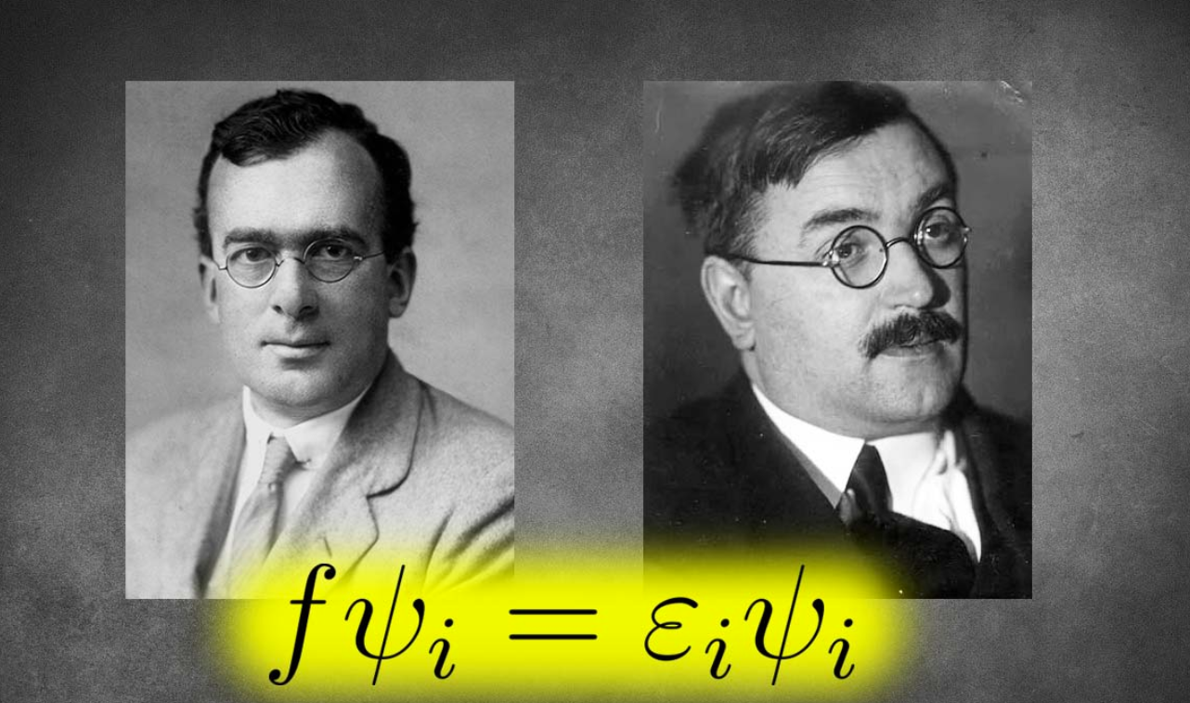
Hartree-Fock Theory

Slide 6
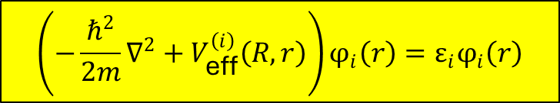

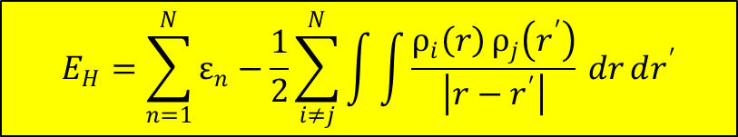
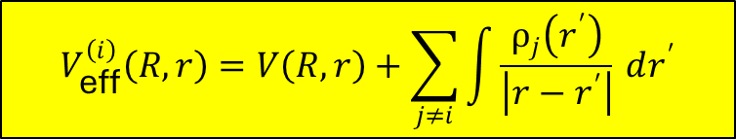
Hartree Approximation
Many-electron wave function can be written as a simple product of one-electron wave functions.
The energy of many-body system:
$$Φ\left(R,r\right)=\prod_{i}{φ_{i}\left(r_{i}\right)}$$
$$\left(−\frac{ℏ^{2}}{2m}∇^{2}+V_{\text{eff}}^{\left(i\right)}\left(R,r\right)\right)φ_{i}\left(r\right)=ε_{i}φ_{i}\left(r\right)$$
$$V_{\text{eff}}^{\left(i\right)}\left(R,r\right)=V\left(R,r\right)+\sum_{j≠i}{\int{\frac{ρ_{j}\left(r^{′}\right)}{\left|r−r^{′}\right|}}} dr^{′}$$
$$E_{H}=\sum_{n=1}^{N}{ε_{n}}−\frac{1}{2}\sum_{i≠j}^{N}{\int{\int{\frac{ρ_{i}\left(r\right) ρ_{j}\left(r^{′}\right)}{\left|r−r^{′}\right|}}}} dr dr^{′}$$
[1]

Slide 7
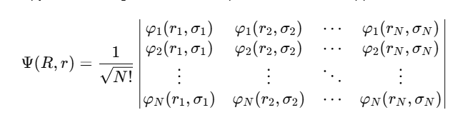
Hartree-Fock Approximation
Improves upon Hartree method by treating electrons as indistinguishable fermions.
Enforces Pauli exclusion principle using an antisymmetrized wavefunction.
Accounts for exchange interaction exactly.
[1,2]

Slide 8
Density Functional Theory (DFT)
Ground state energy of a many electron system is a unique functional of the electron density ρ (r).
Kohn – Sham equations
External Potential
Potential due to Exchange Correlation Energy
Coulomb Potential

Slide 9
Density Functional Theory (DFT)
Kohn-Sham equation:
Real System
Born-Oppenheimer Approximation
The explicit form of exchange-correlation energy
is unknown!
-Local Density Approximation (LDA)
-Generalized Gradient Approximation (GGA)
-Hybrid functional form (e.g., B3LYP)
Kohn-Sham
Non-interacting System
Accuracy in DFT depends primarily on the exchange-correlation function and the basis set.
Guo 2020

Slide 10
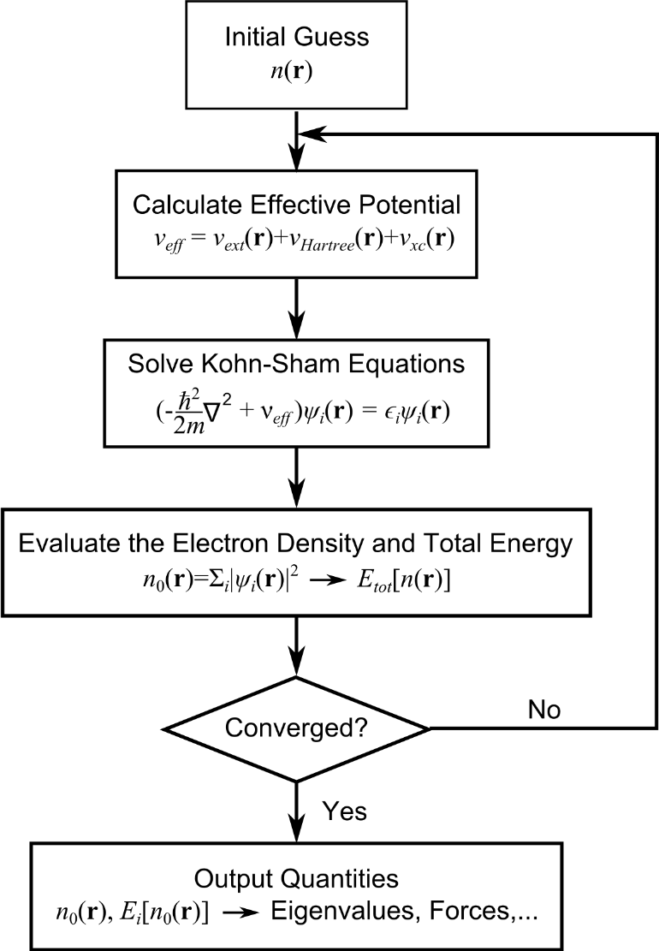
Density Functional Theory (DFT)
Energy surface
Ground state
Solution of Kohn-Sham equations
via Self-Consistent Cycle

Slide 11
Computational Insights into Rare Earth Complexes
Rare earth(RE) elements : Emitters (due to intra-4f transitions).
Application: RE-based optoelectronic devices.
Device fabrication requires a substrate, e.g., Graphene.
RE + Graphene ≈ RE + Benzene(Bz)
Question:
What is the degree of modification in RE properties in the RE-(Bz) complex?

Slide 12
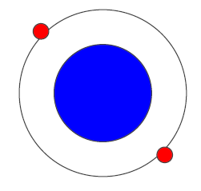
Method
DFT(B3LYP) /6-311G** and SDD basis sets.
C, H atoms: 6-311G** basis set
RE (La-Lu): The Stuttgart-Dresden (SDD) ECP.
Gaussian 16 program package.
Fig. 1: Effective Core Potential (ECP)
Ce: Z=58 e = [Xe] 4f¹ 5d¹ 6s²,
SDD ECP represents 28 core electrons.
Ce: Z=58 e = [Xe] 4f¹ 5d¹ 6s²,
SDD ECP represents 28 core electrons.

Slide 13
GROUND STATE CONFIGURATION
C2
Pseudo Jahn-Teller distortion!
Fig. 2: The ground state of Ce-(Bz) complex
[3]

Slide 14
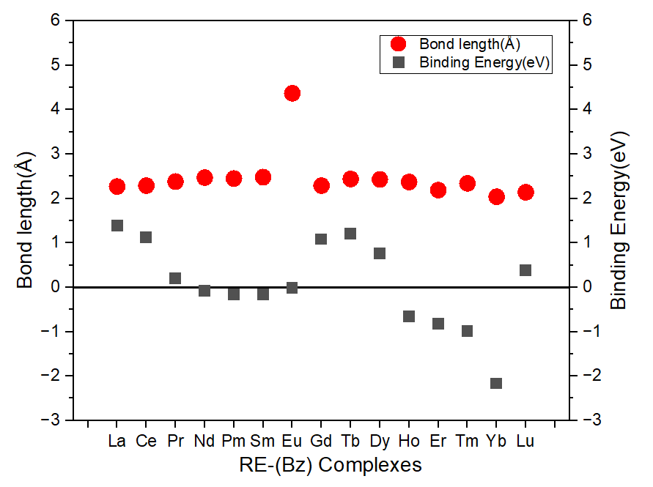
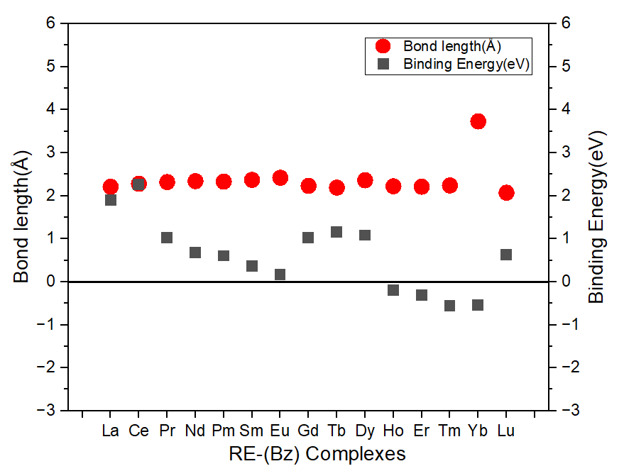
Exchange and Correlation functional forms (B3LYP vs BPW91)
BPW91
Accurate results for organic systems.
Underestimates binding energies in organometallics.
Negative binding energies for (Ho-Yb)-Bz.
Yb-[Xe]4f¹⁴ 6s² -Weak interaction with Bz
due to fully-filled f orbital.
[4]

Slide 15
D3 Dispersion correction
Includes weak long-range forces.
E.g : London dispersion interaction.
Improved binding energy values.
System | Functional | B.E(eV)
Ho-(Bz) | BPW91 | -0.14
 | BPW91+D3 | -0.021
Er-(Bz) | BPW91 | -0.31
 | BPW91+D3 | -0.13
Tm-(Bz) | BPW91 | -0.56
 | BPW91+D3 | -0.38
Analysis is in progress to understand the predicted weak RE–Bz interaction.
[5]

Slide 16
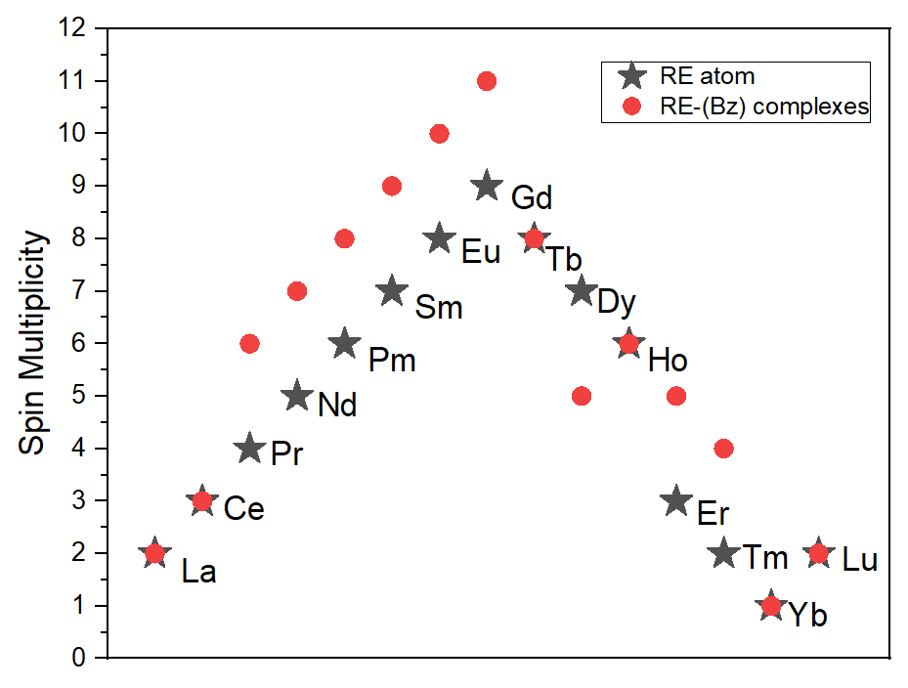
Spin Multiplicity Comparison

Slide 17
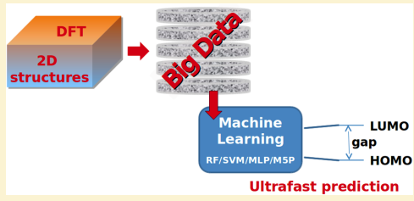
Machine Learning in DFT
HOMO–LUMO energies are crucial for understanding optical properties of RE–substrate complexes.
ML models can quickly predict HOMO/LUMO values across a large RE–substrate dataset using BPW91 results.
[6]

Slide 18
References
[1] Kohanoff, J., & Gidopoulos, N. I. (2003). Density functional theory: basics, new trends and applications. Handbook of molecular physics and quantum chemistry, 2(Part 5), 532-568.
[2] Koch, W., & Holthausen, M. C. (2015). A chemist's guide to density functional theory. John Wiley & Sons.
[3] Liu, Y., Kumari, S., Roudjane, M., Li, S., & Yang, D. S. (2012). Electronic states and pseudo Jahn-Teller distortion of heavy metal-monobenzene complexes: M (C6H6)(M= Y, La, and Lu). The Journal of Chemical Physics, 136(13).
[4] Stöckigt, D. (1999). Contra-Binding Rotation in Al+− L Complexes (L= C6H6, C4H4O, C5H6, C4H4NH): A New Degenerate Rearrangement. Organometallics, 18(6), 1050-1058.
[5] Stefan, G., Andreas, H., Gerit, B. J., & Christoph, B. (2016). Dispersion-Corrected Mean-Field Electronic Structure Methods.
[6] Pereira, F., Xiao, K., Latino, D. A., Wu, C., Zhang, Q., & Aires-de-Sousa, J. (2017). Machine learning methods to predict density functional theory B3LYP energies of HOMO and LUMO orbitals. Journal of chemical information and modeling, 57(1), 11-21.

Slide 19

Questions?

