Slide 1
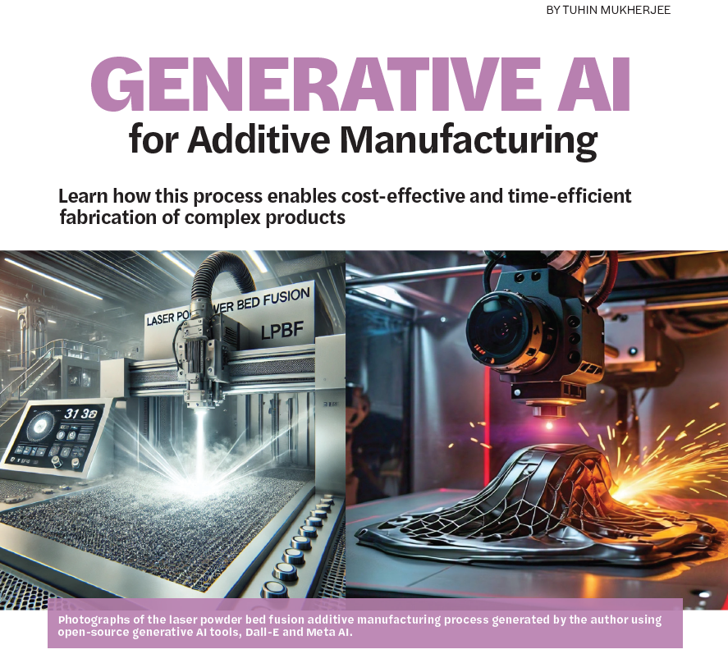
Emerging AI tools for controlling grain structure, phases, and defects in
3D printed metallic parts
Tuhin Mukherjee
Mechanical Engineering, Iowa State University
Contents:
Metal 3D printing: uniqueness and opportunities
Need to control grains, phases, and defects
Why AI?
Several applications
Future perspectives
Workshop for AI-Powered Materials Discovery at Great Plains University of South Dakota, 23 June 2025
T. Mukherjee, Welding Journal, 2024.

Slide 2
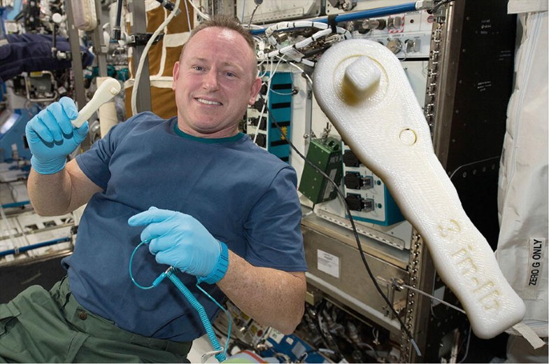
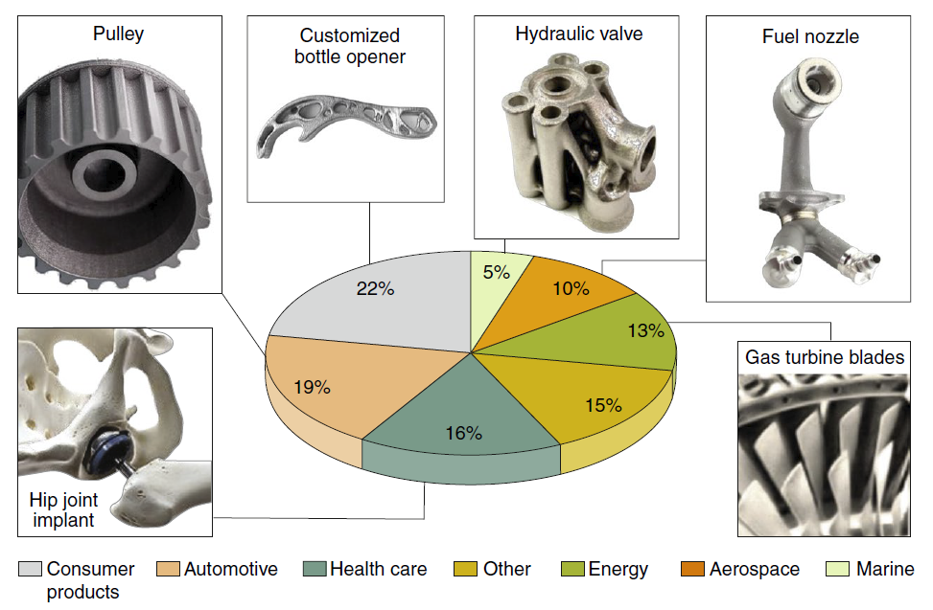
Metal printing: uniqueness and opportunities
3D printing in space (NASA)
DebRoy, Mukherjee, Milewski et al. Nature Materials. 2019
Only a handful of over 5,000 commercial alloys are printed
Failure to control structure, properties, and defects

Slide 3
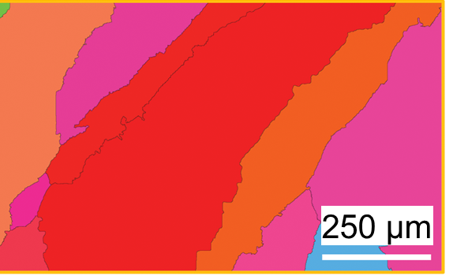
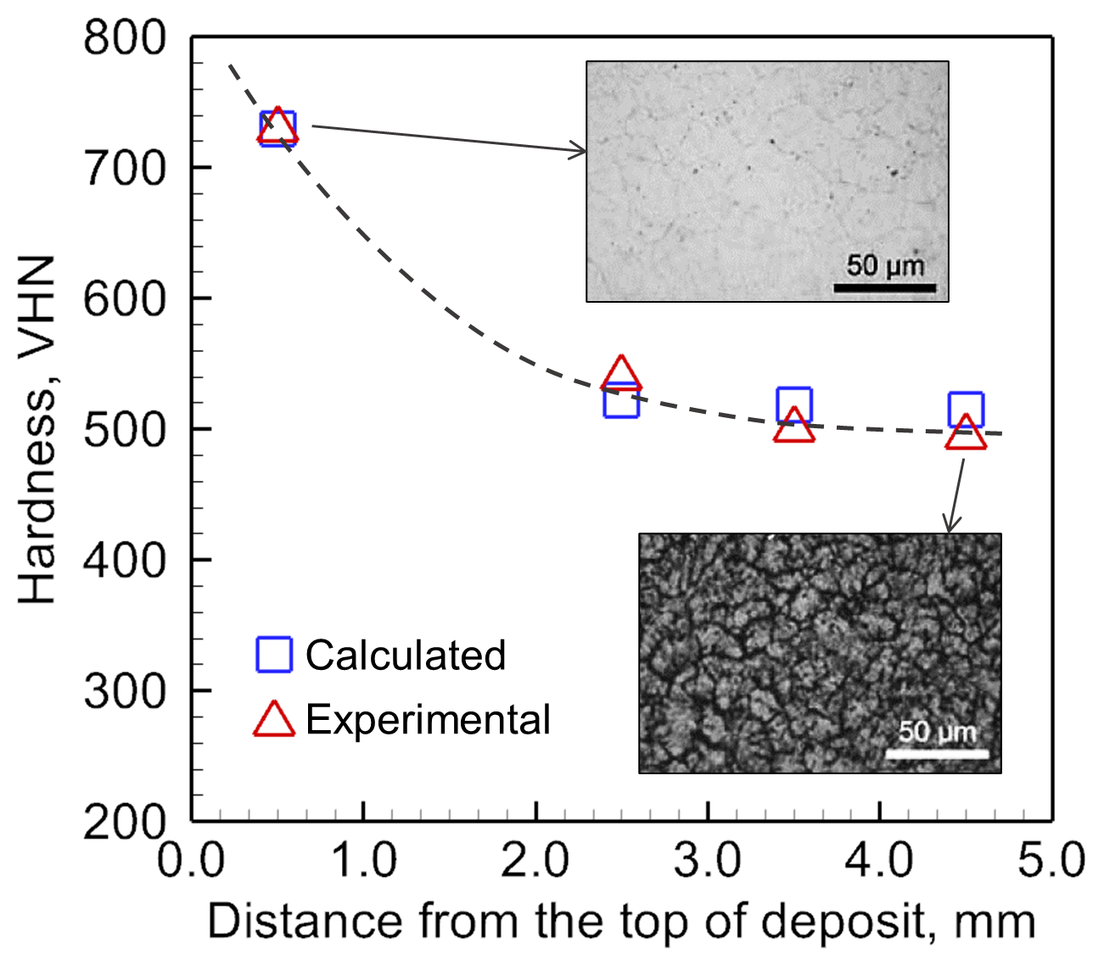
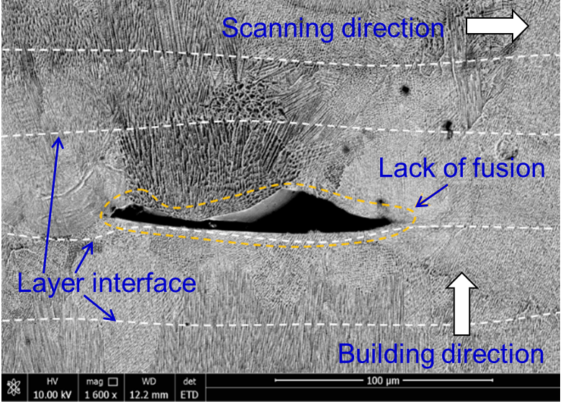
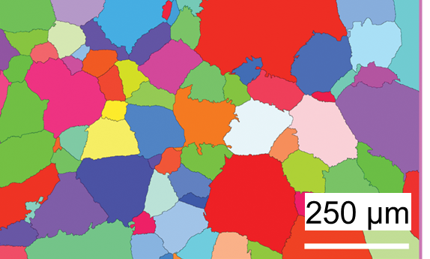
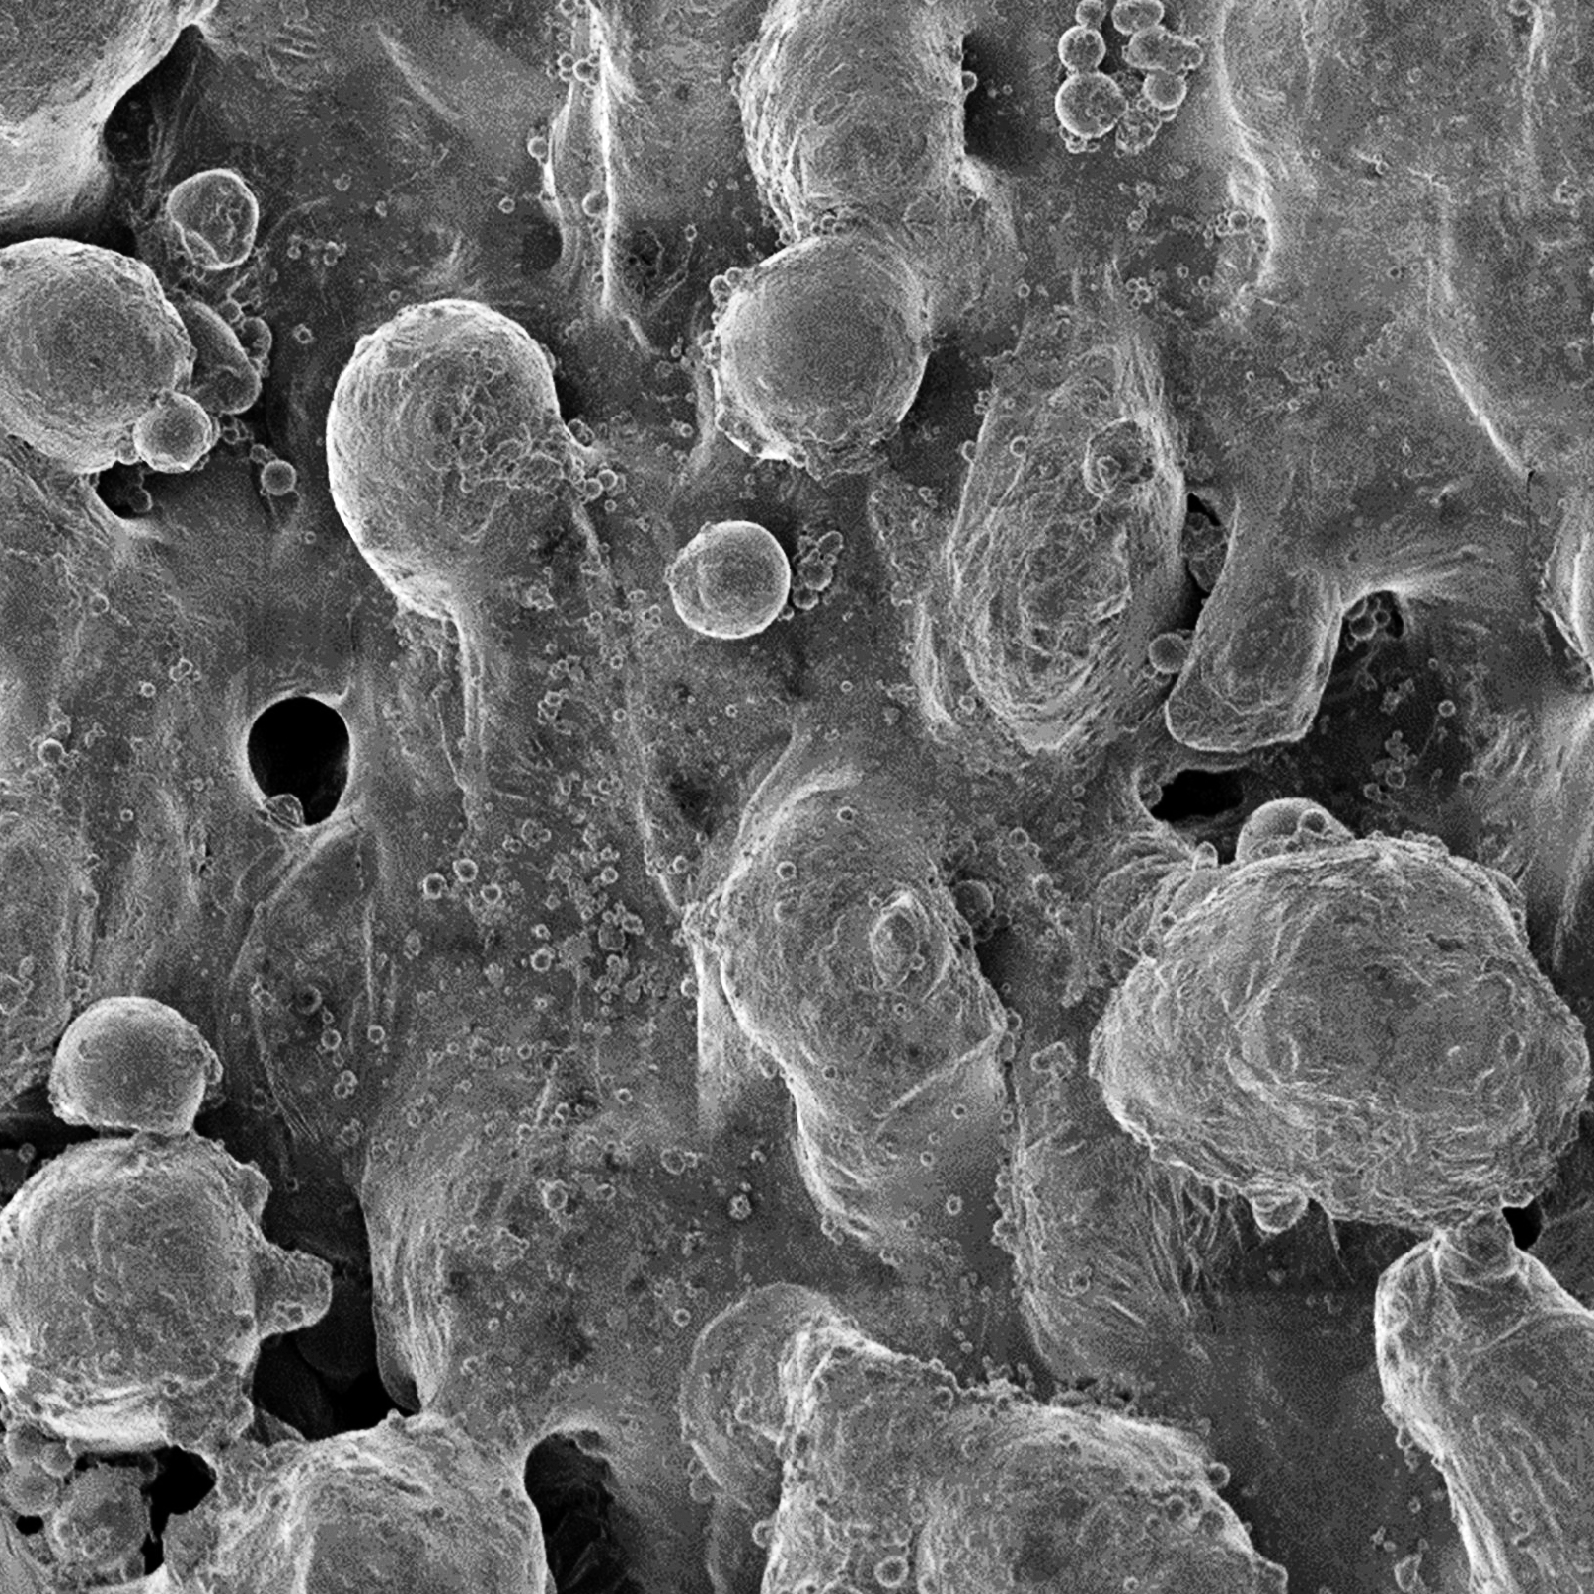
Main challenges: controlling grains, phases, & defects
Structure
Properties
Defects
Columnar grains
Hardness variation
Lack of fusion voids
Equiaxed grains
Xia et al. Int. J Machine Tool. Manuf. 2017
Surface roughness
Todaro et al. Nature Comm. 2020
Mukherjee et al. Acta Mater. 2021
Cao et al. Add. Manuf. 2021

Slide 4
Why artificial intelligence?
Important variables: laser power, scanning speed, laser beam radius, layer thickness, preheat temperature, hatch spacing, substrate dimensions, specific heat, thermal conductivity, density, solidification range, Youngs modulus.
Minimum experiments needed:
2¹² (=4096) - 2-factor DOE
AI tools can help reduce the parameter space, minimize trial-and-error, and improve quality

Slide 5
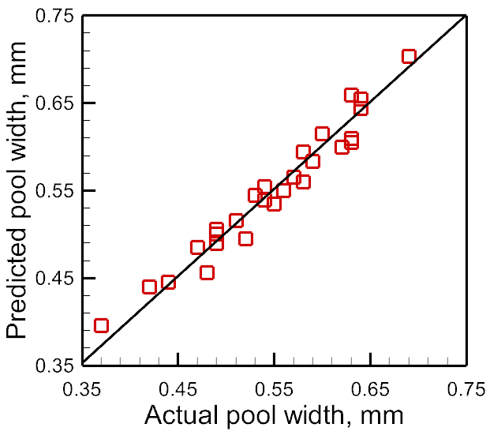
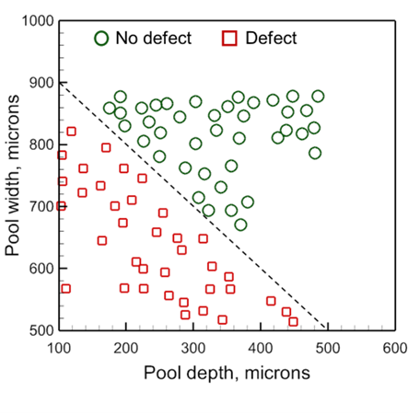
Machine learning
Regression problems
Classification problems
Problem type
Control of geometry, grain size, residual stress, distortion
Control of defect formation, solidification morphology
Examples
Machine learning algorithms
Linear regression, neural network, Bayesian network
Decision tree, random forest, support vector machines

Slide 6
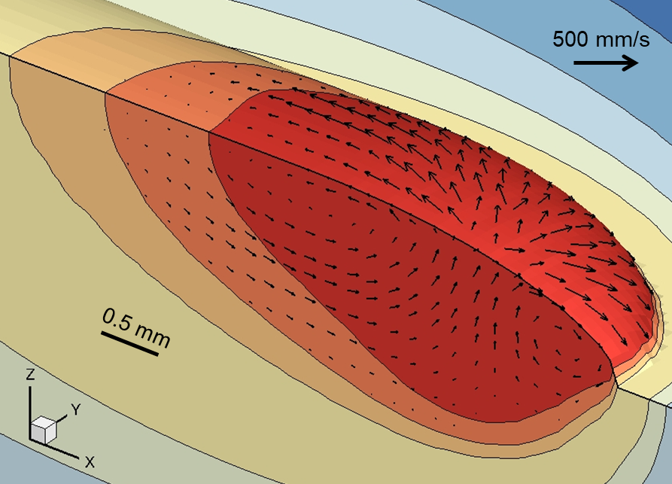
Physics-informed machine learning
Benefits
Calculates variables that affect structure, properties, and defects
Provides scientific insights
Guides experiments by selecting appropriate process conditions
Heat source
Mirror
Roll
Powder bed
Mechanistic modeling
Powder spreader
Part
Benefits
Does not need phenomenological understanding
Reliable prediction with less data
Hierarchical importance of variables
Substrate
Additive manufacturing experiments
Machine learning

Slide 7
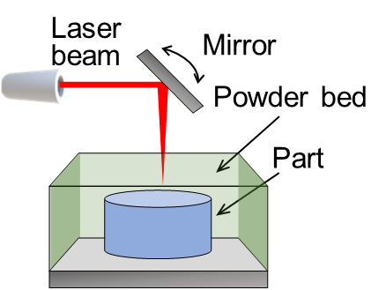
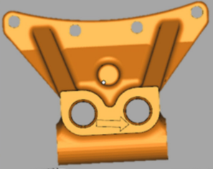
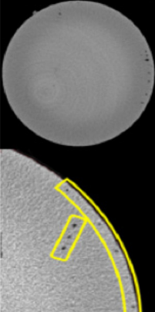
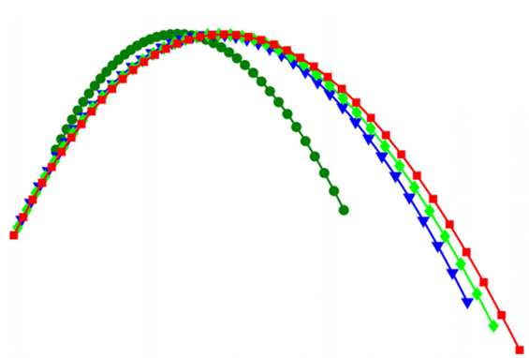
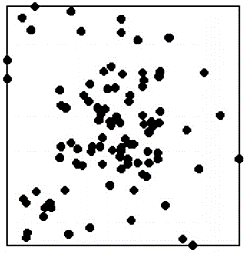
Deep learning
(a) AM process
(b) Printed part
(c) CT image of part
Can handle large dataset
Parameter 2
Variable
Deep learning results support experiments
Adapted from Yao et al. JMSE, 2018
Parameter 1
Sample number
CT images capture the defect formation
(e) Deep learning results
(d) Raw data distribution

Slide 8
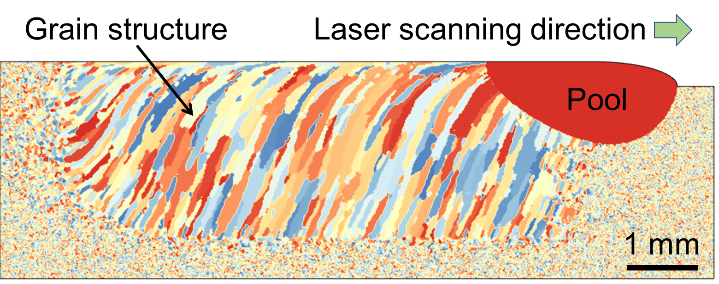
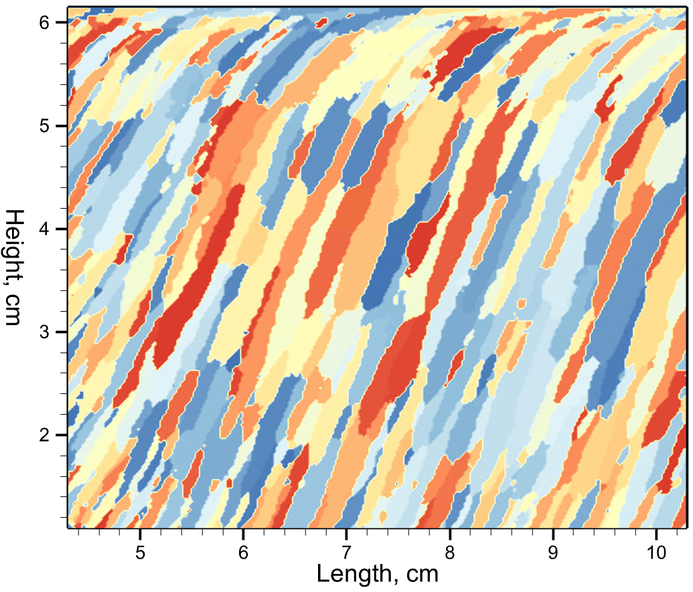
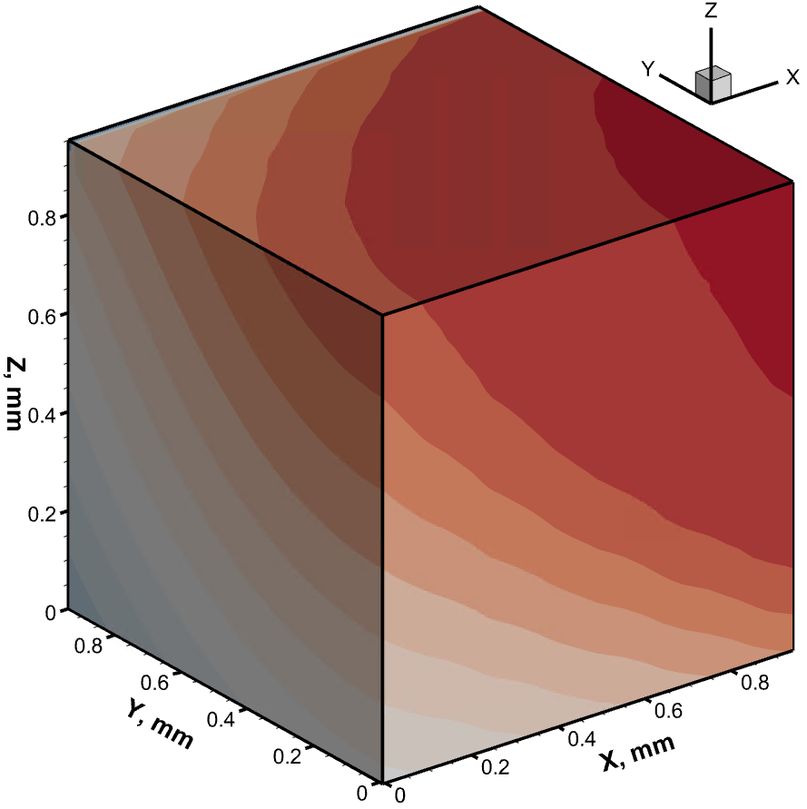
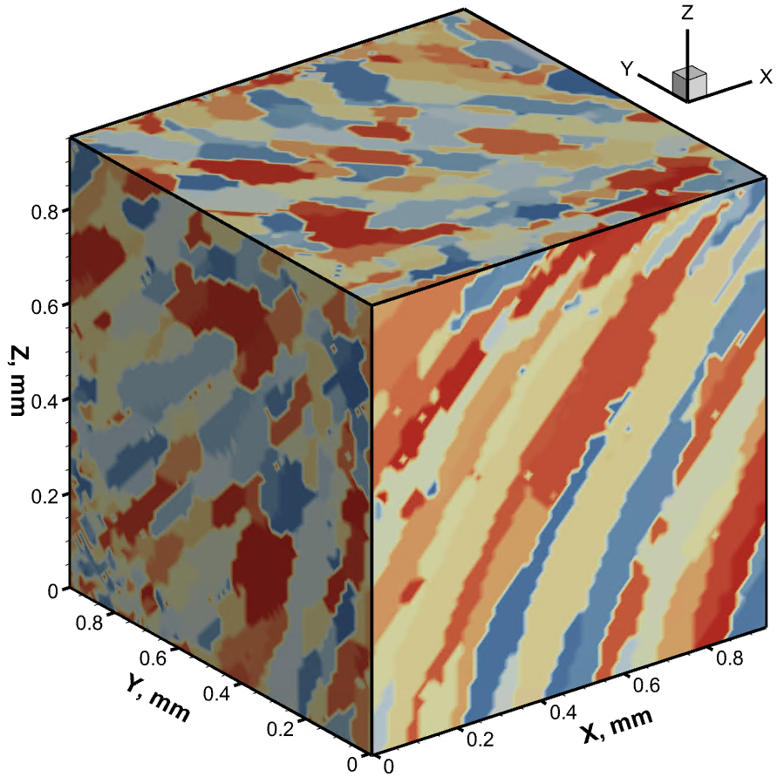
1. Control of grain structure using machine learning
AM process model &
3D kinetic Monte Carlo grain growth model
Ongoing work at
Iowa State University

Slide 9
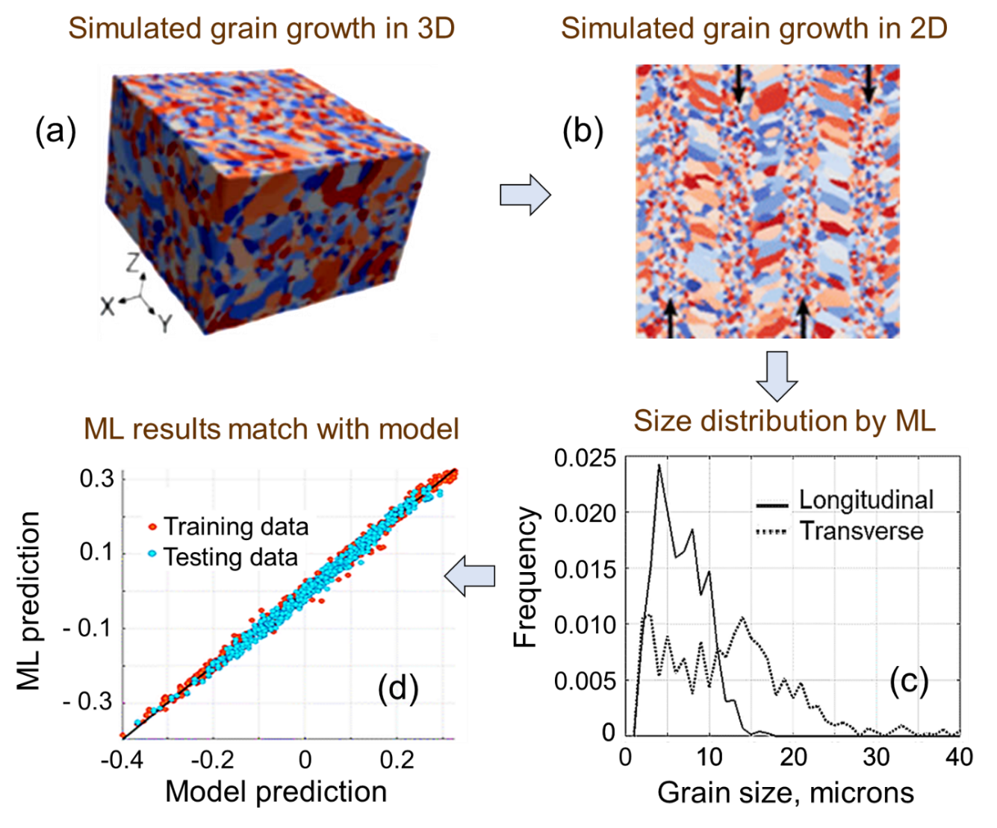
Control of grain structure using machine learning
The grain growth is computed using a Monte Carlo model.
Grain size versus frequency data in longitudinal and transverse directions
These data are used to train a neural network that could then calculate grain growth
DebRoy, Mukherjee, Wei et al. Nature Reviews Materials. 2021
Khanzadeh et al. SMEJMP. 2018

Slide 10
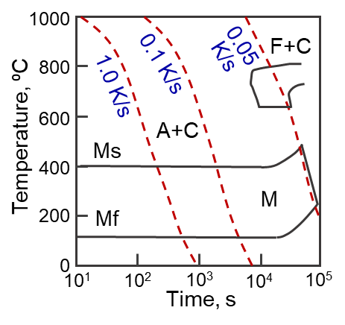
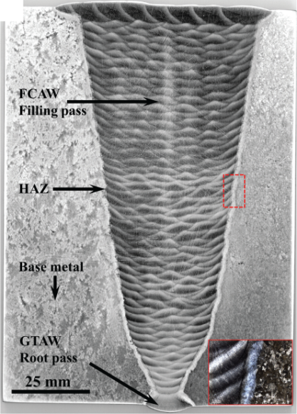
2. Hardness control using physics-informed ML
CCT diagram of Grade 91 ferritic steel
Hardness of ferritic steels parts are affected by martensite
Repeated heating and cooling during multilayer deposition tempers martensite
Mukherjee et al. Acta Materialia. 2021
Mukherjee et al. J Manufacturing Processes. 2022

Slide 11
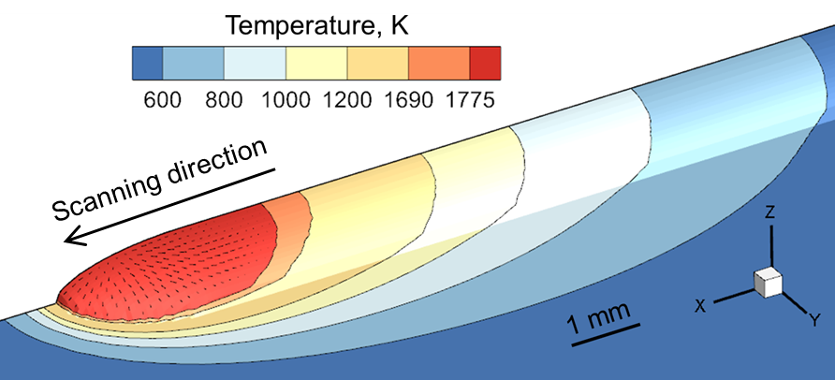
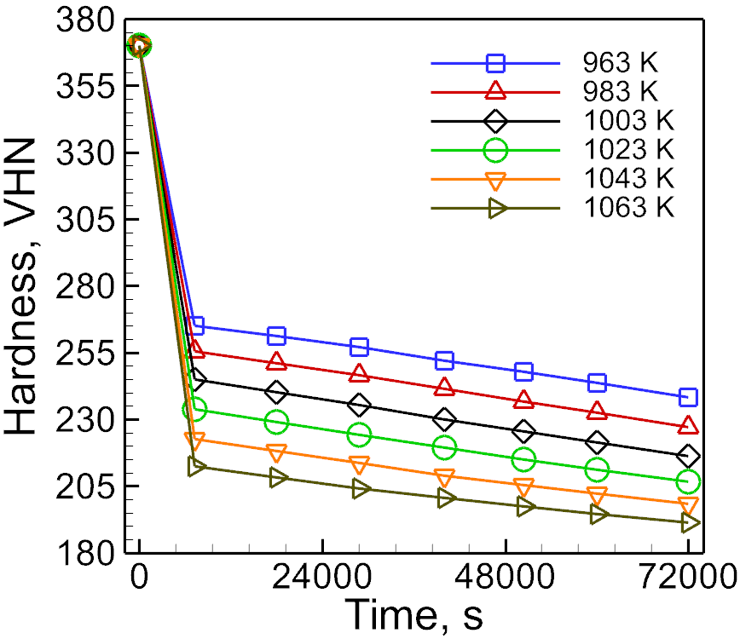
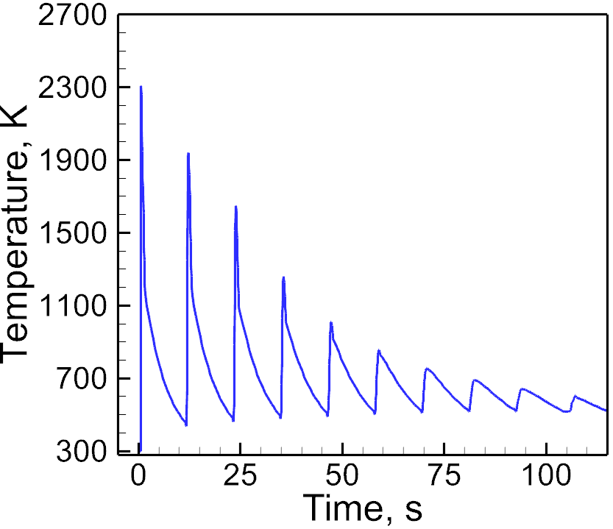
The physics-informed machine learning framework
Tempering data from literature
Process conditions and alloy properties
Input
Hidden layer
Output
Neural network
Heat transfer and fluid flow model
Accurately calculated thermal cycle
JMA: Johnson Mehl Avrami equation
JMA constants
Hardness of the part
Isothermal tempering data
Calculated thermal cycles

Slide 12
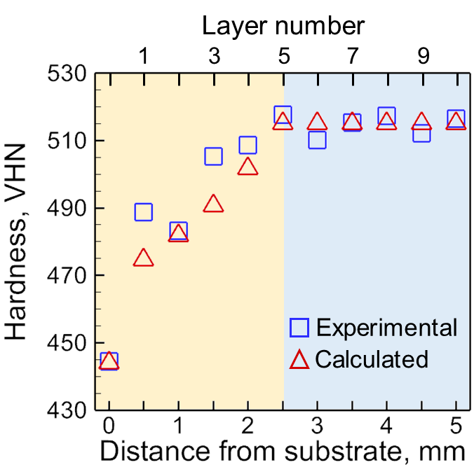
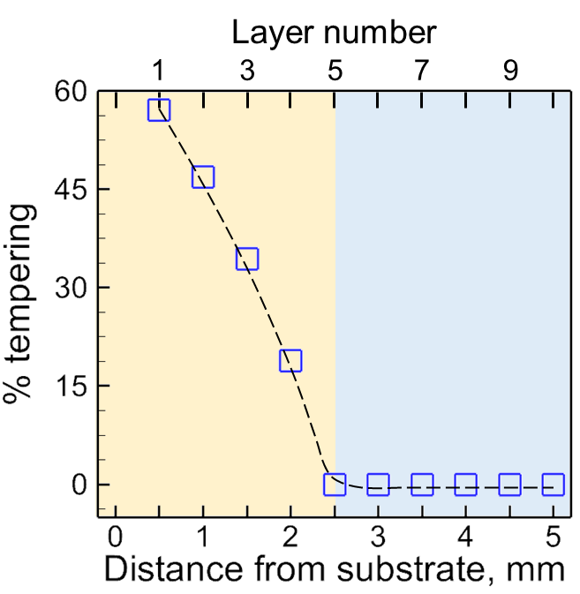
Predicted tempering and hardness
Mukherjee et al. J Manufacturing Processes. 2022

Slide 13
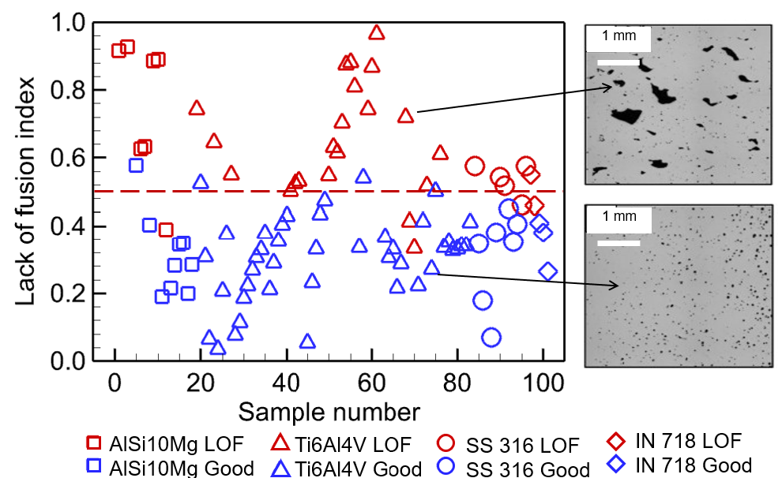
3. Machine learning to reduce lack of fusion
LFI = 0.473 H – 0.15 D – 2.61 × 10⁻⁵Ma – 0.122 T + 0.306 Fo + 0.569
H : Dimensionless hatch spacing
D : Dimensionless pool depth
Ma : Marangoni number
T : Dimensionless peak temperature
F₀ : Fourier number
Jiang, Mukherjee et al. npj Computational Materials. 2022

Slide 14
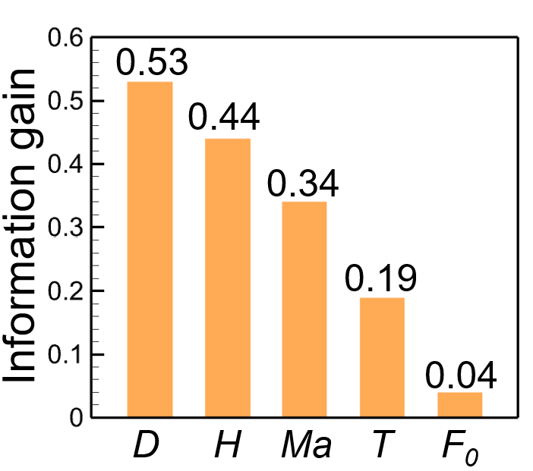
Hierarchy of variables affecting lack of fusion
Hierarchical importance
Dimensionless hatch spacing, H
(Hatch spacing/Pool width)
Dimensionless pool depth, D
(Pool depth/Layer thickness)
Marangoni number, Ma
Dimensionless peak temperature, T
(Peak temperature/Liquidus temperature)
Fourier number, F₀
D > H > Ma > T >F₀
Jiang, Mukherjee et al. npj Computational Materials. 2022

Slide 15
4. Calculation of residual stress to train ML
Stainless steel 316
Different processes
Mukherjee, DebRoy, STWJ, 2019
DED-L
Different materials
Mukherjee, Zhang, DebRoy, Comput. Mater. Sci. 2017.
Inconel 718
Ti-6Al-4V

Slide 16
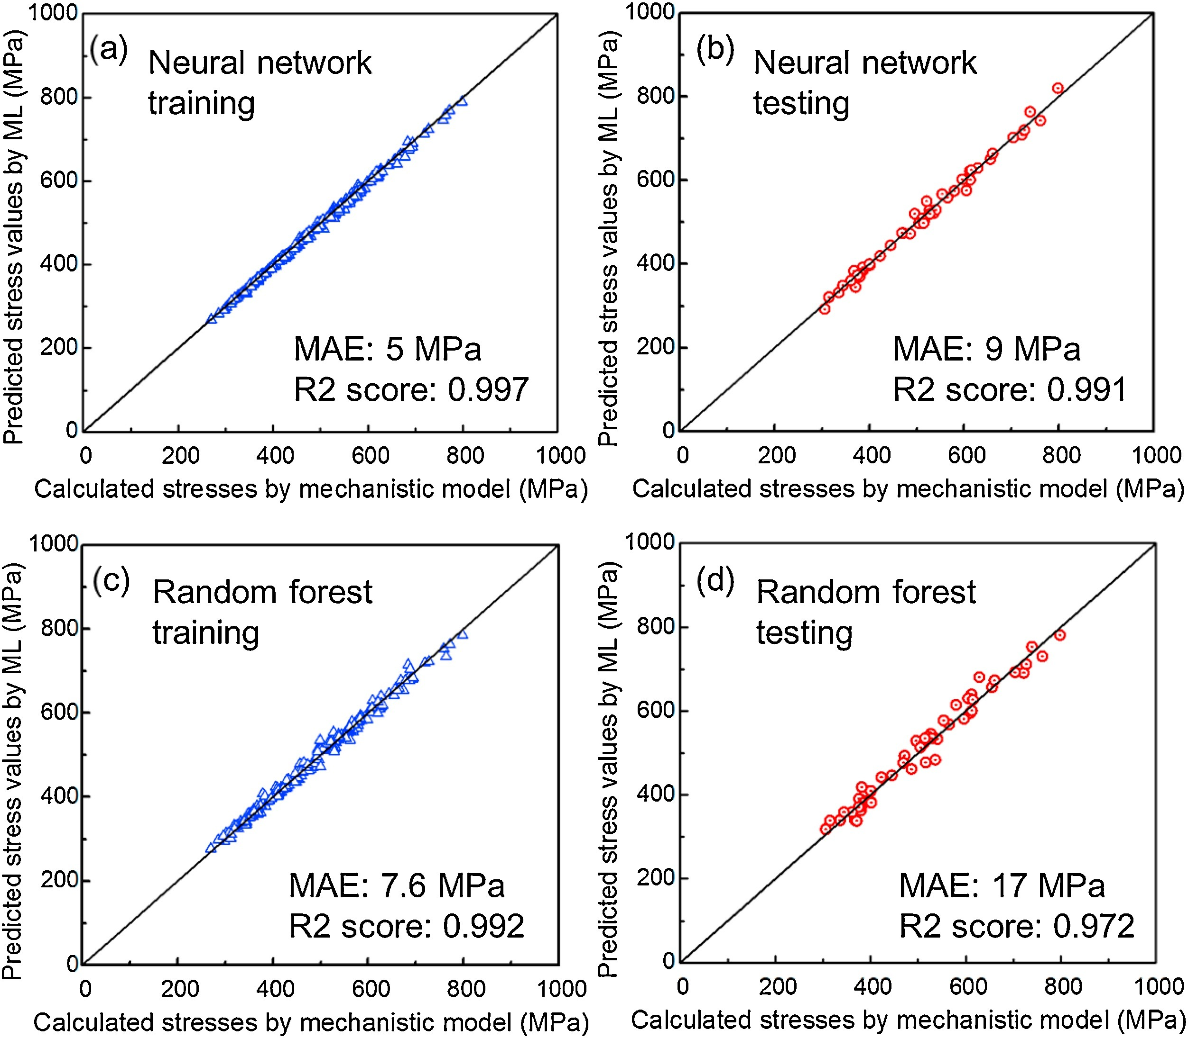
Prediction and control of residual stress
Computed residual stress values were used for training.
Based on 243 datasets of 3 alloys SS 316, IN 718 and 800H
Wu, Mukherjee, De et al. Additive Manufacturing. 2020

Slide 17
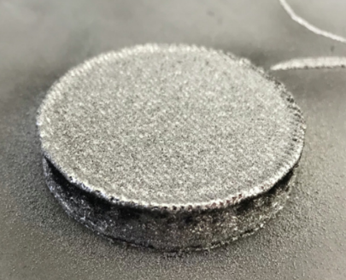
5. Distortion control using deep learning
(a) Printed part
(b) Process parameters
(c) Feedstock properties
Adapted from
Francis et al.
Manufacturing Letters, 2019
(d) Temperature field images captured by a pyrometer
(e) 3D distortion of the part predicted by deep learning

Slide 18
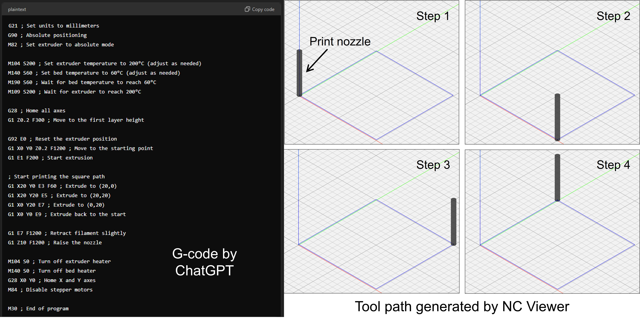
Can ChatGPT etc. help?

Slide 19
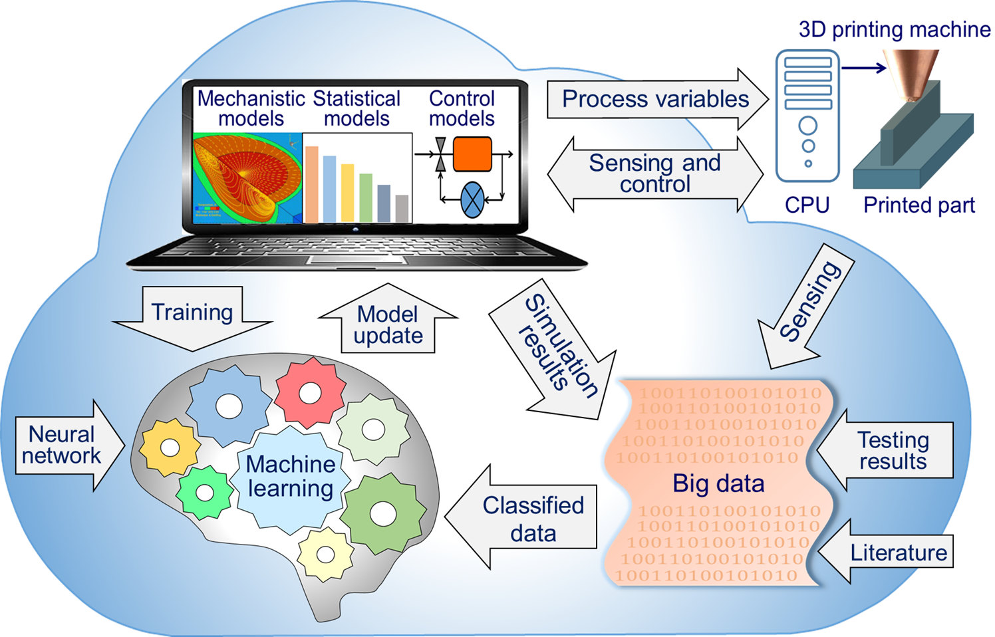
Future perspective: Digital twin of 3D printing
Mukherjee et al. Applied Mater. Today 2019

Slide 20
Future perspective: Need for quantum computing
IBM Qiskit
Quantum Computer
IBM: Quantum computing is expected to help develop breakthrough products and services that will disrupt and redefine manufacturing
https://www.ibm.com/thought-leadership/institute-business-value/report/quantum-manufacturing
SBIR: Small Business Innovation Research in the US has recently emphasized the importance of quantum computing in 3D printing
https://www.sbir.gov/node/1863263
qiskit.org

Slide 21
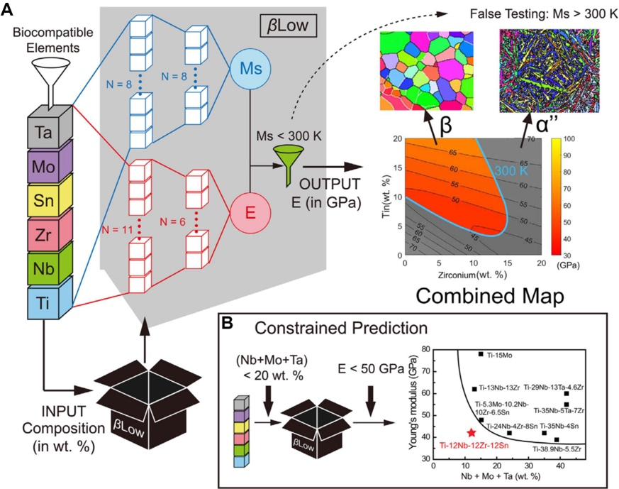
Future perspective: AI-guided materials discovery for AM
Designing biocompatible titanium alloys with specific mechanical properties.
Young's modulus (E), martensite start temperature (Ms), and beta phase stability (βLow)
Similar approach can find new printable alloys
Yu et al. Journal of
Materials Informatics, 2021

Slide 22
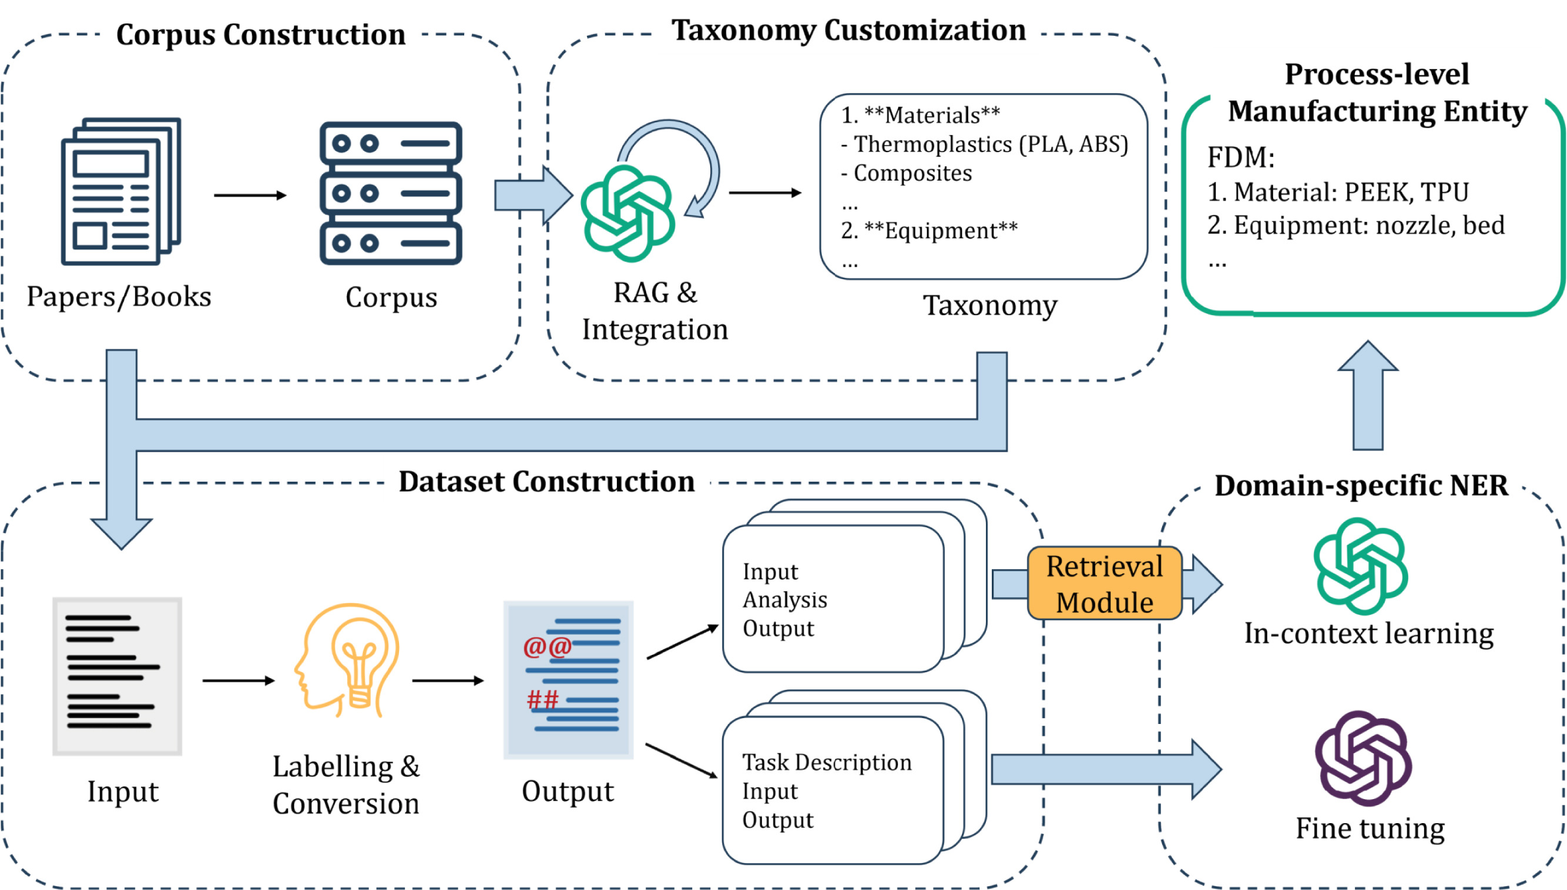
Future perspective: Large language models for AM
Liu et al., RCIM, 2025.
RAG: Retrieval Augmented Generation; NER: Named Entity Recognition

Slide 23
Summary
Artificial intelligence (AI) tools are useful for controlling microstructure, properties, and defect formation during additive manufacturing.
Availability of several well-tested algorithms and open-source codes allows everyone to use AI.
AI tools can reduce the process parameter space to explore, minimize time-consuming trial-and-error, and improve quality.
Use of digital twins, quantum computing, and large language models can strengthen this field

Slide 24
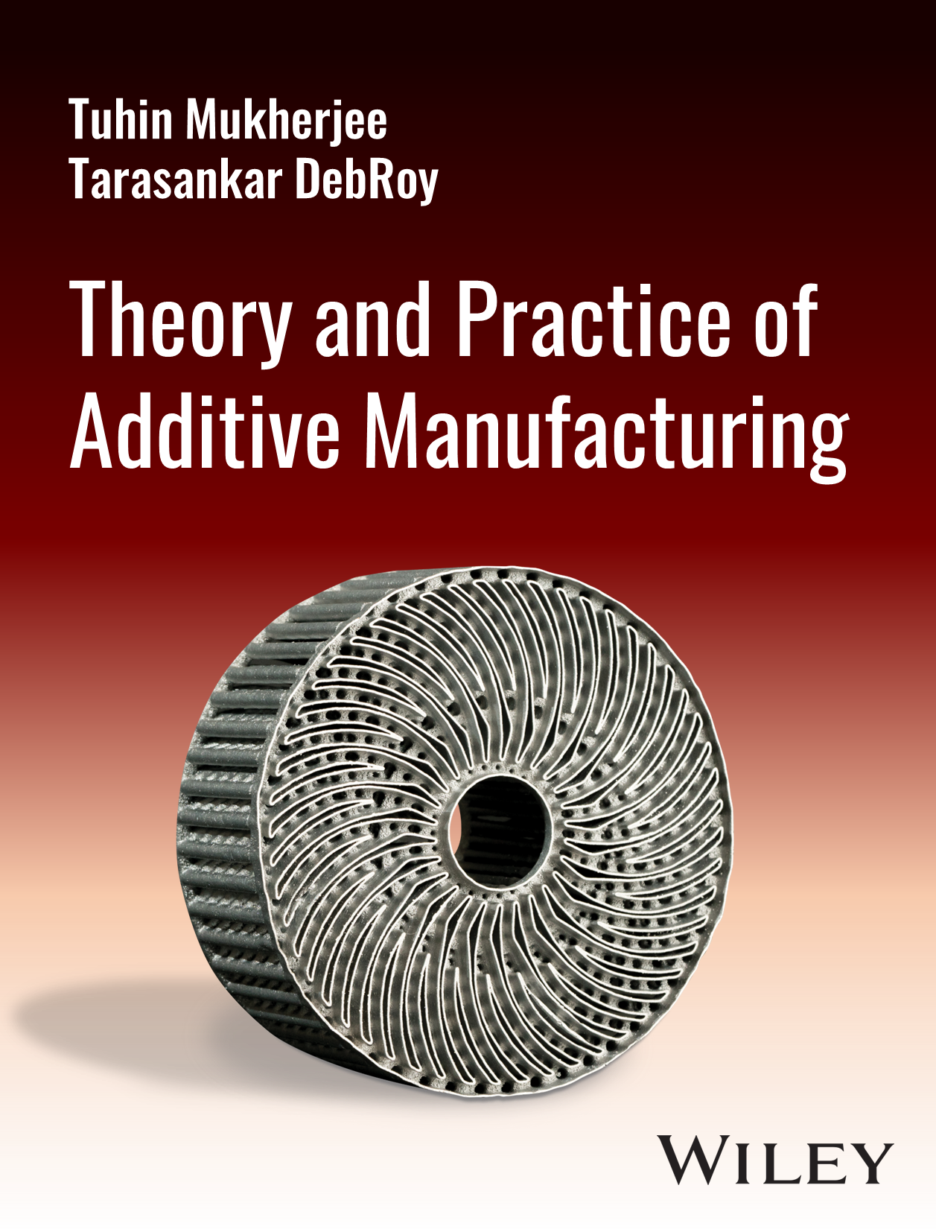
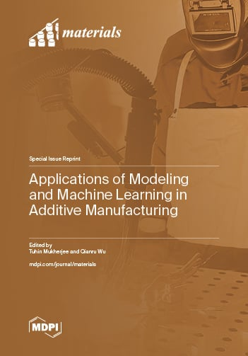
Recent contributions and further details

Slide 25
Thank you!
Tuhin Mukherjee
Assistant Professor
Mechanical Engineering
Iowa State University
tuhinm@iastate.edu
+1 (515)-294-8911

