Slide 1

South Dakota School of Mines and Technology
Department of Chemical and Biological Engineering
Workshop for AI-powered Materials Discovery at Great Plains 22-26 June 2026
AI-Driven Design of Methanotroph-Material Interfaces for Catalytic and Biomanufacturing Applications
Presenter
Dipayan Samanta, PhD
Researcher
Multiomics And Synthetic biOlogy CeNter (MASON)
Department of Chemical and Biological Engineering
South Dakota School of Mines and Technology
Rapid City, SD, USA 57701

Slide 2
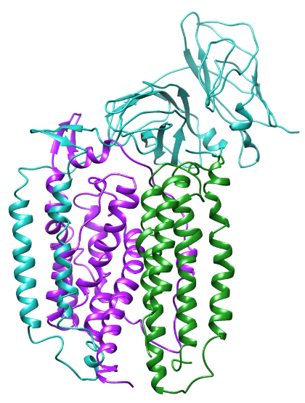
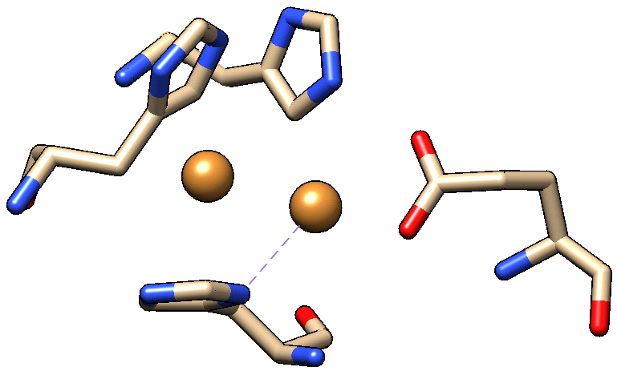
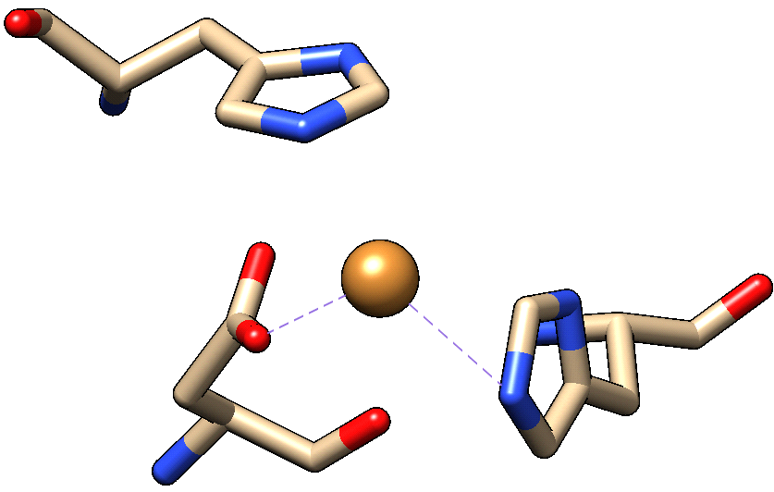

Overview
Outer membrane
HIS 146.A
How can AI/ML aid and circumvent the current technology barrier of low methane oxidation and low methane solubility in biological systems?
Chain A
CU 711.A
GLU 42.A
Diffusion region
HIS 144.A
CU 712.A
Overview of the Talk:
Carbon Pricing: Greenhouse gases
Chemical conversion
Biological conversion: Methanotrophs
Methane monooxygenase
Challenges in Biological conversion
Solutions in Biological conversion
In-silico predictions to enhance methane oxidation
A biologically proposed system
An AI-powered proposed system
Chain B
HIS 40.A
Plasma membrane
Chain C
HIS 146.C
ASP 129.C
CU 661.C
HIS 133.C
Cytosolic region
Methanotrophs
Methane Value added bioproducts
(Feedstock)
(Biomanufacturing)
A typical methane based biological system

Slide 3
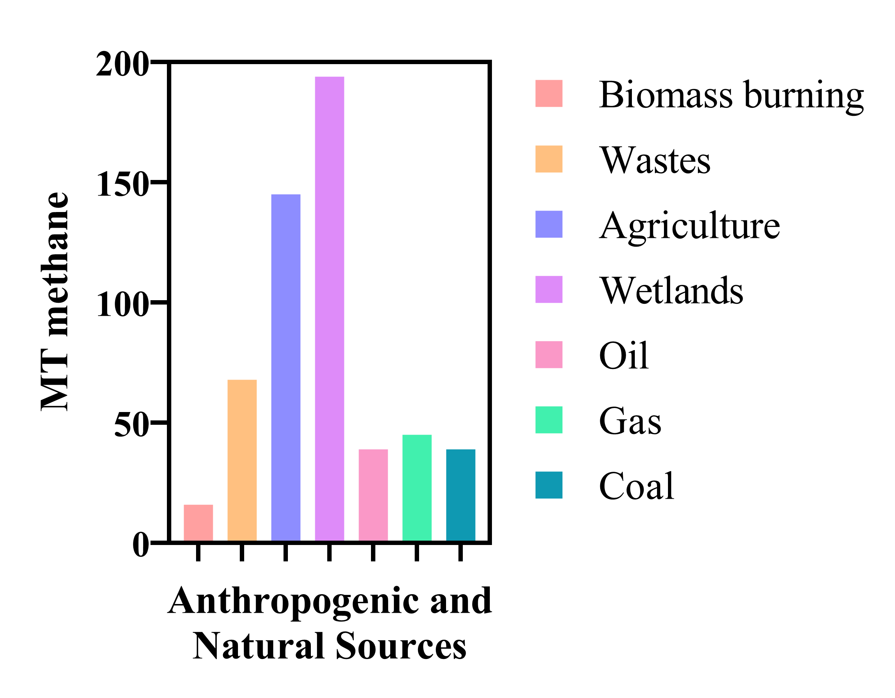
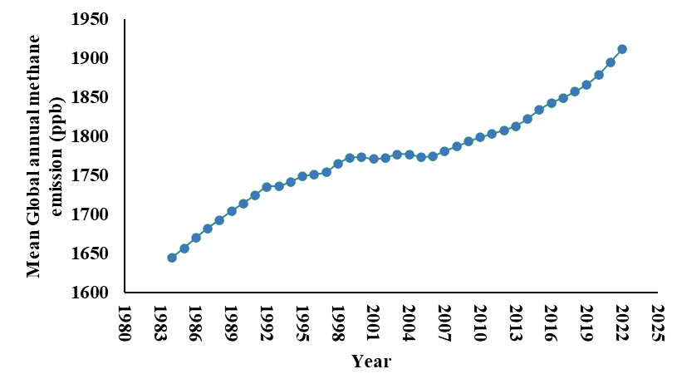
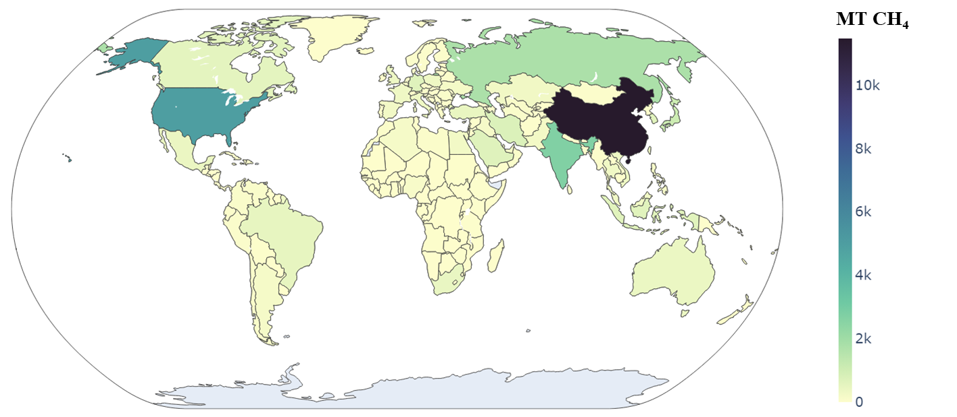
Carbon Pricing: Methane as a Potent Greenhouse gas
Methane has more than 20 times the warming power of carbon dioxide over the first 20 years after it reaches the atmosphere.
Landfills waste, coal mines, and agricultural and human waste are major anthropogenic sources of methane emission in the atmosphere.
Slowing today’s unprecedented rate of warming can help avert our most acute climate risks, including crop loss, wildfires, extreme weather and rising sea levels.
Russia
Alaska
One of the largest methane sources from mankind is the oil and gas industry.
Methane is also a precursor for liquid fuels, which can be a conceptual framework toward the circumvention of vented methane.
Atmospheric concentration of methane is increasing faster now than at any time since the 1980s.
USA
China
Urbanization
Industrialization
Fossil fuels
India
Figure: Illustration of the production of methane in metric tonnes (MT) from both anthropogenic and natural sources, highlighting their collective impact on mean global annual methane emissions (in ppb). Additionally, a heat map is provided to depict the country-wise contributors to methane emissions.
  Samanta, D., and Sani, R. K. (2023). Methane Oxidation via Chemical and Biological Methods: Challenges and Solutions. Methane, 2(3), 279-303.

Slide 4
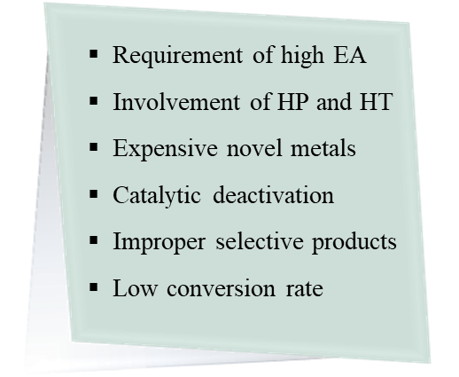


Chemical conversion: Today’s benchmark
Production source
Chemical
Indirect process
O₂
CH₃OH
Steam reforming
CH₄
CH₄
Syngas
CH₃OH
Energy consumption
Cost production
Fate (end-user derivatives)
Demand (US): 19.7 Million MT in 2022
CH₄
O₂
Need alternative???
Wait!!!!
We have biological sector to explore…..
Challenges
4.2% CAGR
CH₃OH
Direct process
Partial oxidation
https://www.marketsandmarkets.com/Market-Reports/methanol-market-425.html
Figure: Catalytic conversion of methane into methanol with direct and indirect process.
CH₄
½ O₂
CH₃OH
Strong C-H bond
Low Stability
  Samanta, D., and Sani, R. K. (2023). Methane Oxidation via Chemical and Biological Methods: Challenges and Solutions. Methane, 2(3), 279-303.

Slide 5
Methanotrophs: Methane oxidizing bacteria
Methanotrophs are gram-negative proteobacteria that utilizes methane as the sole source of carbon and oxidizes it to methanol using the unique complex enzymatic machinery, methane monooxygenase.⁵
Aerobic methanotrophs are mainly found at the oxic-anoxic interface of aquatic environments (e.g., terrestrial, marine, and freshwater), where they oxidize methane, produced by methanogens in anoxic zones.⁵
Figure: Overview of methane conversion in methanotroph

Slide 6
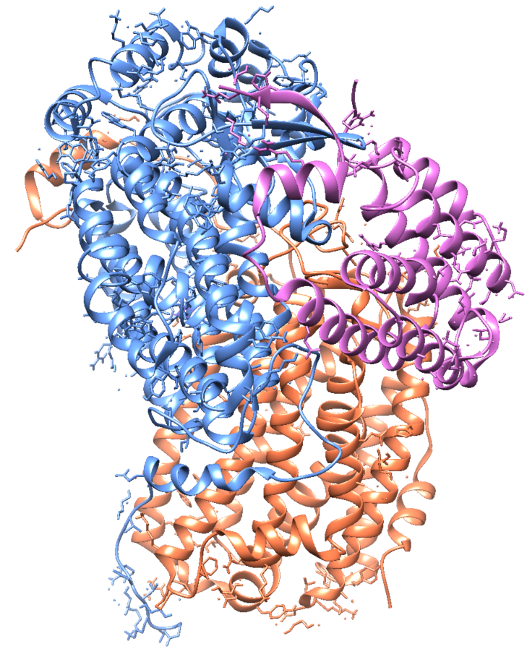
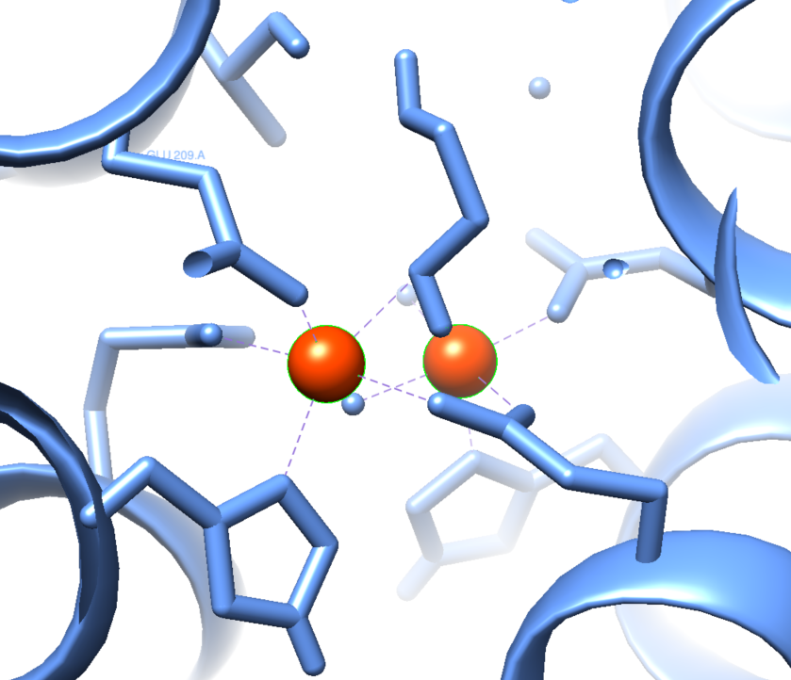
Methane monooxygenase
Outer membrane
HIS 146.A
α- subunit pmoB
Chain A
CU 711.A
GLU 42.A
Diffusion region
HIS 144.A
CU 712.A
pMMO
β- subunit pmoA
Chain B
HIS 40.A
Plasma membrane
Chain C
HIS 146.C
γ- subunit pmoC
ASP 129.C
CU 661.C
HIS 133.C
MMO
Cytosolic region
α- subunit mmoX
Cytosolic region
Chain A
Chain C
Protein A (hydrolase)
β- subunit mmoY
Fe
Fe
sMMO
Protein B (Regulatory)
γ- subunit mmoZ
Protein C (Reductase)
Chain B
Figure: Genetic arrangements of MMOs within M. trichosporium OB3b

Slide 7
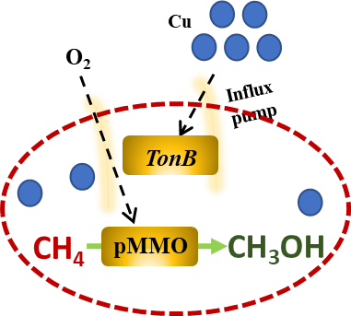
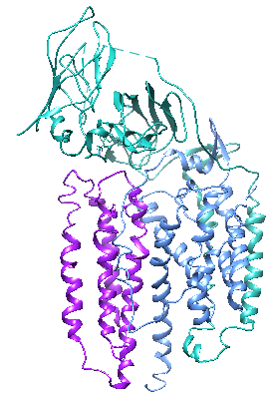
Biological conversion: Challenges & Solutions
Biological
CH₄ trap
Solubility
Surface encapsulated biofilm
Increase in k_{La}
High cell density (maturation)
Possible large scale
CH₄
O₂
Liquid Phase
Surface
Gas Phase
Alteration of copper concentration
pMMO has high turnover frequency, and Cu is the cofactor for pMMO, hence Cu increases in media, methane oxidation increases
Diffusion, k_{La}
Liquid Phase
Genetic engineering
(WT)
ATGCCAATCCT
Increase enzyme activity
Lowers activation energy
Specific rate constant (k) becomes high; rate of reaction increases
ATGGGAATCCT
(Mutant)
k₁
(WT)
Low k_{La}
Low carbon flux to secondary metabolites
Low cell density
Low yield of products
No large scale
Unprofitable commercialization
Strain-wise optimization
CH₄ +
O₂
CH₃OH
k₂
(Mutant)
Heterotrophic consortia
CH₃OH
CH₄
Cyanobacteria and methanotrophic consortia increases methane uptake rate as reported
  Samanta, D., and Sani, R. K. (2023). Methane Oxidation via Chemical and Biological Methods: Challenges and Solutions. Methane, 2(3), 279-303.

Slide 8
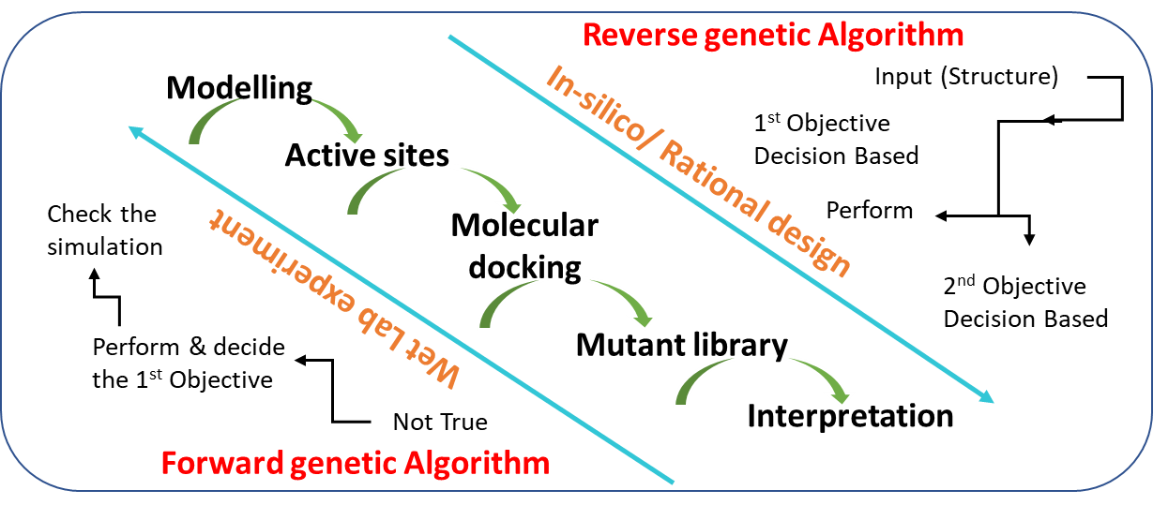
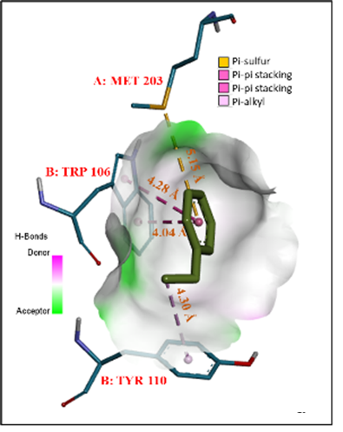
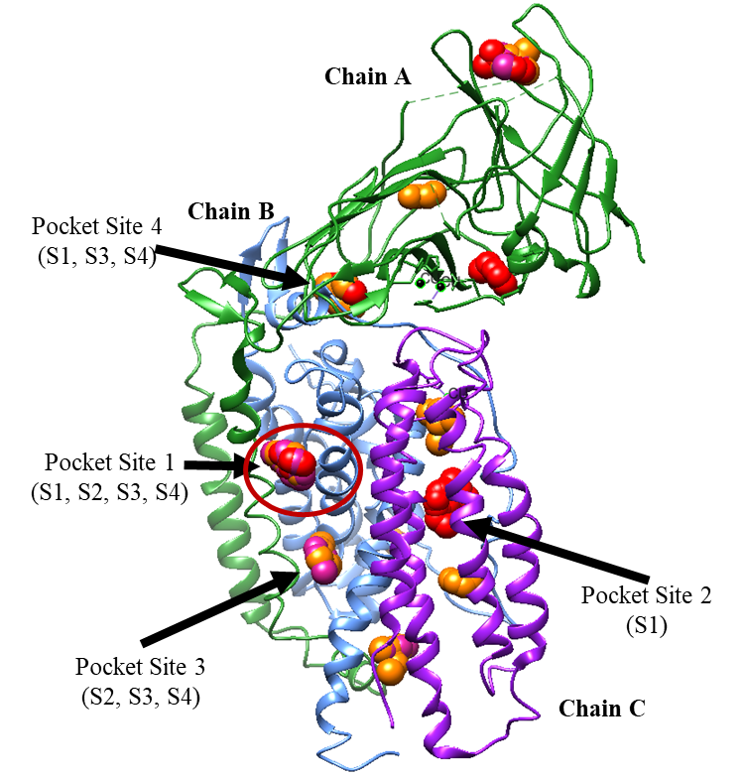
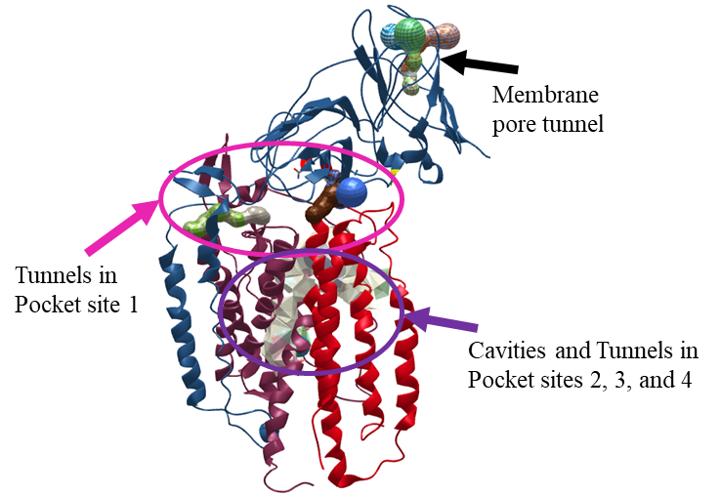
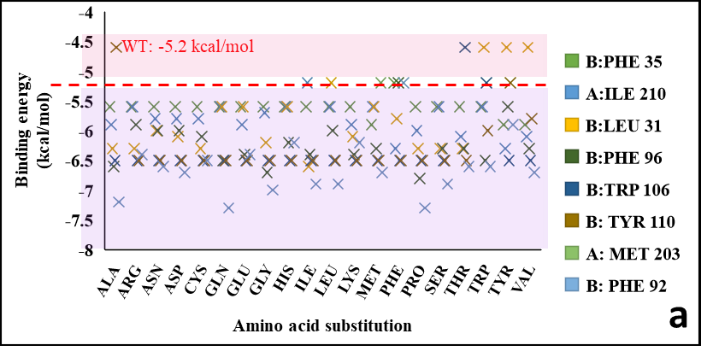
Enhancement of Methane Catalysis (Tailoring Active Site)
Active site prediction
Crucial amino acids
Rationale of the study
The existence of active sites and the overall metal content within pMMO is quite controversial.
The question arises whether these copper centers are responsible for the active site
Mutants that would likely increase methane oxidation rates.
Validations
Substrate diffusion mechanism
Mutant screening
  Samanta, D., et al. (2022). Enhancement of Methane Catalysis Rates in Methylosinus trichosporium OB3b. Biomolecules, 12(4), 560.

Slide 9
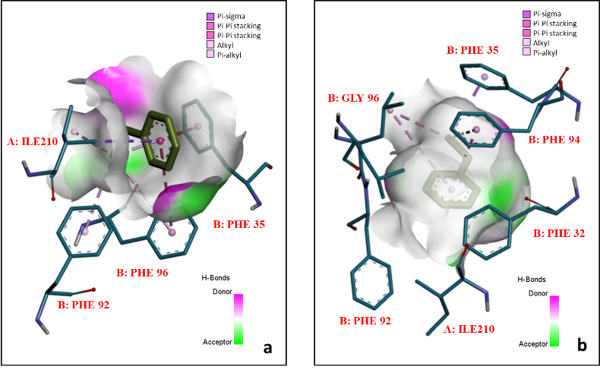
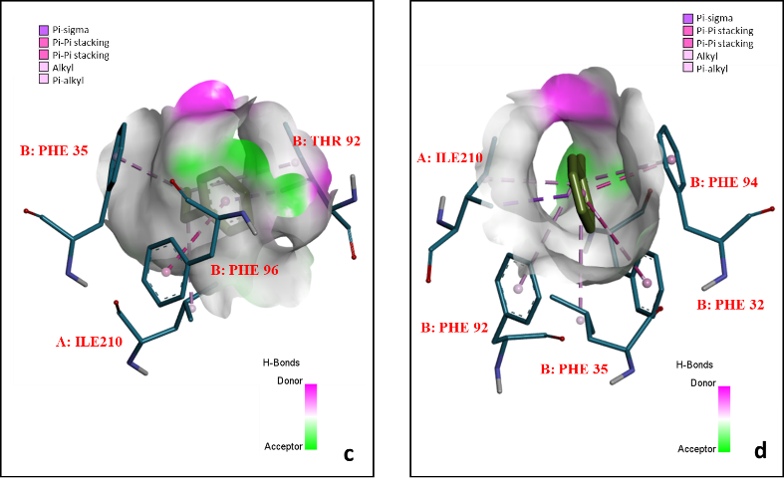
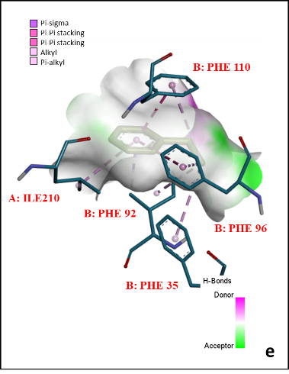
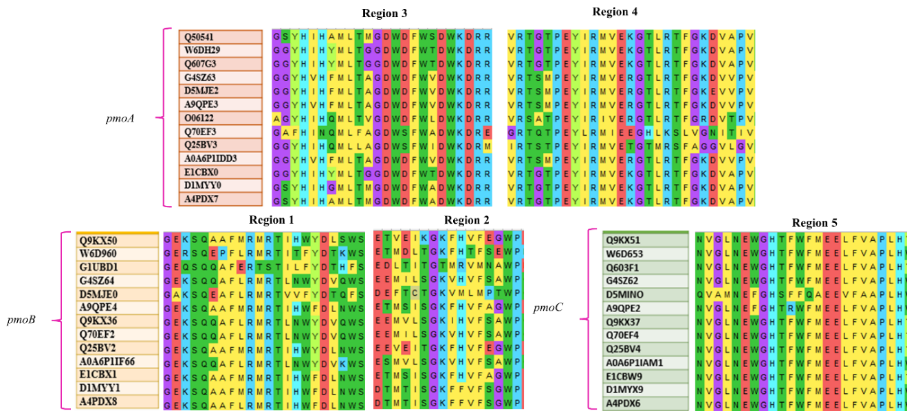
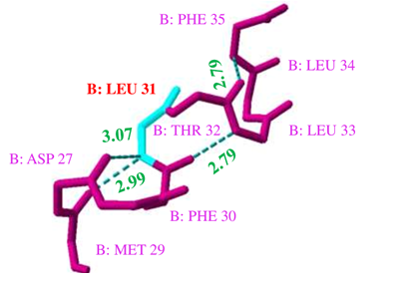
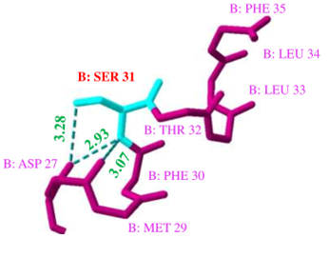
Wild type → Mutants
Mutant Screening was performed on the basis of hydrogen bonds, strain energies, and binding energies to avoid protein instability.
The crucial residues were subjected to conservation analysis to ensure the essentiality of the residues among the methanotrophic strains.
Figure: The interactions between ethylbenzene and (a) B:Leu31Ser, (b) B:Phe96Gly, (c) B:Phe92Thr, (d) B:Trp106Ala, and (e) B:Tyr110Phe
Figure: Hydrogen bonding stability analysis for B:Leu31Ser
  Samanta, D., et al. (2022). Enhancement of Methane Catalysis Rates in Methylosinus trichosporium OB3b. Biomolecules, 12(4), 560.
Figure: Conserved amino acid residues in pmoA, pmoB, and pmoC (along with UNIPROT accession number of respective species) and the correlation with the pocket regions.

Slide 10
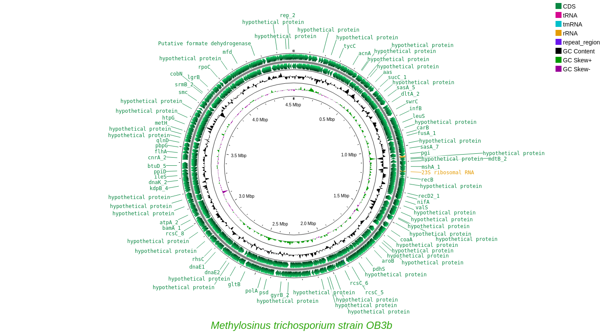
Integrated Whole genome & metabolomics
Genes → Enzymes → Pathways → Metabolites
Annotations
Heat Map
Nanopore sequencing (SDSM&T)
Subsystem features
Biological process
Molecular function
Talking about Biofilm….
Where are the genes?
Samanta et al. (2023). Integrating metabolomics and whole genome sequencing to elucidate the metabolic pathways in Methylosinus trichosporium OB3b. Systems Microbiology and Biomanufacturing, Springer, 1-14

Slide 11
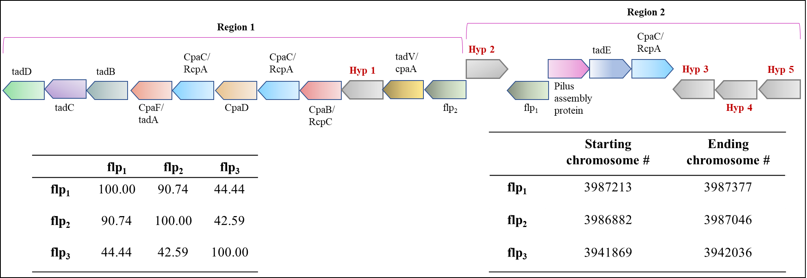
Biofilm forming potential of M. trichosporium OB3b
The architecture of adhesion genes suggests Type IVb pili system.
A unique configuration with three flp Type IVb pilin components
The upstream region of the flp component lacks the signal transduction response regulator. The response regulator tadZ is not present.
The Type II/III secretion system genes tadABCD are downstream of flp component.
tadE is situated in region 2, within a different operon and upstream of the flp component.
Two copies of the RcpA/CpaC genes are present, with one in region 1 and the other in region 2.
The Poly-β-1,6-N-acetyl-D-glucosamine pathway strongly suggests that the organism possesses the capability to form EPS.
Table 2: Categorized motility, chemotaxis genes and biofilm forming genes.
Samanta et al. (2023). Integrating metabolomics and whole genome sequencing to elucidate the metabolic pathways in Methylosinus trichosporium OB3b. Systems Microbiology and Biomanufacturing, Springer, 1-14
Figure: Operon Architecture of the Type IVb Pili System in M. trichosporium OB3b.

Slide 12
An idea to enhance methane catalysis rate
Biotrickling Reactor
Biological conversion methods offer more potential for enhancing methane oxidation rates compared to chemical methods.
Enzyme immobilization in biotrickling reactors shows promise for efficient methane conversion.
Co-cultivating methanotrophs with cyanobacteria or microalgae in biotrickling reactors enhances gas-solid mass transfer.
Encapsulated beads in packed columns increase surface area for efficient gas-to-liquid mass transport.
Pilot-scale studies have shown impressive results, achieving approximately 97% methane conversion using plastic balls as the medium, demonstrating the feasibility of scaling up these technologies.
Genetic engineering can enhance enzymatic activity and improve methane oxidation rates.
Challenges include reactor design, catalyst selection, nutrient supply, and process control.
Economic viability and scalability should be evaluated for practical industrial implementation.
CH₄
O₂
Gas Phase
Diffusion, k_{La}
Liquid Phase
Increased aeration
Biofilm on bead surface
Beads
Genetically engineered methanotroph
Figure: Enhancement of methane using combined techniques

Slide 13
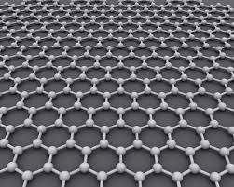
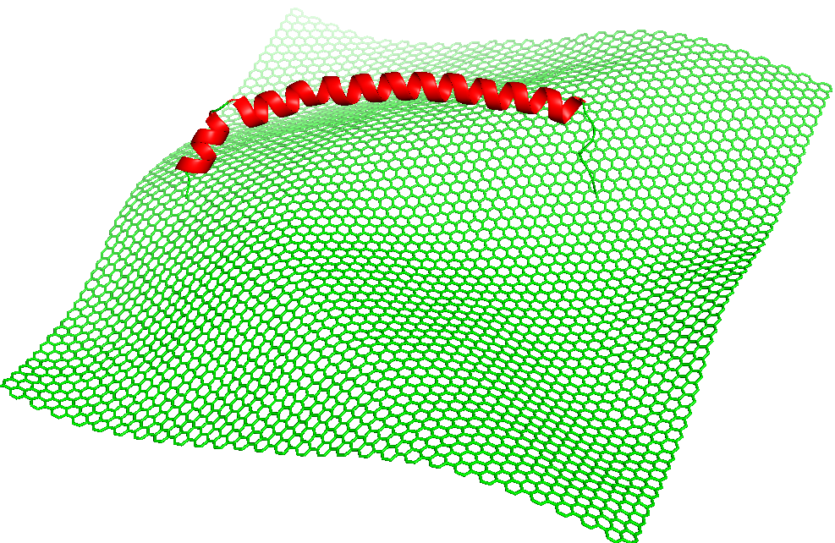
Proposed AI-powered BioCatalysis on Advanced Materials
Material surface (Feature extraction)
extracts physicochemical features (surface area, defect density, bandgap, hydrophobicity, charge distribution, etc.) from material databases or simulations.
3
Data Integration & Model Training
1
Physicochemical features from material databases or simulations
Surface area,
Defect density,
Bandgap,
Hydrophobicity,
Charge distribution
Input
DFT/QM/MM outputs,
Microscopic data,
Spectral data,
Use ML/AI algorithms (e.g., random forest, deep learning) to correlate material-biological features with catalytic performance.
Use AI/ML algorithms
random forest, GNN, CNN) to correlate material-biological features with catalytic performance.
Predictive Models
CH₄ solubility
4
Catalyst Performance Prediction
Predict
Product yield
Turnover frequency
Reaction rate Intermediate
Selectivity
Low temperature & high pressure tolerant
Use ML/AI algorithms (e.g., random forest, deep learning) to correlate material-biological features with catalytic performance.
Enzyme/ Cells Feature extraction
2
extracts physicochemical features (surface area, defect density, bandgap, hydrophobicity, charge distribution, etc.) from material databases or simulations.
Enzyme data
active site
geometry,
redox potential,
membrane localization,
kinetics
Input
PDB Structure,
Omics datasets,
Molecular modeling & docking
Predictive Models
5
Optimization and Feedback loop
Reactants → Products
Use ML/AI algorithms (e.g., random forest, deep learning) to correlate material-biological features with catalytic performance.
Use prediction to design improved material/biocatalyst combinations.
Update model with new data (closed-loop learning)
Figure: Schematic overview of the proposed AI-powered material-enzyme interface

Slide 14
Summary & Conclusion
Combining biological catalysis with AI-driven material design offers a transformative pathway for sustainable methane valorization, addressing global climate and resource challenges
Methane is a potent greenhouse gas - converting it to value‑added chemicals can help mitigate climate change and create economic benefits.
Biological catalysis (methanotrophs) offers a sustainable, mild, and highly selective route for methane conversion.
Material-enzyme interface engineering may improve activity, stability, and efficiency of methane conversion in bioreactors.
AI/ML enable predictive design of enzyme-material combinations for enhanced catalysis and scale‑up.
Future aspects focuses on integrating genome‑scale modeling with rational AI‑driven material engineering for industrial methane conversion to bioproducts.

Slide 15
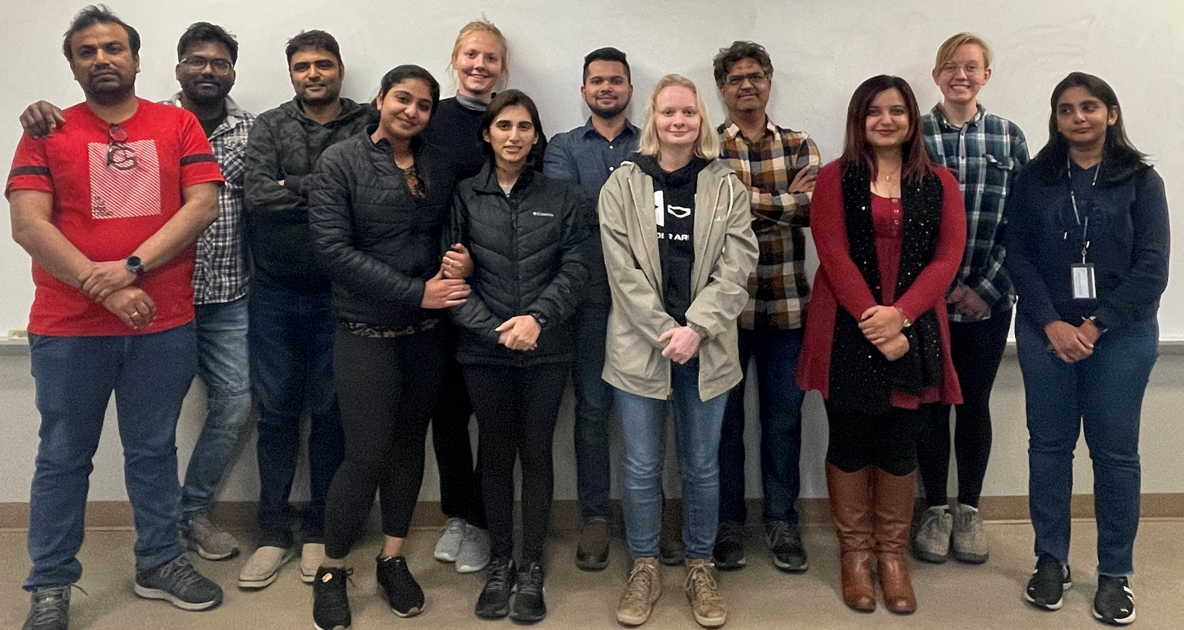

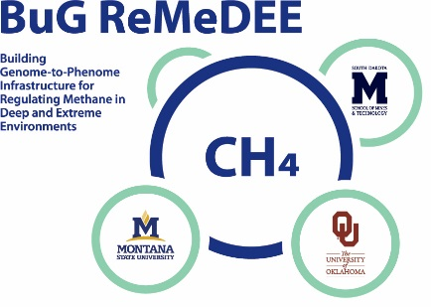
ACKNOWLEDGEMENTS
Major Professor
Dr. Rajesh K. Sani
Department
Karen M. Swindler Department of CBE
National Science Foundation
Building Genome-to-Phenome Infrastructure for Regulating Methane in Deep and Extreme Environments (BuG ReMeDEE)

Slide 16

References
  Samanta, D., Rauniyar, S., Saxena, P., & Sani, R. K. (2024). From genome to evolution: investigating type II methylotrophs using a pangenomic analysis. Msystems, e00248-24.
  Samanta, D., Govil, T., Saxena, P., Krumholz, L., Gadhamshetty, V., Goh, K. M., and Sani, R. K. (2024). Genetical and Biochemical Basis of Methane Monooxygenases of Methylosinus trichosporium OB3b in Response to Copper. Methane, 3(1), 103-121.
  Rai, R., Samanta, D., Goh, K. M., Chadha, B. S., and Sani, R. K. (2024). Biochemical unravelling of the endoxylanase activity in a bifunctional GH39 enzyme cloned and expressed from thermophilic Geobacillus sp. WSUCF1. International Journal of Biological Macromolecules, 257, 128679.
  Samanta, D., Singh, R. N., Goh, K. M., and Sani, R. K. (2023). Integrating metabolomics and whole genome sequencing to elucidate the metabolic pathways in Methylosinus trichosporium OB3b. Systems Microbiology and Biomanufacturing, Springer, 1-14.
  Samanta, D., and Sani, R. K. (2023). Methane Oxidation via Chemical and Biological Methods: Challenges and Solutions. Methane, 2(3), 279-303.
  Tripathi, A. K., Samanta, D., Saxena, P., Thakur, P., Rauniyar, S., Goh, K. M., and Sani, R. K. (2023). Identification of AHL Synthase in Desulfovibrio vulgaris Hildenborough Using an In-Silico Methodology. Catalysts, 13(2), 364.
  Samanta, D., Govil, T., Saxena, P., Gadhamshetty, V., Krumholz, L. R., Salem, D. R., and Sani, R. K. (2022). Enhancement of Methane Catalysis Rates in Methylosinus trichosporium OB3b. Biomolecules, 12(4), 560.
  Chanprateep, S., & Kulpreecha, S. (2006). Production and characterization of biodegradable terpolymer poly (3-hydroxybutyrate-co-3-hydroxyvalerate-co-4-hydroxybutyrate) by Alcaligenes sp. A-04. Journal of bioscience and bioengineering, 101(1), 51-56.,
  Prieto, A., Escapa, I. F., Martínez, V., Dinjaski, N., Herencias, C., de la Peña, F., ... & Revelles, O. (2016). A holistic view of polyhydroxyalkanoate metabolism in Pseudomonas putida. Environmental microbiology, 18(2), 341-357.
  Huijberts, G. N., Eggink, G. E. R. R. I. T., de Waard, P. I. E. T. E. R., Huisman, G. W., & Witholt, B. (1992). Pseudomonas putida KT2442 cultivated on glucose accumulates poly (3-hydroxyalkanoates) consisting of saturated and unsaturated monomers. Applied and environmental microbiology, 58(2), 536-544.
  Liao, C., Xiao, S., & Wang, X. (2023). Bench-to-bedside: Translational development landscape of biotechnology in healthcare. Health Sciences Review, 7, 100097.
  Abinaya, R. V., & Viswanathan, P. (2021). Biotechnology-based therapeutics. In Translational Biotechnology (pp. 27-52). Academic Press.
  Khider, M.L., T. Brautaset, and M. Irla, Methane monooxygenases: central enzymes in methanotrophy with promising biotechnological applications. World Journal of Microbiology and Biotechnology, 2021. 37(4): p. 1-11.
  Tabata, K., et al., Activation of methane by oxygen and nitrogen oxides. Catalysis Reviews, 2002. 44(1): p. 1-58.
  Han, B., et al., Research progresses of methanotrophs and methane monooxygenases. Sheng wu Gong Cheng xue bao= Chinese Journal of Biotechnology, 2008. 24(9): p. 1511-1519.
  Lieven, C., et al., A genome-scale metabolic model for Methylococcus capsulatus (Bath) suggests reduced efficiency electron transfer to the particulate methane monooxygenase. Frontiers in microbiology, 2018: p. 2947.

Slide 17

Thank you for your attention
Welcome Any
Comments
Questions
Suggestions

