Slide 1
Optimizing Detector-Grade Yield in HPGe Crystal Growth for Rare-Event Searches Using Machine Learning
The University of South Dakota
Athul Prem, Sanjay Bhattarai, Narayan Budhathoki, Kunming Dong, Austin Warren, Sunil Chhetri, Dongming Mei
This work was supported in part by NSF OISE 1743790, NSF PHYS 2310027, DOE DE-SC0024519, DE-SC0004768, and research center supported by the State of South Dakota.
#>

Slide 2
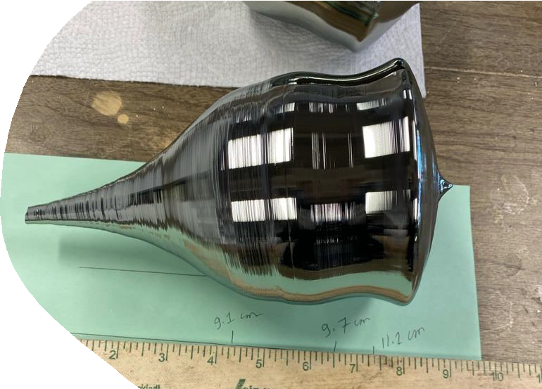
Motivations: Increase the detector grade portion in Ge Crystals
Current region of detector grade region (20%-30%)
Large size detectors reduces background rate per kilogram significantly due to less cable and electronic requirement
Extremely difficult to get large portion of crystal to be detector grade due to difference in segregation of various impurities
Detailed study of impurity segregation required.
Plan to use machine learning tools to analyze different variables and build a predictive model for growing large portion of a crystal to be a detector grade
Goal to get detector grade (60 % of total crystal mass)

Slide 3
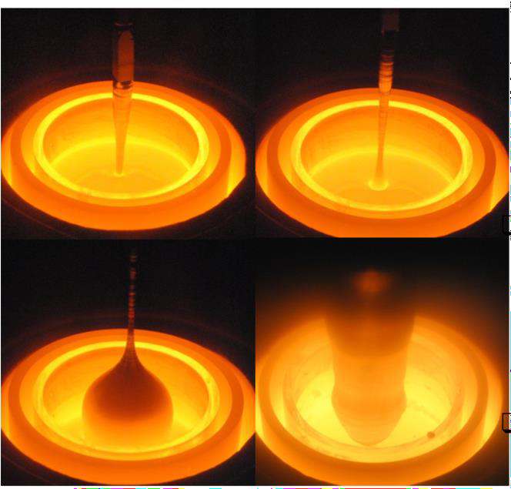
Crystal growth process
The materials used for input are either freshly zone-refined ingots or portions of crystals previously identified as non-detector-grade.
Growth is initiated by immersing a (100) Ge seed crystal in the melt and withdrawing it gradually, ensuring the melt temperature remains just above the melting threshold.
To control CZ crystal growth, parameters such as pull speed, seed rotation, and melt temperature (set by applied power) are systematically varied.

Slide 4
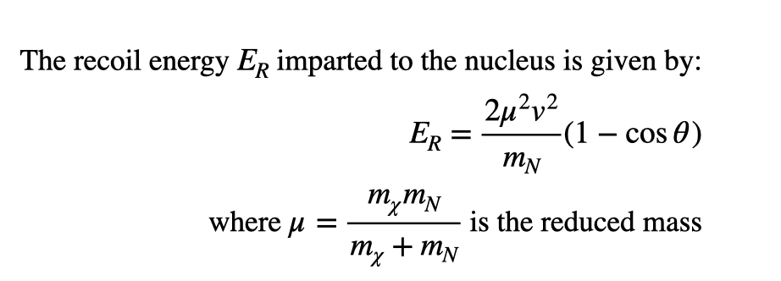
Direct Detection: Importance of HPGe in Dark Matter Detection
In direct detection, we do not observe the dark matter particle itself, but the nuclear recoil energy it imparts when it scatters off a target nucleus.
When it comes to the germanium detectors the recoil energy and the resolution is precise compared to any other detection method:
High energy resolution will be <0.2% at MeV scale. They also have Dual signal readout: phonon + ionization → accurate recoil discrimination

Slide 5
Challenges in Current HPGe detectors
The main challenges in the HPGe crystals are the scalability. Current detectors are only in range of 1-10kg, whereas when it come to xenon we can scale it to ton scale. when the HPGe detectors scale is low their possibility of detection also reduces significantly.
Ge crystal purification and crystal growth is a rigorous task, getting ~10¹⁰/𝑐𝑚³ impurity range in every crystal growth is extremely hard. At USD we have 10 years of data from past crystal growth that can be used for Machine learning to increase detector grade portion

Slide 6
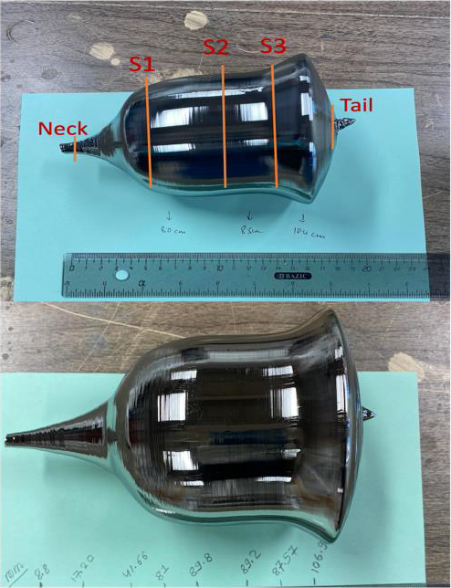
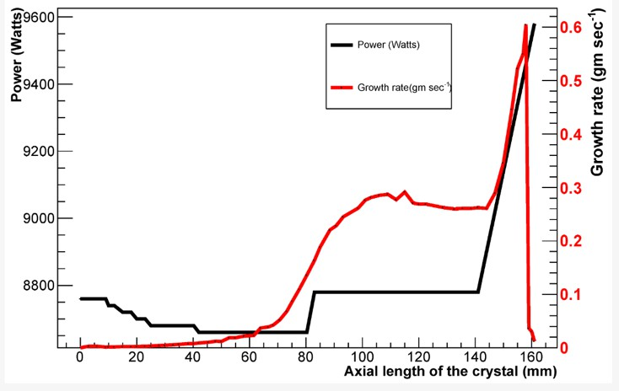
Input parameters
The average net impurity of previous crystal or zone refined ingots acquired using Hall effect measurement , mass of input materials, applied power in the process, growth rate of the crystal (time dependent).
Rotation rate, Pull rate of
crystal are kept same for
uniformity for all growths

Slide 7
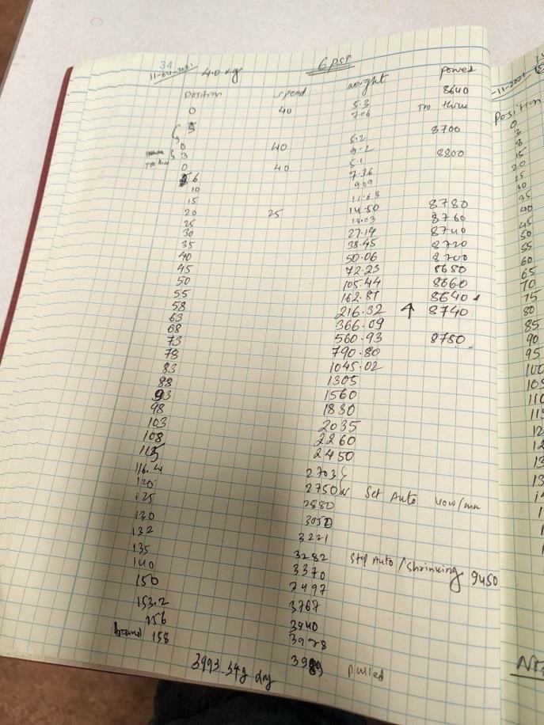
Data Preparation
Already have a large data set from the crystals grown over 10 years of time.
Data taken include quality of input material, pull rate, rotation rate, applied power, growth rate, real
time mass of the crystal and real time photo of the growth process.
Used data sets from 20 crystal growths for first study, then expanded to 50 crystal growth data. Input Parameters: Time, Growth Rate, Power, Impurity of previous crystal etc.
Output
The percentage of detector grade region.

Slide 8
Example data set
Time (sec) | Power(W) | Gr owth Rate (gm/sec) | No. of net impu rity atoms ad ded | Number of net impurity of pre viou s crystal | Ou tpu t net impurity(/cm^3 ) | Detector grade reg ion(%)
0 | 872 0 | 0 | 3.5338 3E+1 3 | 3.4296 9E+1 4 | 4.7434 1E+1 1 | 38
900 | 870 0 | 0.0911 11111 | 3.5338 3E+1 3 | 3.4296 9E+1 4 | 4.7437 7E+1 1 | 38
135 0 | 870 0 | 0.0540 74074 | 3.5338 3E+1 3 | 3.4296 9E+1 4 | 4.7308 9E+1 1 | 38
288 0 | 868 0 | 0.0152 77778 | 3.5338 3E+1 3 | 3.4296 9E+1 4 | 4.7231 4E+1 1 | 38
360 0 | 866 0 | 0.0119 44444 | 3.5338 3E+1 3 | 3.4296 9E+1 4 | 4.7155 7E+1 1 | 38
432 0 | 864 0 | 0.0182 87037 | 3.5338 3E+1 3 | 3.4296 9E+1 4 | 4.7017 1E+1 1 | 38
504 0 | 862 0 | 0.0279 7619 | 3.5338 3E+1 3 | 3.4296 9E+1 4 | 4.6770 7E+1 1 | 38
576 0 | 860 0 | 0.0319 44444 | 3.5338 3E+1 3 | 3.4296 9E+1 4 | 4.6450 8E+1 1 | 38
648 0 | 858 0 | 0.0472 22222 | 3.5338 3E+1 3 | 3.4296 9E+1 4 | 4.5923 5E+1 1 | 38
720 0 | 856 0 | 0.0765 27778 | 3.5338 3E+1 3 | 3.4296 9E+1 4 | 4.4988 E+11 | 38
892 8 | 856 0 | 0.3291 89068 | 3.5338 3E+1 3 | 3.4296 9E+1 4 | 4.0291 8E+1 1 | 38
100 80 | 856 0 | 0.4166 66667 | 3.5338 3E+1 3 | 3.4296 9E+1 4 | 3.4370 6E+1 1 | 38
108 00 | 856 0 | 0.4074 07407 | 3.5338 3E+1 3 | 3.4296 9E+1 4 | 2.9046 4E+1 1 | 38
129 60 | 866 0 | 2.3456 79012 | 3.5338 3E+1 3 | 3.4296 9E+1 4 | 8.61E+10 | 38
134 64 | 870 0 | 0.9358 28877 | 3.5338 3E+1 3 | 3.4296 9E+1 4 | 5.04E+10 | 38
151 20 | 870 0 | 3.1216 93122 | 3.5338 3E+1 3 | 3.4296 9E+1 4 | -5.03E+10 | 38
159 84 | 870 0 | 1.5515 51552 | 3.5338 3E+1 3 | 3.4296 9E+1 4 | -5.87E+10 | 38
165 60 | 870 0 | 0.8997 58454 | 3.5338 3E+1 3 | 3.4296 9E+1 4 | -6.48E+10 | 38
180 00 | 870 0 | 2 | 3.5338 3E+1 3 | 3.4296 9E+1 4 | -1.4565 E+11 | 38
187 20 | 870 0 | 0.8226 49573 | 3.5338 3E+1 3 | 3.4296 9E+1 4 | -2.4313 E+11 | 38
194 40 | 870 0 | 0.6018 51852 | 3.5338 3E+1 3 | 3.4296 9E+1 4 | -3.6795 3E+1 1 | 38
201 60 | 870 0 | 0.6944 44444 | 3.5338 3E+1 3 | 3.4296 9E+1 4 | -6.2403 E+11 | 38
216 00 | 870 0 | 0.9259 25926 | 3.5338 3E+1 3 | 3.4296 9E+1 4 | -6.6365 9E+1 1 | 38
230 40 | 870 0 | 0.7378 47222 | 3.5338 3E+1 3 | 3.4296 9E+1 4 | -7.2430 8E+1 1 | 38
240 48 | 870 0 | 0.4615 76846 | 3.5338 3E+1 3 | 3.4296 9E+1 4 | -7.7103 1E+1 1 | 38
265 82.4 | 940 4 | 1.2414 22896 | 3.5338 3E+1 3 | 3.4296 9E+1 4 | -9.6047 1E+1 1 | 38
292 32 | 950 0 | 2.0354 40613 | 3.5338 3E+1 3 | 3.4296 9E+1 4 | -1.8510 7E+1 2 | 38
Using pull rate, position of the crystal and real time mass of the grown crystal, time and growth rate can be determined.
From the hall effect
measurement of the input materials and their masses, number of net impurity atoms is estimated
Example data set for one crystal growth

Slide 9
Long Short-Term Memory(LSTM) in Crystal Growth Optimization
Input Features
(Growth rate, Impurity, Pull rate, detector grade portion etc)
LSTM (Long Short-Term Memory) is a type of recurrent neural network (RNN) designed to handle sequential and time-series data by learning long-range dependencies.
LSTMs use gated memory cells to retain or forget information selectively, making them well-suited for dynamic process prediction.
LSTM Training
Target Output: Detector Grade
Crystal growth is a time-dependent process, LSTMs capture temporal relationships in experimental data, making them ideal for predicting detector-grade yield based on past growth conditions.
Actual
Predicted
Unlike traditional regression models, LSTMs learn complex, nonlinear correlations between parameters without requiring predefined equations.
8

Slide 10
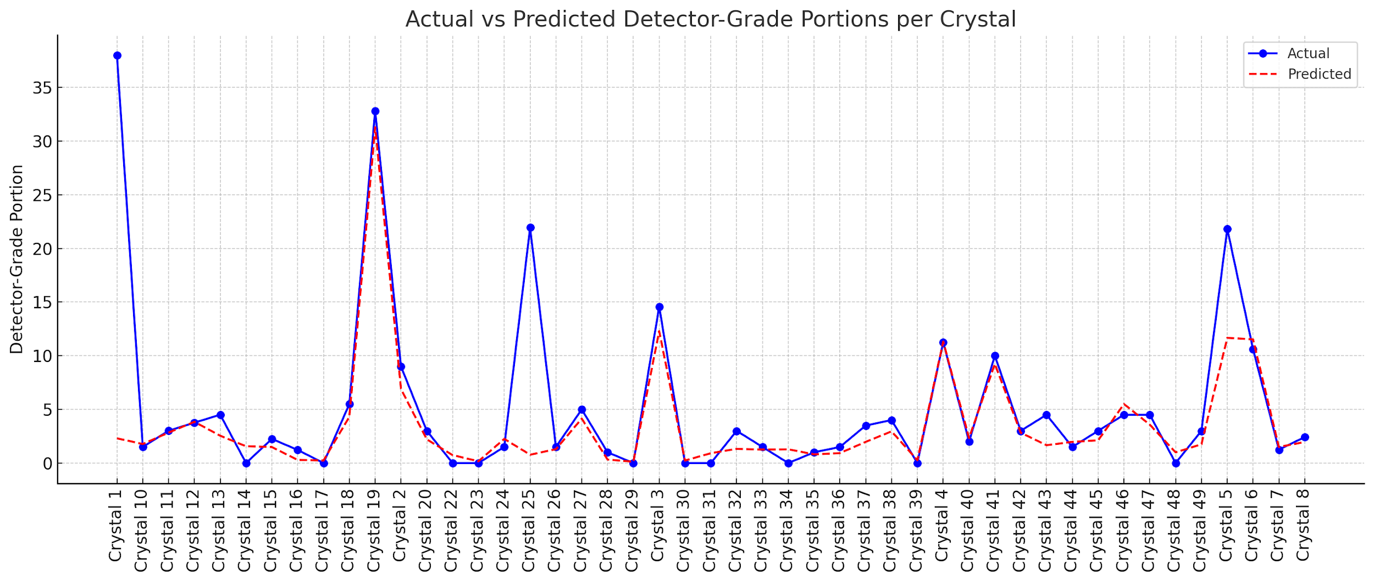
Data Driven LSTM: Actual vs Predicted Detector Grade
At USD, Ge crystals are grown frequently and numerous HPGe crystal growth data have been collected.
Past 50 HPGe crystal growth data have been used to train the LSTM model.
Model has generated successful prediction attaining an average of 90% accuracy in most trials.
The LSTM model can also be used to predict the detector grade portion of newer crystal based on input physical parameters, like impurity, growth rate etc.
Higher the number of data, higher the accuracy of the LSTM model.
9

Slide 11
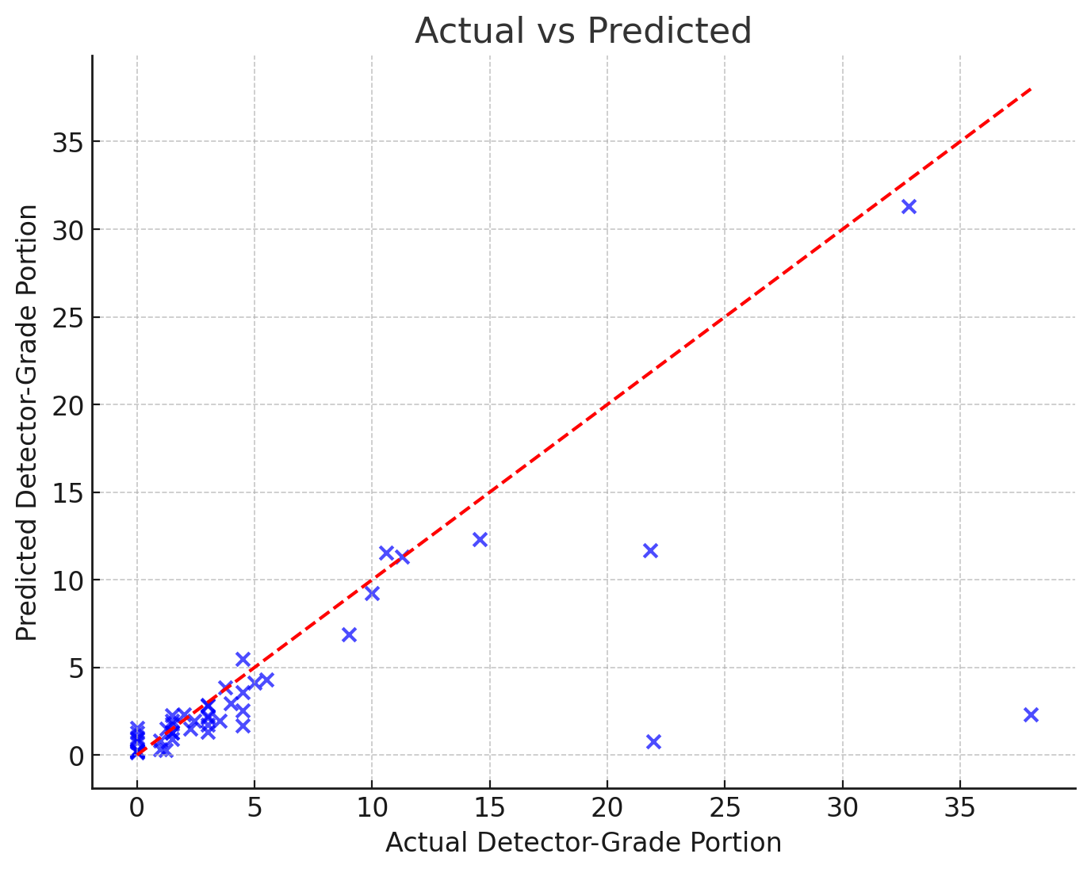
Accuracy of the Model
Most data points correspond to detector-grade portions below 20%, with very few samples above 20%.
The model predicts well for the majority (below 20%).
Limited data for higher values, affecting accuracy in that range above 20%

Slide 12
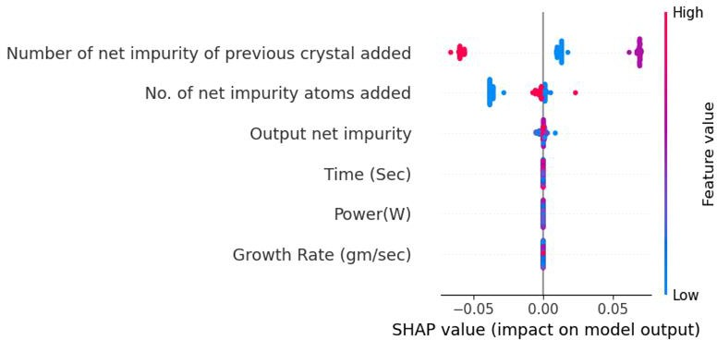
LSTM Feature Importance Analysis (SHAP analysis)
Important Features:
Number of net impurity of previous crystal added:
No. of net impurity atoms added:
Results:
→ Higher impurity → Lower detector- grade
→ Lower impurity → Higher detector-
grade
→ SHAP analysis indicates that Time, Power, and Growth Rate(different from experience) have minimal impact on the detector-grade portion.
10

Slide 13
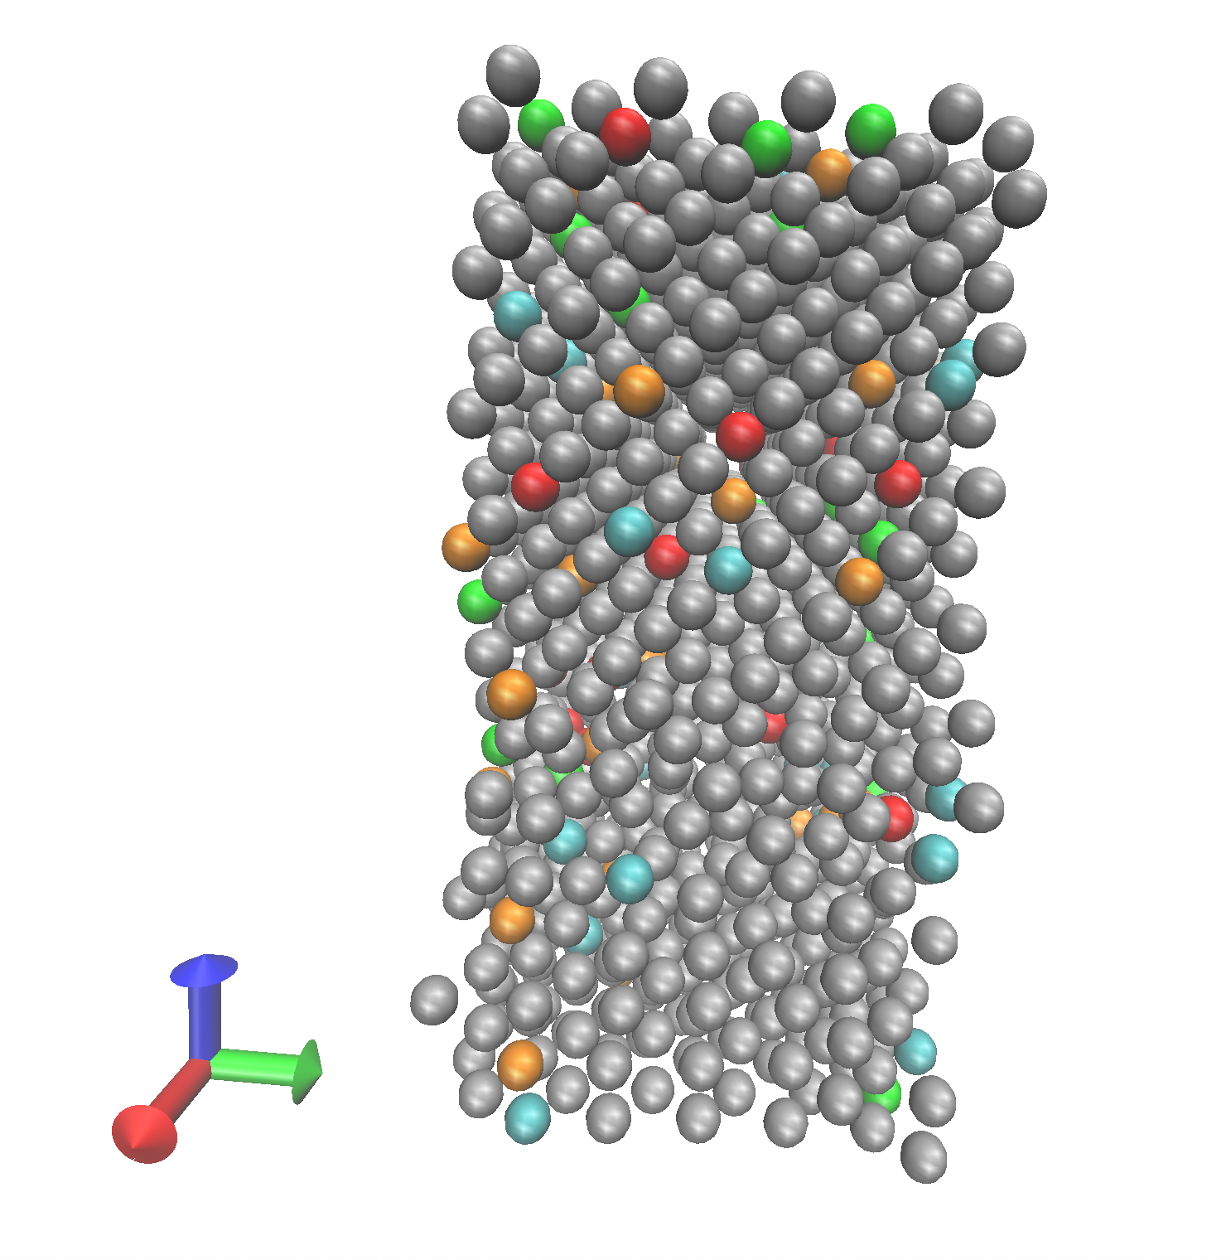
Ongoing Research
From ML model we understood impurities impact the detector grade portion
Investigating impurity segregation during crystal growth is key to understanding impurity transport behavior under varying thermal profiles
Molecular dynamics enables detailed analysis of the solid–liquid interface in crystal growth by modeling both pure Ge-Ge interaction and Ge–impurity systems
With no available SW potentials for Ge–impurity systems, ML-generated potentials can be employed to model the melt region in simulations.
Solid-Liquid interface of Ge

Slide 14
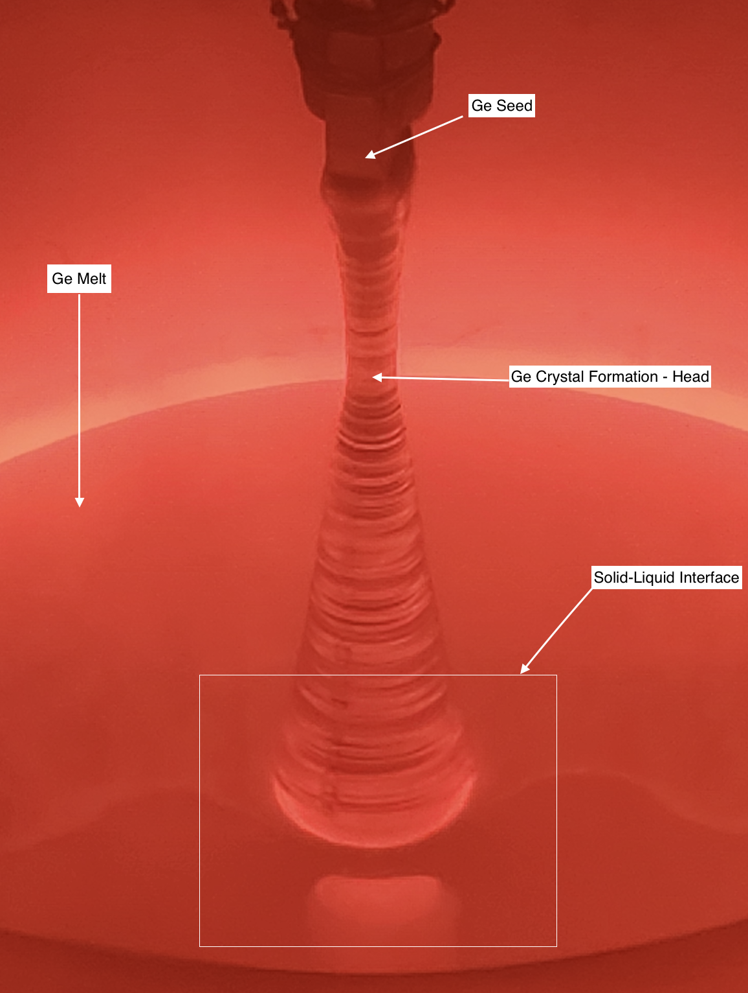
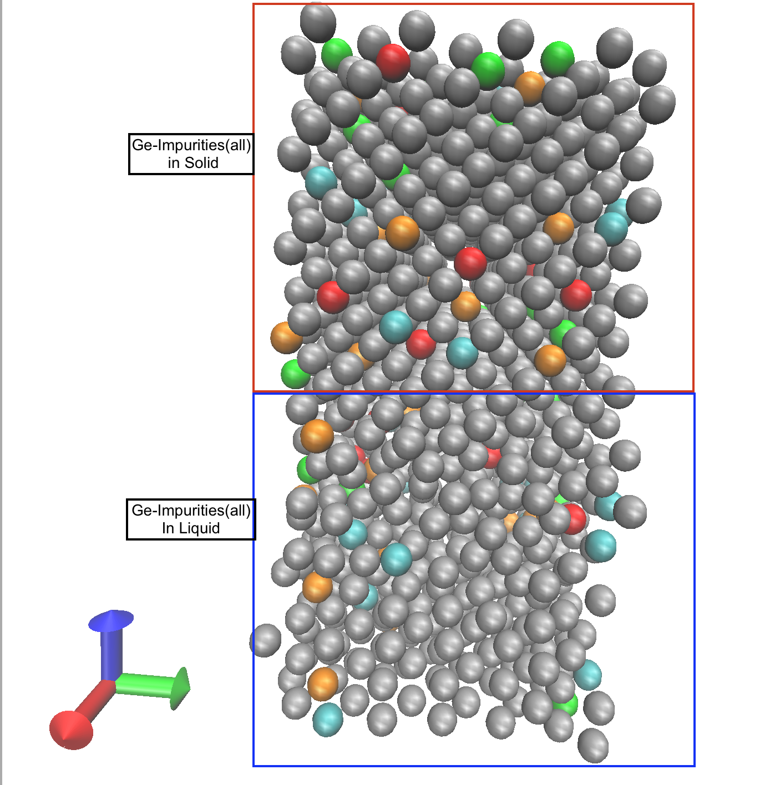
Impurity segregation at Solid-Liquid Interface during Crystal Growth

Slide 15
Future Work:
❏ Expanding the Dataset for Improved Model Accuracy, Include more diverse process conditions to make the model robust against variations. Integrate historical growth data from past experiments to enhance predictive capabilities, optimized search for higher detector grade feeding optimized input parameter.
❏ Enhancing Detector-Grade Yield through Zone Refining Integration, Expand the dataset structure by incorporating zone refining process data alongside crystal growth parameters. Model impurity movement across refining stages to optimize the number of passes required for higher purity.
❏ Real-Time Optimization for HPGe Growth, Implement a real-time machine learning feedback loop to adjust parameters dynamically during growth. Develop an automated process control system integrating LSTM predictions with experimental setups.

Slide 16
Questions or Suggestions?

