Slide 1
Exploring second-order Nonlinear optics in mono- and few-layer 2D perovskites
Workshop for AI-Powered Materials Discovery at Great Plains University of South Dakota
June 24, 2025
Himal Oli
Steve Smith
Tula R. Paudel

Slide 2
Research overview
Background
Why 2D Perovskites?
Types of 2D Perovskites
Basics of Second-Order Nonlinear Optics
My work on Perovskites
Future Prospects
Summary

Slide 3
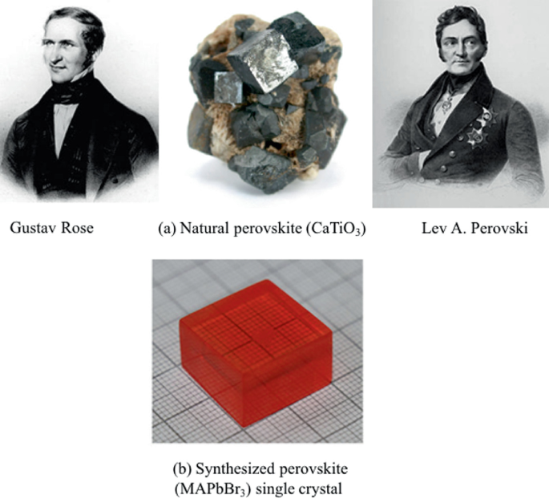
Background
Perovskites
Discovered by German mineralogist Gustav Rose in 1839
Named after the Russian mineralogist Lev Perovski
The mineral is based on calcium titanate ($CaTiO_{3}$)
In 1892, the first synthesis of a cesium lead halide perovskite
In 1978, the first synthesis of organic-inorganic lead halide perovskite
In 1986, the first layered perovskite reported
In 2009, Tsutomu Miyasaka et al. reported the first incorporation of perovskite materials into a solar cell
Mahapatra et al., Intro to Perovskite, Springer, 2024.

Slide 4
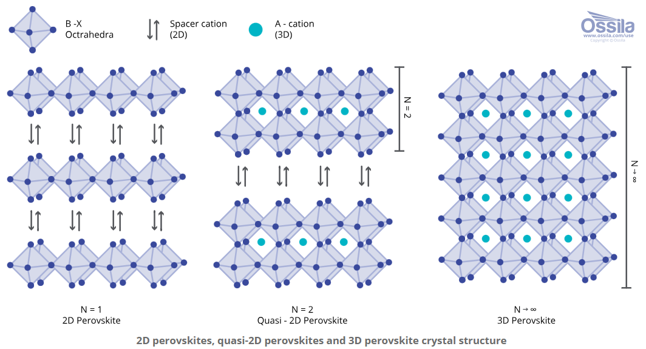
Why 2D Perovskites?
Strong quantum confinement enhances nonlinear optical response
Enhanced light-matter interactions
High χ² (second-order susceptibility) values due to low-dimensional structure and strong excitonic effects
https://www.ossila.com/pages/what-are-2d-perovskites
Tunable optical properties via compositional engineering
Crystal structure of 2D ${\left(Benzylammonium\right)}_{2}PbBr_{4}$ Perovskite
Ultrafast photonic responses
Potential for miniaturized and flexible photonic devices
Pb
N
Br
C
H

Slide 5
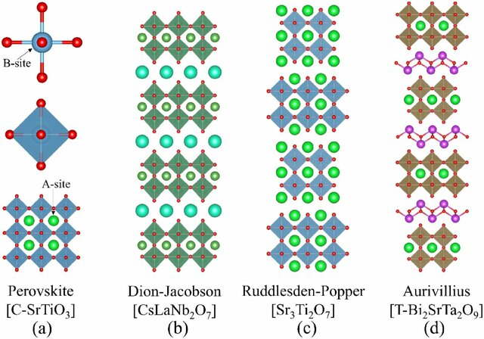
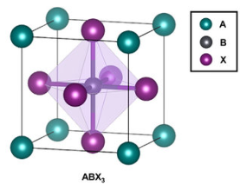
Types of 2D Perovskites
Types of 2D perovskites:
Ruddlesden-Popper: Alternating layers of perovskite and organic spacers
Dion-Jacobson: Similar to Ruddlesden-Popper but without A-site cations
Aurivillius: Typically found in oxide perovskites with alternating oxide layers
Figure: Representative structures of perovskite and layered perovskites: (a) cubic-SrTiO3 with simple perovskite structure, (b) CsLaNb2O7 with n = 2 D–J structure, (c) Sr3Ti2O7 with n = 2 R–P structure, and (d) T-Bi2SrTa2O9 with n = 2 Aurivillius structure.
Influence of structure on optical and electronic properties
B. H. Zhang et al., J. Phys. D: Appl. Phys. 55, 113001 (2022).

Slide 6
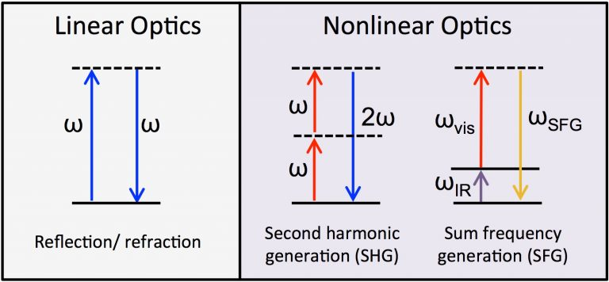
Basics of Second-Order Nonlinear Optics
Second-harmonic generation (SHG): Doubling of photon frequency
Mathematical expression representing second-order susceptibility (χ²)
Requires non-centrosymmetric materials for a non-zero χ²
https://gibbs.chem.ualberta.ca/?p=9

Slide 7
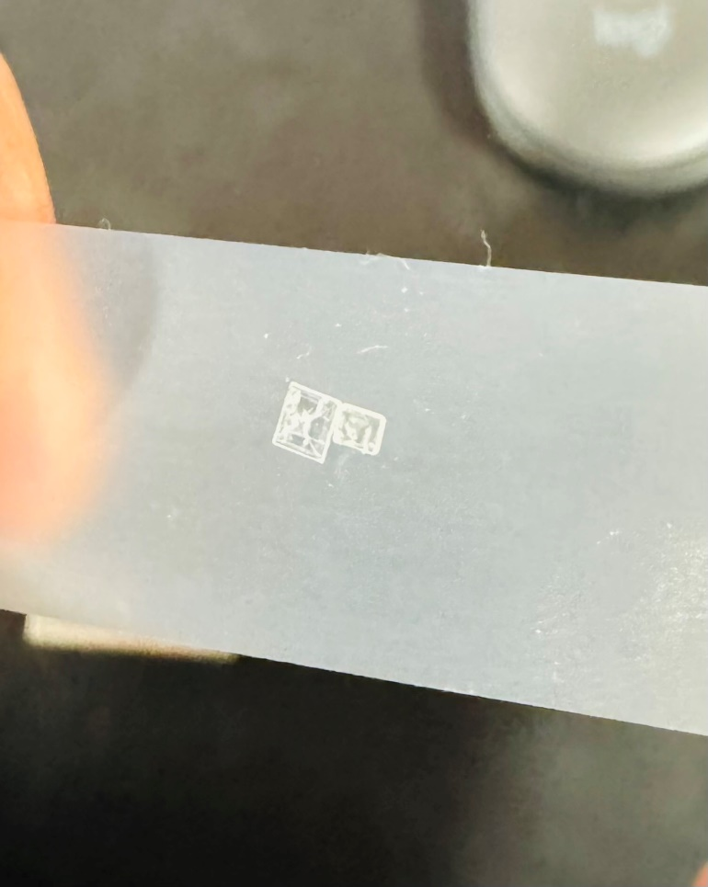
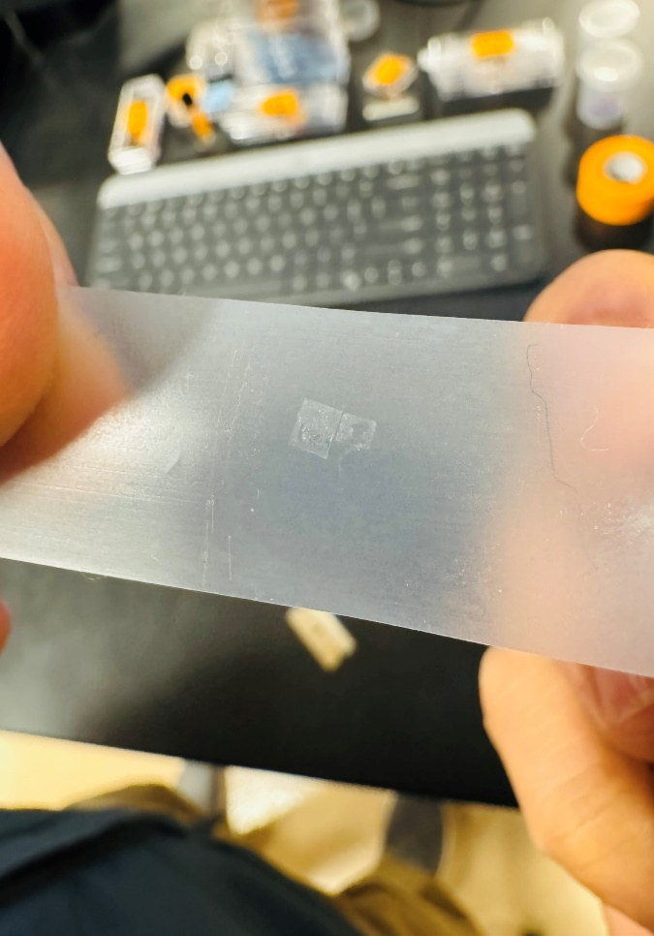
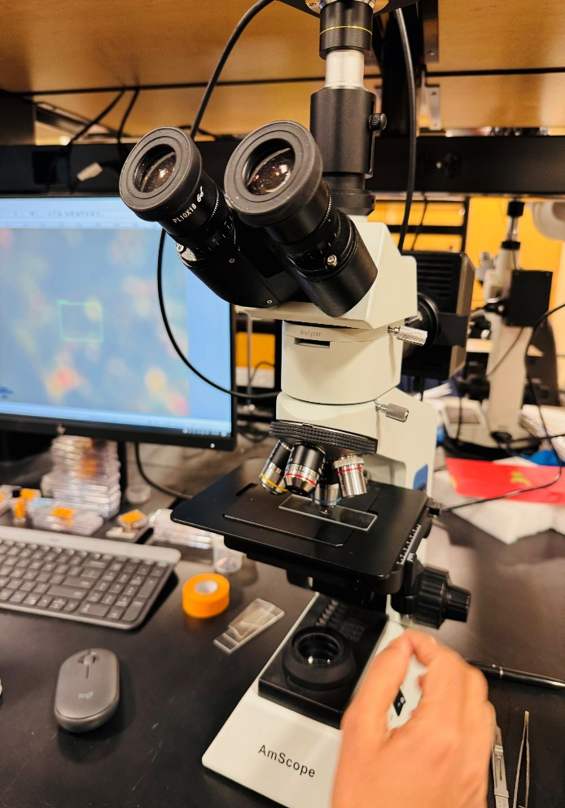
Step by Step of a Mechanical Exfoliation Process
Mechanical Exfoliation

Slide 8
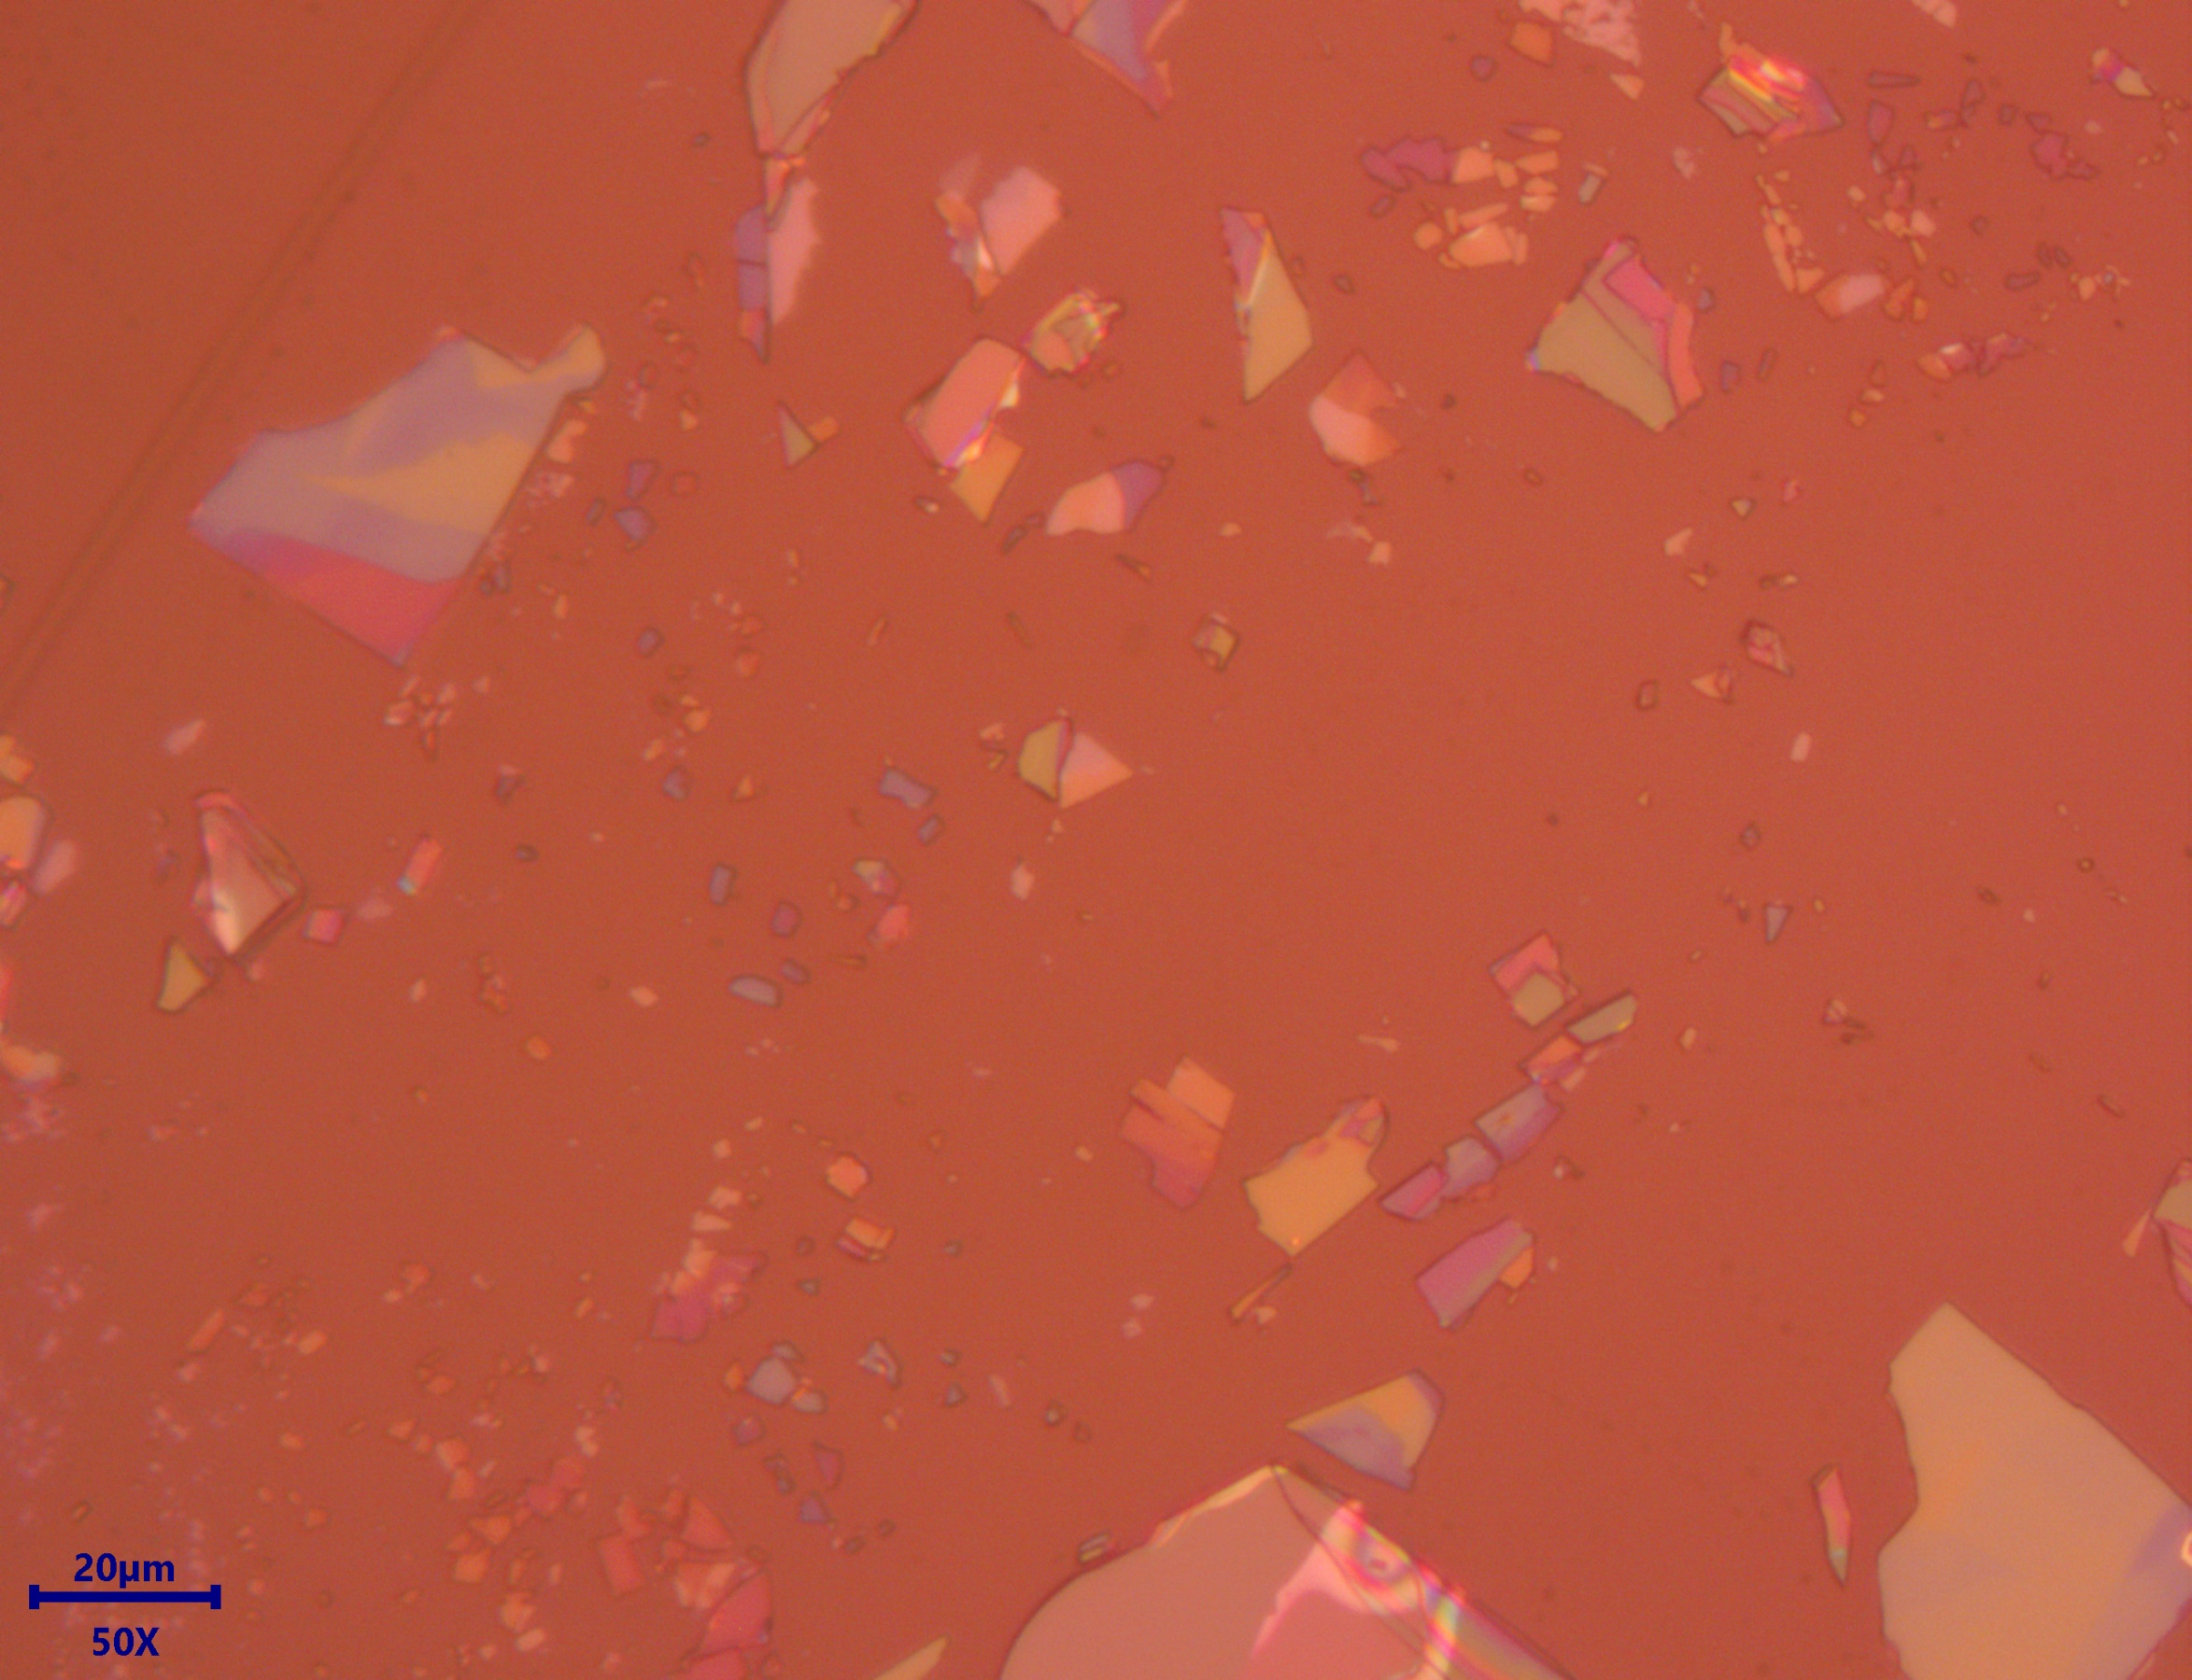
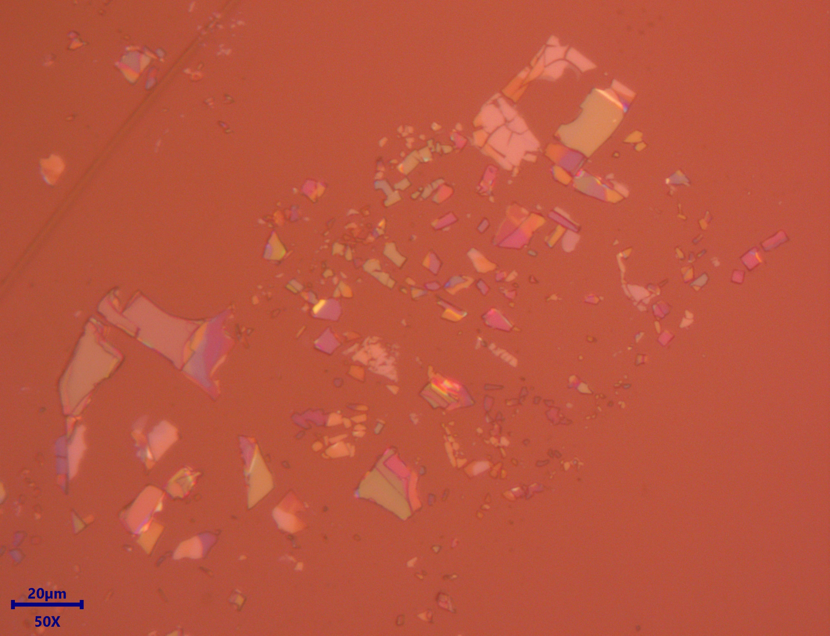
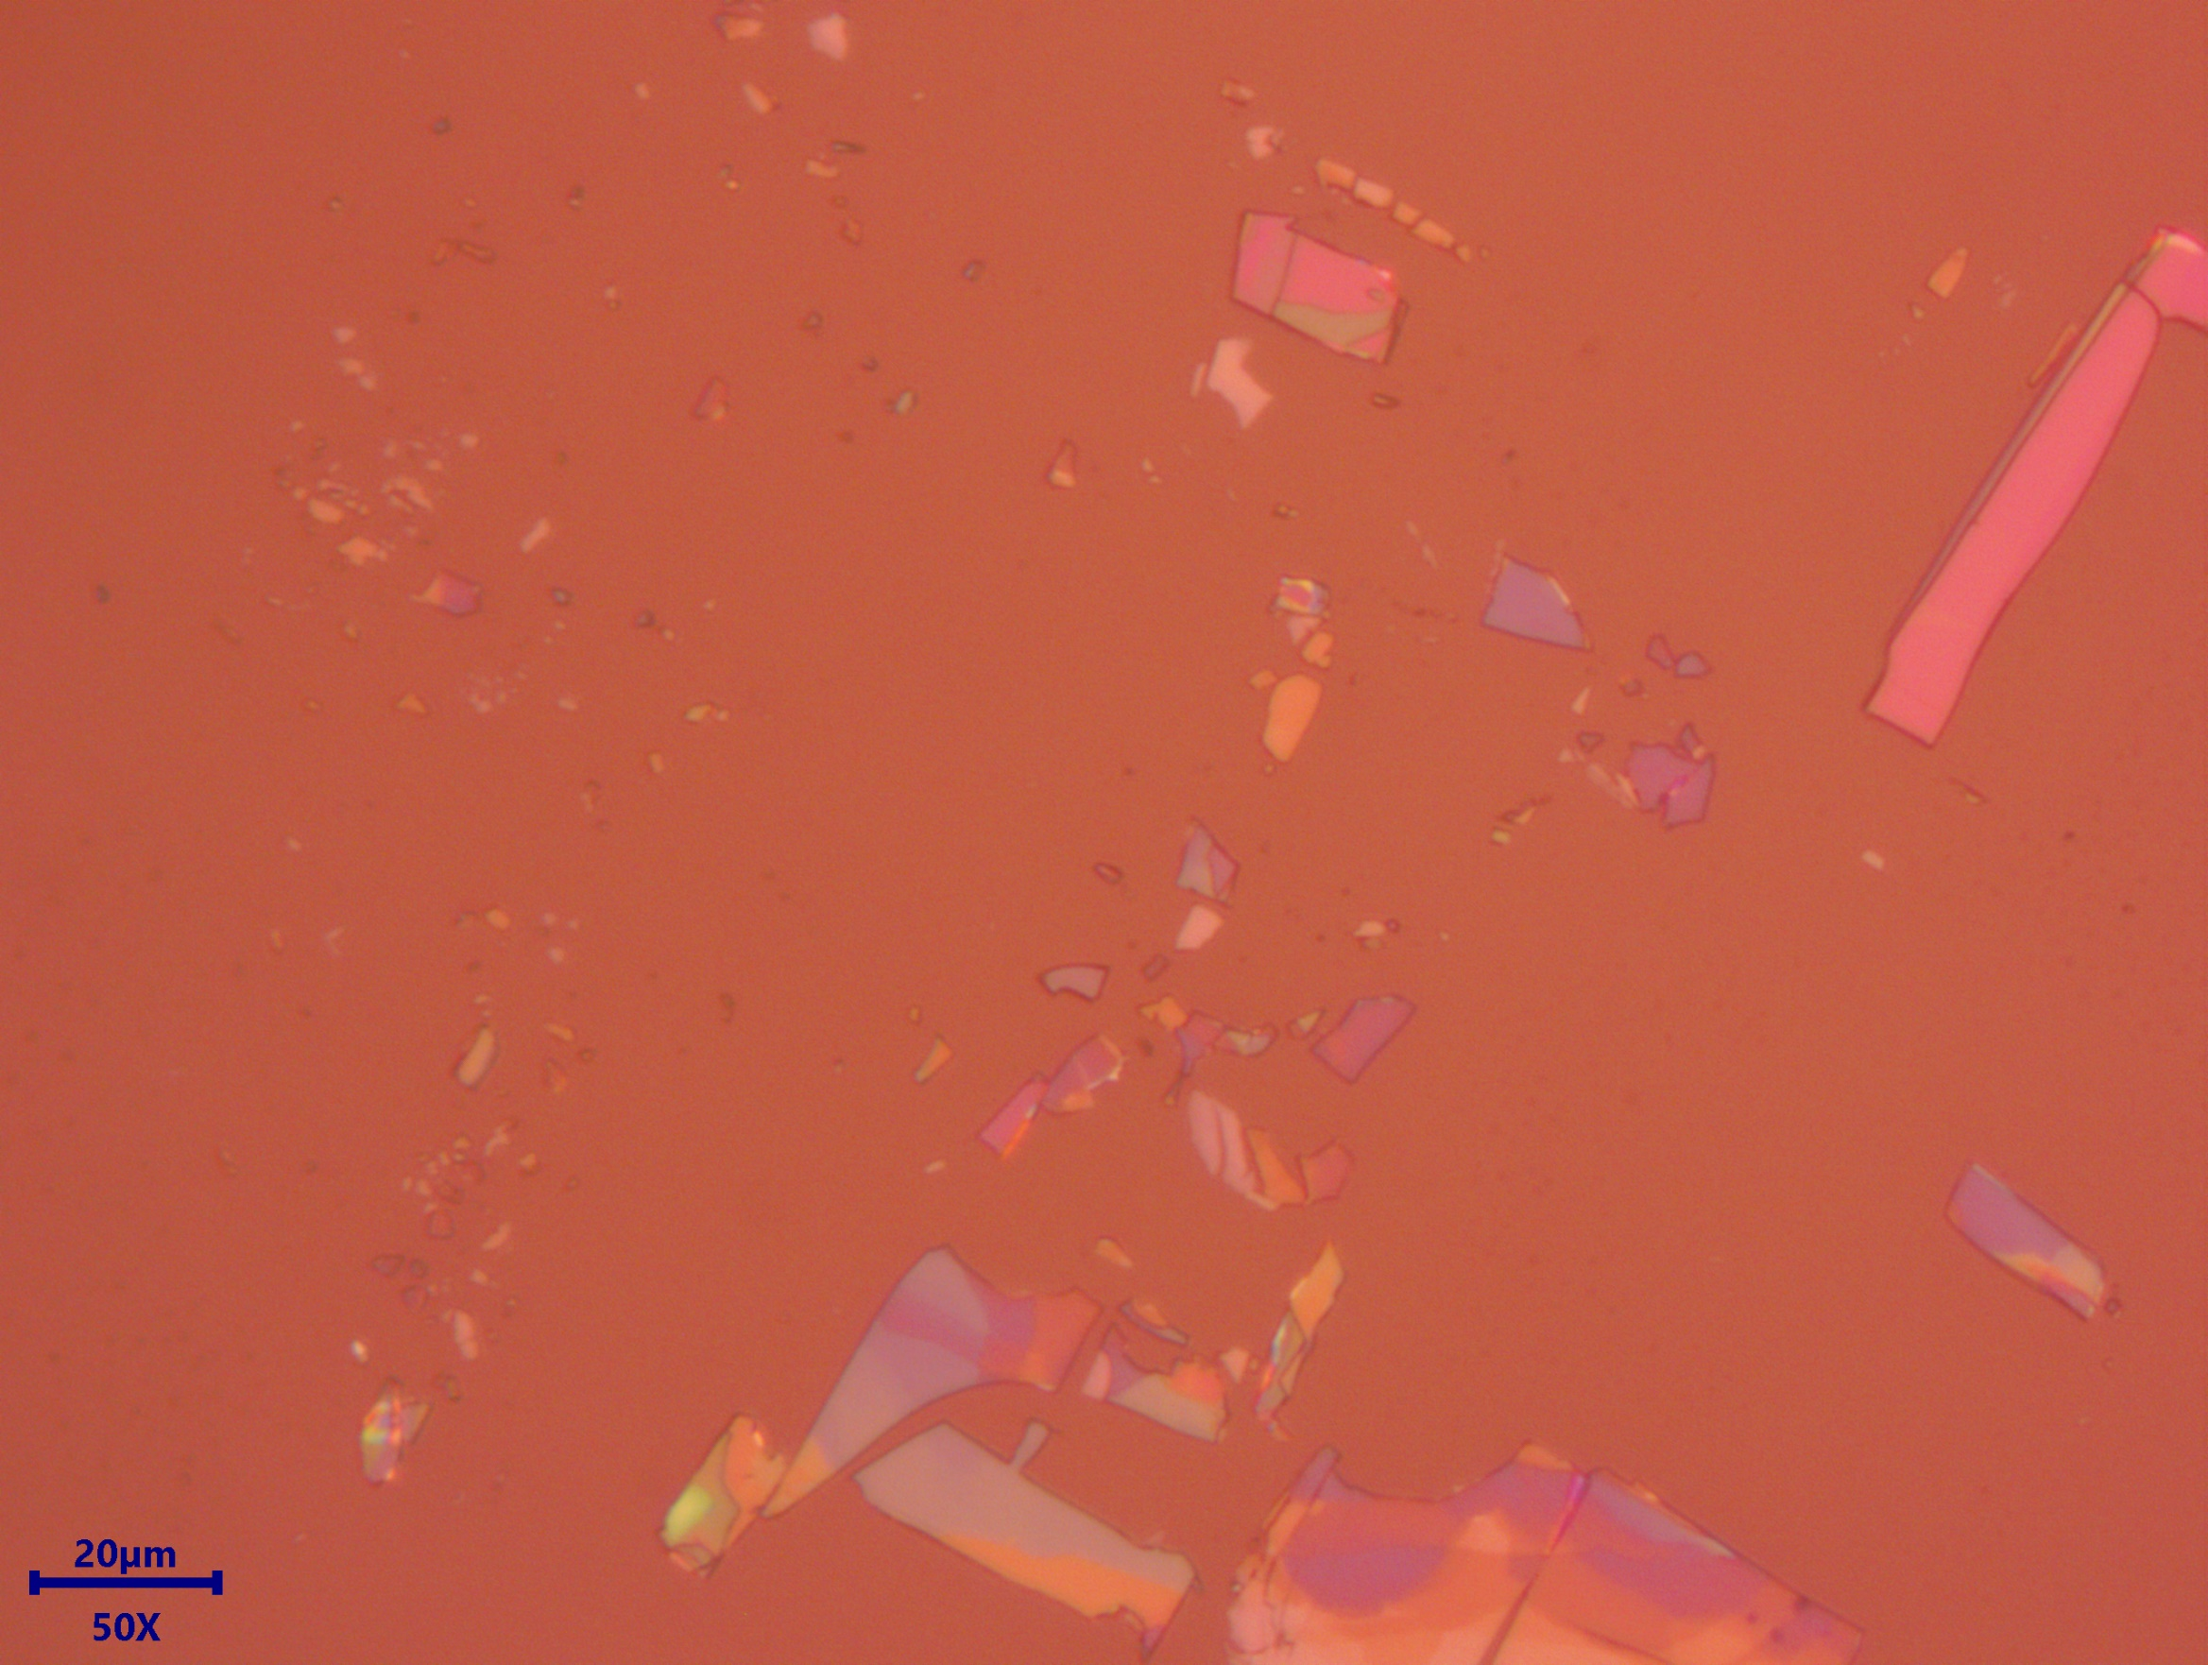
Optical Microscope Images of Exfoliated 2D ${\left(Benzylammonium\right)}_{2}PbBr_{4}$ flake on Glass Substrate
Notes:
AI can be used to

Slide 9
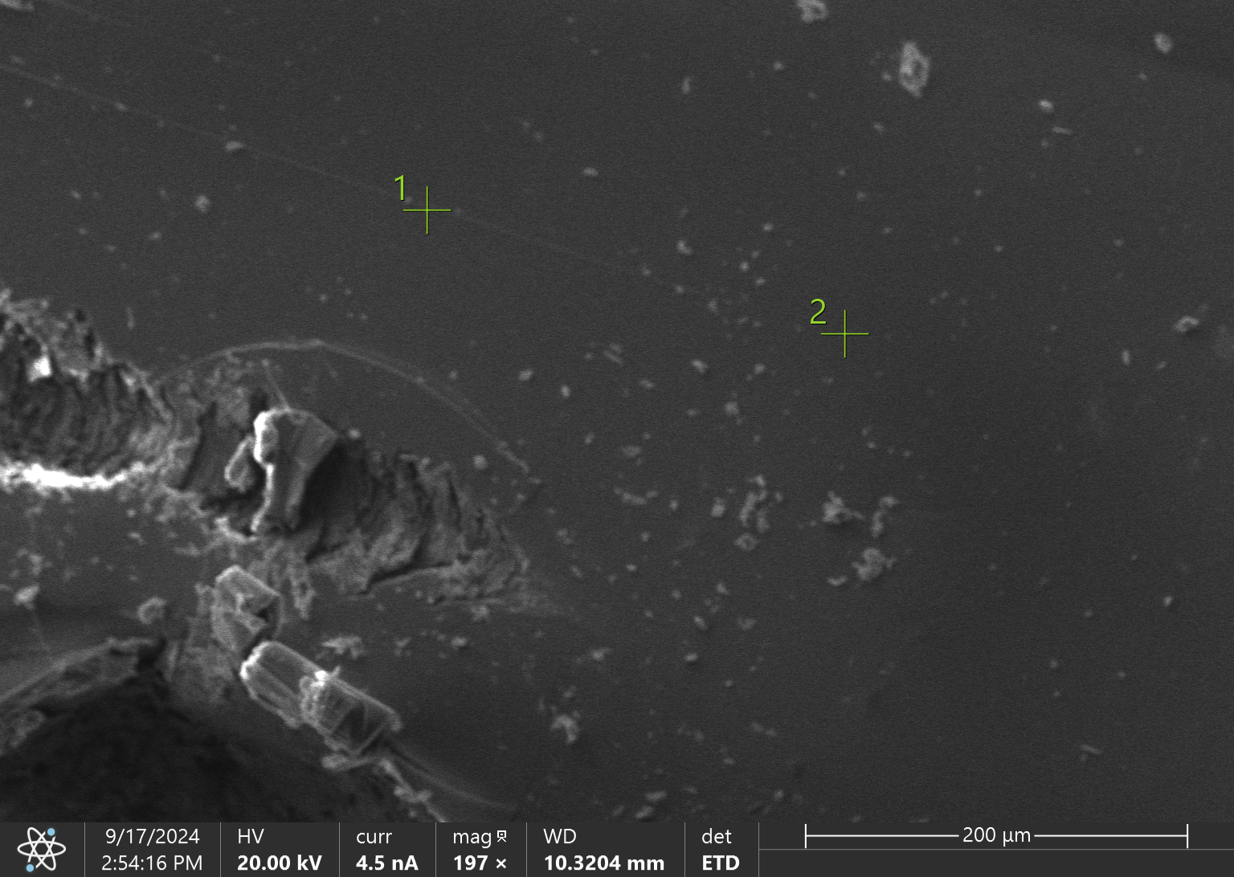
EDS/SEM Elemental Analysis of 2D ${\left(Benzylammonium\right)}_{2}PbBr_{4}$
Element | Atomic % | Atomic % Error | Weight % | Weight % Error | Net Counts
N | 21.5 | 0.9 | 18.9 | 0.8 | 10 117
Pb | 0.9 | 0.2 | 11.4 | 2.0 | 3 182
C | 74.9 | 0.4 | 56.2 | 0.3 | 112 502
Br | 2.7 | 0.3 | 13.6 | 1.3 | 4 250

Slide 10
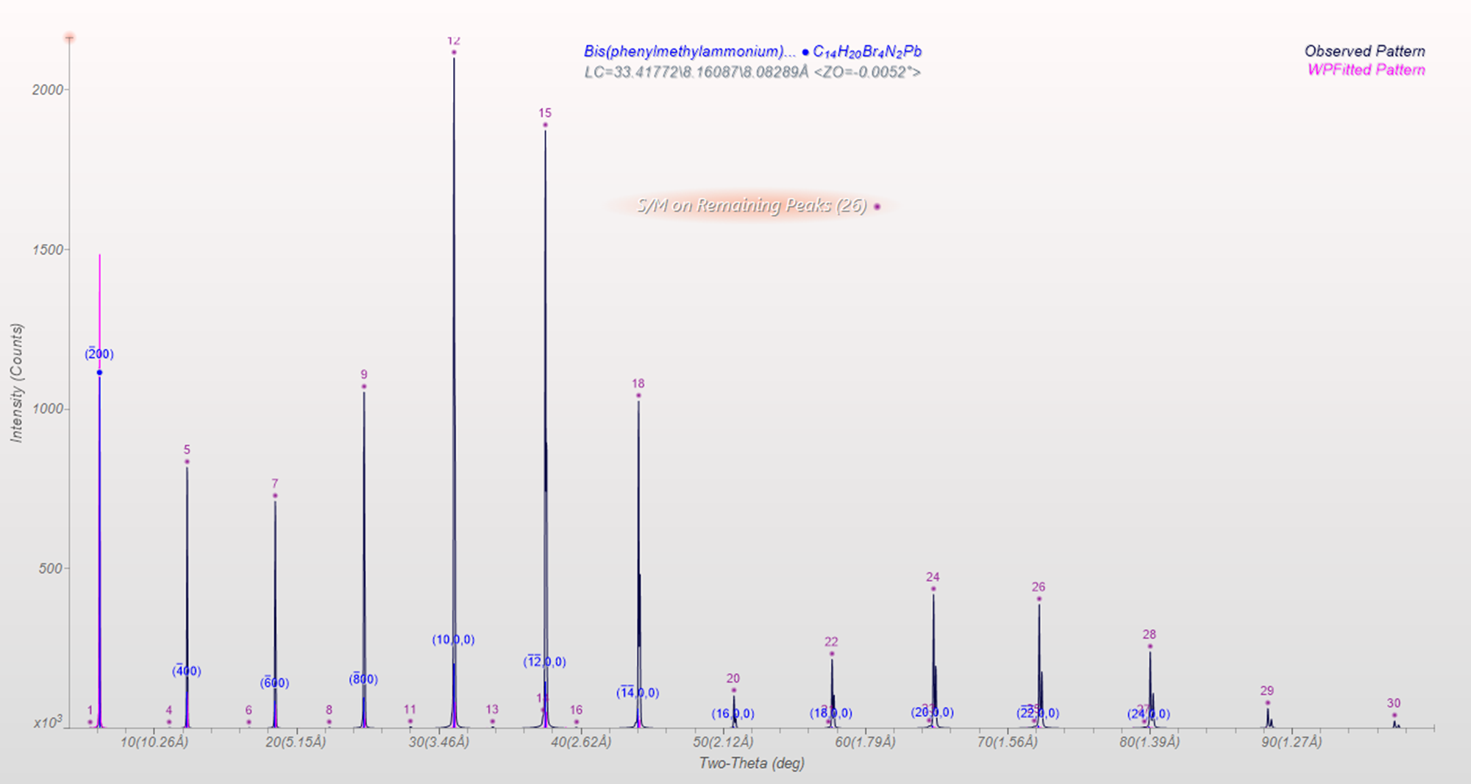
XRD Pattern of 2D ${\left(Benzylammonium\right)}_{2}PbBr_{4}$

Slide 11
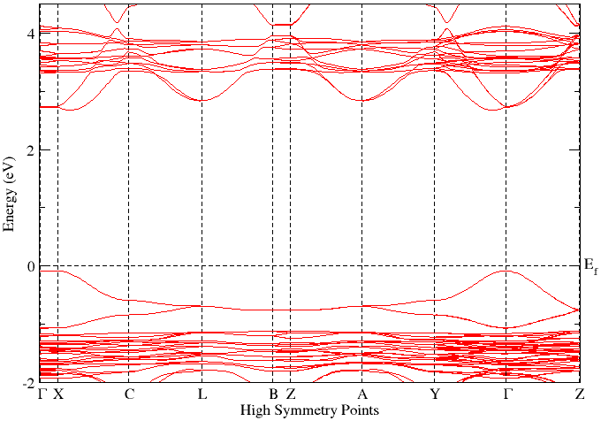
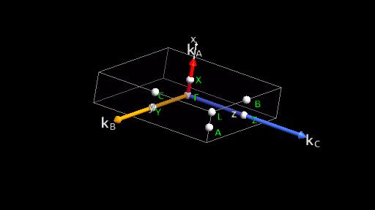
Band Plot of 2D ${\left(Benzylammonium\right)}_{2}PbBr_{4}$
Vienna Ab initio Simulation Package (VASP) for Density Functional Theory (DFT) calculations

Slide 12
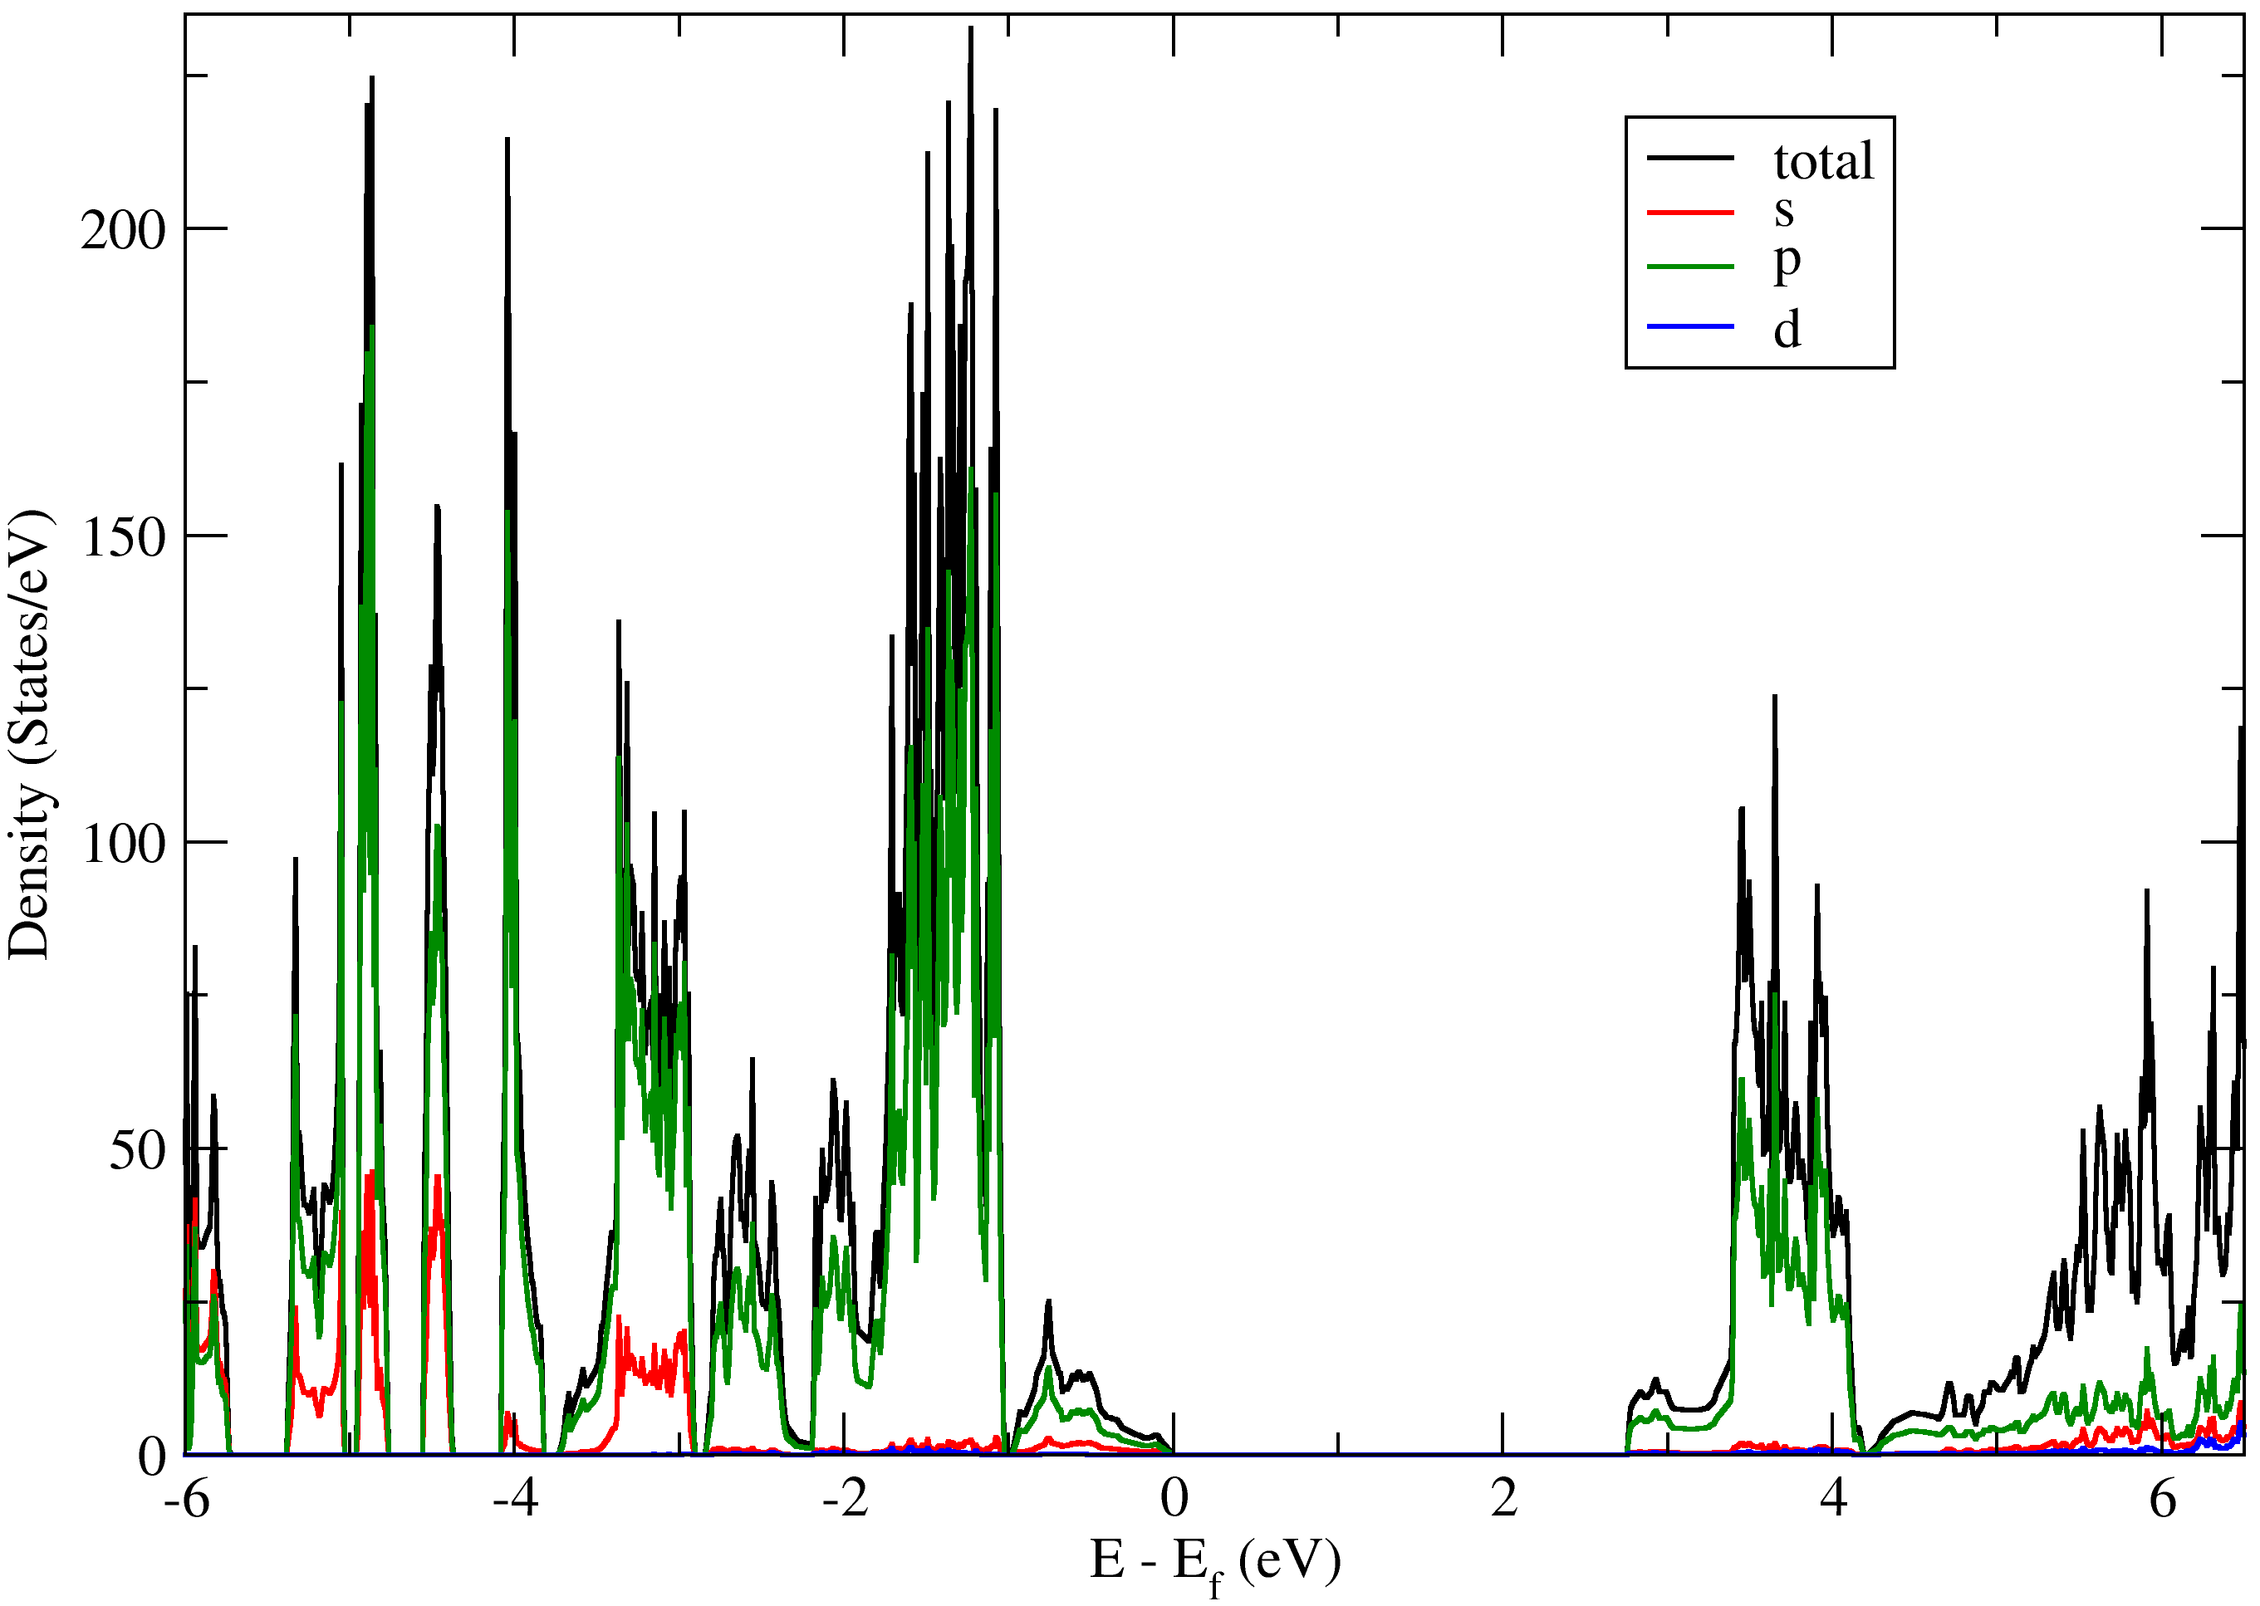
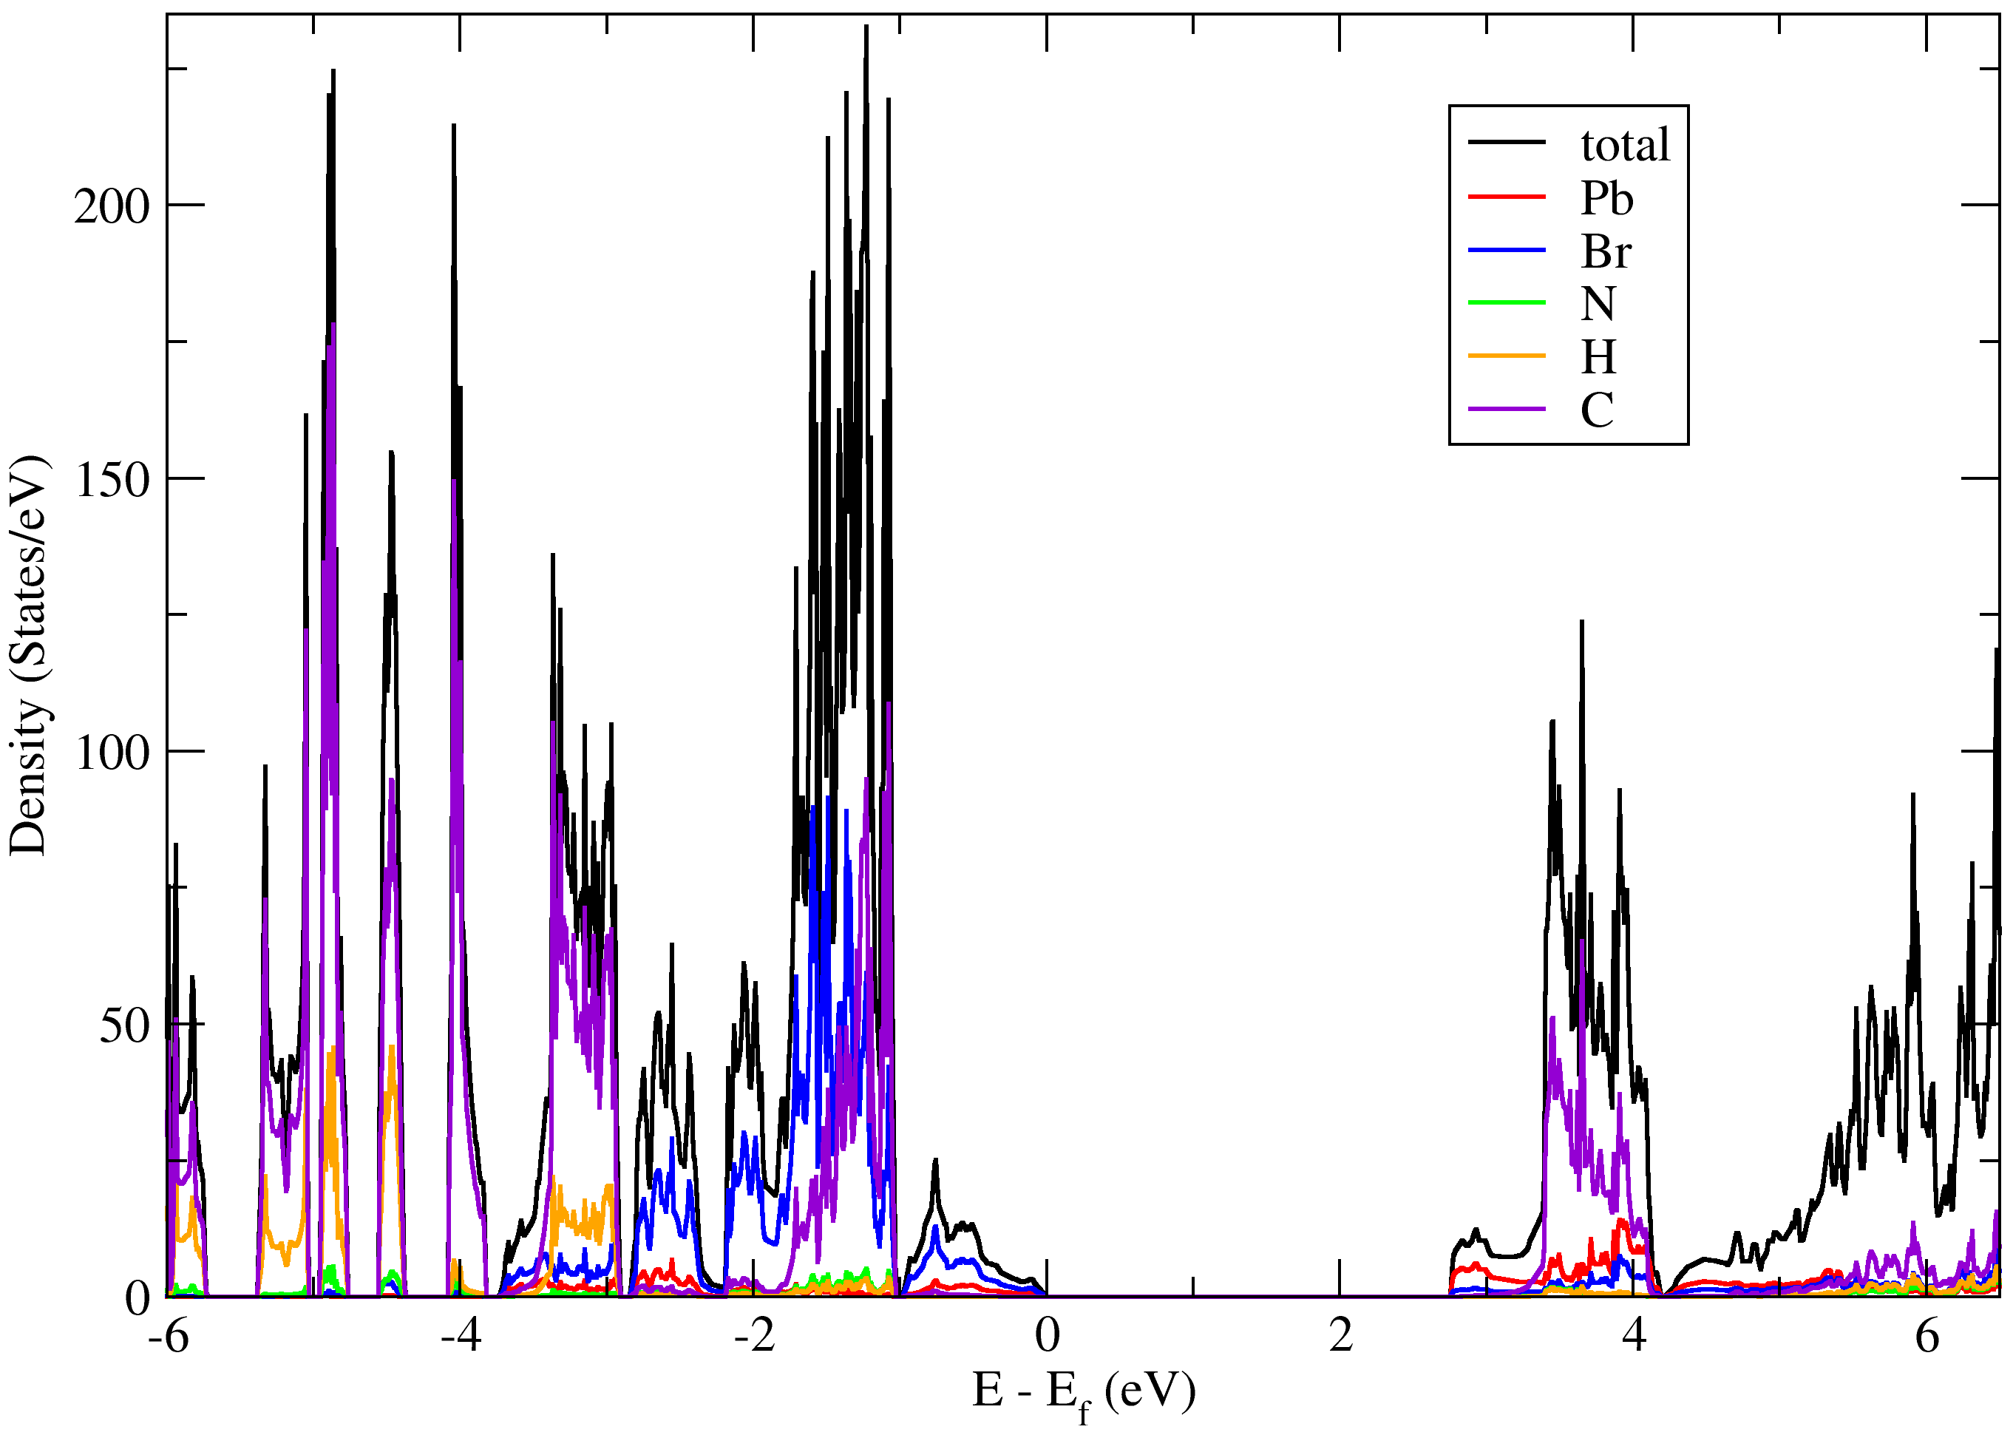
DOS plot of 2D ${\left(Benzylammonium\right)}_{2}PbBr_{4}$
Orbital-resolved DOS plot of 2D (Benzylammonium)2 PbBr4 Perovskite
Atom-resolved DOS plot of 2D (Benzylammonium)2 PbBr4 Perovskite

Slide 13
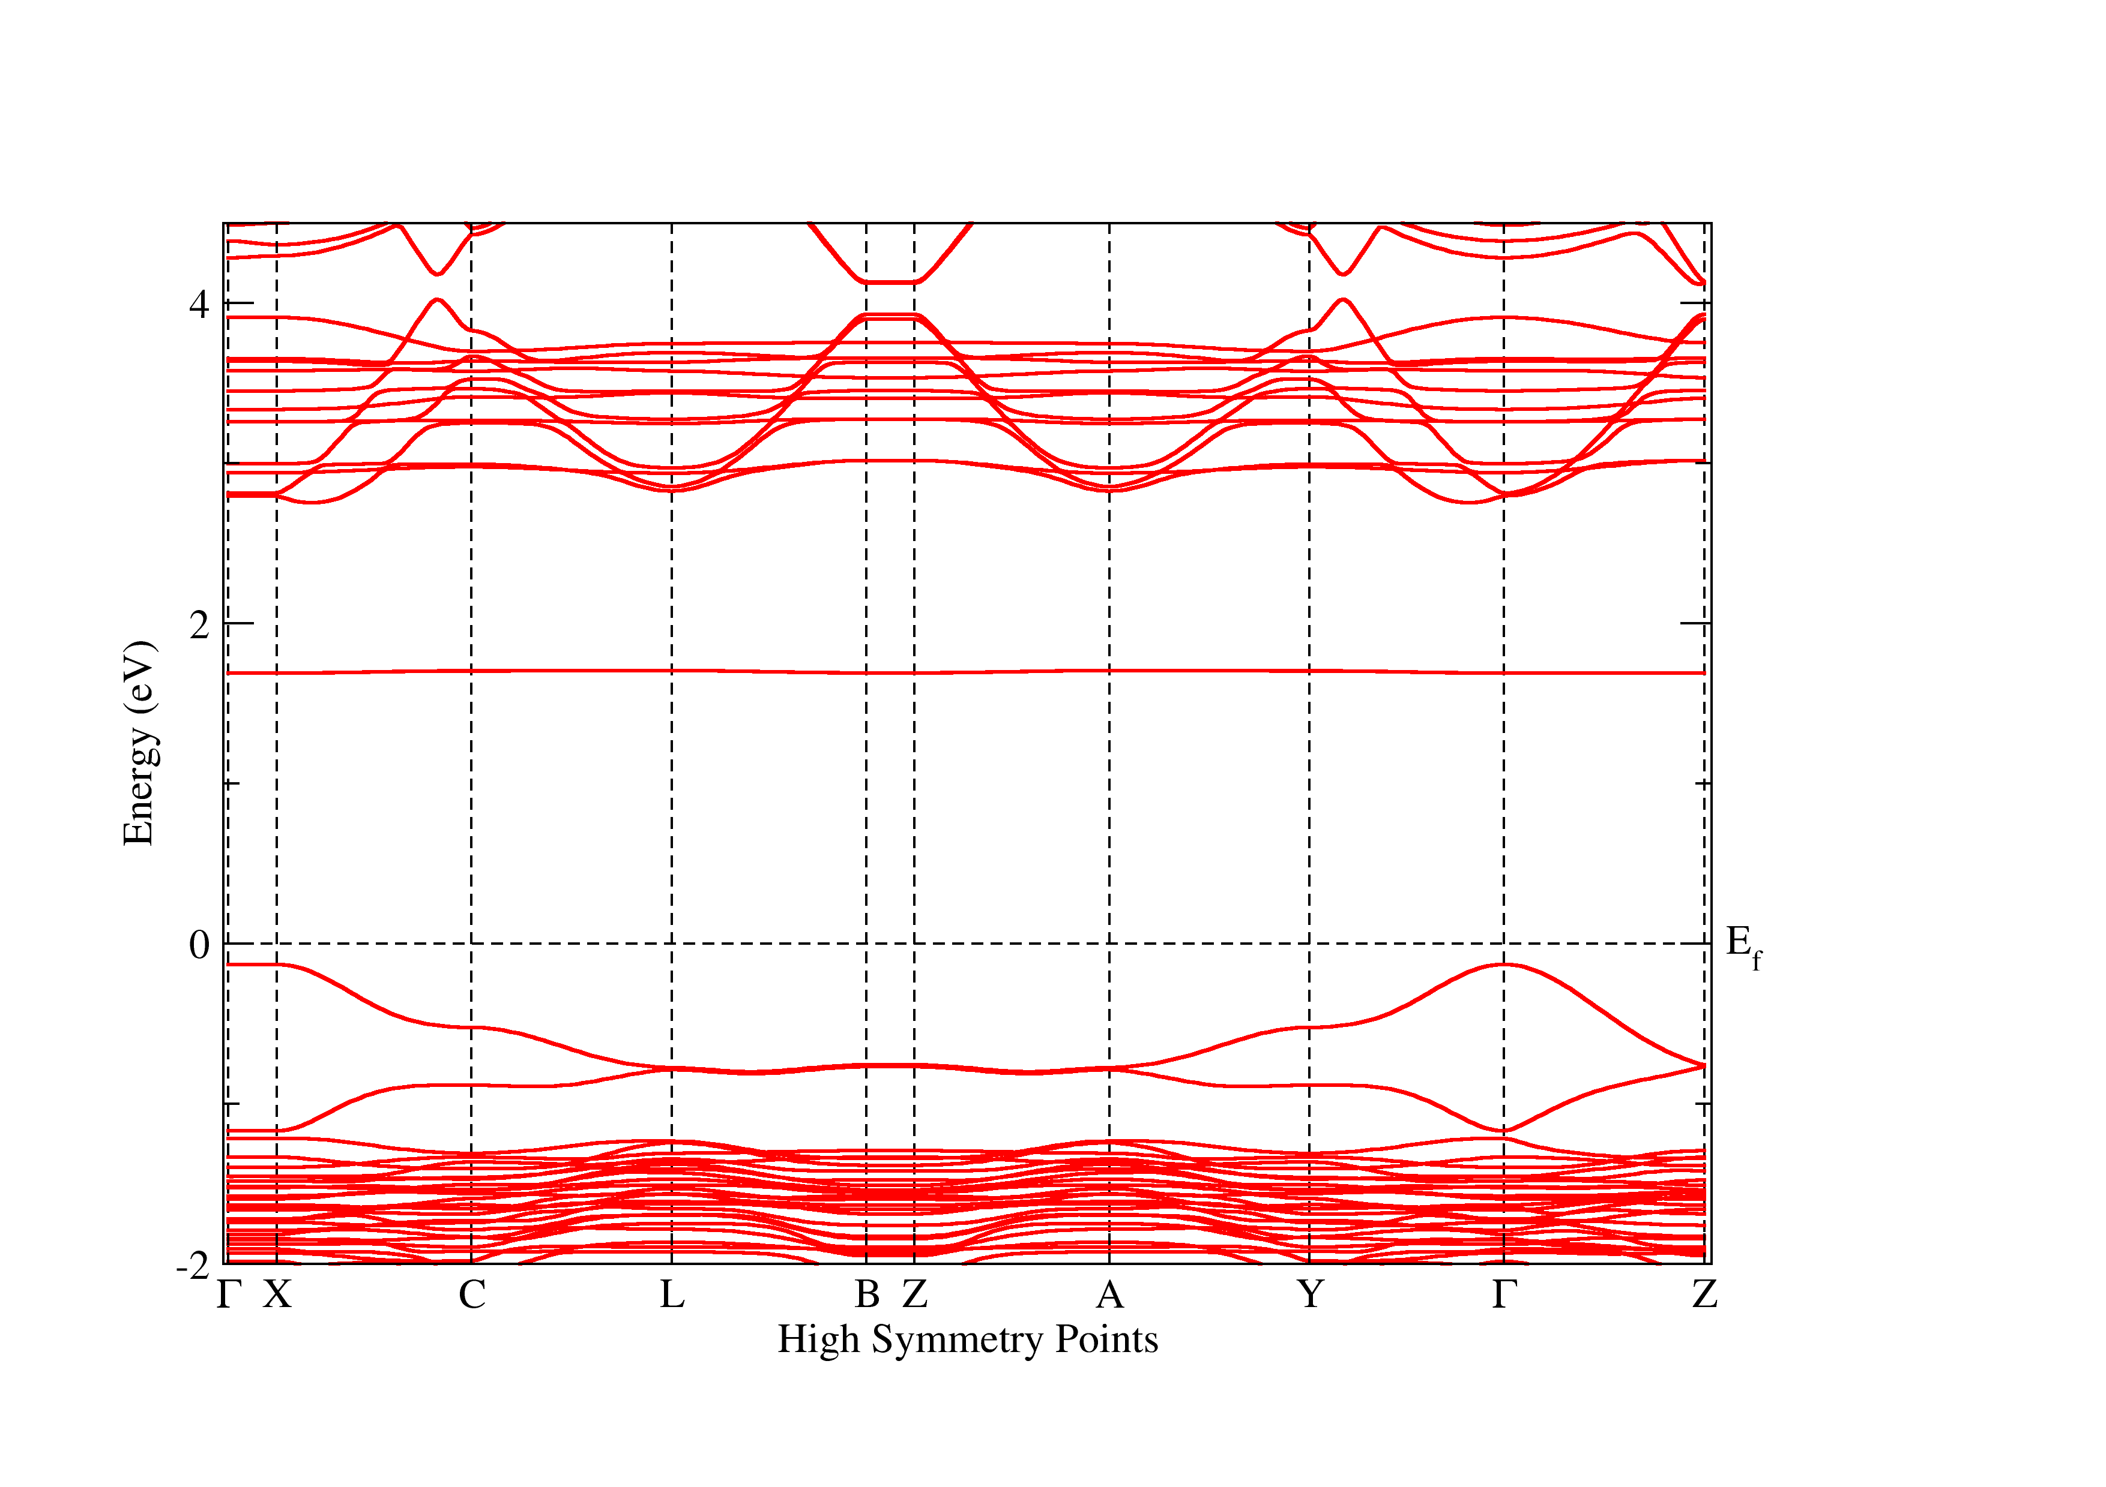
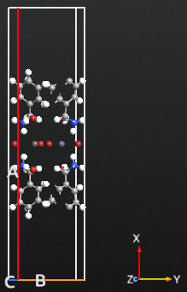
Crystal structure and band plot of monolayer 2D ${\left(Benzylammonium\right)}_{2}PbBr_{4}$

Slide 14
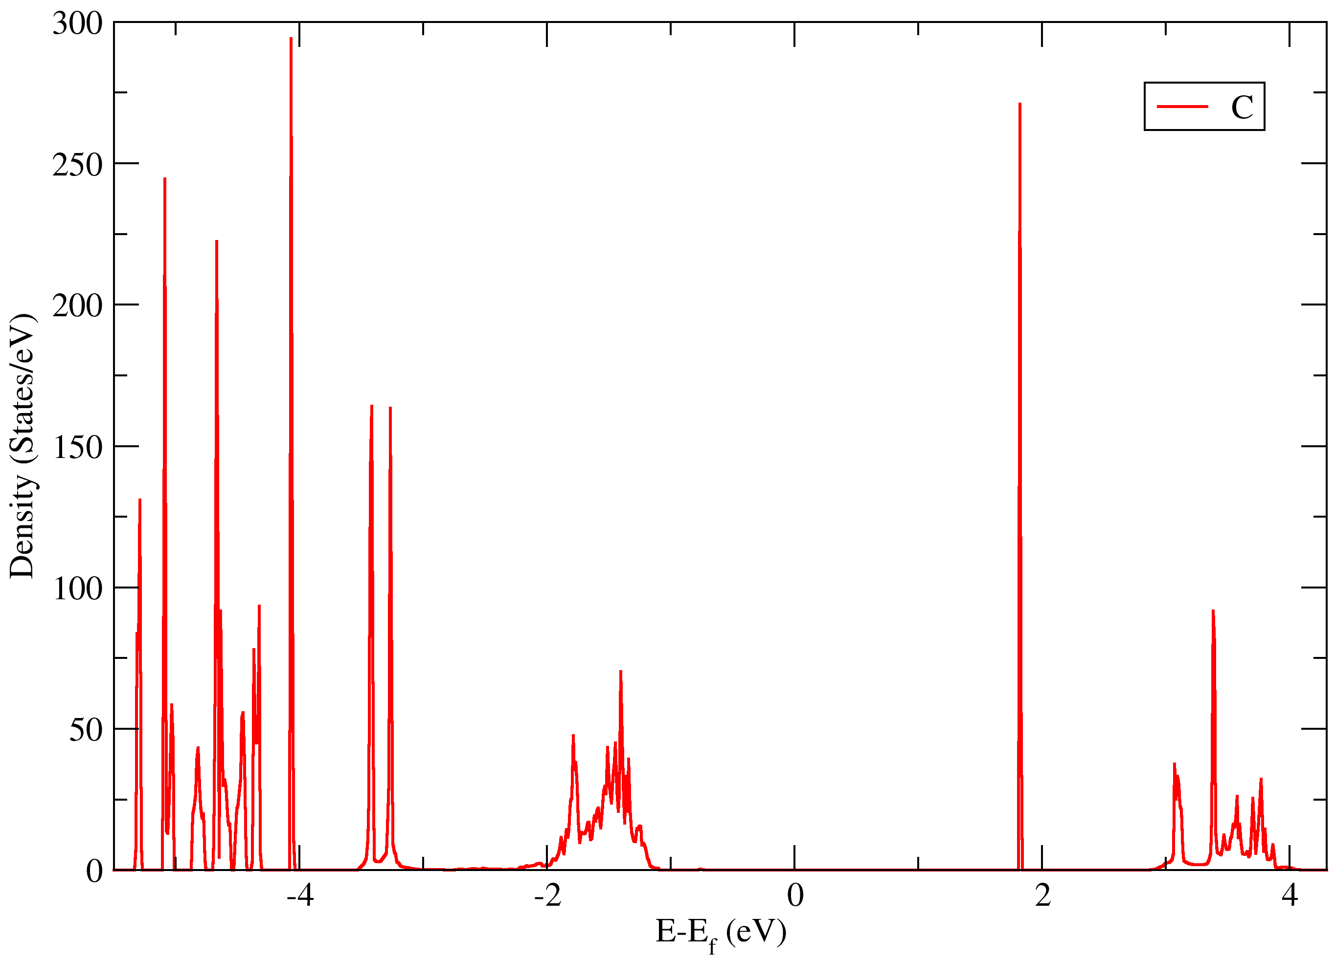
Crystal structure showing atom displacement and dos plot of C-atom of monolayer 2D ${\left(Benzylammonium\right)}_{2}PbBr_{4}$
C

Slide 15
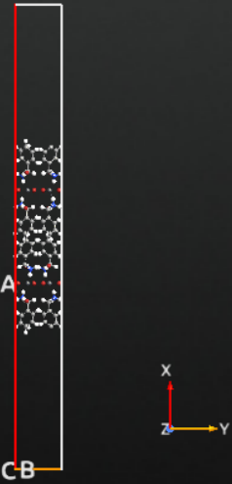
Crystal structure of bilayer 2D ${\left(Benzylammonium\right)}_{2}PbBr_{4}$

Slide 16
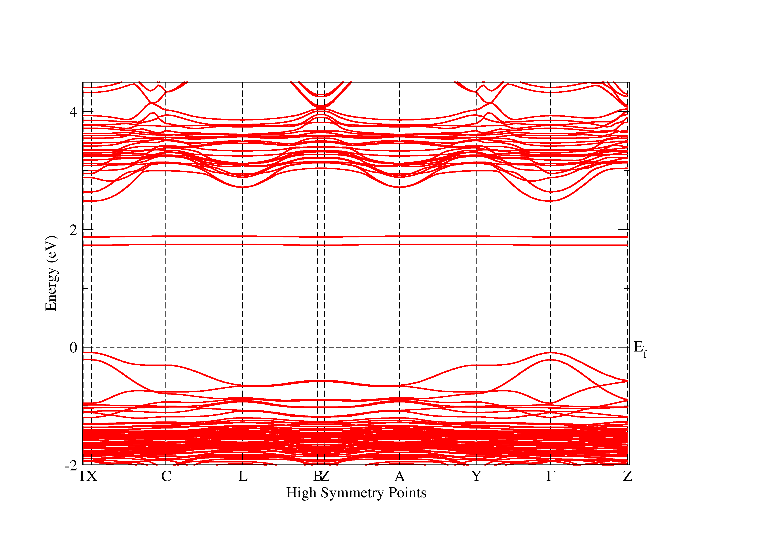
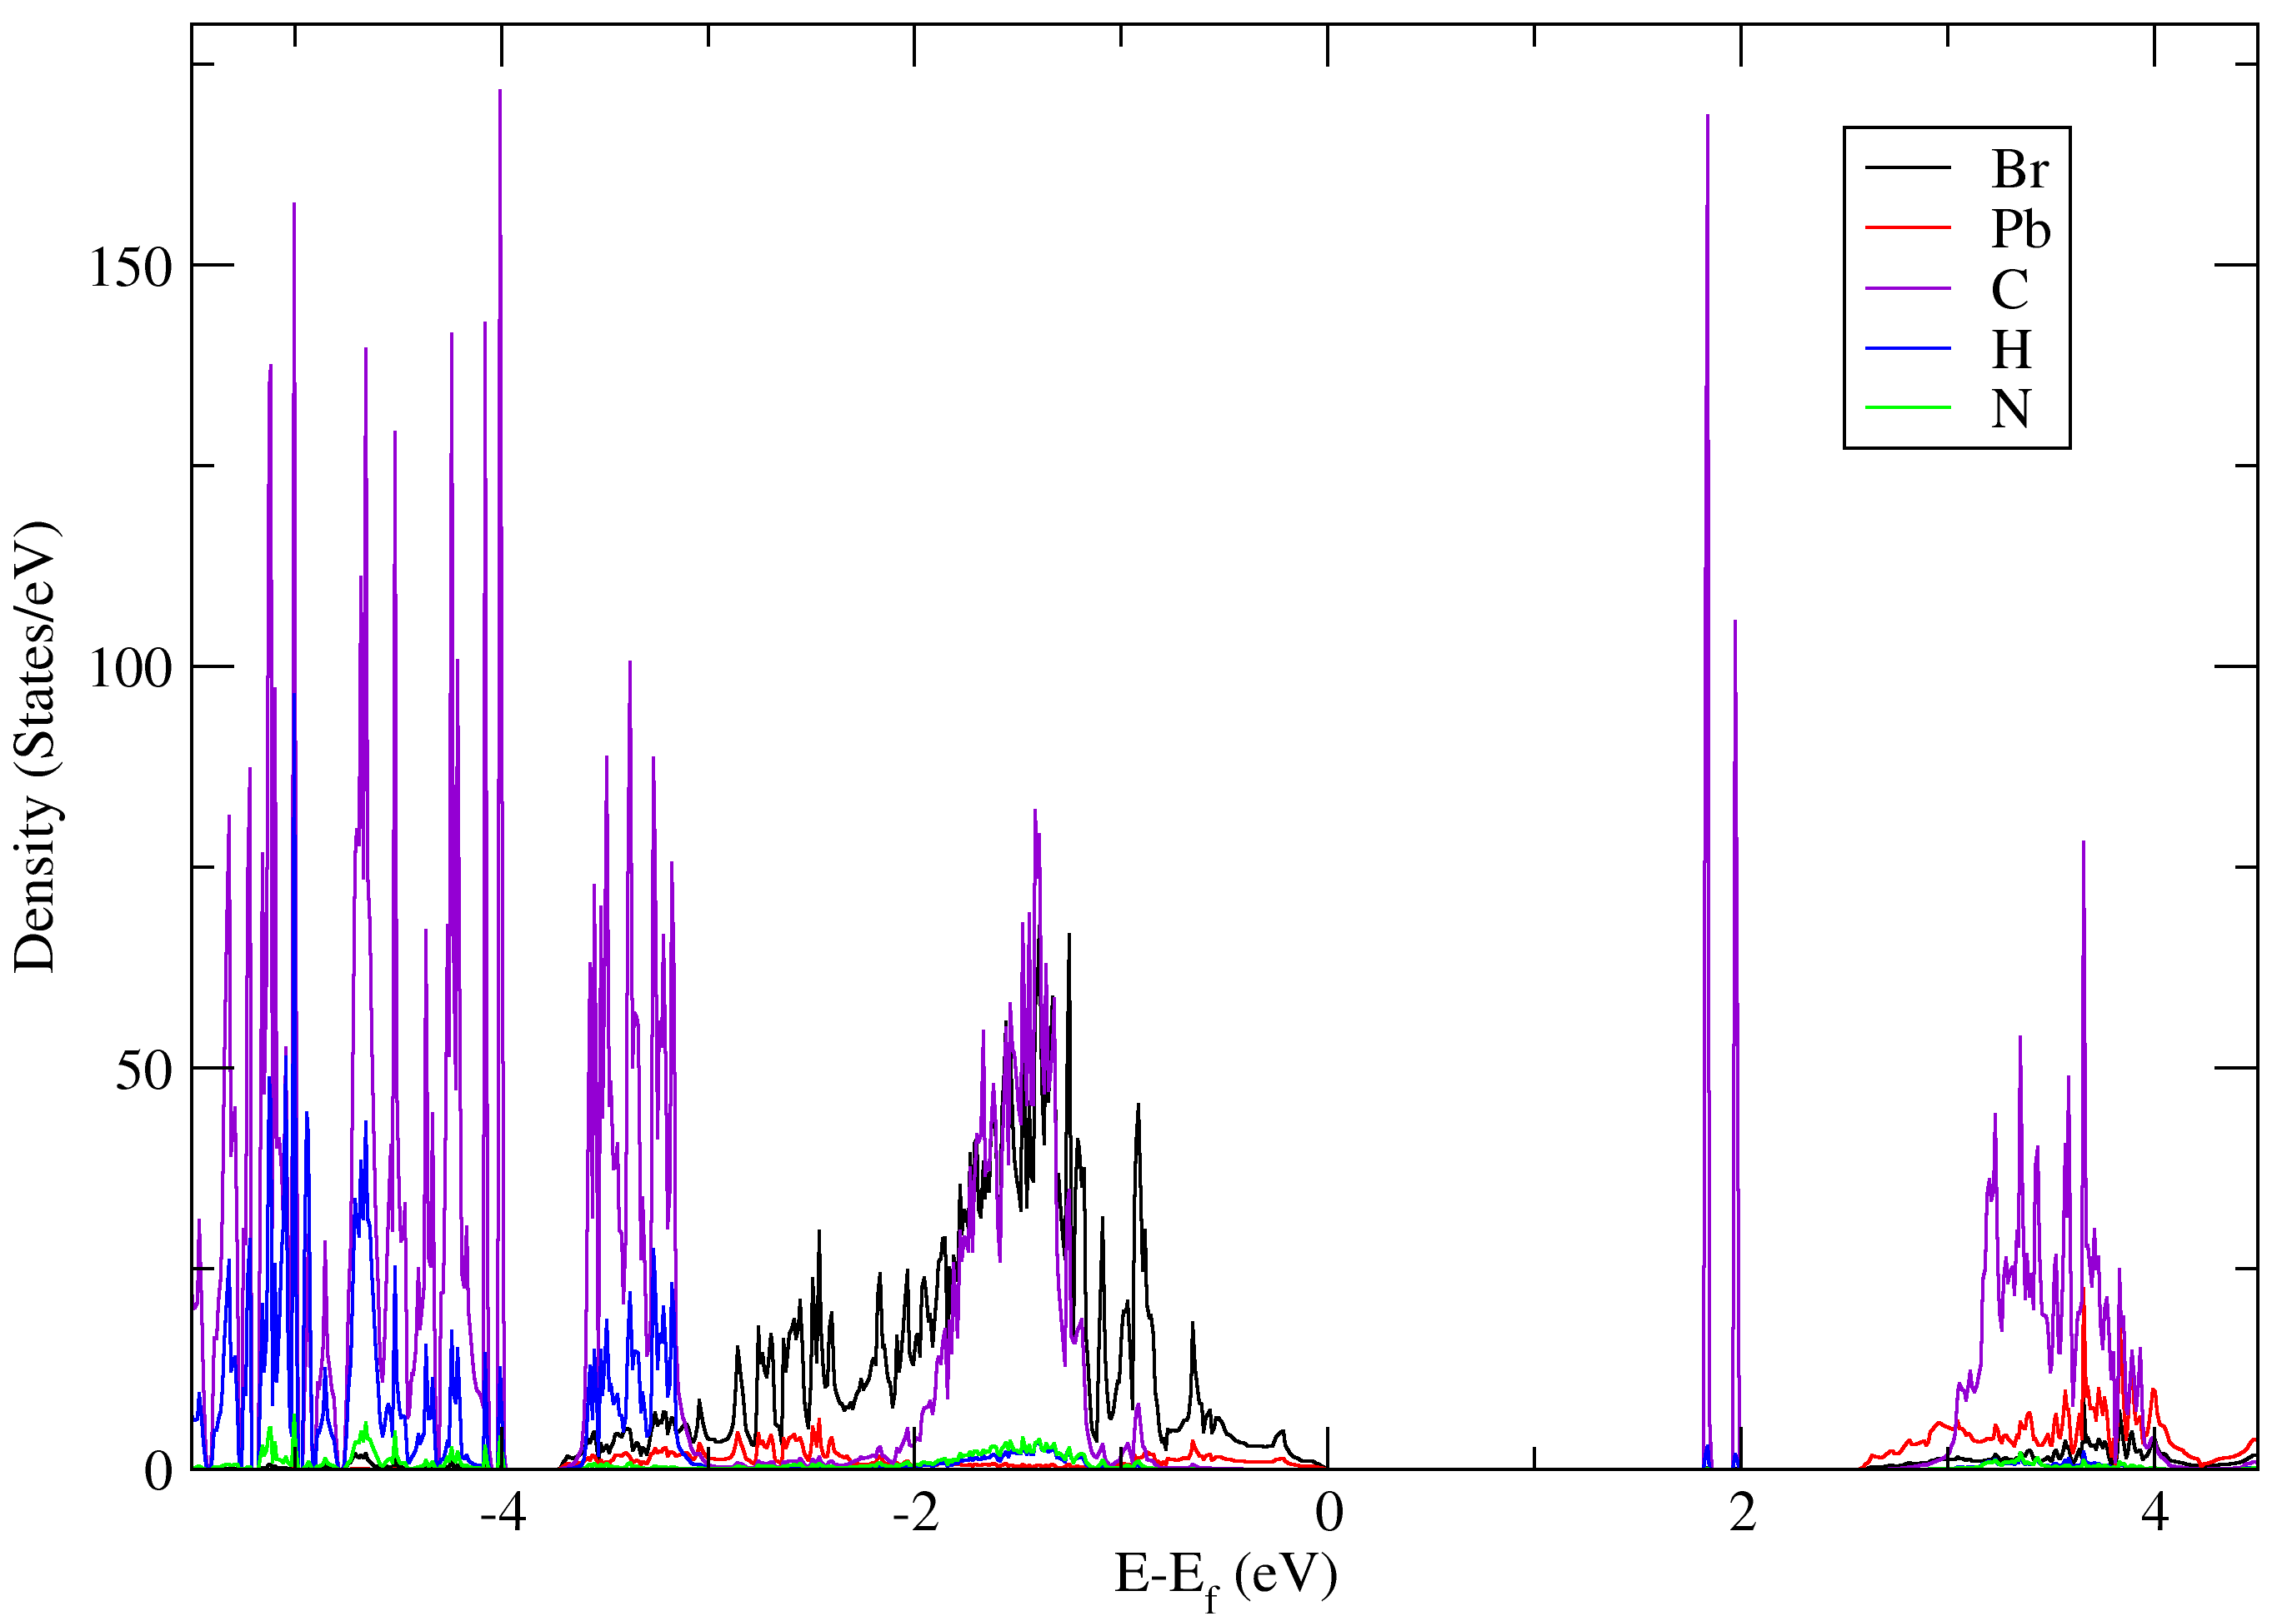
Band and atom-resolved dos plot of bilayer 2D ${\left(Benzylammonium\right)}_{2}PbBr_{4}$

Slide 17
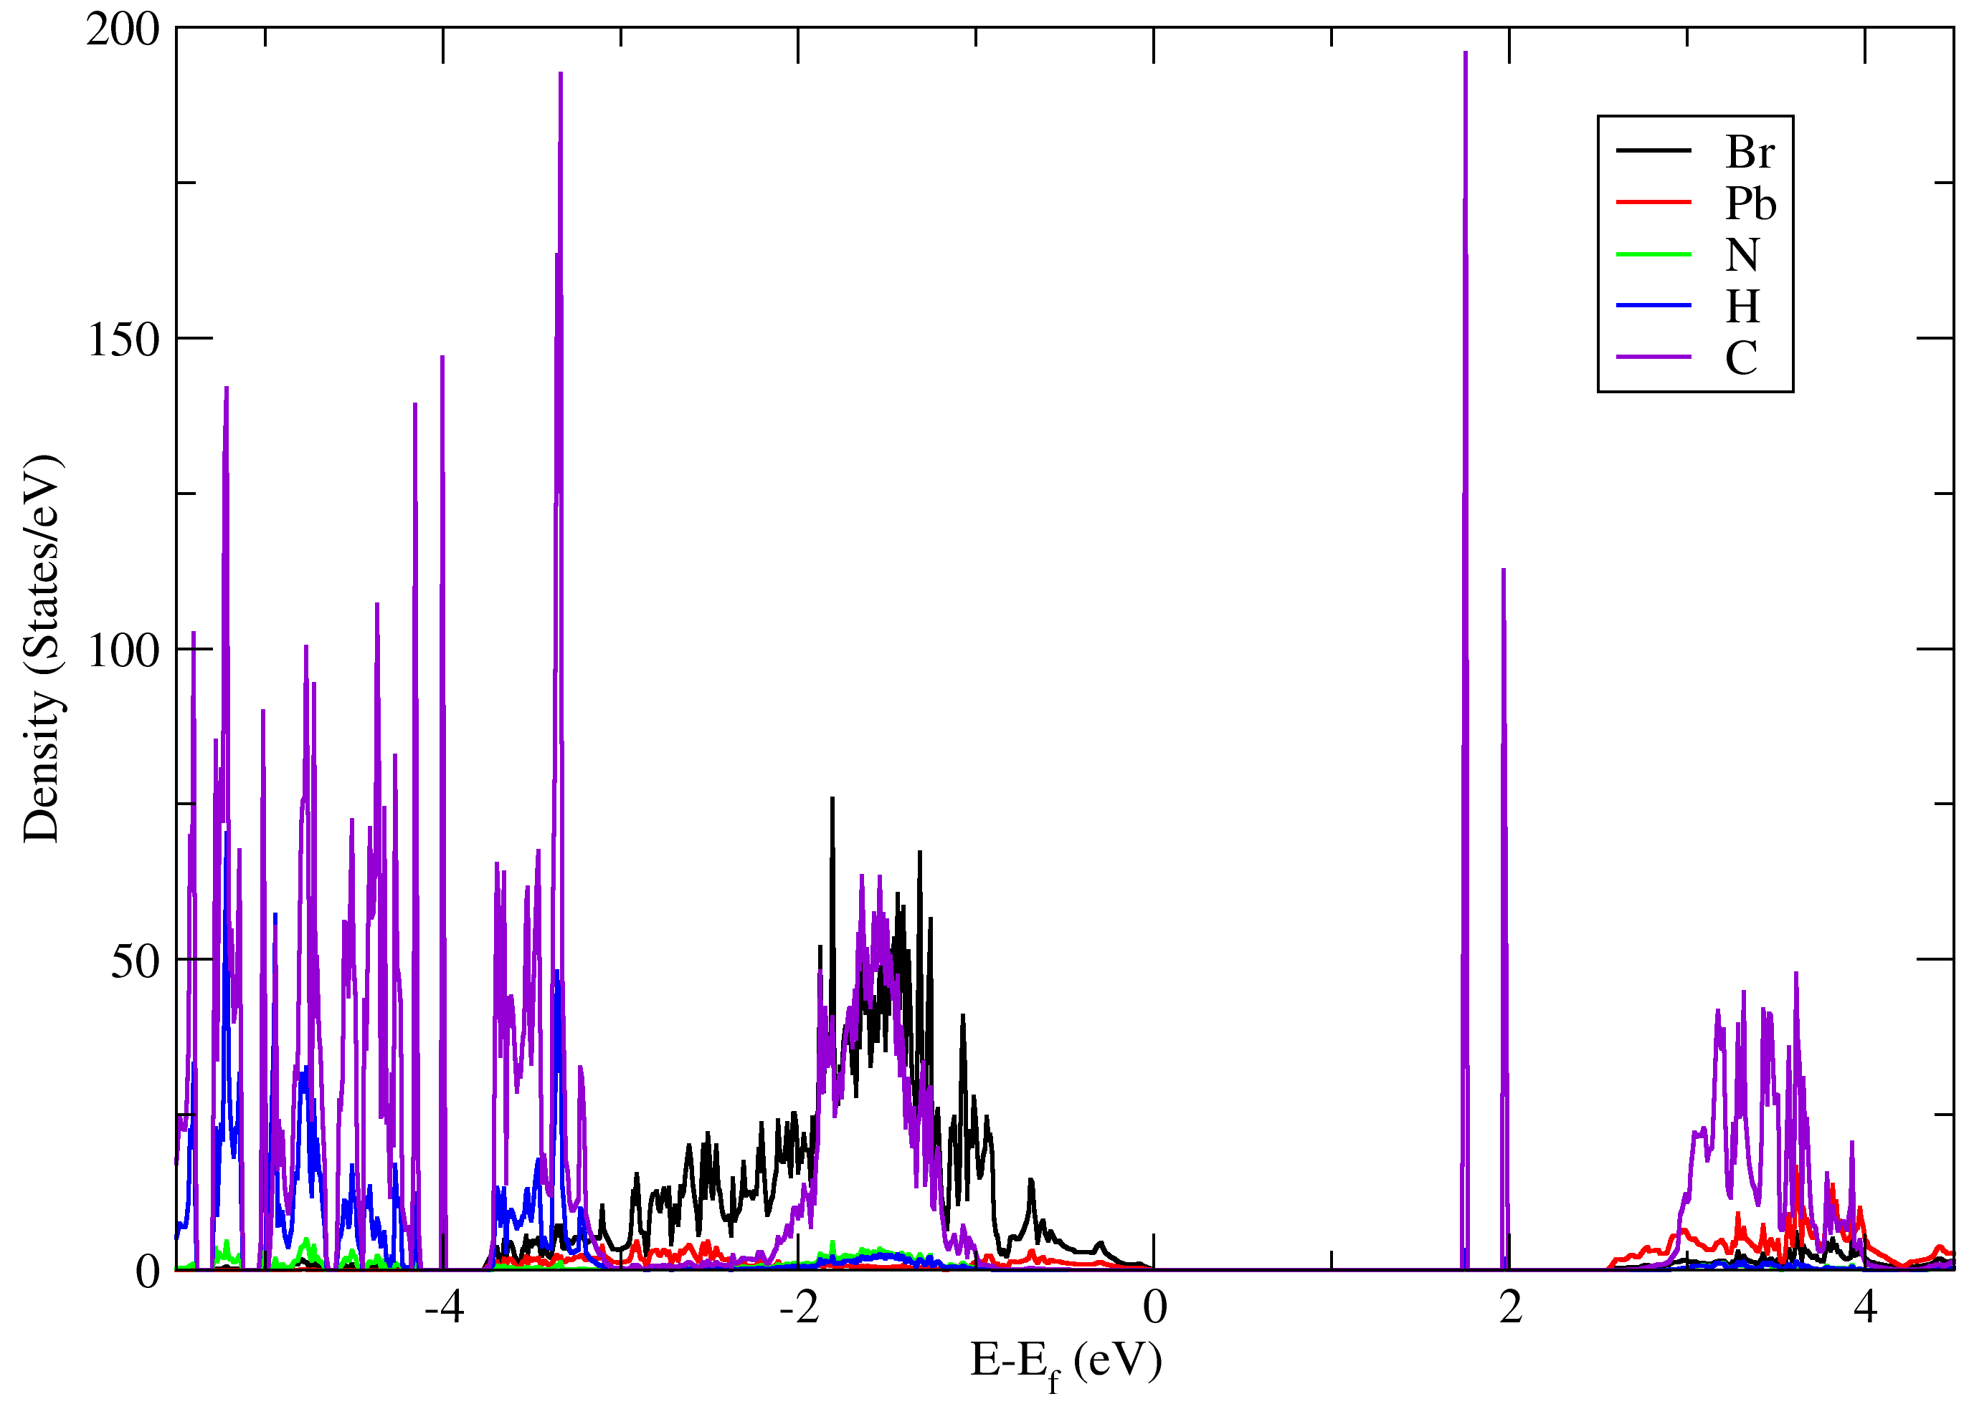
Band and atom-resolved dos plot (dipole correction) of bilayer 2D ${\left(Benzylammonium\right)}_{2}PbBr_{4}$

Slide 18
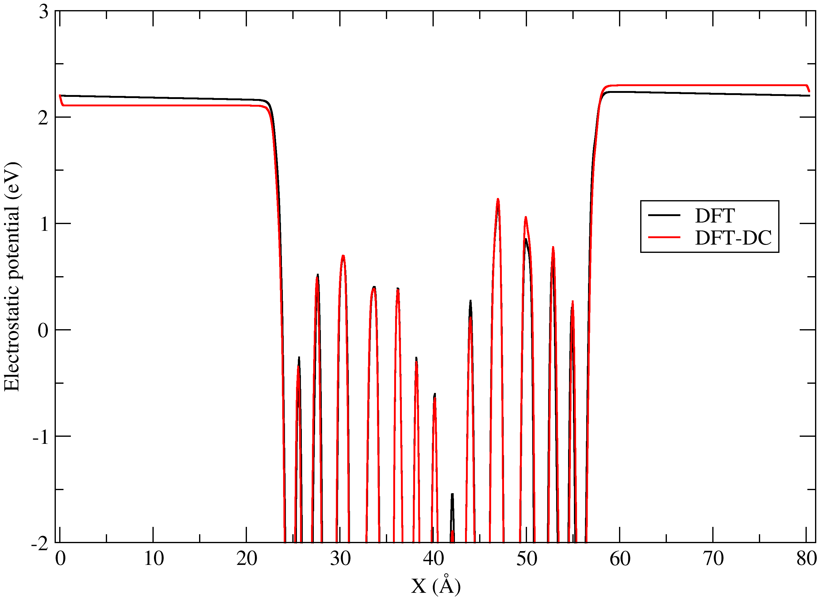
Comparison of Potential Profile of 2D ${\left(Benzylammonium\right)}_{2}PbBr_{4}$ Perovskite

Slide 19
Future Prospects
Future directions:
AFM will be used to quantify nanosheet thickness
Raman spectroscopy and TEM will provide insight into phonon modes, crystallinity, and structural integrity
SHG will be performed to probe the nonlinear optical properties and emission characteristics of these materials
Second-order susceptibility will be calculated theoretically to complement the experimental findings
Future work will extend these investigations to chloride and iodide analogues

Slide 20
AI in 2D Perovskite-Based Nonlinear Optics
Current Challenges:
Thickness-dependent optical nonlinearity
Limited high-throughput prediction of second-order susceptibility $χ^{2}$
AI/ML:
AI-driven deep learning enables automated, accurate identification of mono- and bilayers from microscopy images, streamlining flake isolation without damage (Yu Saito et al., 2019)
Machine learning models trained on computational 2D materials databases (C2DB) have predicted second-order susceptibility χ², accelerating nonlinear material screening (Haastrup et al., 2018)
Notes:
The nonlinear optical response is highly sensitive to the number of layers. Isolating mono- and bilayers without damaging the sample or altering its structure presents a fabrication and reproducibility challenge.
This allows rapid computational screening to identify promising candidate materials without performing full DFT/BSE calculations.

Slide 21
Summary
Mechanical exfoliation technique was used to exfoliate the bulk crystals to few-layered nanosheets.
Characterization techniques like XRD, and EDS/SEM confirmed the crystal structure, elemental composition, and morphology, verifying the high quality and purity of the sample.
Electronic properties were explored through band structure analysis and density of states.
Atom- and orbital-resolved density of states revealed the contributions from lead and halide orbitals.
The additional band(s) near 2 eV in the monolayer and bilayer originated from surface carbon atoms.

Slide 22
Acknowledgments
Special thanks to:
Dr. Tula R. Paudel
Dr. Steve Smith
Dr. Alexey Lipatov and his lab
Mr. Khimananda Acharya

Slide 25
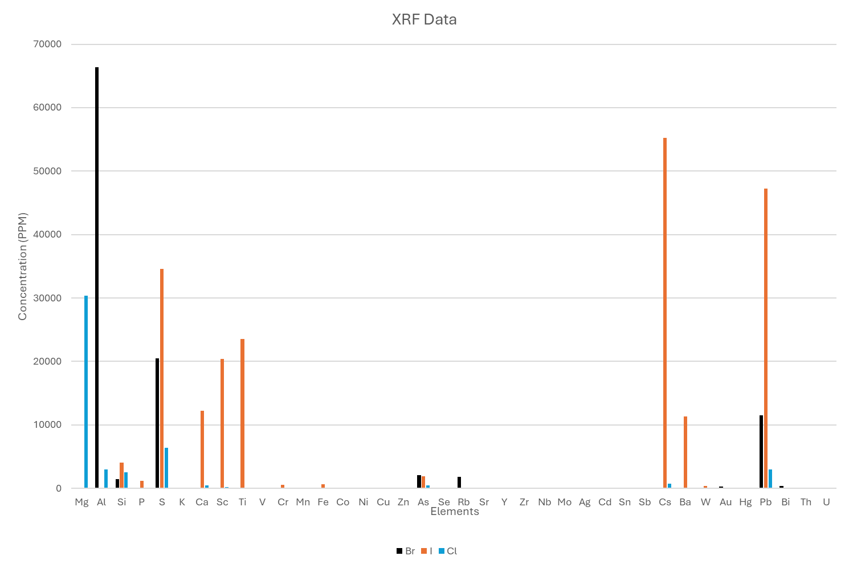
XRF

Slide 26
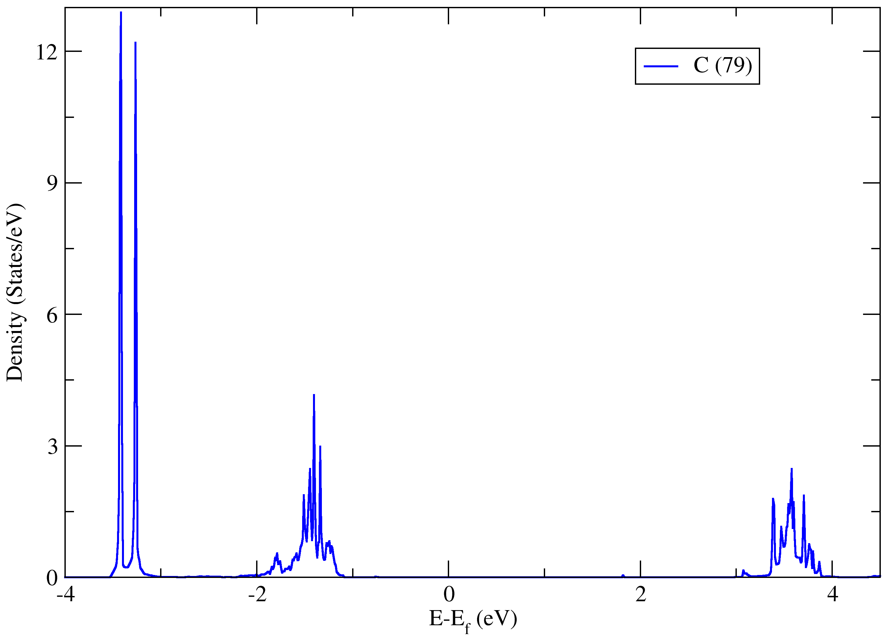
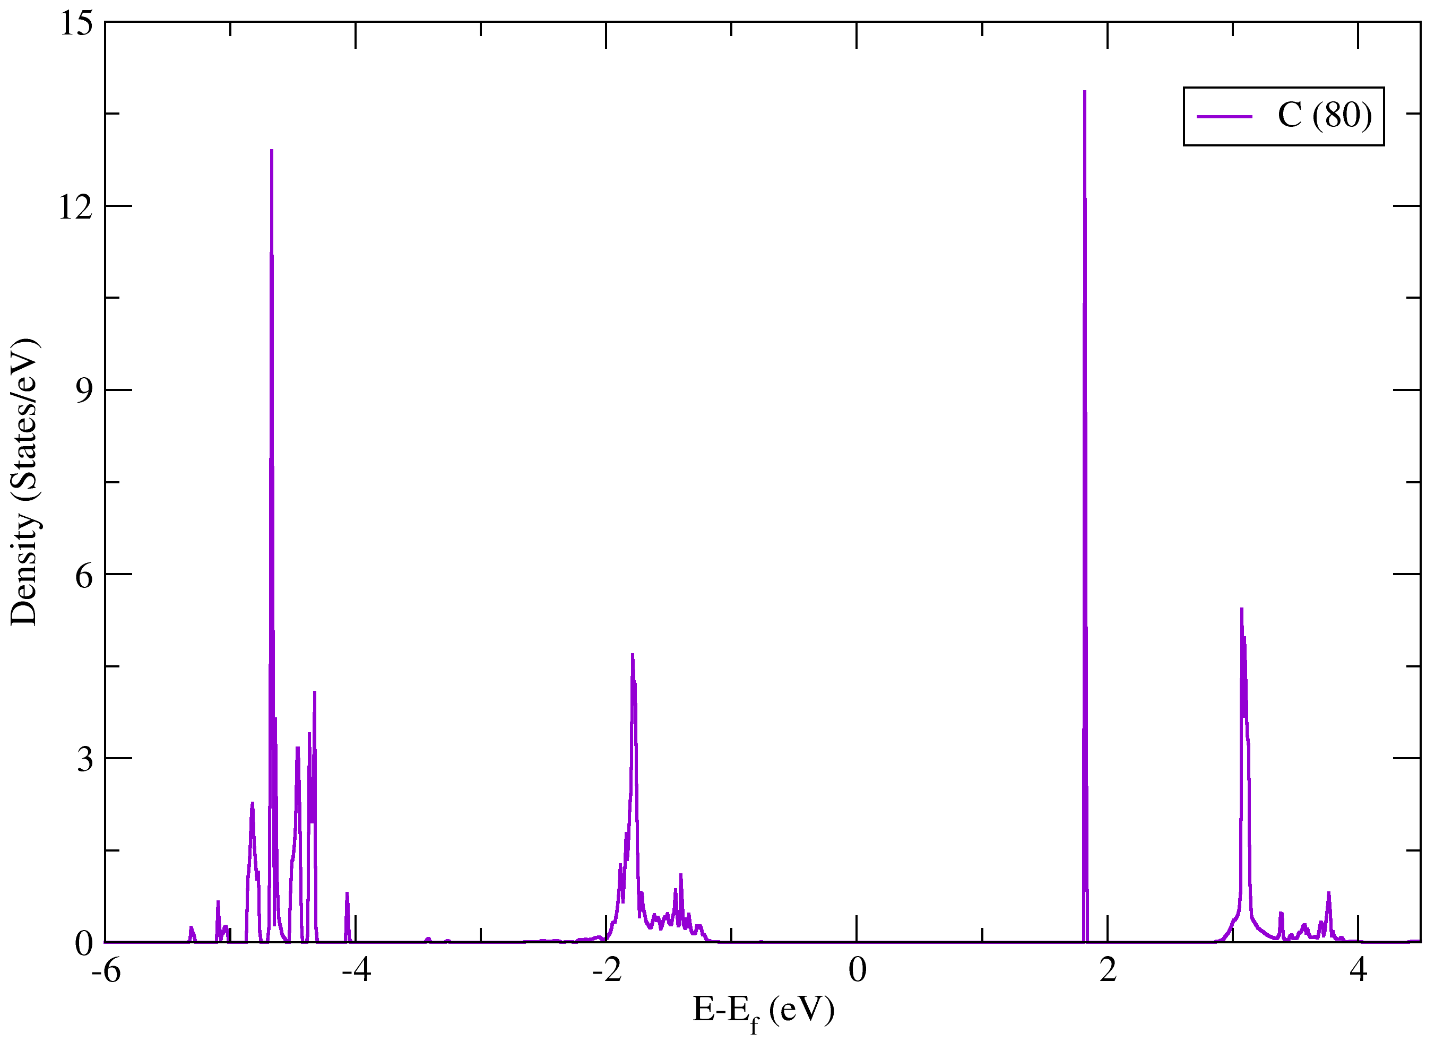
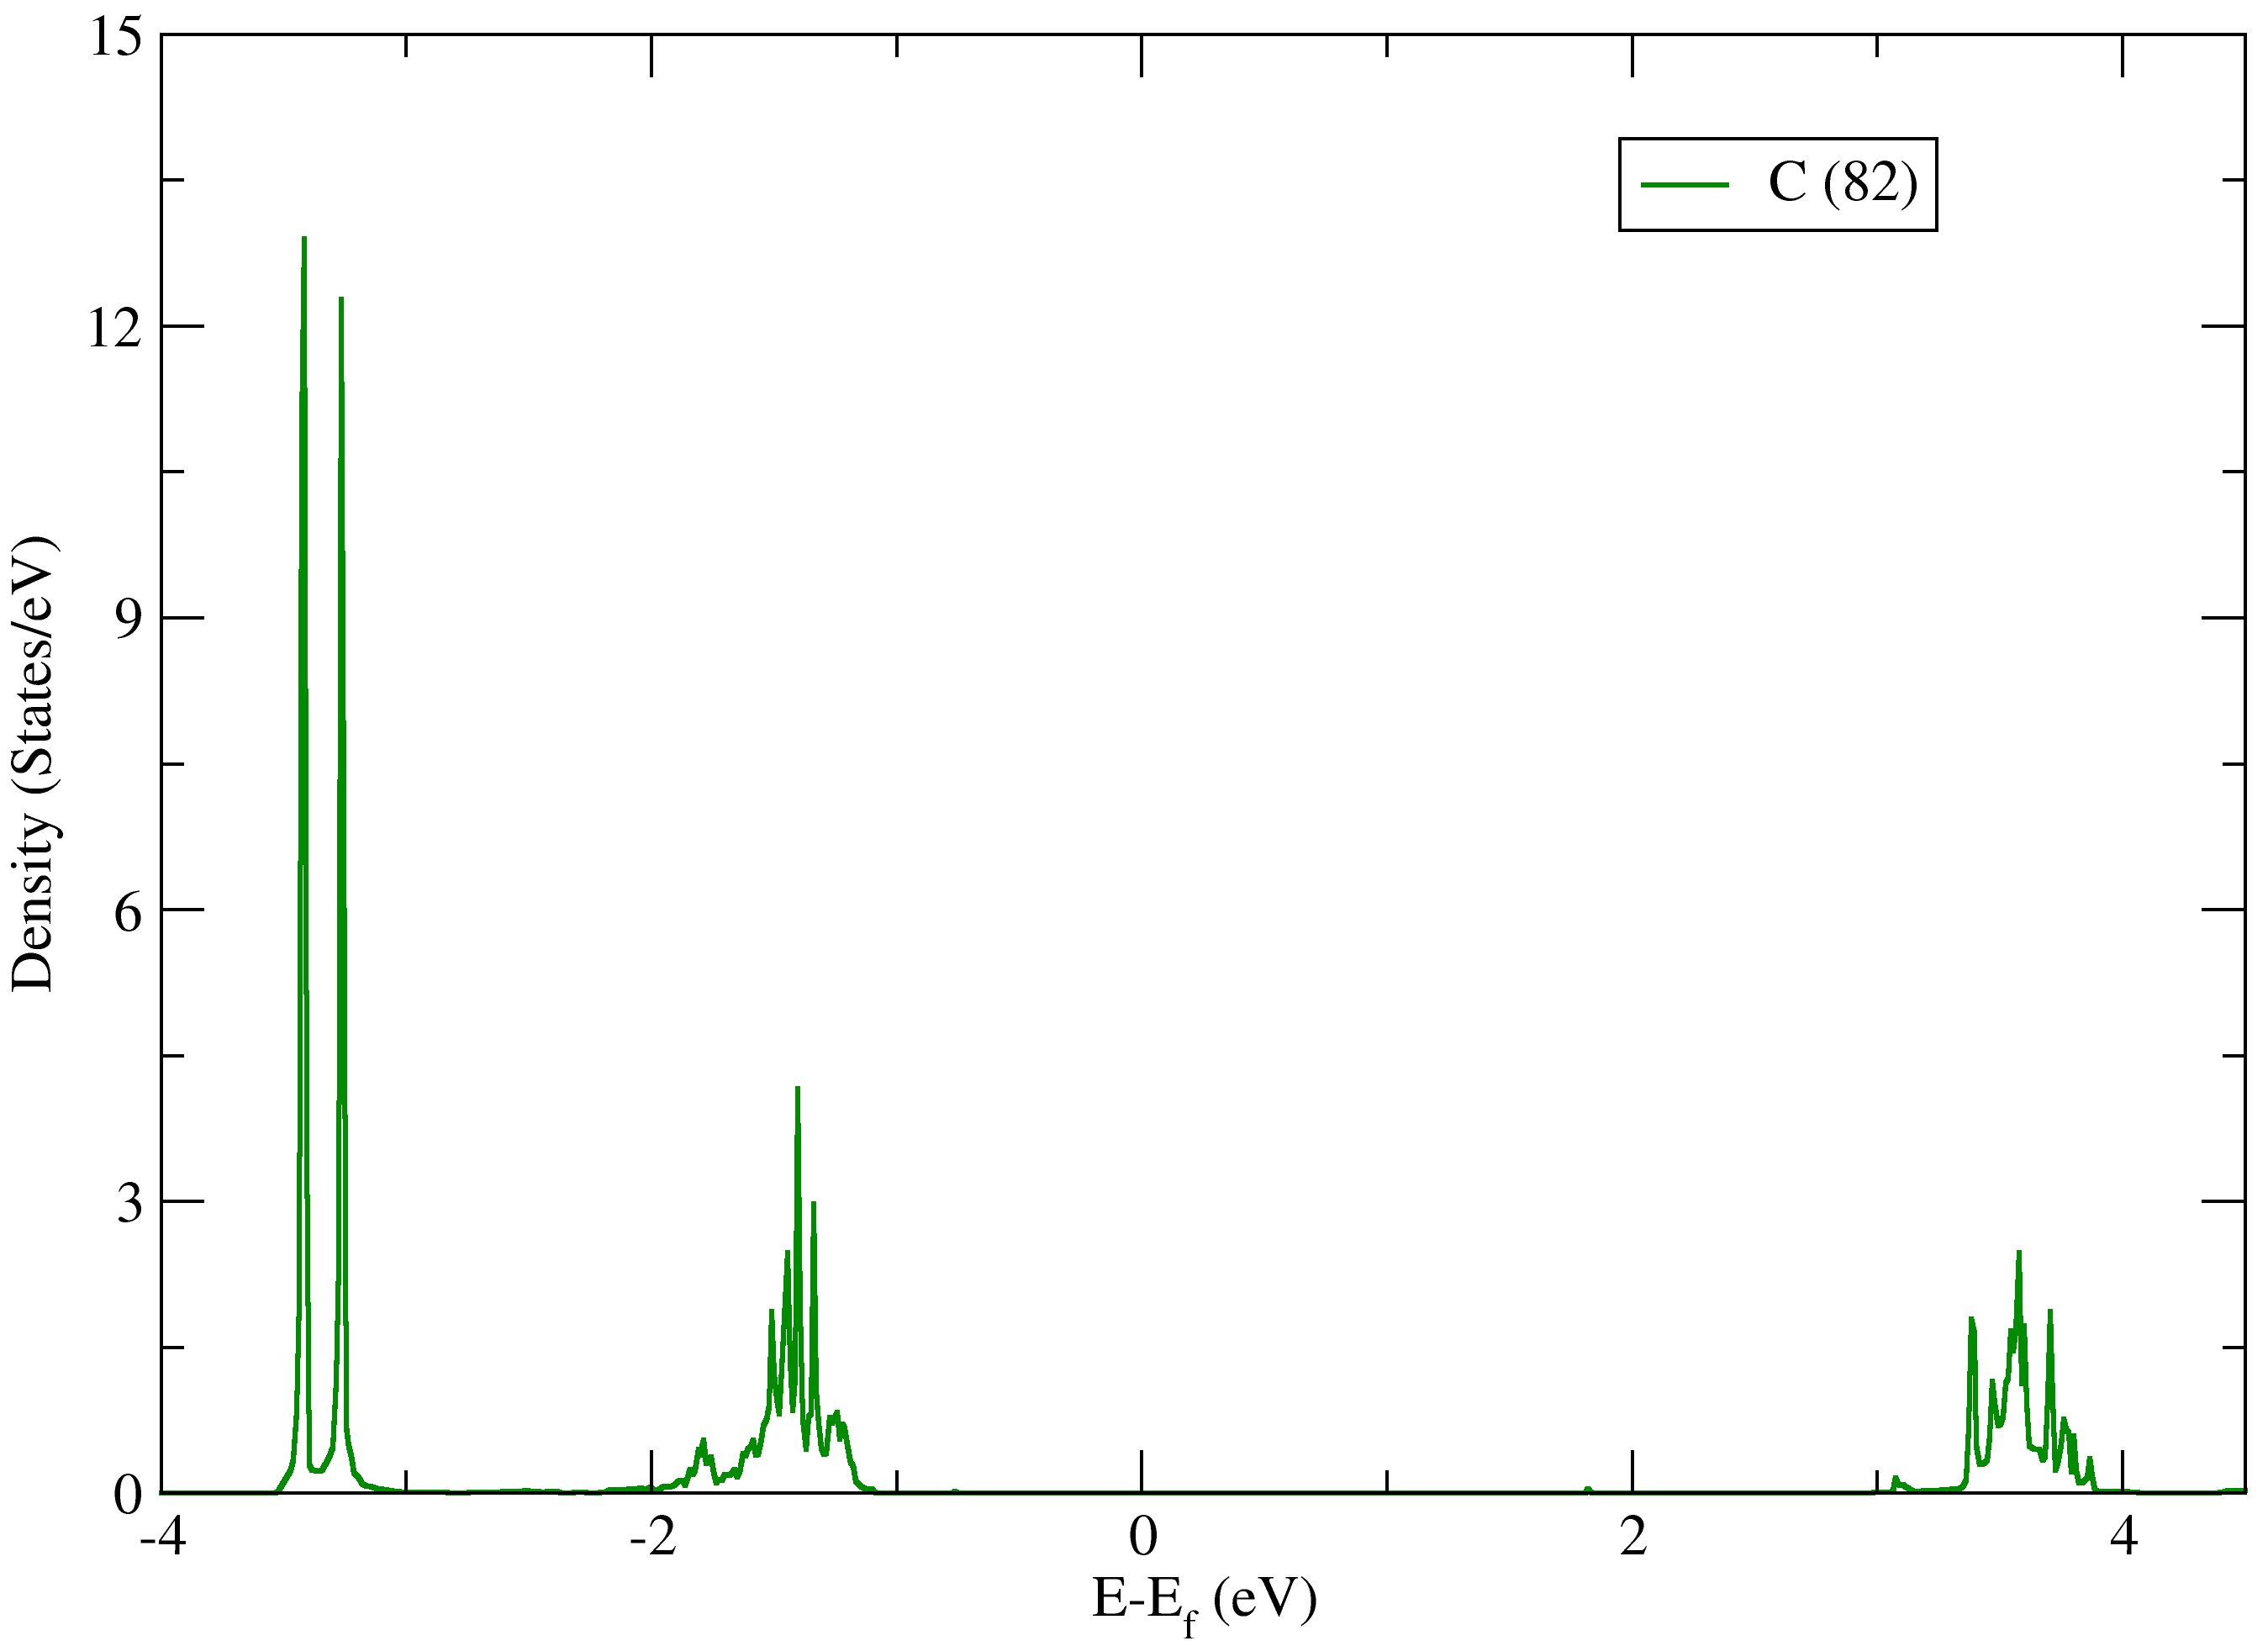
Dos plot of C-atom of monolayer 2D ${\left(Benzylammonium\right)}_{2}PbBr_{4}$

