Slide 1

Understanding Reaction Mechanisms of Ammonia Synthesis through the Combination of Deep Reinforcement Learning and Density Functional Theory
Qi An
Department of Materials Science and Engineering, Iowa State University
Workshop for AI-Powered Materials Discovery at Great Plains
June 23, 2025

Slide 2
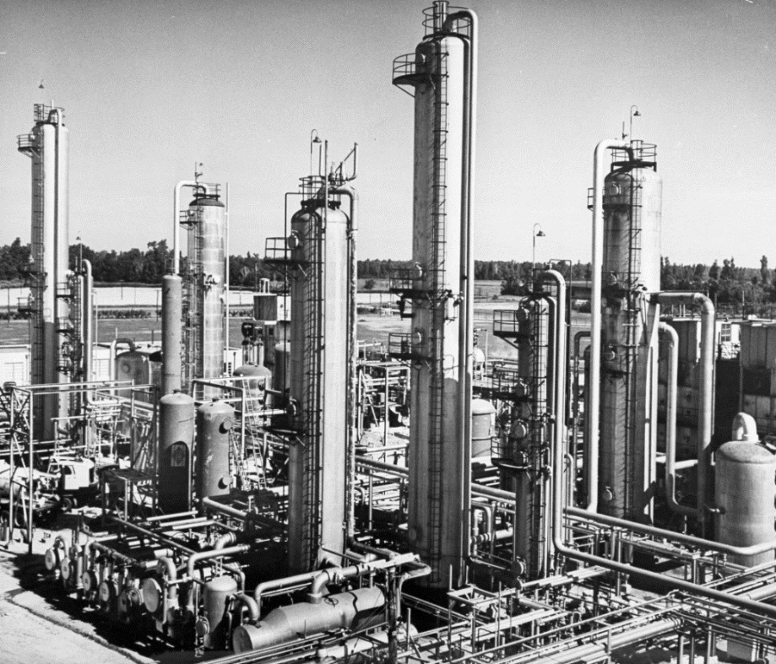
Ammonia Synthesis (Haber–Bosch Reaction)
Haber Bosch = main industrial procedure for the production of ammonia, thus fertilizers →it feeds billions of people.
Ammonia may be used as an energy vector to replace fossil fuels in the future.
Annual production:40 million tons/year
Temperature: 500-600 ˚C
Pressure: 50-200 bar
Catalyst: metal nano-particles: α-Fe (BCC mostly 111), Ru (stepped 0001 most efficient, not used due to cost & environment) –promoter: alkali, especially K
high temperature, pressure to get efficiency → 2% world energy → can we IMPROVE it ?
Ertl, G., Knözinger, H., Weitkamp, J. Handbook of Heterogeneous Catalysis; VCH: Weinheim, 2008.

Slide 3
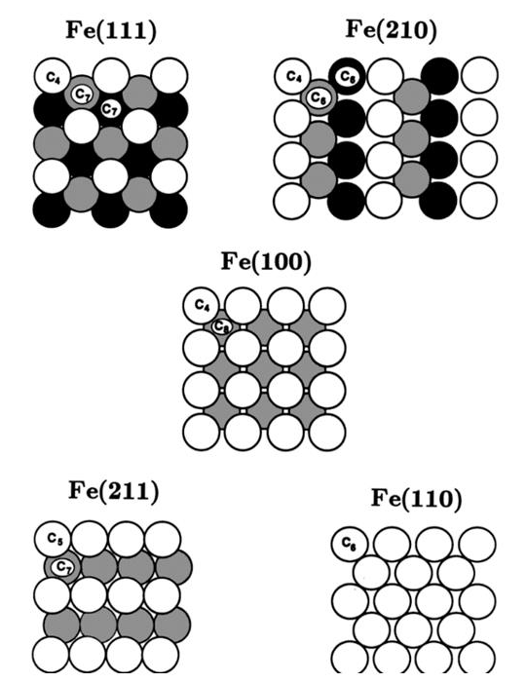
Catalytic Performance of Fe in Haber–Bosch Reaction
Fe(111) and Fe(211) are the most active surfaces for HB reactions.¹
Theoretical studies have been performed to understand the HB reaction mechanism on Fe(111) and Fe(211) surfaces.^{2,3}
[1] D. R. Strongin, J. Carrazza, S. R. Bare, and G. A. Somorjai, J. Catal, 103, 213 (1987). [2] J. Qian, et al. J. Am. Chem. Soc. 140 (20), 6288-6297 (2018). [3] J. Fuller, et al. Phys. Chem. Chem. Phys. 21, 11444-11454 (2019).
3

Slide 4
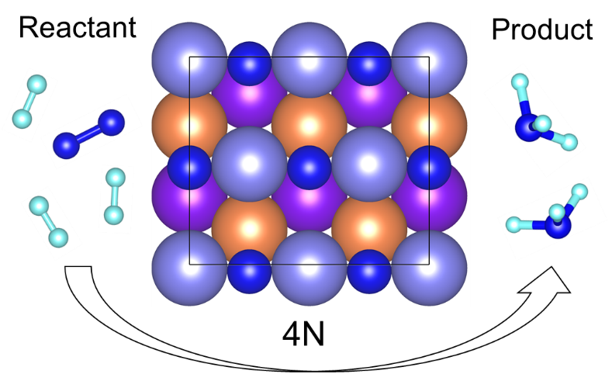
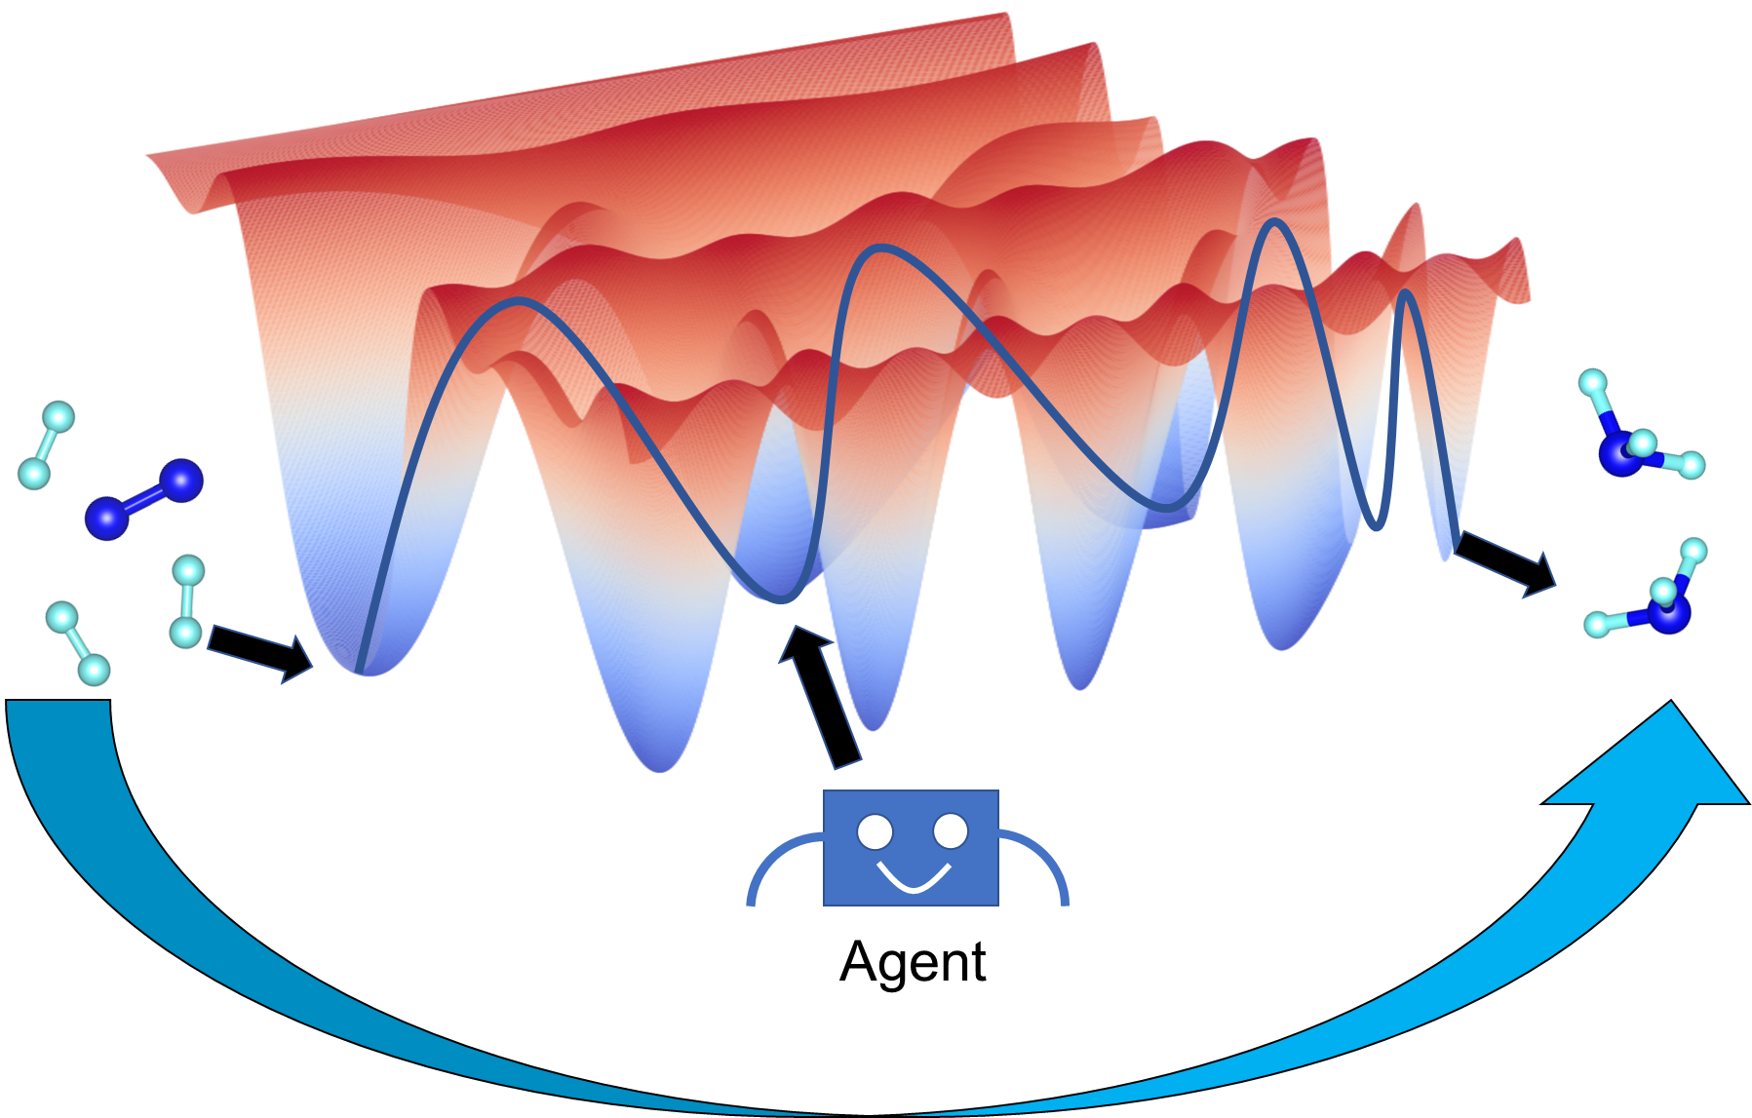
Research Goal: Understand the Reaction Mechanism
Understanding the reaction mechanism of HB on Fe catalyst under realistic conditions from modeling and simulations.
It is crucial to understand the mechanisms for developing reaction-mechanism-based methods to design promising alloys elements for HB reactions.
Reaction mechanism?
AI-aid automatic search?
4

Slide 5
Modeling and Simulation Tools
2 nm
5

Slide 6
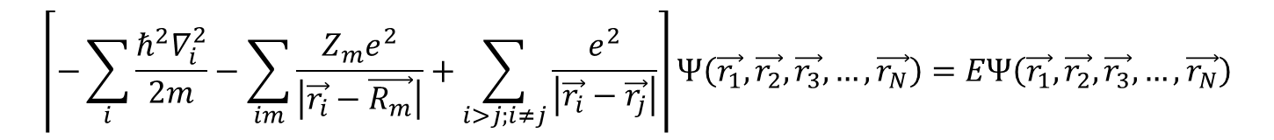
Simulating Reaction Mechanism using Density Functional Theory
Density functional theory:
Born–Oppenheimer approximation:
$$\left\lceil −\sum_{i}{\frac{{ℏ^{2}∇}_{i}^{2}}{2m}}−\sum_{im}{\frac{Z_{m}e^{2}}{\left|\vec{r_{i}}−\vec{R_{m}}\right|}+\sum_{i>j;i≠j}{\frac{e^{2}}{\left|\vec{r_{i}}−\vec{r_{j}}\right|}}}\right\rceil Ψ\left(\vec{r_{1}},\vec{r_{2}},\vec{r_{3}},…,\vec{r_{N}}\right)=EΨ\left(\vec{r_{1}},\vec{r_{2}},\vec{r_{3}},…,\vec{r_{N}}\right)$$
Kohn-Sham (KS) equations (based on DFT):
V_{H}: Hartree (Coulomb) energy; V_{ext}: external potential
V_{xc}: Exchange-correlation energy, local.
Solution of KS equations yield charge density and ground state energy, from which key information for reactions (e.g. intermediate states, transition state, reaction barriers, reaction network) can be obtained.

Slide 7
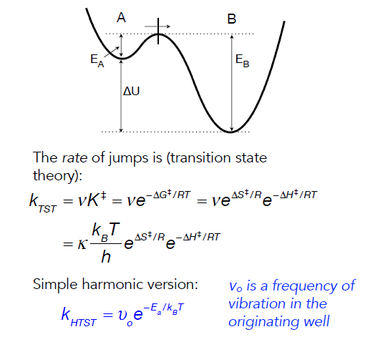
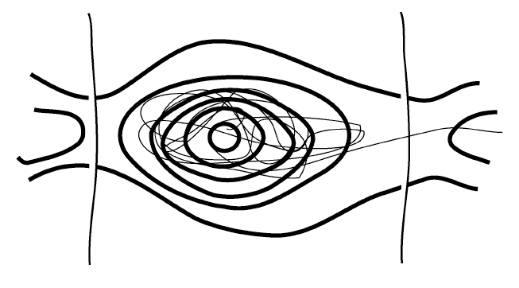
Simulating Kinetics using Kinetic Monte Carlo
Events occur that take the system from one state to another with a well-defined rate.

Slide 8
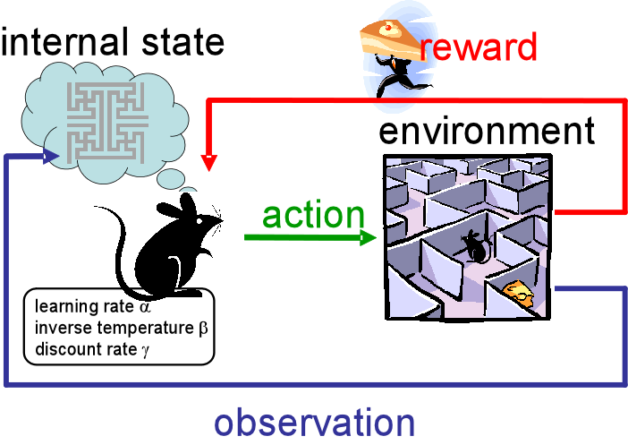
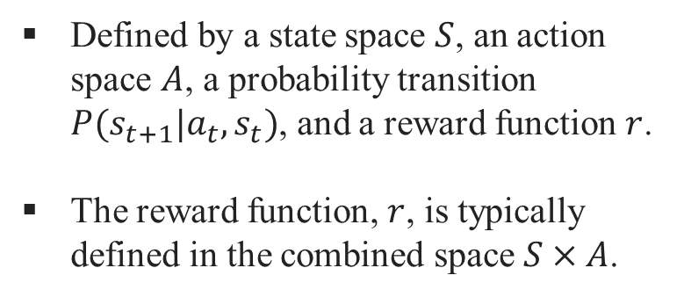
Reinforcement Learning
Markov decision process:
Defined by a state space $S$, an action space $A$, a probability transition $P(s_{t+1}|a_{t},s_{t})$, and a reward function $r$.
The reward function, $r$, is typically defined in the combined space $S×A$.
RL is a machine learning technique that teaches agents how to make decisions to achieve a goal by interacting with an environment.
https://becominghuman.ai/the-very-basics-of-reinforcement-learning-154f28a79071

Slide 9
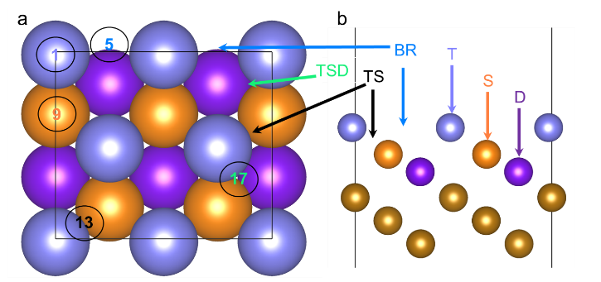
Reaction Mechanism on Fe(111) surface
2 nm
9

Slide 10
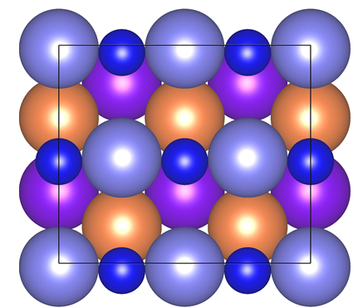
Fe bcc(111) Surface (2x2) Unit Cell with High Coverage N Adsorption (1ML)
T = 110 K
Atomic N
PhysRevLett.53.850
N atom
N2 on Fe(111)
4N configuration
The steady-state reaction has the high N coverage, and we consider constructing the reaction path from 4N configuration.
M. Grunze, et al. Phys. Rev. Lett. 53, 850 (2014).
10

Slide 11
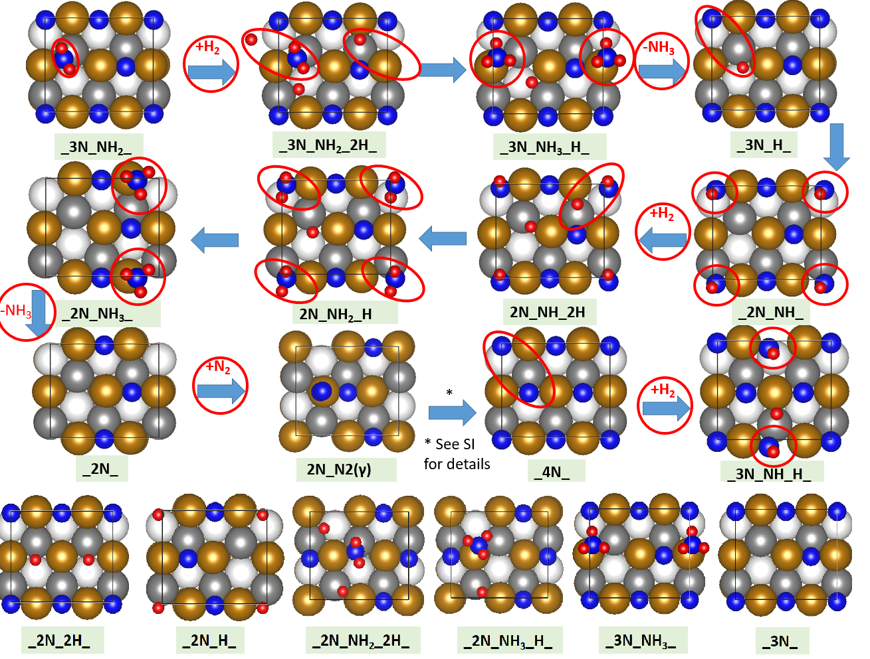
Predicted HB Reaction Network from DFT and Chemical Intuition
Proposed reaction mechanism from DFT
N₂ absorption and dissociation steps
J Qian, Q. An, A. Fortunelli, R.J. Nielsen,W.A. Goddard III, J. Am. Chem. Soc. 140, 6288 (2018).
11

Slide 12
Energy Landscape under Condition of 673 K, 20 atm (P_{NH3}=1.5 torr)
Rate determining step
H
2N.2H configuration
Important reaction steps:
N₂ adsorption (1.57 eV).
H migration (NH₃ formation from NH₂) (1.52 eV or 1.47 eV).
NH₃ desorption (1.42 eV).
J Qian, Q. An, A. Fortunelli, R.J. Nielsen,W.A. Goddard III, J. Am. Chem. Soc. 140, 6288 (2018).
12

Slide 13
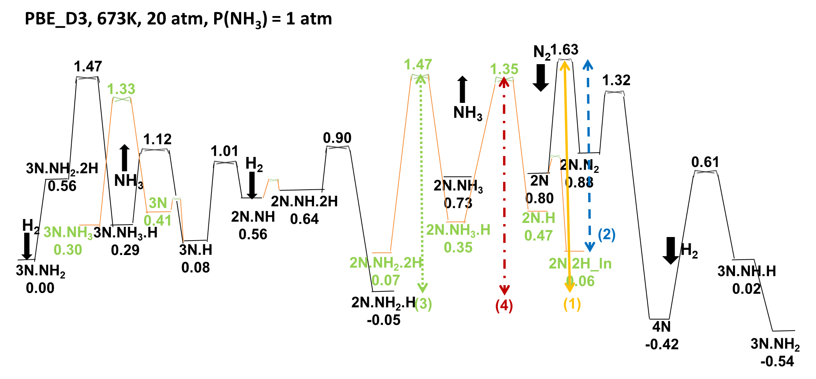
Energy Landscape under Condition of 673K, 20atm (P_{NH3}=1.0 atm)
Rate determining step
Changing the NH₃ pressure will modify the resting (reference) state from the 2N.2H to 2N.NH₂.H.
The major reaction steps remain the same as the low NH₃ pressure.
J Qian, Q. An, A. Fortunelli, R.J. Nielsen,W.A. Goddard III, J. Am. Chem. Soc. 140, 6288 (2018).
13

Slide 14
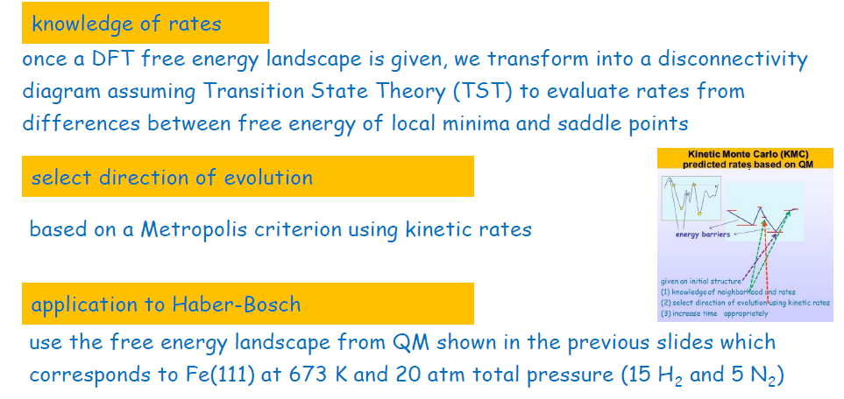
kMC Model to Predict Reaction Rate (based on DFT Barriers)
J Qian, Q. An, A. Fortunelli, R.J. Nielsen,W.A. Goddard III, J. Am. Chem. Soc. 140, 6288 (2018).
14

Slide 15
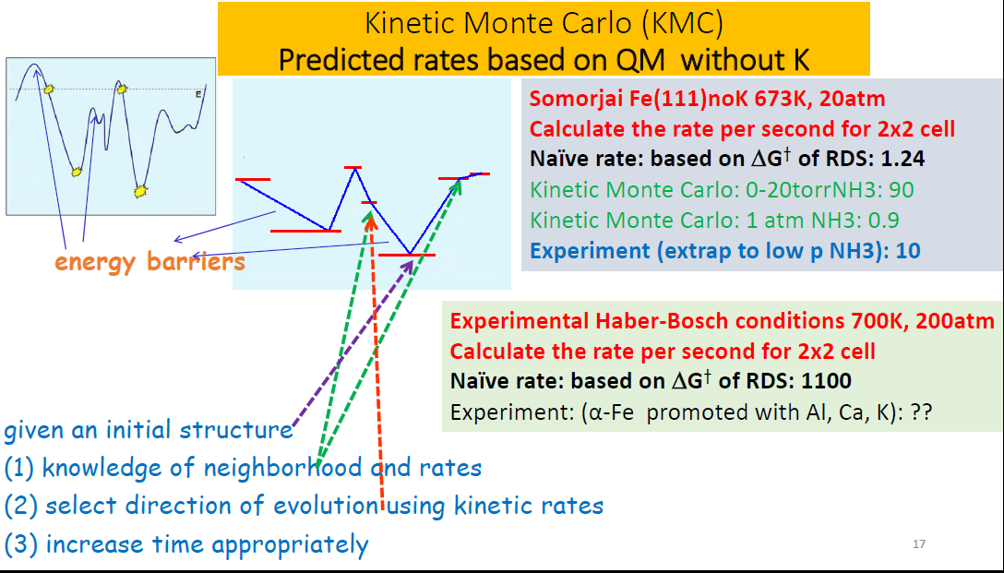
Apply kMC model to Predict Reaction Rate
15

Slide 16
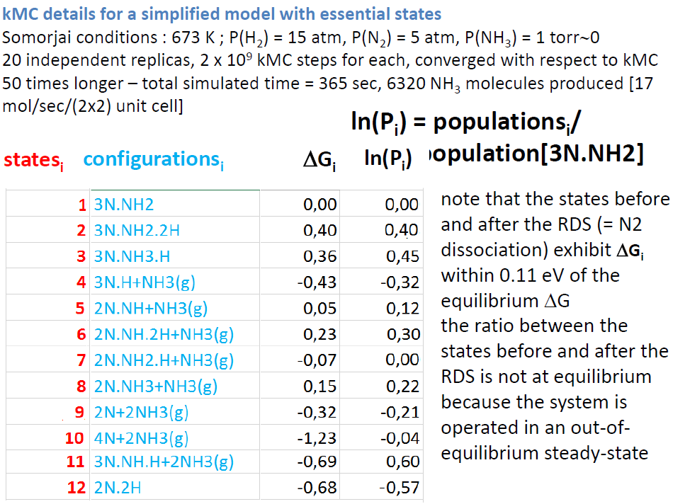
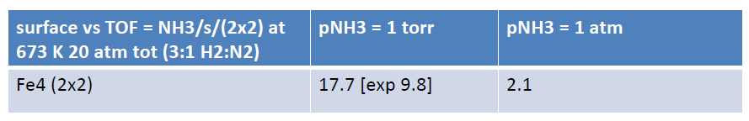
kMC Details and Results
16

Slide 17

RL-Aid Exploration of Reaction Mechanisms
Challenges:
Complexity of multi-step reactions
Short-lived intermediates
Dynamic and heterogeneous nature of many catalytic reactions
2 nm
17

Slide 18
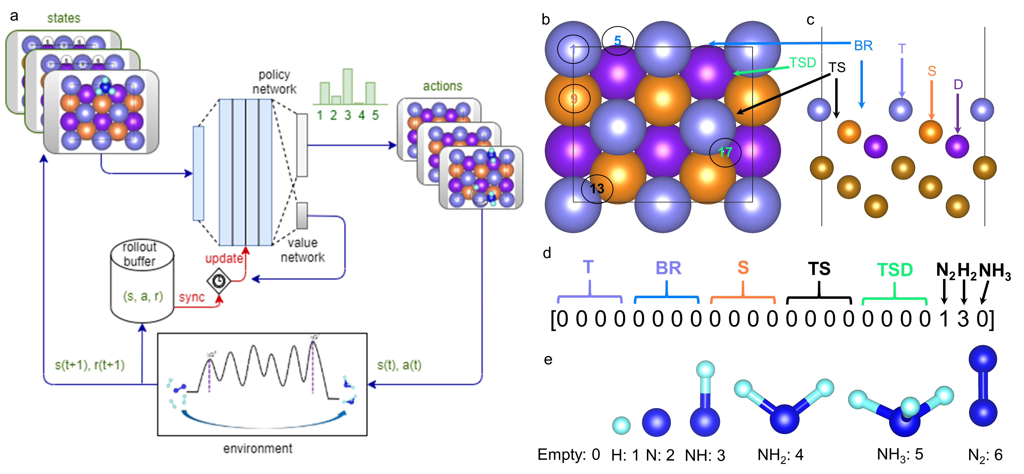
Exploring Reaction Mechanism of HB on Fe(111) Using RL
RL framework to build the full reaction network based on the various known states and barriers.
T. Lan, and Q. An., Journal of the American Chemical Society 143 (40), 16804-16812 (2021).
18

Slide 19
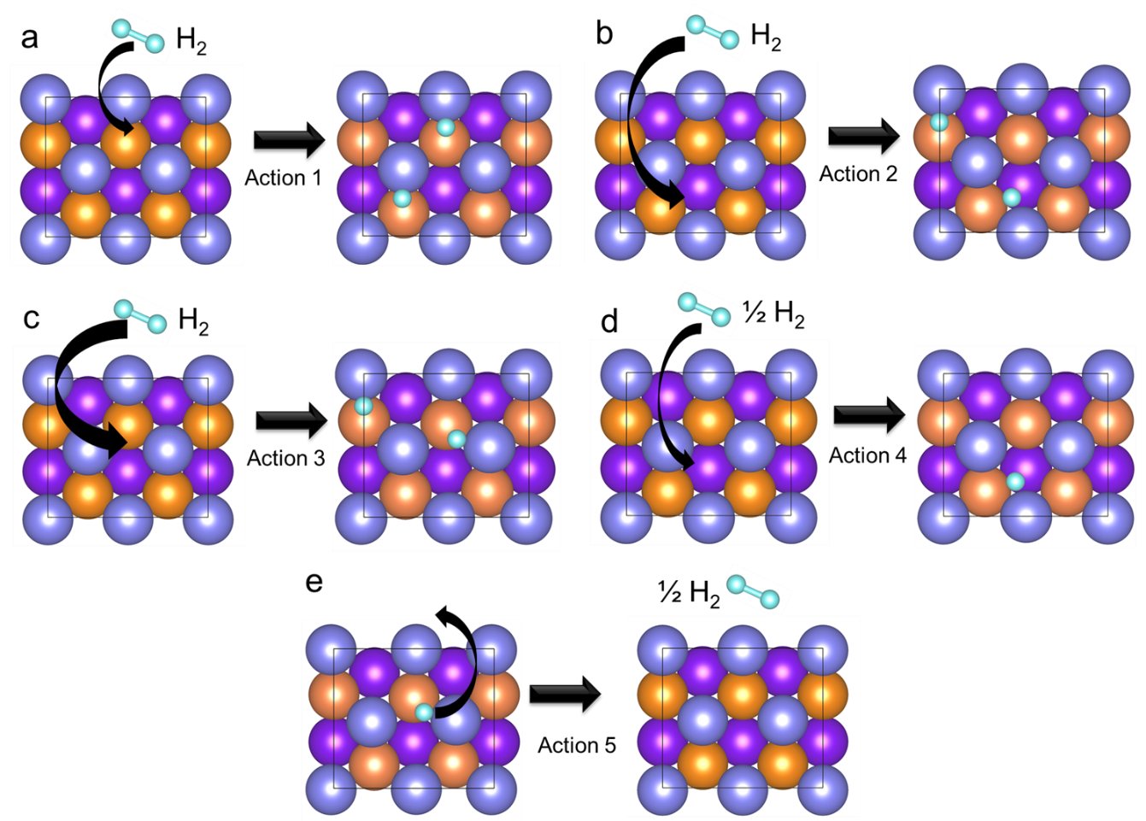
Actions Definition in the RL Framework (H₂ Adsorption/Desorption)
All H₂ related process are considered on high N coverage (not shown)
The free energy barrier for this action is obtained from high N coverage surface
T. Lan, and Q. An., Journal of the American Chemical Society 143 (40), 16804-16812 (2021).
19

Slide 20
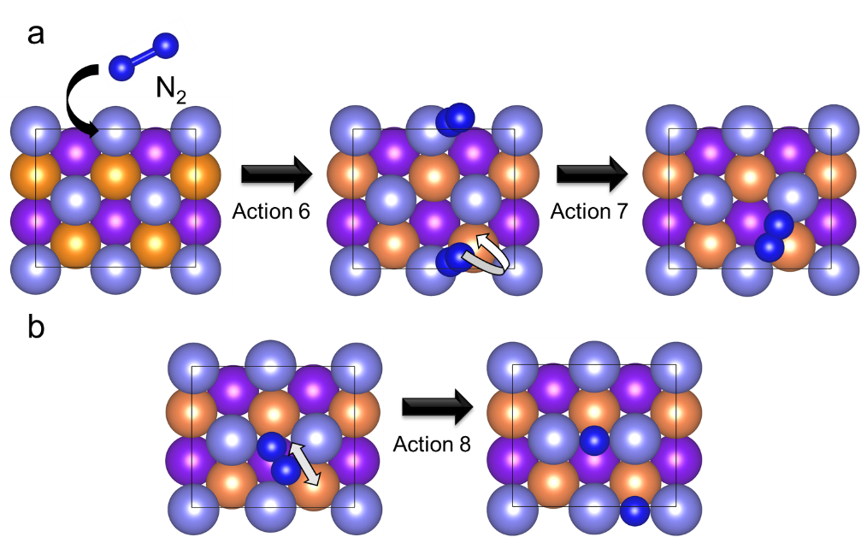
Actions Definition in the RL Framework (N₂ Adsorption/Dissociation )
This process involves various N2 states on the Fe(111) surface (high N coverage, but N was not shown).
T. Lan, and Q. An., Journal of the American Chemical Society 143 (40), 16804-16812 (2021).
20

Slide 21
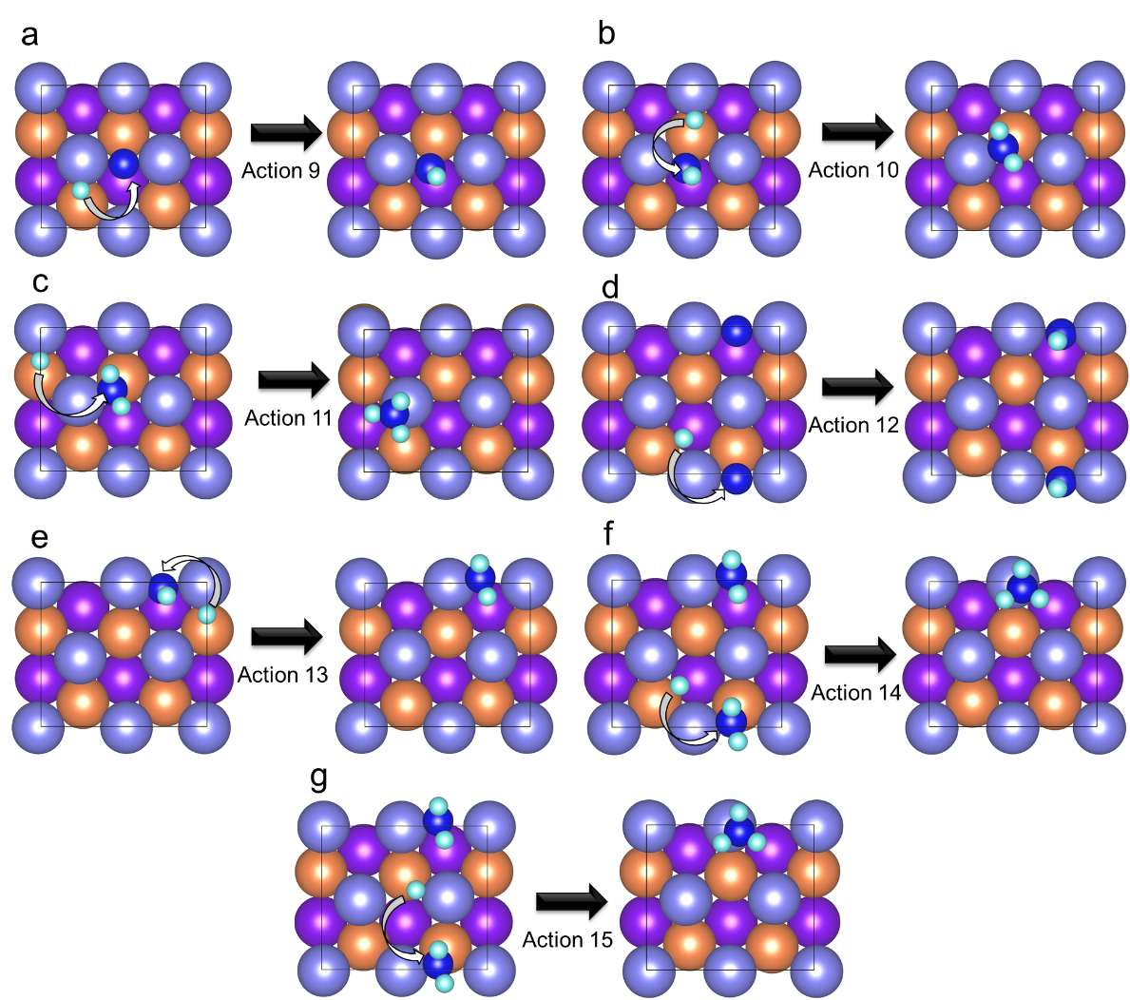
Actions Definition in the RL Framework (H migration)
All the H migration process is considered in Fe(111) surface (high N converge, N is not shown).
These involves NH, NH₂, NH₃ formation at various places.
T. Lan, and Q. An., Journal of the American Chemical Society 143 (40), 16804-16812 (2021).
21

Slide 22
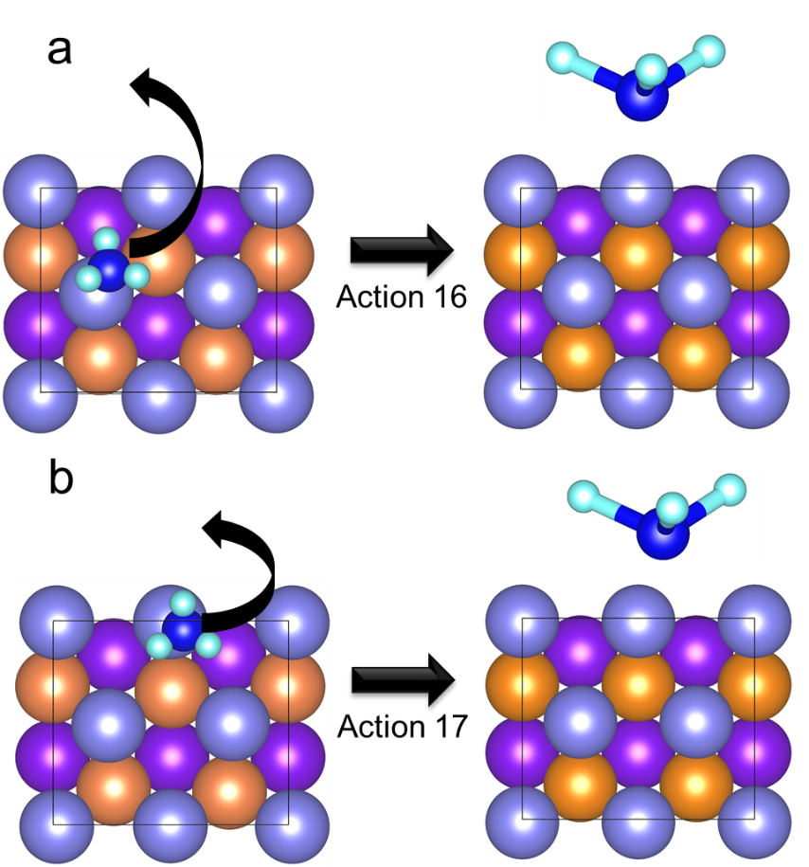
Actions Definition in the RL Framework (NH₃ desorption )
T. Lan, and Q. An., Journal of the American Chemical Society 143 (40), 16804-16812 (2021).
22

Slide 23
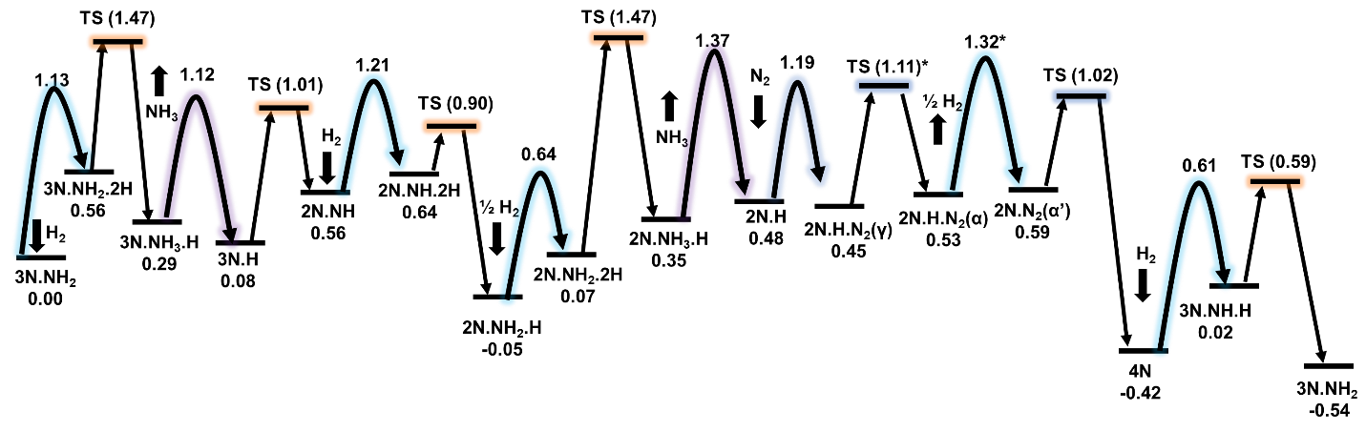
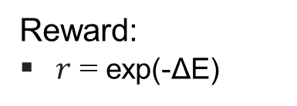
Reward System for RL
Reward:
$r$ = exp(-ΔE)
we assign a uniform reward of 0.1 for cases in which the surface species is repelled by a neighbor absorbent.
A negative reward is assigned if obvious obstacles prevent the action, such as removing absorbent from empty sites and adding species into an occupied site.
Resting States
T. Lan, and Q. An., Journal of the American Chemical Society 143 (40), 16804-16812 (2021).
23

Slide 24
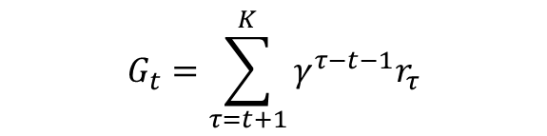
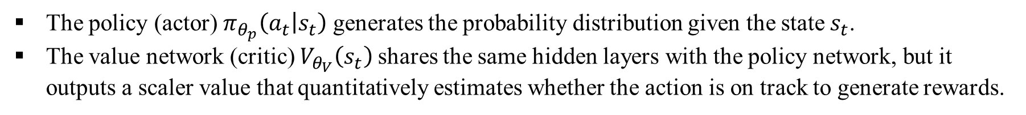
Value and Policy in RL
Value and Policy Networks:
The policy (actor) $π_{θ_{p}}\left(a_{t} | s_{t}\right)$generates the probability distribution given the state $s_{t}$.
The value network (critic) $V_{θ_{V}}\left(s_{t}\right)$shares the same hidden layers with the policy network, but it outputs a scaler value that quantitatively estimates whether the action is on track to generate rewards.
$$G_{t}=\sum_{τ=t+1}^{K}{γ^{τ−t−1}r_{τ}}$$
To update $θ_{p}$, policy gradients (PG) are taken according to the direction given by
$$PG= \left(G_{t}−V_{θ_{V}}\left(s_{t}\right)\right)∇_{θ_{P}}logπ_{θ_{p}}\left(a_{t} | s_{t}\right)$$
T. Lan, and Q. An., Journal of the American Chemical Society 143 (40), 16804-16812 (2021).
24

Slide 25
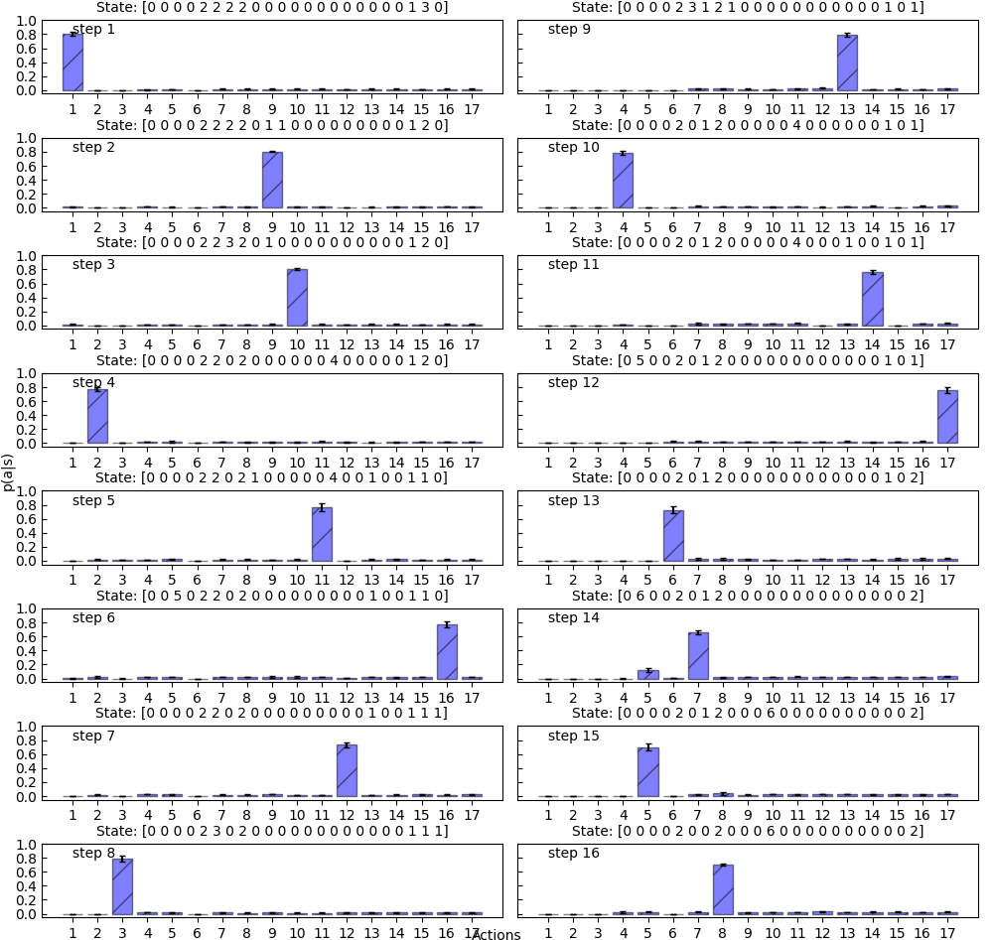
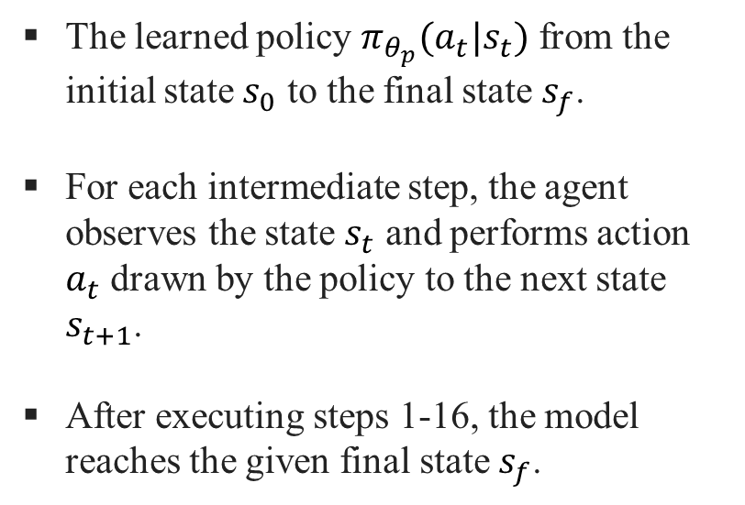
The Learned Policy from Reactant to Product
The learned policy $π_{θ_{p}}(a_{t}|s_{t})$ from the initial state $s_{0}$ to the final state $s_{f}$.
For each intermediate step, the agent observes the state $s_{t}$ and performs action $a_{t}$ drawn by the policy to the next state $s_{t+1}$.
After executing steps 1-16, the model reaches the given final state $s_{f}$.
T. Lan, and Q. An., Journal of the American Chemical Society 143 (40), 16804-16812 (2021).
25

Slide 26

Predicted Reaction Paths using RL
The major difference between this reaction mechanism and previous study is the H desorption on 2N.H configuration.
In the previous study, it was suggested that the H was desorbed before the N₂ adsorption.
However, the deep RL model suggests the opposite: The H will be desorbed after the adsorbed N₂ migrates from the top site to the sublayer site.
T. Lan, and Q. An., Journal of the American Chemical Society 143 (40), 16804-16812 (2021).
26

Slide 27
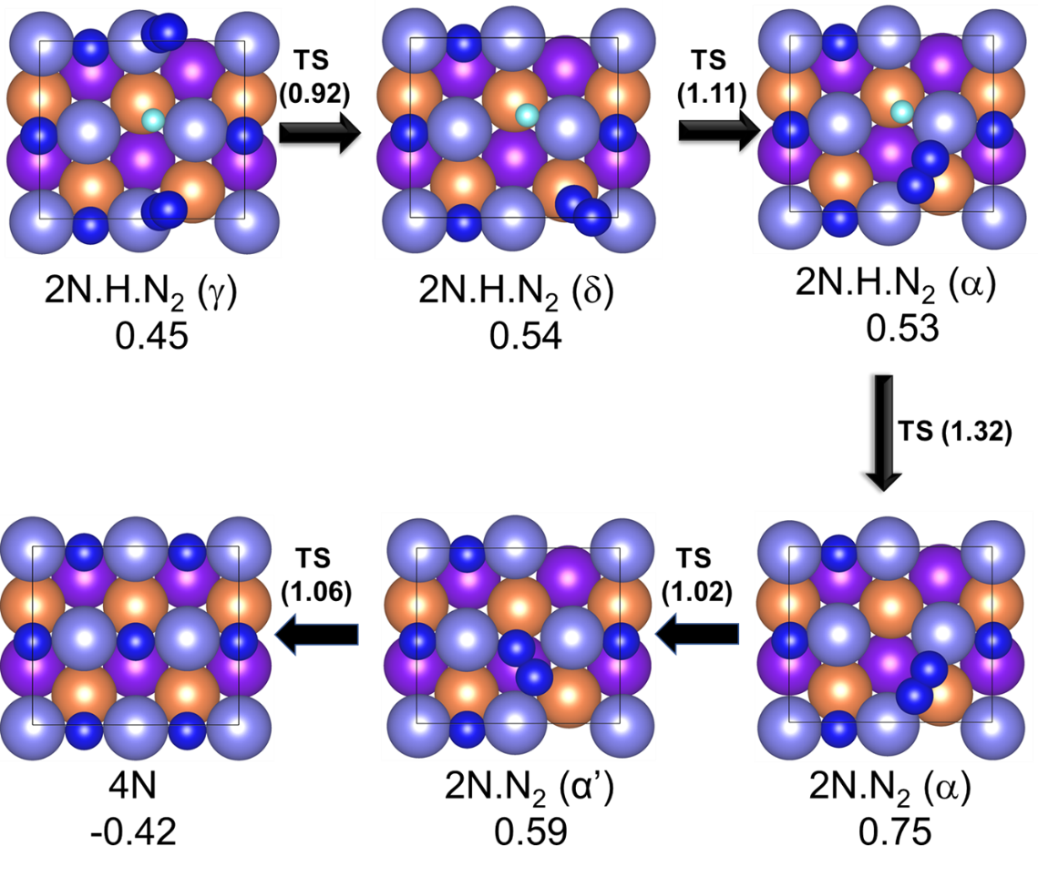
Detailed Reaction Paths of N₂ dissociation.
The number in each configuration corresponds to the free energy at T = 673 K and P(N₂, H₂, NH₃) = (5, 15, 1) atm using the 3N.NH₂ as the reference state.
T. Lan, and Q. An., Journal of the American Chemical Society 143 (40), 16804-16812 (2021).
27

Slide 28
Free Energy Landscape of the DRL-derived Reaction Network
T = 673 K, P=20atm (P_{NH3}=1.0 atm)
The N₂ desorption barrier is significantly reduced compared to our previous work.
Now the rate-determined steps becomes hydrogenation process of NH₂.
T. Lan, and Q. An., Journal of the American Chemical Society 143, 16804-16812 (2021).
28

Slide 29
Challenges with This RL Framework
Potential energy landscape (PEL) of chemical systems is characterized by strong nonconvexity, high noise, and high dimensionality.
This framework primarily focuses on modeling the environment with a semi-empirical representation based on specific chemical reactions.
It does not offer a transferable solution since it tends to be applicable to a specific reaction and requires a considerable amount of empirical design, hyperparameters tuning, and semi-empirical calculations.
The actions connecting states are defined in terms of some specific chemical reactions in which the atomic motion are not explicitly involved in these reactions.
T. Lan, and Q. An., Journal of the American Chemical Society 143, 16804-16812 (2021).
29

Slide 30
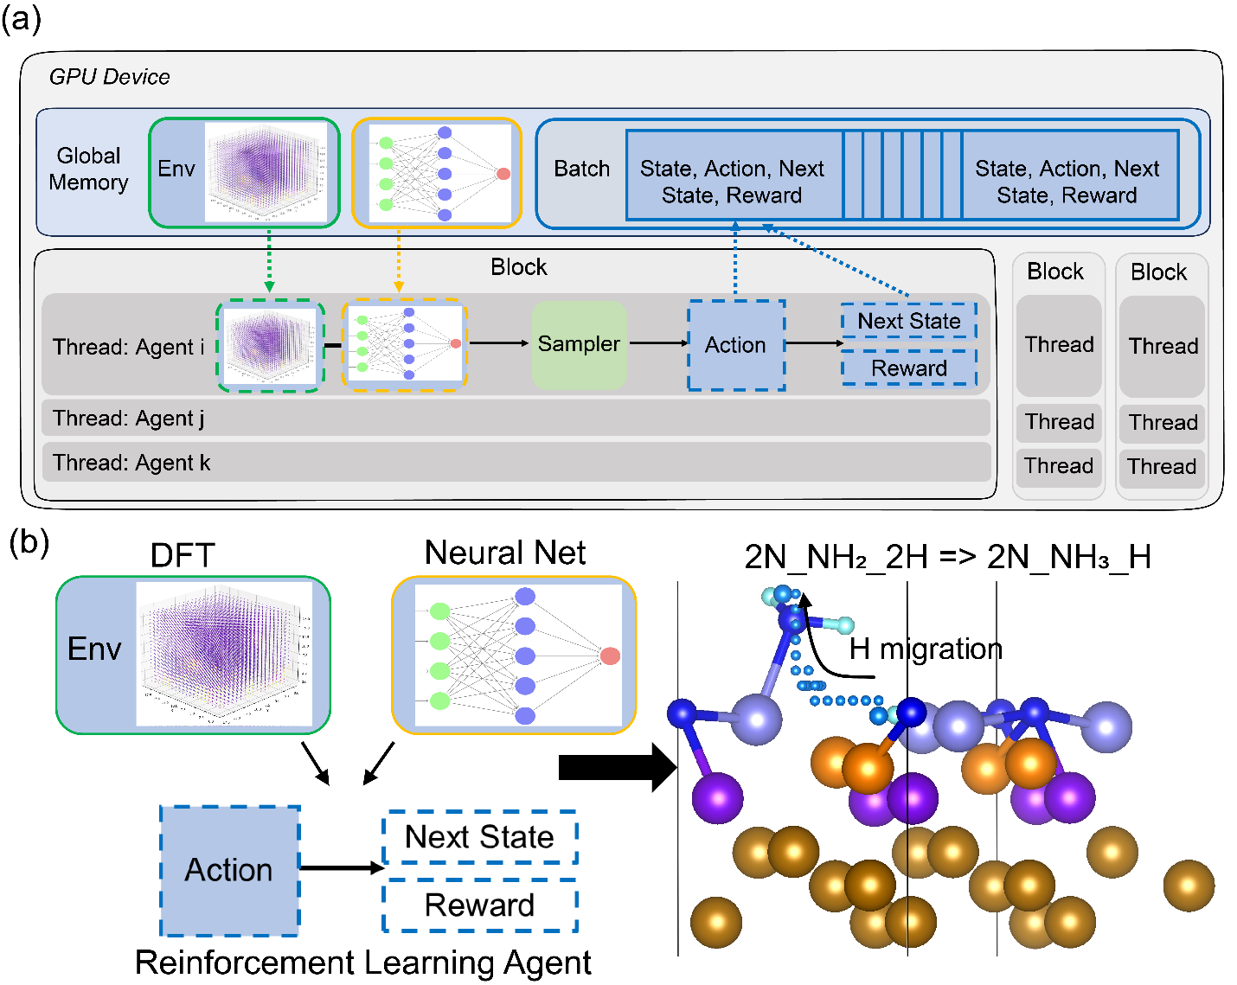
HT-RL Framework for Studying Reaction Mechanisms
High-Throughput reinforcement learning (RL) framework for studying hydrogenation reactions in ammonia synthesis on the Fe(111) surface.
A flow chart depicting the first-principles-instructed, high-throughput reinforcement learning framework used in the study of the hydrogenation reaction in ammonia synthesis on the Fe(111) surface.
Massive number of parallel agents diversify the exploration of environment into numerous uncorrelated regions, resulting in significant improvement of the training stability.
The target scientific questions to be addressed: the hydrogenation reaction of ammonia synthesis on Fe(111) surface.
T. Lan, H. Wang, and Q. An., Nature Communications 15 (1), 6281 (2024)
30

Slide 31
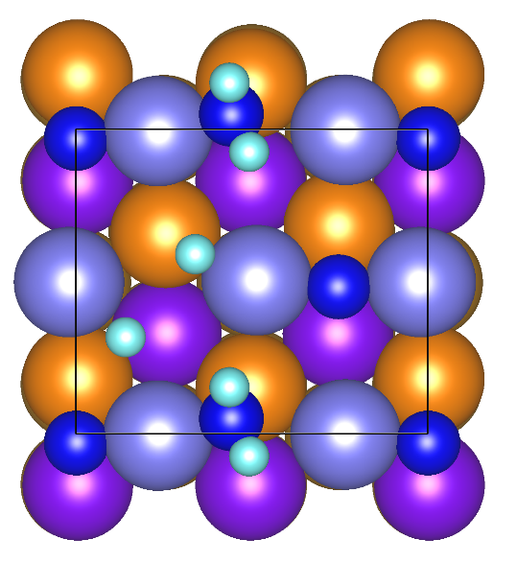
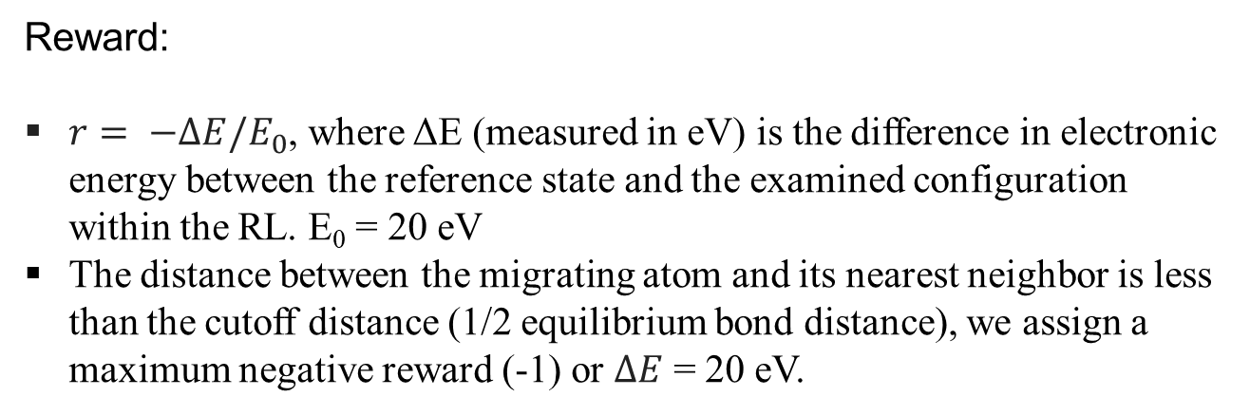
Action and Reward Systems for RL
Action Definition:
3D grid with dimensions 20 × 18 × 50 inside the simulation cell (8.01 × 6.94 × 20 Å³); grid spacing ~0.04 Å
Move atom (e.g. H) from one grid to neighboring grid: (1) forward, (2) backward, (3) up, (4) down, (5) left, and (6) right.
Action space (multi-atoms): (1) atom choice and (2) move direction (PBC applied to avid atom missing)
Reward:
$r= −∆E/E_{0}$, where ΔE (measured in eV) is the difference in electronic energy between the reference state and the examined configuration within the RL. E₀ = 20 eV
The distance between the migrating atom and its nearest neighbor is less than the cutoff distance (1/2 equilibrium bond distance), we assign a maximum negative reward (-1) or $∆E$ = 20 eV.
Reference state for the reaction:
H migration to NH₂ to form NH₃
T. Lan, H. Wang, and Q. An, Nature Communications 15 (1), 6281 (2024)
31

Slide 32
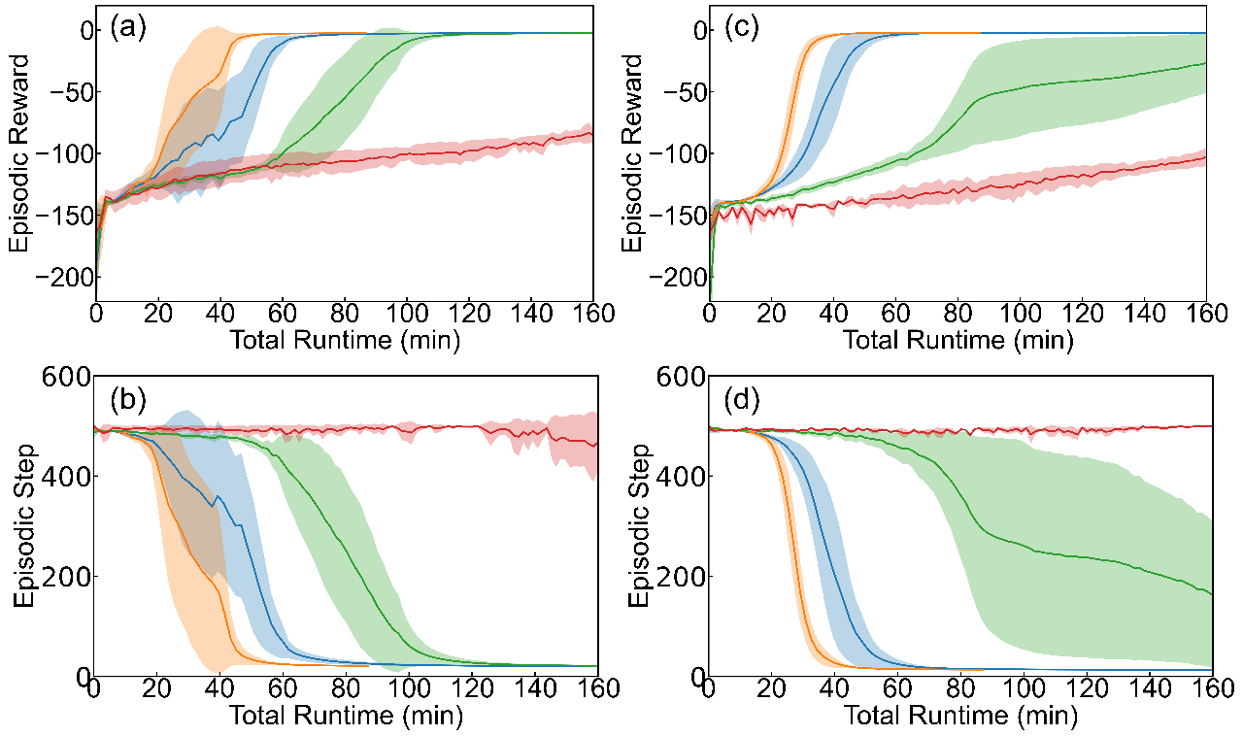
Convergence and Learning Speed
Target reaction
(a, b) Langmuir-Hinshelwood and Eley-Rideal (c, d) hydrogenation reaction of NH₂ to NH₃.
Different numbers of concurrent environment instances were used – n=4 in red, n=20 in green, n=100 in blue, and n=500 in yellow.
T. Lan, H. Wang, and Q. An, Nature Communications 15 (1), 6281 (2024)
32

Slide 33
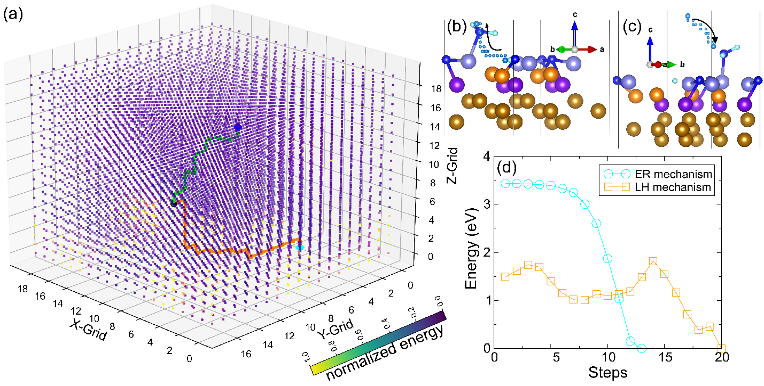
Exploring the Chemical Environment (H migration in 3-D)
Hydrogen migration pathways and potential energy landscape (PEL) on Fe(111) surface, differentiated by Langmuir-Hinshelwood (LH) and Eley-Rideal (ER) mechanisms.
T. Lan, H. Wang, and Q. An., Nature Communications 15 (1), 6281 (2024)
33

Slide 34
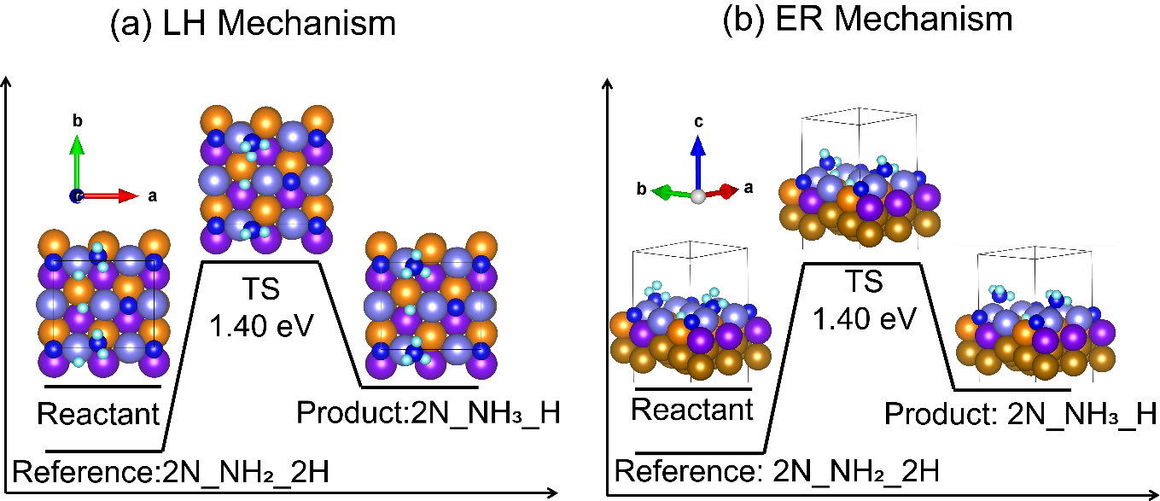
NEB Calculations Based on the RL Results
Overview of the transition-state analysis and energy alterations along the reaction pathway of hydrogen migration from 2N_NH₂_2H to 2N_NH₃_H based on reinforcement learning (RL)-guided nudged elastic band (NEB) simulations.
T. Lan, H. Wang, and Q. An., Nature Communications 15 (1), 6281 (2024)
34

Slide 35
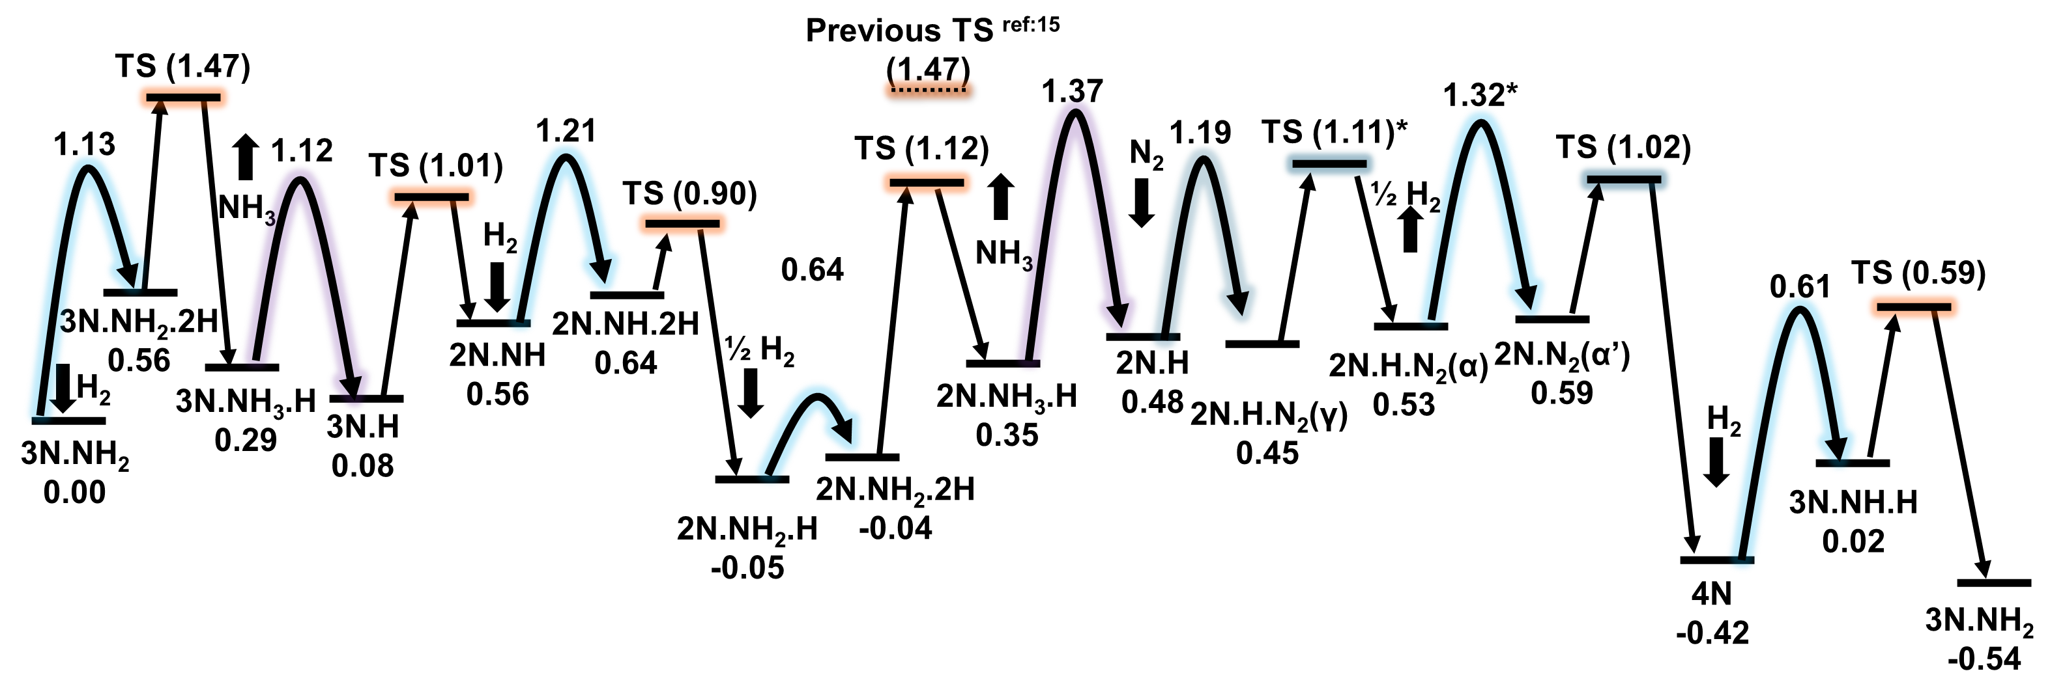
Free Energy Diagram Refined by RL and DFT
T = 673 K, P=20atm (P_{NH3}=1.0 atm)
Overview of the transition-state analysis and energy alterations along the reaction pathway of hydrogen migration from 2N_NH₂_2H to 2N_NH₃_H based on reinforcement learning (RL)-guided nudged elastic band (NEB) simulations.
Free energy landscape of the reaction network of the Haber−Bosch process on the Fe(111) surface.
T. Lan, H. Wang, and Q. An., Nature Communications 15 (1), 6281 (2024)
35

Slide 36
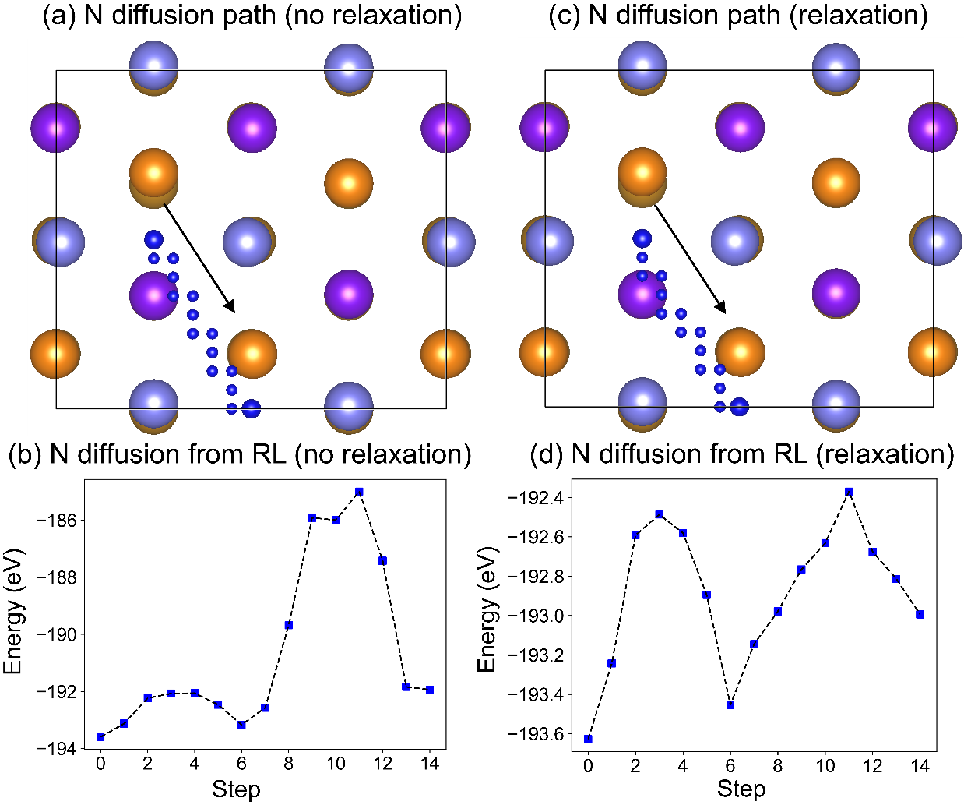
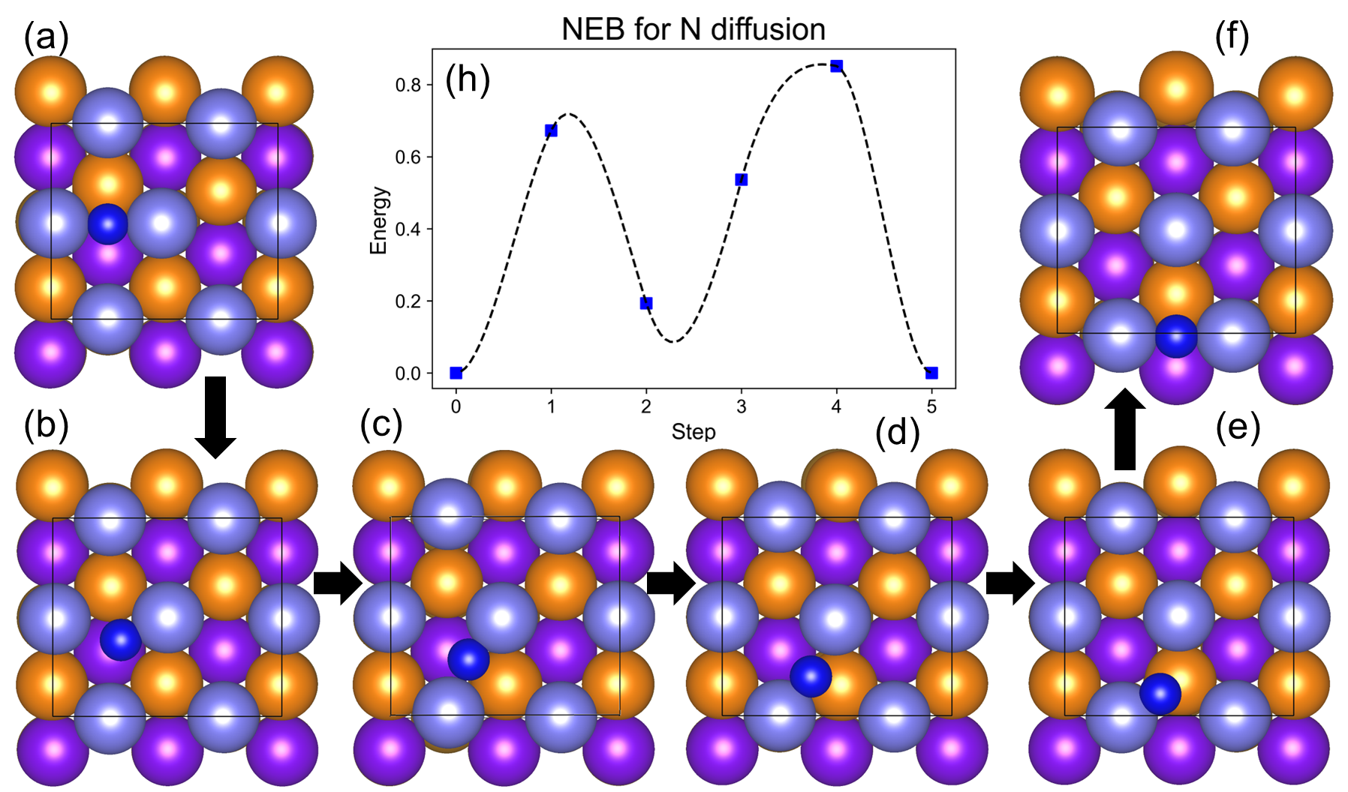
Another Case Study: N diffusion (relaxation vs. non-relax)
HTRL+DFT
NEB+DFT
The identified N diffusion path on the bare Fe(111) surface as determined by reinforcement learning (RL): (a, c) The diffusion path for the N atom from one bridge site to the other bridge site.
(b, d) The potential energy profile for the snapshots taken along the diffusion path of N atom.
T. Lan, H. Wang, and Q. An., Nature Communications 15 (1), 6281 (2024)
36

Slide 37
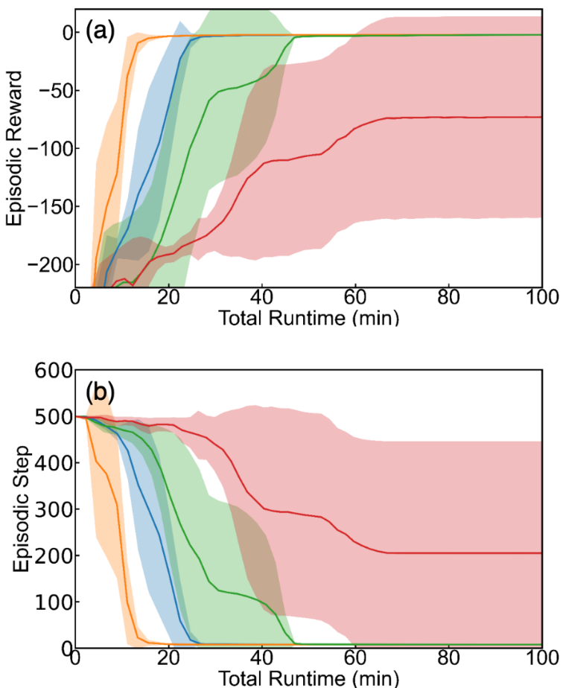
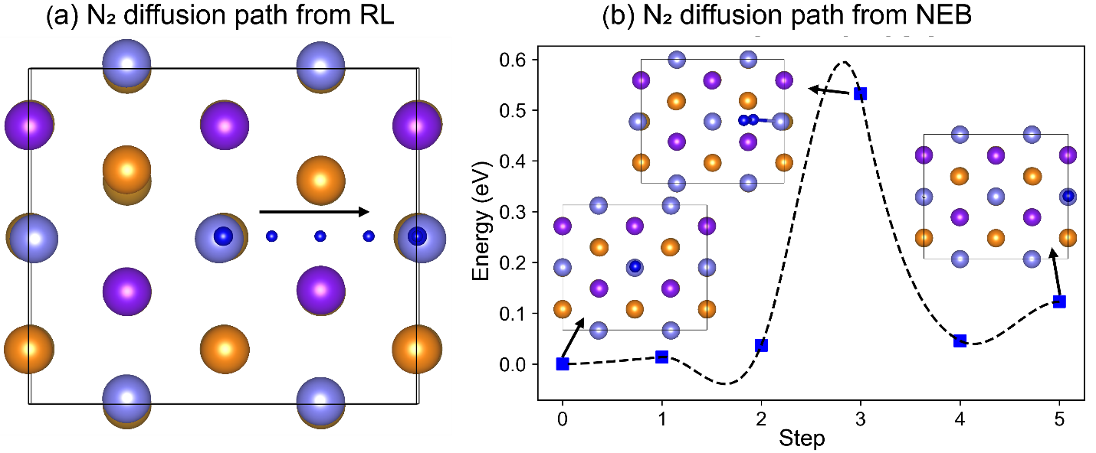
Another Case Study: N₂ Diffusion (Multi-Atoms)
Convergence and learning speed
The identified N₂ diffusion path on the bare Fe(111) surface from the one top site to another top site as determined by reinforcement learning (RL) (a), followed by the nudged elastic band (NEB) calculation (b) to determine the reaction barriers and transition state.
T. Lan, H. Wang, and Q. An., Nature Communications 15 (1), 6281 (2024)
37

Slide 38
Summary
We have used DFT and kMC to predict reaction mechanisms and kinetics for NH₃ synthesis on Fe(111) – the best single crystal surfaces for ammonia synthesis. The kMC analysis on these two surfaces predicts excellent reaction rates compared to Somorjai’s single crystal experiments at 673 K and 20 atm
We developed two RL framework to examine the HB reactions on Fe(111) surfaces and refined the free energy diagrams derived from domain knowledge.
38

Slide 39
Acknowledgment
Collaborators:
Reaction Mechanism: William A. Goddard III (Caltech); Alessandro Fortunelli (CNR-ICCOM, Italy)
RL work: Dr. Tian Lan at Salesforce AI Research
Thank you for your attention!
Q&A
39

